Slide 1
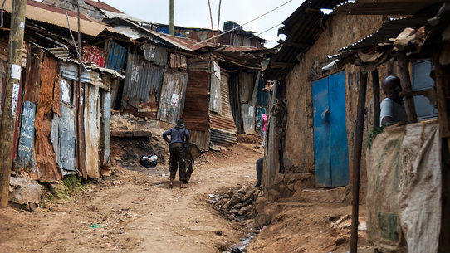
Concept of poverty
Lecture 2

Slide 2
Learning objectives
To describe/define the concept of poverty
To explain the characteristics of poverty and its dynamic nature
To use some sociological approaches to describe poverty

Slide 3
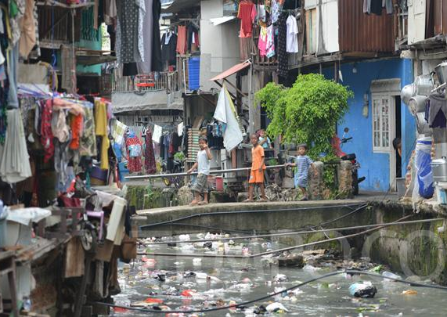
Definition of poverty
In general, poverty is seen as economic deprivations experienced by poor people in their daily lives
“a condition characterized by severe deprivation of basic human needs, including food, safe drinking water, sanitation facilities, health, shelter, education and information. It depends not only on income but also on access to services” (UN, 1995)

Slide 4
Poverty from Well-being perspective
Poverty is defined by the World Bank as a ‘pronounced deprivation in well-being’. It can be defined narrowly or more broadly, depending on how well-being is understood.
Narrow definitions of well-being are typically linked to commodities, i.e. whether households or individuals have enough resources to meet their needs.
In this case, poverty is seen largely in monetary terms in relation to household’s income or consumption.
Income and consumption are generally defined at household level and do not take account of intra-household variations which obscures individual poverty.
Broader definitions of well-being include subjective well-being, psychological well-being and social well-being

Slide 5
Absolute Vs Relative poverty
Absolute poverty is poverty below an official line (poverty line) set at the ‘absolute standard of what households should be able to count on in order to meet their basic needs’.
The most commonly used global comparative poverty lines were USD 1.25 (updated in October 2015 to USD 1.90) and USD 2.00 (updated to USD 3.10) a day.

Slide 7
Monthly ceiling in Czech Republic

Slide 8
Relative poverty
Relative poverty is defined in relation to other people in that society at the same time.
Relative poverty is often defined this way in high-income countries to acknowledge that people are part of a society and to take into account broader quality of life issues (Hulme, 2010).

Slide 9
What are the characteristics of poverty
Social exclusion
Many family members/more children
Generational poverty
Low education/minimum
Lack of skills
Addictions
Violence/family violence
Poor access to health, education, entertainment, communication etc
Poor economic capacity of the gvt
Ownership
Short-term contracts/low salaries
Insecure work

Slide 10
Poverty as a multidimensional phenomenon
United Nations Definition of Poverty “Fundamentally, poverty is a denial of choices and opportunities, a violation of human dignity. It means lack of basic capacity to participate effectively in society. It means not having enough to feed and cloth[e] a family, not having a school or clinic to go to, not having the land on which to grow one’s food or a job to earn one’s living, not having access to credit. It means insecurity, powerlessness and exclusion of individuals, households and communities. It means susceptibility to violence, and it often implies living on marginal or fragile environments, without access to clean water or sanitation.”

Slide 11
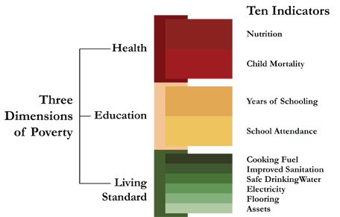
Three dimensions of poverty

Slide 12
Health
Nutrition: deprived if any adult or child for whom there is nutritional information is malnourished
Child mortality: deprived if any child has died in the family
Education
Years of schooling: deprived if no household member has completed five years of schooling
Child enrolment: deprived if any school-aged child is not attending school in years 1 to 8
Standard of Living
Cooking fuel: deprived if they cook with wood, charcoal or dung
Sanitation: deprived if they do not have an improved toilet or if their toilet is shared
Drinking water: deprived if the household does not have access to clean drinking water or clean water is more than 30 minutes walk from home
Electricity: deprived if the household has no electricity
Flooring: deprived if the household has dirt, sand or dung floor
Assets: deprived if the household does not own more than one of: radio, TV, telephone, bike, or motorbike, and do not own a car or tractor (Alkire and Santos, 2010, p. 2).

Slide 13
Some important terminologies to further conceptualize of poverty
Shelter poverty, food poverty, asset poverty, time-poverty or health poverty refer to lack of that specific good
The chronically poor are poor for years at a time or even their whole lives Vulnerability to poverty is the probability or risk of being in poverty or falling into poverty in the future

Slide 14
What are the causes of poverty
Discuss with your friends

Slide 15
Poverty as capability deprivation
As articulated by Amartya Sen (1987), looks at well-being arising through people’s ability to function in society. Poverty arises when people lack key capabilities and so have ‘inadequate income or education, or poor health, or insecurity, or low self-confidence, or a sense of powerlessness, or the absence of rights such as freedom of speech’ (Haughton & Khandker, 2009, p. 2-3).
Viewed in this way, poverty is a multidimensional phenomenon and less agreeable to simple solutions. For instance, while higher average incomes will certainly help reduce poverty, these may need to be accompanied by measures to empower the poor, or insure them against risks, or to address specific weaknesses such as inadequate availability of schools or a corrupt health service.

Slide 16
Poverty as a culture
American anthropologists, Oscar Lewis developed the Theory of culture of poverty (Five Families: Mexican Case Studies in the Culture of Poverty, 1959)
He stated that being in poverty tends to create a way of living that becomes a culture of its own or subculture
He tired to capture the way of behaving and thinking of poor in comparison to middle class people
This culture is “learned, shared and transmitted as a behavior of a social group
Culture of poverty proposed that approximately 20% of poor people are trapped in cycles of self-perpetuating behavior that caused poverty.

Slide 17
Culture of poverty contains
More specifically, 70 behavioral traits or characteristics are identified with those who have a culture of poverty. These characteristics include
weak ego structure
strong present-time orientation
confusion of sexual identification
Strong feeling of marginality, helplessness, dependency, inferiority
(Oscar Lewis, 1958)
Lewis received many criticisms
Structural inequalities are not questioned

Slide 18
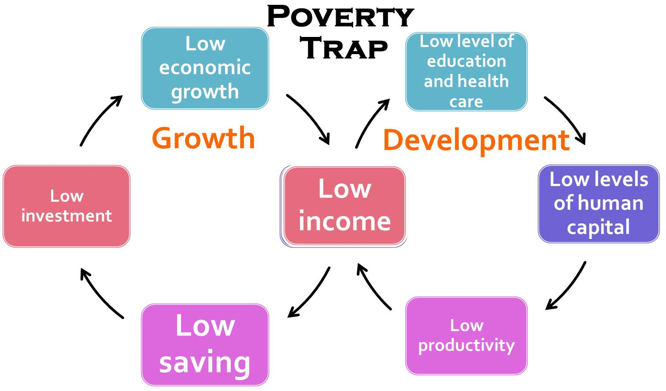
Poverty cycle

Slide 19
For your consideration
Do you think that poverty can be prevented by giving the poor money/subsidies
Talk to few poor people/families (3-5) and try to capture
Characteristics of their poverty
Their perspectives on their poverty
Reasons
Suggestions to overcome

Slide 20
Haughton, J., & Khandker, S. R. (2009). Handbook on poverty and inequality. Washington, DC: World Bank

