Slide 1
Strategies of poverty alleviation
Lecture 3

Slide 2
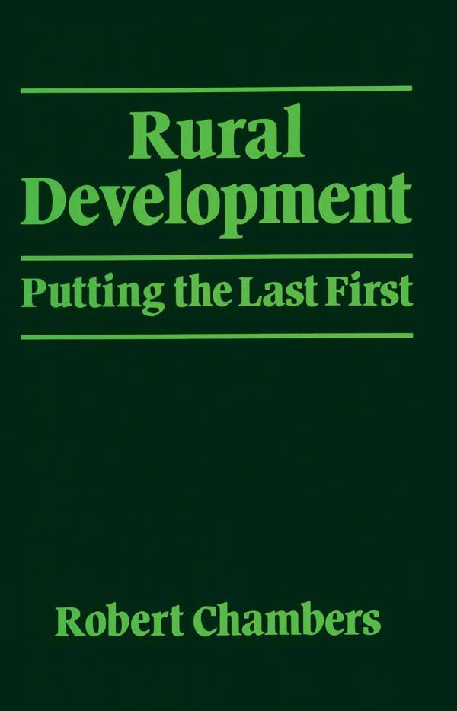
Top-down vs Bottom-up
Top-down approach
  Poverty is recognized/defined by experts
  Programmes are designed by these experts
Bottom-up
Poor keep the top/centre
Poverty alleviation strategies have been shaped by
these major two paradigms

Slide 3
Poverty Alleviation strategies
Poverty alleviation strategies may be categorized into four types (by UNDP)
  Community organizations based micro-financing
  Capability enhancing
  Social security
  Market-based
  Good governance

Slide 4
  Community organizations based micro-financing
Micro-finance is a predominant poverty alleviation strategy
Having spread rapidly and widely over the last few decades, it is currently operational across several developing countries in Africa, Asia, and Latin America
Many researchers and policy-makers believe that access to micro-finance in developing countries,
  empowers the poor (especially women)
  supporting income-generating activities
  encouraging the entrepreneurial spirit
  reducing vulnerability

Slide 5
  Capability programmes
Capability approach is intended to enhance people’s well-being and freedom of choices
According to Sen, development should focus on maximizing the individual’s ability to ensure more freedom of choices
Improving the capabilities of the poor is critical for improving their living conditions
Improving individuals’ capabilities also helps in the pooling of resources while allowing the poor to engage in activities that benefit them economically
Social inclusion of vulnerable communities through the removal of social barriers is as significant as financial inclusion in poverty reduction strategies

Slide 6
Social security programmes
Social security is a set of public actions designed to reduce levels of vulnerability, risk, and deprivation
It is an important instrument for addressing the issues of inequality and vulnerability
It also induces gender parity owing to the equal sovereignty enjoyed by both men and women in the context of economic, social, and political activities

Slide 7
  Market-based
Economic growth will create opportunities to poor
Economic growth is more important giving essential social services directed towards the poor while creating financial and social safety nets
Public spending on social protection, including social insurance schemes and social assistance payments, will depend on economic development
Promote market-oriented behavior in the poor
This approach believes that participation in markets provides substantial benefits and that making the market more inclusive for the poor will “enhance their economic empowerment and human development” (Mendoza and Thelen 2008, 427).

Slide 8
  Good governance
Good governance relevant to poverty alleviation has gained top priority in development agendas over the past few decades
developing countries have to deal with enormous challenges related to social services and security due to the weak and political and administrative systems
High level of corruption culture damages the efficiency, effectiveness and transparency of delivering social services
Thus, in order to receive financial aid from multinational donor agencies, a good governance approach towards poverty reduction has become a prerequisite for developing countries
This calls for strengthening a participatory, transparent, and accountable form of governance if poverty has to be reduced while improving the lives of the poor and vulnerable

Slide 9
Activity
Case analysis
What are the available approaches of poverty alleviation in the Czech Republic

