Slide 1
Microfinance as Anti-Poverty Tool
Lecture 9

Slide 2
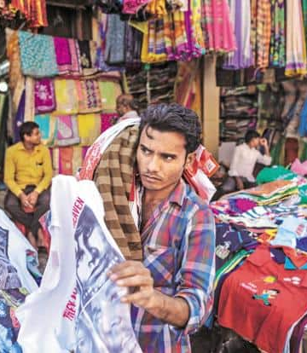
Introduction
The word “microcredit” was not existent before the seventies. But now it has turn out to be a buzzword among development practitioners.
Professor Mohammad Yunus, the founder of Grameen Bank in Bangladesh and the originator of the concept of microfinance, believes that 5% of Grameen Bank’s clients exit poverty each year.
However, there are surprisingly few credible estimates of the extent to which microcredit actually reduces poverty
Entrepreneurship is the fundamental basis of the microfinance approach to poverty alleviation.
As Bruton et al. (2013: 688) state, ‘market-based solutions such as entrepreneurship offer the best opportunity to create substantial and significantly positive change within poverty settings’.

Slide 3
Definitions of Microfinance
The Journal of Microfinance describes it as what “is arguably the most innovative strategy to address the problems of global poverty” (Woodworth and Woller, 1999). The General Secretary of the United Nations, Kofi Annan, stated in 2002 that microcredit is a critical anti-poverty tool and a wise investment in human capital (Annan, 2002).
“Microfinance has evolved as an economic development approach intended to benefit low-income women and men. It refers to the provision of financial services to low – income clients, including the self-employed” (Ledgerwood, 2000).
It is normally characterized as making small loans available directly to small-scale entrepreneurs to enable them either to establish or to expand micro-enterprises and small businesses.
Microcredit is normally applied to target groups that would otherwise not qualify for loans from formal institutions. This includes the majority of those living below the poverty line (Commonwealth Secretariat, 2001).

Slide 4
Characteristics of microfinance
Small amounts of loans and savings
Short- terms loan
Payment schedules attribute frequent installments (or frequent deposits)
Installments made up of both principal and interest, which is remunerated over the course of time.
Higher interest rates on credit - MFIs in the Asia-Pacific region charge rates ranging from 30 to 70% a year.
Easy entrance to the microfinance
Application procedures are simple
Short processing periods (between the completion of the application and the disbursements of the loan).
The clients who pay on time become eligible for repeat loans with higher amounts.
The use of tapered interest rates (decreasing interest rates over several loan cycles) as an incentive to repay on time.
No collateral (surety, guarantee) is required contrary to formal banking practices.

Slide 5
The impacts of microfinance
David Hulme and Paul Mosley (1996). Poor households do not benefit from microfinance; it is only non-poor borrowers (with incomes above poverty lines) who can do well with microfinance and enjoy sizable positive impacts
More troubling is the finding that a vast majority of those with starting incomes below the poverty line actually ended up with less incremental income after getting micro-loans, as compared to a control group which did not get such loans
Credit is only one factor in the generation of income or output. There are other complementary factors, crucial for making credit more productive. Among them, the most important is recipient’s entrepreneurial skills.
Banerjee et al (2007) say, most poor people do not have the basic education or experience to understand and manage even low-level business activities. They are mostly risk-averse, often fearful of losing whatever little they have, and struggling to survive

Slide 6
Criticisms to microfinance
Microfinance led to increasing levels of indebtedness among already impoverished communities and exacerbated economic, social and environmental vulnerabilities
Inability to repay loans eroded the assets of the communities and led to poor health outcomes while undermining household relations and social capital
People mostly use credit for consumption purposes not investments

Slide 7
Vijay Mahajan (2005), a social entrepreneur “Microcredit is a necessary but not a sufficient condition for micro-enterprise promotion.
Other inputs are required, such as
identification of livelihood opportunities
selection and motivation of the micro-entrepreneurs
business and technical training
establishing of market linkages for inputs and outputs
common infrastructure and sometimes regulatory approvals.
In the absence of these, micro-credit by itself, works only for a limited familiar set of activities – small farming, livestock rearing and petty trading, and even those where market linkages are in place.”

