Slide 1
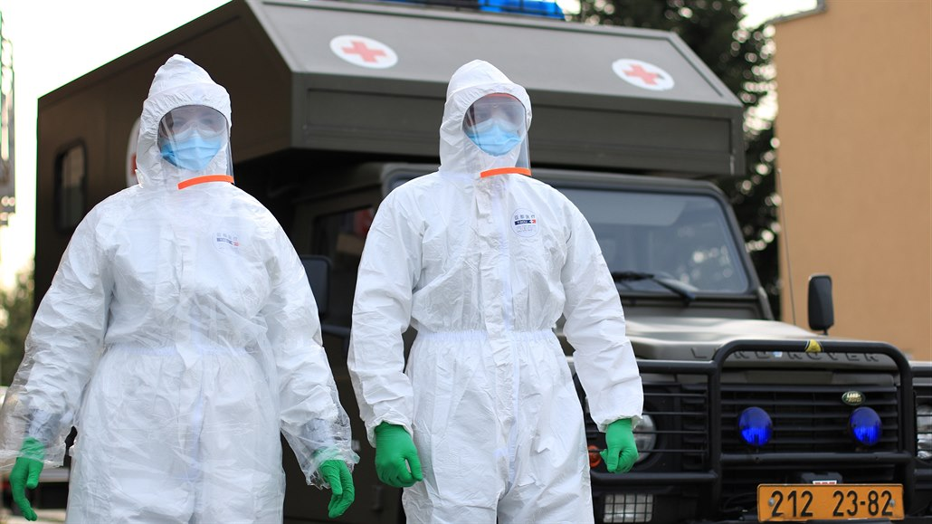

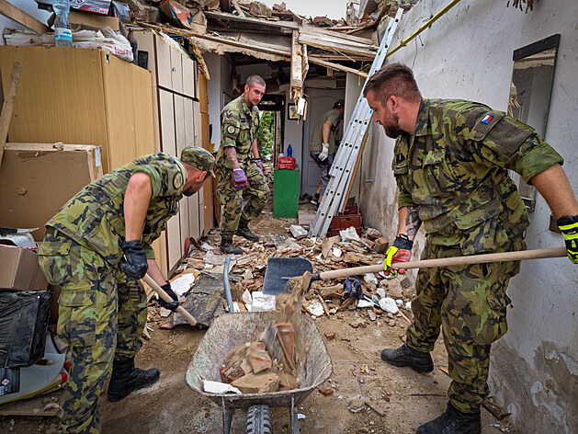
Military Responses to Unintentional Threats
Source: idnes.cz
Unintentional and natural threats to security (BSSb1194)
10/04/2024
Jan Kleiner
Source: natoaktual.cz
Notes:
INTRO video: https://www.youtube.com/watch?v=_-8YpkQTs5w&ab_channel=tvarmycz
Otevřít švédskou příručku

Slide 2
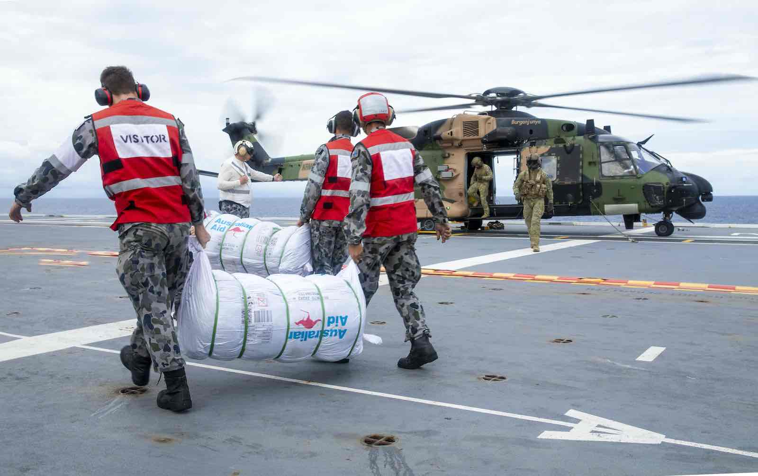
Outline-ish
Civil Defence.
Czech Army – COVID-19; floods, strategic documents, legal framework.
CIMIC.
Miltaries in (international) humanitarian relief.
COVID-19 and militaries + positive, negative impacts.
Source: lowyinstitute

Slide 3


Warm-up
Discussion: What are unintentional threats?

Slide 4

Unintentional threats definitions
´A threat can be foremost a natural phenomennon defined in terms of physics etc., e.g., a natural disaster. We call such a threat unintentional´ (Zeman et al., 2002, p. 55).
(Buzan, Waever, De Wilde, 1998, pp. 156-157) - Unintentional threats also as:
  accidental, one-time threats;
  ´unavoidable, interlocking, inadvertent´ threats due to security conflicts between or among states and their conflicting principles (e.g., definition of Estonia as a threat to Russian minority and Russia).

Slide 5
Where does the military stand in the crisis management?
(Alexander, 2002 as cited in Coppola, 2011, p. 10)
Winkler´s (1997) equation of risk as cited in Zeman (2002, p. 63)

Slide 6
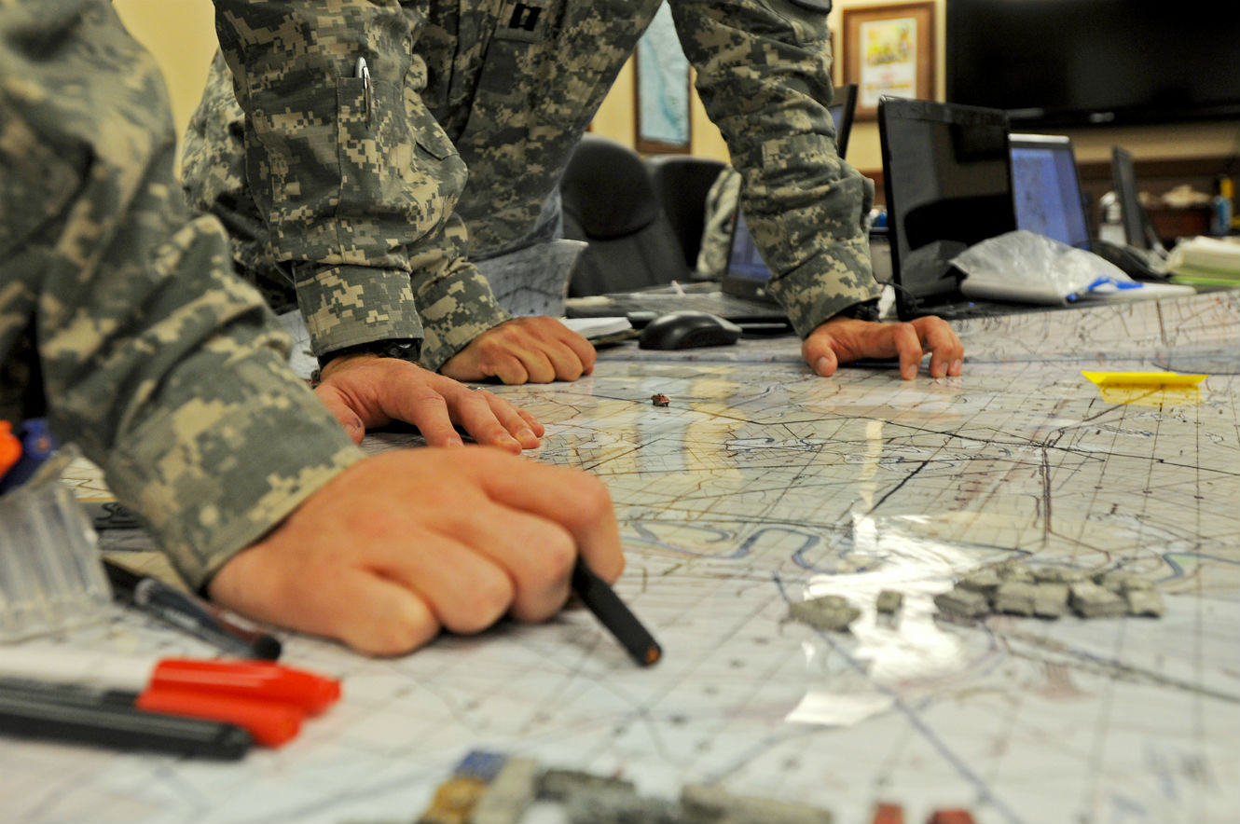
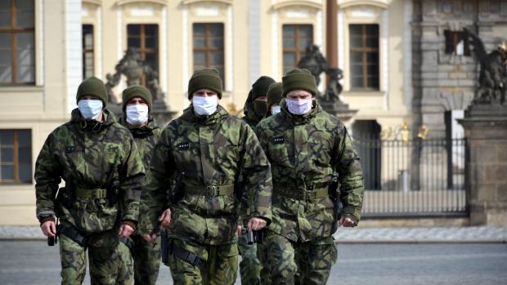
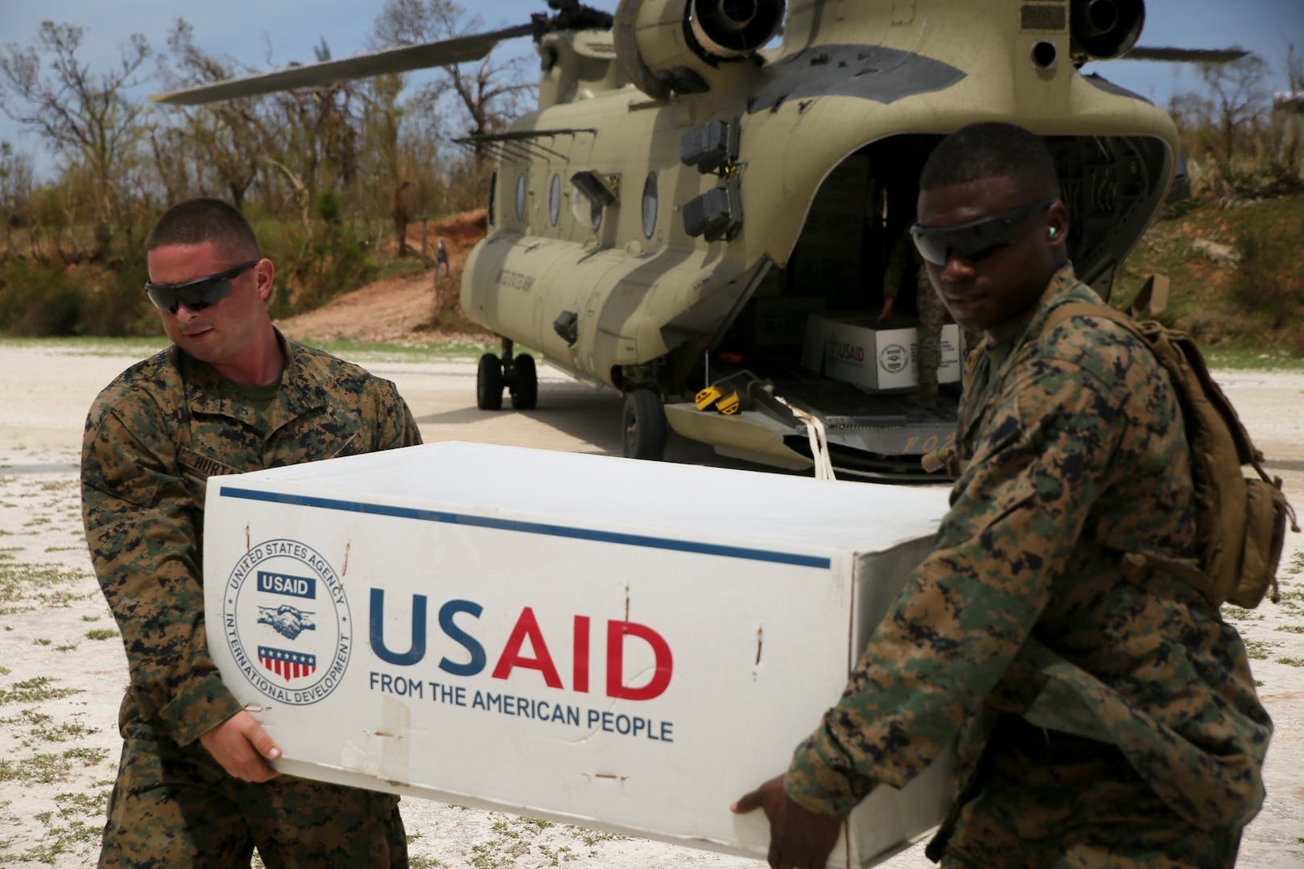
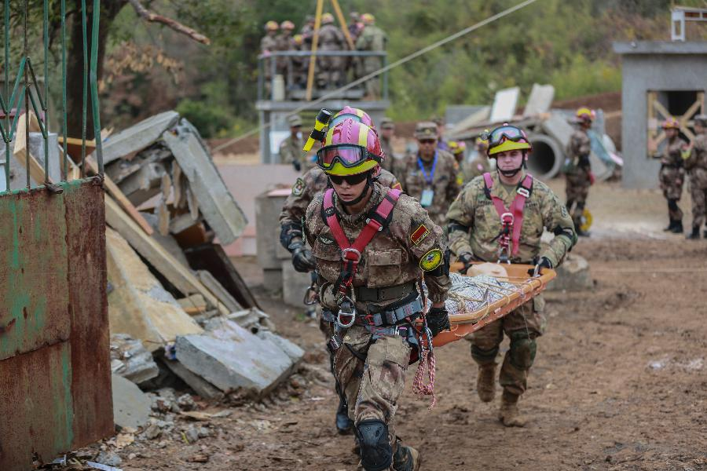
Source: War on the Rocks
Source: iRozhlas.cz
Source: Defense Logistic Agency
Source: ecns.cn

Slide 7

Civil Defence (Protection)
(Carpet) bombing runs in WWI (zeppelins) and WWII.
Focus on WMDs during the Cold War era.
After the CW thought to be outdated…
…but terrorism, pandemics, climate crisis, rogue states and Russia said nope → increased demand for survival and resilience (Cronqvist, Farbøl and Sylvest, 2022).
Shift: intentional threats only → incl. unintentional ones.
Internationally recognized symbol of the CD units; rooted in the IHL.

Slide 8
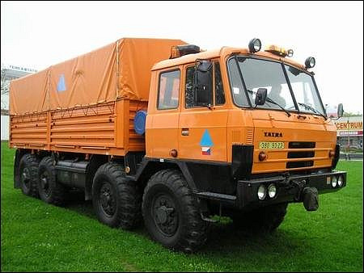
Czech Civil Defence (SH ČMS, n.d.)
1951-1993 (civilní obrana)
1993 - ´Civil Protection´ (civilní ochrana)
2001 – moved from the DoD to DoI (zákon č. 239/2000 Sb. – Integrated Rescue System) – fire dept (ochrana obyvatelstva)
From original 5 military rescue batalions only 2 companies (under the 15th engineer regiment).
Source: Požáry.cz

Slide 9
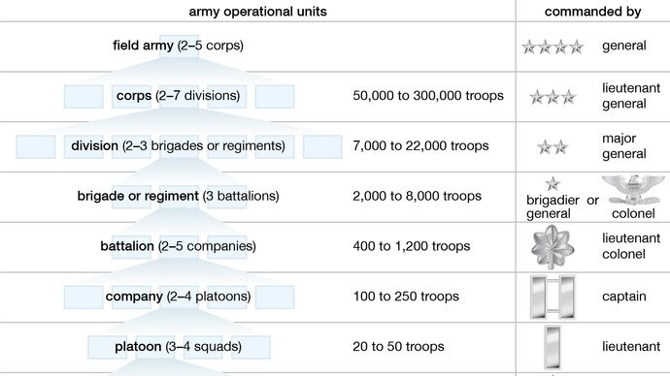
Source: Encyclopaedia Britannica

Slide 10
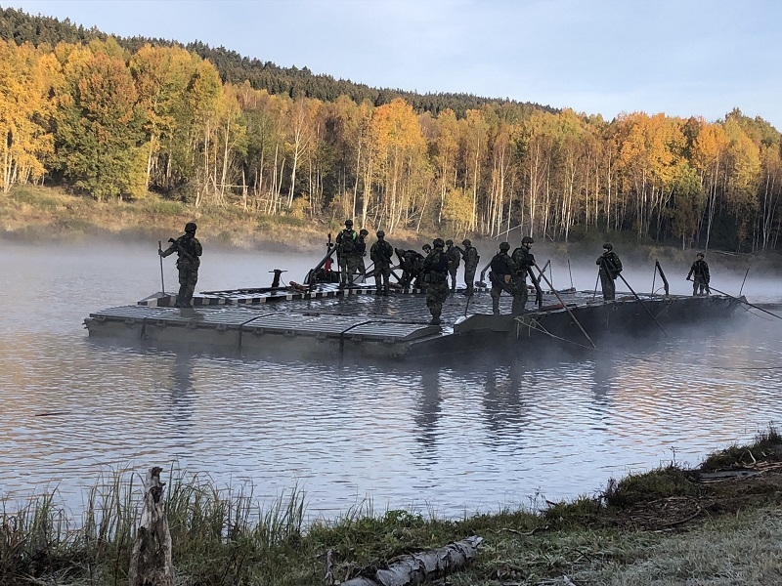
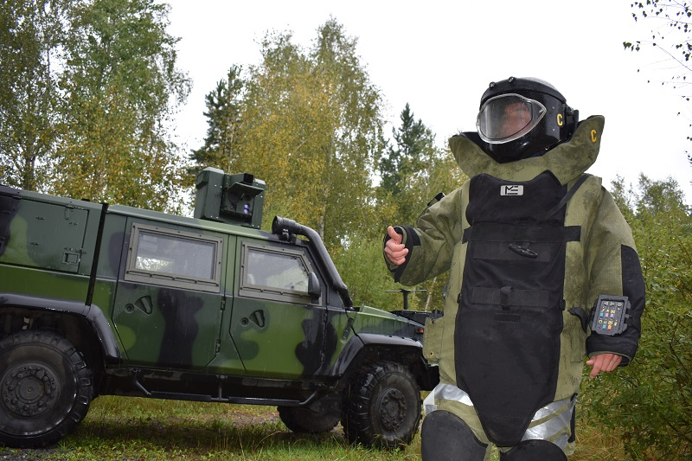
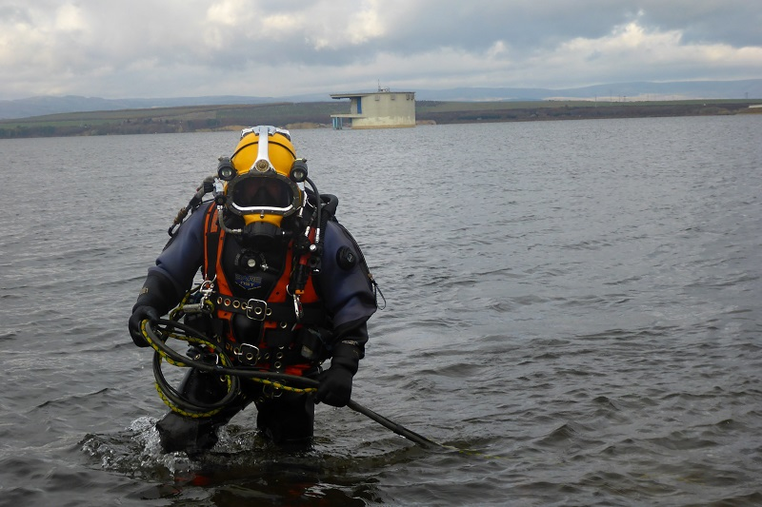
15th Czech Army´s Engineer Regiment
Source: AČR
3 battalions – 2 in Bechyně, 1 in Olomouc
(non)combat engineer support for the Czech Army, suppresing enemy´s activity, rescue activities, support of the IRS, humanitarian tasks

Slide 11
Sweden - 2018
Total defence duty – all citizens aged between 16 and 70 can be mobilized for war efforts + huge effort goes civil protection → MOOTWs (civil defence) and combat ops (military defence) are highly connected.
Focus on education and strategic communication towards citizens, citizens´ preparedness + warn against false information → (civil) defence is multidomain, multimodal and cummulative effort of the whole nation.
https://rib.msb.se/filer/pdf/28706.pdf

Slide 12

Council of the Baltic Sea States (CBSS, n.d.)
Denmark, Estonia, Finland, Germany, Iceland, Latvia, Lithuania, Norway, Poland and Sweden.
One of the bodies – Civil Protection Network.
  Civil protection and societal security.
  Capacity building, knowledge and expertise exchange, and implementation of transnational project.
  Priority: the UN´s Sendai Framework for Disaster Risk Reduction Implementation.

Slide 13
Sendai Framework for Disaster Risk Reduction Implementation (United Nations, 2015)
UN strategic document adopted at the Third UN World Conference in Sendai, Japan, in March 2015.
Outlines specific goals and priorities, underscores the importance of international cooperation, the roles of various stakeholders, and the need for dedicated efforts towards understanding disaster risk, strengthening disaster risk governance, investing in disaster risk reduction, and enhancing disaster preparedness.
Synergies with other strategic UN documents: The Paris Agreement on Climate Change, The Addis Ababa Action Agenda on Financing for Development, the New Urban Agenda, and the Sustainable Development Goals.
Does not mention civil defence/protection specifically though.

Slide 14
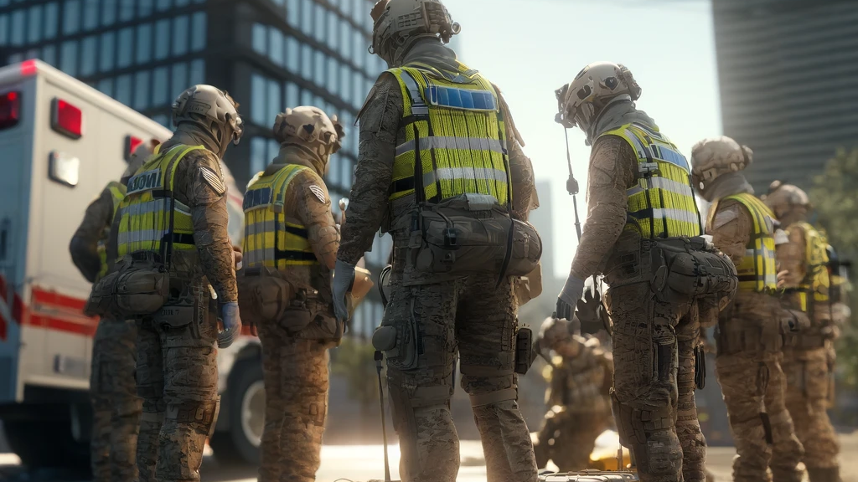
Discussion: how does civil defence/protection look like in your country?

Slide 15
Are countries without the CD irresponsible towards their citizens?

Slide 16
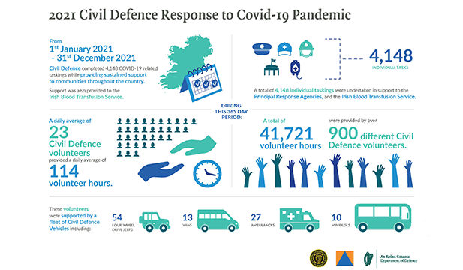
Case 1: Irish Civil Defence during COVID-19
Source: Civildefence.ie

Slide 17
Case 2: Czech Army during COVID-19 (AČR, 2021)
Around 15,000 personnel deployed → the largest Czech military op.
Over 13 ops – border patrols deployment, IRS support, logistics (incl. ´Condor flights´), deployment in homes for the elderly, clever quarantine, Litovel area lockdown, mixed police-army patrols etc.
Source: AČR, 2021

Slide 18
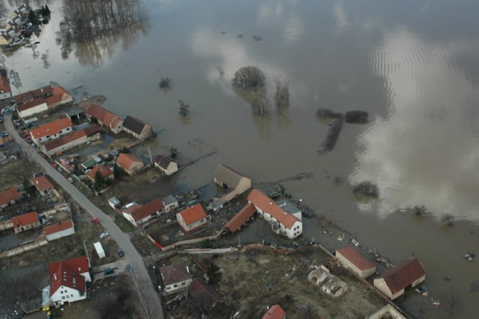
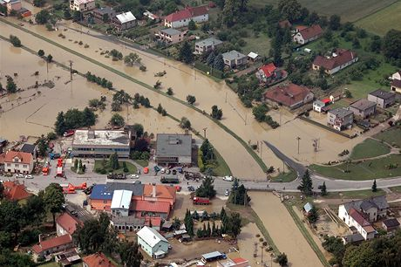
Czech Army floods mitigation efforts
2009 – aftermath liquidation with 8020 deployed personnel and 2047 vehicles.
Source: vláda.cz
Source: idnes.cz
Source: AČR, 2021

Slide 19
Relevant Czech legal framework
The Armed Forces Law (zákon č. 219/1999 Sb.)
  Main task for the AF defined as the defence against external threats.
  Rescue and humanitarian international missions.
  AČR can be tasked with helping the police, with a response to a natural disasters and other serious events that can result in significant public health risks or property damage.
  BTW - What do the Czech Armed Forces consist of?
Marginal mention in the z. č. 240/2000 Sb. (430/2010 Sb.).

Slide 20
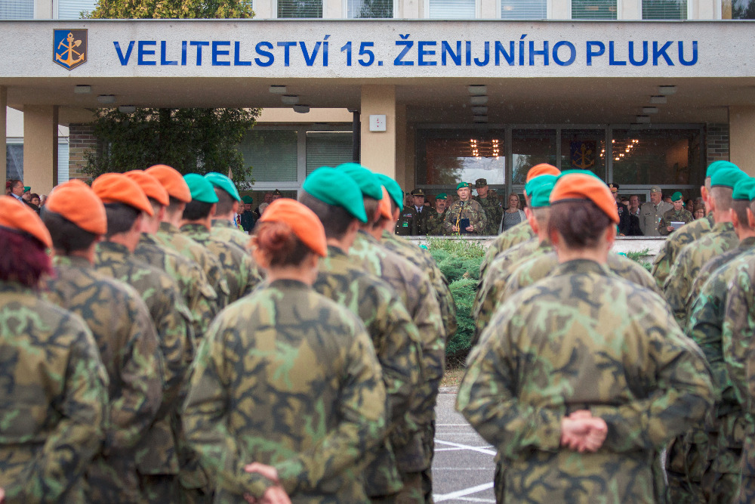
Relevant Czech strategic security documents
Conception of Civil Protection until 2025 (up to 2030) – HZS ČR.
  Does not mention Czech AF.
  Previous version (…until 2020): AČR as a potential part of the rescue system and as liquidator (its role is regulated by a framework agreement between the DoD and DoI).
Czech Army Doctrine 2004 - ´Support ops´ - humanitarian relief to the citizens, civil administration and organizations.
Source: army.cz

Slide 21



Relevant Czech strategic security documents
Long-term Prospect for Defence 2035 – emphasis also on civil support during states of crisis and support for the IRS (especially the engineer corps).
The POKOS programme (and its conception 2014-2024).
Source: army.cz

Slide 22
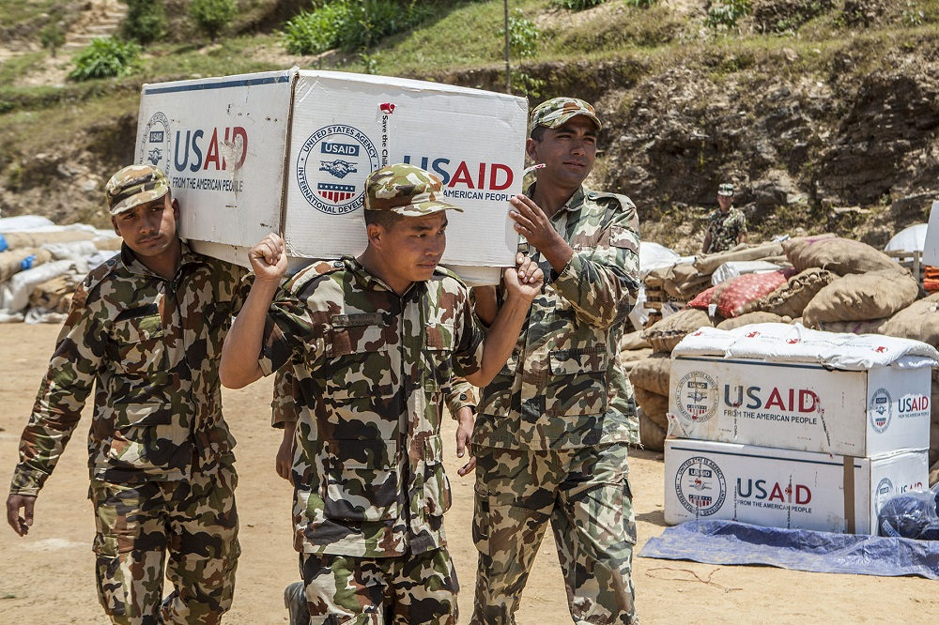
Militaries and (international) humanitarian relief
Source: cgdev.org
Notes:
INTRO VIDEO: https://www.youtube.com/watch?v=F6GwMC3-GqU&ab_channel=RoyalAustralianNavy - EXCERCISE of the RAN

Slide 23
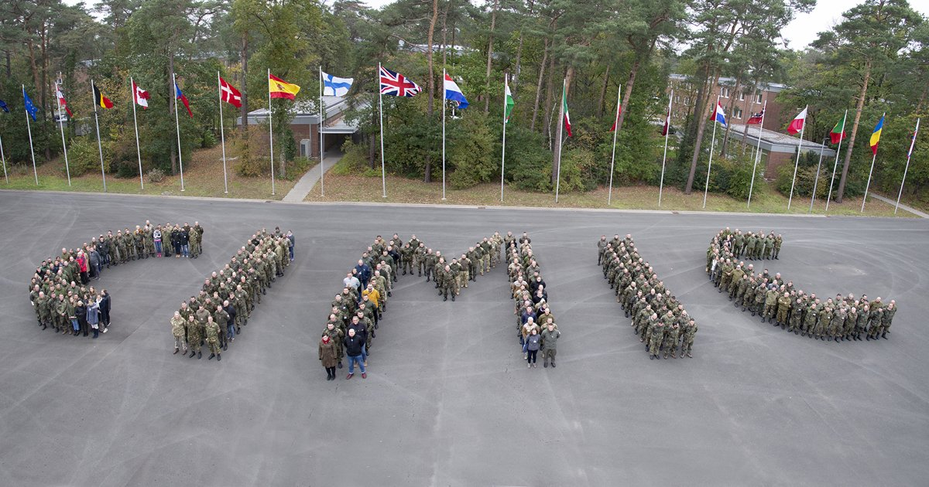
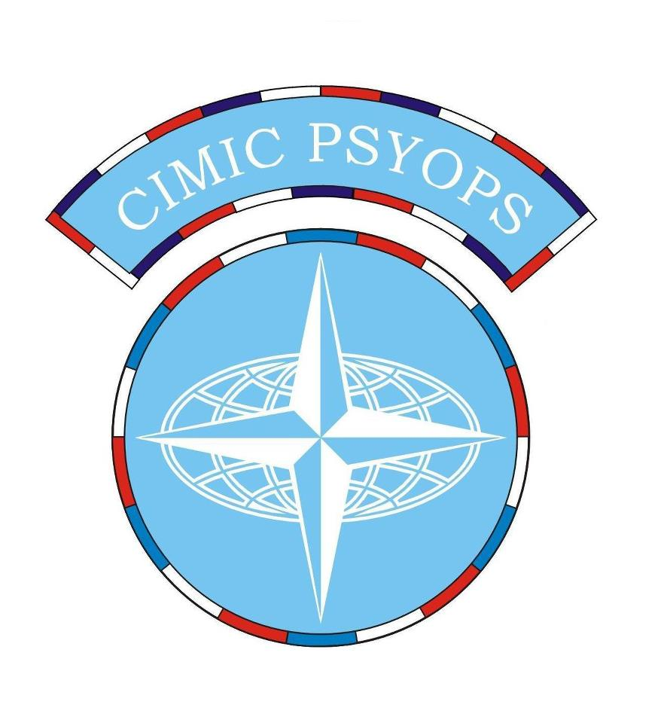
Humanitarian assistance as identified as MOOTW (mil. ops other than war).
Contribution to humanitarian supply chains and logistics – main roles:
  security and protection;
  distribution;
  engineering. (Barber, 2012)
Civil-military cooperation/coordination (103rd Centre CIMIC).
Source: CIMIC-COE
Source: válka.cz

Slide 24
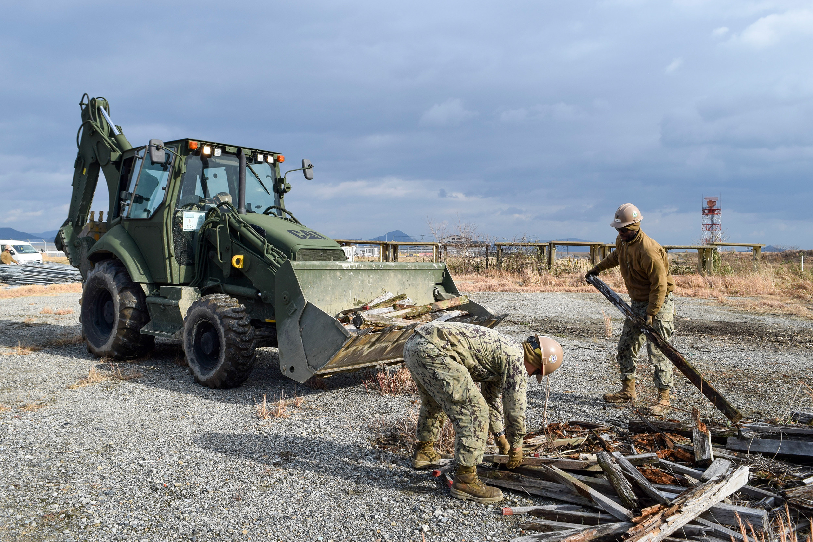
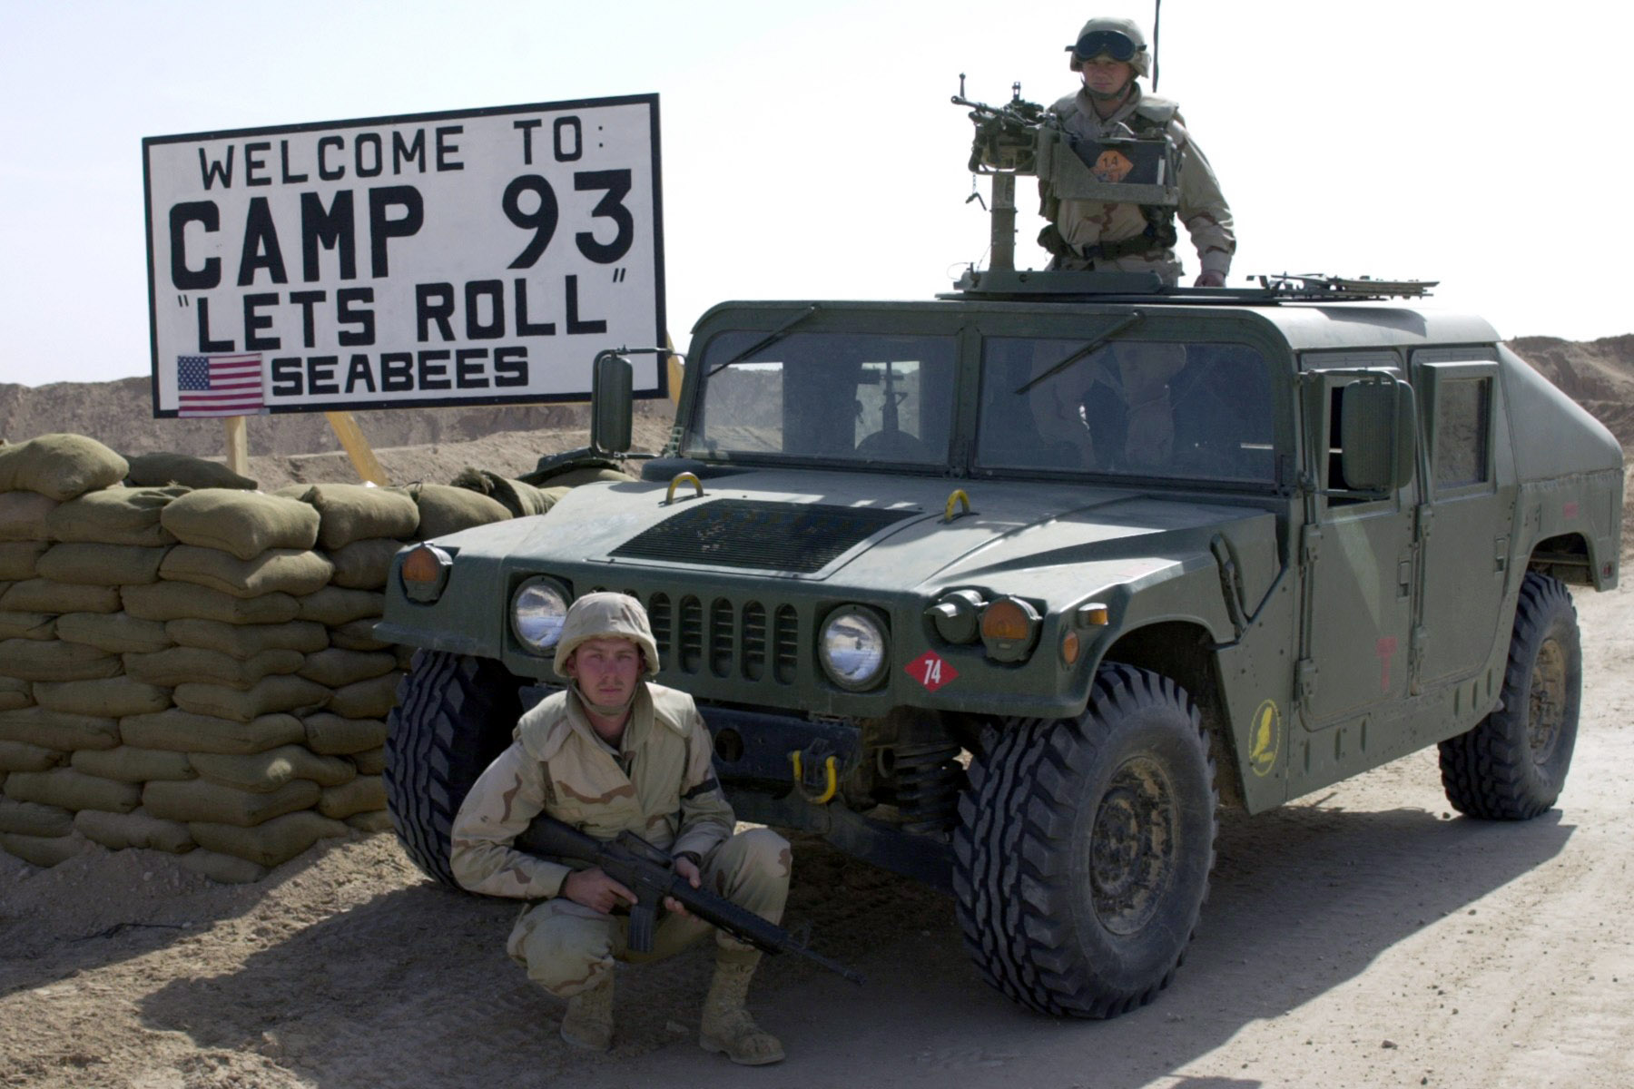
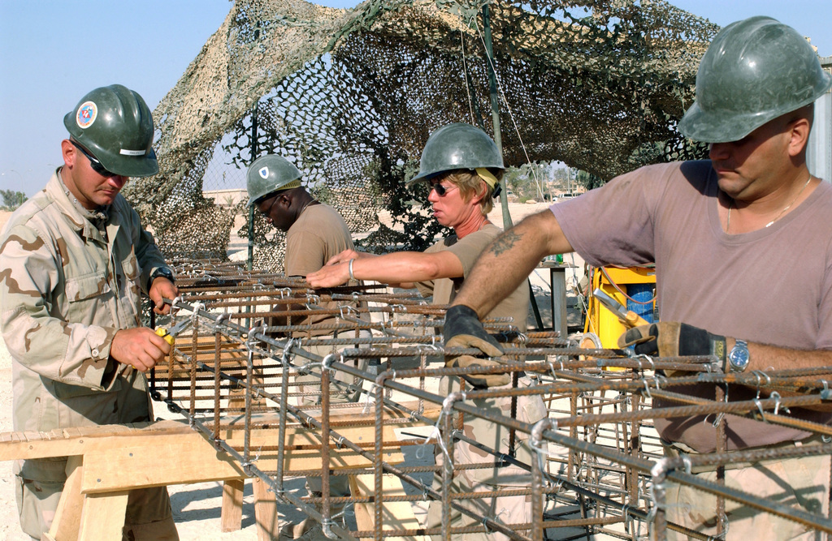
Recognize this unit?
Source: pacom.mil
Source: seabeehf.org

Slide 25

United States Naval Construction Battalions

Slide 26
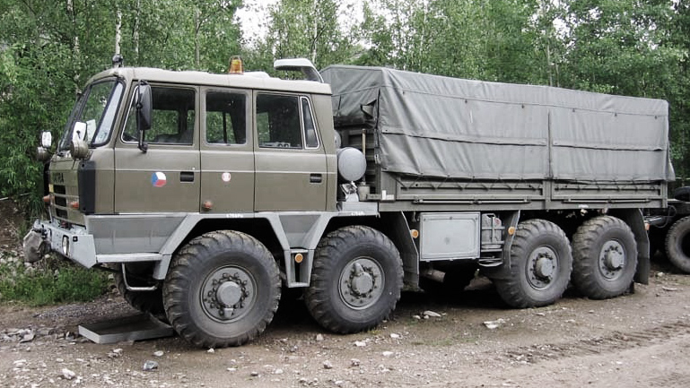
A military definition of logistics (Barber, 2012)
´The science of planning and carrying out the movement and maintenance of forces… those aspects of military operations that deal with the design and development, acquisition, storage, movement, distribution, maintenance, evacuation and disposition of material; movement, evacuation, and hospitalization of personnel; acquisition of construction, maintenance, operation and disposition of facilities; and the acquisition of furnishing of services´ (p. 124).
Rapid response (capabilities to distribute, shelter, sanitate, evacuate, construct, liquidate etc.) → main characteristic ´capacity for preparedness´ (p. 128).
Military logistics are mostly appreciated in the early stage of a crisis situation.
2005 Hurricane Catrina – large military supply convoys for New Orleans.
Source: czdefence

Slide 27
CIMIC in Humanitarian Relief
Not so smooth – differences among various militaries.
  Principles, doctrines, agendas, SOPs etc.).
CIMIC humanitarian dimension not new - Napoleonic Wars, WWI/II (Marshall Plan), Berlin Airlift, Yugoslavia, Rwanda etc.
conceptual confusion - the ´C´ in CIMIC
  ´Collaboration: working with others on a joint project.
  Coordination: integrating diverse elements in an harmonious operation.
  Cooperation: promoting assistance or awillingness to assist´ (OED, 2000 as cited in Heaslip, 2012, p. 152).

Slide 28
Humanitarian Aid Supply Network (Kovács and Spens, 2008, p. 223 as cited in Heaslip, 2012, p. 151)
(Too) many actors

Slide 29
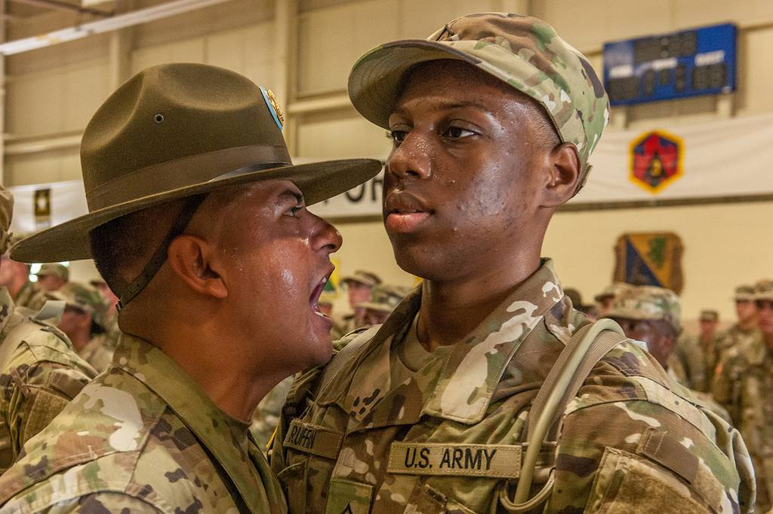
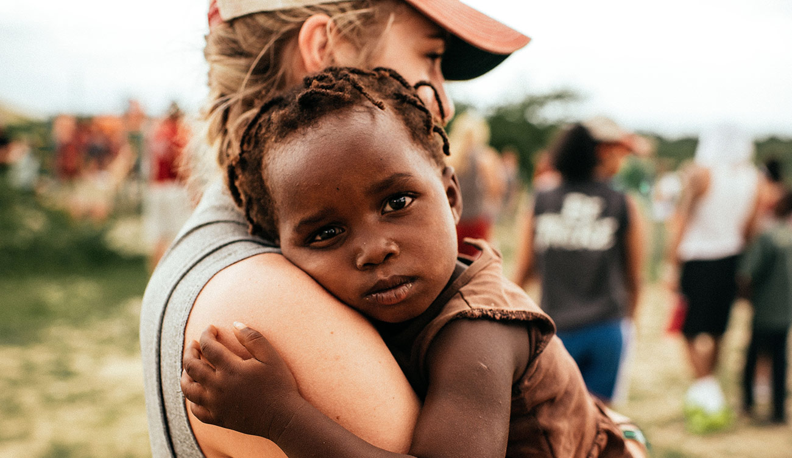
Challenges (Heaslip, 2012)
Coordination with other actors.
  Parallel activites, and duplication avoidance, time-sensitive tasks, military sense of precedence etc.--> planning and negotiation.
  → (non)UN cluster groups (e.g., Haiti earthquake aftermath):
    Water, sanitation and hygiene – chaired by UNICEF.
    Health cluster – chaired by WHO etc.
Culture – military and civilian especially.
Resource and capability gap – how to get relief resources to the disaster area?
  Elements of uncertainty and randomness of disasters.
  UNJLC – UN Joint Logistics Centre – logistics information services.
Source: Army Times
Source: ctg.org

Slide 30
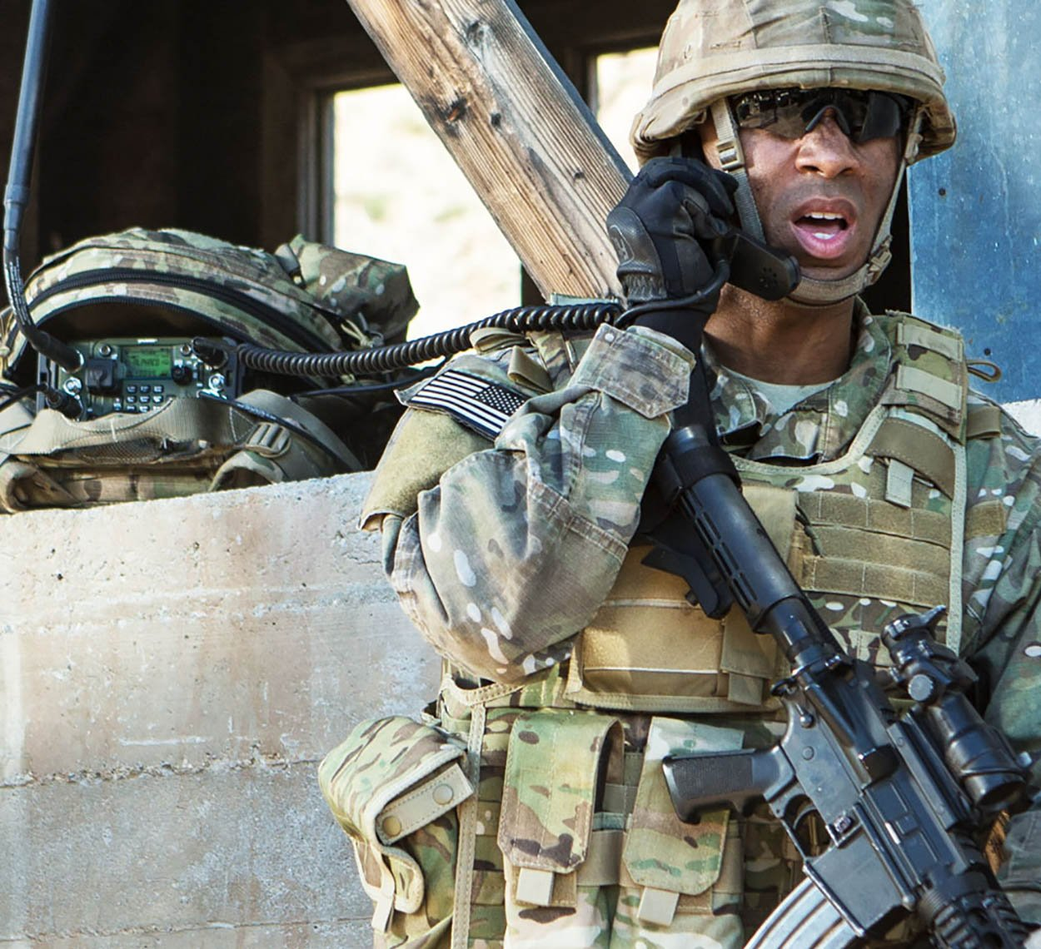
Financial and human resources.
  Focus often on short-term funding.
  Donors negligent towards strenghtening organizational capacity and capability.
  → available aid, noone to deliver.
Infrastructure degradation.
Comms (e.g., incompatible radios).
Personality
  Success of collaboration depends on the field-level personnel rather than SOPs
  high rate of staff turnover, differences in cultures and chain of command, comms breakdown, absence of communication procedures, refusal of military aid due to independence and impartiality, threat of use of force by military.
Source: L3Harris

Slide 31
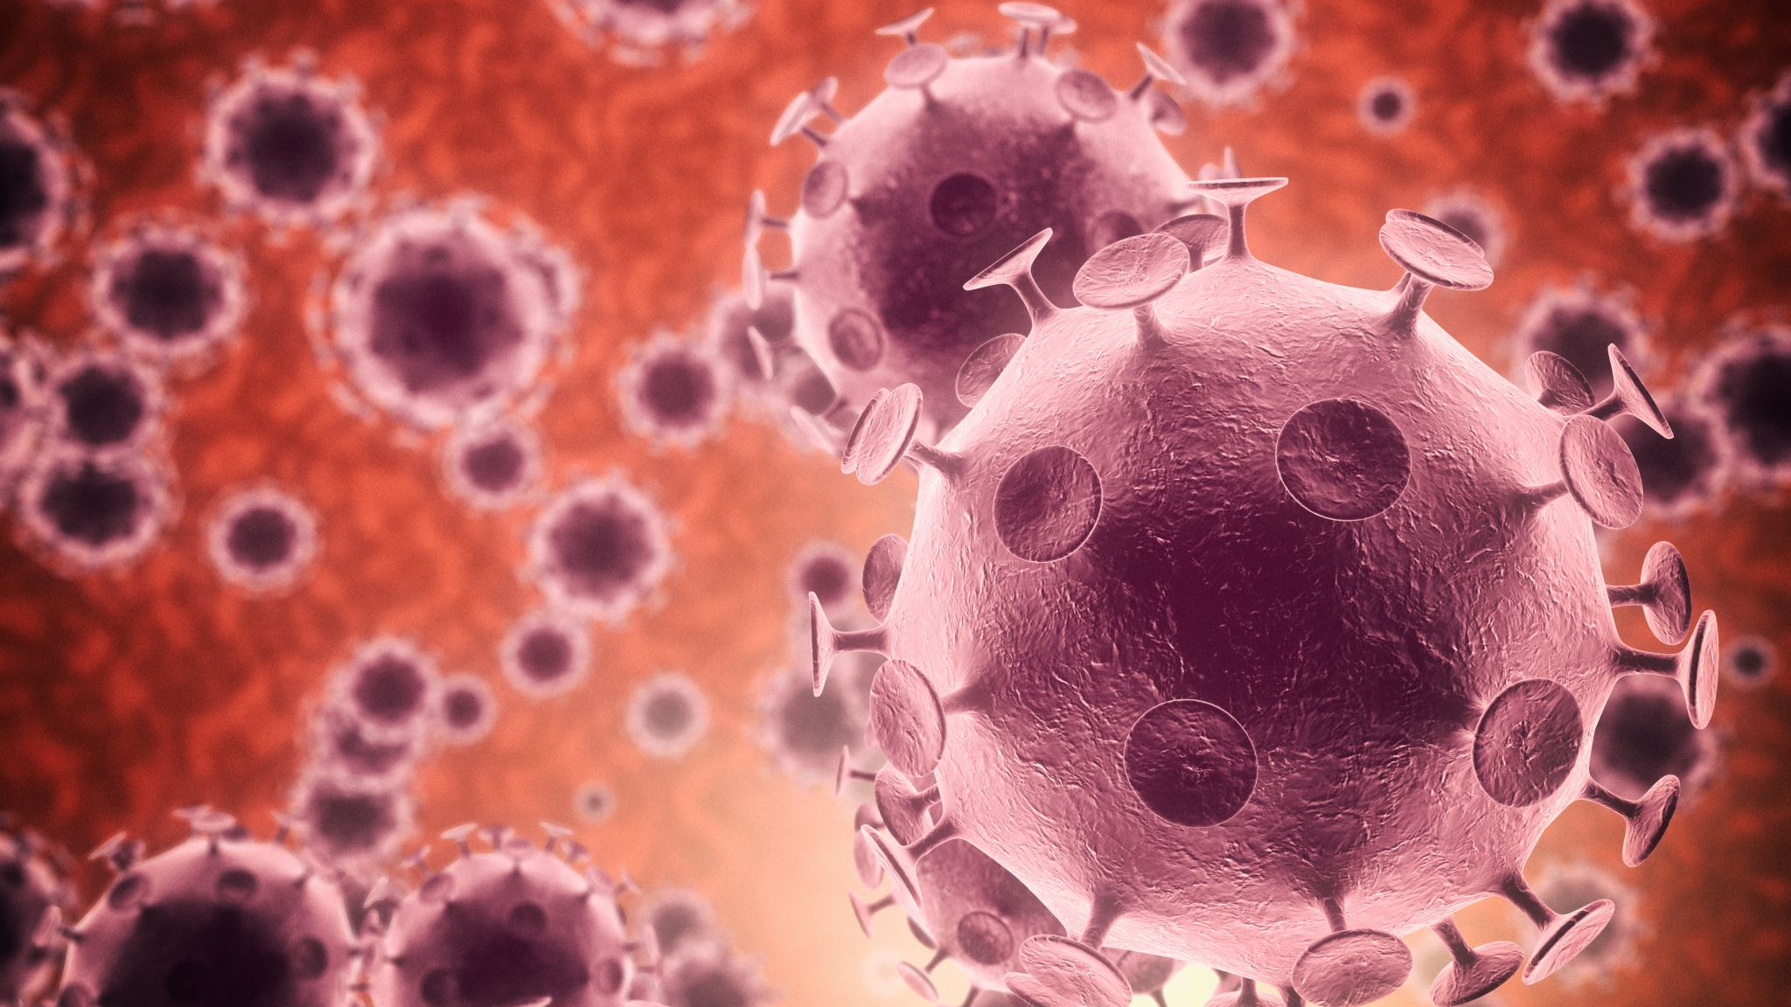
COVID-19 and militaries + how did the pandemic impact the armed forces?

Slide 32
Wartime rhetoric (Macron, Trump, Babiš etc.) → massive deployment of militaries.
WMDs protection units, research fascilities etc.
Usually medical assets deployed after a disaster.
Need to separate infected and uninfected can be a challenge → need of close communication with local authorities – can be also challenging (CIMIC).
Military is driven by defence and security objectives – can be problematic in global health issues.
Intro
(Michaud et al., 2019; Kleiner, 2022)

Slide 33
Ramifications
Austerity cuts – defence ministries often come first (Zandee et al., 2020).
  Why are ad hoc defence budgetary cuts harmful for the military (see Kufčák, 2015)?
Regular military activities harder or impossible to perform (Kalkman, 2020).
Mental toll on deployed personnel (Gupta et al., 2020; Lázaro-Pérez at al., 2020).
Personal toll (families – children).
Enforcement of public-restrainment measures.

Slide 34
Positive impacts (Kleiner, 2022)
Public opinion – PR campaigns (e.g., British – see Kennard and Glenton, 2020).
Also after floods – public support of 33% (1997) → 74% (2019) (STEM, 2021).
Kalkman (2020) – the worth of taxpayers´ money.

Slide 35
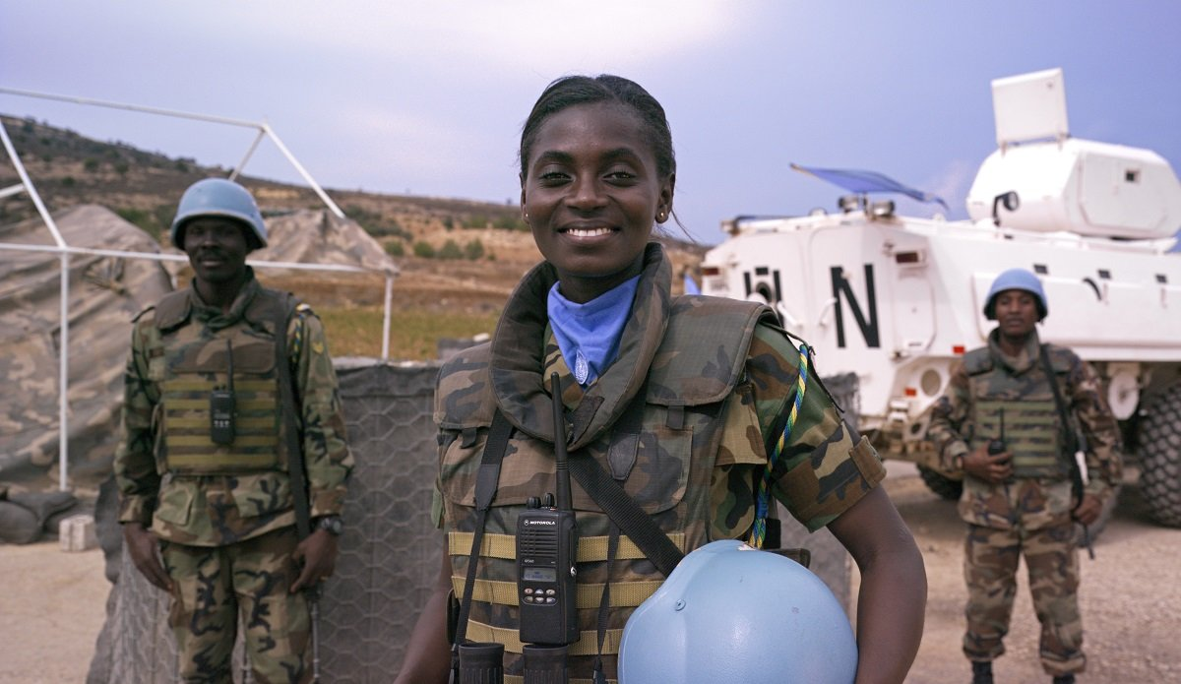
Wrap-up
Civil Defence (Protection) units still operational
Military as an actor in all phases of the Crisis management cycle.
Military as a capable fast-responder (mainly logistics, but also combat engineers, scientists etc.).
Military has its own interests (dealing with ramifications of a crisis, PR campaigns, defence and security).
The importance of CIMIC (among other things mitigating ramifications of the military-civil cooperation during humantarian relief efforts).
Source: UNFIL

Slide 36
References I
AČR. (2021). Armáda české republiky v roce 2020. Ministerstvo obrany České republiky.
Barber, E. (2012). Military Involvement in Humanitarian Supply Chains. In: Kovács, G. And Spens, K. M. Relief Supply Chain for Disasters: Humanitarian, Aid and Emergency Logistics. Hershey: Business Science Reference, pp. 123-146.
Buzan, B., Weaver, O. and De Wilde, J. (1998). Security: A New Framework for Analysis. Boulder, Colo: Lynne Rienner Pub.
CBSS. (n.d.). Civil Protection Network. Council of the Baltic Sea States [online]. Available from: https://cbss.org/cbss-bodies/civil-protection-network-2/
Coppola, D. P. (2011). Introduction to International Disaster Management. Burlington: Butterworth-Heinemann.
Cronqvist M., Farbøl R., Sylvest C. (2022). Introduction: New Paths in Civil Defence History. In: Cronqvist M., Farbøl R., Sylvest C. (eds) Cold War Civil Defence in Western Europe. Palgrave Macmillan, Cham. https://doi.org/10.1007/978-3-030-84281-9_1
Gupta, S., Kohli, K., Padmakumari, P., Dixit, P. K., Prasad, A. S., Chakravarthy, B. S., Shukla, R., Ghana, P., Mahapatra, D., & Varadaraj, G. (2020). Psychological health among armed forces doctors during COVID-19 pandemic in India. Indian Journal of Psychological Medicine, 42(4), 374–378. https://doi.org/10.1177/0253717620934037

Slide 37
References II
Heaslip, G. (2012). Challenges in Civil Military Cooperation / Coordination in Humanitarian Relief. In: Kovács, G. And Spens, K. M. Relief Supply Chain for Disasters: Humanitarian, Aid and Emergency Logistics. Hershey: Business Science Reference, pp. 147-172.
Kalkman, J. P. (2020). Military crisis responses to COVID-19. Journal of Contingencies and Crisis Management, September, 1–5. https://doi.org/10.1111/1468-5973.12328
Kleiner, J. (2022). Battling Defense Austerity Cuts With the COVID-19 Crisis Response? The Czech Army’s Online Public Perception. Armed Forces & Society, 0(0). https://doi.org/10.1177/0095327X221114654
Kufčák, J. (2015). The V4 Countries and the Impacts of the Austerity Cuts on their Defence Spending and Armed Forces. Obrana a Strategie (Defence and Strategy), 14(2), 35–48. https://doi.org/10.3849/1802-7199.14.2014.02.035-048
Lázaro-Pérez, C., Martínez-López, J. Á., Gómez-Galán, J., & Fernández-Martínez, M. D. M. (2020). Covid-19 pandemic and death anxiety in security forces in spain. International Journal of Environmental Research and Public Health, 17(21), 1–16. https://doi.org/10.3390/ijerph17217760

Slide 38
References III
Michaud, J., Moss, K., Licina, D., Waldman, R., Kamradt-Scott, A., Bartee, M., Lim, M., Williamson, J., Burkle, F., Polyak, C. S., Thomson, N., Heymann, D. L., & Lillywhite, L. (2019). Militaries and global health: peace, conflict, and disaster response. The Lancet, 393(10168), 276–286. https://doi.org/https://doi.org/10.1016/S0140-6736(18)32838-1
SH ČMS. (n.d.). Manuál pro přípravu techniků OO: Historie a současnost civilní obrany, civilní ochrany a ochrany obyvatelstva. https://www.vzdelavani-dh.cz/publicCourse?id=61&head=132&subhead=340
STEM. (2021). Instituce | Stem.cz. https://www.stem.cz/category/instituce/
United Nations. (2015). Sendai Framework for Disaster Risk Reduction 2015-2030. United Nations Office for Disaster Risk Reduction.
Zandee, D., Duchateau-Polkerman, E., & Stoetman, A. (2020). Defence and Covid-19: Why budget cuts should be off the table. Clingendael, April.
Zeman, P. et al. (2002). Česká bezpečnostní terminologie. MO ČR: Ústav strategických studií Vojenské akademie v Brně.

Slide 39
Thank you for your attention. Questions?
jkleiner@mail.muni.cz

