Slide 1
International organizations and regimes
Lucie Konečná
CDSn4005 Security Systems and Actors
09/04/2024

Slide 2
ICI Division
International Cooperative Institutions (ICI)
  International - affecting two or more nations, states, trade unions or non-governmental organizations
  Cooperative - involving mutual assistance in working towards a common goal
  Institution - a set of formal and informal rules that determine roles, behavior and action and influence expectations
A) International Organization (NGO and IGO - Intergovernmental organization) (NATO, UN or AU)
B) International Regime (UN Convention on Civil and Political Rights, CEFTA - Central European Free Trade Agreement)
C) Convention (Peacekeeping)

Slide 3
International Organisation
„An international organization is a stable set of norms and rules meant to govern the behavior of states and other actors in the international system.“
International organizations are institutions = administrative apparatus, formal and material essence
Union of International Associations/UIA – 15 types/categories of IO
  Federation of International Organizations – UN
  International organization with universal membership - International Labor Organization
  International organization with intercontinental membership – NATO
  Regionally defined organizations – AU
  Less autonomous international organization - International Court of Justice
  Organization with a special form - Asian Development Bank
  Non-active organization - The Council for Mutual Economic Assistance
  Religious, secular groups – Atheist Republic
  Proposed organizations not yet established (International Criminal Court 1998-2002)

Slide 4
International Organisation
Conditions for the existence of IO:
  1. goals must be international, active in at least three countries
  2. existence of individual or collective membership with full voting rights of members (3 states)
  3. the statute must provide the right to regularly elect executive bodies, leaders, the existence of a permanent headquarters
  4. the principle of regular rotation of top representatives
  5. at least 3 members must contribute to the budget
  6. the ability to exist independently in the international system
  7. carries out current independent and regular activities, establishes relationships with other organizations

Slide 5
International Regime
„International organizations are generally seen to be more formally specified institutions, with a secretariat, permanent office, and the like. International regimes have been defined as sets of principle, norms, rules, and decisions upon which actors' expectations converge (Krasner 1983).“
The definition suggests more permanence, where regimes are often temporary.
International regimes always relate to a specific issue.
They do not have an administration or an office.
They are institutions with a differentiated structure that is divided into four levels: principles, norms, rules and decision-making processes.

Slide 6
Convention
Ad hoc grouping, qualitatively lower grouping than the regime.
Entities that precede regimes and organizations.
„Conventions help to shape the actor's expectations, coordinate their behavior, enable mutual understanding of the parties even without set rules.“
Advantageous in coordination situations - actors are interested in behaving in a certain way as long as others do.
Example - Diplomatic immunity.

Slide 7
Brief History of ICI/IO
Periodization of the evolution of IO:
a) Prenatal period (ICI are created very rarely, ex. Amphictyonia and Symmachia)
b) Early period of foundation formation (1648-1815, formation of diplomatic contacts, deepening of economic relations)
c) Period of the first international organizations (security, economic and social ICI, Congress of Vienna – several changes)
d) Period after the First World War (rapid increase of ICI, League of Nations)
e) Period after the Second World War (UN, monetary and economic institutions, regionalism)
f) Period after the end of bipolar confrontation (disintegration of bloc organizations , new ICI within Europe, massive increase of NGOs)

Slide 8
Security architecture and relations among states
„An institutional system of organizing relations between states guaranteeing their security. It is based on the assumption that issues and problems related to the security of states cannot be solved individually.“
Cooperative security - ongoing effort to reduce the risk of war that does not target a specific state or coalition of states
Collective security - states avoid the use of force in mutual relations (two principles - the obligation to resolve all disputes by peaceful means, the prohibition of the use of force in mutual relations)
Collective defense - system of joint defense against external threats, i.e. against attacks by states that are not members of the organization

Slide 9
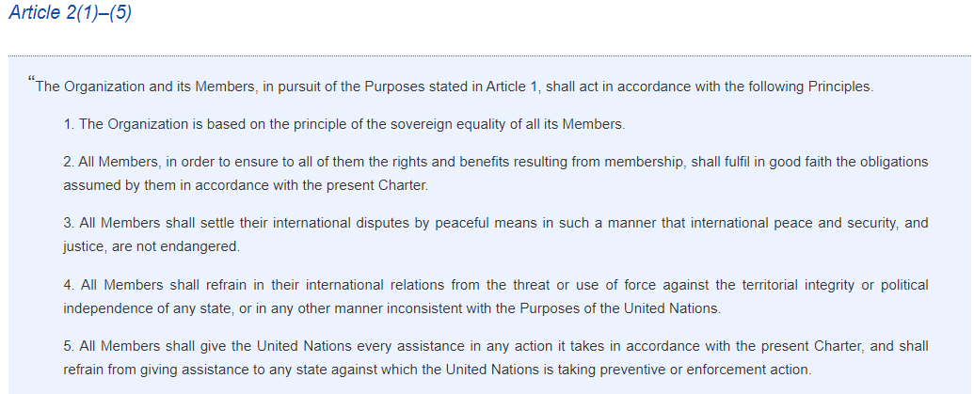
Security architecture and relations among states

Slide 10

UN – United Nations
24 October 1945, San Francisco
193 member states
The goal of the UN is to preserve international peace, security and ensure international cooperation. Membership in the UN is based on the principle of sovereign equality
Security Council – 15 members, 5 permanent members
General Assembly – all UN member states
UN Secretariat - day-to-day duties, 7,500 officials from 170 countries
International Court of Justice - fifteen judges elected by the General Assembly and the Security Council
Economic and Social Council - 54 members who are elected for 3 years
Trusteeship Council - Purpose?

Slide 11
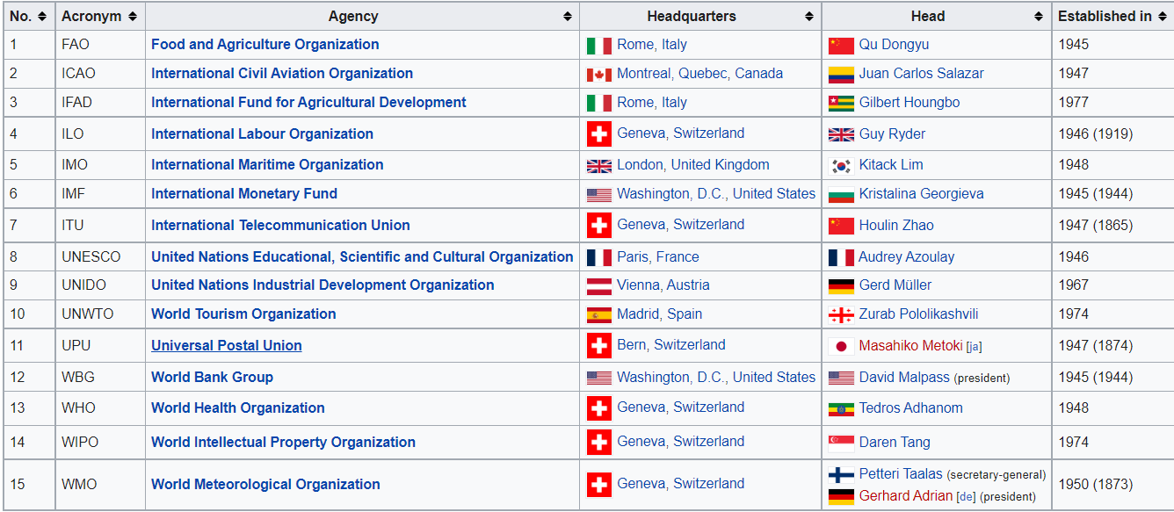
UN – United Nations

Slide 12
UN Charter
Preamble
Chapter I: Purposes and Principles
Chapter II: Membership
Chapter III: Organs
Chapter IV: The General Assembly
Chapter V: The Security Council
Chapter VI: Peaceful Settlement of Disputes
Chapter VII: Action with respect to Threats to the Peace, Breaches of the Peace, and Acts of Aggression
Chapter VIII: Regional Arrangements
Chapter IX: International Economic and Social Co-operation
Chapter X: The Economic and Social Council
Chapter XI: Declaration regarding Non-Self-Governing Territories
Chapter XII: International Trusteeship System
Chapter XIII: The Trusteeship Council
Chapter XIV: The International Court of Justice
Chapter XV: The Secretariat
Chapter XVI: Miscellaneous Provisions
Chapter XVII: Transitional Security Arrangements
Chapter XVIII: Amendments
Chapter XIX: Ratification and Signature

Slide 13
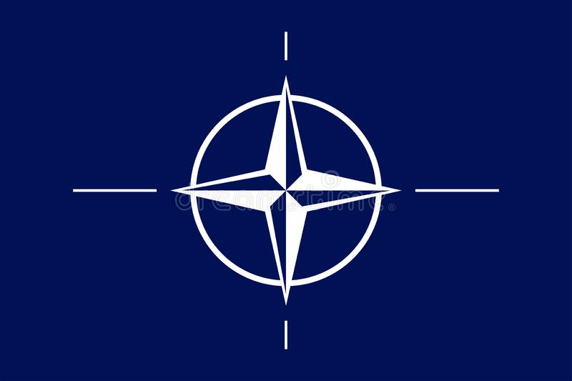
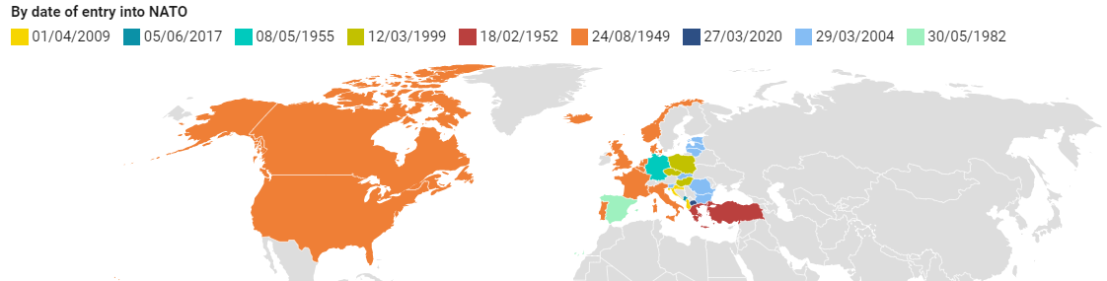
NATO - North Atlantic Treaty Organization
4 April 1949 – North Atlantic Treaty (Washington)
32 member states
NATO's main headquarters are located in Brussels, Belgium
Civilian structure – North Atlantic Council, NATO Headquarters, Nuclear Planning Group, Secretary General
Military structure – Military Committee, Allied Command Operations, Allied Command Transformation

Slide 14
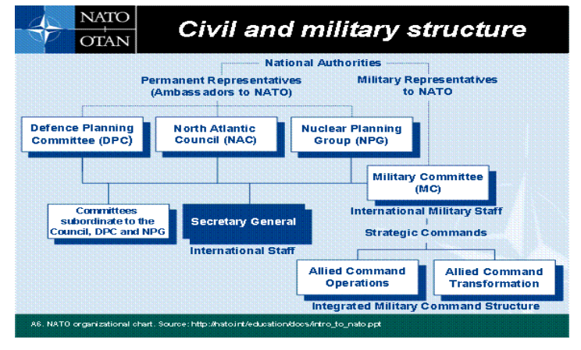


NATO - North Atlantic Treaty Organization
https://www.nato.int/cps/en/natolive/structure.htm#CS

Slide 15
NATO - North Atlantic Treaty
Article 5
„The Parties agree that an armed attack against one or more of them in Europe or North America shall be considered an attack against them all and consequently they agree that, if such an armed attack occurs, each of them, in exercise of the right of individual or collective self-defence recognised by Article 51 of the Charter of the United Nations, will assist the Party or Parties so attacked by taking forthwith, individually and in concert with the other Parties, such action as it deems necessary, including the use of armed force, to restore and maintain the security of the North Atlantic area.“
„Any such armed attack and all measures taken as a result thereof shall immediately be reported to the Security Council. Such measures shall be terminated when the Security Council has taken the measures necessary to restore and maintain international peace and security.“

Slide 16
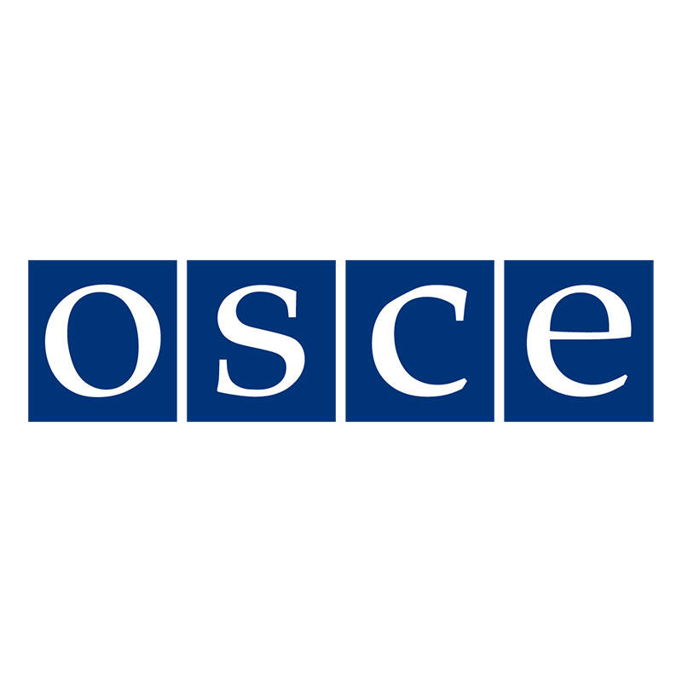
OSCE - Organization for Security and Co-operation in Europe
1975 Conference on Security and Co-operation in Europe
Shift from the CSCE to the OSCE on 1 January 1995
Topics: Arms control, border management, education, elections, human rights, migration, good governance, economic activities, cyber security, democratization, national minority issues, conflict prevention, etc.
Three dimensions:
  Politico-military
  Economic and environmental
  Human

Slide 17
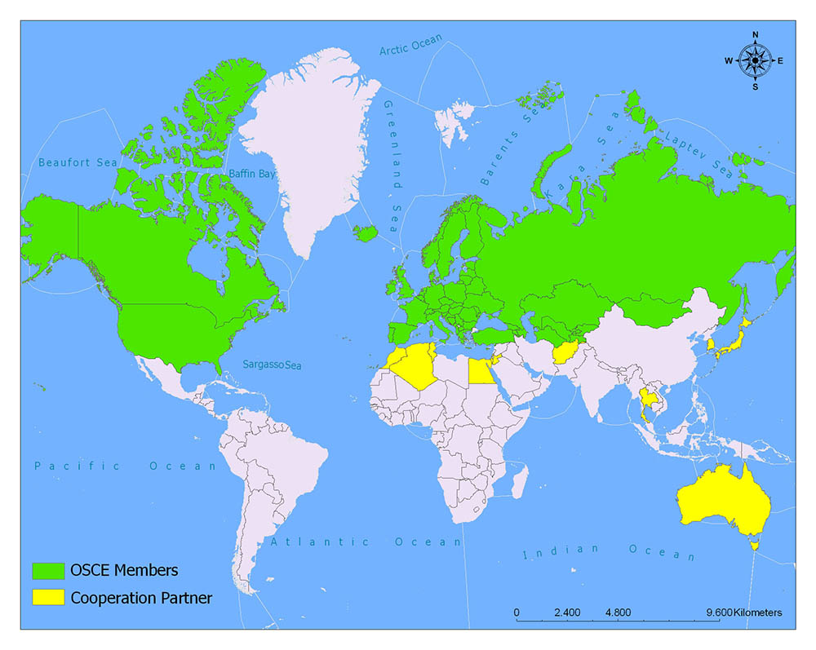
OSCE - Organization for Security and Co-operation in Europe

Slide 18
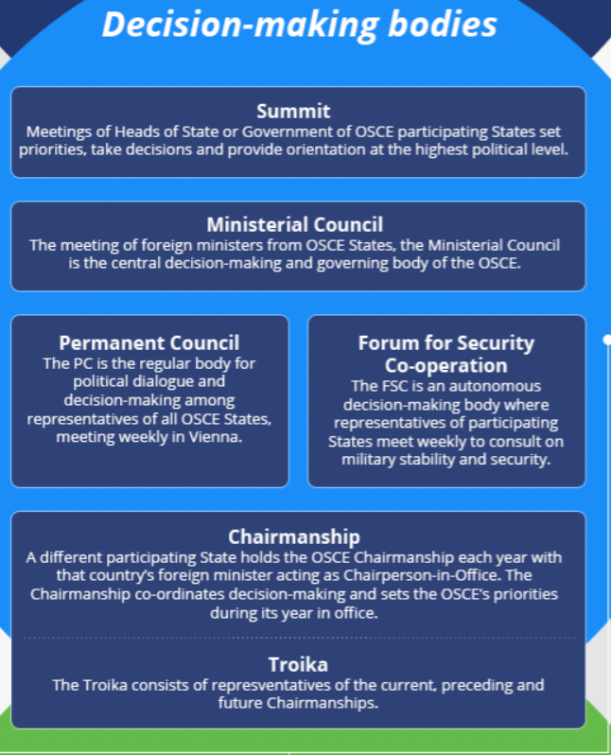
OSCE - Organization for Security and Co-operation in Europe

Slide 19
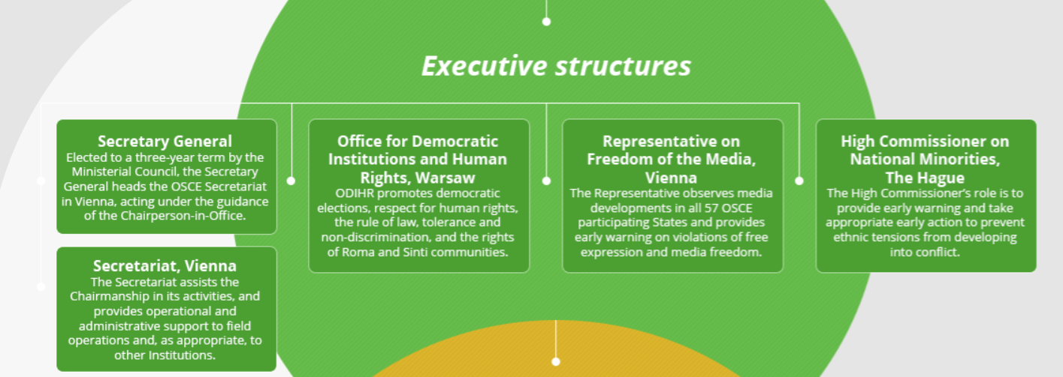
OSCE - Organization for Security and Co-operation in Europe

Slide 20
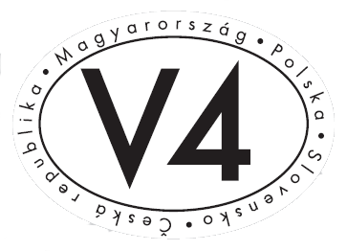
V4 - Visegrad Group
Czech Republic, Poland, Slovakia and Hungary
To advance co-operation in military, economic, cultural and energy affairs
15 February 1991
International Visegrad Fund
Non-institutionalized, regular meeting of top executives
Presidency lasts one year

Slide 21
Class Participation- Discuss the following points:
What type of security cooperation is the most effective? Justify your answers
  Cooperative Security, Collective Security or Collective defence?
What do you think are the advantages and disadvantages of NATO membership?
Which of the UN specialized agencies do you think is the most useful one and why?

Slide 22
Thank you for your attention

