Slide 1
National, International and Human Security
Security Systems and Actors, March 26, 2024
Vendula Divišová, vendula.divisova@mail.muni.cz

Slide 2
Outline
Different levels of security
National security
International security
Human security
Vernacular security
Group discussion

Slide 3
National security
state is given a monopoly on the use of force only insofar as it is capable of protecting its citizens
‘national security’ = all those public policies through which the nation state ensures its survival as a separate and sovereign community → the safety and prosperity of its citizens

Slide 4
National security: definitions
"… a nation is secure to the extent to which it is not in danger of having to sacrifice core values if it wishes to avoid war, and is able, if challenged, to maintain them by victory in such a war.“ (Walter Lippman, 1943)
“… security, in an objective sense, measures the absence of threats to acquired values, in a subjective sense, the absence of fear that such values will be attacked.“ (Arnold Wolfers, 1952)
“Security itself is a relative freedom from war coupled with a relatively high expectation that defeat will not be a consequence of any war that should occur.“ (Ian Bellamy)

Slide 5
National security
national security as the absence of threats to acquired values through deterrence or defence capabilities
security pursued by reducing vulnerability (implies a self-help = military power and economic resources)
bias towards great powers
Why (absolute) national security cannot be achieved?
security dilemma
risk of creating a militarised and security-obsessed society

Slide 6
International security
focus on the sources and causes of threats → aims to reduce / eliminate them
depends on the management of relations among states
agree to conduct their sovereign affairs in accordance with specified normative standards
principles, norms, rules of behaviour → some degree of order and certainty
international organizations and regimes
criticism:
in practice depends on great powers + might lead to excessive vulnerability

Slide 7
“The concept of security has for too long been interpreted narrowly: as security of territory from external aggression, or as protection of national interests in foreign policy or as global security from the threat of a nuclear holocaust. It has been related more to nation-states than to people.“
„Forgotten were the legitimate concerns of ordinary people who sought security in their daily lives. For many of them, security symbolized protection from the threat of disease, hunger, unemployment, crime, social conflict, political repression and environmental hazard.“

Slide 8
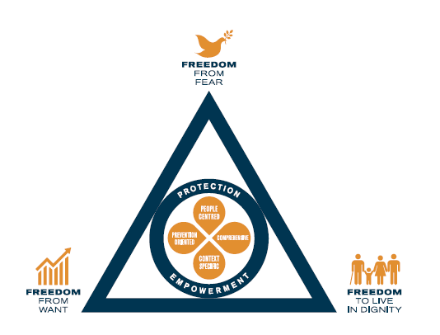
Change of paradigm? Human security
NS and IS both view states as protectors rather than oppressors of its own citizens
states might endanger their own citizens
paradigm of human security
moral primacy to the well-being of men, women and children over and above the rights and interests of states or of international society
different definitions - safety → well-being, human rights
freedom from fear + freedom from want + freedom to live in dignity

Slide 9
Dimensions of human security
Economic
Food
Health
Environmental
Personal
Community
Political

Slide 10
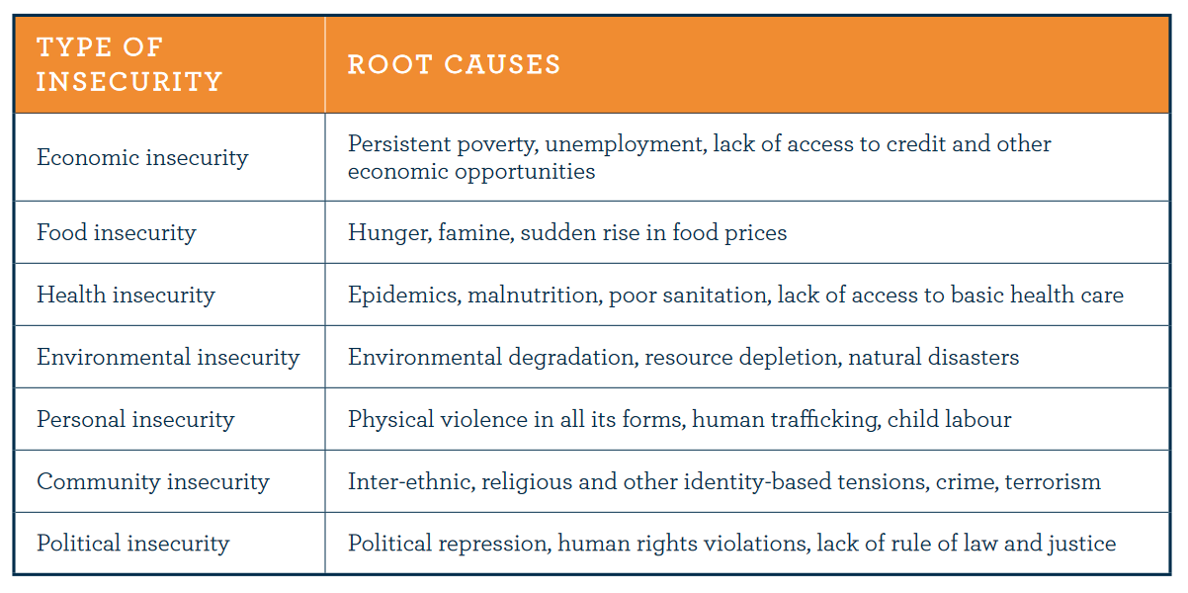

Slide 11
Human Security Network
established in 1999, a loose grouping of states led by Canada, Norway, Switzerland
the task of promoting the concept of human security as a feature of national and international policies
agenda for political action:
elimination of antipersonnel landmines
stopping the use of child soldiers
promoting respect of international humanitarian law and the work of the ICC
stop proliferation and misuse of small arms and light weapons
protection of civilians in conflict

Slide 12
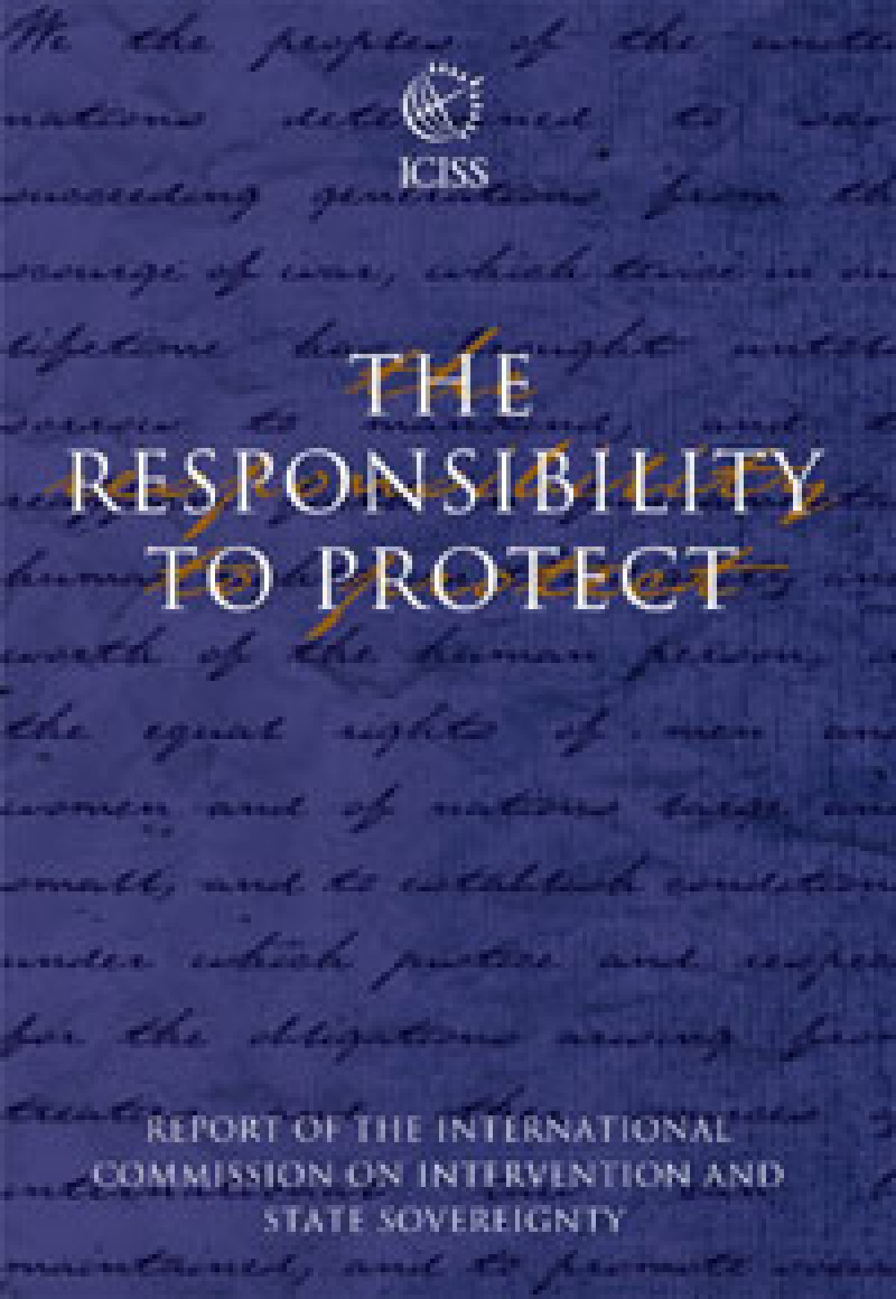
Responsibility to protect (R2P)
ICISS report (2001) - proposed the doctrine of R2P:
„State sovereignty implies responsibility, and the primary responsibility for the protection of its people lies with the state itself.“
„Where a population is suffering serious harm, as a result of internal war, insurgency, repression or state failure, and the state in question is unwilling or unable to halt or avert it, the principle of non-intervention yields to the international responsibility to protect.“
applies to genocide, war crimes, crimes against humanity, ethnic cleansing

Slide 13
Responsibility to protect (R2P)
prevention as the most important dimension of R2P
military intervention as an exceptional measure in cases of serious and irreparable harm occurring to human beings (or imminently likely to occur)
A. large scale loss of life (genodical intent or not) as a product of deliberate state action / neglect / inability to act / failed state situation
B. large scale ‘ethnic cleansing‘
application of “precautionary principles“ (right intention, last resort, proportionality, a reasonable chance of success)

Slide 14
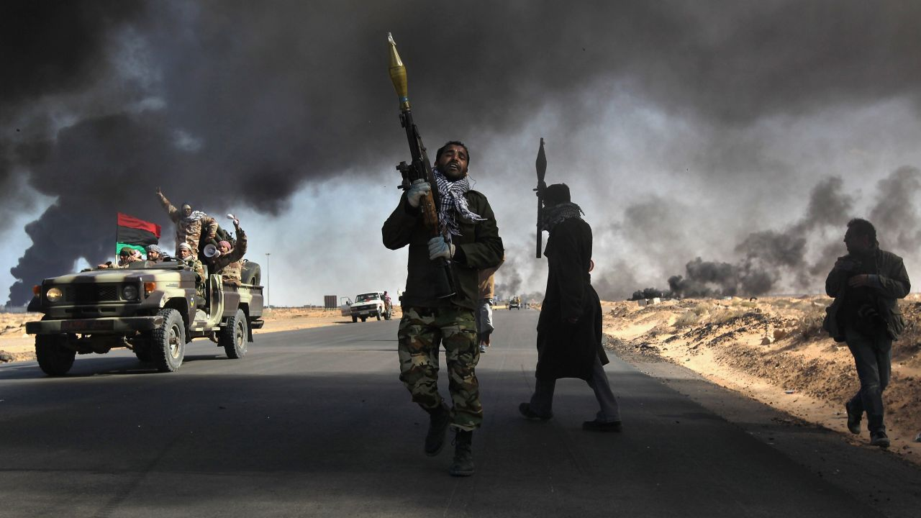
Human security approach: criticism
lacks a precise definition
too broad → little guidance for policymakers
not a useful framework of analysis for scholars
can justify (military) interventions in other states

Slide 15
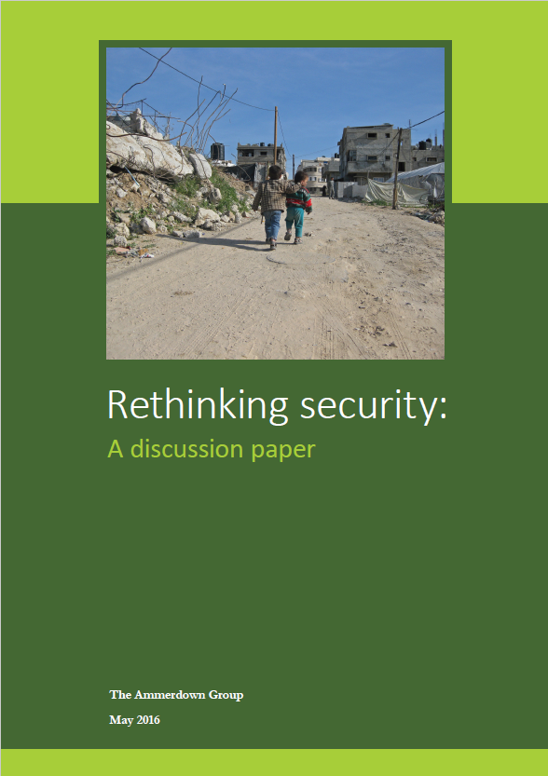
Rethinking security
The Ammerdown Group. „Rethinking security: A discussion paper growing insecurity“
established approach - identify threats and „neutralise“ them through „capabilities“ (mostly hard power)
the military response has been ineffective and counterproductive
the goal of security must be grounded in the wellbeing of people in their social and ecological context
priority issues: scarcity and climate change, inequality, militarism, violent conflict
need for greater understanding of the adversaries

Slide 16
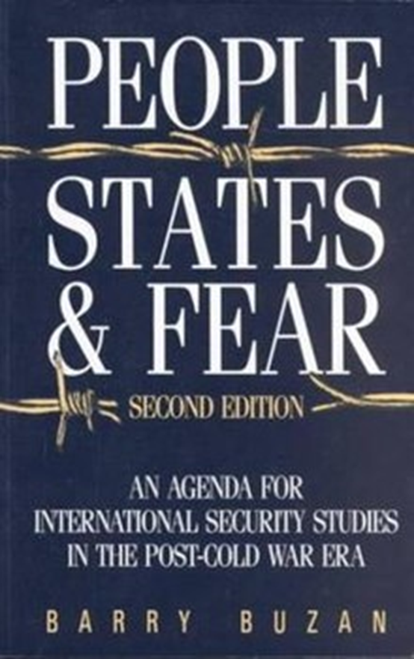
A holistic view of security
Buzan: 3 levels of security - individuals (level 1) - state (level 2) - international system (level 3)
strong interconnections, they cannot be addressed separately!
need for reintegration
► systemic security - interconnecting all three levels
taking account of the vulnerabilities of other actors, threat from one‘s own state…
solution to the power-security dilemma (excessive vulnerability x provocation)
stability of the system - by distributing the control as wide as possible across the levels

Slide 17
Vernacular security
based on the constructivist approach to security and human security
it criticises speaking for people x talking to people / with people
security as a contested concept = different meanings for different people
What meaning do people attach to security in their daily lives?
a great plurality of meanings
securities instead of a security

Slide 18
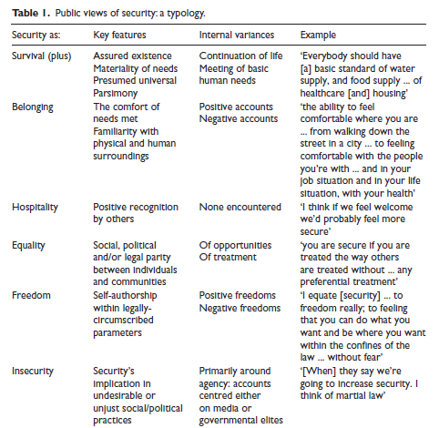
Vernacular security: example 1
Lee Jarvis a Michael Lister (2012) Vernacular Securities and Their Study: A Qualitative Analysis and Research Agenda
a project examining public attitudes towards security, citizenship and anti-terrorism policy within the UK
(a) What kinds of security threats do people in this country face? (b) What are the main issues or threats to your own security? (c) In what ways do you think threats to security have changed over time, if any? (d) What does security mean to you? (e) Who do you think is responsible for providing security?
= heterogenity of vernacular securities

Slide 19
Vernacular security: example 2
Bruce Bakera and Manu Lekunze (2019) The character and value of vernacular security: the case of South West Cameroon
perception of security in South West Cameroon
„what counts as a security issue? for whom is security? how is security provided? who allocates security?“
Security is contested
A broad view of threats
Security is subjective
Security is communal
Security favours certainty and stability
Multiple providers
security as freedom

Slide 20
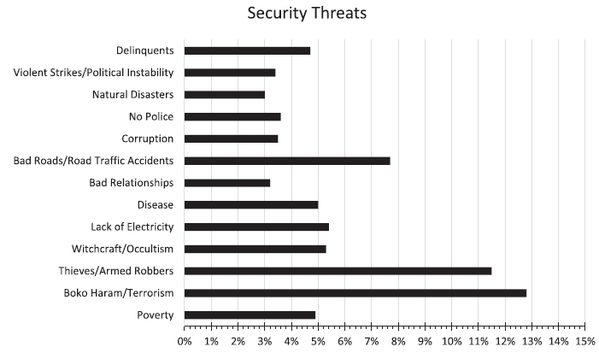
Vernacular security: example 2
What issues do the people of South West Cameroon perceive as the biggest threats?

Slide 21
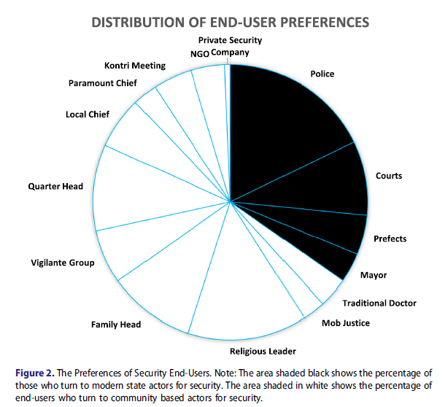
Vernacular security: example 2
Notes:
Figure 1. The Principal Security Threats. Note: Other threats which form less than 3% of the total threats mentioned were: tribal/cultural differences; exclusion; mob justice; western culture/demise of local values; rape; poor mobile phone connection; rain; injustice; homelessness; lack of opportunity; assault; pollution; death; disputes; bad neighbours/neighbourhoods; natural disasters.
When interviewees were asked to list five issues which made them feel insecure, listing the most severe first, their responses clearly showed that security meant different things to different people. Figure 1 below shows security threats mentioned which constitute 3% or more of the total number of issues mentioned.
A hallmark of the data was how small the degree to which end-users agreed as to what security/insecurity was. Out of the 1,525 threats mentioned by the 407 respondents, there was no single threat that more than 50% of the respondents agreed on. In fact, less than20% of the end-users agreed on one single threat as the most important threat.

Slide 22
Group discussion
What meaning do you personally attach to security? Can you agree on a common definition of security within your discussion group?
What dimensions of human security are the most threatened in your countries? What are the main insecurities people face?

