Slide 1
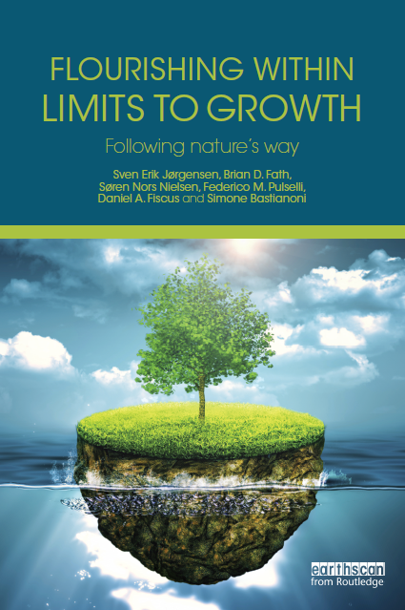
2015

Slide 2
Chapter 1 - Introduction
Natural principles of chemistry, mechanics and biology are not merely limits. They’re invitations to work along with them. —Jane Jacobs, The Nature of Economies, 2000, p. 12
Your reaction
What does the quote mean and what does it have to do with this chapter?
What part was most confusing or most difficult to understand?

Slide 3
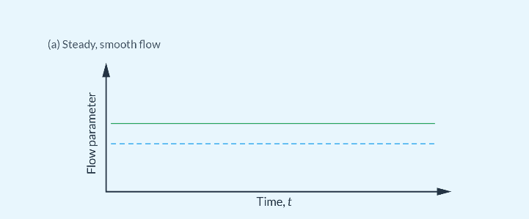
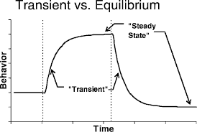

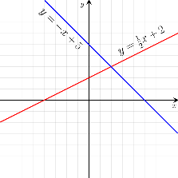
Steady state and linear growth
Linear growth – change in constant amount

Slide 4
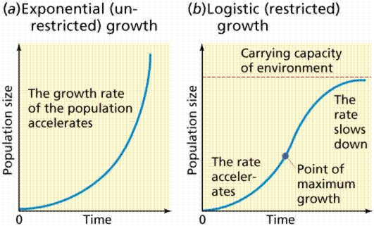
Exponential and logistic growth
Unconstrained Growth
Constrained Growth
(environmental resistance)
Exponential growth – change at a constant rate (unconstrained positive feedback)
Logistic begins exponential but then feels the negative feedback pressure of the CC

Slide 5
Drake Equation – is there life out there?
Where, N = the number of civilizations in the Milky Way galaxy with which communication might be possible (i.e. which are on the current past light cone);
R∗ = the average rate of star formation in our Galaxy.
fp = the fraction of those stars that have planets.
ne = the average number of planets that can potentially support life per star that has planets.
fl = the fraction of planets that could support life that actually develop life at some point.
fi = the fraction of planets with life that go on to develop intelligent life (civilizations).
fc = the fraction of civilizations that develop a technology that releases detectable signs of their existence into space.

Slide 6
Fermi paradox - Where is everybody?
Explanations can be divided into three classes:
Few intelligent civilizations ever arise.
  This is an argument that at least one of the first few terms, R∗ · fp · ne · fl · fi, has a low value. The most common suspect is fi, but explanations such as the rare Earth hypothesis argue that ne is the small term.
Intelligent civilizations exist, but we see no evidence, meaning fc is small.
  Typical arguments include that civilizations are too far apart, it is too expensive to spread throughout the galaxy, civilizations broadcast signals for only a brief period of time, communication is dangerous, and many others.
The lifetime of intelligent, communicative civilizations is short, meaning the value of L is small.
  Drake suggested that a large number of extraterrestrial civilizations would form, and he further speculated that the lack of evidence of such civilizations may be because technological civilizations tend to disappear rather quickly. Typical explanations include it is the nature of intelligent life to destroy itself, it is the nature of intelligent life to destroy others, they tend to be destroyed by natural events, and others.

Slide 7
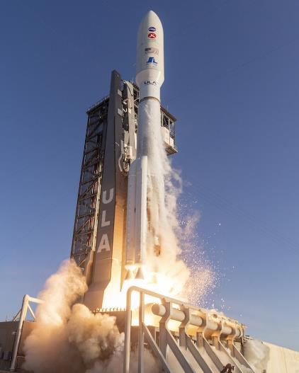
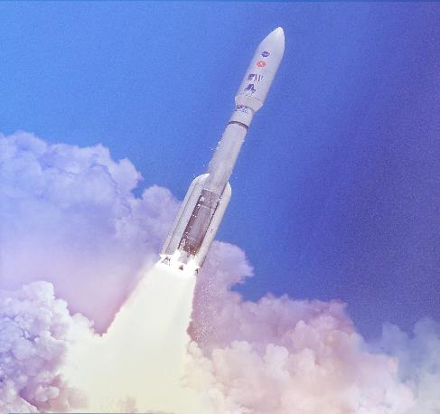
Race to the stars (or at least Mars)

Slide 8
Ecosystemic Life hypothesis
Which came first the organism or the ecosystem?

Slide 9
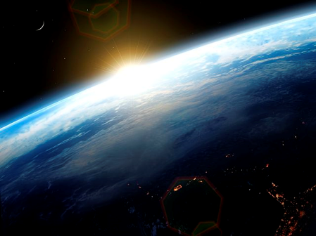

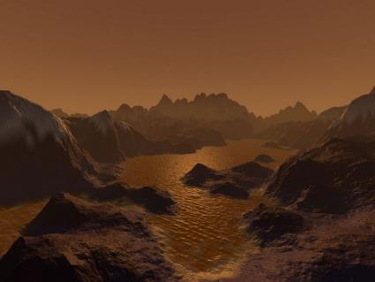
Earth before Life

Slide 10
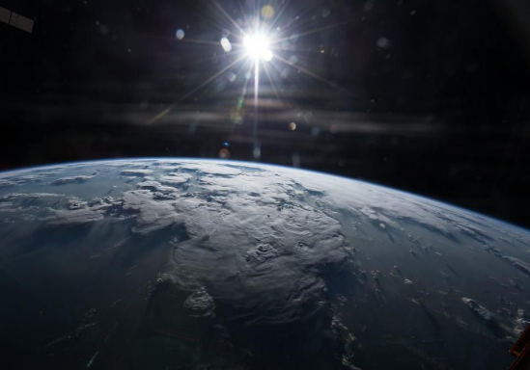
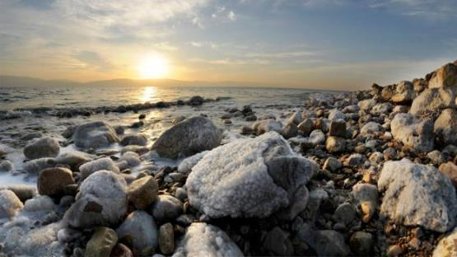
Solar energy

Slide 11
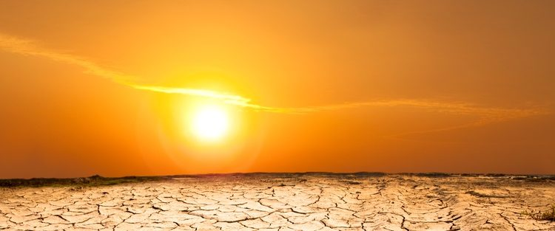
Relentless input of energy – something must be done with it
Diurnal, annual, and latitudinal cycles and variation

Slide 12
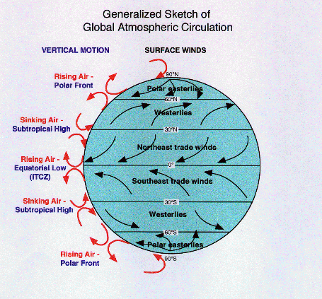
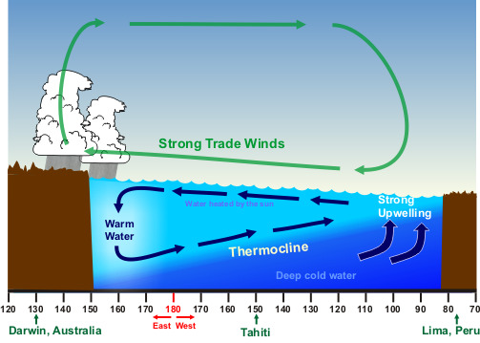
Energy gives rise to gradient formation
In air and sea together

Slide 13
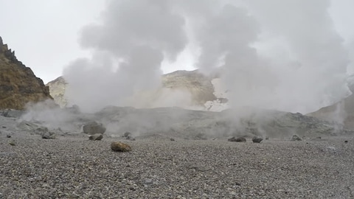
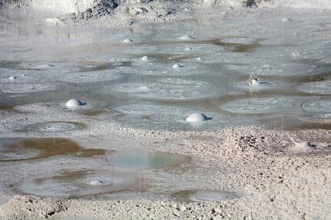
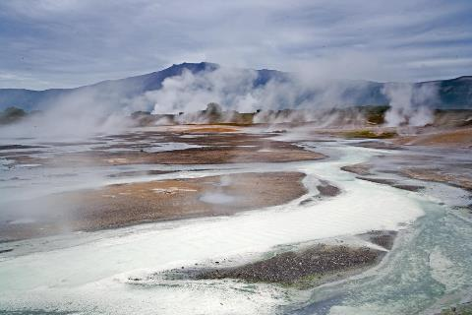
Geothermal energy
Also gives rise to gradients and flow

Slide 14
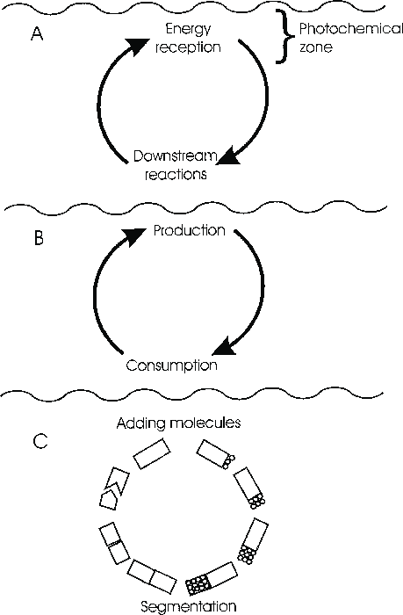
Ecological Origin of Life
HT Odum
Prebiotic coupled complementary processes
Production
Consumption
The ecological cycle generated
cells
organisms

Slide 15
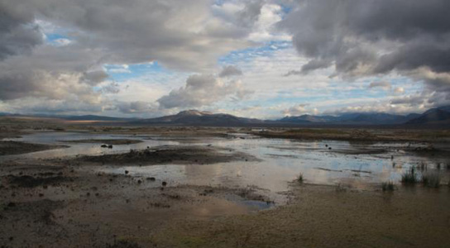
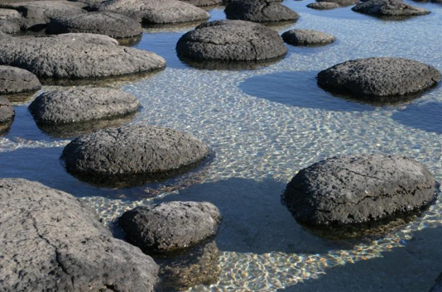
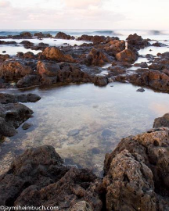
Encapsulation of the processes
In the seas and at the margins of land
Estuarine turbidity maximum

Slide 16
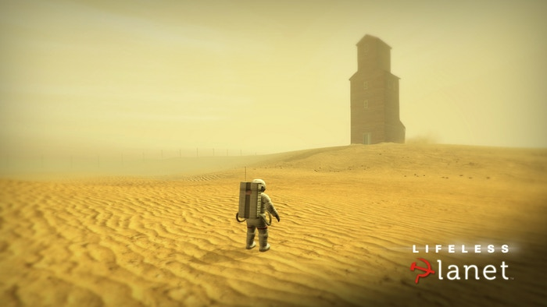
An alternative – the first organism
I’m here
What’s for dinner?
An organism without an ecosystem?

Slide 17
Gandhi
There is enough for everyone’s need, but not enough for everyone’s greed
What ethics, policies, motivations can promote this worldview (and suppress the alternative)?
Questions

Slide 19
Chapter 2 – Limits to growth
Trees cannot grow into the sky
Your reaction
What does the quote mean and what does it have to do with this chapter?
What part was most confusing or most difficult to understand?
How long does it take to grow a 100-year-old tree?

Slide 20
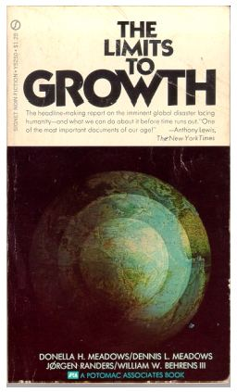
The 11 state variables selected were:
1. Nonrenewable resources
2. Service capital
3. Industrial capital
4. Agricultural capital
5. Population aged 0–14 years
6. Population aged 15–45 years
7. Population aged above 45 years
8. Pollution
9. Urban and industrial land
10. Arable land
11. Potential arable land.
1972
What, if anything, is missing?

Slide 21
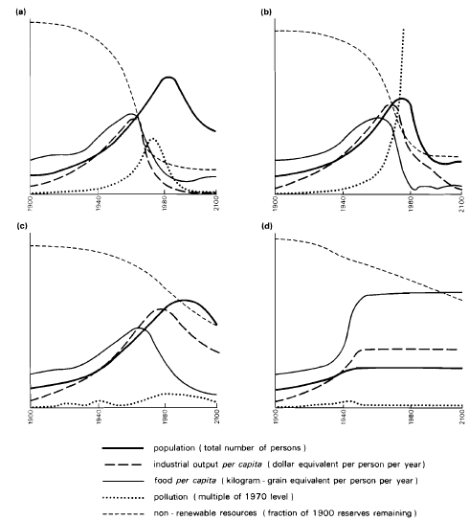
Forrester-Meadows world model
(a) A standard computer simulation based on 1970 values.
(b) Pollution-induced collapse even when known natural resource reserves are 2x.
(c) Collapse due to population growth even though resources are set as unlimited and pollution controls are assumed.
(d) Stabilized model producing a sustainable future. Assumptions: birth rate= death rate, capital investment= capital depreciation, and technological policies are implemented, e.g., resource recycling, pollution control, and restoration of eroded and infertile soils.
Baseline model points towards a resource crisis
(After Meadows, 1971)

Slide 22
Doomsday or collapse
Resilience is the capacity to successfully navigate all stages of the adaptive cycle
K
Conservation – mature stage
Ω
Ecological orientor
Reorganization
Release –
creative
destruction
α
r
Exploitation – pioneer stage
Connectedness

Slide 23
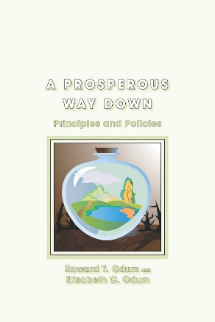
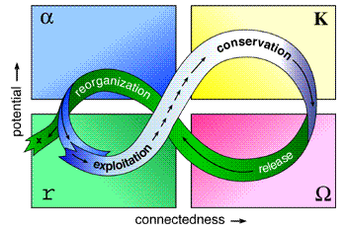

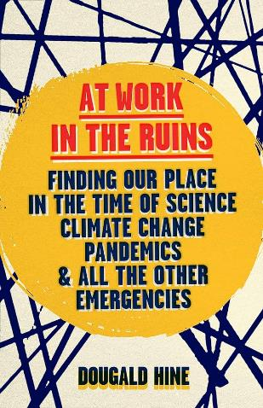
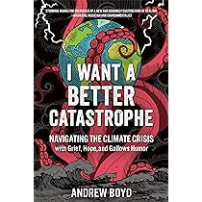
Doomsday or collapse – there is something in the air
What comes next?
2001
2021
2023
2023

Slide 24
Climate change and IPCC

Slide 25
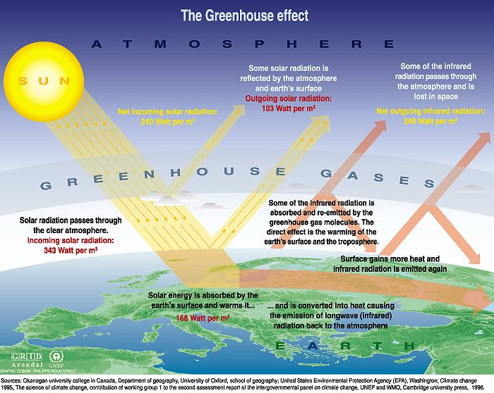

Slide 26
Energy Balance
Input
Atmosphere
Output
Earth
system

Slide 27
Energy Balance
More energy in the system leads to warming
Solar energy
Atmosphere
Infrared radiation
Earth
system
Energy In > Energy out
Not because E_{in} is ↑,
but because E_{out} is ↓

Slide 28
Three Climate Basics
Sun and Earth are at different temperatures, therefore radiate energy at different wavelengths
  Sun emits short-wave mostly visible light radiation
  Earth emits long-wave mostly infrared radiation
Certain gases (GHG) in the atmosphere respond to energy at different wavelengths (passing short, absorbing long)
The concentration of greenhouse gases in the atmosphere is increasing

Slide 29

We need to think in systems (Meadows)
(think like a mountain - Leopold)
Food for a growing population
Climate change
Abate poverty
Education for all
Slowing human population growth
Renewable energy (down scaling)
Interdisciplinary science and problem solving – more focus on schools
Why the emphasis still on disciplinary boundaries? Was your experience different?
2008

Slide 30
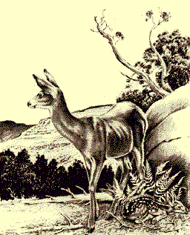
Ecological Cascades
Thinking like a mountain
Recycling – Indians
    … and Astronauts

Slide 31
LtG still not acceptable
Business as usual mostly continues
  Short-term costs versus long-term consequences
Ozone depletion was handled which gave confidence for other areas
1950 – 2000 (also see Millennium Ecosystem Assessment Report)
Human population increased 2 ⋅
Number of registered vehicles increased 10 ⋅
Oil consumption increased 7 ⋅
Rice production increased 4 ⋅
Wheat production increased 4 ⋅
Iron and steel production increased 4.5 ⋅
Aluminum production increased 15 ⋅

Slide 32
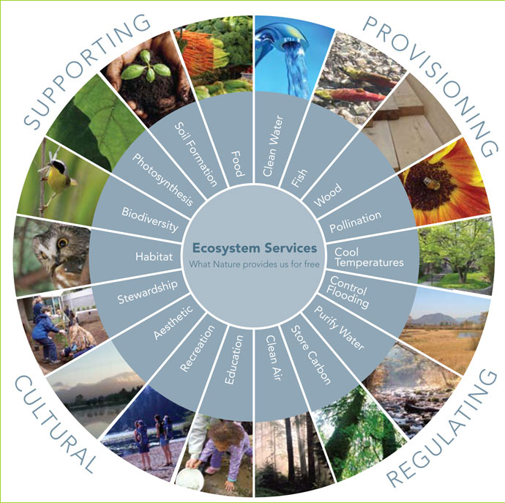
Ecosystem services
1. Primary production and the creation of new biomass
2. Purification of water and air
3. Decomposition of organic matter that otherwise would deplete the oxygen in aquatic ecosystems
4. Decomposition of harmful toxic organic compounds
5. Mitigation of droughts and floods
6. Recycling of important elements
7. Moderation of extreme weather conditions
8. Storage of the genetic pool and maintenance of biodiversity
9. Pollination
10. Pest control
11. Aesthetic and recreational areas.

Slide 33
Sustainable Development

Slide 34

Sustainable Development vs Sustainability
Sustainable Development: “development that meets the needs of the present generation without compromising the ability of future generations to meet their own needs” – Our Common Future/ Brundtland Report, 1987
Sustainability: a system’s ability to generate and maintain self-organizing processes
What are “our needs”?

Slide 35
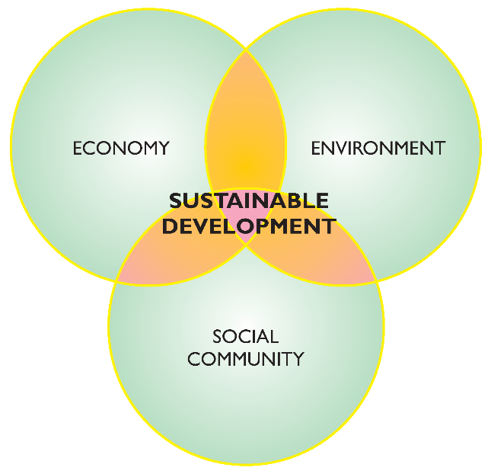
Three dimensions of Sustainable Development
?
?

Slide 36
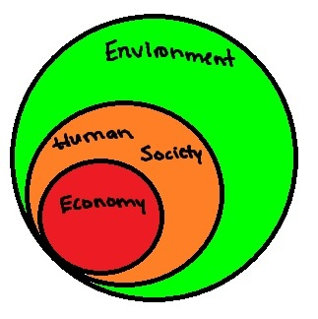
Environment is foundation for all aspects, others are subsets

Slide 37
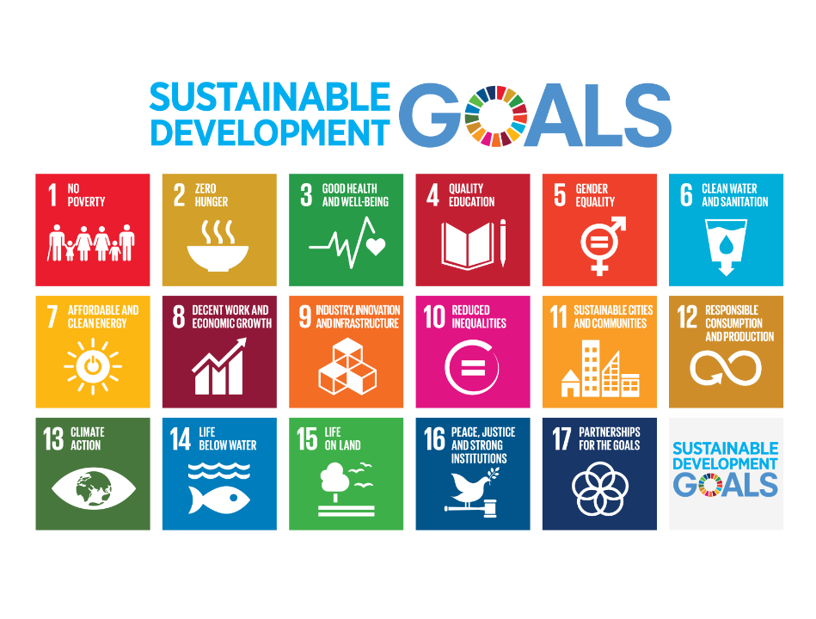

Adopted September 2015 – also called Agenda 2030

Slide 38
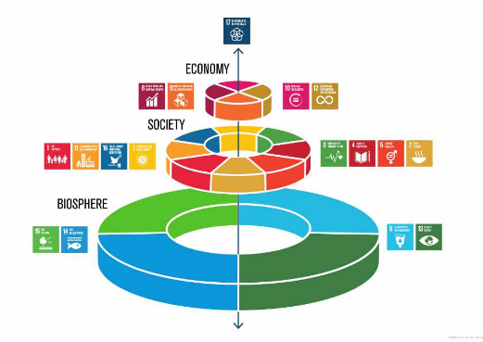

Slide 39
How to shift from quantitative growth to qualitative development?
Increase education investment
Internalize externalities
Agriculture increase through efficiency
Halt deforestation increase reforestation
Decrease GHG emissions
Low carbon mobility
Use efficiency
Next steps, barriers, questions?

