Slide 1
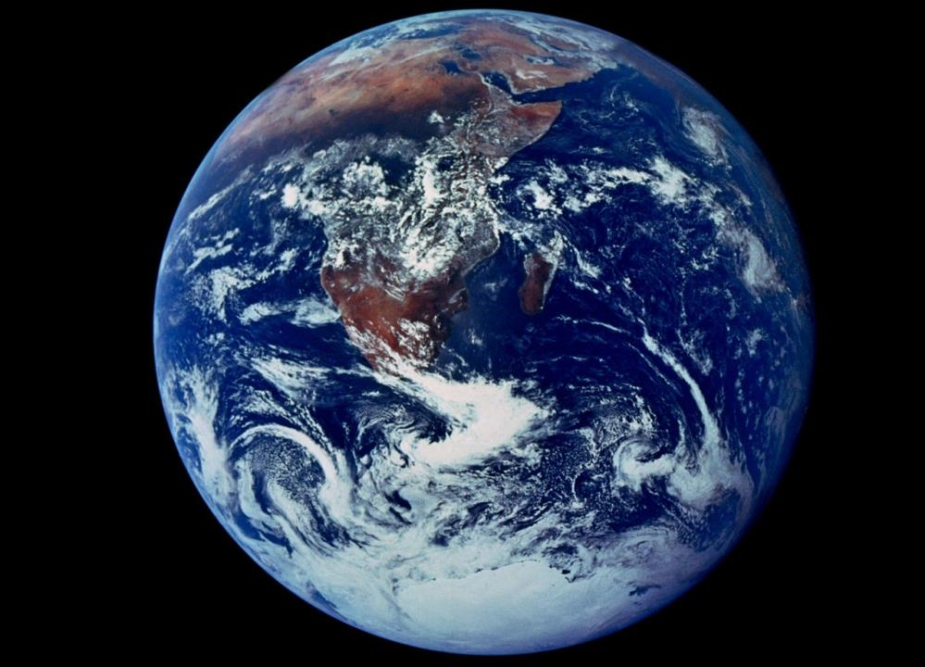
Blue Marble Photo
Dec 1972, Apollo 17
Planetary limits
Learning to flourish within them

Slide 2
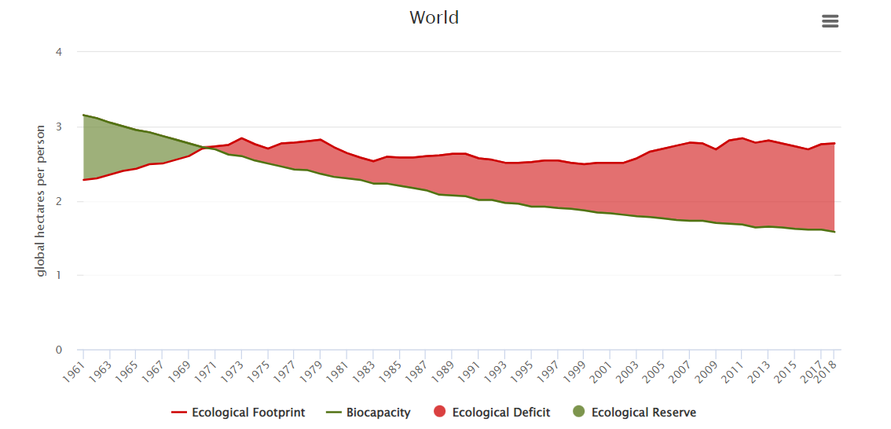
Overshooting the limits

Slide 3
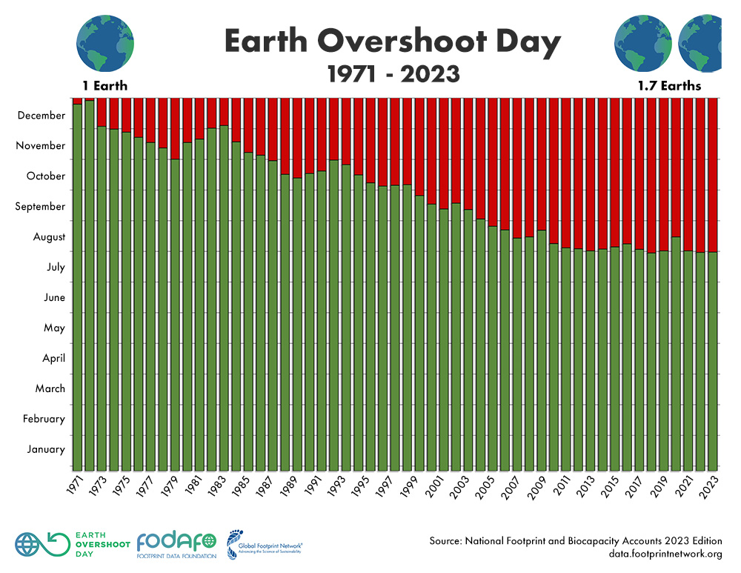
Overshooting the limits – July 25, 2024

Slide 4
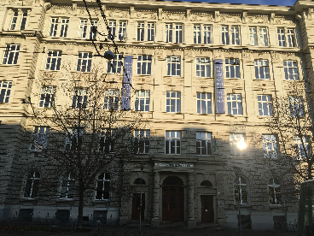
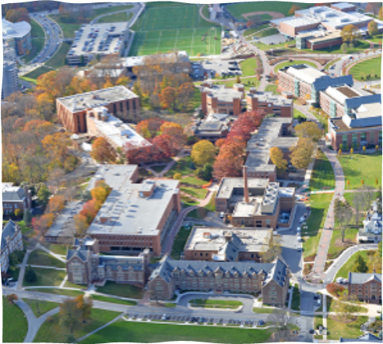
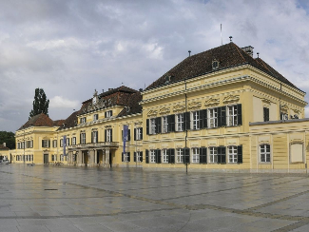
Flourishing within Limits to Growth
Brian D. Fath, Ph.D. – bfath@towson.edu
Professor, Department of Biological Sciences, Towson University, Baltimore, Maryland, USA
Principal Research Scholar, International Institute for Applied Systems Analysis, Laxenburg, Austria
Fulbright Distinguished Chair, Dept of Environmental Studies, Masaryk University, Brno, CR

Slide 5
Background
B.S. Physics. B.S. Aeronautics (Miami University, Oxford, Ohio)
Started M.S. program in Aeronautical Engineering, switched to Environmental Science with focus on energy resources (peak oil modelling) (Ohio State University, Columbus, Ohio)
  During this time exposed to systems ecology (Patten, Odum, Jorgensen), ecological economics (Daly, Costanza), environmental history and philosophy (Cobb, Rawls, Cronon)
Ph.D. in Systems Ecology developing and applying network methods for whole system analysis – direct and indirect effects. (University of Georgia, Athens, Georgia)
Currently, applying these approaches on socio-economic-ecological networks, namely urban metabolism, food-energy-water, regenerative economy, etc.

Slide 6
Course Goals:
To provide students with a basic understanding of the environment as a system including the biological, physical, and chemical foundations of ecosystem services
2. To understand how nature provides resources and constraints to socio-economic development and to students’ everyday life.
3. To learn how human activities impact and interfere with this ecological functioning
4. To explore how human activities could promote sustainable, win-win, flourishing outcomes within these limits
Course Outline: Arranged in 6- 3 hour blocks; specific readings (in bold) from Encyclopedia of Ecology, Fath and Jørgensen (eds). 2019. Elsevier.

Slide 7
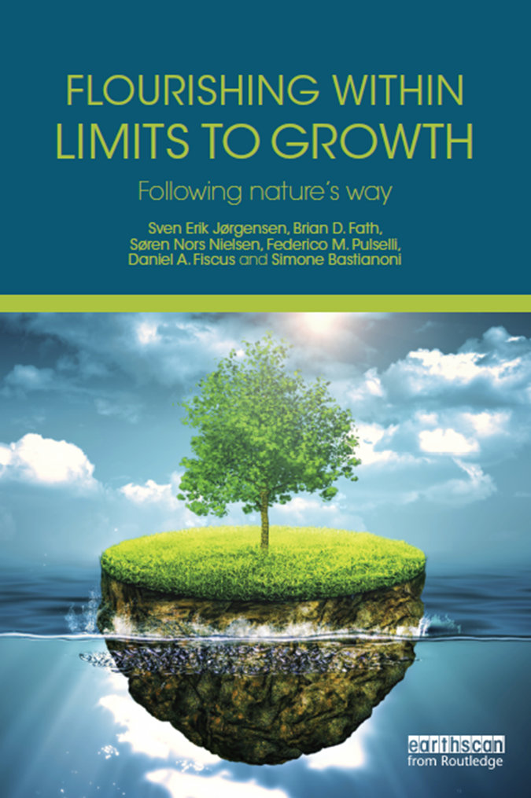
Feb 29 - 3 hours (virtual) 12:00–15:00 CET
Lecture 1: Systems thinking: Where it comes from and where it goes; Human Ecology; Energy resources
Readings: Ecological Systems Thinking: D W Orr; Human Ecology: Overview: F Steiner
March 7 - 3 hours (virtual) 12:00–15:00 CET
Lecture 2: Natural ecosystems, ecological succession, ecosystem services; Limits to Growth
Readings: Ecosystem Services: K A Brauman and G C Daily; Limits to Growth: B D Fath
March 14 - 3 hours (virtual) 12:00–15:00 CET
Lecture 3: Flourishing within limits
Readings: Flourishing within limits: Jørgensen et al. 2015 Chapters 1, 2 & 3
Student groups to lead the chapters
March 20 ???
March 21 - 3 hours In person 12:00–15:00 CET
Lecture 4: Flourishing within limits
Readings: Flourishing within limits: Jørgensen et al. 2015 Chapters 4, 5 & 6
Student groups to lead the chapters
March 28 - 3 hours (virtual) 12:00–15:00 CET
Lecture 5: Flourishing within limits; summary
Readings: Flourishing within limits: Jørgensen et al. 2015 Chapters 7, 8 & 9
Student groups to lead the chapters
April 4 - 3 hours (virtual) 12:00-15:00 CET
Lecture 6: A path to Sustainability
Readings: Ecological Footprint: M Wackernagel and J Kitzes

Slide 8
Introductions

Slide 9
“The greatest discovery of the past century had nothing to do with nuclear physics, or computer science, or genetic engineering. Rather it was the discovery of the essential connectedness of life and environment.”
Orr 2019
“It is a century now since Darwin gave us the first glimpse of the origin of species. We know now what was unknown to all proceeding caravan of generations: that men are only fellow-voyagers with other creatures in the odyssey of evolution.
Leopold 1949
Moving toward the Ecozoic!!

Slide 10
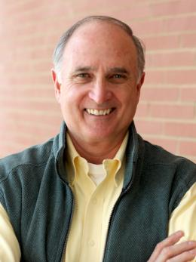
Professor David Orr
Oberlin College
Paul Sears Distinguished Professor of Environmental Studies and Politics Emeritus
Senior Advisor to the Oberlin College President
Systems thinker, writer, and orator.

Slide 11
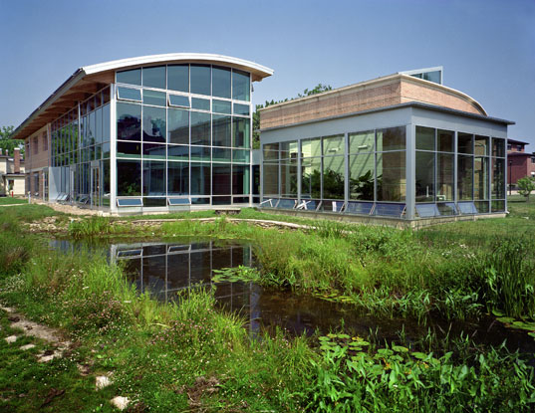
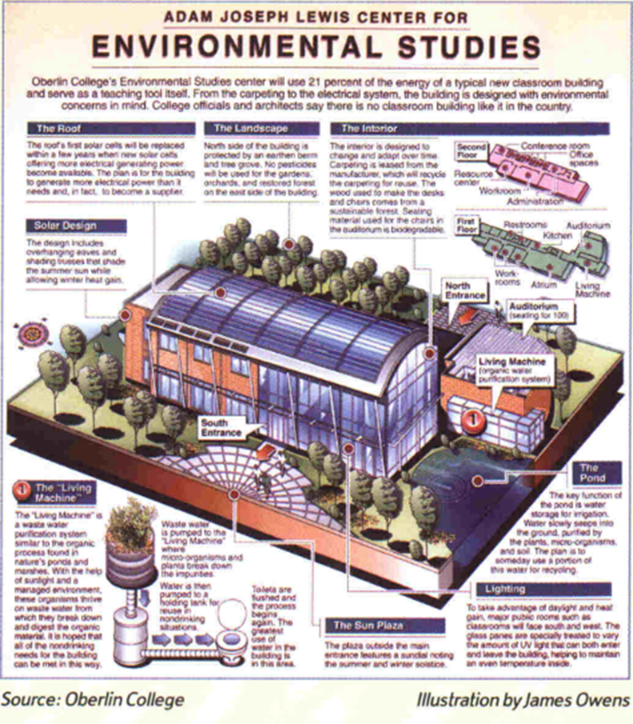
Oberlin’s Environmental Science Building:
Adam Joseph Lewis Center, was named by an AIA panel in 2010 as “the most important green building of the past 30 years,” and as “one of 30 milestone buildings of the twentieth century” by the U.S. Dept of Energy.

Slide 12
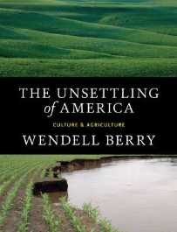
“Systems thinkers see the world as networks of interdependence” Orr, 2017, p. xv
“There is no such thing as autonomy;
there is only a distinction between responsible and irresponsible dependence” p.116 - Berry 1977

Slide 13
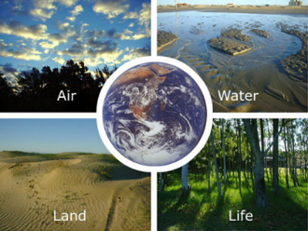
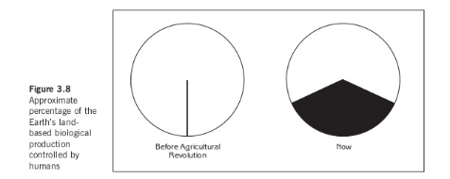
Systems thinking
“We live in a web of obligations and relationships that transcend the conventional boundaries by which we organize academic disciplines and bureaucracies” Orr, 2017, p. xv
“humans have appropriated the majority of the planet’s net primary productivity” Orr, 2017, p. xvi

Slide 14
Environmental education – gaining Eco-literacy
should constitute a comprehensive lifelong education … and the provision of skills and attributes needed to play a productive role toward improving life and protecting the environment with due regard given to ethical values.
By adopting a holistic approach, rooted in a broad interdisciplinary base, it recreates an overall perspective which acknowledges the fact that natural environment and manmade environment are profoundly interdependent….
UN-sponsored Conference at Tbilisi, Georgia, 1978
the idea of interrelatedness has yet to take hold of us in a deep way.
We still live in thrall to a world created by Descartes, Bacon, Galileo, and their heirs who taught us to dissect, divide, parse, and analyze by reduction but not how to put things back together or see the world as systems and patterns.
Orr, 2019

Slide 15
What educational experiences have had the most effect on you?
How can the current educational system be reformed to focus on these items?
How will education be different in the future?

Slide 16
AN ASSIGNMENT FOR THE CAMPUS
Does four years at college make you a better planetary citizen?
Does this college contribute to the development of a sustainable regional economy or, in the name of efficiency, to the processes of destruction?

Slide 17
Examine resource flows on campus: food, energy, water, materials, and waste
Where does stuff come from? Where does it go?
“No student should graduate without understanding how to analyze resource flows and without the opportunity to participate in the creation of real solutions to real problems.”

Slide 18
Ecological literacy
Every student should graduate with basic comprehension of:
the laws of thermodynamics
the basic principles of ecology
carrying capacity
energetics
least-cost, end-use analysis
how to live well in a place
limits of technology
appropriate scale
sustainable agriculture and forestry
steady-state economics
environmental ethics
Are you learning these topics

Slide 19
Pause

Slide 20
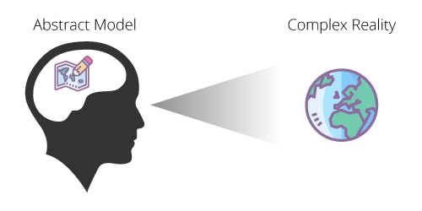
Understanding Reality
Complex Reality
Abstract Model
Modelling Function

Slide 21
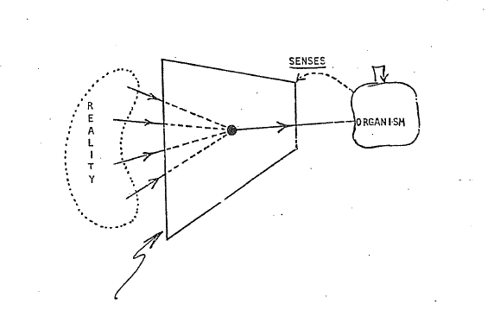
Understanding Reality
The filter or “corruption”
Patten - Systems Ecology lecture notes

Slide 22

Fragmentation:
What we get wrong about Environment
System
(Self, Species, City,
State, Nation)
Environment
Separation and fragmentation of the system from its environment
Environment is “out there”

Slide 23
Old perspective, dichotomy between system and environment
System
Environment
New perspective, system is focus of two environments
Input Environment
H
Output Environment

Slide 24
Environment
System
Input environ
H_{j}
H_{j}
H_{j}
Object
H_{i}
H_{j}
H_{j}
H_{j}
H_{j}
Output environ
Feedback
Any object/system is inseparable from its TWO ENVIRONMENTS

Slide 25
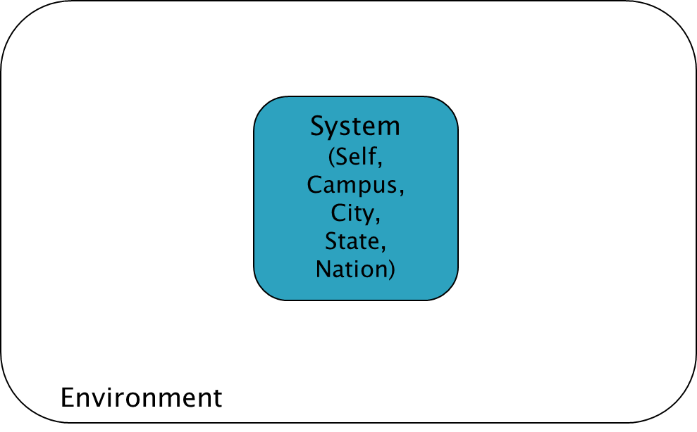
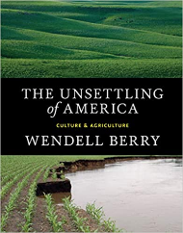
“What is Environment”
The concept of … place becomes simplified as ‘the environment’ that is, what surrounds us.
Once we see our place, our part of the world, as surrounding us, we have already made a profound division between it and ourselves.
We have given up the understanding - dropped it out of our language and so out of our thought - that we and our country create one another, depend on one another, are literally part of one another;
our land passes in and out of our bodies just as our bodies pass in and out of our land; all who are living as neighbors here, human and plant and animal, are part of one another, and so cannot possibly flourish alone;
our culture must be our response to our place, our culture and our place are images of each other and inseparably from each other, and so neither can be better than the other.
    Berry (1977, p. 24).

Slide 26
How are ways that you depend on the environment?
The environment is not “out there”, but rather in you and on you, a part of you
Homework – identify 1 mineral element that is used in the making of your smart phone, describe where it comes from and the extraction methods to get it.
What happens to it when you are done with the phone?
Post your findings on the Blackboard discussion page.

Slide 27
Systems Perspective
See how things are connected and interrelated
Where does it come from?
Where does it go?
Complex – many parts, many interactions
Adaptive – respond and change
Systems – set of parts interacting together to function as a whole

Slide 28
In other words, the action intended to solve the problem actually makes it worse because unintended side effects change the system & end up exacerbating the problem.

Slide 29
Unintended consequences
Acid precipitation/rain
Ozone depletion
Eutrophication
Global climate change
Automobile dependency
…
All of today’s major environmental problems emerge from yesterday’s solutions.

Slide 30
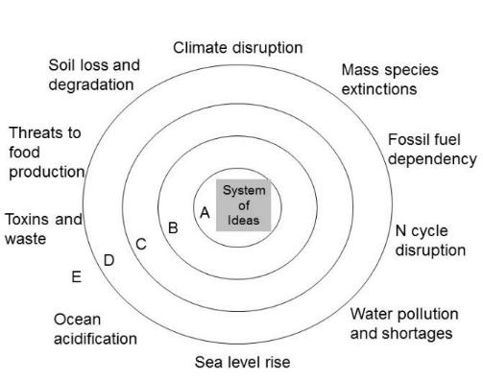
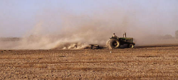
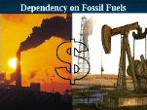
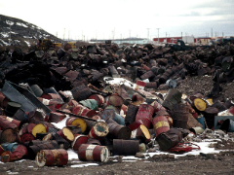
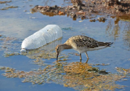
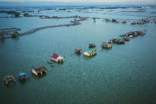
Environmental challenges are symptoms of deeper problems
Soil erosion
Toxins and waste
Automobile dependency
Water pollution
Sea level rise

Slide 31
Human Ecology summary
Humans are part of the biosphere;
We are living organisms like other animals in many respects, but
  we have an advanced social organization, and
  the ability to extract and use energy and resources that characterizes us and our impacts on the planet.
That does not make us independent from the environment though

Slide 32
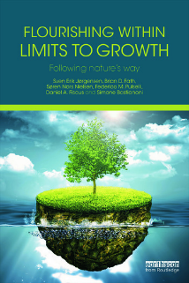
Flourishing within limits to growth
Recognize physical, planetary boundaries and capacities
Understand sustainable system design and function
Act accordingly, in all things, at all times, as part of a routine with nature

