Slide 1
Flourishing within Limits to Growth: Revising Economic Systems by Using
Nature as a Model
Brian D. Fath
Professor, Biology Dept, Towson University, USA
Senior Research Scholar, IIASA, Austria

Slide 2
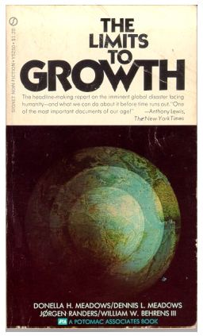
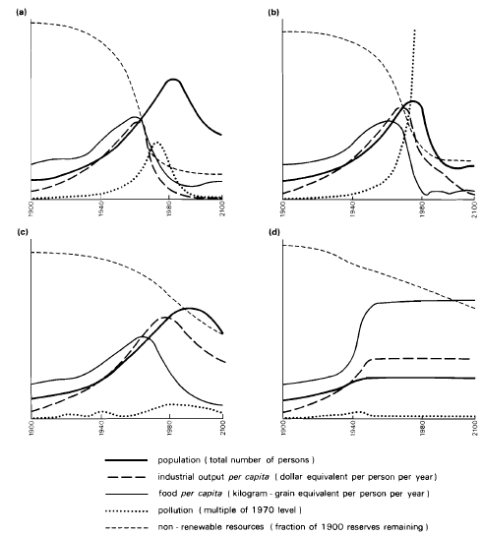

Slide 3
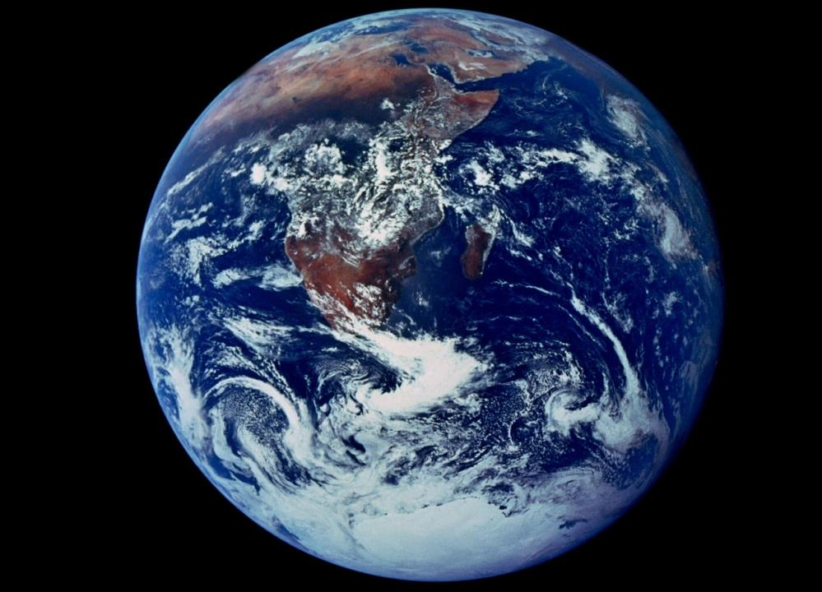

Slide 4
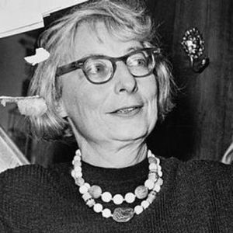
Limits to Growth
“Natural principles of chemistry, mechanics and biology are not merely limits. They’re invitations to work along with them.”
Jane Jacobs, 2000, p. 12
The Nature of Economies

Slide 5
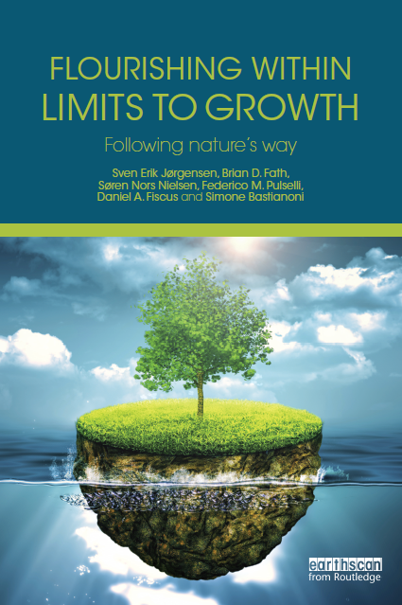
Club of Siena
SE Jørgensen, BD Fath,
SN Nielsen, FM Pulselli,
DA Fiscus, S Bastianoni
clubofsiena.eco-soft.dk

Slide 6
9 properties of ecosystems
Material constraints
Ecosystems conserve matter and energy – 1st law
All processes are dissipative – 2nd law
All life uses largely the same biochemical constituents and processes
Ontological properties
An ecosystem uses surplus energy to move further away from thermodynamic equilibrium (physically driven biological aspect) – centripetality
An ecosystem co-evolves by adapting to and modifying its environment (biologically driven biological aspect)
Phenomenological properties
Ecosystems have diversity of structure and function
Ecosystems work together in networks that improve the resource flow utilization
Ecosystems are emergent hierarchically
Ecosystems have an enormous amount of genetic, biochemical, and process information
Understand these and apply to socio-economic systems

Slide 7
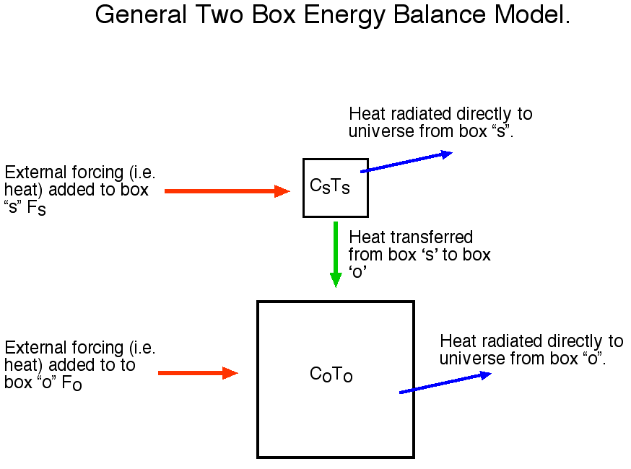
1. Ecosystems conserve matter and energy
This principle allows one to write balance equations, such as:
accumulation = input – output.

Slide 8
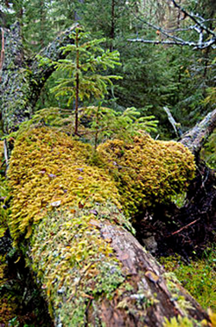
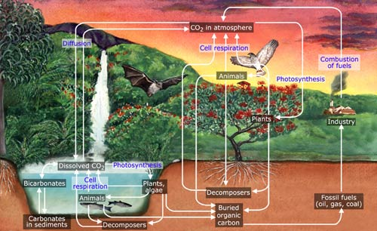
1.1. There are no trash cans in nature
Material is reused again and again through functional couplings

Slide 9
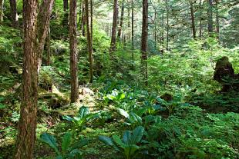
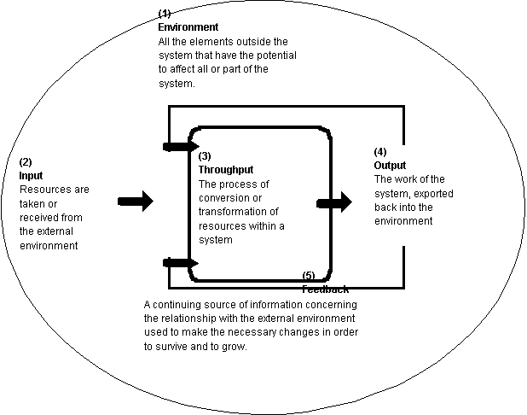
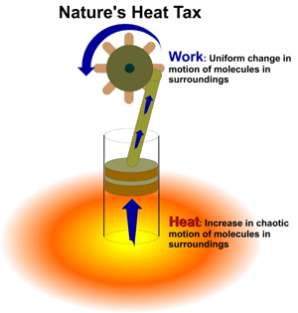
2. All ecosystem processes are dissipative and irreversible
(useful way to express the 2nd Law in ecology). Evolution is a step-wise development that is based on previous configurations for survival in a changeable and very dynamic world.

Slide 10
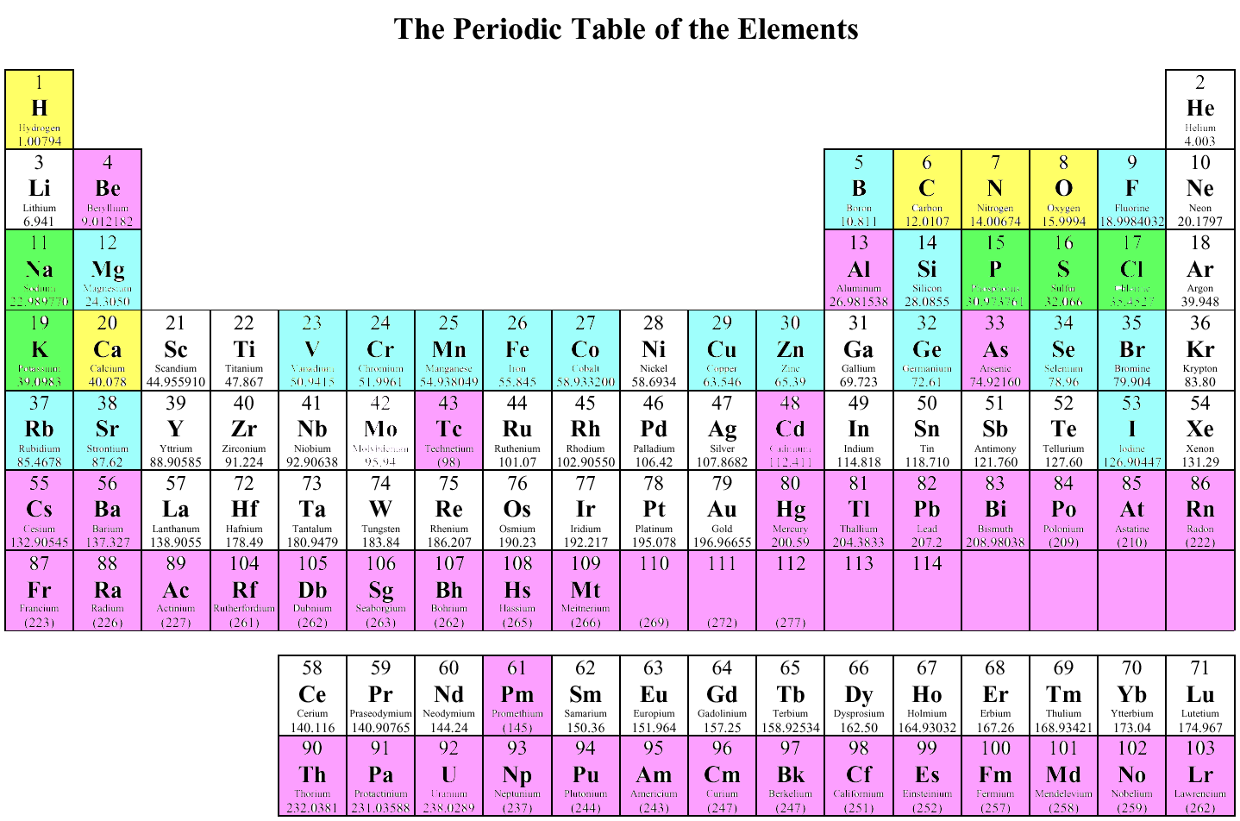
3. All life uses largely the same biochemical constituents and processes
  Many biochemical compounds can be found in all living organisms. They have therefore almost the same elemental composition derived from about 25 elements.
Yellow Boxes = Top 5 Elements present in the human body
Green Boxes = Second 5 Top Elements present in the human body
Blue Boxes = Trace elements that are required by the human body
Violet Boxes = Elements that are deleterious to the human body.

Slide 11
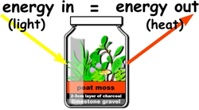
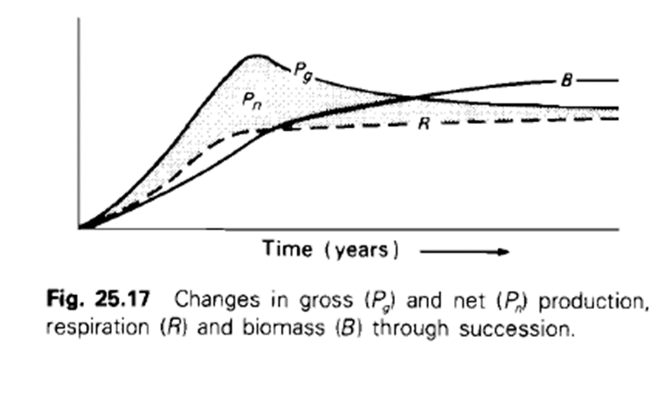
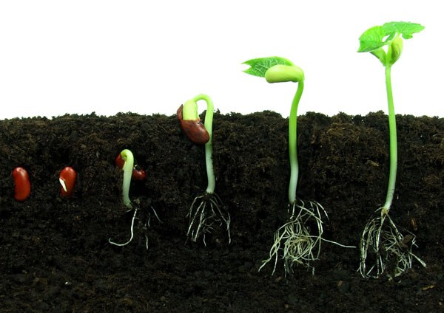
4. An ecosystem uses surplus energy to move further from thermodynamic equilibrium (physically driven biological aspect).
Another way of expressing that ecosystems can grow – progressive, directional change

Slide 12
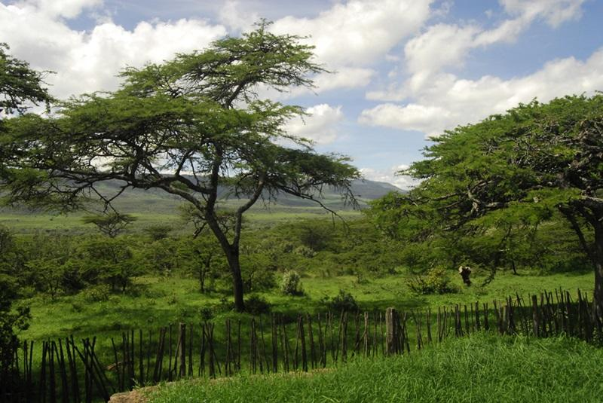
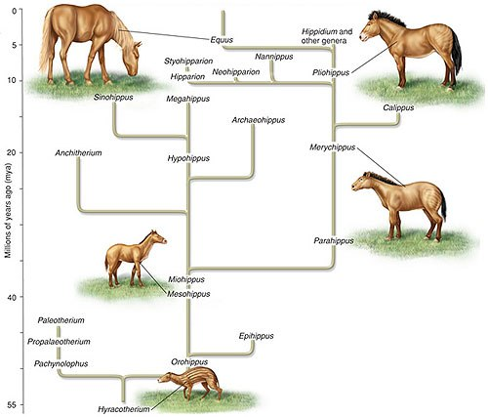
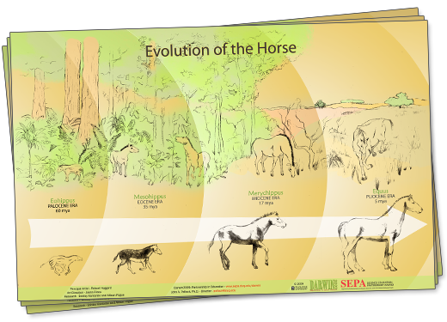
5. An ecosystem co-evolves by adapting to and modifying its environment (biologically driven biological aspect).

Slide 13
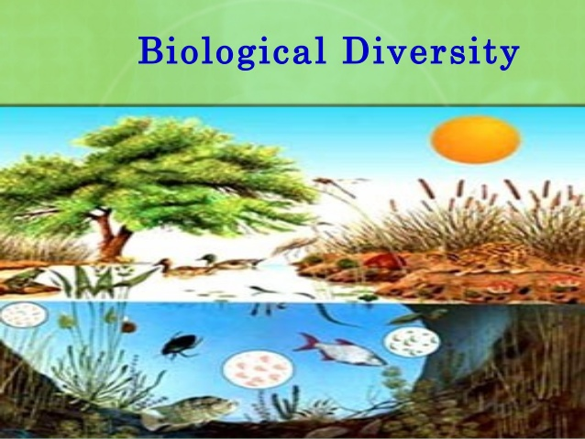
6. Ecosystems have diversity of structure and function.

Slide 14
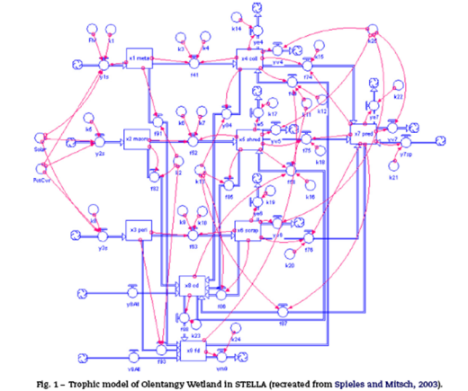
7. Ecosystems work together in networks that improve the resource flow utilization
Connectivity is a basic property that, through transactions and relations, binds ecosystem parts together as an interacting system.

Slide 15
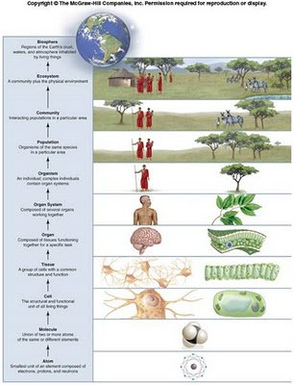
8. Ecosystems are emergent hierarchically
Ecosphere
Ecosystems
Communities
Populations
Organisms
Organ systems
Organs
Tissue
Cells
Molecules
Atoms

Slide 16
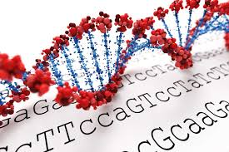
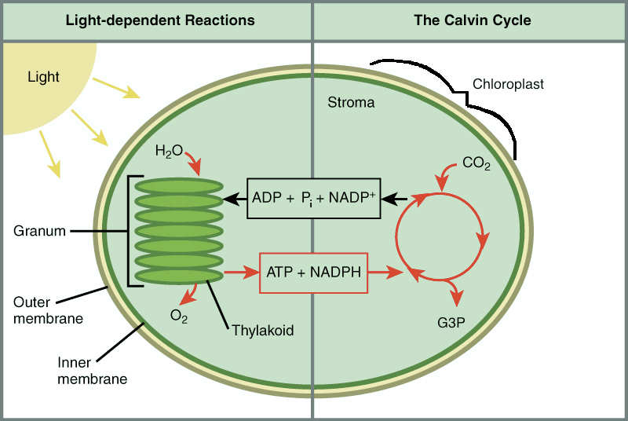
9. Ecosystems have an enormous amount of genetic, biochemical, and process information

Slide 17
Similarities between human and natural systems
Have to respect that mass and energy are conserved
Have only irreversible processes, where work energy is lost as heat energy that cannot do further work
Are open and need an input of work energy for maintenance
Are organized hierarchically
Have high diversity
Have components working in interactive networks
Have high information level

Slide 18
Differences between natural and human systems
Ecosystems recycle most resources; human systems recycle very modestly compared to the overall potential
Ecosystems store surplus work energy in biomass and increased organizational complexity. Human societies do the same to a certain extent, but the primary energy source – fossil fuels – are non-renewable and create pollution problems
Ecosystems use growth and development to continue flourishing, while human societies rely largely on growing through increased input of natural resources, underutilizing networks and information
Economic rewards are given for either building or exploiting gradients, without differentiation

Slide 19
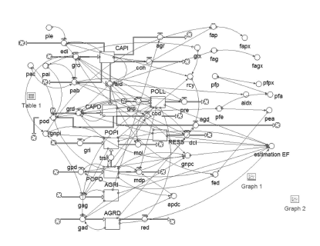
Global Model

Slide 20
Business as usual scenario
2000
2025
2050
2075
2100
POLL=pollution; POPD=population (developing countries); POPI=population (industrial countries); RESS=resources

Slide 21
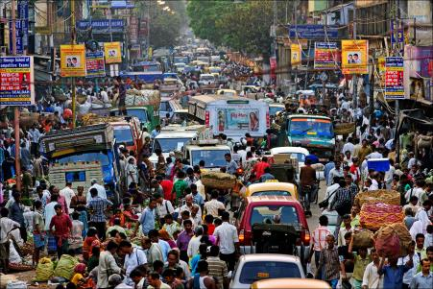
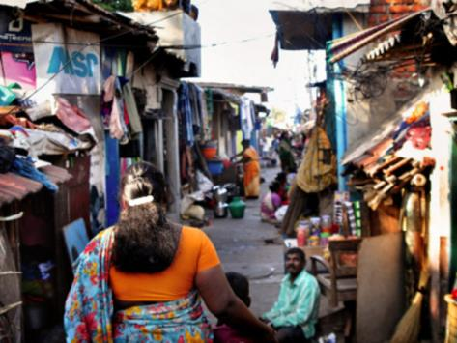
How can we curb population growth?
In the developing countries, supporting birth control and increase in GNP per capita
It is also important to raise the education level, particularly for women

Slide 22
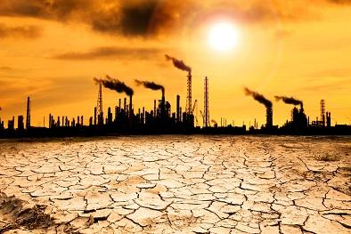
How can we curb pollution?
Invest in pollution abatement through the introduction of a fair accounting framework, such as a Pigovian tax, based on internalizing the externalities.
The “invoice” to the polluter should include the costs of all the consequences of pollution, including the reduction of ecosystem services

Slide 23
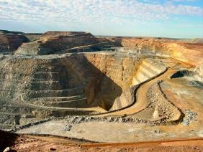
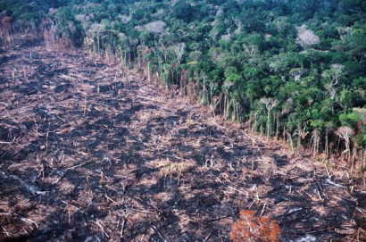
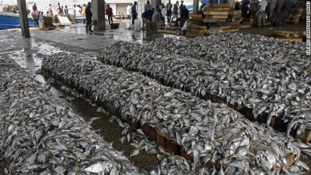
How can we slow down natural resource use?
Creating an economy that minimizes the level of unwanted wastes by coupling flows through by-product synergies
An accounting framework that internalizes externalities
Investment in education, innovation, and research
Production decreases when resources are unavailable

Slide 24
Summary: 6-point action plan
  All industrialized countries with a GNP/capita > $20,000/yr pay 0.8% of GNP increasing by 0.04% per year
  10% of this support is used for family planning
  40% of the support is used to improve education in the developing countries; remaining 50% is negotiated between the donor and the receiving country
  2.5% of the production value is allocated to pollution control
  An 8% Pigovian tax encourages resource efficiency
  Investment, ≥10% of GNP, is made in education, innovation, and research in the industrialized countries

Slide 25
Results of using the 6-point plan
State variable | unit | Initial value (2000) | 2054 | 2100
production capacity of industrial countries | rel. | 340 | 539 | 814
production capacity of developing countries | rel. | 110 | 158 | 659
population of industrial countries | 10⁹ | 1300 | 1590 | 1900
population of developing countries | 10⁹ | 4700 | 6768 | 3860
Total Pop | 10⁹ | 6000 | 8358 | 5760
Agricultural output of industrial countries | rel. | 100 | 121 | 186
Agricultural output of developing countries | rel. | 100 | 172 | 252
Pollution emissions | rel. | 100 | 122 | 104
Resource availability | rel. | 20 | 19.4 | 18.8
GNP/cap (industrial countries) | $1K/cap | 29.5 | 32.4 | 44.4
GNP/cap (developing countries) | $1K/cap | 2.7 | 3.2 | 19.5

Slide 26
8 recommendations
Use the three R’s (reduce, reuse, and recycle) much more extensively.
Use solar radiation, directly or indirectly, as sole energy source.
Focus on flourishing rather than growing by changing from quantitative growth that requires natural resources to qualitative development which uses network organization and information to remain vigorous and dynamic
Changing the objective toward building and maintaining greater work energy capital rather than exploitation of the gradients for short-term economic return. Economic profit should reflect how much work energy is built not how much is extracted.

Slide 27
8 recommendations
Improving integration on and between all hierarchical levels.
Appreciating diversity and understanding that it gives society a wider array of resistance and buffers to changes.
Promoting and valuing opportunities to increase information by investing in education, research, and innovation.
Maintain and replenish ecosystem services.
These improvements can be made within the current economic framework through altered pricing and incentives

Slide 28
Is it possible? Is it enough?
More systemic/radical alternative…

Slide 29
A bottom up re-visioning is vital:
A new holistic paradigm for life
Contrary to the dominant mainstream view, the basis of all current biology and life science education, it now is becoming clear that life is not only (or even primarily) an organismal property.
In the view actively emerging, life is not centered on or emanating from organisms, nor is it primarily a localized, objectified or material phenomenon.
Life is inherently relational, distributed, and non-localized

Slide 30
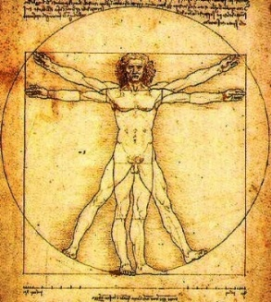
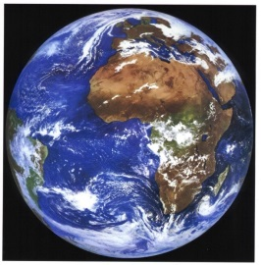
Mental models and outcomes
Real impacts of choice of system boundaries
Inherent in this paradigm, life is separated from environment in mind and action - severs the unity of life and life support systems
Once fragmented, it is possible and likely that the value of environment is seen and treated as less than the value of life
Environment is consumed and degraded as manifest in many symptoms of ecological crisis, and the influence of the citizens’ mental fragmentation and devaluation of environment travels upward to larger scales and produces the global crisis
Tragedy of the Commons
Humans win, environment degrades
Life
Environment
Figures by Dan Fiscus

Slide 31
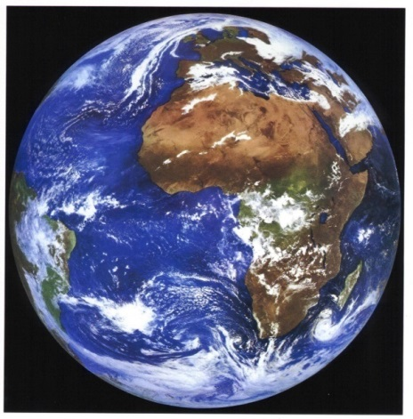

Recursive nature of nature
Life and environment are best understood and modeled as unified as a single “life–environment” system.
A hyperset equation explicitly and formally prohibits fragmentation of life from environment
Bounty of the Commons
Humans win, environment improves
life–environment =
{environment{ecosystems{organisms{environment}}}}
Fiscus D, Fath BD, Goerner S. 2012. E:CO 14(3), 44–88.

Slide 32
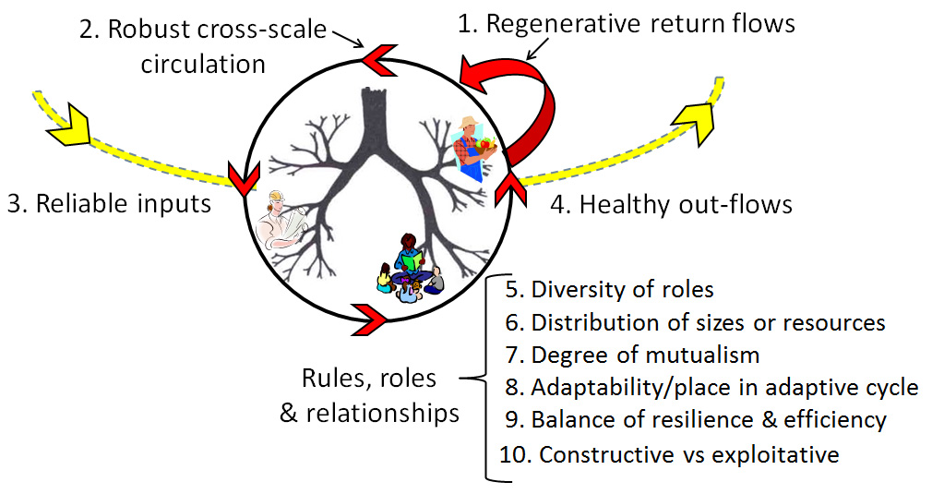
Regenerative economy
Input, Output, and System Dynamics
4.
3.
FUTURE/ONGOING RESEARCH
1.
2.

Slide 33
Conclusion
The business-as-usual approach of chasing perpetual economic growth is failing. It is not sustainable on our finite planet and it is not solving the problems of unemployment, poverty, and inequality - in contrast to what economists and politicians claim.
However, actions such as:
increased investment in education and knowledge creation,
accounting the contributions of ecosystem services,
a transition from non-renewable to renewable energy sources,
focus on development and quality over growth and quantity, and
building community networks within sustainable places,
can guide human society closer to ecological balance by learning and adopting how nature flourishes within the imposed biophysical and thermodynamic constraints.

Slide 34
Read all the details here!
clubofsiena.eco-soft.dk
Thank you for your attention!

