Slide 1
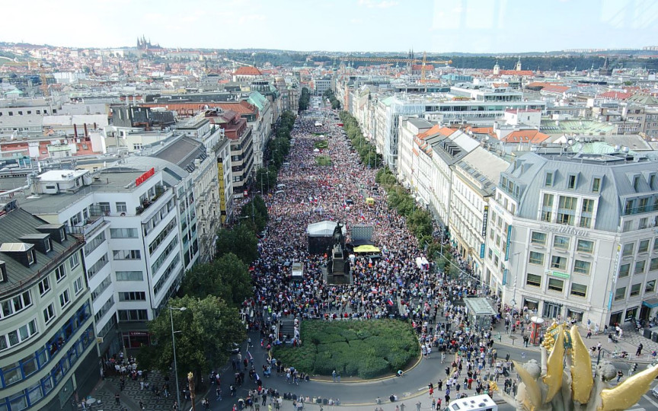
GLCb1014 Social Movements: Multidisciplinary Approach
Lecture 3: Contextual conditions

Slide 2
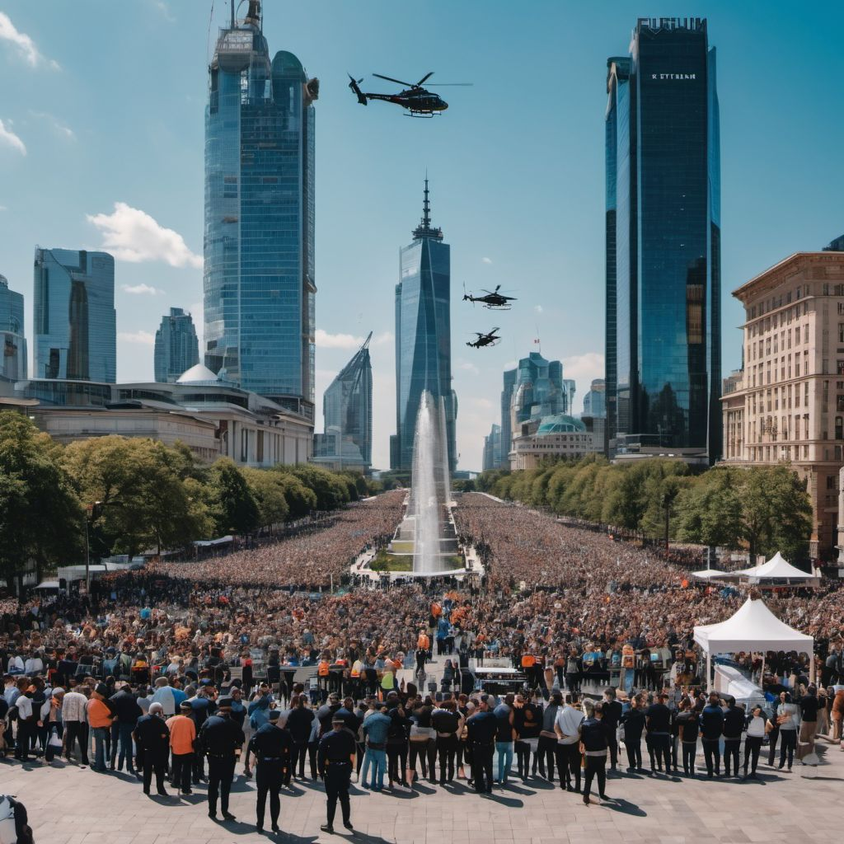
Contextual conditions
Opportunities and threats
Resources
Social space

Slide 3


Political opportunities and threats (S. Tarrow)

Slide 4
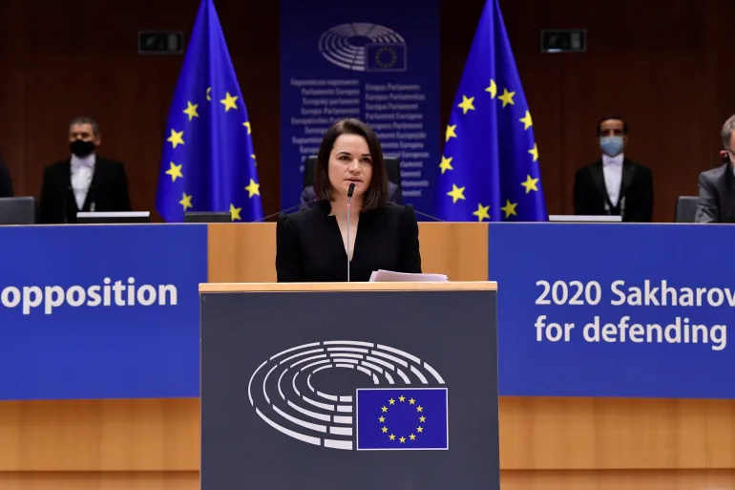
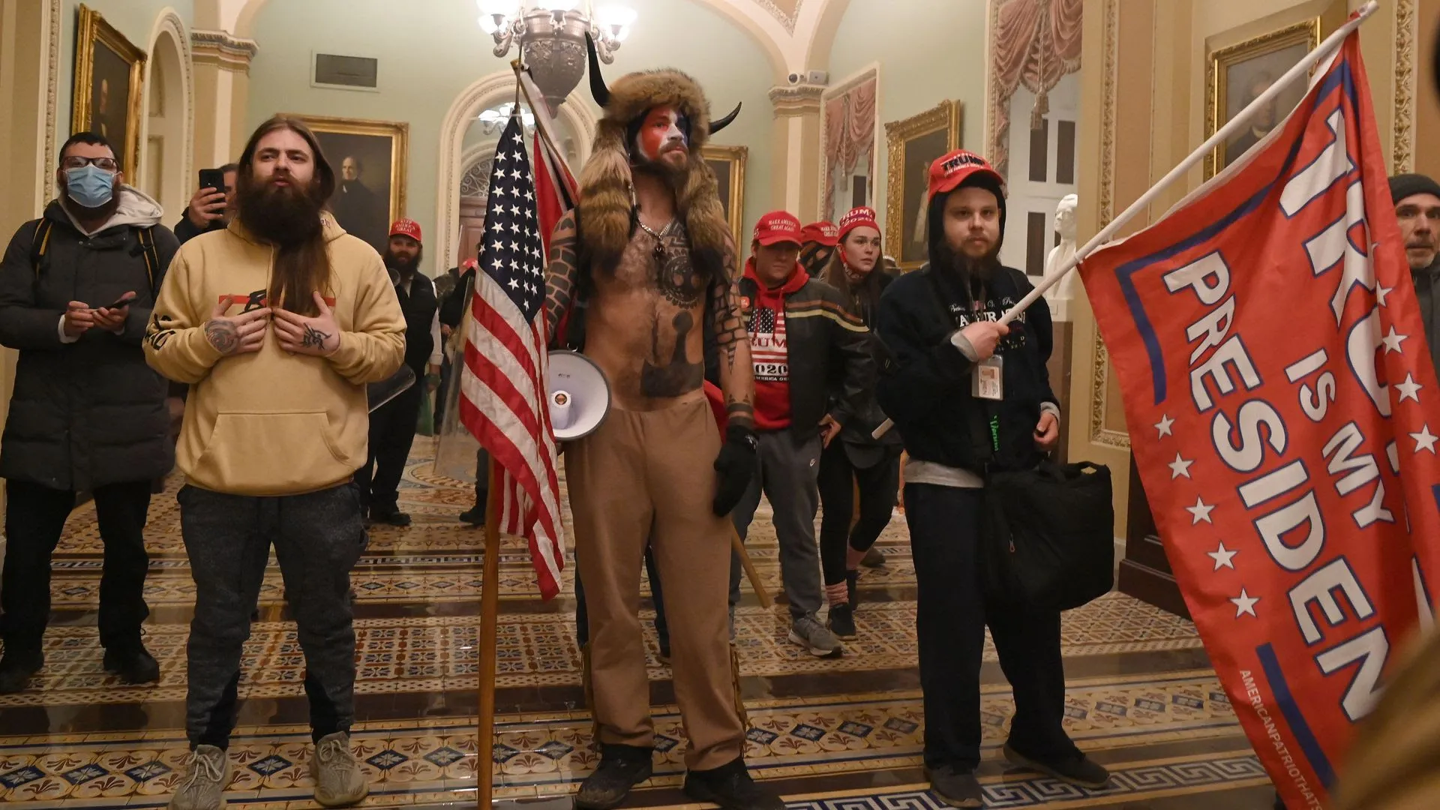
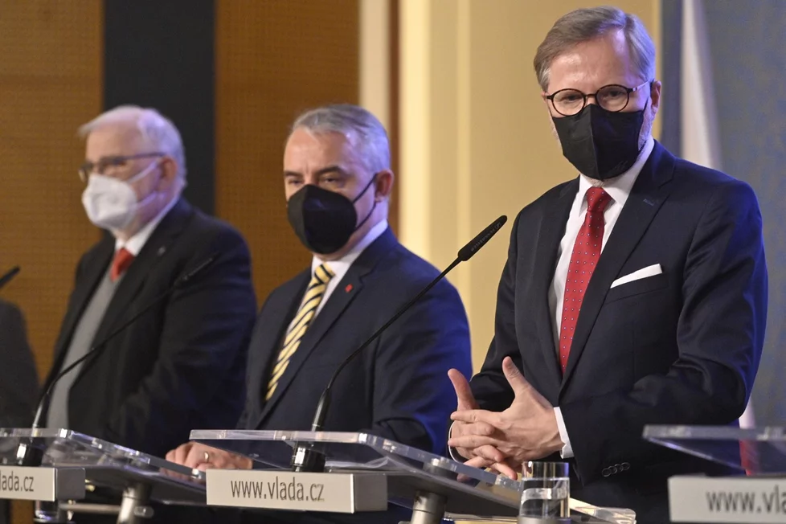
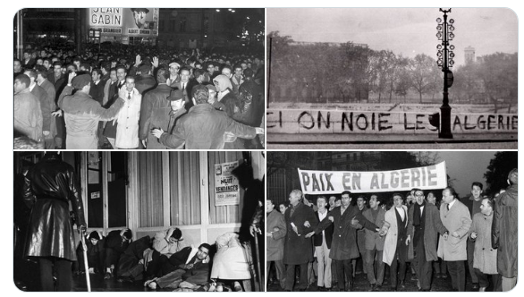
Political opportunities
Access for new actors
Changing political support
Availability of influential allies
Conflict within the elite
Repression: hard and soft
Objective vs. Subjective dimensions
Institutional vs. Soft Opportunities

Slide 5
Political opportunities

Slide 6
Resources for mobilization

Slide 7
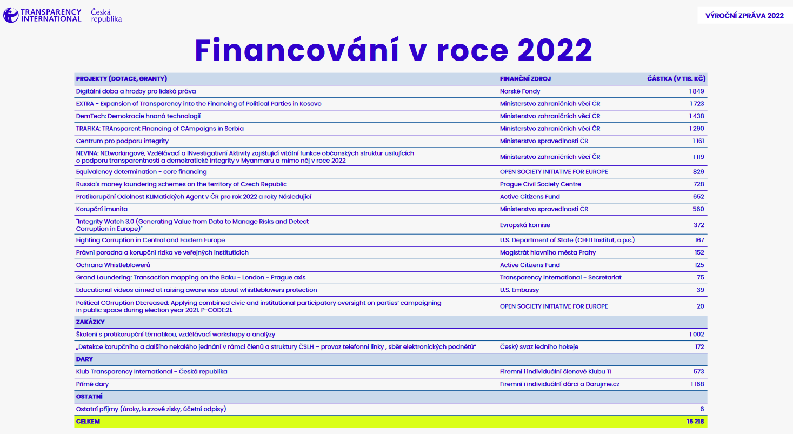
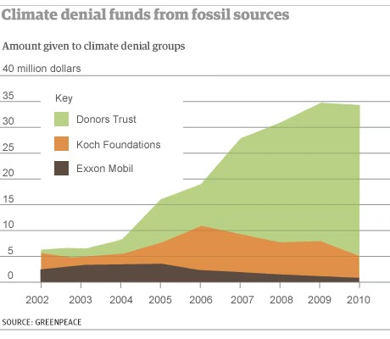
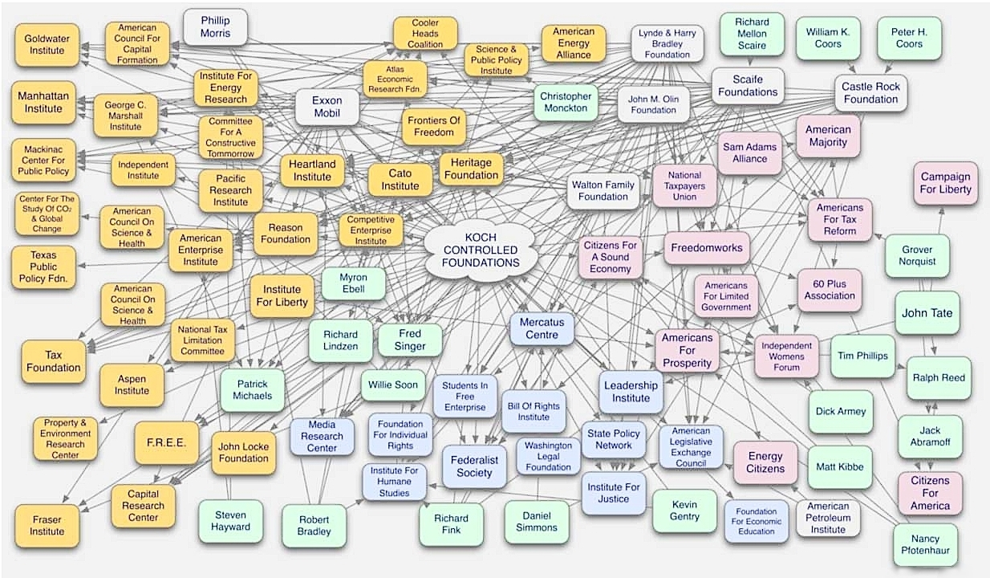


Resources for mobilization
Types of sourcing (external vs. internal)
Effect of external sourcing

Slide 8
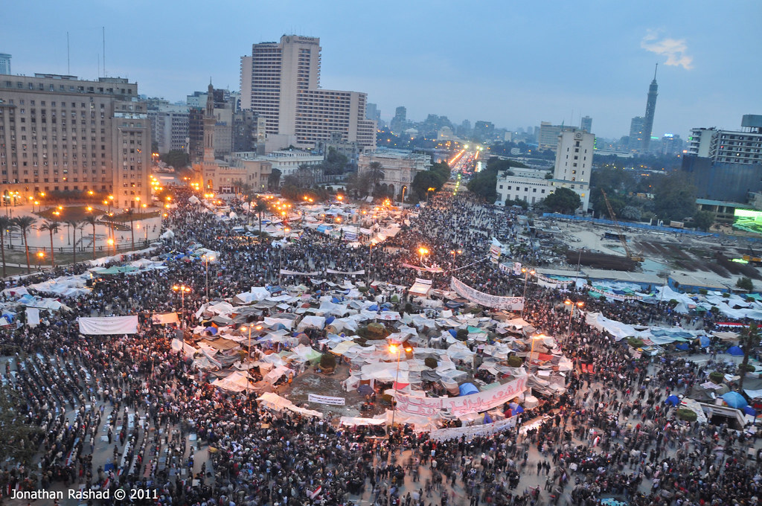
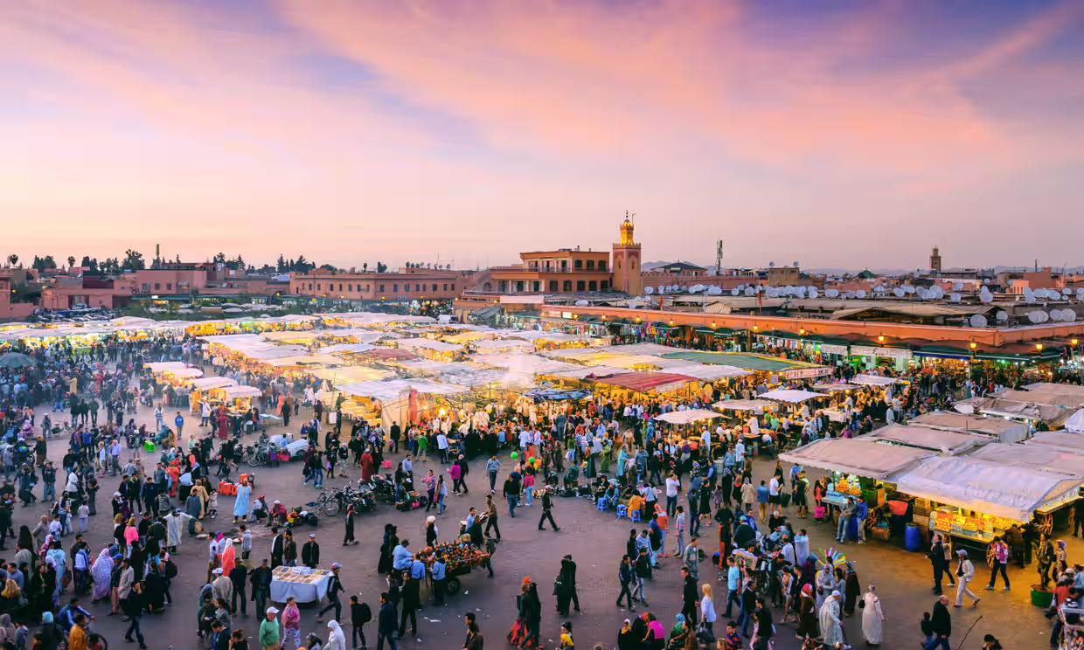
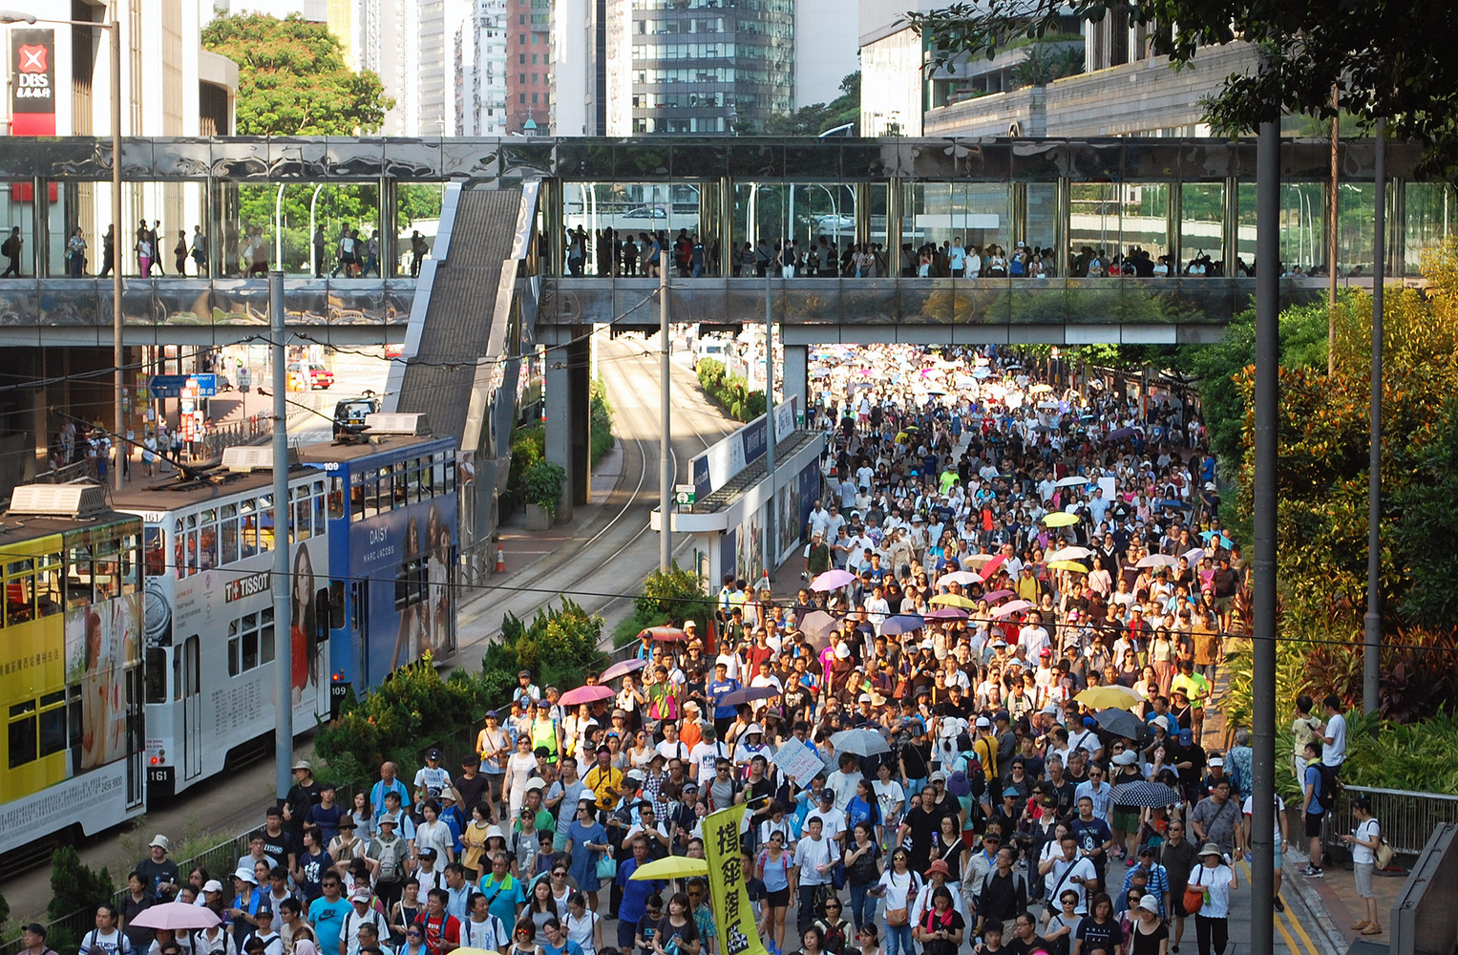
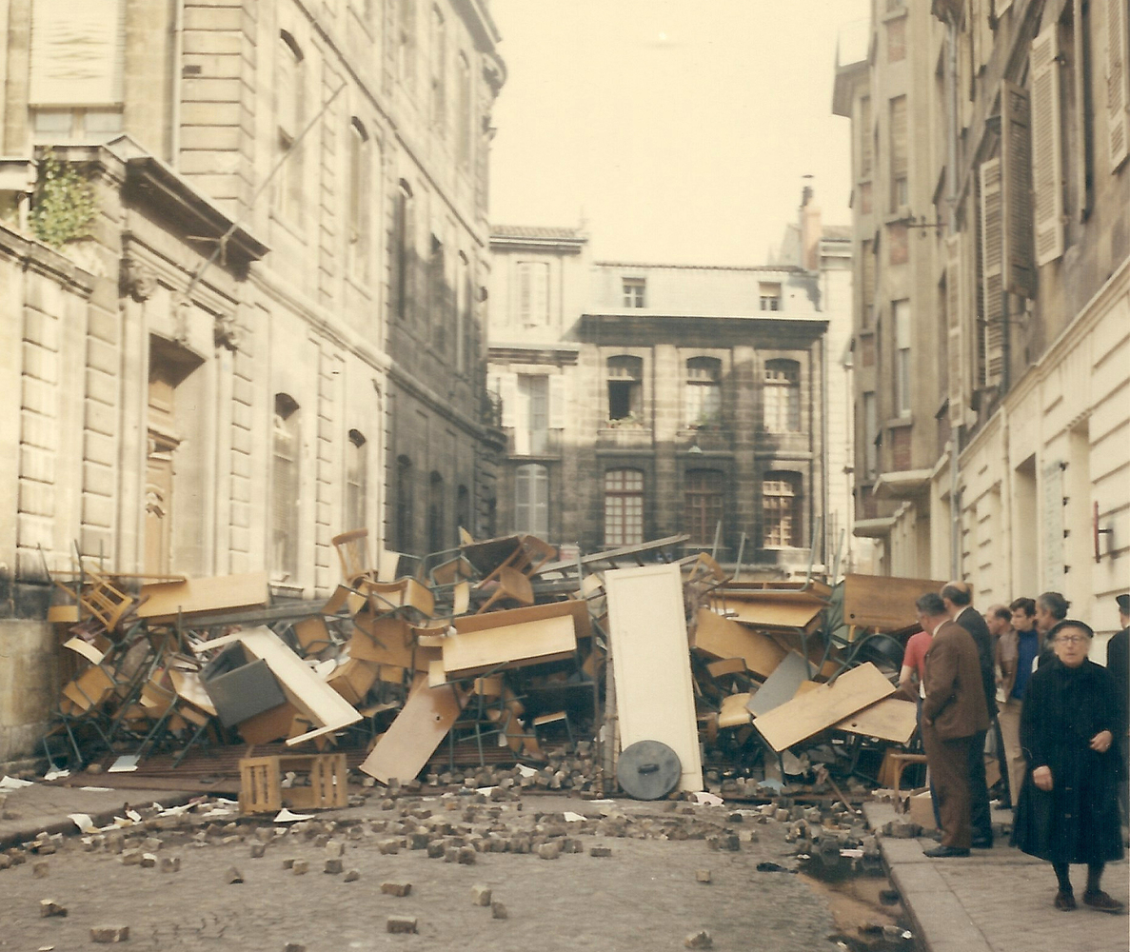
Ecological factors
Social environment for mobilisation
Population density, population type, communication options, availability of repression, physical space

