Slide 1
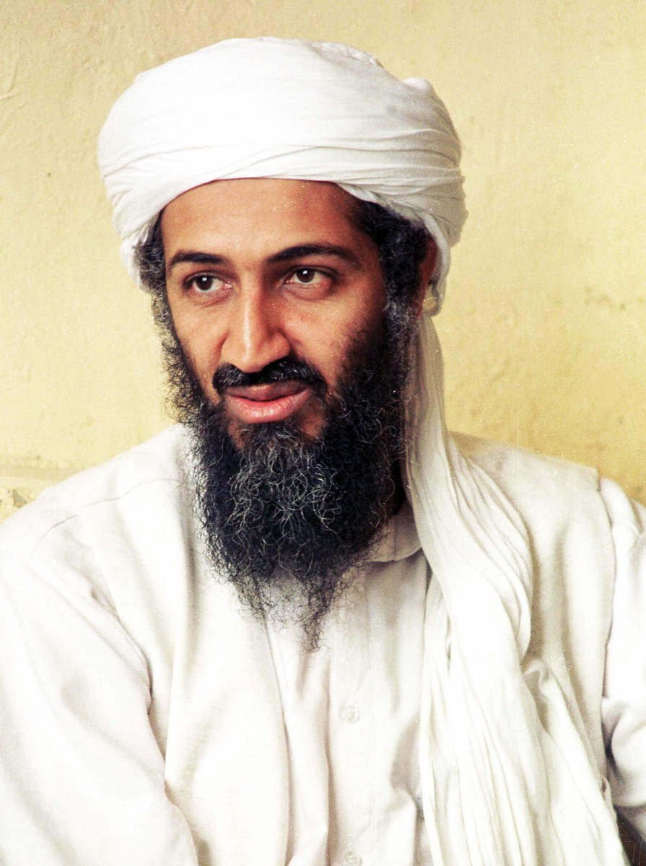
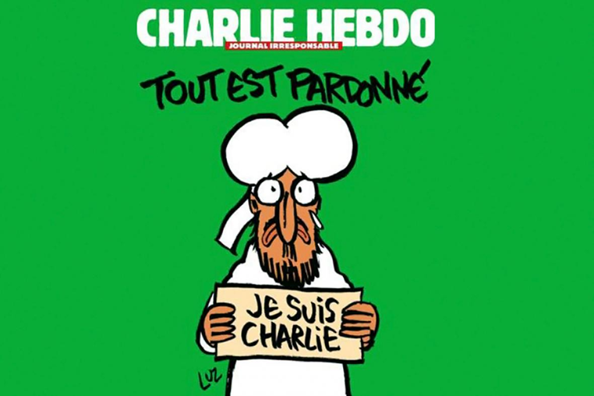
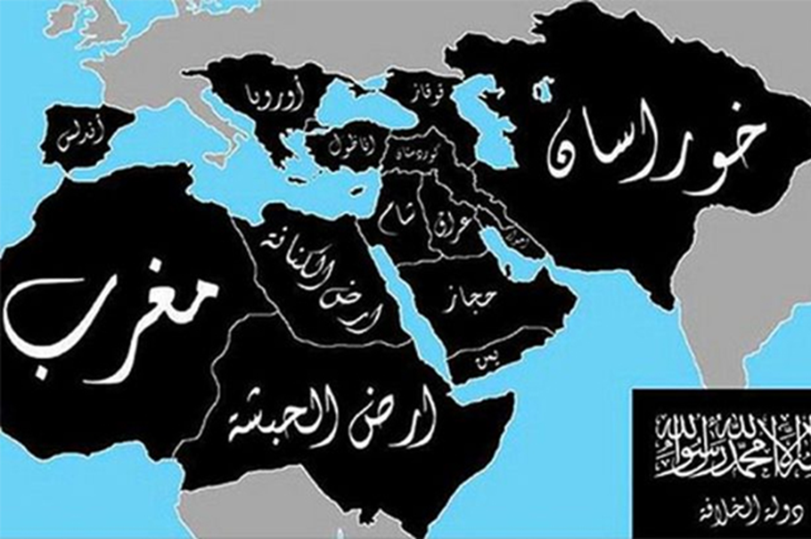
Global Jihadism:
Clash of civilization confirmed?
Mgr. Eva Taterova, M.A., Ph.D.
Middle East Crossroads

Slide 2
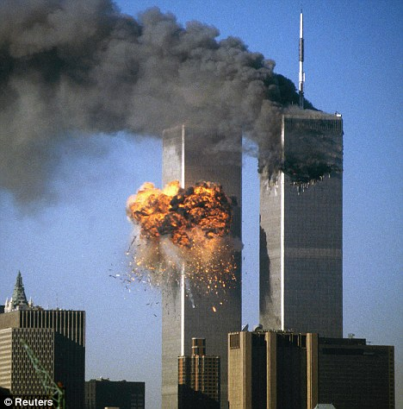
GLOBAL JIHADISM
Terrorist attacks on New York City and Washington, D.C. in September 11, 2001→ huge shock for the western world – growth of global jihadism (al-Qaeda as well as the other organizations).
So called war against terrorism (al-Qaeda, Boko Haram, ISIS) – Bush doctrine.
Huntington, Samuel P. The Clash of Civilizations and the Remaking of World Order. New York: Simon & Schuster, 1996.

Slide 3
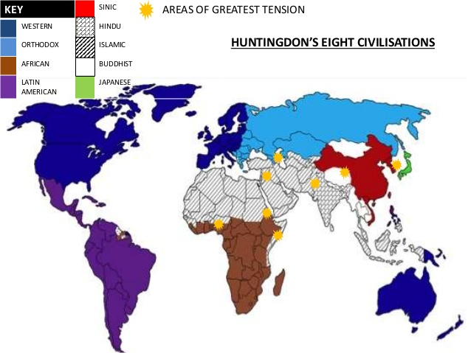

Slide 4
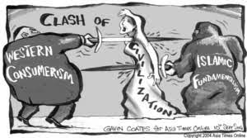
WAS HUNTINGTON RIGHT? CAN WE SEE
THE CLASH OF CIVILIZATIONS TAKING PLACE TODAY?

Slide 5
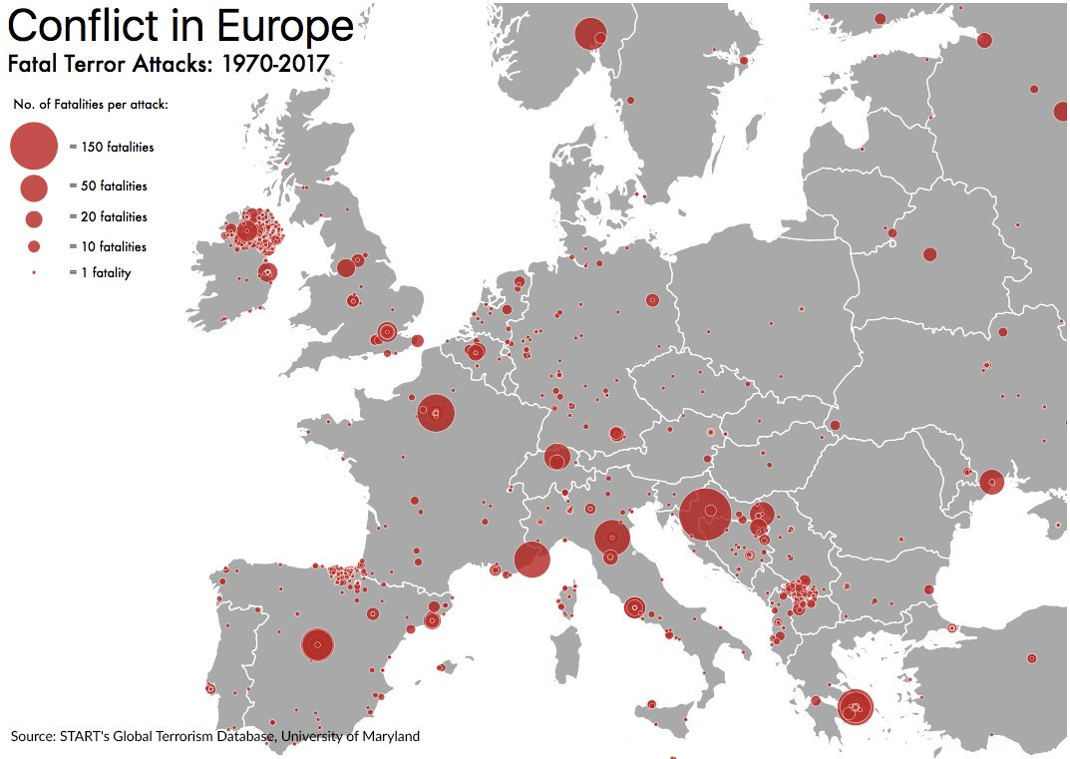
TERRORISM IN EUROPE
Long history – often linked to nationalist or separatist movements (IRA, ETA, Red Brigades).
The number of terrorist attack in Europe is relatively low however receives a significant media coverage.
So far, no really a problem for Central European countries but might change rapidly.

Slide 6
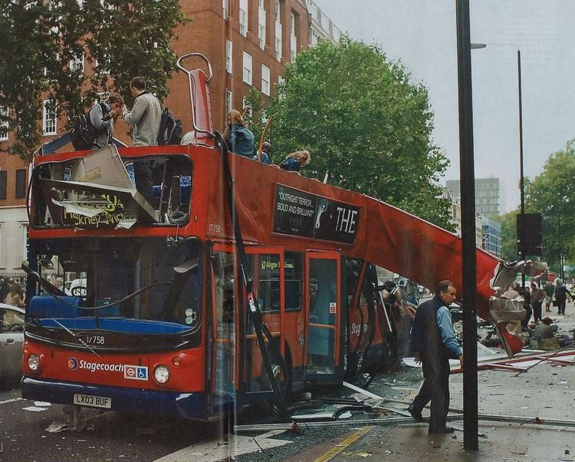

AL-QAEDA ATTACKS IN EUROPE
2004: Madrid train bombings (190 people killed).
2005: London bombings (52 people killed).
2015: attack on Charlie Hebdo in Paris.

Slide 7
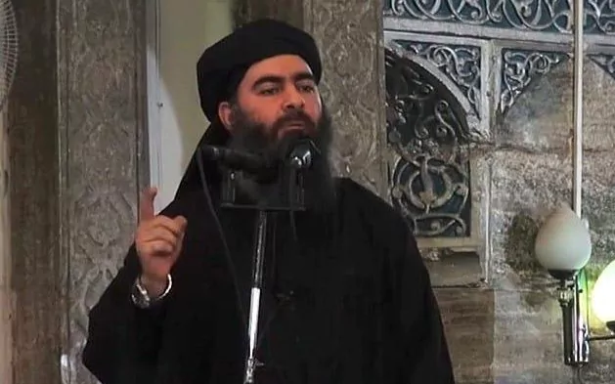
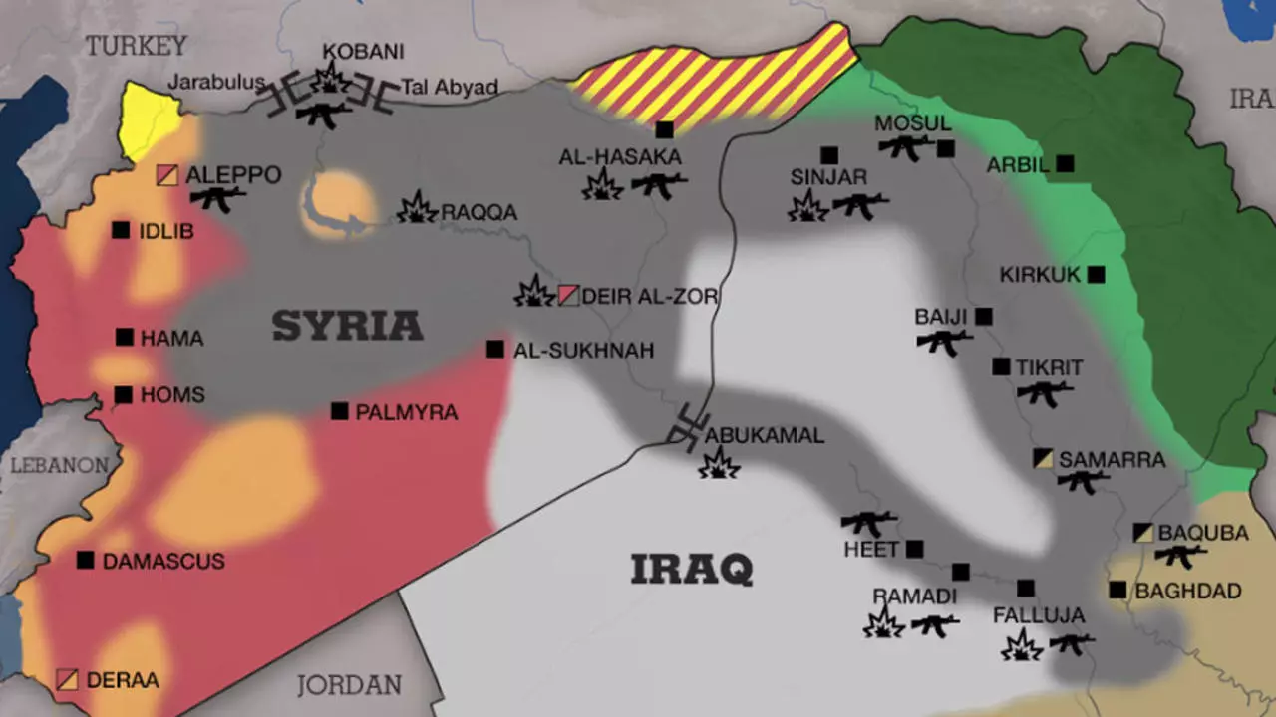
GROWTH OF ISLAMIC STATE
Close connection to wars in Iraq and war
in Syria – al-Qaeda was a great inspiration for Abu Bakr al-Baghdadi, the leader of ISIS.
Abu Bakr al-Baghdadi has been a leader
of ISIS since 2010 - in 2014 he claimed himself to be caliph)
Increase of activities since the withdrawal of US army from Iraq in 2011, and the war
in Syria.
The main rival of ISIS has been especially
the Kurdish forces (peshmerga).

Slide 8
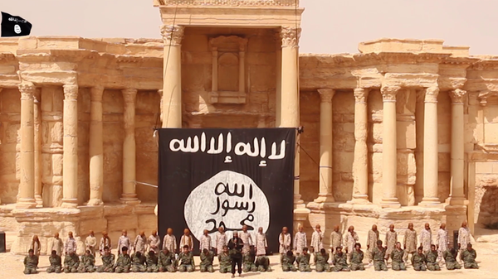
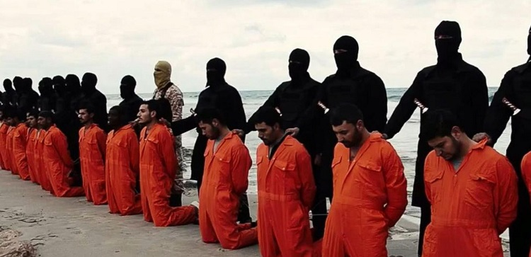
GROWTH OF ISLAMIC STATE
Significant emphasis on propaganda and media campaign on the Internet and social networks.
A massive recruitment of new followers on the Internet.
Terrorist attacks outside of the Middle East (Paris
in November 2015, Istanbul in January 2016, Brussels March 2016, Berlin December 2016, Vienna 2020).
At this moment, ISIS is in fact defeated – some members have been waiting for the trials,
the others moved to the other countries (Libya, Yemen, western countries).

Slide 9

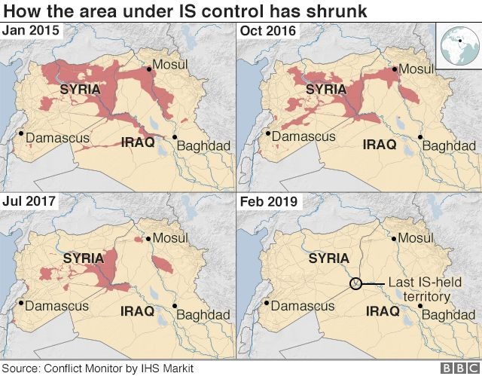
↑
ISIS TERRITORIAL CLAIMS

Slide 10
IS THERE A WAY HOW TO PREVENT TERRORISM?

Slide 11
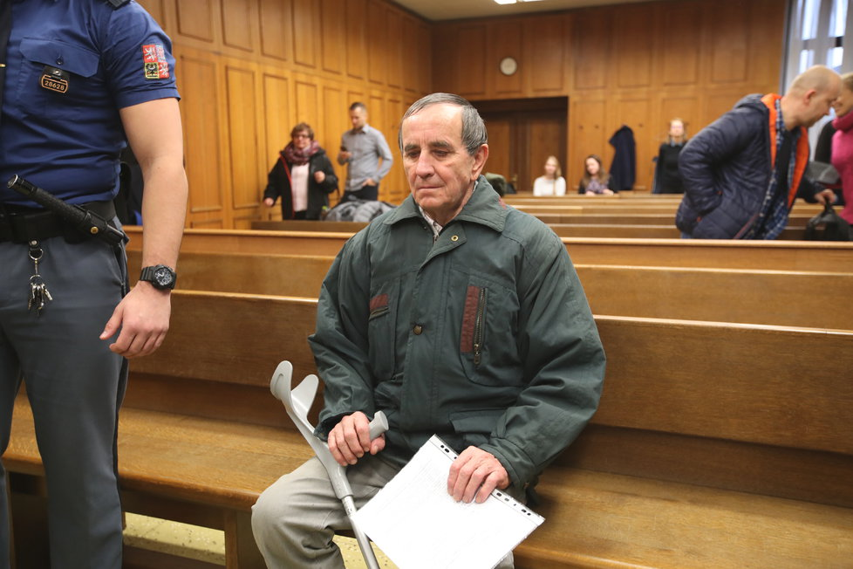
TERRORISM IN THE CZECH REPUBLIC
In 2017, Jaromir Balda attacked two trains by felling trees onto the tracks with a plan to blame the islamist radicals for this crime.
The courts sentenced him to 4 year in prison for terrorism as the first Czech citizen.
Debate regarding the anti-Islam narrative in the Czech Republic as interpreted by some Czech political parties.

Slide 12
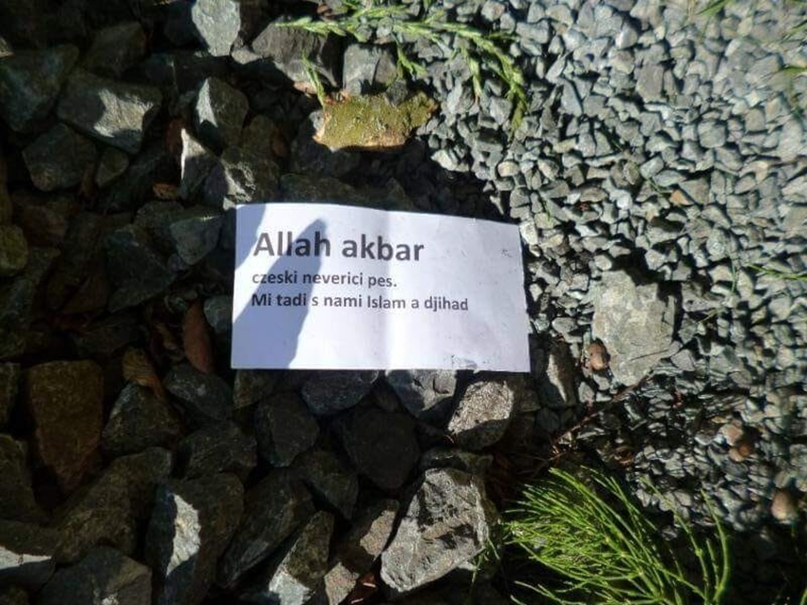
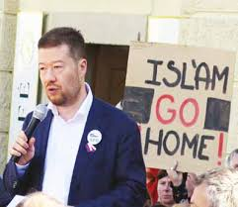
Allah akbar (the God is great)
Czech unbelieving dog.
We are here and we brought Islam and Jihad.

Slide 13
THANK YOU FOR YOUR ATTENTION

