Slide 1
Types of Political Systems
Political and Media Systems PMCb1006
Doc. Marek Rybář, PhD.
Spring 2024

Slide 2
Normative basis of democratic government
1. governing must be linked to elections
2. government is constrained by constitutional limits (vertical and horizontal accountability)
Government in representative democracies may take several forms, the most common are presidentialism, parliamentarism and semi-presidentialism

Slide 3
Parliamentarism 1/2
Is a system in which:
1. there is a head of government distinct from the head of state; the head of government is elected by the parliament and accountable to it
2. the terms of the executive and of the parliament are not fixed, they are mutually dependent

Slide 4
Parliamentarism 2/2
The executive without a parliamentary support will normally resign; the cabinet often has the power to dissolve the parliament and to call for new parliamentary elections
”an almost complete fusion of executive and legislative powers"; members of the executive are typically recruited among the most senior members of parliament, i.e. they simultaneously hold positions in the two bodies

Slide 5
Presidentialism 1/2
Is a system where
1. president is simultaneously the head of government and the head of state, s/he is directly elected; and
2. the terms in office of the president and the parliament are fixed and not connected (a system of mutual independence)

Slide 6
Presidentialism 2/2
The executive led by president cannot dissolve the legislature and and call the new elections; the legislature may not remove the president
Presidentialism is a system of mutual independence of the two branches of power
Members of parliament may not simultaneously hold executive positions (strict separation of powers)

Slide 7
Semipresidential systems
It is the arrangement with a president directly elected for a fixed term, AND with a prime minister and his/her cabinet accountable to the parliament
Originally, M. Duverger (1980) also added that the president had to have “quite considerable powers”, this feature is now abandoned in favour of a purely institutional understanding of the concept

Slide 8
Directorial form of government
It exists only in Switzerland
The executive (the so-called Federal Council) is composed of seven persons, each of them individually elected by a joint decisions of the two chambers of parliament
The term of the Federal Council is fixed, it overlaps with the term of the parliament
However, it is not accountable to the parliament and cannot be voted out of the office

Slide 9
Directly elected Prime Minister
A short-lived system that existed in Israel between 1996 and 2003
Prime Minister was directly elected by all voters in a majority runoff system (simultaneously with parliamentary elections)
the PM and his government was accountable to Parliament, in case of successful no confidence motion, early elections were to be held

Slide 10
Differences among parliamentary systems
The extent to which parliament is “rationalized” is the key explanatory factor:
How difficult de facto is it for the parliament to pass a vote of no confidence to the cabinet?
To what extent does the government control the parliamentary agenda?
How difficult is it for MPs to submit “private member’s bills”?
It all depends on the so-called party discipline

Slide 11
Single-party majority cabinets 1/2
The UK as a typical example
With an absolute majority in the House of Commons, cabinet formation is straightforward, since party discipline is imposed (a CP majority of 365 out of 650 seats in 2019 elections)
The opposition forms a shadow cabinet, a future government-in-waiting, and hopes to win the next parliamentary elections

Slide 12
Single-party majority cabinets 2/2
The norm of collective responsibility, a uniquely British doctrine: all members of the cabinet must support the official line
In a vote of no confidence, MPs vote along strictly party line (the role of party whip)
The executive is not omnipotent: it must contend with powerful interest groups outside parliament and must also consider the wishes of party backbenchers

Slide 13
Minimal-winning cabinets 1/2
In most parliamentary systems, no party controls a parliamentary majority
One possibility is to form coalition government with as many parties cooperating as are necessary to form a coalition to attain a majority in parliament
Germany after 2017 elections: SPD 206, CDU/CSU 196, the Greens 118, FDP 92, AfD 78, the Left 39, (total 709 parliamentary seats)
355 seats needed to form the MWC

Slide 14
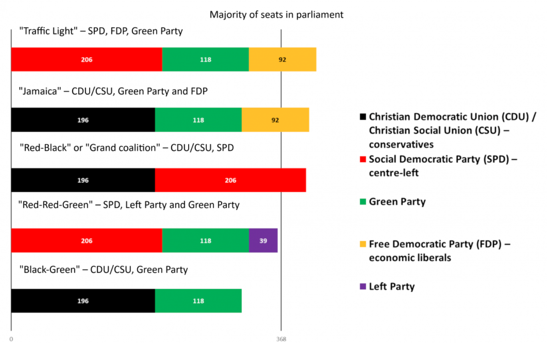
Minimal-winning cabinets 2/2

Slide 15
Oversized cabinets 1/2
Include more parties than are necessary to attain a parliamentary majority
Switzerland: four largest parties form a 7-member Federal Council and divide the seats along the so-called “magic formula” 2:2:2:1
The logic is not that all four parties agree on a common program but rather that all should be represented when the Federal Council makes its decisions
If no consensus is reached, a majority voting will decide

Slide 16
Oversized cabinets 2/2
Oversized cabinets are often established when societies are fragmented on religious, linguistic or ethno-regional grounds
The idea is to allow each group to participate in the political process
More often created in times of war, during economic crises or in the wake of cataclysmic political events

Slide 17
Minority cabinets 1/2
When the party (or parties) forming the cabinet does not possess a majority of parliamentary seats
Frequent in Spain and Scandinavian countries, especially in Sweden, Denmark and Norway
After the 2021 Canadian elections, a single-party minority government of the Liberal Party was formed (160 seats)
It was 10 seats short of a parliamentary majority

Slide 18
Minority cabinets 2/2
Occupying the ideological centre and dividing the opposition
Policy-oriented rather than office-seeking politicians
Anticipated voter reactions restrict office-seeking behaviour

Slide 19
Caretaker cabinets
Sometimes it takes quite a long time for a coalition government to be put together
In such cases, the old cabinet stays in office as caretaker cabinet
It handles everyday business but cannot take major initiatives
Following the 2020 Slovak elections, a majority government was formed but one party left it and joined the opposition to pass a vote of no confidence in 2022
the cabinet stays in office until early elections

Slide 20
Differences among presidential systems
Contrast the case of the US presidentialism and many Latin American presidential systems:
Two-party vs. multiparty format
Strong constitutional prerogatives of the US presidents vs. not-always-so-strong Latin American ones
Weak horizontal accountability in Latin America vs. strong horizontal accountability in the US

Slide 21
Are parliamentary systems better?
Cheibub a Limongi (2002):
differences in the survival of presidential and parliamentary systems cannot be derived from the way they are constituted
Deadlocks are not so common in presidential systems; they also exists in parliamentarism
coalition governments also exist in presidentialism

Slide 22
Are parliamentary systems better?
the key to effective governance is the centralization of decision-making and the monopolization of the legislative agenda, otherwise there is a risk of a lack of coordination and "stalemate"
centralized decision-making more common in parliamentarism, but not always (France and Italy as ineffective parliamentarisms in the past, and conversely Brazil as an example of effective multiparty presidentialism)

Slide 23
Are parliamentary systems better?
there are no guarantees that the president will have support of a parliamentary majority in presidentialism
parliamentarism is a system in which the establishment and continuation of government is conditional on the consent of parliament
however, minority governments are common in parliamentary systems

Slide 24
Legislative success of governments
In parliamentarism, majority and minority governments have roughly the same legislative success rate of around 83%,
while presidents with a majority support have a success rate of 67.5%
and presidents without a majority support have a success rate of 62.2%

Slide 25
Presidents and multipartism 1/4
in Latin America (1979-2006), only two presidentialisms with a two-party system - Mexico and Costa Rica; the rest had multi-party systems
coalitions necessary for the functioning of the system
coalitions in presidentialism are different from parliamentarism: the president is the de facto permanent formateur who tries to put together coalitions to push through legislative proposals

Slide 26
Presidents and multipartism 2/4
cabinet posts and other appointments
"pork" and
policy concessions
these are often more important than ideology and party identity of the MPs who support the president

Slide 27
Presidents and multipartism 3/4
strong constitutional powers of the President to be able to sustain the initiative and ward off potential counter-proposals from the opposition
Latin American experience suggests that constitutionally weak presidents cannot govern effectively in multiparty parliaments

Slide 28
Presidents and multipartism 4/4
But that does not mean a blank cheque from parliament or a usurpation of powers by the president
at the same time, there are strong control mechanisms for parliament, the courts, the prosecutor's office, etc., including against the president
all branches of government must be effective and strong

Slide 29
Policy implications of government systems 1/2
Gerring et al (2009): parliamentary systems have visible advantages over semi/presidential systems in a number of aspects
Examines only democratic regimes and their impact:
Political development (corruption, quality of bureaucracy, political stability, rule of law)
economic development (GDP per capita, infrastructure, level of investment)

Slide 30
Policy implications of government systems 2/2
parliamentarism is positively related to a range of outcome indicators, suggesting its cumulative effect on governance
parliamentarism is probably better able to function as a tool for coordination

