Slide 1

Typologies of Media Systems II
Political and Media Systems, Klára Smejkal

Slide 2

Refreshing knowledge from previous lecture

Slide 3
Media systems and its research
All media in the country (McQuail, 1994)
Media system research
  Normative theories – four theories of the press, McQuail and others, inductive approach ​
    McQuail (1994) – based on basic communication values – freedom, equality, diversity, information quality (objectivity), solidarity, cultural order​
  Empirical theories​
    Hallin and Mancini (2004) – but just political dimension​

Slide 4
Comparing media systems
Hallin and Mancini, 2004
arguing that media research from 50‘s shifted to media effects research, neglecting media systems
follow-up on Four theories of the Press from 50‘s
  But
  based on empirical evidence
  stayed away from normative approach

Slide 5
Why comparative approach?
It senzitizes us to variation and to similarity
Important aspects of different aspects of media systems assumed to be natural
Comparison forces us to conceptualize individual aspects more clearly
Protect us from generalization

Slide 6
Comparing media systems: characteristics
18 countries in Europe and North America
3 types of media systems, based on 4 dimensions of comparison
Take in the account political and media history – co-evolution
Beyond 18 countries – not apply to the rest of the world without modification

Slide 7
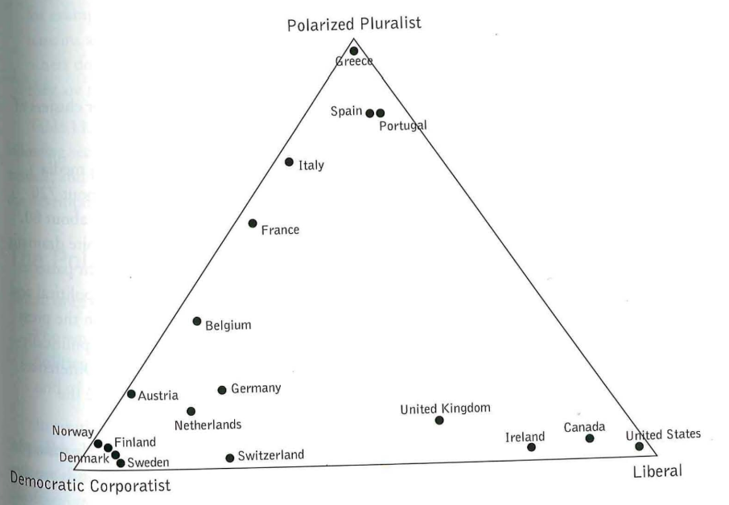

Slide 8
Dimensions of comparison
Development of the mass press
  Press circulation, mass vs. elite oriented
Political paralelism
  Newspapers have a clear political identification, also manifested in news content
Journalistic proffessionalism
  Autonomy, shared norms and standards, serving the public as a whole
The role of the state
  Public service media, press subsidies

Slide 9
 | Mediterranean or Polarized Pluralist Model (France, Greece, Italy, Protugal, Spain) | Northern European or Democratic Corporatist Model (Austria, Germany, Belgium, the Nertherlands, Denmark, Finland, Norway, Sweden, Switzerland) | North Atlantic or Liberal Model (Britain, U.S., Canada, Ireland)
Newspaper Industry | Low newspaper circulation, elite politically-oriented press | High newspaper circulation, mass press | Medium newspaper circulation, early mass press
Political Parallelism | High political parallelism, external pluralism, commentary oriented journalism, parliamentary or government model of broadcast governance | External pluralism especially in press, historically strong party press, shift toward neutral commercial press, politics in broadcasting systém with substantial autonomy | Neutral commercial press, information-oriented journalism, professional model of broadcast governance – formally autonomous
Proffessionalization | Weaker professionalization, instrumentalization | Strong professionalization, institutionalized self-regulation | Strong professionalization, non-institutionalized self-regulation
Role of the state | Strong state interventation, press subsidies, periods of cenzorship | Strong state intervention but with protection of freedom, strong PSB | Market dominated (except PSB in Britain and Ireland)

Slide 10
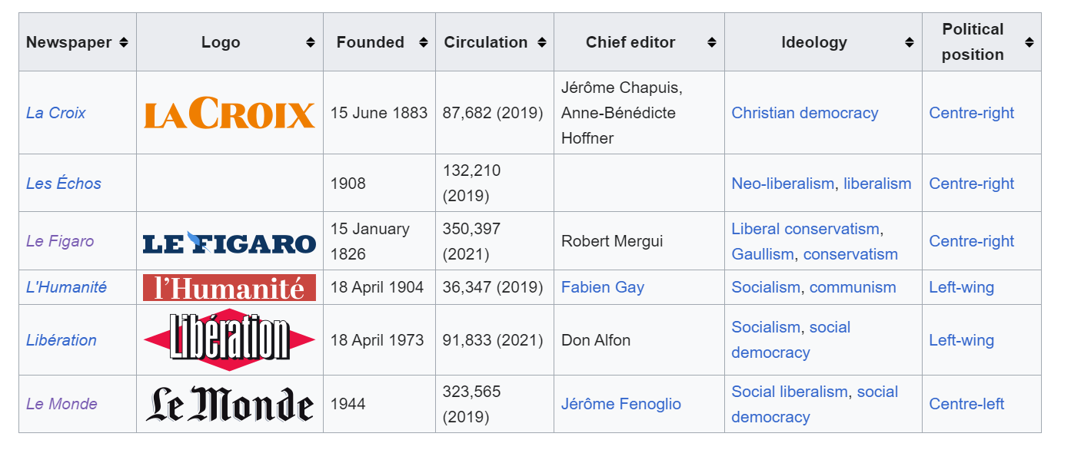

Slide 11
Shortcomings and disadvantages of this approach
It is not going beyond western world
Didnt take in the account new media and digital media environment
Didnt také in the account globalization

Slide 12
Shortcomings and disadvantages of this approach
Qualitative analysis
Didn‘t go beyond the western world
Didn‘t take in the account development of online media environment
Didn‘t take in the account globallization

Slide 13
Media systems beyond western world
https://jamboard.google.com/d/1jalAOderLowivgNTVqfZBkeXuwuTHCy-ymswciePYEk/edit?usp=sharing

Slide 14
Comparing media systems 12 years later
Hallin and Mancini's classification caused a revolution - a huge increase in publications and articles responding to their analysis
Development of approach focusing on quantitative operationalization
Political parallelism manifested in four types of phenomena: structural ties between media and political organizations, political affiliations of journalists, owners and media managers, media content, news consumption patterns
Downey and Stanyer – fuzzy-set approach

Slide 15
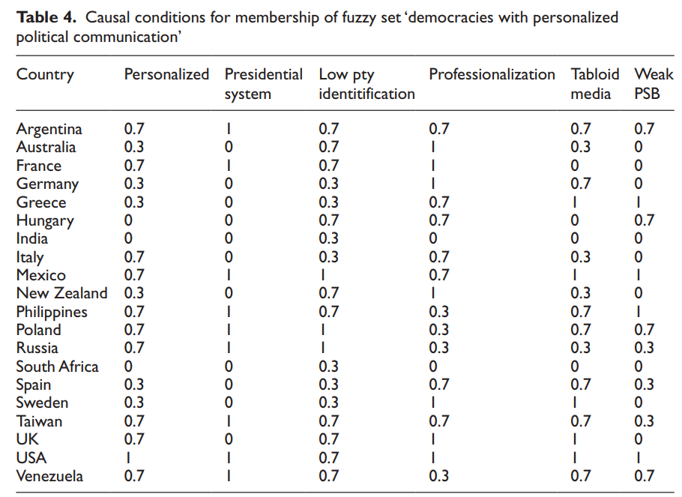
Downey, J., & Stanyer, J. (2010). Comparative media analysis: Why some fuzzy thinking might help. Applying fuzzy set qualitative comparative analysis to the personalization of mediated political communication. European Journal of Communication, 25(4), 331-347. https://doi.org/10.1177/0267323110384256

Slide 16
New testing – 4 types of media systems
Southern (Spain, France, Greece, Italy) → Polarized Pluralist Model
Nordic (nordic countries + the Netherlands, Belgium) → Democratic Corporativist Model
  Strong press subsidies, little ownership regulation
Central (Germany and United Kingdom)
  Weak press subsidies, big ownership regulation
Western (U.S., Ireland, Portugal)

Slide 17
Changes in media environment
Globalization – convergence to liberal model and commercialization
Online media development
  Two hypotheses:
    Blurring national differences
    Continuity – online media development would reflect offline media environment
Systems are not reducible to their component part

Slide 18
Main take aways
Neutral press is not existing anymore
Diversification in european media
Western focused

