Slide 1
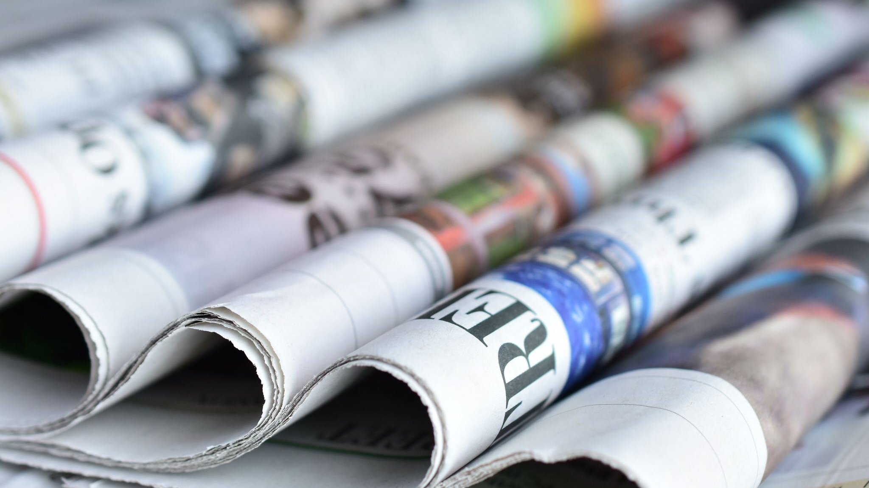
Political journalism from a comparative perspective
Lucie Čejková
luc.cejkova@mail.muni.cz
PMCb1006 Political and media systems
week 7

Slide 2
Outline
media systems
media + politics
political journalism

Slide 3
Think of different factors that influence journalism.
form pairs and come up with different factors (aim for specific examples)
write them on the whiteboard
5 minutes

Slide 4
Media system
= all media in a particular country, interrelated organizations, and actors, subject to a set of laws and regulations, shared journalistic culture
→ but different media sectors: different business models, ownership, media type, audience served

Slide 5
Media system
journalism rooted in the society → shape and form of the media system
with variations according to cultures and subcultures, individual choices, technological and political changes…
national media systems are always, in some respect, unique
to compare, it is essential to focus on key systemic factors

Slide 6
Media system
socio-structural factors – historical differences (quality × popular press), distribution of the news audience across social classes (print, TV, online), demographics (population size, age, gender, ethnicity…), geographical differences, geo-political influence on international distribution
political factors – legal and regulatory arrangements, relations between political actors and journalists (see Hallin & Mancini, 2004 – three models)
economic factors – ownership (diversity, owner influence, market vulnerability), source of finance (advertising, audience income, public funding), competition (quality, diversity)

Slide 7
Media + politics
Pluralism + independence = media freedom
media independence and plurality as frequent indicators to measure the quality of democracy (Landman, 2012; Jakubowicz, 2017)
media independence = no political, corporate, or ownership influence or pressures
media plurality
internal: the plurality of voices, opinions, and sources (content)
external: various types of media and their owners (media)

Slide 8
Media + politics
Examples of independence and plurality of media worldwide:
Media Pluralism Monitor reports
World Press Freedom index
Fairness in news coverage analysis, Digital News Report 2021

Slide 9
Media + politics
Some of the current challenges
weakened influence of citizens in the society: society permeated by media and economic forces that are trying to make the most of the opportunity to put pressure on the political system (Blühdorn, 2007; Jakubowicz, 2017)
increasing media coverage of politics: politicians trying to adapt to the media logic → actions shrunk to media–interesting topics that lose their ideological essence (Jakubowicz, 2017)
commodification, digitalization, changing audience routines (Macek, 2015)
prevalence of false information (Egelhofer & Lecheler, 2019)

Slide 10
Media + politics
Some of the current challenges
political polarization: according to Inglehart & Norris (2019) caused by the division of society into socially liberal and socially conservative groups
technological, economic, and political changes: fragmentation of media, allowing audiences to consume only the content that matches their beliefs and thematic interests, which may increase political and media polarization (Tewksbury & Rittenberg, 2012)

Slide 11
Media + politics
Some of the current challenges
decline in trust in traditional political elites: especially in politically polarized countries → often accompanied by decreasing trust in the professional media (Hanitzsch et al., 2017; Van Dalen, 2019)
emergence of a large number of media outlets that hold specific positions of opinion and tend, along with far-right populist politicians, to undermine trust in professional media: professional media portrayed as “heralds of biased elites” (Rauch, 2015)

Slide 12
Media + politics
Independent and professional journalists
professional autonomy of journalists = an important part of how journalism fulfills its democratic function and how journalistic independence and professionalism are manifested (Deuze, 2005)
Journalistic autonomy: “the degree of self–governance within the profession, and the extent to which the profession is independent of other societal institutions” (Örnebring, 2013, p. 39)

Slide 13
Media + politics
The level of journalistic autonomy can be determined by a range of factors, for example:
the state of democracy
presence of interest groups
nature of the media system
the inner workings of the media itself (including owner interference in content)
concentration of media ownership
characteristics of individual journalists

Slide 14
Media + politics
failing to maintain independence from those covered in journalism, inability to serve as independent monitors of power → less professional journalism
“If the journalists don't do their best, the trust of the people or the respect is going down, which is actually happening here. People are rejecting the media and I think that this is a real problem for democracy.”
Ioana Avădani, Director, Centre for Independent Journalism, Romania

Slide 15
Political journalism
new media, social networking sites → different relationship between politicians and journalists → journalists needed to communicate the politicians’ messages × direct communication
journalists more dependent on the politicians’ online messages, willing to take anything as a quotation
= different power relations between politicians and journalists
“It is a distribution problem and obviously we can’t get back to the old times, when journalists were the gatekeepers. And I don’t think that it was good, it was not very democratic, but what we have now is bad for journalists but also for democracy.”
András Pethö, Editor, Direkt36, Hungary

Slide 16
Political journalism
Roles of journalists in political systems
journalists’ identity and place in society (journalists' professional roles) seen as important for democracy (Hanitzsch & Vos, 2018; 2017).
Hanitzsch and Vos (2017), two analytically distinct levels of roles:
Role orientations: normative (what journalists ought to do); cognitive (what they want to do)
Role performance: practiced (what they really do in practice); narrated (what they think they do)

Slide 17
Political journalism
Normative roles
“encompass generalized and aggregate expectations that journalists believe are deemed desirable in society. Most normative roles of journalists are derived from a view that emphasizes journalism’s potential contribution to the proper workings of democracy”
Cognitive roles
“comprise the institutional values, attitudes and beliefs individual journalists embrace as a result of their occupational socialization. These roles tend to appear as evident, natural, and self-explaining to the journalists”

Slide 18
Political journalism
Practiced roles
“practiced role performance captures the roles of journalists as they are executed in practice”
Narrated roles
“subjective perceptions of and reflections on the roles that journalists carry out in practice”

Slide 19
Political journalism
various roles = good and bad political journalism (De Vreese et al., 2016)
quality × news performance (different functions of media)
news performance – strategy and game framing, interpretative journalism, negativity, political balance (?), personalization, …
in practice: usually different levels of quality and news performance

Slide 20
Political journalism
Journalists + politicians
“democracy dependent on a well-informed citizenship, and it is up to journalism to provide the people with accurate and reliable information based on which to make informed political decisions” (McNair, 2008, p. 238)
→ professional relationship between political journalists and politicians = integral part of the democratic societies

Slide 21
Political journalism
politicians trying to attract journalists to cover them, journalists need politicians as one of the most important sources of information
×
journalists’ and politicians’ close relationships, let alone emotional → considered unprofessional (Hájek et al., 2015).
→ constantly negotiated and renegotiated boundaries
→ the role of emotions and individual values

Slide 22
Political journalism
Context
journalists under increasing pressure to maintain good relations with politicians due to increasing online presence of politicians (Van Dalen, 2019)
journalists perceived as being increasingly dependent on politicians’ statements online (Broersma and Graham, 2016).
journalist-politician relationship: verbal attacks on journalists, political hostility towards media (Krämer, 2018; Figenschou and Ihlebæk, 2019), accusations of fake news spreading across the political spectrum (Aalberg et al., 2017)

Slide 23
Group activity
form groups of up to 3 people
choose one country
briefly characterize its media system with a specific focus on the relationships between media and politicians
find its position in one of the independence and/or pluralism rankings
shortly present to the class (one of you, two, all three – up to your choice)
15 minutes to prepare + up to 3 minutes speech after

Slide 24
Some sources from the many:))
Adserà, A., Boix, C., & Payne, M. 2003. Are You Being Served? Political Accountability and Quality of Government. Journal of Law, Economics and Organisation 19 (2): 445–490. doi:10.1093/jleo/ewg017
Beattie, P. 2019. Social Evolution, Political Psychology, and the Media in Democracy: The Invisible Hand in the U.S. Marketplace of Ideas. New York: Palgrave Macmillan. doi: 10.1007/978-3-030-02801-5
Benson, R. 2008. Journalism: normative theories. The international encyclopaedia of communication, 6, 2591-2597.
Blühdorn, I. 2007. The third transformation of democracy: On the efficient management of late–modern complexity. In I. Blühdorn & U. Jun (Eds.), Economic efficiency – Democratic empowerment, 299–331. Lanham: Lexington Press.
Carey, J. 1999. In Defense of Public Journalism. In T. Glasser (Ed.), The Idea of Public Journalism 49–66. New York: Guilford Press.
Carpini, M. X. D., & Keeter, S. 1996. What Americans know about politics and why it matters. Yale University Press.
Centre for Media Pluralism and Media Freedom. Media Pluralism Monitor. https://cmpf.eui.eu/mpm2021-executive-summary/
Egelhofer, J. L., & Lecheler, S. 2019. Fake news as a two–dimensional phenomenon: A framework and research agenda. Annals of the International Communication Association 43(2): 97–116. doi: 10.1080/23808985.2019.1602782
Fenton, N. (Ed.) 2009. New Media, Old News: Journalism and Democracy in the Digital Age. London: Routledge.
Hanitzsch, T., & Vos, T.P. 2017. Journalistic Roles and the Struggle over institutional identity: the Discursive Constitution of journalism. Communication theory 27. 115-135. Doi: https://doi.org/10.1111/comt.12112
Inglehart, R., & Norris, P. 2019. Cultural backlash. Trump, Brexit and the rise of authoritarian populism. New York: Cambridge University Press.
Jakubowicz, K. 2017. Média a demokracie v 21. století: hledání nových modelů. Brno: Masaryk University.
Landman, T. 2012. Assessing the Quality of Democracy: The International IDEA Framework. Eur Polit Sci 11: 456–468.
Macek, J. (2015). Média v pohybu. Brno: MUNI Press.
McNair, B. 2008. Journalism and democracy. In K. Wahl-Jorgensen & T. Hanitzsch (Eds.), The handbook of journalism studies, 237–249. New York: Routledge.
Rauch, J. (2015). Exploring the Alternative–Mainstream Dialectic: What “Alternati-ve Media” Means to a Hybrid Audience. Communication, Culture & Critique 8(1), 124-143. doi: 10.1111/cccr.12068
Reporters Without Borders. World Press Freedom index. https://rsf.org/en/ranking
Reuters Institute. 2021. Digital News Report. https://reutersinstitute.politics.ox.ac.uk/digital-news-report/2021
Tewksbury, D., & Rittenberg, J. 2012. News on the Internet: Information and citizenship in the 21st century. New York: Oxford University Press.
Toka, G. 2008. Citizen Information, Election Outcomes and Good Governance. Electoral Studies 27(1): 31–44. doi: 10.1016/j.electstud.2007.11.006
Van Dalen, A. 2019. Rethinking journalist–politician relations in the age of populism: How outsider politicians delegitimize mainstream journalists. Journalism. Advance Online Publication. doi: 10.1177/1464884919887822
Deuze, M. 2005. What is Journalism? Professional identity and ideology of journalists reconsidered. Journalism 6(4): 442–464. doi: 10.1177/1464884905056815
Hanitzsch, T. 2017. Professional Identity and Roles of Journalists. Communication. Oxford Research Encyclopedias. https://oxfordre.com/communication/view/10.1093/acrefore/9780190228613.001.0001/acrefore-9780190228613-e-95
Hanitzsch, T., & Vos, T.P. 2017. Journalistic Roles and the Struggle over institutional identity: the Discursive Constitution of journalism. Communication theory 27. 115-135. Doi: https://doi.org/10.1111/comt.12112
Hanitzsch, T., & Vos, T. P. 2018. Journalism Beyond Democracy: A new look into journalistic roles in political and everyday life. Journalism 19(2): 146–164. doi: 10.1177/1464884916673386
Örnebring, H. 2013. Anything You Can Do, I Can Do Better? Professional journalists on citizen journalism in six European countries. The International Communication Gazette 75(1): 35–53. doi: 10.1177/1748048512461761
Reich, Z., & Hanitzsch, T. 2013. Determinants of Journalists Professional Autonomy: Individual and National Level Factors Matter More Than Organizational Ones. Mass communication and Society. 16(1). 133-156. DOI: 10.1080/15205436.2012.669002
Singer, J. B. 2006. The socially responsible existentialist. A normative emphasis for journalists in a new media environment. Journalism Studies 7(1): 2–18. doi: 10.1080/14616700500450277

Slide 25
Thank you & see you next week!
Lucie Čejková
luc.cejkova@mail.muni.cz
PMCb1006 Political and media systems
week 7

