Slide 1
Introduction to Electoral Systems. The Principles of Majority.
PMCb1012 Elections and campaigning

Slide 2
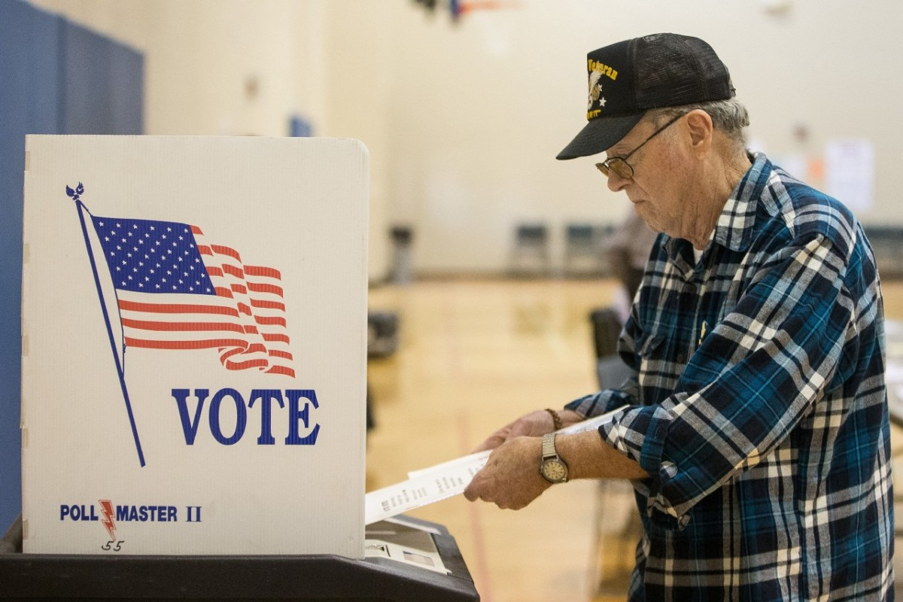
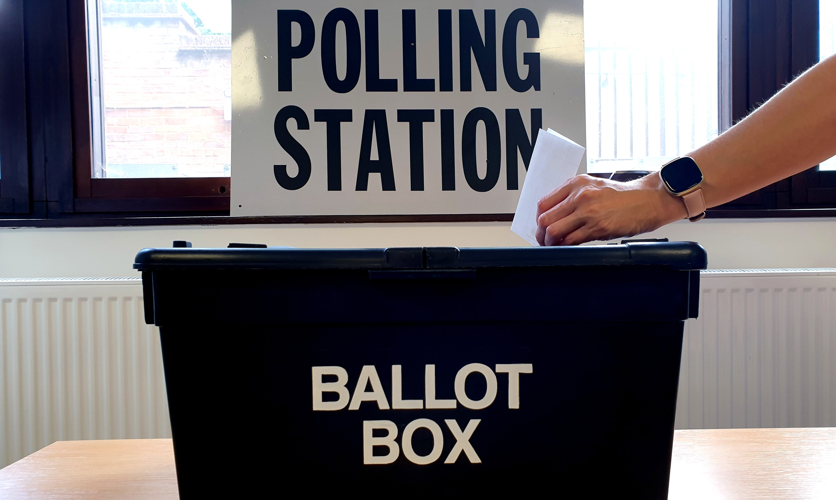
Are Elections Necessary?

Slide 3
Elections
A necessary but not a sufficient condition for democracies
Various benefits:
Accountability
Representation
Legitimacy
A peaceful transfer of power (unlike a military coup)
Civic mobilization
Only free and fair elections fulfil this role

Slide 4
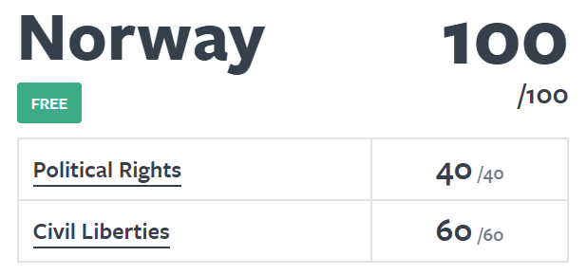
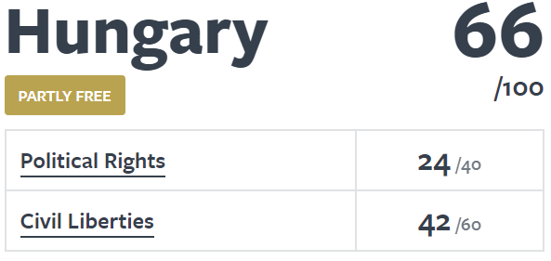
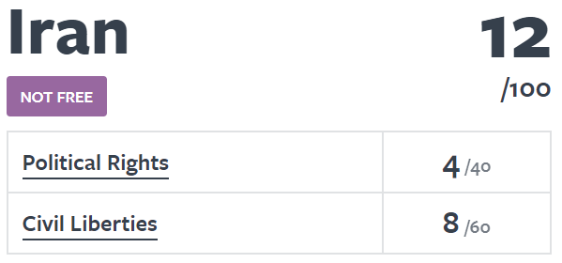
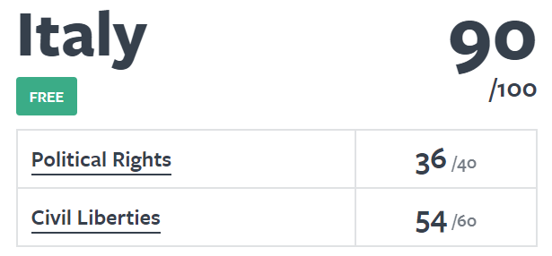
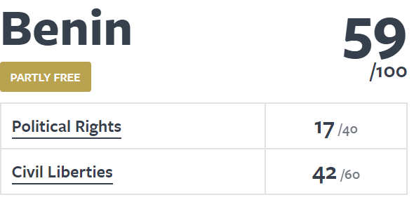
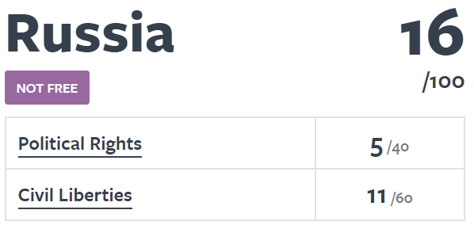

Slide 5
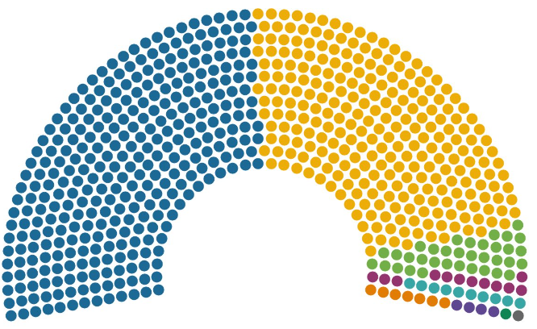
What to Do with the Votes?
Electoral
Systems

Slide 6
Electoral Systems
Set of rules and procedures based on which elections are held
Main role – transformation of votes to seats
Various types and consequences
Fairness and ‘fairness’

Slide 7
Main Electoral Systems (not all included)
1) Systems based on plurality and majority:
First past the post (FPTP)
Majoritarian systems
2) Proportional representation
3) Mixed systems

Slide 8
FPTP and Majoritarian Systems
‘Winner takes all’
Usable for election of:
Individual representatives (presidents, mayors)
Collective bodies (parliaments, assemblies)
Based on single-member constituencies
Each party nominates only one candidate to a constituency
Independent candidates are typically allowed
One winner in each constituency
They differ in victory conditions

Slide 9
First Past the Post
Voters cast single vote for a candidate in a constituency
Victory condition – plurality
The candidate who obtains the most votes wins
Plurality does not require majority of votes
Examples – UK, USA, Canada

Slide 10
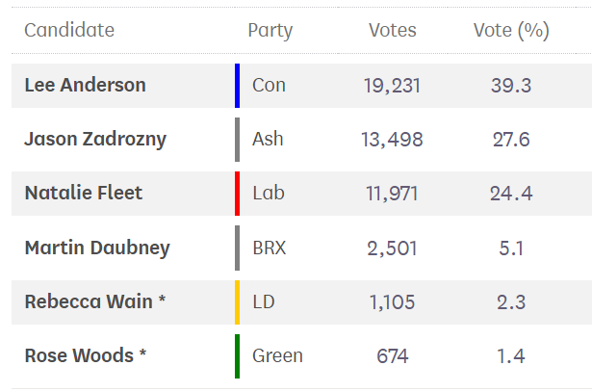
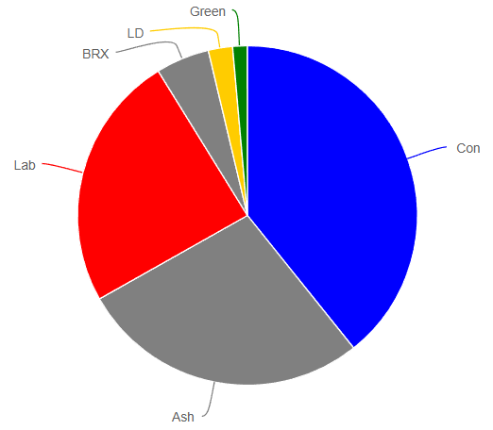
UK General Elections – Ashfield (2019)

Slide 11
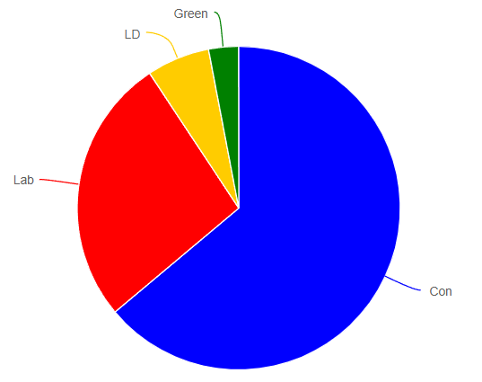
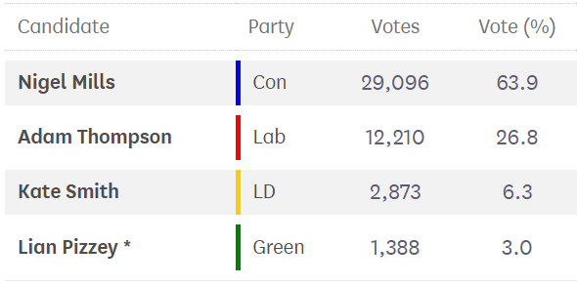
UK General Elections – Amber Valley (2019)

Slide 12
Majoritarian Systems
Voters cast single vote for a candidate in a constituency
Victory condition – majority
The candidate who obtains 50+ percent of votes wins
Examples – France, Australia, many presidential elections around the world

Slide 13
What if no candidate obtains majority?

Slide 14
Runoff
Second round of elections
Typically only a limited number of candidates
Two best from the first round
France – two best + all with 12.5+ percent of votes of all registered voters
The candidate who receives plurality wins
If only two candidates are allowed plurality always equals majority

Slide 15
Czech Presidential Election 2023
Candidate | Party affiliation | First round votes | First round % | Second round votes | Second round %
Pavel Fischer | Independent | 376,707 | 6.8
Jaroslav Bašta | SPD | 248,375 | 4.5
Petr Pavel | Independent | 1,975,156 | 35.4 | 3,359,301 | 58.3
Tomáš Zima | Independent | 30,769 | 0.6
Danuše Nerudová | Independent | 777,080 | 13.9
Andrej Babiš | ANO | 1,952,214 | 35.0 | 2,399,898 | 41.7
Karel Diviš | Independent | 75,476 | 1.4
Marek Hilšer | MHS | 142,912 | 2.6

Slide 16
Alternative Vote (Instant Runoff)
Ensures a winner with majority of votes in a single round
Voters do not cast only a single vote but they rank candidates according to their preferences (1, 2, 3 etc.)
Initially, first preferences are counted – victory requires majority
If nobody has majority, the last candidate is eliminated and their second preferences are given to the others
This process is repeated until one of candidates has majority

Slide 17
Alternative Vote - Example
Food selection
Five options – orange, apple, ice cream, cake, chocolate
Elections decide what to eat
Each voter ranks all choices with 1-5 (1 to the most preferred food, 5 to the least preferred food)

Slide 18
First Preferences Counted

Slide 19
Ice Cream is Eliminated

Slide 20
Still no Majority

Slide 21
Chocolate is Eliminated

Slide 22
Still no Majority

Slide 23
Orange is Eliminated

Slide 24
Majority Obtained – Apple is the Winner

Slide 25
Consequences
Similar impact of FPTP and majoritarian systems
Advantage for large parties (disadvantage for small parties)
Clear selection of winners
Wasted votes
Penalty for extreme parties and candidates
Winner does not necessarily needs to obtain most votes among all

Slide 26
Advantage for Large Parties
Plurality/majority hardly achievable for small parties
Mechanical and psychological effects
Strategic behaviour of voters (why to support small parties?)
→ reduction of number of parties in the system

Slide 27
Example with plurality
District | Party A | Party B | Party C | Party D
1 | 45 | 28 | 21 | 6
2 | 32 | 51 | 8 | 9
3 | 44 | 33 | 19 | 4
4 | 29 | 61 | 3 | 7
5 | 64 | 33 | 2 | 1
6 | 39 | 43 | 10 | 8
7 | 55 | 39 | 2 | 4
8 | 51 | 42 | 4 | 3
Seats | 5 | 3 | 0 | 0

Slide 28
Advantage for Large Parties
Exemption from this rule
Small parties with concentrated territorial support
Small nationally v. large locally
Scottish National Party

Slide 29
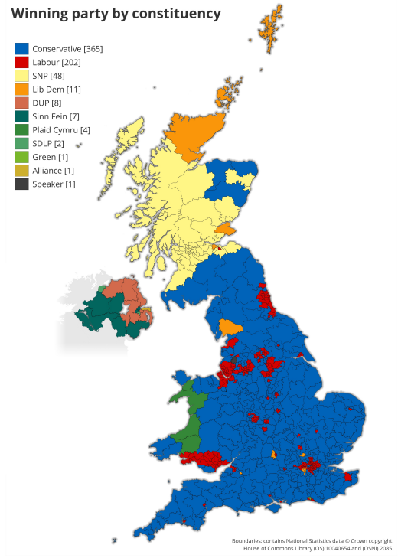
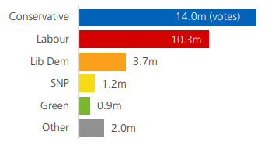
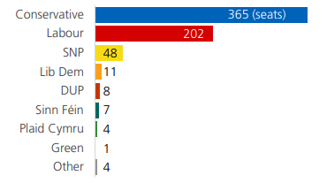
UK election 2019

Slide 30
Penalty for Radical and Extreme Parties
Partly based on penalty for small parties
Stronger penalty in majoritarian system
Runoff – extreme candidates do not attract support of others
Alternative vote – extreme candidates either obtain first preference (from their supporters) or the last one
Works only if radicals do not grow into large parties

Slide 31
French general elections (FN/RN)
Election | Votes % | Seats (out of 577)
1997 | 14.9 | 1
2002 | 11.3 | 0
2007 | 4.3 | 0
2012 | 13.6 | 2
2017 | 13.2 | 8
2022 | 18.7 | 89

Slide 32
Winner Does not Need to be First
Plurality/majority is about winning the most seats
Highest national gain of votes is secondary (although helpful)
Opens questions leading to mechanisms affecting fairness of elections – see the lecture on (un)fairness

Slide 33
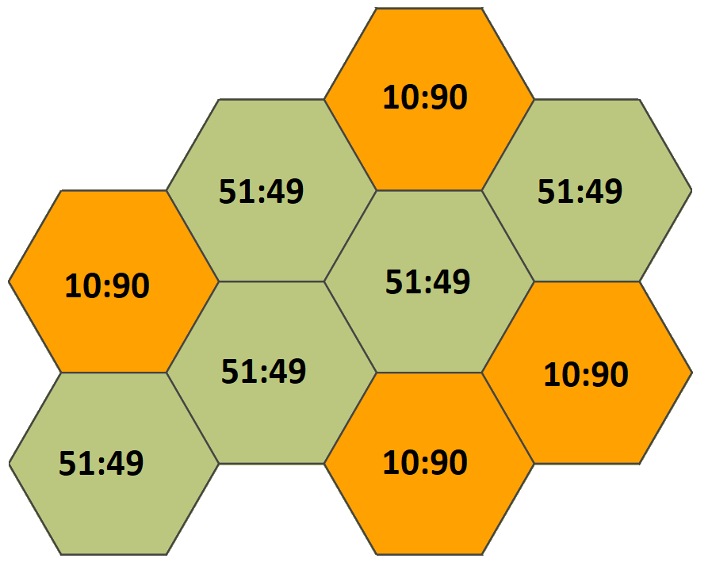
District | Party A | Party B
1 | 51 | 49
2 | 51 | 49
3 | 51 | 49
4 | 51 | 49
5 | 51 | 49
6 | 10 | 90
7 | 10 | 90
8 | 10 | 90
9 | 10 | 90
Votes nationally | 295 | 605
Seats | 5 | 4

