Slide 1
The Phenomenon of
Pork Barrel Politics
Money and Politics

Slide 2
What is Politics?
Plenty of various definitions
What comes to your mind when you hear the word ‘politics’?
Many associated concepts

Slide 3
What is Politics?
Includes many practical and seemingly non-political actions
Project of a new highway approved by national government
A region discusses where to build a school
Small village aims to improve the surroundings of its main road by planting a few trees

Slide 4
Money and Politics
Money is necessary for decision making in politics
Decisions require not just an approval but also an implementation
The question of flow of money
  Where does it come from?
  How much is needed?
  Who benefits and who loses?
Money shares some physical features of pure energy

Slide 5
Importance of Money in Politics
Where does political power come from?
Imagine public money to be completely separated from politics
Consequences?

Slide 6
What Money Will We Talk About
Public money and their distribution
Legal money
Money that political representatives have ‘at their disposal’
  Not the mandatory expenditures of countries – wages of teachers, pensions, interests from debts the country has etc.
Together – distribution of public money that might seem to have no problems until we find out more and get to details

Slide 7
Pork Barrel Politics
Distributive politics – distribution of money that concentrates benefits in specific geographic areas while its costs are spread through general taxation (Shepsle and Weingast 1981)
Pork barrel politics – distribution of money affected by political and partisan interests
Key points:
  Concentrated benefits (only someone profits)
  Spread costs (everybody contributes)
  Politics in the game (distribution in accordance with political and partisan goals)

Slide 8
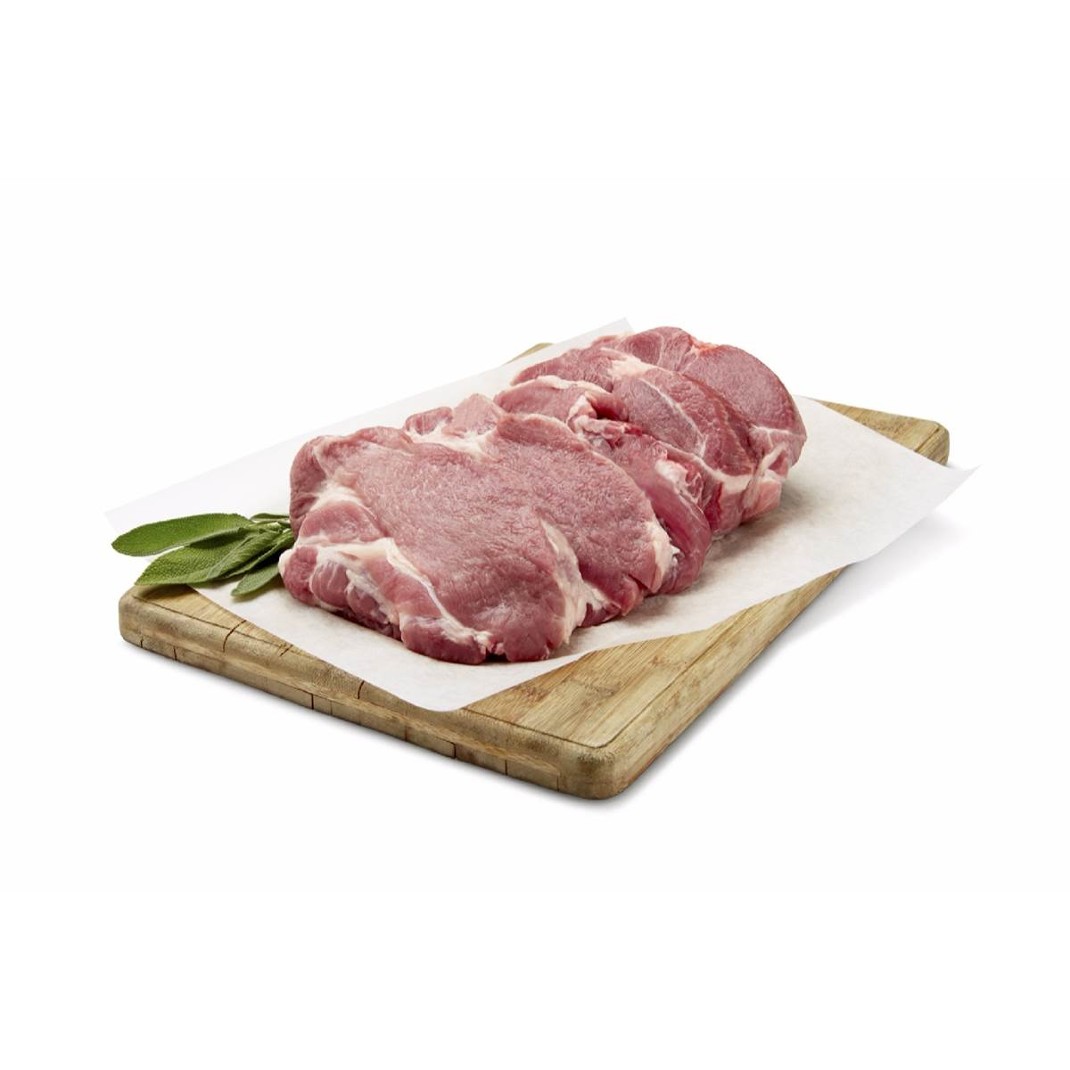
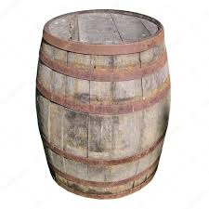
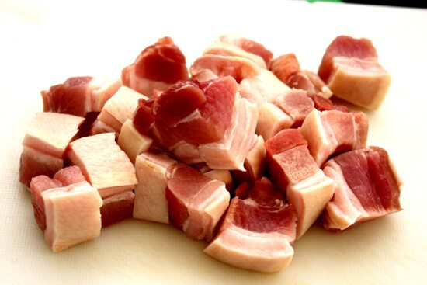
Historical Origins

Slide 9
Historical Origins
19th century in the USA (before the Civil War)
Custom of slavers to give barrels of pork to their slaves during holidays
The fights between slaves for food used later as an analogy for struggles of U.S. Congress members when trying to provide public money to their constituencies

Slide 10
Game of Points
Let’s assume it is the beginning of April (after my lectures and position papers graded)
I have 120 points in this course to distribute to you (60 people)
Suggest various ways how I can distribute the points so that
  The distribution can be considered just, and
  We can defend the outcome of the distribution with rational arguments

Slide 11
Possible Ways of Distribution
1. Two points to everybody (equality)
2. More points to those who attend our sessions (attendance)
3. More points to those who are more active (active attendance)
4. More points to those with less points from position paper (compensation)
5. More points to those with more points from position paper (motivation)
6. More points to ‘older’ students (rescue and risk aversion)

Slide 12
Other Ways of Distribution
Color of hair
  More points given to those with brown hair over all the others
Sympathies towards the lecturer
  Questionnaire where you select how you like the lecturer on a 0-10 scale
  After that the lecturer distributes more points to those who gave him more points
Problems? Of what sort?

Slide 13
Logic of Distribution
Any distribution of public money inevitably leads to those who benefit and those who do not (or at least not to such extent)
Conditions of a just distribution:
  Ability to rationally defend the outcome of the distribution
  The explanation of the distribution lies within the goal of the distribution
  The result of distribution is not affected by relations between those who control the money and those who obtain it
Pork barrel politics contradicts all three conditions

Slide 14
One or More Pork Barrel Politics?
Anthony Hoare (1992) on transport investments in New Zealand
The character of pork barrel politics depends on local political conditions
Main role of power relations and institutional setting
Differs between two (three) types of pork barrel politics

Slide 15
Individual Pork Barrel Politics
Evolves when political parties are less powerful than individual political representatives (USA)
Resources used as a way to introduce and pass legislation
Rewards and compensations based on the actual situation
Benefits spread beyond partisan lines

Slide 16
Centralized Pork Barrel Politics
Evolves in countries with powerful political parties and weaker individual representatives (Europe)
Parties in government control the resources and use them to support their members on various territorial levels
Benefits primarily given to members of governmental parties
Two subtypes (Hoare 1992) – safe seat v. marginal

Slide 17
Type | Individual | Centralized
Conditions | Individual representatives > parties | Parties > individual representatives
Goal | Legislation, reelection | Reelection
Who benefits | Anyone willing to cooperate | Governmental parties and their members
Example | USA | Europe

Slide 18
Legality and Legitimacy
Legality – in accordance with legal rules
Legitimacy – accepted as understandable, relevant, fair, rightful etc.
For a smooth democratic governance legality and legitimacy should not stand against each other

Slide 19
Examples
Laws adopted in Nazi Germany (1933-45) against human rights
Opposition activities in non-democratic regimes
A law prescribing that elections are held once in 25 years
Project of coal power plant in accordance with the legal rules
2021 US Capitol attack

Slide 20
Is Pork Barrel Politics Legal?
Usually without any doubt:
  Based on existing norms
  Follows its own formal rules
  Realized by official governmental agencies
No law defining features such as ‘political ally’, ‘political enemy’, ‘positive bias for one’s own party’ etc.
Violation of legality is very seldom in pork barrel politics

Slide 21
Is Pork Barrel Politics Legitimate?
A million dollar question

Slide 22
The ‘New School’ project
Situation:
  20 towns in a region, each town has a primary school
  Due to budget cuts the region has to close one of the schools and the people will definitely not like it
  What factors should the region take into account?
Options:
  Amount of savings on wages, energies etc.
  Distance the kids have to travel to other towns (impact on environment)
  Amount of kids (families) affected by the change
  Capacities of schools in adjacent towns
  Cultural impact on the selected towns (any libraries in there?)
  Is the mayor of the town our political ally or a political rival?

Slide 23
Is Pork Barrel Politics Legitimate?
A million dollar question
Pork barrel politics relies on distribution of money based on reasons NOT connected to the supported goal
Impact on moral issues – it creates an impression that using public resources for political ambitions is okay and acceptable
Evans (2004): ‘pork barreling, despite its much maligned status, gets things done’
Machiavellianism at its best

Slide 24
Pork Barrel Politics and Electoral Corruption
Pork barrel politics often labeled as ‘vote-buying mechanism’
Electoral Corruption (Birch 2009):
  Manipulation of rules
  Manipulation of voting
  Manipulation of voters
Does pork barrel politics fall under such manipulation?

Slide 25
Pork Barrel Politics and Electoral Corruption
Corruption of voters:
  Direct benefits to individual voters
  Direct instructions how to vote
  Control of behavior of voters
Pork barrel politics:
  Benefits provided to whole territories
  No instructions how to vote and absence of control
The aims might be the same but realization is different

Slide 26
What About Corruption?
Rothstein (2014) – What is the opposite of corruption?
  Outcomes as well as the procedures are important
  The essence of corruption is the denial of impartiality
Pork barrel politics also stands on denial of impartiality
Test of logical thinking – is pork barrel politics the same as corruption?

