Slide 1
Interest Groups and Lobbying
Money and Politics
15.4.2024

Slide 2
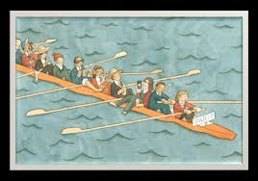
What are interest groups?
Organized interests: formal and informal, key characteristic: collective action
Interest groups: usually NGOs, informal groups and business groups
Dilemma of collective action (common or public goods) – the free rider problem (Mancur Olson)
Logic of Collective Action in Four Minutes
https://www.youtube.com/watch?v=3rchT42duN8
http://www.beneffice.eu/sites/default/files/workshop/8.%20Part%20B_Free%20riding%20and%20rebound%20effect%20presentation_v2.pdf

Slide 3
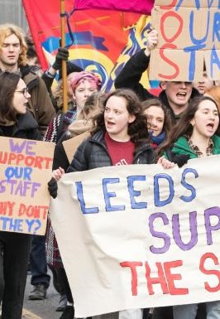
2. How does money influence collective action?
Likelihood
costs of collective action, organizational costs
What can be the costs of collective action?
Effectivity
What does the effectivity of collective action depend on?
Resources, circumstances and luck

Slide 4
Non-Governmental Organizations (NGOs)
Associations
NGOs: two main approaches:
An organization not controlled by the government (independent, voluntary, not-for-profit)
b) An organization not controlled by the government and not self-serving (or working for social good)
Non-profits (NPOs, not always NGOs)
How do we determine which organization is self-serving?

Slide 5
What do interest groups do in politics?
advocacy (interest aggregation and articulation, sometimes selection)
agenda-setting
services
mobilization
socialization

Slide 6
HOW INTEREST GROUPS PROMOTE GOOD GOVERNANCE?
checking the power of majorities (watchdog role)
better representation of interests
avenue for political involvement (political participation)
dispersal of costs (expert information, know-how, information on positions of stakeholders, implementation, control etc.)

Slide 7
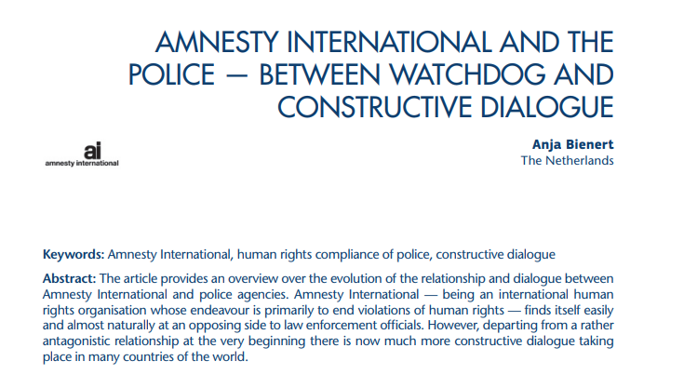
NGOs AS WATCHDOGS
As the main goal or as a byproduct of promoting other interests
Often in cooperation with the media (NGOs as experts)

Slide 8
TYPES OF GROUPS
insider x outsider
primarily oriented inside x outside
private interest groups x citizen / public interest groups
Protective – represent sectional interests of certain groups in society
Promotional / advocacy – act on behalf of particular causes or ideas, arising out of attitudes and beliefs (rather than the self-interests ?) of their members
Service groups

Slide 9
NIMBY GROUPS
NIMN (Not in my neighborhood)
NAMBI (Not against my business or industry)
SOBBY (Some other ***’s back yard)
x
NIABY (Not in anyone’s backyard)
BANANA (Build absolutely nothing anywhere near anyone)
CAVE (Citizens against virtually everything)
Not In My Back Yard
NIMBYism
usually promoting the status quo (ambience, architectural style, landscape, character of the community)
against new developments
mostly relatively short term, ad hoc organization, formal or informal
great mobilization potential x difficult to keep up long-term interest of members
E.g.
2007: opposition of some Czech villages and groups against a proposed U.S. radar base

Slide 10
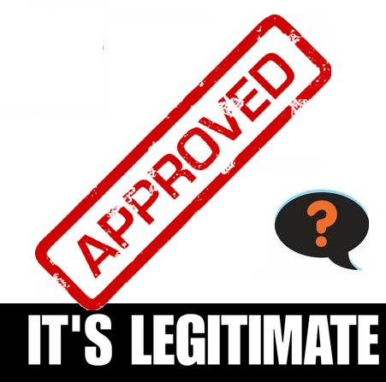
WHAT DOES AN INTEREST GROUP NEED TO EXERT INFLUENCE?
ACCESS
RESOURCES
LEGITIMACY
ABILITY TO SANCTION

Slide 11
FUNDING NGOS
Nonprofit, typically citizen-based organizations
Independent from the government (formally)
Often heavy dependence on public budgets
Fundraising
Grants and project funding
Programe funding
Other revenue

Slide 12
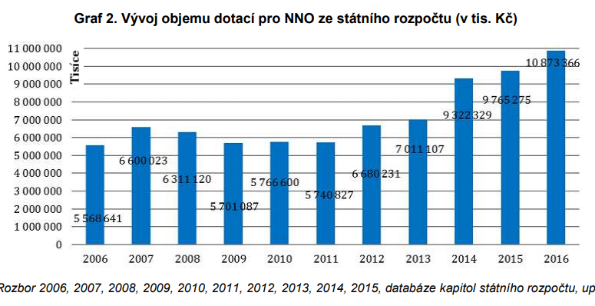
NGOS FUNDING FROM STATE BUDGET
CZECH REPUBLIC in thousands

Slide 13
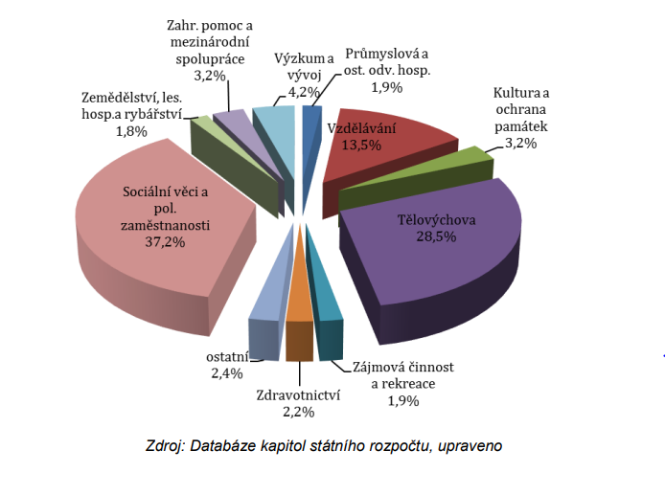
NGO STATE FUNDING BY FIELD

Slide 14
Lobbying
broad understanding – any activity aiming to influence political decisions
narrow understanding – negotiations or exchange of information between the lobbyist and a public official (decision maker, civil servant)
diverse intensive activities of social groups, chambers and companies in the political and bureaucratic vestibule’ (Beyme 1980)
‘lobbying is the attempted or successful influence of legislative-administrative decisions by public authorities through interested representatives. The influence is intended, implies the use of communication and is targeted on legislative or executive bodies’. (Koeppl 2001: 71)
lobbying confers an unfair advantage on those that can afford to carry it out and therefore runs counter to the notion of democracy’ (Warleigh and Fairbrass 2002: 2)

Slide 15
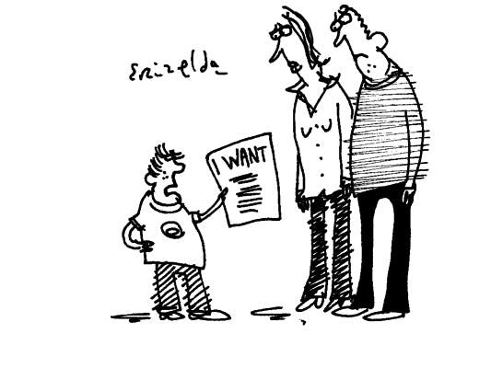
Who can (and does) lobby?
ANYONE
WITH THE RESOURCES
Businesses, NGOs, states, municipalities, IGOs, INGOs …. and professional lobbyists

Slide 16
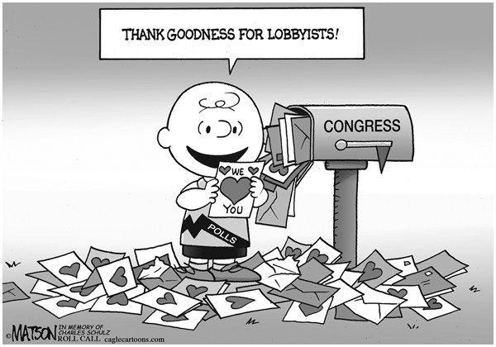
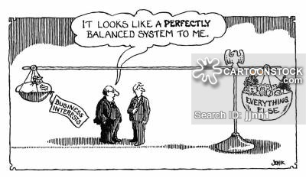
Legitimacy of lobbying
Should decision-makers let themselves be lobbied?
WHY?
WHEN?
BY WHOM?
HOW?
https://poststar.com/news/opinion/editorial/commentary-slow-down-the-revolving-door-from-congress-to-lobbying/article_c0cd1ac0-b7e4-11e4-8334-7ff2a676b41c.html
https://www.cartoonstock.com/directory/b/business_lobbies.asp

Slide 17
Lobbying vs. bribery
Similarities
Immediate goal of lobbyist/bribers: to influence policy-making decisions (or administrative decisions)
means/method: to provide politicians or public officers resources
Both are based on negotiations between the lobbyist or briber and the policy-maker or decision-maker (mutual exchange) and require a certain level of trust.

Slide 18
Lobbying vs. bribery
Differences between the concepts:
Lobbying:
Type of resources (payment): information, know-how, expertise, services?, favours?
Gain: public and private
Means: providing information supporting the lobbyists’ position
Goal of the decision-maker: to help to clarify benefits and costs of each decision, gather information on the issue and on positions of stake-holders
Ultimate goal of lobbyists: To promote their interests or interests of their clients
Bribery:
Type of resources (payment]: money, gifts, services, influence, favours
Gain: private only
Means: providing incentives for decision-makers to adopt the preferred decision.
Goal of the decision-maker: personal enrichment or another type of private gain
Goal of corrupters: Promote their interest and make decision-makers misuse their power.

Slide 19

“CASINO JACK“ ABRAMOFF

Slide 20
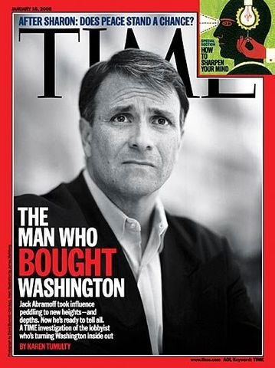
Dirty “lobbying”
The case of Jeff Abramoff
Jack Allan Abramoff (*1959)
Republican Lobbyist, movie producer
Greenberg Traurig, „Team Abramoff“, Michael Scanlon
An elaborate network of favour granting, gift giving and information exchange.
Jack Abramoff Native American lobbying scandal (SunCruz Casinos)
2006 and 2008 sentenced to 6 years and 4 years (released in 2010)

Slide 21
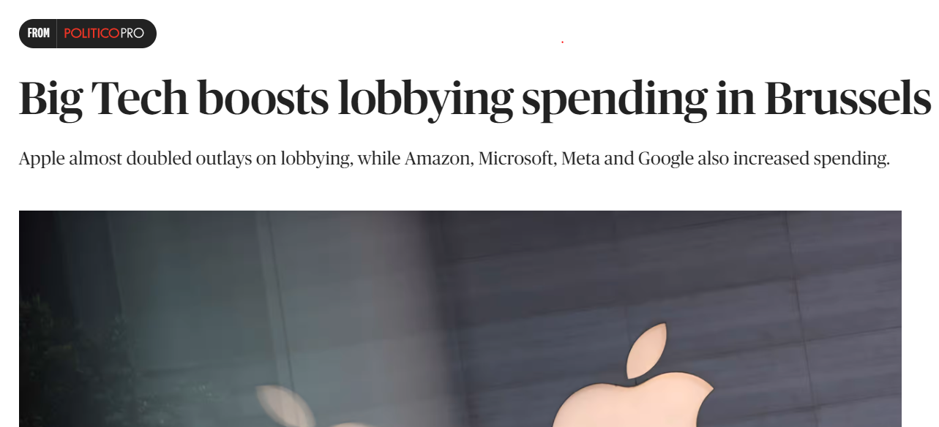
If lobbying is not bribery... Why is it still controversial?
General lack of transparency.
More resources = more influence.
Diffuse vs. concentrated interests.
Professional lobbyists are typically more effective (at least in some political systems) WHY?

Slide 22
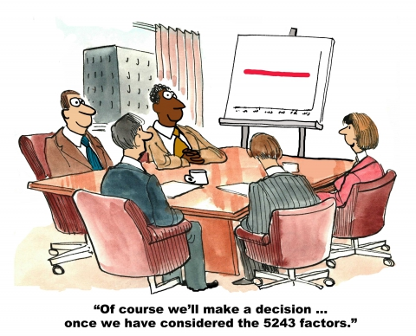
When is lobbying legitimate? Can there be objective criteria?
Transparency
Public good?
?

Slide 23
A) Is money all that determines lobbying success? B) Can a lobby be successful without (significant amounts) of money?
A) OBVIOUSLY NO. However, it is a powerful determinant.
B) In some circumstances (the use of internet, emotional issue, limited opposition and if employed with other strategies)
“the language of money” in lobbying (and policy-making in general) – e.g. USA: medical coverage for the ABA therapy or Ford Pinto cost benefit analysis (https://www.youtube.com/watch?v=z9TAuSelsag)

Slide 24
Literature
Giovannoni, F. 2001. Lobbying versus Corruption. CESifo DICE Report 1/2001, online.
Rose-Ackerman, S. 1999. Corruption and Government: Causes, Consequences, and Reform. Cambridge: Cambridge University Press, s. 127-174.
Schendelen, R. van. 2003. Machiavelli in Brussels : The Art of Lobbying the EU. Amsterdam : Amsterdam University Press.
Sinclair, B. 2004. Unorthodox Lawmaking: New Legislative Processes in the U.S. Edition, CQ Press.

