Slide 1
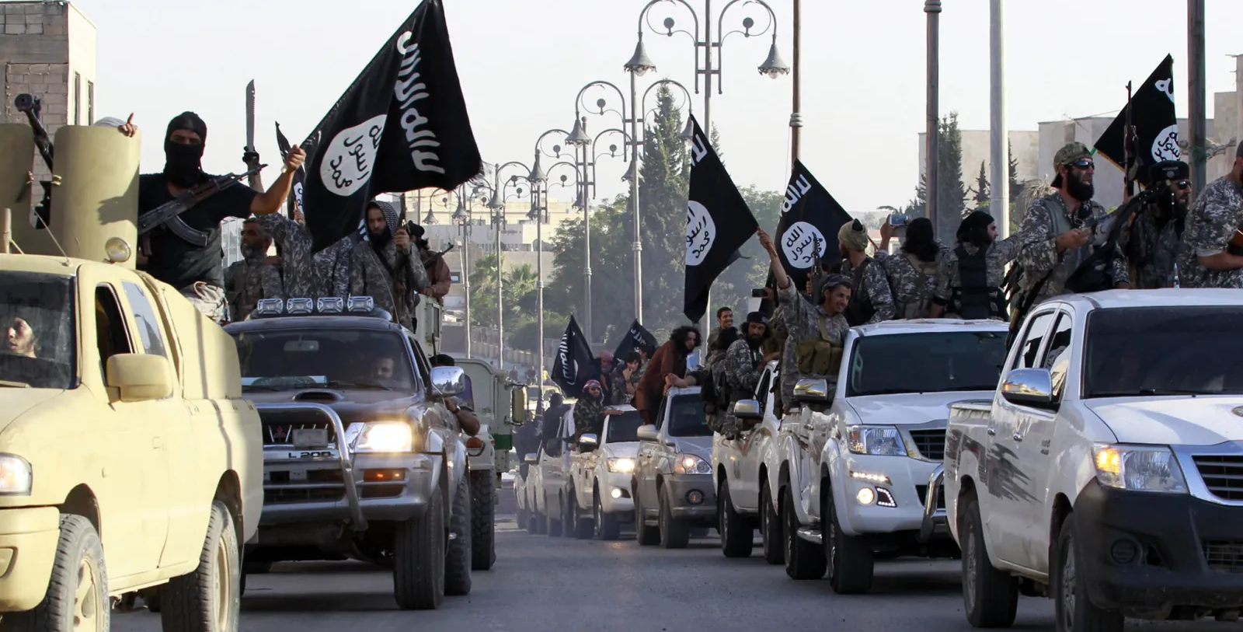
ISIS Governance
A Comprehensive Overview of the Islamic State's Rule and Administration

Slide 2
ISIS – Timeline
2006
Merged into Islamic State of Iraq (ISI) in 2006
2011
Expanded into Syria in 2011, creating Jabhat al-Nusra
2013
Rebranded as ISIS in 2013
2014
Declared a caliphate in 2014 under Abu Bakr al-Baghdadi
ISIS origins as Jama'at al-Tawhid wal-Jihad (JTJ)
1999
2017-ish
Military defeat of ISIS
2004
JTJ merges with other jihadist groups into AQI

Slide 3
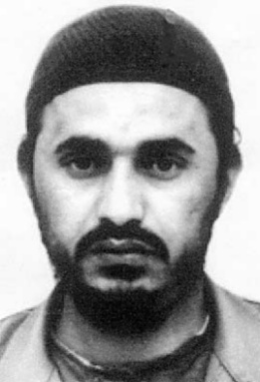
Abu Musab al-Zarqawi
Jordanian militant influenced by Qutbism and Salafism
Advocated sectarian violence and Takfir
Played a key role in shaping ISIS ideology
Killed in 2006 by a U.S. airstrike

Slide 4
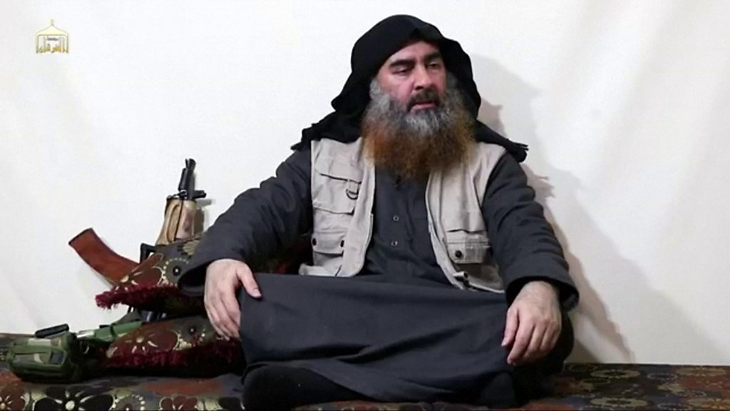
Abu Bakr al-Baghdadi
Ph.D. in Islamic Studies, rose through ISI ranks
Declared caliph in 2014
Ideologically rooted in Salafi Jihadism
and Wahhabism
Influenced by Sayyid Qutb’s writings
Called for global jihad and rejection
of the West
Promoted Takfir and strict Sharia
Killed in a U.S. raid in 2019

Slide 5
Ideological Foundations of ISIS
„Abu Muhammad al-Maqdisi is the most influential living Jihadi Theorist„
„By all measures, Maqdisi is the key contemporary ideologue in the Jihadi intellectual universe.”
→ But harsh criticism of ISIS
Salafi jihadism
Qutbism
Wahhabism

Slide 6
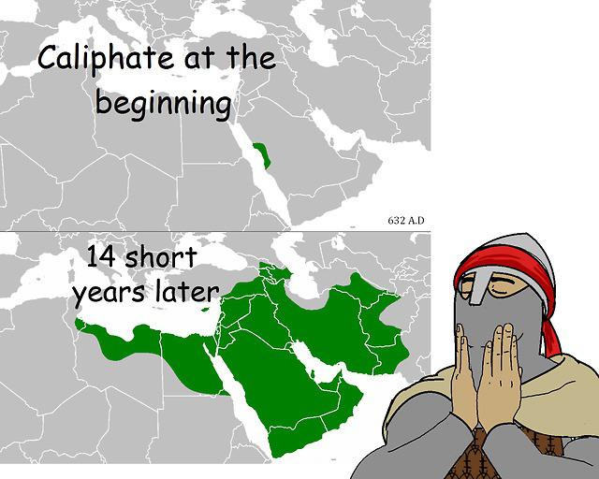
What is a Caliphate?
Islamic state ruled by a caliph under Sharia law
Seeks to unify Muslims globally
Claims religious and political authority
Baghdadi claimed leadership as caliph

Slide 7
Establishment of the Caliphate
Baghdadi appeared publicly in Mosul in 2014
Proclaimed 'Islamic State' and urged Muslims to join
Used media to enhance legitimacy
Marked a key moment in jihadist history

Slide 8
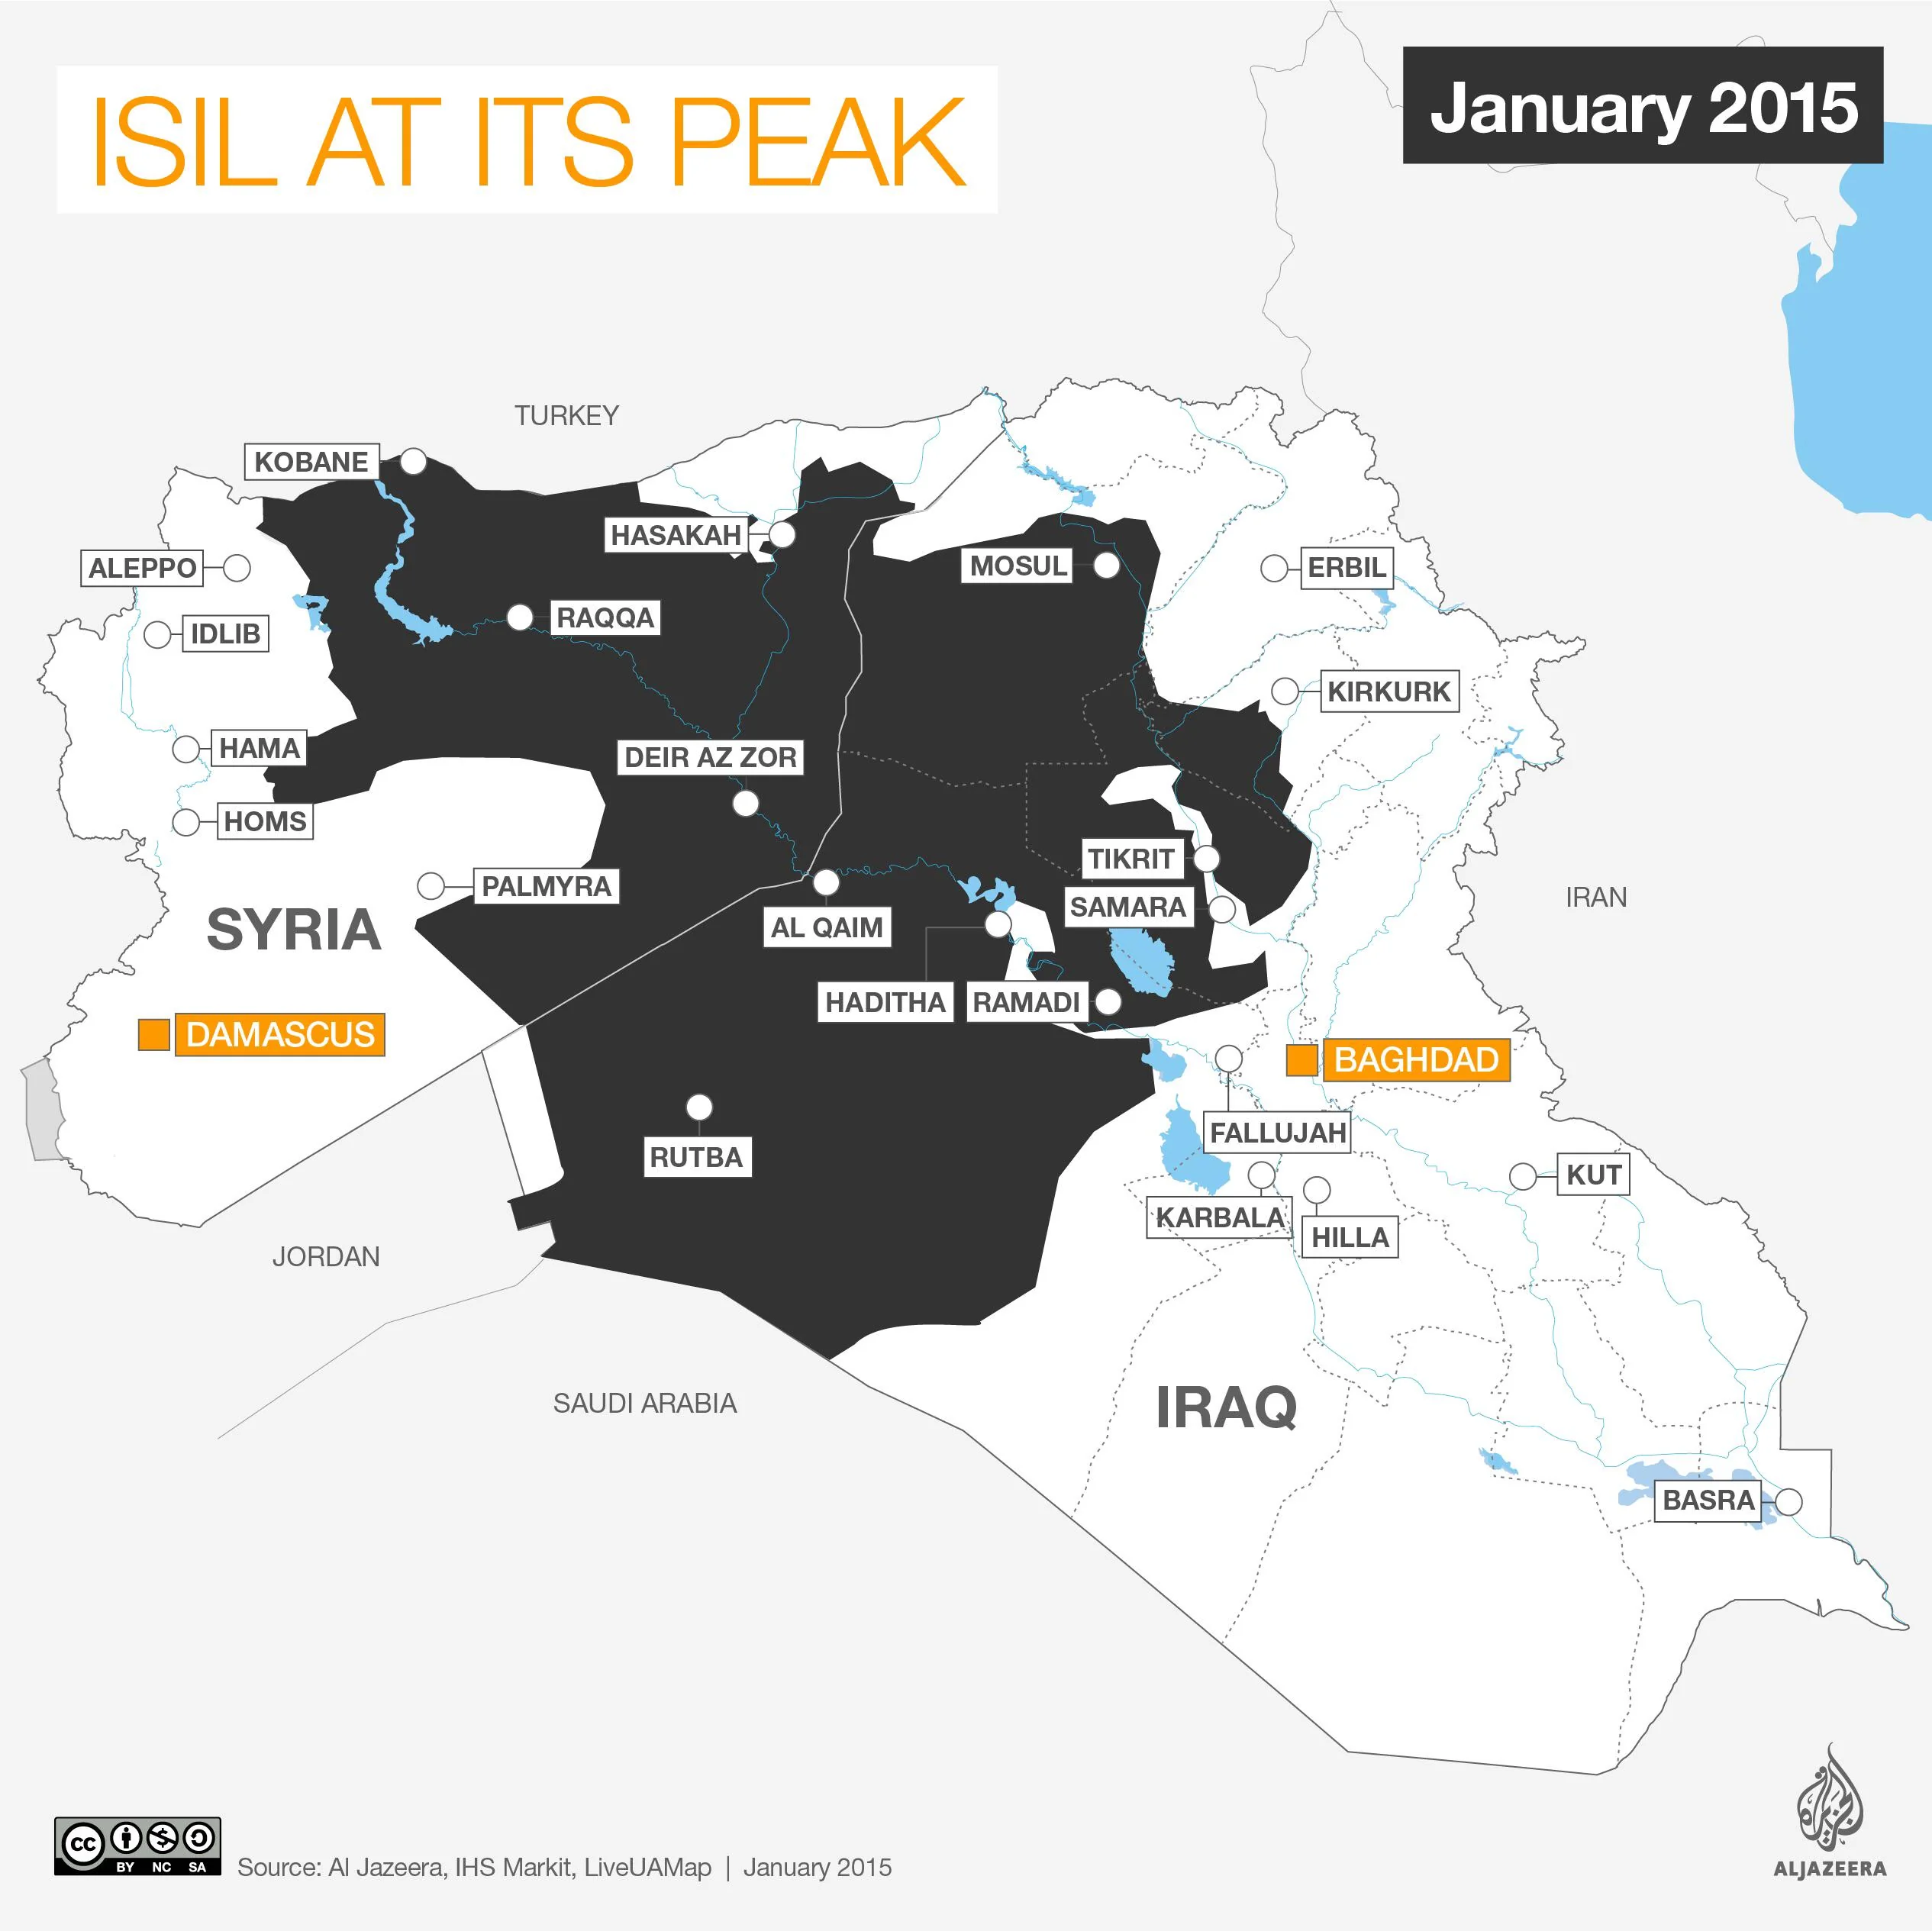
Territorial Expansion
Seized large parts of Iraq and Syria in 2014
Raqqa and Mosul became strongholds
Declared provincial affiliates globally
Extended influence to Africa and Asia

Slide 9
ISIS Governance
„The Good, the Bad, and the Deadly“ (Iannaccone, Berman 2006)

Slide 10
Healthcare and Welfare
Established hospitals and clinics
Provided aid to widows and orphans
Distributed food and water
Welfare system for fighters' families

Slide 11
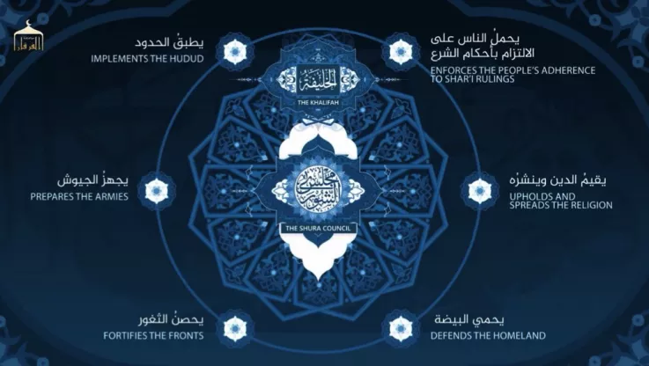
Governance Structure
Centralized leadership with Shura council
Ministries for security, media, finance,
education
Local councils implemented policies
Highly bureaucratic for a terror group

Slide 13
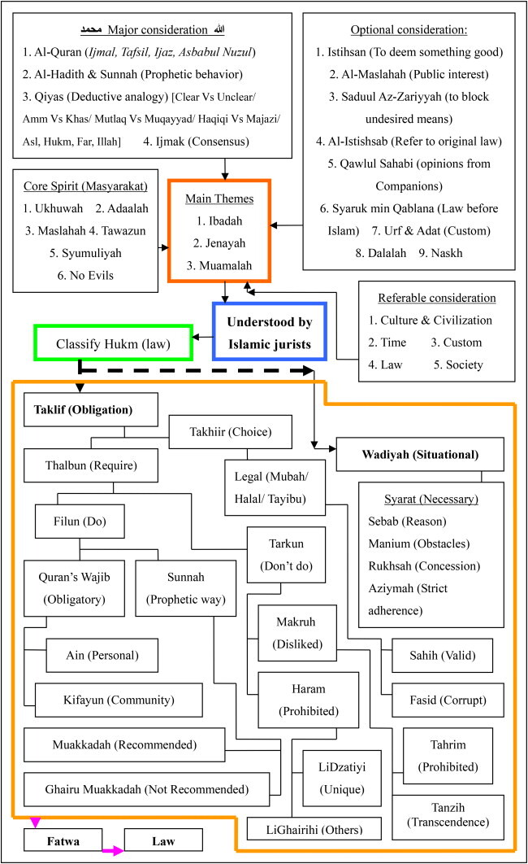
ISIS Legal System
Strict interpretation of Sharia law
Harsh punishments: executions, amputations
Courts for civilians and fighters
Used fear and spectacle to maintain order
Chun-Leung, J. L., Mohd Nor, M. R., Mustaffa, K. A., & Isa, K. bin. (2024). Islamic law and its application as penal code by the Islamic State of Iraq and Sham (ISIS). Cogent Arts & Humanities, 11(1). https://doi.org/10.1080/23311983.2024.2382519

Slide 14
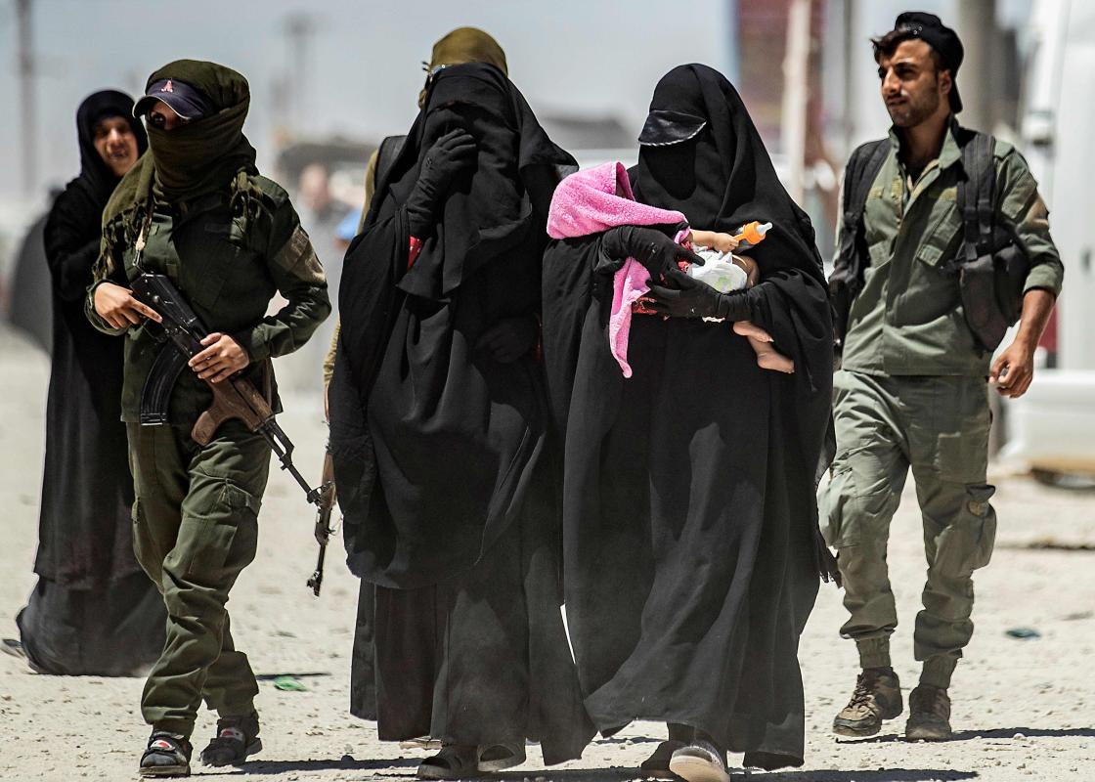
Social Norms Enforcement
Dress codes and gender segregation
Ban on music, smoking, and secular activities
Mandatory prayers and fasting
Religious police enforced morality

Slide 15
Chun-Leung, J. L., Mohd Nor, M. R., Mustaffa, K. A., & Isa, K. bin. (2024). Islamic law and its application as penal code by the Islamic State of Iraq and Sham (ISIS). Cogent Arts & Humanities, 11(1). https://doi.org/10.1080/23311983.2024.2382519

Slide 16
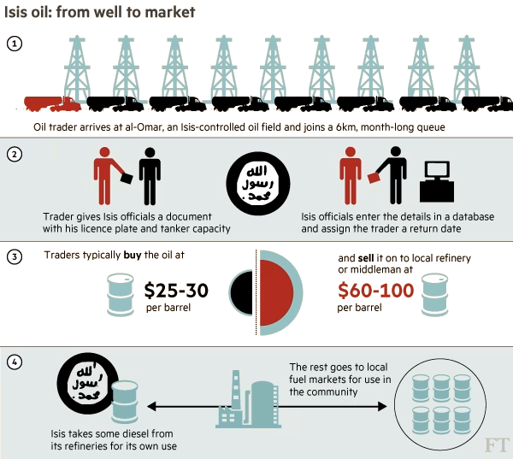
Economic Policies
Revenue from oil, taxation, and extortion
Controlled agriculture and trade
Enforced zakat and jizya taxes
Prohibited interest-based finance

Slide 17
Education System
Focused on Islamic studies and Arabic
Secular subjects removed
Military training included
Girls' education severely restricted

Slide 18
Media and Propaganda
Sophisticated use of social media
Promoted governance successes
Recruitment videos and online magazines
Framed brutality as divine justice

Slide 19
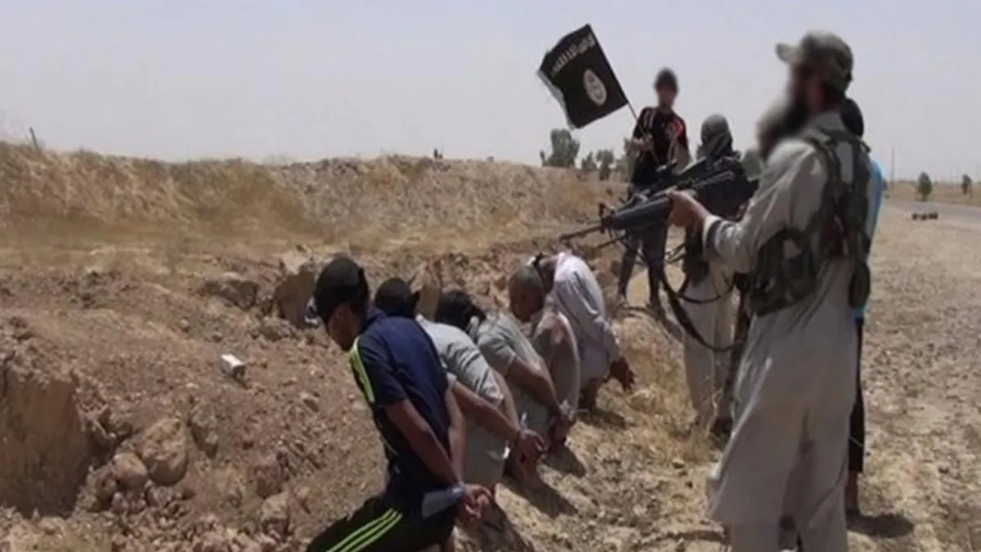
Summary of ISIS Rule
Extreme brutality and human rights abuses
Suppression of women and minorities
Public executions and sexual slavery
Widespread international condemnation

Slide 20
Downfall and Resurgence

Slide 21
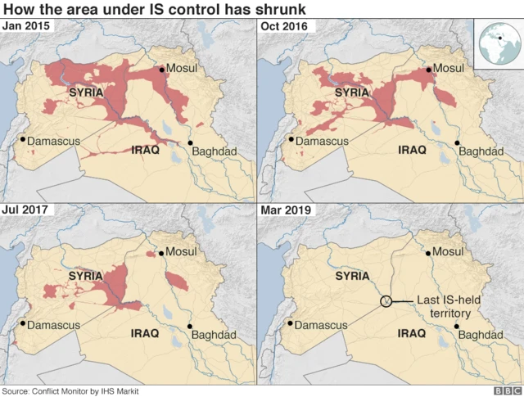
Military Decline
2015: Coalition forces push back
Loss of Raqqa and Mosul by 2017
Baghdadi’s death in 2019
ISIS caliphate dismantled

Slide 22
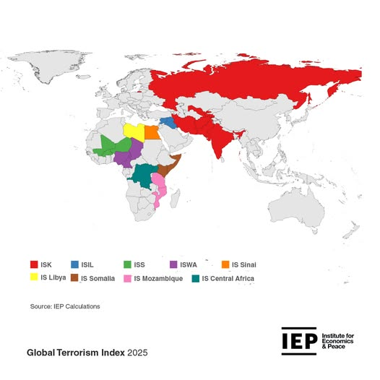
Global Impact
Inspired attacks worldwide
Affiliates in Libya, Nigeria, Philippines
Drew tens of thousands of foreign fighters
Challenged global counterterrorism

Slide 23
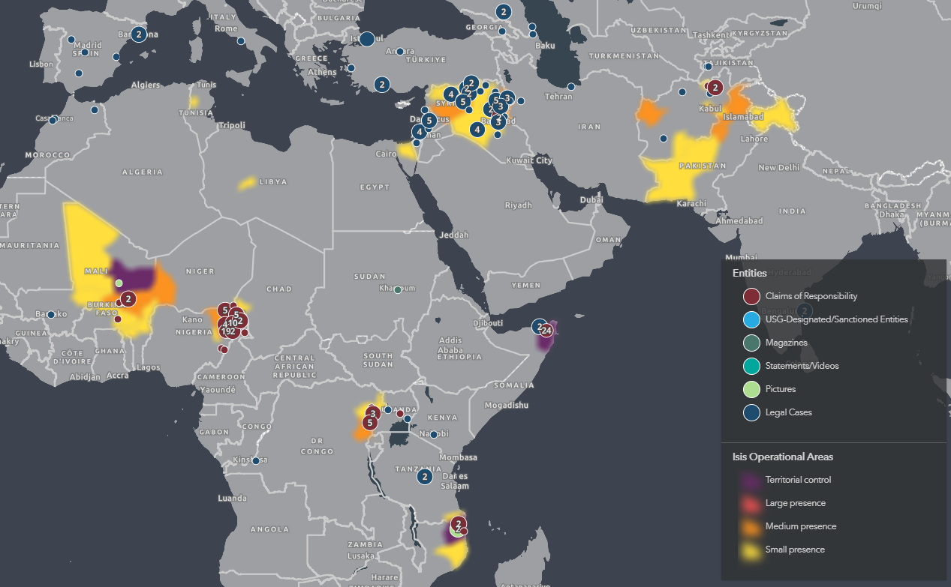
https://www.washingtoninstitute.org/islamicstateinteractivemap

Slide 24
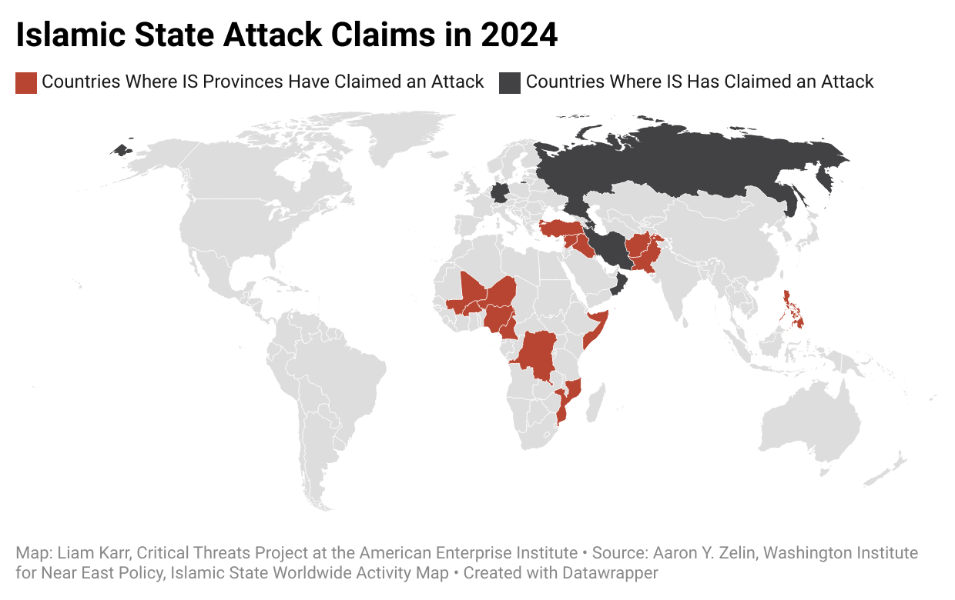
Post-Caliphate Resilience
Regrouped in rural Iraq and Syria
Continued asymmetric warfare
Persistent online propaganda
New affiliates in Africa and Central Asia

Slide 25
Conclusion
ISIS governance blended ideology and pragmatism
Maintained order through fear and services
Exploited power vacuums and sectarianism
Legacy continues through affiliates and ideology

Slide 26
Thank you for attention!

