Slide 1
Food, sustainability and
alternative food networks
Session 1 – Introduction
Dr Daniel Keech
Countryside and Community Research Institute
University of Gloucestershire, UK
dkeech@glos.ac.uk
Masaryk University, Brno, 31st March – 4th April 2025

Slide 2
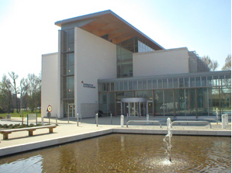
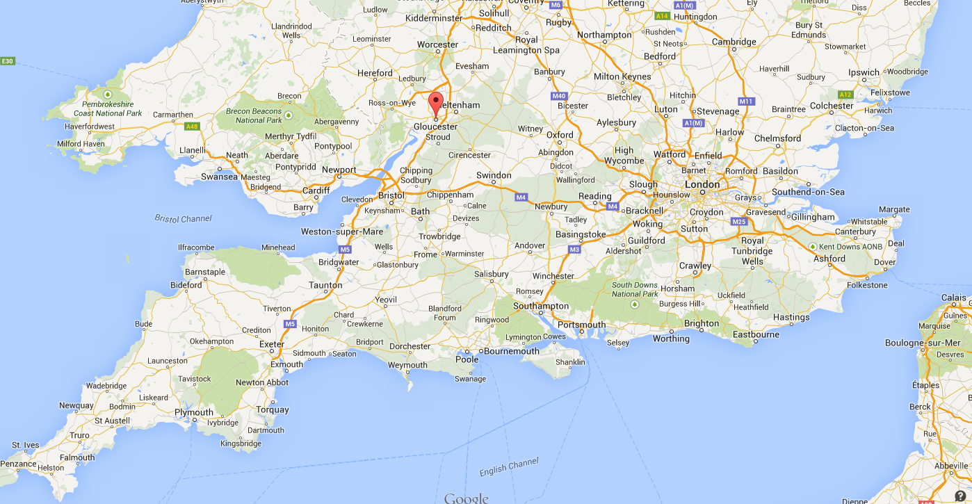
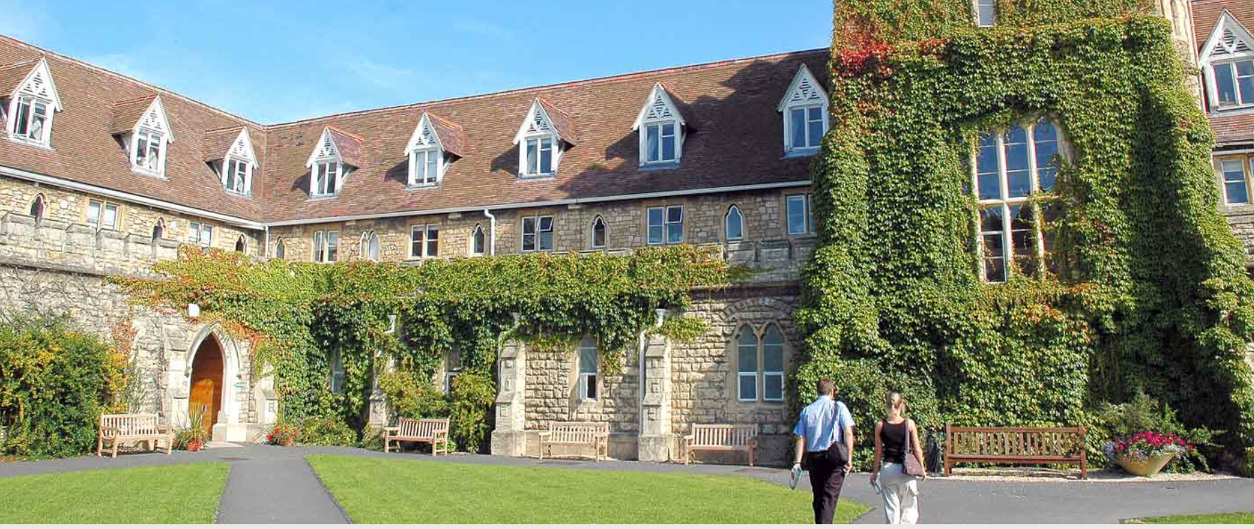
University of Gloucestershire
Small university in SW England
Originally est. in 1847
c. 10,000 students + 1,500 PG
Specialisms: arts, applied and social sciences, sport, business, education
Four campuses in two adjacent towns
Countryside & Community Research Inst
Since 1986 one of UK’s largest rural research centres. Now more broadly based around social innovation, environment, sustainability and policy.
Masters teaching and PhDs
Research: international partnerships
Transdisciplinary methods

Slide 3
Introductions (c. 30 seconds each)
Your name
Where are you from region of CZ, or home country if outside CZ.
Study areas at MUNI – e.g. environmental studies, psychology, journalism, economics etc…
What interests you about this course?

Slide 4
Overview of the week
Together we will:
Explore the changing narratives about food over recent decades.
Critically consider some public, scientific and policy debates around food supply, production and consumption, including the complexities and inter-connectedness of local and global food.
Examine local ‘alternative’ and community food provision models.
Carry out independent group research which aims to help students reflect on and communicate their grasp of issues covered in scientific articles.
Notes:
4

Slide 5
Course progression (1)
Session 1: Mon 31st March, 18.00
Introductions, overview, research exercise.
Lecture: Changing narratives - debates and concerns about sustainability and food security.
Session 2: Tues 1st April, 14.00
Urban focus
Cities as spaces of food production / provisioning drawing esp. on two case studies: De Site (Ghent) and Bamberg (Germany)
Class exercise.
Notes:
5

Slide 6
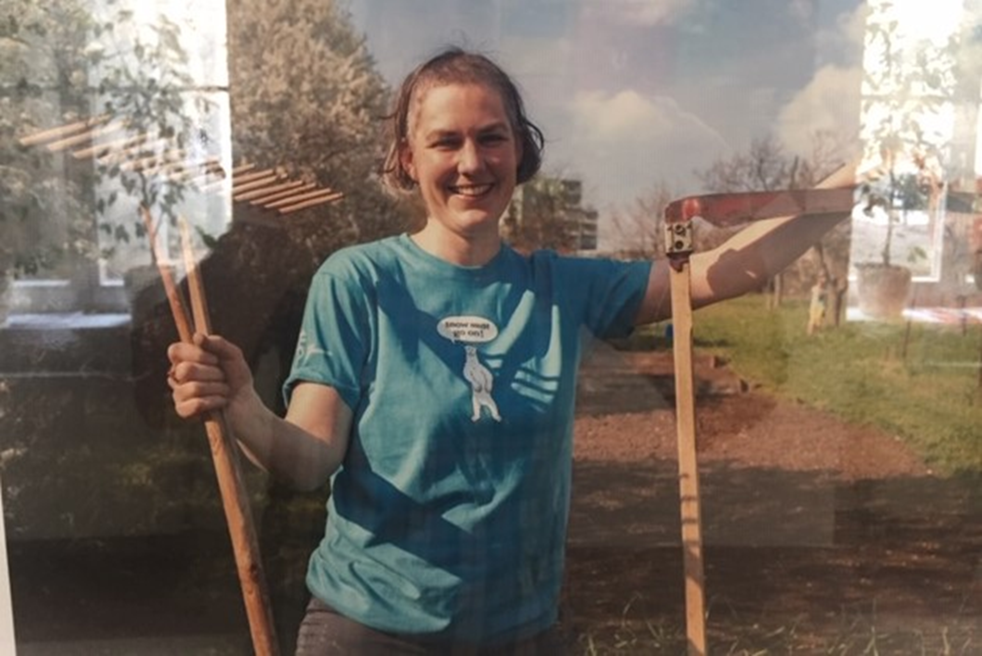
Course progression (2)
Session 3: Wed 2nd April, 8.00 (+/-)
Field trip to Tišnov – Think: clothing, money for train and lunch (ČzKR 50 in cash).
Session 4: Thur 3rd April, 2.00
Rural focus. AFNs revive cultural landscapes to develop solidarity-based models. Helena Továrková, Veronica Foundation.
Session 5: Friday 4th April, 8.00
Student group presentations.
By 11th April – 500 words on the presentations to me to mark.
Notes:
6

Slide 7
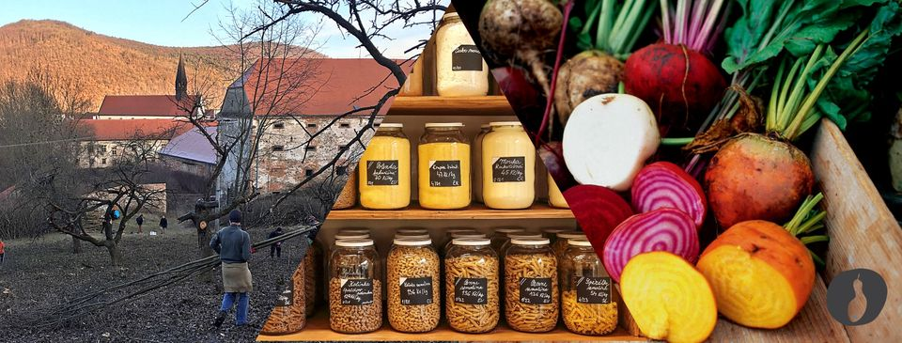
Field trip
Excursion to Tišnov. Tour of gardens by Tereza Kuhlánková from Hojnost + work + lunch.
Bring sturdy shoes and coat. 20 minutes walk each way.
The weather forecast is… Train time from Brno n.l. is 8.51
Notes:
7

Slide 8
Sustainable food – research task
Food diaries – change from previous years; MUNI’s assessment needs.
Review of scholarly papers
Authors | Subject | Journal
Brunori et al. 2016 | Comparing the sustainability performance of local and global food chains for certain foods. | Sustainability
Lang and Barling 2014 | The case for a sustainable diet: debates and challenges. | Development
Svobodová et al. 2021 | Food self-provisioning in S. Moravia compares rural & peri-urban residents. | European Countryside
Diekman et al. 2020 | Social benefits of urban food systems | Frontiers in Sustainable Food Systems
Keech et al. 2025 | Localising school food supply with digital technology | Food and Food Ways
Notes:
The purpose of this exercise is to illustrate how sustainability is problematised in different ways by scholars. It will also promote team work and reviewing/summary skills, which are necessary in scholarly research.
8

Slide 9
Instructions
Read the abstracts (summaries) of all five articles – this will help you consider which one you are most interested in.
Talk to others – can do it in class, or you can arrange privately – get into groups of 4 (or 5 maximum). Select one article.
As a group, prepare a presentation about the paper of your choice. What is it about? What debates about sustainable food does it illuminate? What methods are used to do this? What do you think of it? Have you got any critical reflections? Approach it in sections, each person speaks.
Presentation on Friday 4th in class (powerpoint, poster?)
By 11th April each group needs to have converted the presentation into a short word text (500) words. Four sections: intro, method/literature, results, critical reflections or areas of future research.
Notes:
The purpose of this exercise is to get students to reflect on what social, cultural, political, ethical… values they attach to food in theory. On Friday we will recall this exercise when students present their diaries.
9

Slide 10
Any questions/comments so far?
Notes:
10

Slide 11
Another example - Food diaries
Food diaries are highly useful ways of gathering research data in fields including psychology, marketing, cultural geography, sociology, nutrition. For example:
Harrington et al. 2001 – comparison between eating habits in the north and south of Ireland
Bellisle et al. 2003 – dietary contrib’n of snacks vs. meals in France
Kniazeva and Ventakesh 2007 – symbolism of food in US
Brown and Paszkiewicz 2016 – role of food in Polish migrant journey
Sadella and Burroughs 1981 (quoted from Almerico 2014) – ‘People who eat fast food and synthetic food were classified as religious conservatives who often wore polyester clothing. Health food personalities were characterised as antinuclear activists… Vegetarians were likely to be … pacifists who drive foreign cars…’
Notes:
11

Slide 12
Research exercise
Keep a diary keep of what you eat from breakfast on Saturday 8th May until lunch on Thursday 13th May (hopefully started). When you are buying food and eating, what things do you look for, which contexts inform your actions?
The table shows some examples of considerations:
Preference | Reason | Indicator
I buy ready-meals. | I don’t enjoy cooking. | Cooking instructions
I buy the cheapest food available. | I am a student with not much money. | Price
I try to buy organic food. | I believe it’s better for your health. | Certification label
Notes:
The purpose of this exercise is to get students to reflect on what social, cultural, political, ethical… values they attach to food in theory. On Friday we will recall this exercise when students present their diaries.
12

Slide 13
Research exercise – food diary
Buying: What decisions were involved in making your purchases? Did you make any compromises or trade-offs?
Menu: What did you cook and eat and what decisions were linked to this (preferences, religion, memories, occasion)?
Consequences: Consider the sustainability issues of your meals and purchasing in this period. Food chains - human and non-human issues; lifestyle adaptations, tensions. We are not trying to define the ideal sustainable diet but to explore how sustainability affects the ways we eat.
Alternatives: What would you like to change if you could? How would you achieve that? What/who needs to act for changes to happen, in your opinion?
Notes:
13

Slide 14
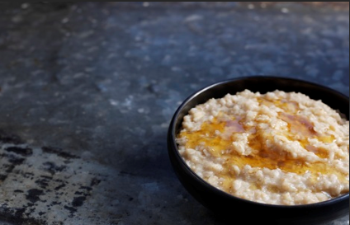
Example of food diary
record
Monday 24th April 2023
Breakfast – Tea, oatmeal porridge with honey.
Lunch – Vegetarian meal from university canteen: soup, potato salad and cheese sandwich. Chocolate bar.
Evening meal – Frozen pizza and frozen chips from the supermarket.
Comments – My aunt’s honey. Always buy fair-trade tea. I’m a vegetarian. Just can’t resist chocolate! Quick evening meal, I am meeting friends tonight. Afternoon coffee plus rhubarb cake at new local produce street stall run by people I know. (for example)
Pic: https://www.jordanscereals.co.uk/news/a-short-history-of-porridge
Notes:
The exercise is intended to reveal a number of influences on food intakes and purchasing decisions. In this case, fair-trade coffee displays ethical concern for distant commodity farmers; evening meal is likely to be high in fat and suggests familiarity with Italian foods (see lunch). Vegetarianism may be a political choice.
Chocolate cake may carry guilt associations, unlike the coffee. Support for acquaintances shows social structures in some market situations. Tues is not a day for food hedonism, or perhaps reflects work-life balance issues.
14

Slide 15
Food diary verbal report
This is based on your diary in the form of an oral presentation to the rest of the group. Need to divide into groups.
Can be simply speaking, power-point, phone video, excel sheet… all this is fine. But draw out critical questions or dilemmas which you have encountered or find interesting. For example:
Health: do labels influence your choices? How?
Environment: did you throw lots of food away? Packaging?
Ethics: fair-trade is essential; or an apology for neo-liberalism…
Meat: climate disaster; or a way to save cultural landscapes…
Social: no fresh fruit and veg in my neighbourhood; grow my own…
Lifestyle/gender – class of 2016… vegan/protein and changing trends class of 2013 (home), 2018 (cafes)
Economic: does sustainable food cost more?*
Has COVID changed what you would normally do?
Be as honest as possible – this is data collection, not an ethical contest.
Notes:
A note on price. Students are not usually rich. Furthermore we are all experiencing food price inflation linked to energy price rises and the Ukrainian war. So these are new challenges for us when thinking about feeding ourselves. But it would be useful if you could think broadly about the role of price. Don’t just say: if I had more money, I’d buy more organic food. What is perhaps more interesting is what strategies you employ to balancing price and your preferences.

Slide 16
Working together this week
Please feel encouraged to interrupt at any time. Demand clarity.
Have you got more/alternative/contrasting examples to complement the case studies? Please contribute. I’m working in UK/Europe.
Support one another. Be respectful. You have to work together.
Think about Friday – you know what to do?
If there are problems talk to me after the class (or Nadia).
Please attend all sessions!
Notes:
Please attend all sessions.
You will need to get into groups to do the assignment. We’ll review this process in a moment.
Do join in. Use your voice. Don’t be silent. Your opinion counts. Can you offer similar/different examples? What about Czech or Slovak case studies (Hoštetin or Hustopeče?)
We have a course structure, but please feel free to ask questions as they arise (use the chat, too); discussions may develop and be pursued where time allows.
I appreciate that English is not your first language and that my examples are often from UK/Germany.
16

