Slide 1


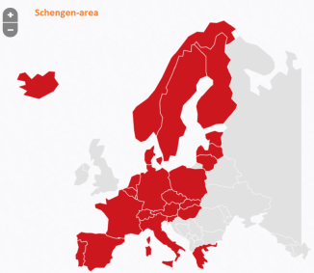
Justice & Home Affairs
EU External Border Control
          The policing of:
          44,000 km of external sea borders
          9,000 km of land borders
          hundreds of airports and maritime ports
          hundreds of millions of border crossings per year
          Assigned readings for this session:
          Peers (2011), pp. 178-200
          Ferraro & De Capitani, (2016), pp. 385–398
          Pacciardi & Berndtsson (2022), pp. 4010–4028
VIS
Eurosur
Integrated Border Management
Rabit Regulation
European Border and Coast Guard
Frontex
Schengen Border Code

Slide 2
Commission Communication
2004
EU Schengen Catalogue
2002
2002: exchanges on definition of ‘integrated border management’
  Council: ‘EU Schengen Catalogue’ (February 2002)
    focus on intra-state cooperation
  Commission: Communication ‘Towards integrated management’ (May 2002)
    focus on common EU instrument, “in the run-up to a European Corps of Border Guards” (Communication p. 12)

Slide 3
2004
Frontex
2006
Frontex established in 2004 by Council Regulation 2007/2004 (not – yet – EP)
  its main tasks:
    coordination of joint operations by member states,
    training of border guards,
    risk analysis,
    technical and operational assistance to member states, and support for member states in joint return operations

Slide 4
2004
Frontex
2006
JHA Council on IBM
2006
Further clarification of ‘IBM’ terminology in Council Conclusions (December 2006).

Slide 5
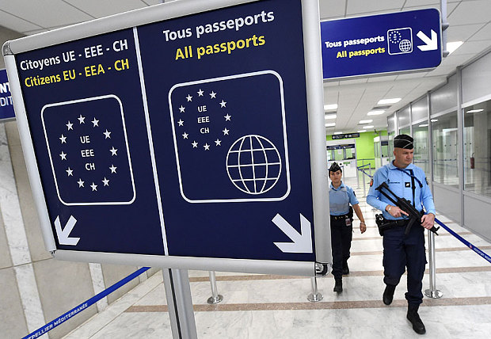
Council's idea of ‘integrated border management’
border control, including risk analysis and crime intelligence;
detecting and investigating “cross-border crime”
the four-tier/filter access control model;
inter-agency cooperation including border guards, customs and police, national security and military services; and
coordination between national and transnational level
Conclusion JHA Council 2006

Slide 6

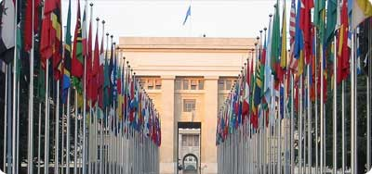
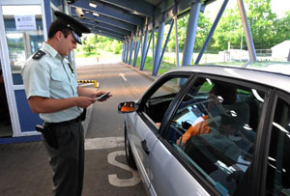

1
‘four-tiers’ approach: four-filter access
2
3
(mainly consular) activities in third countries
4
international border cooperation (with third countries)
checks and surveillance at external borders
activities inside the territory (limited “internal border checks”)

Slide 7
2004
Frontex
2006
JHA Council on IBM
2006
Further clarification of ‘IBM’ terminology in Council Conclusions (December 2006).
It was the go-ahead for:
  a common corpus of legislation;
  more operational capacity at EU level (i.e. Frontex)

Slide 8
2006
Schengen Borders Code
2007
Schengen Borders Code (Regulation 526/2006)
  rules on temporary re-introduction internal border checks
  entry conditions (valid visa, short-stay, long-stay, etc.)
  border checks on EU citizens
    ‘minimum checks' as a rule
  border checks on third-country nationals
    'thorough checks' as a rule
    conditions for relaxation of border controls (in case of intense traffic and excessive delays)
    very topical (because of Ukraine): the humanitarian exception clause
  rules on border surveillance
  operational coordination and cooperation

Slide 9
Schengen Borders Code
2007
2006
RABIT Regulation
2008
RABIT Regulation (863/2007) was first amendment of the 2004 Frontex Regulation
  it foresees in the creation of Rapid Border Intervention Teams from a pool of national border guard services
  in particular for surveillance of border lines between formal crossing points
  they are emergency border teams which can be called in by member states
  the first time a RABIT was invited by a state to assist was at the Greek Turkish borders in 2010

Slide 10
2008
VIS
2009
Visa Information System (VIS)
  VIS is established by Regulation 767/2008
  it is a large-scale IT system (containing biometric data) allowing Schengen States to exchange visa data, thereby facilitating checks and the issuance of visas

Slide 11
2008
VIS
2009
Lisbon Changes
2016
Lisbon Changes
  concept of 'integrated management’ system enshrined in TFEU
  art. 77(2)d: the EU can adopt “any measure necessary for the gradual establishment of an integrated management system for external borders”
  which proved to be the basis for upgrading Frontex

Slide 12
2016
EBCG
2016
EBCG
2017
EBCG (2016)
Regulation 2016/1624: upgrading of Frontex to European Border and Coast Guard (EBCG)
stronger coordinating power “placing it ‘functionally’ above the MS administration.” (Ferrara & de Capitani 2016: 393)

Slide 13

‘EBCG’ Regulation 2016/1624
It transformed Frontex “from an element of horizontal network to the core of hierarchically integrated structure.”
(Ferrara & de Capitani 2016: 392)
the 2015 refugee crisis was the catalyst for establishing EBCG
In case of “disproportionate” migratory pressure the Agency may, either at the request of EU country or on its own initiative, organise and coordinate rapid border interventions and deploy its own teams
EBCG staff would be more than doubled
ability to purchase own equipment and deploy it as it sees fit

Slide 14
2016
EBCG
2017
EBCG (2016)
Regulation 2016/1624: upgrading of Frontex to European Border and Coast Guard (EBCG)
stronger coordinating power “placing it ‘functionally’ above the MS administration.” (Ferrara & de Capitani 2016: 393)
Which also included availability of monitoring tools:
  “common integrated risk analysis model” (being less dependent on national analyses)
  vulnerability assessments (i.e. monitoring& assessing capacity and readiness of Member States

Slide 15
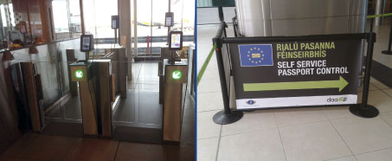
"Smart Borders" Package
Objective:
address the problem of bottlenecks at cross-border points (by introducing categories of ‘trusted traveller' , facilitating pre-screening procedures at consular posts, the use of automated border gates, etc.)
One of the initiatives: Entry-Exit Regulation (2017)

Slide 16
2017
‘Smart Borders’
2020
today
IBMF & revison SBC
Integrated Border Management Fund (IBMF) a financial instrument for supporting border management
is allocated € 6,5 billion (for 2021-2027 period)
EU Summit February 2023:
  with the MS in want of even more EU money for financing external border policing
  revision of the Dublin ‘first entry rule’ (into redistribution system based on quotas) has chance to materialize

Slide 17

Implementation mainly deals with security perspective and intelligence-led policing
(Ferrara & de Capitani 2016: 396; see also: Hess & Kasparek 2017: 49-50)
Critical Issues
Even in the EBCG instrument, ‘integrated management’ concept still misses clarity and overarching strategy
(Ferrara & de Capitani 2016: 387)
Weak implementation of ‘integrated’ management
Focus on security
weak implemen-tation of ‘integrated’ management
Yet, MS objective is preventing migrants from reaching the EU’s territory by irregular means
However, the ‘Smart border package’ indicates also facilitation of legal migration through development of traveller-friendly services
Still not clear how responsibility should be shared
There is no financial overview
Therefore, no capacity to calculate and share costs “fairly” between all member states (Ferrara & de Capitani 2016)
Border management should be targeted at checking whether persons meet the entry requirements established by law
Focus on security
A compensatory mechanism under construction (IBMF)

Slide 18
Leading statement for in-class debate of tomorrow:
Europol should acquire more operational powers.

Slide 19
Leading statement for in-class debate of today:
Member states should be allowed to (continue to) externalize reception and registration in neighbouring (third-state) countries

Slide 20
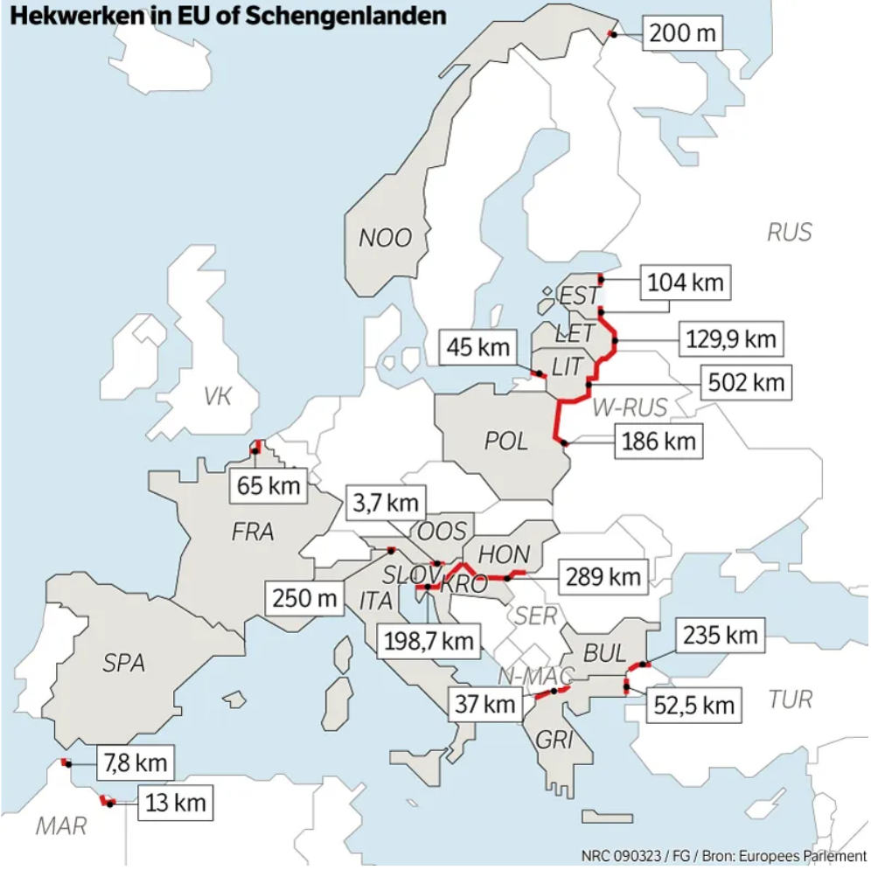
The 2022 shift in discourse: ‘fences around Europe’

Slide 21
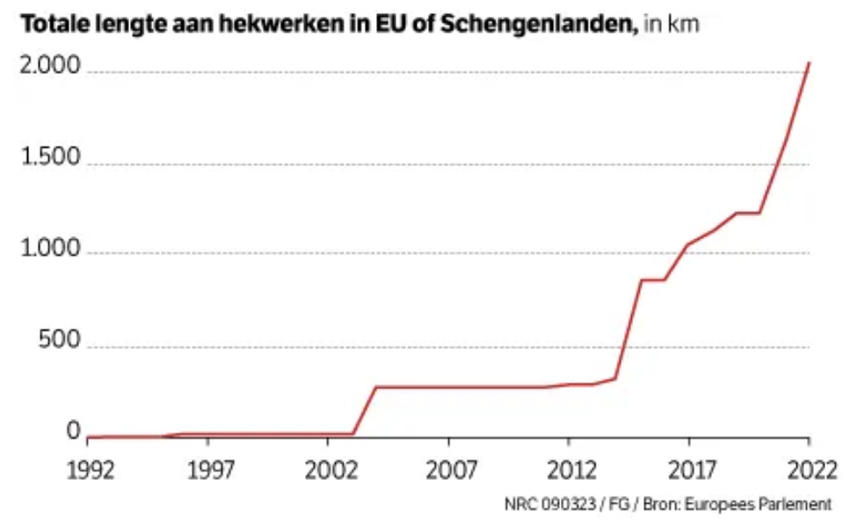
The 2022 shift in discourse: ‘fences around Europe’

Slide 22
Extra info on ‘hotspots’
  ‘Hotspot’
  ‘Relocation’
  ‘Pushback’
  externalization by member states of reception and registration in neighbouring (third-state) countries.

Slide 23
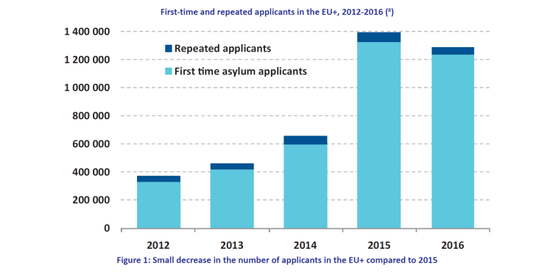
Refugee crisis 2015

Slide 24
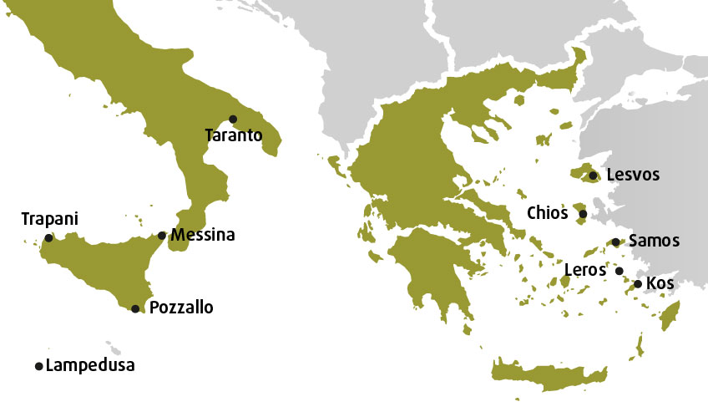
Creation of ‘Hotspots’
Source: European Agency for European Rights, ‘Map of hotspots in Greece (5) and Italy (5) as of February 2018’

Slide 25

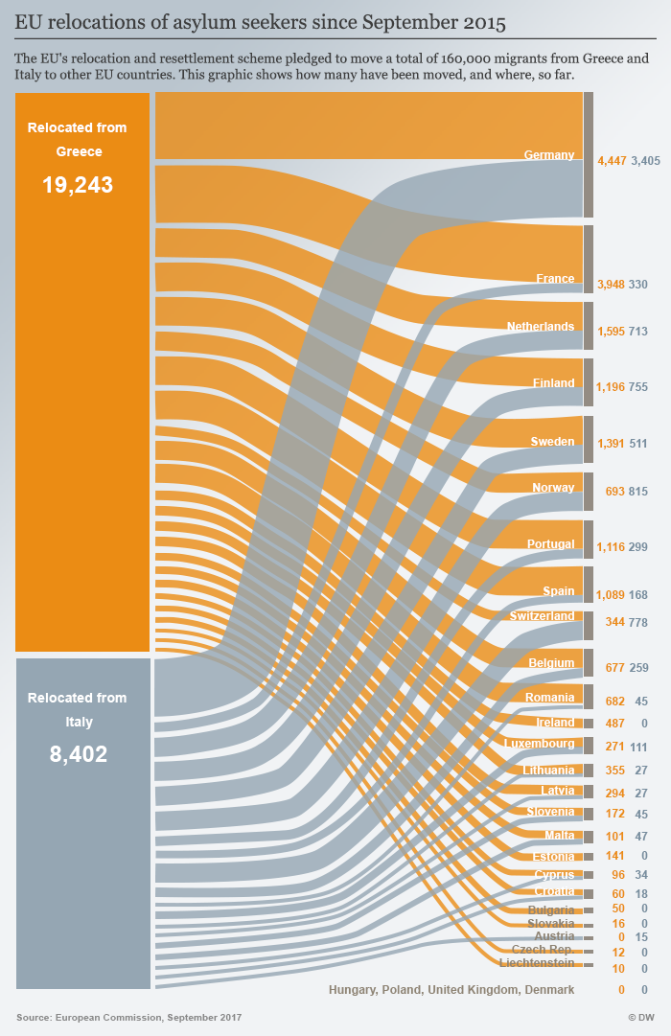
2015 Relocation Plan

Slide 26
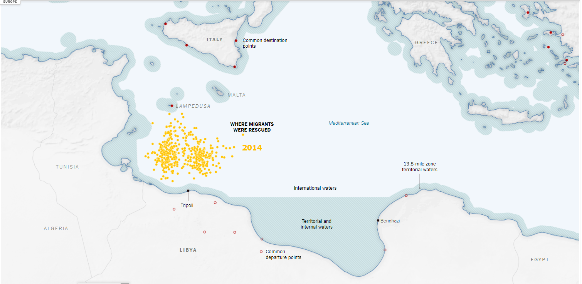
Before 2014, rescues took place closer to Italy, with migrant boats traveling as far as Italian water. By 2014, many rescues were occurring farther sought in the Mediterranean.
Source: Stuart A. Thompson and Anjali Singhvi, ‘Efforts to Rescue Migrants Caused Deadly, Unexpected Consequences’, The New York Times, June 14, 2017

Slide 27
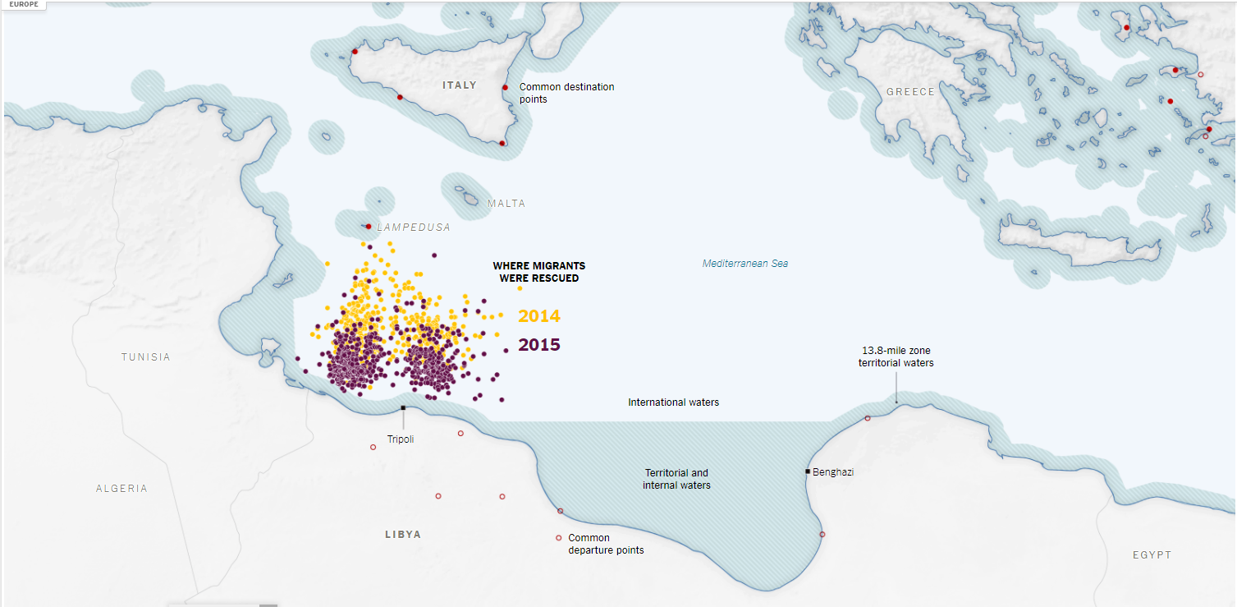
By 2015, rescues reached even closer to the Lybian side of the Mediterranean Sea
Source: Stuart A. Thompson and Anjali Singhvi, ‘Efforts to Rescue Migrants Caused Deadly, Unexpected Consequences’, The New York Times, June 14, 2017

Slide 28
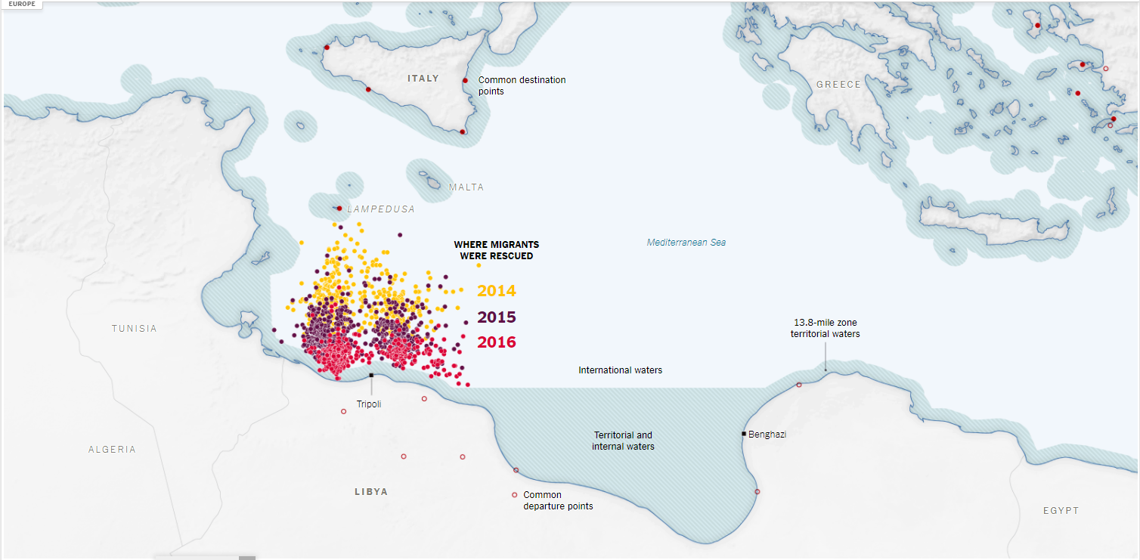
More recently, rescues reached were taking place closer to Lybian territorial waters.
Source: Stuart A. Thompson and Anjali Singhvi, ‘Efforts to Rescue Migrants Caused Deadly, Unexpected Consequences’, The New York Times, June 14, 2017

Slide 29
END
  Santino Lo Bianco PhD
  Email: santinolobianco@outlook.com

