Slide 1
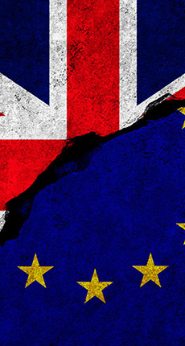

Justice & Home Affairs
‘Reintroduction of internal border checks
          Assigned readings for this session:
          Guild, Brouwer et al. (2015), 1-24- Brière, Chloé (2020)
          Cornelisse, Galina (2020)
Eurojust
visa, asylum & immigration
Justice Cooperation in criminal matters
Police cooperation &
Europol
European Arrest Warrant
Frontex
Dublin Regulation

Slide 2
Reintroduction of internal border checks
2011
‘Franco-Italian affair’
2015
‘Franco-Italian affair’ (2011)
  Italian government issued Schengen visas to 25.000 Tunisians migrants following an uprising in Tunisia
  France temporarily closed its border with Italy in April 2011.
Consequently, Schengen Border Code was revised in 2013 (artt. 23-25):
  providing grounds and time limits under which Schengen states are entitled to introduce intra-state border controls on persons
  tasking the Commission with the evaluation of reasons and applications of these emergency measures

Slide 3
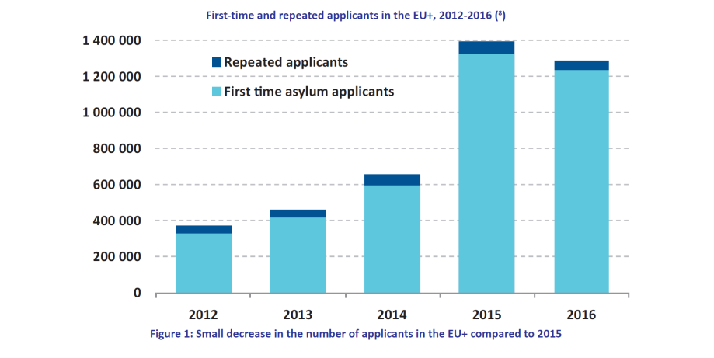
Reintroduction of internal border checks
2011
‘Franco-Italian affair’
2015

Slide 4
Germany
1997
13 September 2015
13 September 2015: German temporary reintroduction of border controls
  controls at the German-Austrian land border
  justification: “uncontrolled and unmanageable influx of third country nationals affecting public order and internal security”
  on 12 October a prolongation of temporary controls was announced

Slide 5
Germany
15 September
13 September
Austria
16 September
15 September 2015: Austrian temporary reintroduction of border
  Justification: mass inflows and the security challenge it presented (overburdening the police, emergency services and public infrastructure)
  controls at the borders with Hungary, Italy, Slovenia and Slovakia
  two subsequent prolongations – for 20 days (under Articles 23 and 24 SBC)
  Austria provided in an annex a list of all designated border crossing points as required by Article 23 SBC

Slide 6
16 September
Slovenia
12 November
16 September 2015: Slovenian temporary reintroduction of border controls
  Justification: uncontrollable migration flows
  On 24 September Slovenia prolonged for a further 20 days

Slide 7
16 September
Slovenia
12 November
Sweden
25 November
12 November 2015, Sweden: immediate and ex-tended border controls
  justification: serious threat to public policy and internal security resulting from the unprecedented migratory pressure and “ensuing significant challenges to the functioning of Swedish society” (strains on housing, health care, schooling and social services)
  controls were extended until 11 December

Slide 8
25 November
Norway
13 November
25 November 2015: Norway reintroduces border controls the following day
  justification: unpredictable migratory flows amounting to a serious threat to public policy and internal security
  controls were extended until 26 December

Slide 9
25 November
Norway
13 November
France
2010
On 13 November France reintroduces border controls
  justification: security of conference on climate change from 13 November to 13 December
  these controls were retained after the attacks in Paris (of 13 November)

Slide 10
throughout second half 2015
Belgium, Denmark, Finland, Luxembourg, Netherlands and Switzerland did not introduce controls at their internal borders
  Belgium and the Netherlands intensified the (police) controls in the zones behind their internal borders
  in most of these cases economic and practical reasons influenced the decision not to introduce border controls
  “systematic controls at the highways between Antwerp and the Netherlands, at the borders near Basel and Geneva or at the Øresund Bridge would create massive congestion of cross-frontier workers commuting by car.” (Guild et al. 2015: 9)

Slide 11
2021
Since 2015, internal border controls have been reinstalled more than 80 times,
with Member States justifying these measures on account of
  secondary movements of migrants,
  the threat of terrorism and
  the situation at the external borders of the EU.
Then, in 2021, the Covid-19 pandemic introduced another reason: public health risk

Slide 12
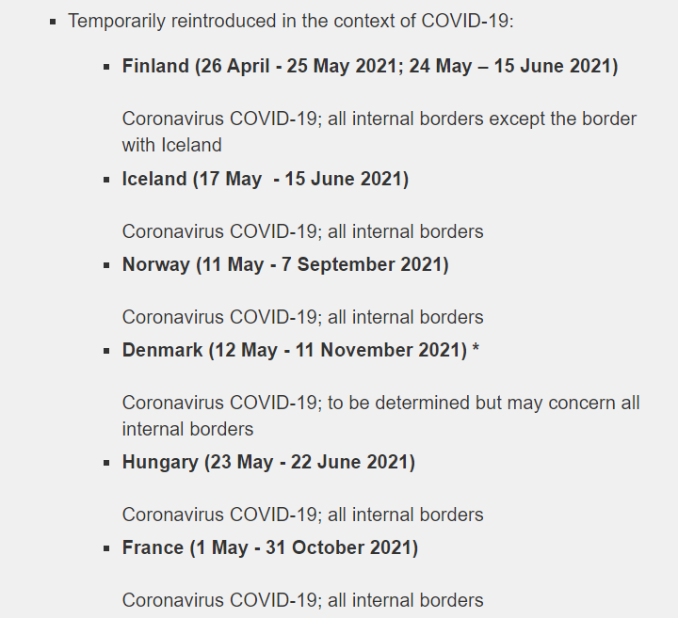
The ‘Covid Notifications’ of 2021

Slide 13
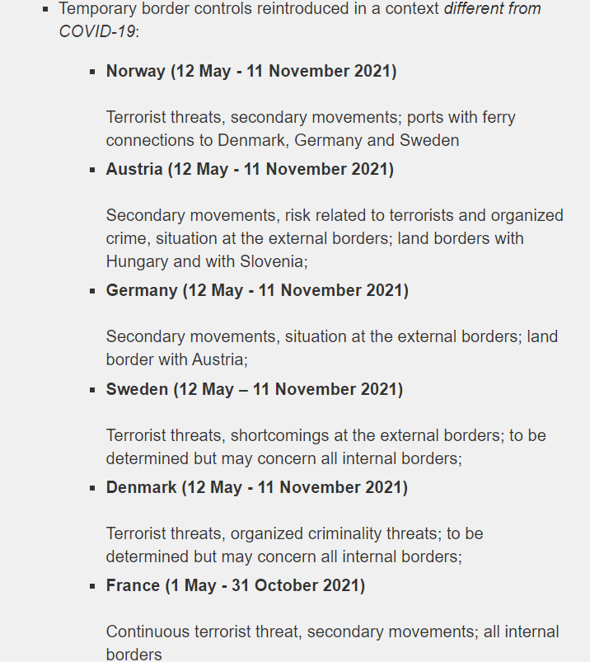
But also the ‘usual’ motivation (since 2015)

Slide 14
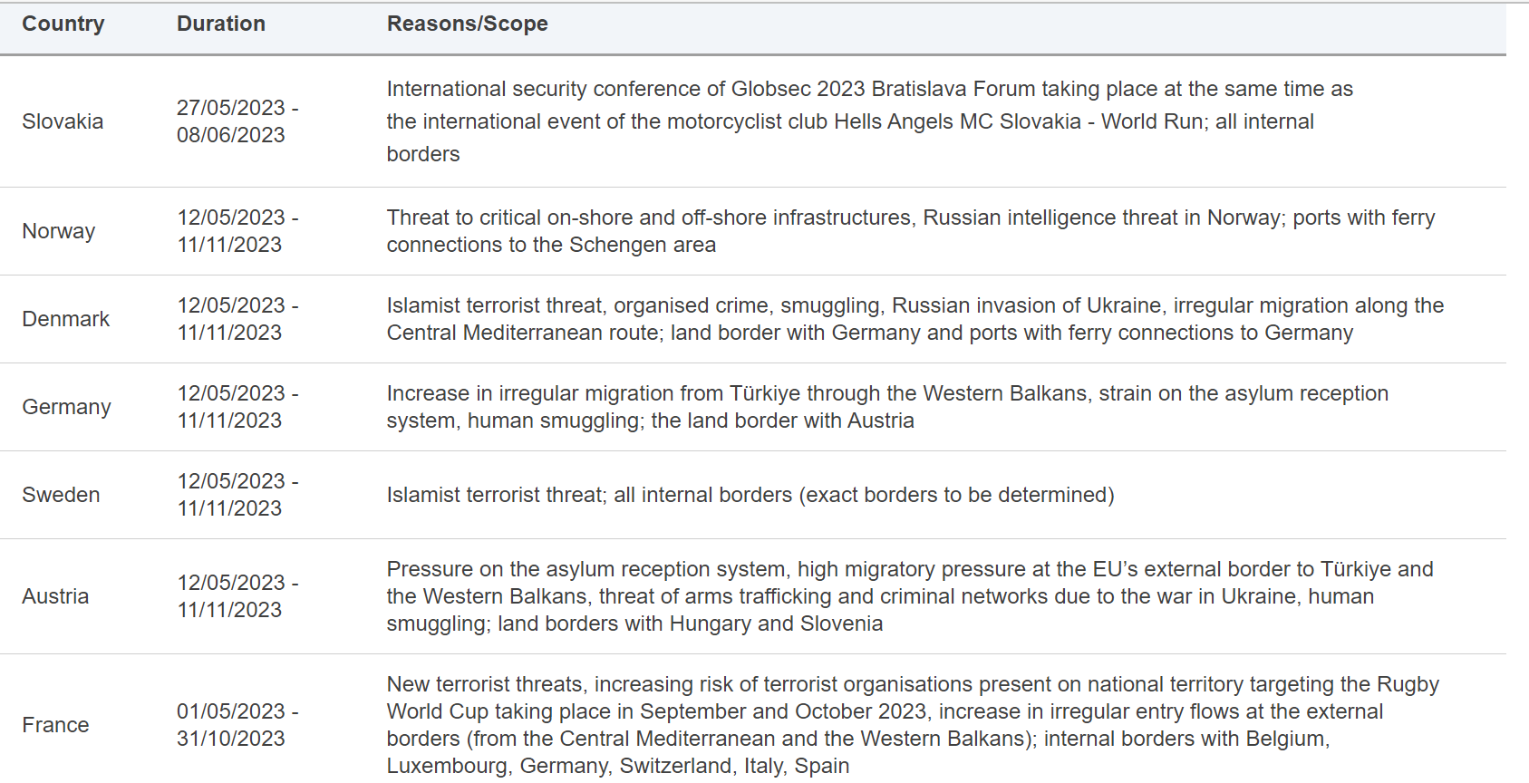
It has become ‘everyday practice’

Slide 15
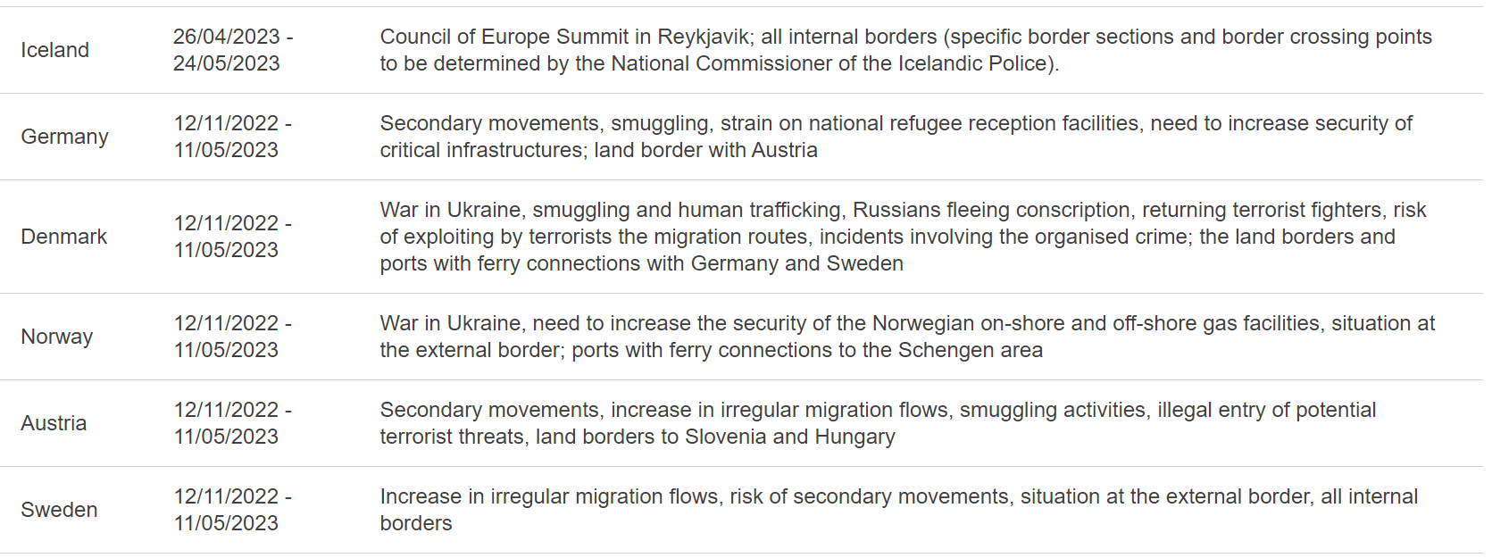
And it has become ‘everyday practice’

Slide 16
Reviewing the notifications
controls have overtly been reintroduced in accordance with EU law
Commission was, as evaluator, often sympathetic to the justifications (whether in relation to the extraordinary influx, perceived threats to public order, internal security or public health risks)
there are still points requiring attention, though
Point 3
Point 1
Conclusive Remarks
Point 2
the 2013 SBC expressly stipula-ted that “a large number” of refugees or secondary movements, as such, should not be considered a threat to security, even though it is widely used
Conclusion by Guild et al. (2015: 17): the overarching interest is “protecting the free movement of persons as laid down in Article 20 SBC, with only limited and conditioned options for internal border checks”.
even less convincing are justifications referring to hard security concerns (e.g. possibility of ‘radicalised people’ hiding among refugees or illegal migrants)
deployment of police checks in border areas raised the question what the difference is between police checks in border areas and border controls
Still, with the principled use of the “symbolism of Schengen” the Commission and EP are often outplayed by the pragmatic cost-benefit reasoning of the member states in the discussion on internal border checks (Cornelisse, 2020)
Commission proposes a strategy on the future of Schengen, scheduled for the second quarter of 2021

Slide 17
SBC revision of 2021
14 December 2021: proposal for a regulation amending SBC
The main elements of the proposal:
  A new coordination mechanism dealing with health threats
  A safeguard mechanism providing a common response at the internal borders in situations of threats affecting a majority of Member States
  Updated procedural requirements for reintroduction of internal border controls
  Promote the use of alternative measures (such as more operational police checks in border regions)
  Limiting impact of internal border checks on border regions – e.g. by establishing ‘green lanes’

Slide 18
Leading question for presentations of today’s lecture:
Should internal borders be reinstated
in the EU?

Slide 19
END
KONEC
  Santino Lo Bianco PhD
  Email: s.lobianco@hhs.nl

