Slide 1
Research design: The Basics
Andrew Roberts

Slide 2
Goals of this class
Acquaint students with research design and methodology
Basics and more advanced techniques
Emphasis on practical issues to help with dissertations

Slide 3
Structure
3 meetings including today
  Others include (i) regression, (ii) experiments, (iii) qualitative methods, (iv) causal inference
3 short exercises
I will also be glad to review methods sections of your dissertations

Slide 4
Tell me about yourself
Where are you from and what should I visit in your area?
What are your academic interests/ professional plans?
Give us a cultural recommendation that you love but we may not be aware of: book, film, TV, album…

Slide 5
About me
New Jersey, USA. Visit the Grounds for Sculpture in Hamilton.
Projects on billionaires in politics, how countries view each other, women in politics
Book: Lee, Pachinko
TV: Borgen
Album: Santigold

Slide 6
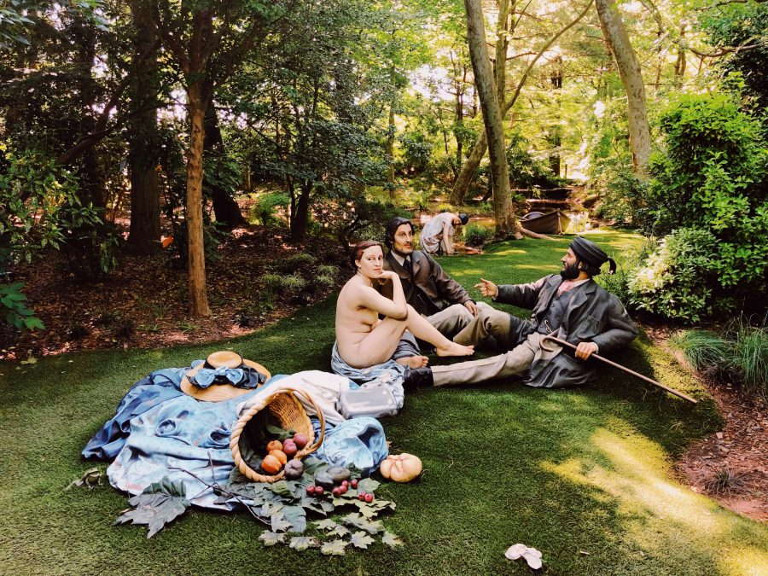

Slide 7
Topics
What are political scientists trying to do?
Fundamental problem of causal inference
KKV template
Ways of framing a research question
Inductive and deductive research
Quantitative versus qualitative research
Practical advice

Slide 8
1. What are political scientists trying to do?

Slide 9
Social science versus journalism
Quick journalism: Factoids
  95% of representatives reelected
Slow journalism: systematic gathering of data
  Reelection varies but increasing over time
Social science: causal mechanisms which explain patterns – causes & effects
  Economy better managed
  Growth of government: MPs can help constituents

Slide 10
Reelection rates in Congress

Slide 11
Scientific method
Question or puzzle: Why did that happen?
Theory or model: outcome as result of some process
Implications (hypotheses): what should we see if our theory is true
Test: are implications consistent with evidence; try hard to falsify

Slide 12
The goal of social science
The ultimate goal is causal inference
  Cause and effect relationships
Both qualitative and quantitative researchers agree
  Main dissent is from interpretivists
  Also political theorists do something different
Two elements in most projects
  Outcome/effect: dependent variable
  Cause(s): independent variable(s)

Slide 13
This is it
X → Y
Note: Of course, also much more complicated versions.

Slide 16

Why causality?
Understanding a phenomena means knowing what causes it (or its effects)
Causality is essential if we want to make interventions to save the world

Slide 17
But: very hard to show causality
Many studies do something else
  Description: finding trends & patterns
  Exploratory study to generate new hypotheses
  Creation of new concepts or typologies
  Descriptive inference: generalizing from sample to larger universe (surveys)
  Explore mechanisms of causal processes
But keep causality in mind

Slide 18
2. Fundamental problem of causal inference

Slide 19
The philosophy of causality
Causality related to counterfactual
  To say that X causes Y means that if we take away X, we don’t get Y
  “Not X” is the counterfactual
  Causal effect of a drug = health (with drug) – health (without drug)

Slide 20
Fundamental problem
We can’t observe both X and not X at the same time (even in experiment)
You either get the drug or you don’t
We never really know causal effect

Slide 21
Three solutions
Experiments
  Control group is counterfactual
Comparisons with observational data: countries or regions or groups or individuals
  Some are treatment, some are controls
Time series: a case changes over time due to some event
  Compare before and after an event
  Event is treatment that might cause change

Slide 22
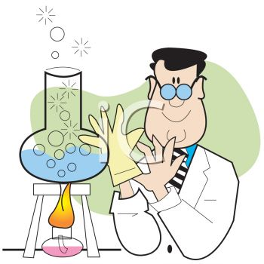
Experiment as gold standard
Assign subjects randomly to two groups
  One group receives treatment, other doesn’t
Any difference in outcomes should be caused by treatment
Types
  Lab experiments
  Survey experiments
  Field experiments
  Natural experiments

Slide 23
Observational data
Gather data from the real world
Try to determine if outcomes systematically related to key independent variable
  Eg, do more democratic countries tend to be richer than less democratic ones
  Eg, does external intervention lead to democracy
But lots of difficulties in showing causality
  Main ones: other possible causes & reverse causality

Slide 24
Internal versus external validity
Internal validity: extent to which we find a true causal relation in our cases
  Typically high in experiments because of randomization
  Lower with observational data
External validity: extent to which our finding generalizes to other situations
  Worry that low in experiments because situation is artificial and doesn’t apply to real world
  Higher with observational data

Slide 25
3. KKV Template

Slide 26
Where to start?
Let’s say we find a relationship or correlation between two variables, X & Y
  Eg, economic development & democracy
Does it mean that one causes the other?
Maybe, but correlation doesn’t equal causation
What can go wrong?

Slide 27
Nic Cage causes drowning?

Slide 28
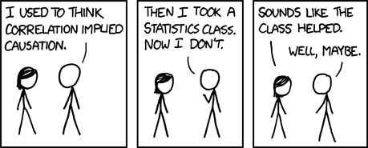

Slide 29
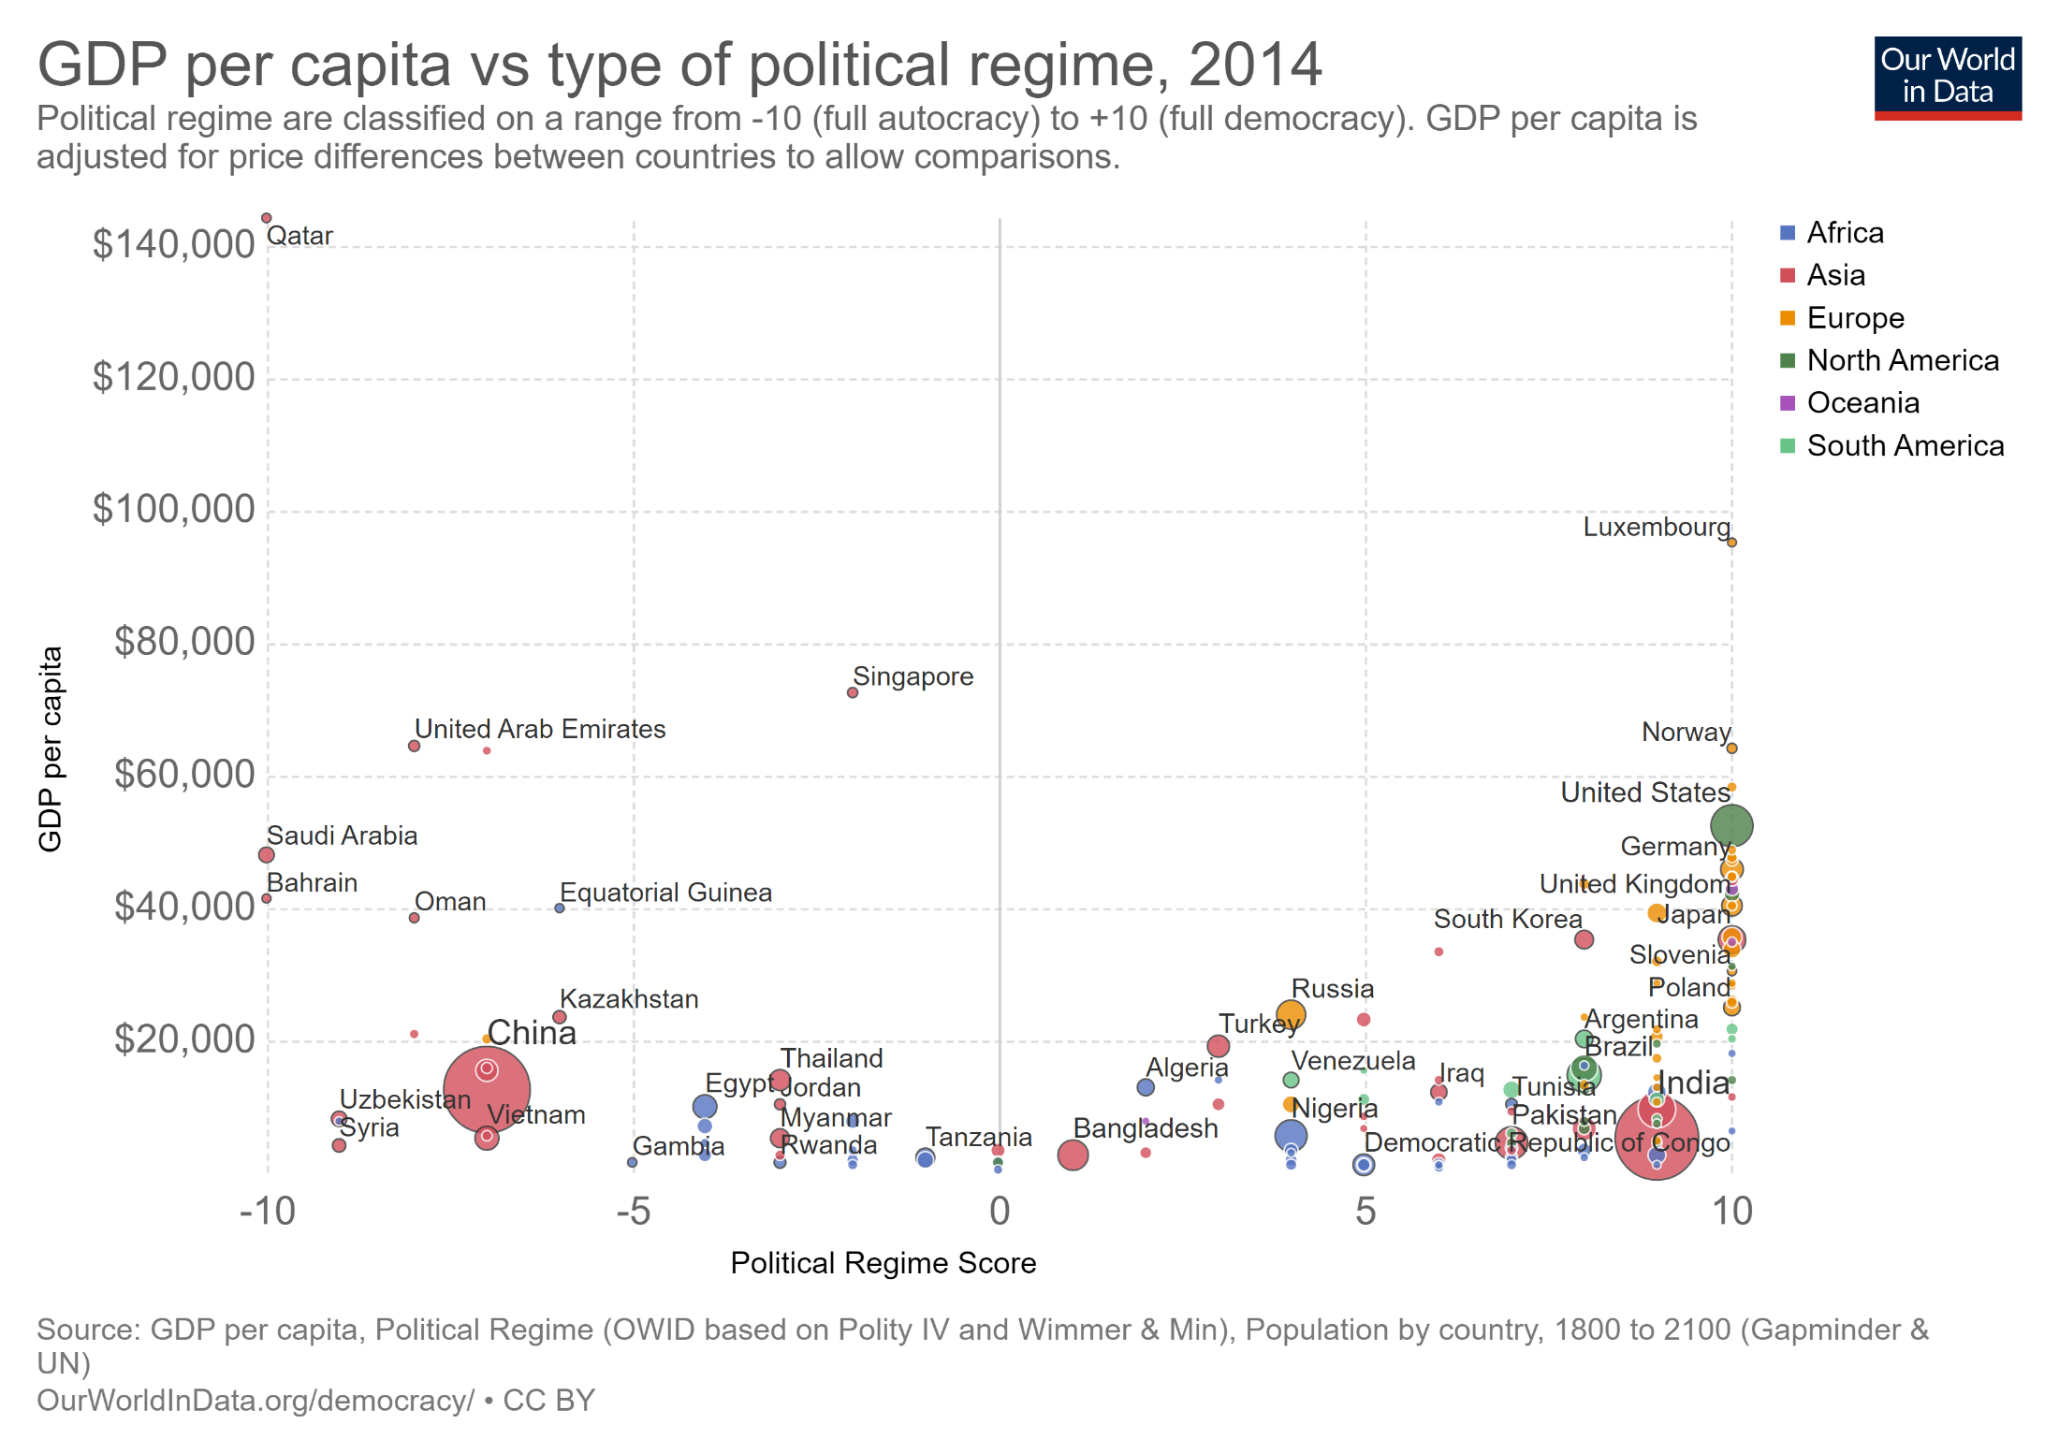

Slide 30
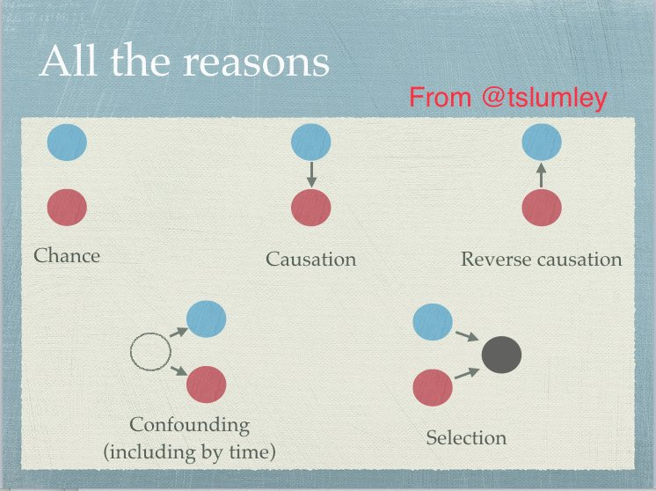
Potential explanations for correlation

Slide 31
Omitted variables
Is there another variable Z that causes both X & Y?
  What factors might cause both democracy & development?
Solutions
  Try to control for all of these variables – include them in your statistical or qualitative model

Slide 32
Endogeneity or reverse causality
Is it possible that Y causes X?
  Does democracy cause development or does development cause democracy?
Solutions
  Timing: X occurs before Y (but maybe previous value of Y causes X)
  Identify situations where X is exogenous
  Instrumental variables to create an exogenous X

Slide 33
Selection bias
Make sure that your cases include variation on the dependent variable
  Both successes and failures
  Try not to pick cases according to outcomes
If only successes, then can’t identify causes
  Can’t study causes of democracy by only looking at what democracies have in common
  You need to find what distinguishes democracies from non-democracies

Slide 34


Slide 35
Conditioning on a collider
Cases are selected due to independent variables
  Eg, there is no correlation between height & success in the NBA
  NBA teams choose players based on height & other factors like talent
  If we focus on entire population, we see that height increases basketball success
Be careful of the selection rule for a sample

Slide 36
Potential explanations for correlation

Slide 37
Mechanisms
Also useful to have evidence of a mechanism in order to demonstrate causality
How exactly does X cause Y?
  What are intermediate steps?
  Do we have evidence for them as well?
Relationship between economic development & democracy work through education, middle class, etc.

Slide 38
Does development cause democracy?
Omitted variables: culture, geography, etc.
Endogeneity: can democracy cause development?
Selection: are we looking at all countries & all time periods?
Mechanisms: how exactly does development cause democracy?
Measurement: how do we measure democracy & development

Slide 41
The big distinction: Experimental versus observational studies
Experiment usually solves these problems
But randomization uncommon in real world
  1st term of Czech Senate, reserved seats for women in India
Without randomization hard to show causality
Two options
  Search for natural experiments
  Do the best you can ☺

Slide 42
Even more worries
Key assumptions usually aren’t met in observational studies
Independence of observations
  Is each observation separate? (Eg, time-series)
Conditional independence of assignment and outcome
  Is assignment of cases to treatment and control unrelated to other factors that affect outcome?
Causal homogeneity
  Does politics work the same in CZ and US?

Slide 43
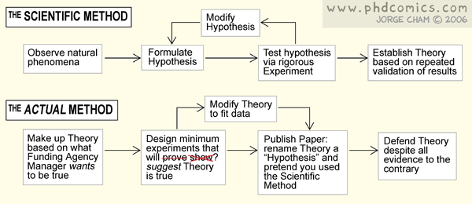

Slide 44
4. Ways of framing a research question

Slide 45
Two sorts of causal questions
Causes of effects – backwards causality
  Focus on outcome (=>Y) and work backwards
Effects of causes – forwards causality
  Focus on cause (X=>Y) and work forwards

Slide 46
Causes of effects
Examples
  Why do some people die from Covid?
  Why are some countries democratic and others not?
Advantages
  Most important questions in social science
  Good for identifying new hypotheses
Disadvantages
  Very hard to show causality
  Hard to eliminate other potential causes
  Big selection biases & endogeneity

Slide 47
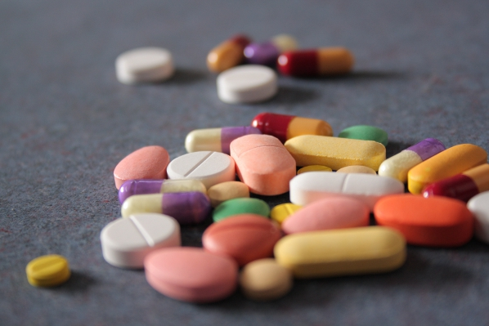
Effects of causes
Examples
  Does this vaccine prevent Covid?
  Do ethnic divisions hinder democracy?
Advantages
  Best way to get reliable inferences
  Approximates experimental design
Disadvantages
  Questions are limited

Slide 48
A useful exercise
What experiment would you conduct to answer your question if you were all-powerful?
  What is your treatment?
  How would you assign the treatment?
This often helps you to figure out how to conduct research in the real world
  Is there a natural experiment that approximates this hypothetical experiment?

Slide 49
Many conflicts due to different ?s
A forward causality project: does tutoring improve educational outcomes?
  Reverse causal objections: you are ignoring inequality, race and gender; does tutoring matter more than these things?
A backwards causality project: why are some students more successful than others?
  A forward perspective objection: how do you know that these factors are really causal?

Slide 50
Causality is not all there is
Systematic description
  Create new data
  Uncover new patterns and trends
Lots of areas where we know very little
Examples from my own work:
  What do millionaires think about politics?
  How much do billionaires participate in politics?
  Do women have different preferences than men?
  Are public preferences stable over time?

Slide 51
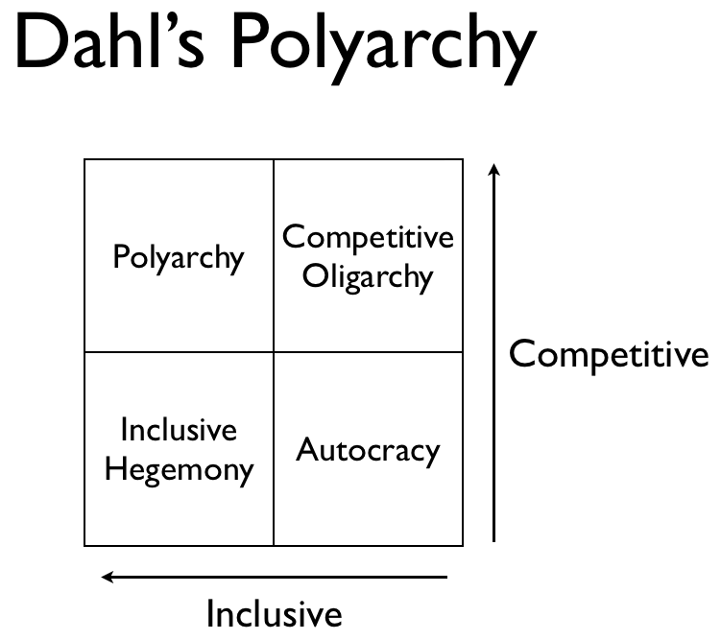
Also concept formation
See Goertz, Social Science Concepts & Collier et al., Putting Typologies to Work
  More on this next time
Often 2X2 tables but more elaborate ways
  Over-arching concept
  Row & column vars

Slide 52
5. Inductive & deductive

Slide 53
Deductive approach
Create a model of politics
Often start with assumptions about human nature plus set of constraints
  Goal-oriented behavior: office, power, ideology
  Instrumental rationality: actors do the best they can given information
Then logically reason to outcome

Slide 54
Voter turnout
Voters weigh costs and benefits when deciding whether to vote
  Costs of voting = time, energy, money
  Benefits of voting = benefit if your party wins (B) * probability that your vote matters (p)
Usually C > p*B (because p very small)
Implications
  Most people won’t vote
  Registration rules increase C => less likely to vote
  Closeness of election increases p => more likely

Slide 55
Criticism of deductive models
Unrealistic, over-simplification of reality
  Better just to look at facts
  But what are the facts? Which ones?
  How do the facts relate to each other?
But models a useful disciplining force
  Makes assumptions very clear
  Shows logic of connections
  Clear what is missing

Slide 56
Inductive approach
Search for patterns across independent and dependent variables
  Different countries, time periods, groups
Which independent variables related to dependent variable
But is this relationship enough?

Slide 57
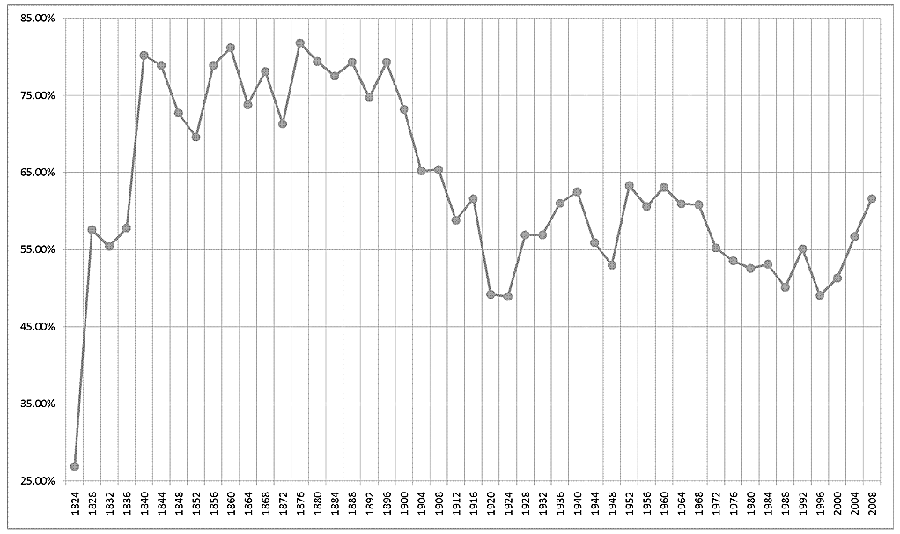
Consider election turnout

Slide 58
Potential causes
Election | Turnout | Closeness of election | Importance of election | Other things?
US – 2000 | 50% | Hi | No
US – 2004 | 56% | Med | Yes
US – 2008 | 57% | Lo | Yes
US - 2012 | 55% | Lo | No

Slide 59

Inductivist turkey
How to know whether association means causality?
Which variables to include?
  Which ones are important?
Never enough cases
Lacking a theory

Slide 60
Usually go together
Need a theory to prevent inductivist turkey
  Not just machine learning
Need data to keep theory tied to reality
  People vote more than theory predicts
  Add a civic duty term: p*B – C + D
Often go back and forth
Kant: percepts without concepts are blind, concepts without percepts are empty

Slide 61
6. Quantitative versus Qualitative

Slide 62
Two cultures?
Do qualitative and quantitative methods have different logics?
  KKV: single logic for all inference
  Mahoney and Goertz: two different logics

Slide 63
Approaches and concepts
Quantitative | Qualitative
Large # of cases Usually continuous measures | Small # of cases Often ordinal or cardinal measures
Goal = estimate size of average effects of independent variables on dependent variable, often effects of causes | Goal = fully explain causes of individual cases, typically causes of effects
Probabilistic conception of cause | Deterministic conception of cause: necessary and sufficient conditions Equifinality: multiple discrete causal paths

Slide 64
More qualitative specificities
Case selection focused on specific, positive cases
  Negative cases don’t tell us as much
  Some cases more important than others (eg, WWII)
Each case should be explained correctly
  Because causation is deterministic
Few cases => avoid causal heterogeneity
Sequences and pathways are important
More attention to concepts, revision of concepts

Slide 65
Data set (DSO) versus causal process (CSO) observations
DSO = Excel spreadsheet
CSO = insight or piece of data that provides information about context, process, or mechanism
  Eg, Nuclear taboo: documentary evidence that leaders thought about taboo
  Eg, Why do Latin American leaders switch to neoliberalism? Evidence that they spoke with international investors and got scared

Slide 66
Issues with qualitative template
Is social world deterministic or probabilistic?
  How many phenomena where cause is necessary or sufficient for outcome?
  “No bourgeoisie, no democracy”
Often simply historical or descriptive
Can it predict?
  Small scope conditions mean that inferences don’t apply outside of particular cases
Is it useful for making interventions?
  Can it tell us what we should do?

Slide 67
7. Practical Advice

Slide 68
What makes a good project?
An interesting empirical puzzle
  Differences in outcomes: why here, but not there
  Or why did things change: why then, but not now
Strong research design
  Natural experiment
  Great answer to less important question versus weaker answer to important question
New data
Policy & current events relevance

Slide 69
Be clear about your novelty
New question: nobody has investigated this dependent variable before
New theory: nobody has considered this hypothesis, independent variable before
New method: this method hasn’t been used and is better than existing methods
New data: I have created or gathered new data (eg, new country, new time period)

Slide 70
Construct falsifiable theories
Theory should have as many observable implications as possible
Hypotheses should be as concrete and specific as possible
  Best to list hypotheses: H1, H2, …
Make sure to consider other possible explanations in addition to your preferred one
  Try to create real contenders rather than “straw men”

Slide 71
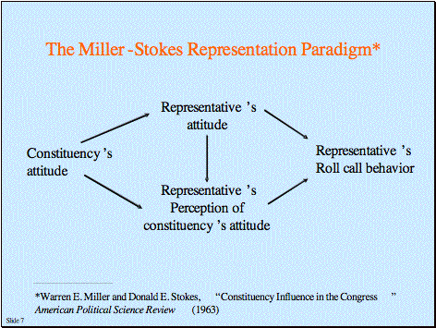
Arrow diagrams
When dealing with multiple variables, important to draw arrow diagrams
Few readers can follow a causal chain without a graphical picture

Slide 72
Create new data!
A new data set means an automatic contribution
  Simple descriptions of new patterns
Perfect for dissertation: requires lots of time and elbow grease
Likely to gain citations as others use it
To successfully reanalyze old data, you need very good skills

Slide 73

The quick and easy way
Find a really good published article
Apply its methodology to a new case (eg, CZ) or a new time period
  Recreate data in new case
  Use same technique of analysis
Voila!

Slide 74
Critique your own research design
Omitted variables: What other factors might affect X and Y?
Endogeneity: Could Y cause X?
Selection bias: Are observations chosen from full range of outcomes? If not, how to justify?
Mechanisms: What steps connect X to Y?
Measurement & conceptualization: Are measures & concepts valid and reliable?

Slide 75
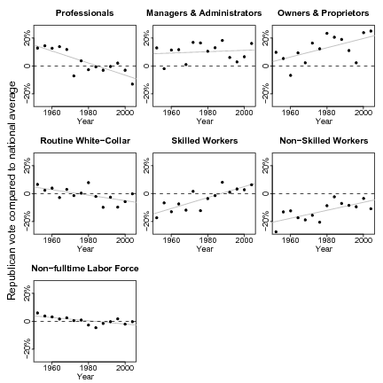
Cheap ways to impress
Lots of pretty graphics, not so many tables
  Figures in Stata or R
Use Latex as your word processor
  Nice typefaces, large margins

Slide 76
Real ways to be smart
Follow many political scientists on Twitter
Read outside of political science
  Psychology, Sociology, Economics, History
  Again Twitter and blogs
Take online courses: MOOCs, Coursera, etc
Learn lots of literatures
  Annual Review of Political Science/Sociology
  Journal of Economic Perspectives
  Oxford Handbooks of…

Slide 77
Next time
More advanced qualitative techniques
  Process tracing
  Structured, focused comparison
  Case selection techniques
  Concepts/typologies

