Slide 1
Permaculture
What it is and what it might have to offer a green economist

Slide 2
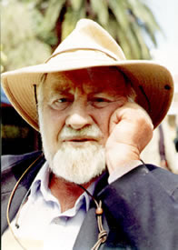
Definition
‘The use of systems thinking and design principles that provide the organising framework for implementing a vision of consciously designed landscapes that mimic the relationships and patterns found in nature’

Slide 3
‘Linear relationships are easy to think about: the more the merrier. Linear equations are solvable, which makes them suitable for textbooks. Linear systems have an important modular virtue: you can take them apart and put them together again—the pieces add up.
Non-linear systems generally cannot be solved and cannot be added together . . . Non-linearity means that the act of playing the game has a way of changing the rules . . . That twisted changeability makes non-linearity hard to calculate, but it also creates rich kinds of behavior that never occure in linear systems’
James Gleick, Chaos: Making a New Science

Slide 4
Traditional wisdom
‘Because of feedback delays within complex systems, by the time a problem becomes apparent it may be unnecessarily difficult to solve’
Translation: ‘A stitch in time saves nine’
A diverse system with multiple pathways and redundancies is more stable and less vulnerable to external shock than a uniform system with little diversity
Translation: Don’t put all your eggs in one basket

Slide 5
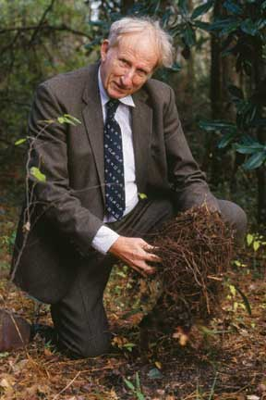
Howard Odum
Odum developed methods for tracking and measuring the flows of energy and nutrients through complex living systems
Ways of understanding the links between flows of money and goods in society and the flows of energy in ecosystems
‘industrial man . . . eats potatoes largely made of oil’ Environment, Power and Society, 1971

Slide 6
‘Odum proposed that a measurement of the amount of transformed solar energy embodied in any product of the biosphere or human society—for which he coined the term ‘emergy’—could provide a kind of ‘universal currency’ which would allow fair and accurate comparison of the human and natural contributions to any particular economic process. This approach was so original that it has still not been fully incorporated into thinking about responses to climate change, where understanding the embodied energy in products is arguably more critical than only considering the direct energy flows in electricity generation or the work of an internal combustion engine.’
Steve Harris

Slide 7
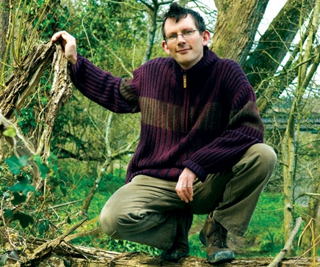
A Proto-Transitioner?
Devised the concept of an ‘energy descent’ in his final book A Prosperous Way Down (2001)
Economic values based on measures of the quantity and quality of embodied solar energy, rather than on monetary worth
Modern societies have reached the climax of a period of massive growth driven by fossil fuel energy: downturn is now inevitable

Slide 8
Permaculture is a way of looking at the world as a system and ‘creating sustainable human habitats by following nature’s patterns’ (Holmgren, 2002). It follows a series of principles that its proponents claim arise from nature, such as use and value diversity, produce no waste, and use small and slow solutions. It challenges the immediate rush to action that is the response of many to first learning about the environmental crisis and cautions, instead, that we should engage in maximum contemplation and minimum action. ‘Permaculture is not a set of rules; it is a process of design based around principles found in the natural world, of co-operation and mutually beneficial relationships, and translating these principles into actions.’

Slide 9
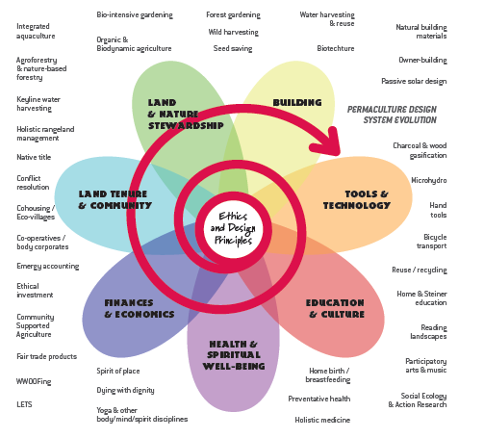

Slide 10
Permaculture principles
Observe and interact - By taking time to engage with nature we can design solutions that suit our particular situation.
Catch and store energy - By developing systems that collect resources at peak abundance, we can use them in times of need.
Obtain a yield - Ensure that you are getting truly useful rewards as part of the work that you are doing.
Apply self-regulation and accept feedback - We need to discourage inappropriate activity to ensure that systems can continue to function well.

Slide 11
Permaculture principles
Use and value renewable resources and services - Make the best use of nature's abundance to reduce our consumptive behaviour and dependence on non-renewable resources.
Produce no waste - By valuing and making use of all the resources that are available to us, nothing goes to waste.
Design from patterns to details - By stepping back, we can observe patterns in nature and society. These can form the backbone of our designs, with the details filled in as we go.
Integrate rather than segregate - By putting the right things in the right place, relationships develop between those things and they work together to support each other.

Slide 12
Permaculture principles
Use small and slow solutions - Small and slow systems are easier to maintain than big ones, making better use of local resources and producing more sustainable outcomes.
Use and value diversity - Diversity reduces vulnerability to a variety of threats and takes advantage of the unique nature of the environment in which it resides.
Use edges and value the marginal - The interface between things is where the most interesting events take place. These are often the most valuable, diverse and productive elements in the system.
Creatively use and respond to change - We can have a positive impact on inevitable change by carefully observing, and then intervening at the right time.

Slide 13
Industrial ecology
Industrial ecology provides a powerful prism through which to examine the impact of industry and technology and associated changes in society and the economy on the biophysical environment. It examines local, regional and global uses and flows of materials and energy in products, processes, industrial sectors and economies and focuses on the potential role of industry in reducing environmental burdens throughout the product life cycle. (International Society for Industrial Ecology website: http://www.is4ie.org/)

Slide 14
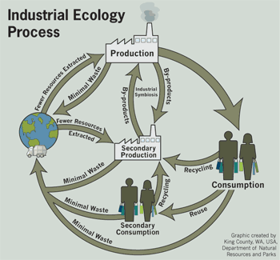

Slide 15
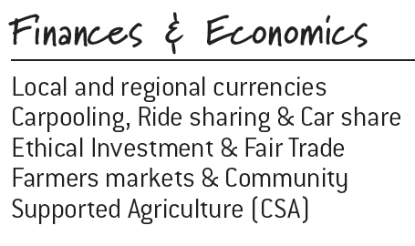

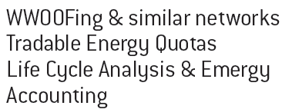
What permaculture says about economics

Slide 16
Life-Cycle Accounting
Applies systems thinking to a production process
Includes assessments of impacts in the product life-cycle outside the producing company
All costs and benefits throughout the life-cycle
‘cradle to cradle’

Slide 17
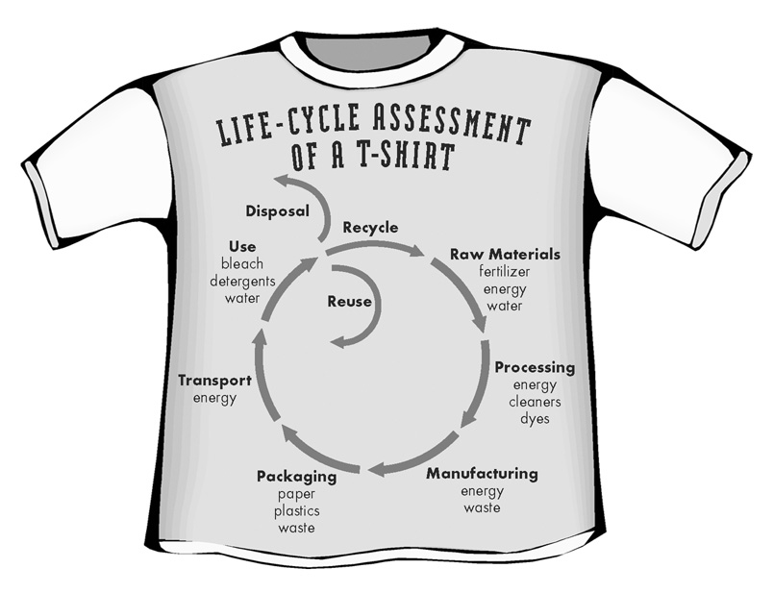

Slide 18
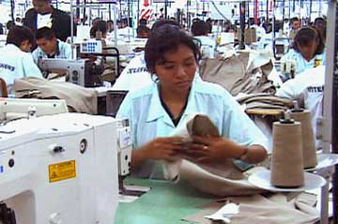
Products can be evaluated through each stage of their life-cycle:
    Extraction or acquisition of raw materials
    Manufacturing and
    processing
    Distribution and transport
    Use and reuse
    Recycling
    Disposal
For each stage, identify inputs of materials and energy received; outputs of useful product and waste emissions
Find optimal points for improvement –
eco-efficiency

Slide 19
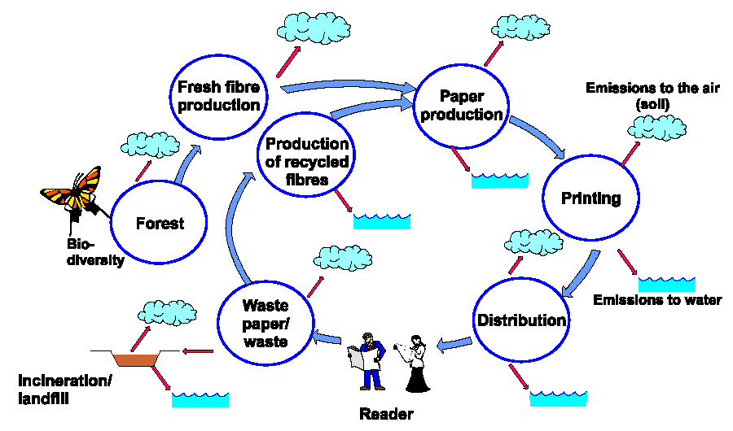
Identify the boundaries

Slide 20
Life-cycle consideration of a fridge
$
$
Disposal & Post-Disposal
Use
Acquisition
Acquisition
Refrigerator A
Refrigerator B
Refrigerator A
Refrigerator B
Purchase Price
Refrigerator A appears cheaper
Price + Life-Cycle Costs
Refrigerator B costs less overall

Slide 21
Regional Emergy Intensities

Slide 22
Agricultural Emergy Intensities

Slide 23
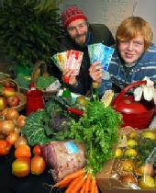
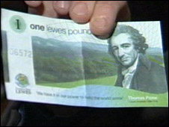
Use small and slow solutions - Small and slow systems are easier to maintain than big ones, making better use of local resources and producing more sustainable outcomes
Stroud pound vs. Lewes pound
Media and the importance of large
‘Is it working?’

Slide 24
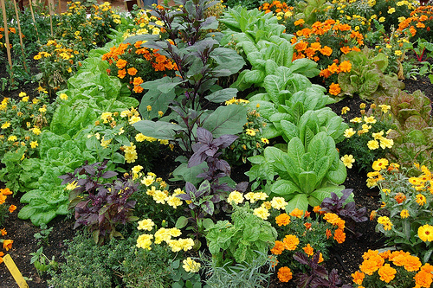
Integrate rather than segregate - By putting the right things in the right place, relationships develop between them and they work together to support each other
Companion planting
Cottage industry?
Synergy between different transition projects?
Local production, local currency, local markets

Slide 25

Design from patterns to details - By stepping back, we can observe patterns in nature and society. These can form the backbone of our designs, with the details filled in as we go
Can we use these principles in urban design?
What about Abu Dhabi?
What about Curitiba?

Slide 26
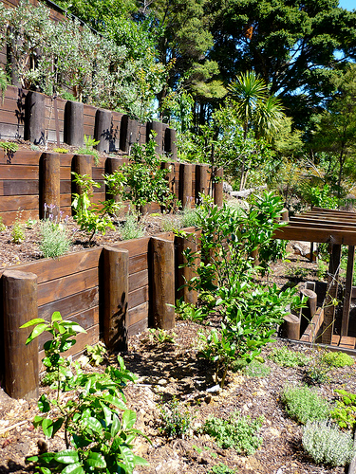
Use edges and value the marginal - The interface between things is where the most interesting events take place. These are often the most valuable, diverse and productive elements in the system
Concept of liminality
Creole cultures and music
Guerrilla gardening
Alternatives within capitalism, such as mutualism

Slide 27
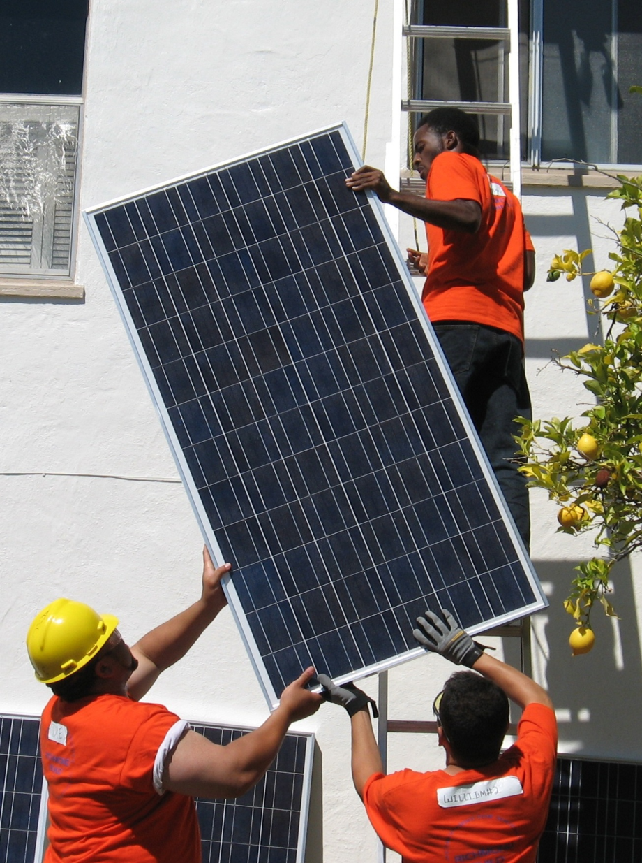
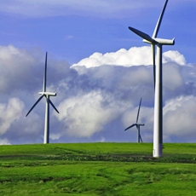
Choose three of the principles
Think how you might apply them to an economic system or process to make it more sustainable

