Slide 1

Transition Towns
Molly Scott Cato

Slide 2
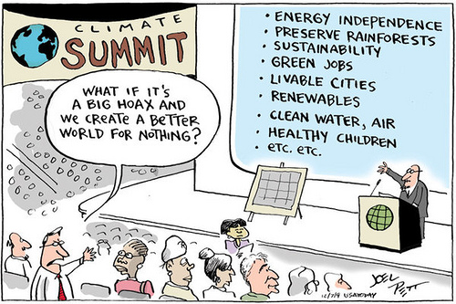
Living Experimentally

Slide 3
A brief history . . .
Transition Towns launched in Totnes in September 2006
  if we wait for the governments, it'll be too little, too late
  if we act as individuals, it'll be too little
  but if we act as communities, it might just be enough, just in time.
Transition Stroud launched in January 2007

Slide 4
Three key concepts
Resilience: ‘the property of a material to absorb energy when it is deformed elastically and then, upon unloading to have this energy recovered.’
Ecological citizenship: intrinsic and ethical motivations towards protecting the environment
Critique: the importance of political economy

Slide 5
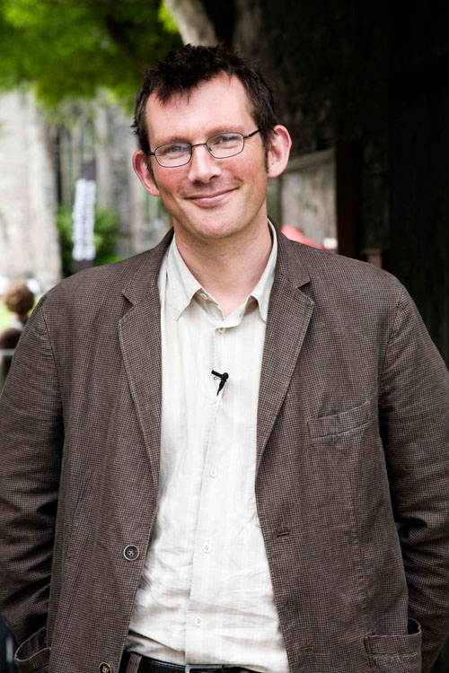
Psychological aspects
‘Moving from probabilities to possibilities’
http://www.youtube.com/watch?v=0q90_phxAOk

Slide 6
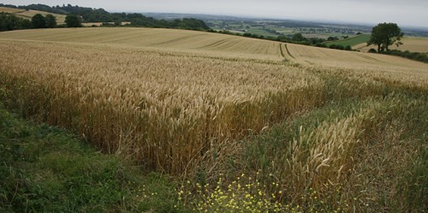
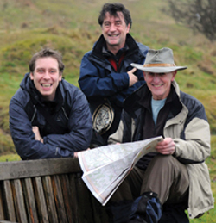

Locality: Walking the Land
Notes:
Landscape and walking provide the catalyst for Walking the Land’s creative activities. Based in the Gloucestershire countryside, Walking the Land comprises three lead artists, Richard and Tom Keating and Kel Portman. Each share a passion for the landscape, using artworks to bring landscape and environmental issues to a wider public audience. As painters, sculptors, photographers, videographers, curators and educators we produce work which refers to specific places, localities and environments.

Slide 7
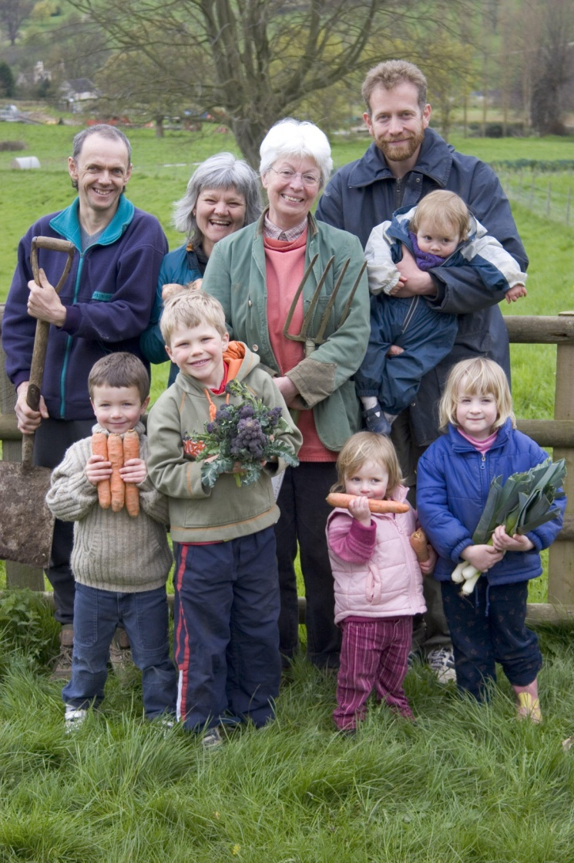
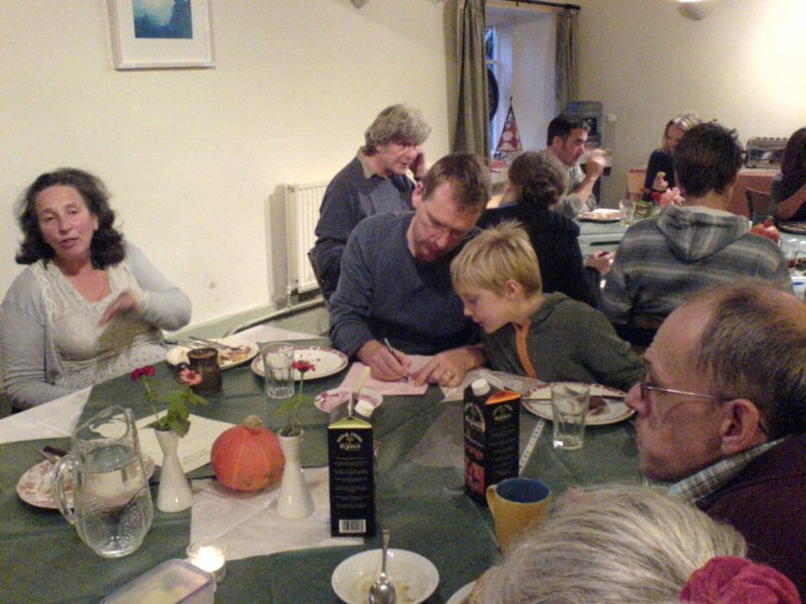
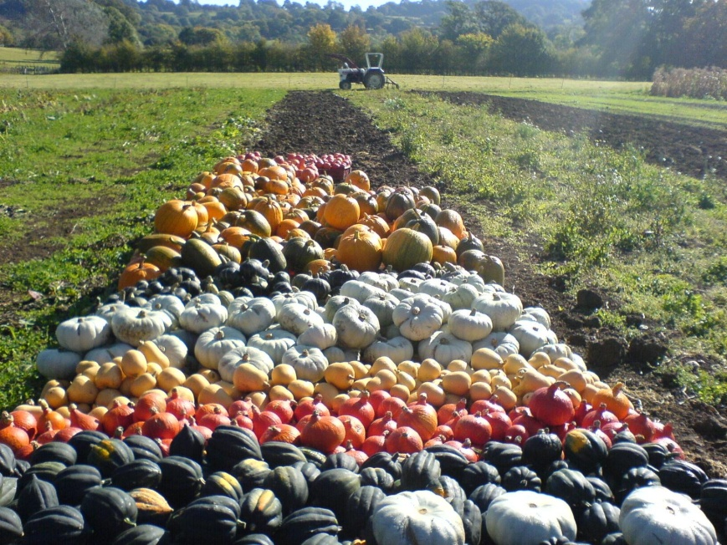
Accountability: Stroud Community Agriculture
Notes:
Built on cooperation and mutual support the risks and rewards of farming are shared between the farmers and consumers. The consumers commit themselves to supporting the farm and providing a fair income for the farmers. The farmers can then develop the health and fertility of the farm, its wildlife and environment. All the produce from the farm is shared between the supporting consumers or sold locally if there is a surplus. Rent 46 acres of land on two sites near Stroud. Feed 185 families throughout the year with seasonal organic vegetables.

Slide 8
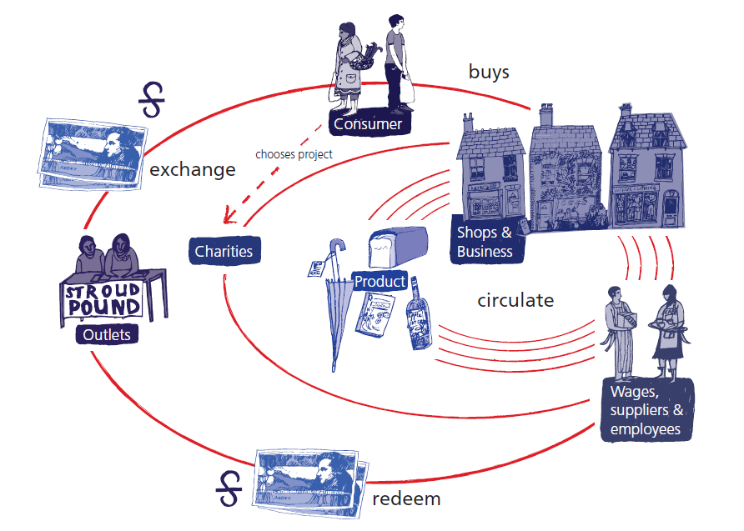
Community: Stroud Pound
Notes:
The Stroud Pound was launched in September 2009. In the first year a total of £10,066 were exchanged for Stroud Pounds. By the end of the year slightly over half of those (£5940) had been redeemed, which meant that £290 had been allocated to the ten local good causes which people had chosen. A year after the launch of the scheme SP4,126 were in circulation. The scheme had around 180 consumer members and 44 outlets or service providers where the local currency could be spent.

Slide 9
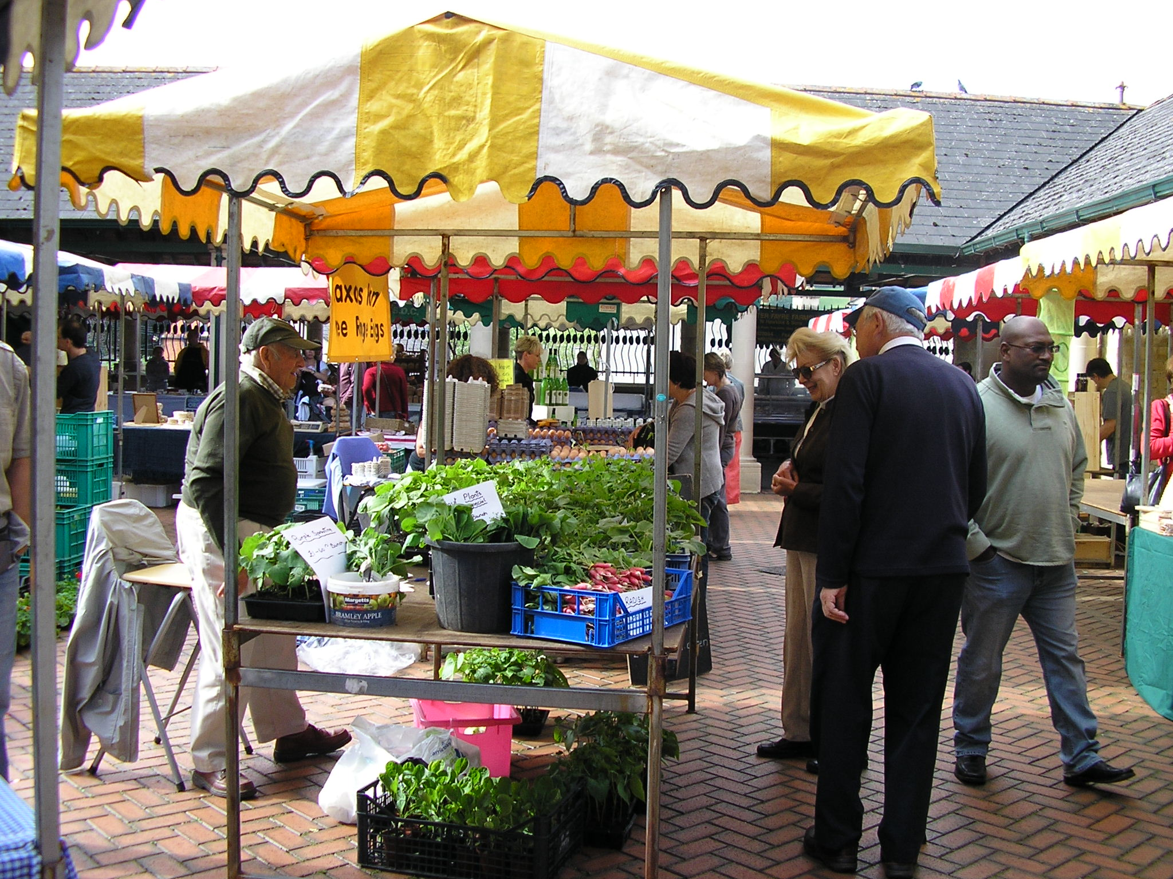
Conviviality: Stroud Farmers’ Market

Slide 10
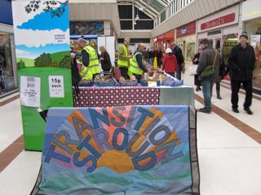
The Seeds of a Greener Future?
Notes:
Flourishing within limits
A new consumption ethic
Re-embedding

Slide 11
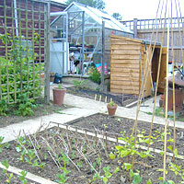


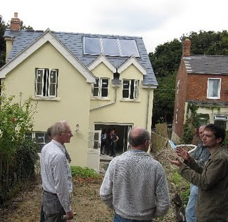
Open Homes and Gardens

