Slide 1
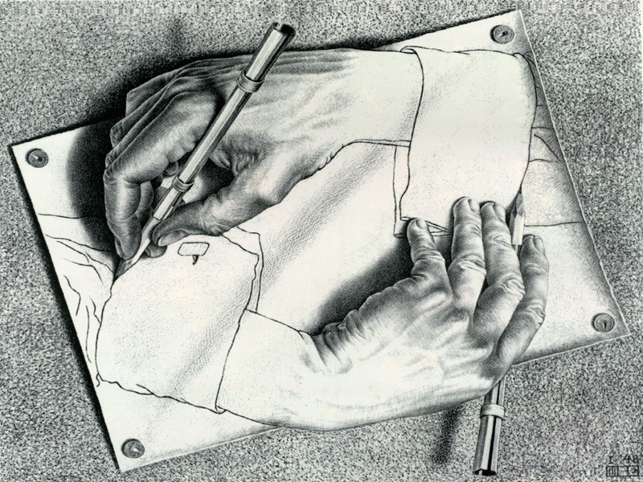
Cognitive psychology
Introduction to information processing
Michaela Porubanova

Slide 2
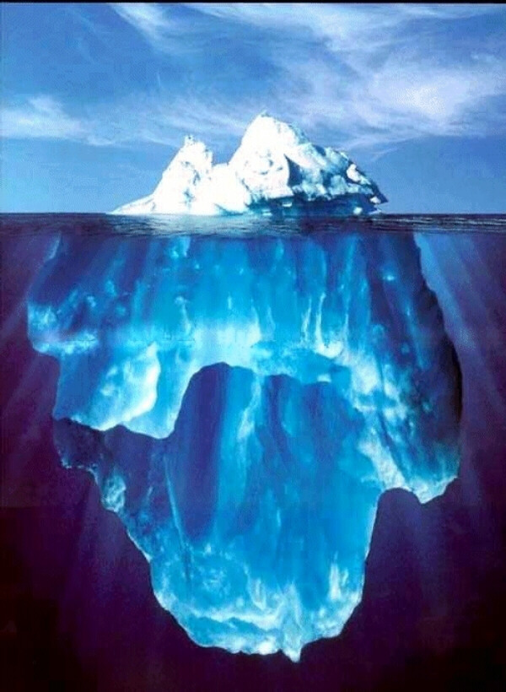

Slide 3
MIND
A mysterious form of matter secreted by the
brain. Its chief activity consists in the endeavor to ascertain its own nature, the futility of the attempt being due to the fact that it has nothing but itself to know itself with.
Ambrose Bierce, The Devil’s Dictionary

Slide 4

Intro to cognitive Ψ
Cognition
- cognosco (Greek)
Assumptions of C Ψ:
a, a human being is an individual, a subject that observes the world, anticipates, formulates hypotheses, plans, experiments, makes conclusions and via already acquired information adjusts to and forms it as well
b, mental processes and external behavior depend on information we acquire
c, an individual is influences by information stored in long-term memory

Slide 5
Goals and subjects of study in Cognitive psychology
to understand human cognition- how we process information (acquisition, storage, transformation, use of knowledge)
Subjects of study:
Perception
Attention
Memory
Thinking
Language
Reasoning and decision making
Consciousness
History:
-Aristotle
-Wundt
-Ebbinghaus
-behaviorism
-gestalt
-information-processing approach (comparison with PC)

Slide 6
Keep in mind (before we start)
1. The cognitive processes are active, rather than passive.
2. The cognitive processes are remarkably efficient (what about accurate).
3.CP handle positive information better than negative.
4. CP are interrelated with one another, they do not operate in isolation.
5. Many CP rely on BOTH bottom-up (importance of info from stimuli) and top-down (role of concepts, expectations, memory) processing (e.g. recognition of a familiar person)

Slide 7
Complexity of cognition.
Why would you say cognition is complex?

Slide 8
Brief history of CP
Cognitive psychology/ cognitive science
19 century- F.Donders- mental chronometry
60th “real birth” of CS

Slide 9
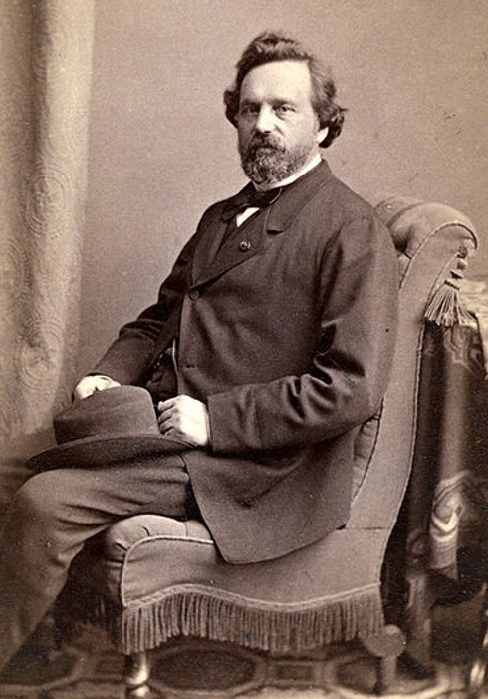
Franciscus Donders
1818-1889
Opthalmology
Reaction time measures
Simple RT
http://www.cogtest.com/tests/cognitive_int/srtflash1.html#top
Choice RT
http://www.cogtest.com/tests/cognitive_int/crtflash1.html#top

Slide 10
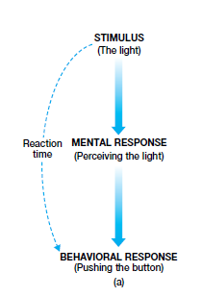

Slide 11
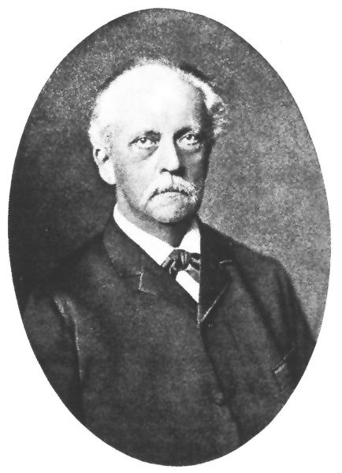
Hermann von Helmholtz
1821-1894
perception
theory of unconscious inference- role of experience in perception

Slide 12
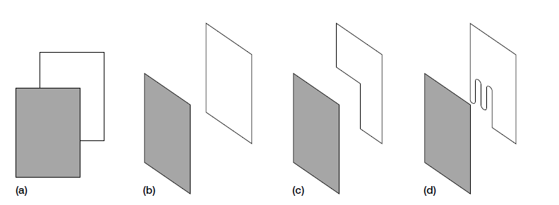

Slide 13
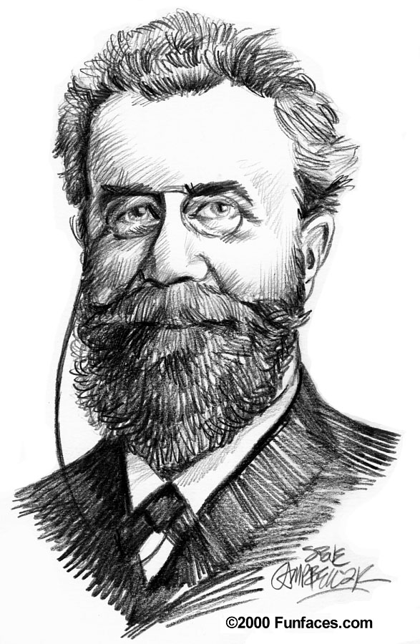
Ebbinghaus
1850-1909
Classical experiments on memory
serial position curve:
1,the primacy effect
2,the recency effect

Slide 14
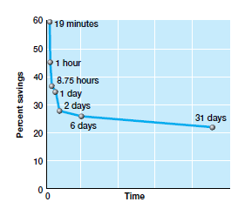
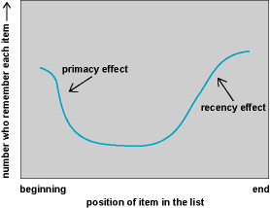
Ebbinghaus’ s retention curve
Serial position curve

Slide 15
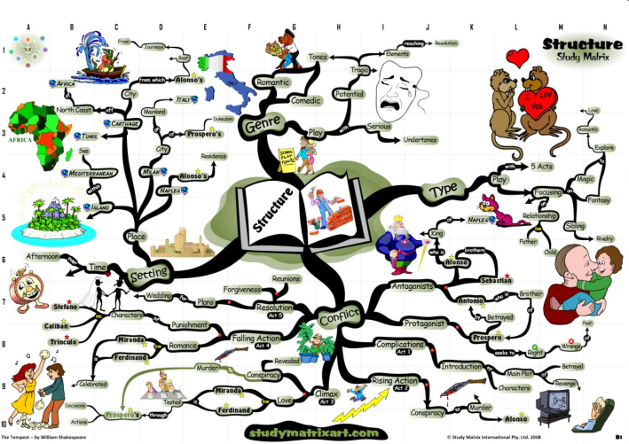
Psychological Antecendents of
Cognitive Psychology
STRUCTURALISM
  Titchener (Phd under Wundt)
  understanding the structure of mind; influence of chemistry and physics; experience that is constituted from elements (for example: the taste of lemonade into elements of sensation : bitterness, sweetness)
  study of sensations through a method of introspection
  4 different dimensions of sensations: quality, intensity, duration, and clarity
  problems with introspection

Slide 16

Psychological Antecendents of
Cognitive Psychology
FUNCTIONALISM
- Wiliam James (1842-1910)- critique of structuralism
  purpose of mind (what does it serve for?), analysis of elements of consciousness should be disregaded, rather dynamic, unstable, changeable nature, core of the consciousness
  how does mind serve for adaptation and functioning in the environment? (Darwin)
  method of introspection, but also observation of behavior as a subject of study
  theory of emotions- first theory of emotions (with Lange) physiological reactions cause emotions
EXAMPLES>Why do we dream -- what function does it serve?
>Why do we have emotions -- what function do
they serve?

Slide 17
Psychological Antecendents of
Cognitive Psychology
Gestalt psychology
1912
in the center of study was perception, how do we organize experience. what we see depend mainly on the stimuli in relation to the background and their organization (distance, proximity, similarity)
laws of perception (Wertheimer).

Slide 18
Psychological Antecendents of
Cognitive Psychology
Behaviorism
- founded by J.B. Watson
-research based on results with animals mostly (influence of Darwin)- if humans are related to other species it might be useful to systematically study animal behavior and create implications for human mind functioning
  bh refused to take into account existence of mind, or rather considered it to be the black box
  similarly as emphasized in empiricism, a human is determined by education, upbringing
  role of environment (compare to nativism)

Slide 19
Beginning of Cognitive Psychology
Noam Chomsky
  Linguistic arguments against behaviorism
  Arguments from language acquisition
    Behaviorists are not able to explain how children can produce newsentences they never heard
    Generative grammar

Slide 20
Emergence of Cognitive Psychology
Alan Turing
  Development of first computers
    His “Colossus” computer helped break the German “Enigma” codes during the World War II
    TURING machines- simple abstract computational devices intended to help investigate the extent and limitations of what can be computed
  Analogy between computers and human minds
    Hardware (brain), Software (mind)
    Thinking as a process of algorithmic manipulation of some information
    These ideas helped to establish the information processing paradigm in psychology – thus, cognitive psychology

Slide 21

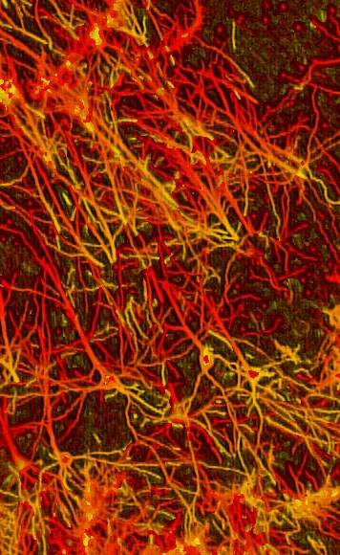
Stars in Milky way vs. Neurons in brain

Slide 22


Slide 23


Slide 24

Necker cube

Slide 25

Necker cube

Slide 26
Perception
Object recognition
Gibson (bottom-up information processing)
Constructivism (top- down information processing)
Gestalt principles
Optical illusions

Slide 27
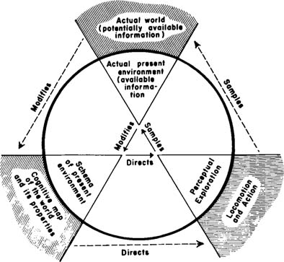
Ulric Neisser’s perception cycle

Slide 28
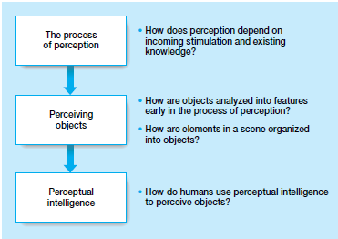

Slide 29
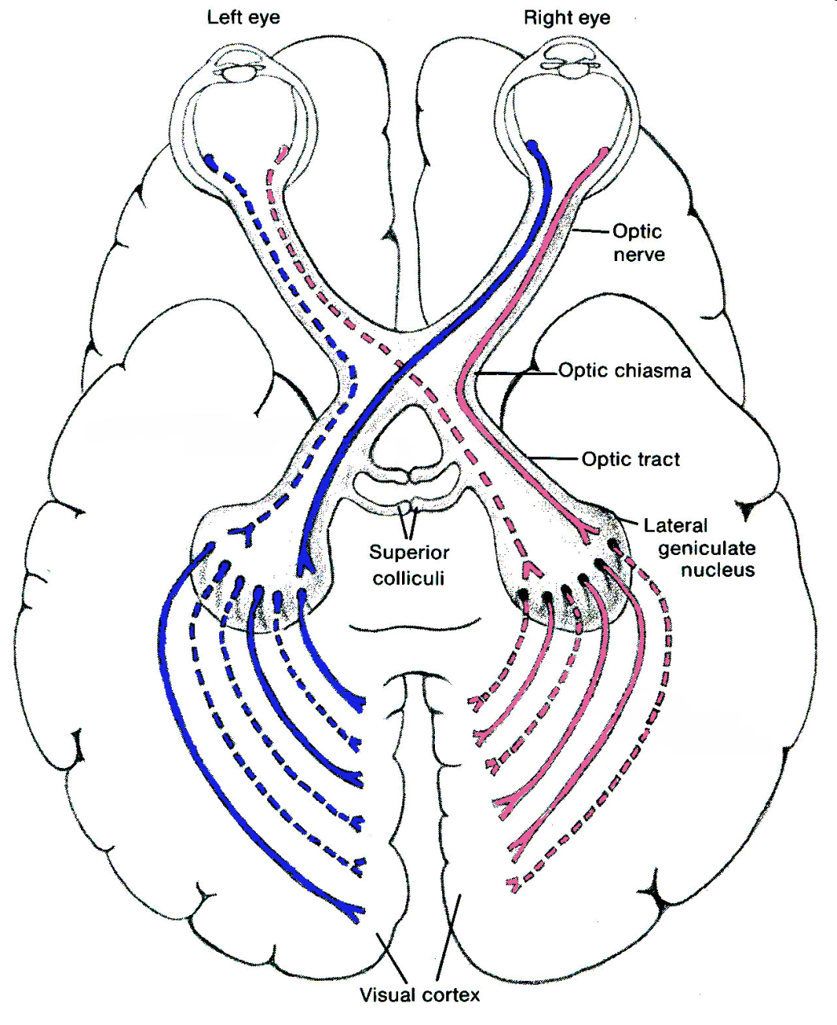
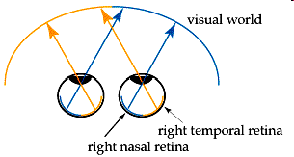
Visual pathways
http://iknow.net/phys_eye_education.html#_nogo

Slide 30

Knowledge (top-down)
Face / Saxophoonist
Pattern of light (bottom-up)

Slide 31
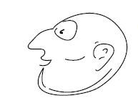


rat–man demonstration

Slide 32
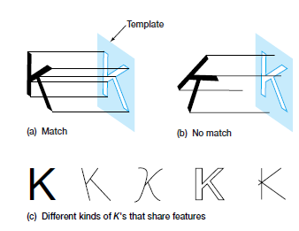
Object recognition- template matching
Disadvantages?

Slide 33
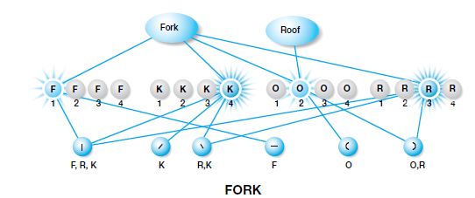
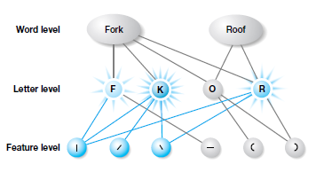
Object recognition- Interactive activation model
Rumelhart & McClelland

Slide 34
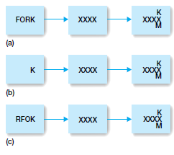
Interactive activation model :
Word Superiority Effect

Slide 35
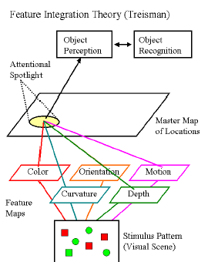
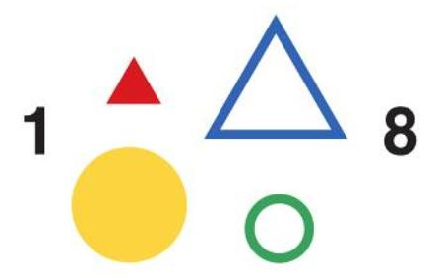
Feature Integration Theory
illusory conjunctions occur because at the beginning of the perceptual process each feature exists independently of the others

Slide 36
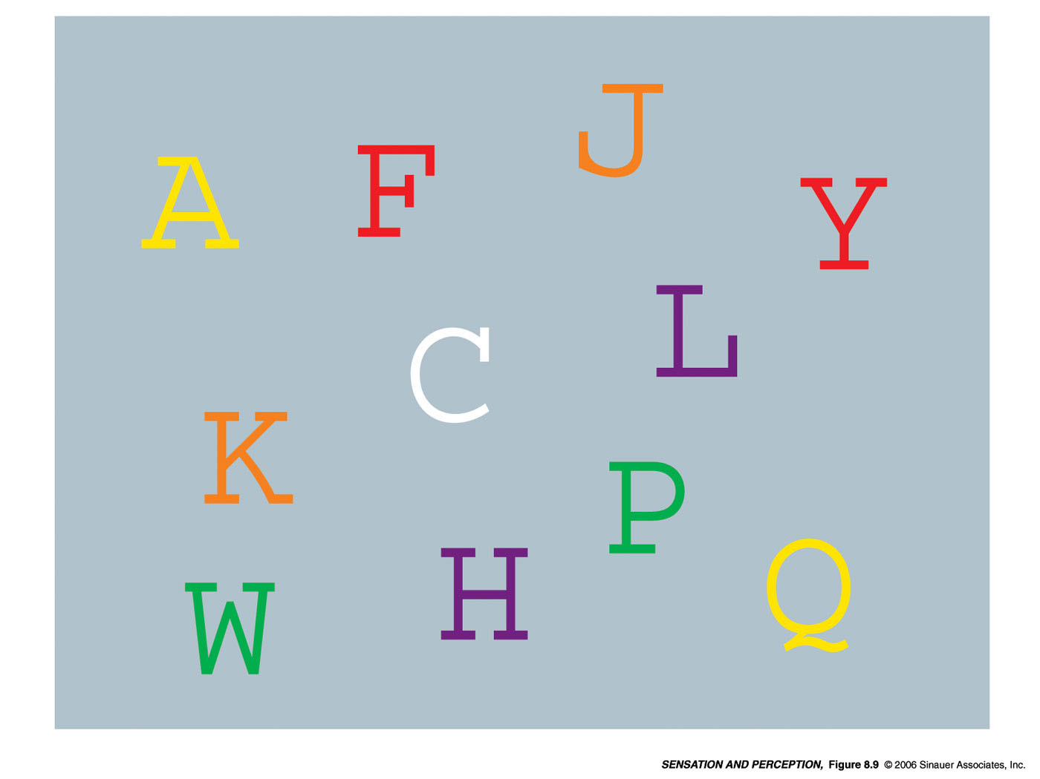

Slide 37
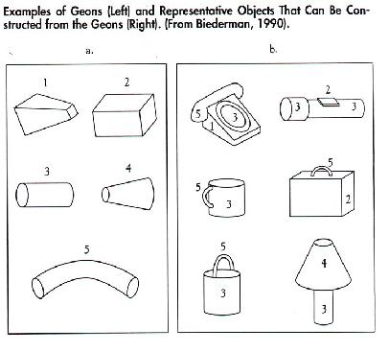
Recognition-by-Components Theory
Geons:
-36
-can be identified when viewed from different angles
-view invariance
-discriminability
- resistance to visual noise

Slide 38



Slide 39
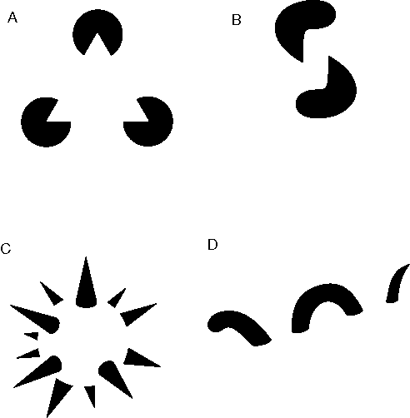
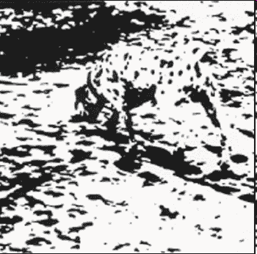
Perceptual organization
the organization of elements of the environment into objects
Gestaltists
“The whole is greater than the sum of its parts”

Slide 40

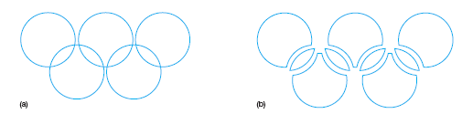
laws of perceptual organization
Law of Pregnanz (good form/shape/figure)
- every stimulus patterns perceived in the simplest possible form

Slide 41
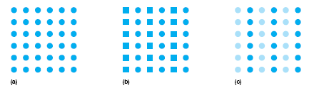

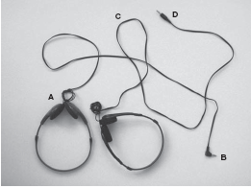

laws of perceptual organization
Law of similarity
Law of good continuation

Slide 42

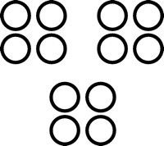
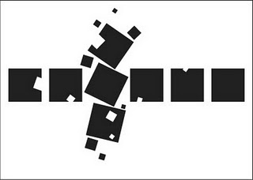

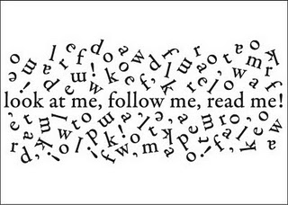
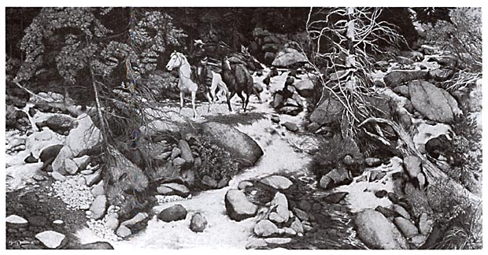

laws of perceptual organization
Proximity
Common Fate
Familiarity

Slide 43
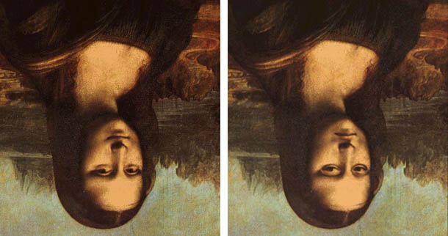
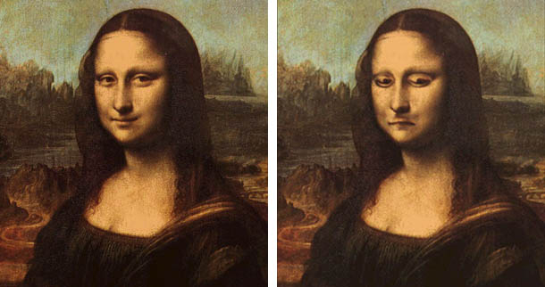
Familiarity/ Meaningfulness

Slide 44
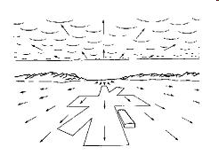
Gibson‘ s theory of direct perception
ecological’ theory: with background, horizons, other objects, etc. all playing a part.
Gibson first developed his theory during WW2 when he was given the task of preparing training films for pilots. From this he developed a theory of optic flow patterns, based on a fixed point towards which the pilot is moving which appears motionless. The rest of the visual environment is moving away from that point, flowing over and around the viewer.
Affordance
This means attaching particular meaning to visual information. Gibson rejected the theory that long term memory provides meaning. Rather, he argued that the potential use of an object is directly perceivable - a ladder 'affords' climbing up or down, a chair 'affords' sitting.
Gibson's theory was that of direct perception, which means that humans directly perceive their environment through stimulation of the retina. Traditionally, and especially by Gestalt psychologists, perception was believed to be indirect. According to this theory, humans do not directly perceive their environment. It is only through sensory stimulation over time that we learn what is in our environments, and that we perceive much more than mere sensory input.

Slide 45
Constructivist theory of perception
“Constructivists” such as Helmholtz, Rock and Gregory claim that incoming visual data are insufficient for perception to be achieved, and that the brain must supplement these data with top down processing
process whereby the brain makes a series of hypotheses about the external world, stress the importance of central factors such as memory and expectation in determining the phenomenological content of perception

Slide 46
Comparison between the theories
Comparison of two theories to perception:
1. Mental processes to pick up information or not
The constructivists see the stimulation reaching our senses as inherently insufficient necessitating an “intelligent” perceptual system that relies on inferential types of mechanisms to overcome this inherent equivocality of stimulation.
The ecologically oriented theorists argue that the information in the ambient environment suffices and is not equivocal and thus no “mental processes” are needed to enable the pick up of the relevant information.
2. Direct or indirect perception
The constructivists see perception as multistage with mediational processes intervening between stimulation and percept, i.e., perception is indirect.
The ecological theorists see perception as a single-stage process, i.e., it is direct and immediate.
3. Relying on stored information
For the constructivists, memory, stored schemata, and past experience play an important role in perception.
The ecologically oriented approach sees no role for memory and related phenomena in perception.
4. Process versus stimulation
The constructivists excel at analyzing the processes and mechanisms underlying perception.
The ecological approach excels at the analysis of the stimulation reaching the observer.

Slide 47
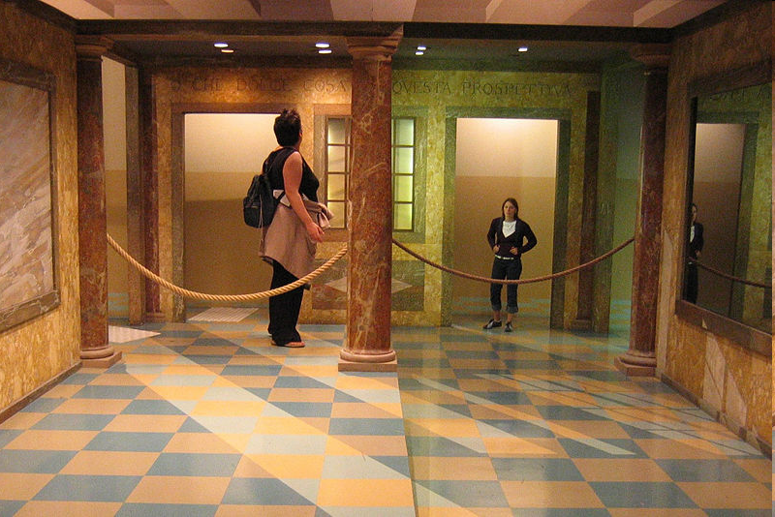
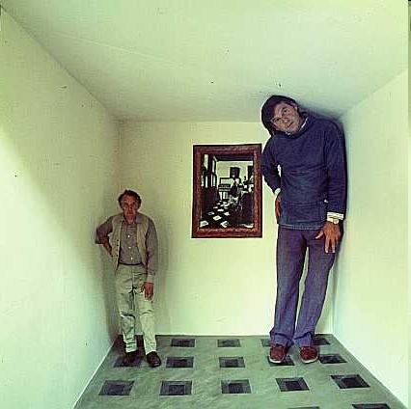
AMES ROOM
http://www.youtube.com/watch?v=Ttd0YjXF0no&feature=related

Slide 48
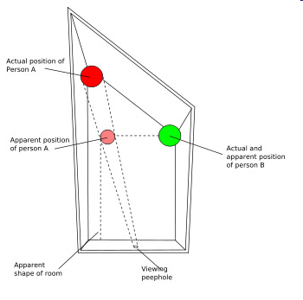
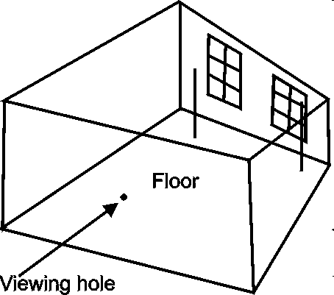
Architecture of Ames Room

