Slide 1
Attention
Michaela Porubanova

Slide 2
William James (1890)
Everyone knows what attention is. It is the taking possession of the mind, in clear and vivid form, of one out of what seem several simultaneously possible objects or trains of thought. Focalisation, concentration, of consciousness are of its essence.

Slide 3
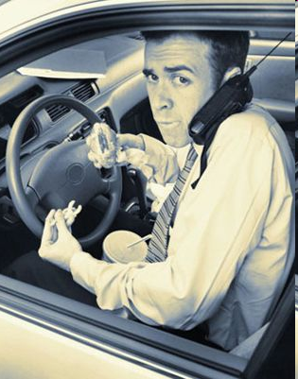
Attention as limited capacity processor

Slide 4


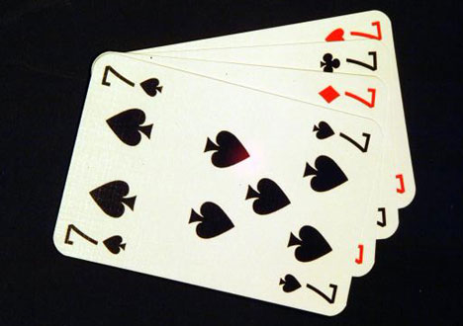
Introduction to attention
After behaviorism
selectivity of processing
Content vs. span
Baars- connection between A and consciousness
: “We look in order to see” / “We listen in order to hear”
W. James: active and passive models of attention (bottom-up vs. top-down)
Covert versus overt attention
G.E.Miller – 7±2, chunks

Slide 5
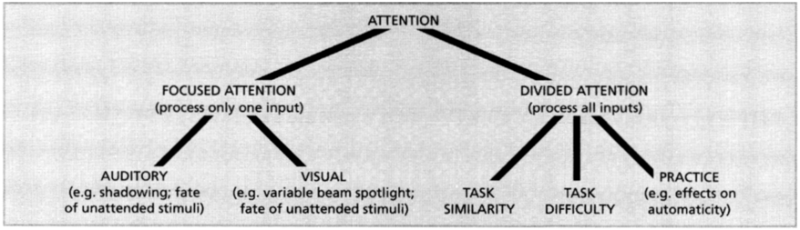
FOCUSED VS. DIVIDED ATTENTION unitary attentional system?

Slide 6
Research on attention
Disadvantages of laboratory experiments on attention:
- separation of external and internal stimuli
- only environmental stimuli
- disregard of „internal motivation“, but rather task specificity
- 2 D images

Slide 7
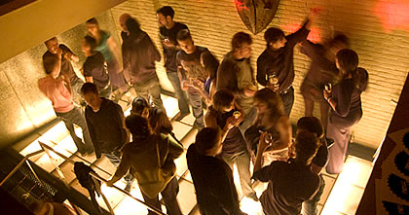
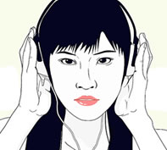
‚
COCKTAIL PARTY EFFECT‚
Colin Cherry (1953)
Focused auditory attention
The ability to tune our attention to just one voice from a multitude
As at a party….
http://www.youtube.com/watch?v=lNv4v3KQJRA

Slide 8
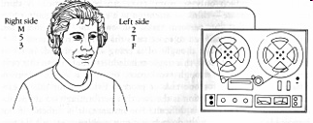
Dichotic listening versus shadowing task
Shadowing task= listening to two messages but attending to only one (repeat out loud)
Simultaneous listening to 2 messages (nonsensical or by the same speaker)= dichotic listening
Broadbent (presenting two rows of digits)
But unattended message:
could not identify a single phrase from the speech presented to the rejected ear.
weren't sure the language in the rejected ear was even English.
failed to notice when it changed to German.
mostly didn't notice when the speech to the rejected ear was being played backwards (though some did report that it sounded a bit strange).
But! Gender change, tone→ speaker change

Slide 9
Dichotic listening
http://www.youtube.com/watch?v=NCIuZGsSmlI
Broadbent:
First message has dominance for processing, later one processed after→ preventing the system overload
Role of expertise
Similarity of inputs deteriorates the performance

Slide 10
Theories of attention
Broadbent (1958)
Treisman (1960)
Johnston and Heinz (1978)

Slide 11
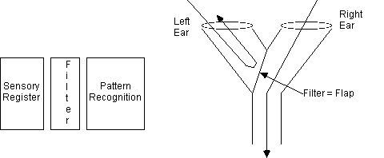
Broadbent’ s filter theory
Inspired by divided auditory attention research
Attention as a filter: it prevents overloading of the limited-capacity mechanism beyond the filter
Importance of physical characteristics of stimulus
Unattended stimuli rejected! (untrue)
Role of similarity of the messages
- inflexibility of the model
- ignorance of meaning in
selective attention (no physis. charact.)

Slide 12
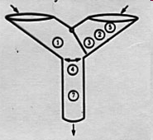
Filter theory of attention (Broadbent)
Sensory channels have an unlimited capacity
There is a bottleneck allowing only one piece of information into working memory at a time.
A selective filter allows in information from only one channel at a time.
Information from unattended channel is completely blocked
Time is required to switch from one channel to the next

Slide 13
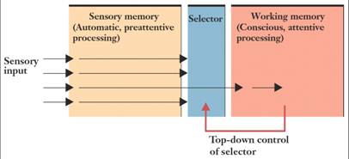

Slide 14
Treisman´s attenuation model
Messages differ in terms of their "subjective loudness". Paying attention to a message means increasing its subjective loudness.
In the shadowing task, messages from the shadowed ear have a higher subjective loudness than messages from the non-shadowed ear.
There is also a dictionary which contains words and concepts. Concepts in the dictionary differ in terms of the subjective loudness required for that concept to be noticed.
Some concepts are permanantly in the dictionary at a low threshold (like one's name) and some concepts are temporarily in the dictionary at a low threshold due to one's current goals.

Slide 15

Treisman
Even some unattended stimuli were processed-“breakthrough“
Context dependence on what is attended
Levels of processing:
physical cues → syllabic pattern → specific words →
individual words → grammatical structure → meaning
thresholds of all stimuli (e.g., words) consistent with current expectations are lowered
all stimuli are fully analyzed, with the most important or relevant stimulus having preference (Deutsch & Deutsch, 1968)

Slide 16
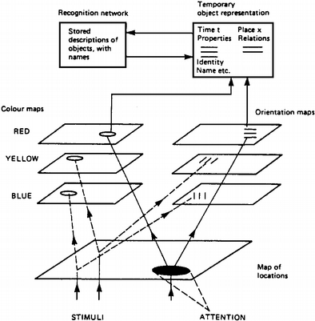

Slide 17
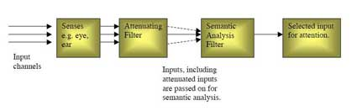

Slide 18
Selective attention demonstration
http://www.youtube.com/watch?v=vJG698U2Mvo

Slide 19
Johnston and Heinz’s theory
Importance of early selection of information- to decrease the overload of capacity
Experiment: dichotic listening
1 pair of words:
A, target word from a category
B, non-target: neutral, confusing meaning, appropriate meaning

Slide 20
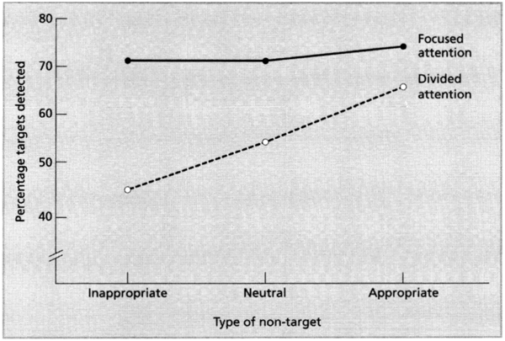

Slide 21
Focused attention
Spotlight or zoom lens?
Unattended visual stimuli
Visual search
Disorders of visual attention

Slide 22
Attentional Disorders
Neglect
Extinction
Balint’s syndrome

Slide 23
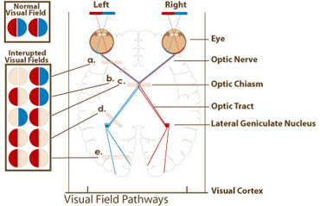
neglect
after damage to one hemisphere of the brain, a deficit in attention to and awareness of one side of space is observed
Right parietal lobe
Sensation is intact, perception of hemifield is damaged
Usual cause: stroke
Contralateral
http://www.youtube.com/watch?v=ymKvS0XsM4w

Slide 24
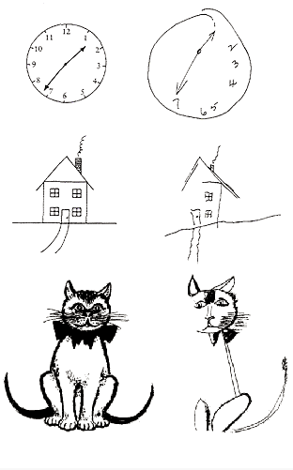
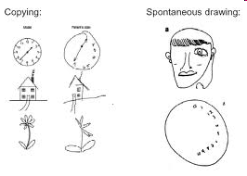
neglect

Slide 25
extinction
a neurological disorder which occurs following damage to the parietal lobe of the brain
difficulty to perceive contralesional stimuli when presented simultaneously with an ipsilesional stimulus
but the ability to correctly identify them when not presented simultaneously
frequently found in neglect patients

Slide 26
Balint’s syndrome
triad of severe neuropsychological impairments:
inability to perceive the visual field as a whole (simultanagnosia)- only one object can be fixated at a time
difficulty in fixating the eyes (ocular apraxia)
inability to move the hand to a specific object by using vision (optic ataxia)- difficulty in reaching for stimuli using visual guidance
Causes: consequence of two or more strokes at more or less the same place in each hemisphere (rare)
http://www.youtube.com/watch?v=4odhSq46vtU

Slide 27
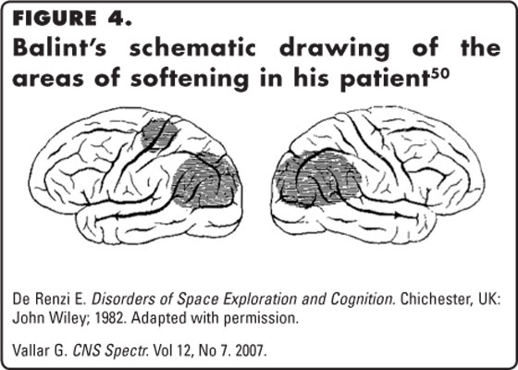
Balint’ s syndrome
Posterior parietal cortex
Occipito-parietal region
In Alzheimer or other injuries to PC or OC

Slide 28
Focused visual attention
Spotlight or zoom lens?
Pashler- spotlight moving across visual scene
the attentional spotlight moves at a constant rate
Zoom-lens model- decreasing or increasing the region which is dependent on task demands

Slide 29
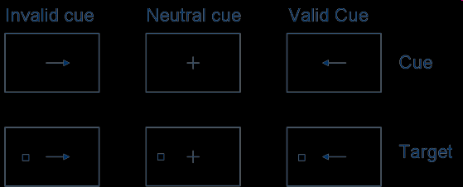
Focused visual attention
Posner:
2 attentional systems:
Exogenous (“automatic”, stimulus properties)
Endogenous (intentions, motivations, top-down)
Reaction times in moving eyes to the target are quicker in the valid cue trials
(Posner, 1980). This could suggest that attention is
linked with planning of eye movements.

Slide 30
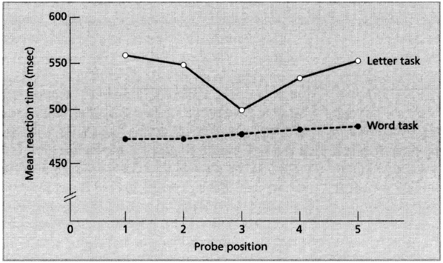
FOCUSED VISUAL ATTENTION
La Berge (1983):
- categorize letter
-categorize word

Slide 31
FOCUSED VISUAL ATTENTION
http://www.youtube.com/watch?v=mAnKvo-fPs0
http://nivea.psycho.univ-paris5.fr/Slowchanges/index.html
http://nivea.psycho.univ-paris5.fr/Mudsplash/Nature_Supp_Inf/Movies/Movie_List.html

Slide 32
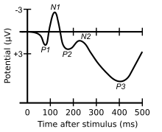
Unattended visual stimuli
reduced processing
ERPs larger to attended stimuli than unattended
ERPs show that attention influences visual info processing 100ms after the stimulus onset (such as early selection models of A propose)
Processing of unattended stimuli
(evidence from neglect patients)

Slide 33
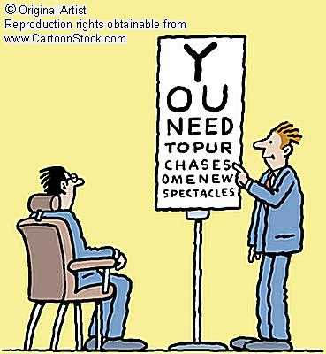
Unattended visual stimuli
Priming-
increased sensitivity to certain stimuli due to prior experience
http://www.youtube.com/watch?v=McS9BNeeW2k&feature=related

Slide 34

Visual search

Slide 35

Visual search

Slide 36
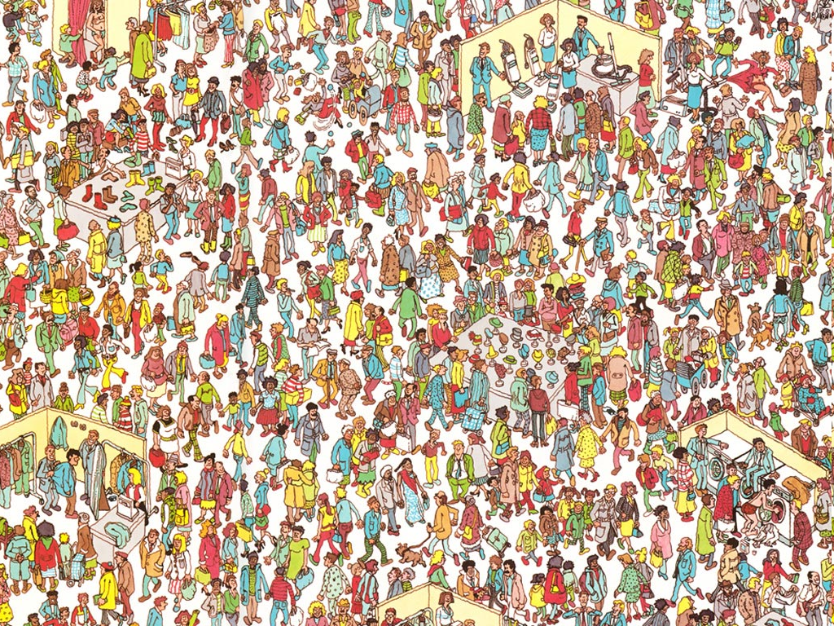

Slide 37
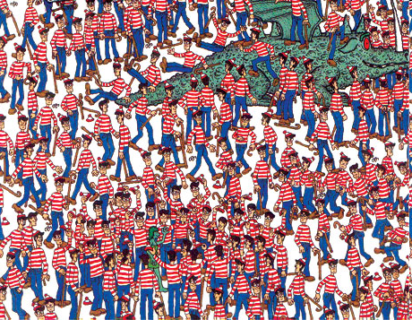

Slide 38
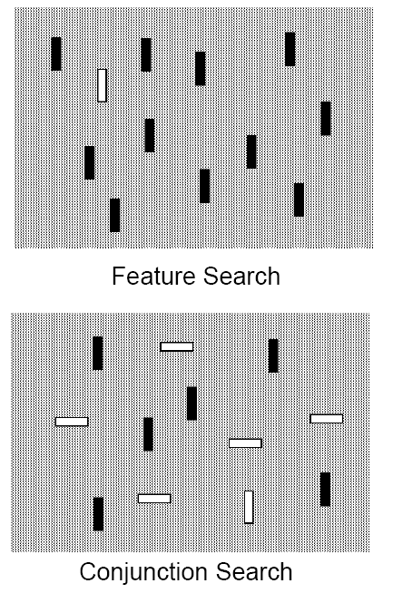
Visual search
Feature
Or
Conjunction
search

Slide 39
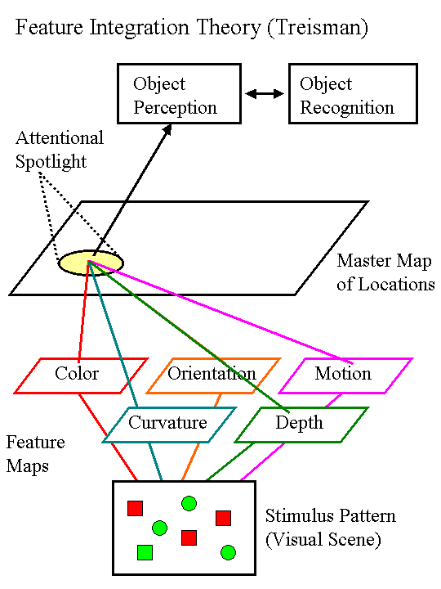
Feature Integration Theory

Slide 40


Preattentive stage
RED CIRCLE?

Slide 41
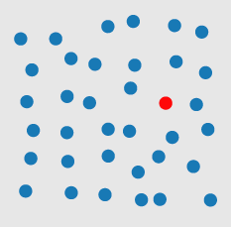

Preattentive stage
RED CIRCLE?

Slide 42
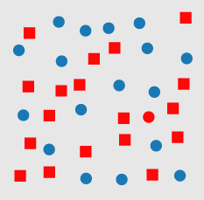
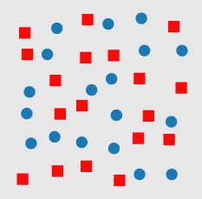
FOCUSED ATTENTION STAGE
RED CIRCLE?

Slide 43
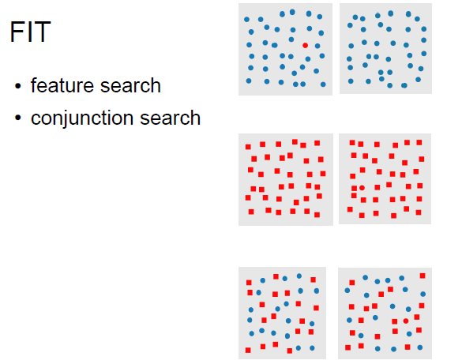

Slide 44
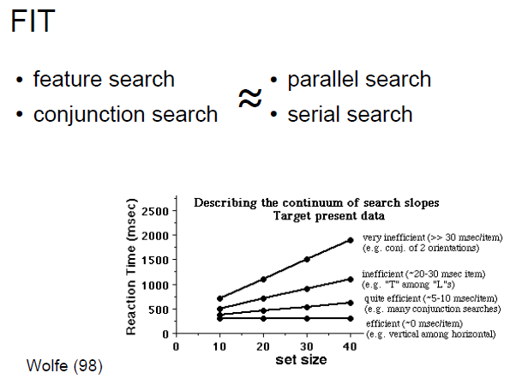

Slide 45
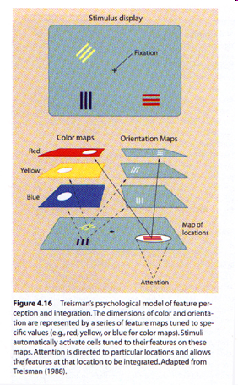
Treisman´s feature integration theory
rapid initial parallel process- not dependent on attention
features combined to form objects
attention provides the “glue” forming unitary objects
Feature combination can be influenced by stored knowledge

Slide 46
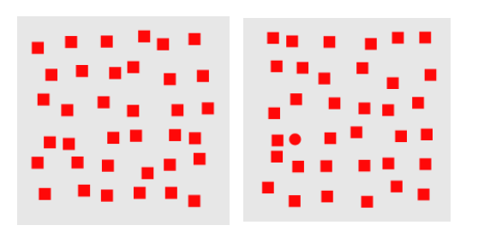
Focused vs. involuntary attention

Slide 47
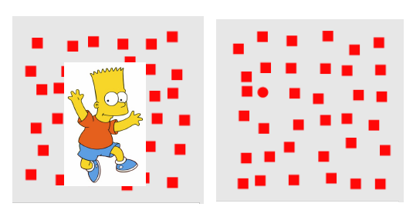
Focused vs. involuntary attention

Slide 48
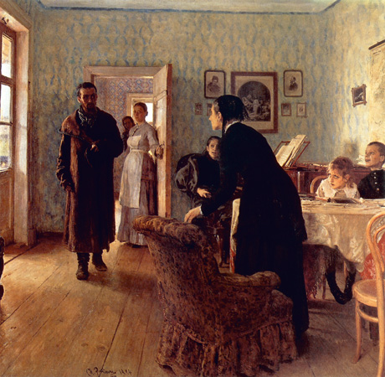
Focused attention
Eye movement tracking
1, scan-paths
2, task-dependence
Yarbus

Slide 49
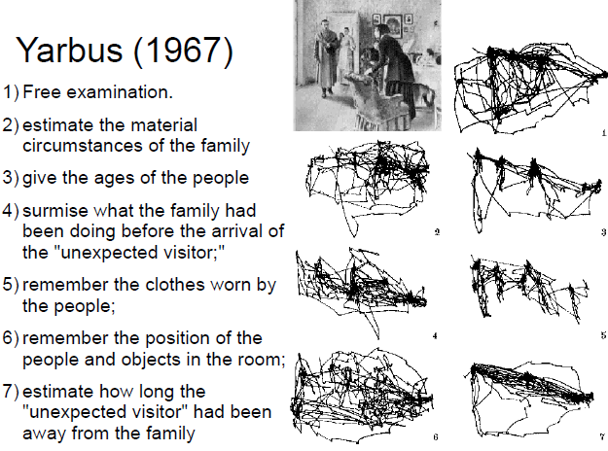

Slide 50
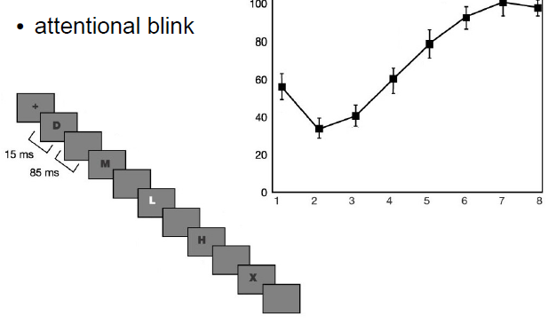
Attentional blink
http://www.youtube.com/watch?NR=1&v=MH6ZSfhdIuM

Slide 51


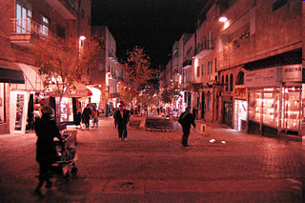
Attention restoration theory
(Kaplan, 1995, 2001)
natural versus urban environments- influence on cognitive processing
involuntary versus directed attention
Restorative effects of nature on directed attention
2 groups: attention test:

Slide 52
“the door” study
http://www.youtube.com/watch?v=FWSxSQsspiQ&feature=related

Slide 53
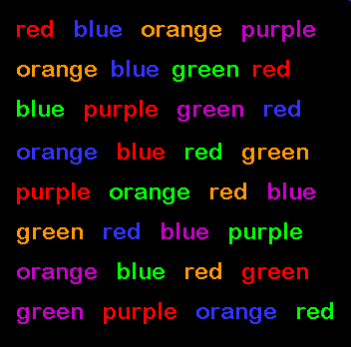
Automatic processing
Stroop effect
http://www.youtube.com/watch?v=Tpge6c3Ic4g

Slide 54
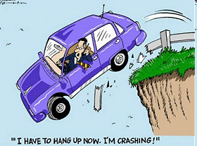
Pay attention!

