Slide 1

Language
PSY270 Michaela Porubanova

Slide 2
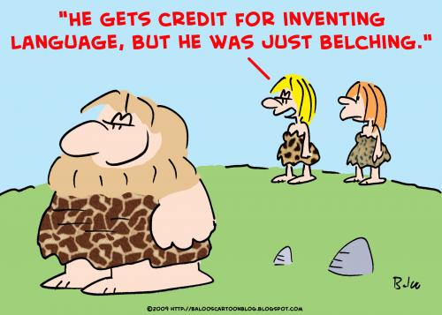
Language
a system of communication using sounds or symbols that enables us to express our feelings, thoughts, ideas, and experiences

Slide 3
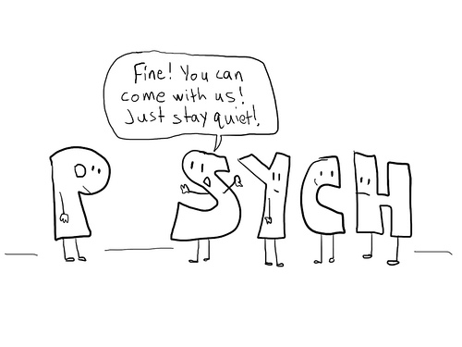
Language
Phonology sound of words- systematic organization of sounds
Morphology smallest unit of L with some autonomous meaning
Syntax grammar rules
Semantics word meanings
Lexicon mental vocabulary

Slide 4
Creativity of language
new words
Metaphors
New combinations of words

Slide 5

Language
A, Hierarchical (combinations of elements into greater wholes)
B, governed by rules ( we all implicitly know the grammar rules)
C, universal (rules,
language production in children)

Slide 6
Skinner (behaviorism)- Language as entirely learned behavior
Noam Chomsky- genetic grammar
Psycholinguistics (comprehension, speech production & acquisition)

Slide 7
Chomsky: Universal grammar
Poverty of the stimulus (ungrammatical and incomplete input in children→ grammatical output)
Infinite number of sentences without prior knowledge
Constraints and principles cannot be learned
Children start babbling early; first word 1 year; basic grammar around 6 (without the cognitive capacities to understand the grammar)
Patterns of development are universal
LAD language acquisition device (innate)

Slide 8
http://www.youtube.com/watch?v=qu3XxSDRuKM&feature=related

Slide 9
Why do we have language?
Communication
Adaptation
Social interaction
Thinking?
Problem solving
When is language insufficient?
Language and thoughts!
Do we think only using language?

Slide 10
Does language enhance our thinking?
Could we have complex, complicated thoughts without language?
Does language help our ability to think?
Does language limit our ability to think?

Slide 11
Complex thoughts are ingrained in simple elements (words, concepts)
Language is “labeling” our reality
L is a means to solving problems

Slide 12
Representations
Computational approach to language
Role of R in thinking

Slide 13

Sapir- Whorf hypothesis
The principle of linguistic relativity- the structure of a language affects the ways in which speakers are able to conceptualize their world, i.e. their world view
(i) the strong version that language determines thought and that linguistic categories limit and determine cognitive categories
(ii) the weak version that linguistic categories and usage influence thought and certain kinds of non-linguistic behavior
Research on color perception

Slide 14
phonemic restoration effect
restoring the missing speech sound perceptually without any difficulty
Inability to identify the position of coughing
Top-down influence in language processing

Slide 15
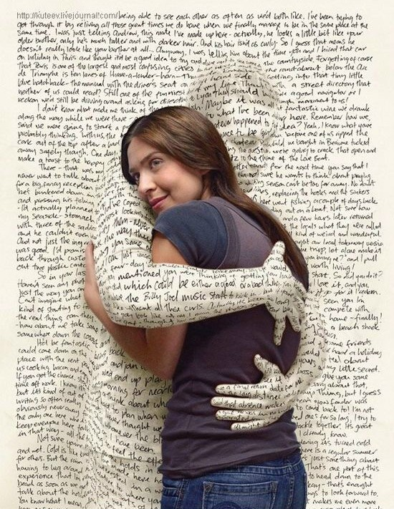
Understanding words
Word-frequency effect
People read high-frequency words faster than low-frequency words
“Sam wore the horrid coat though his pretty girlfriend complained,”
contains the high-frequency target word pretty.” (demure)
Effect of the context
The bankers were frightened by the walrus
The Eskimos were frightened by the walrus
Lexical ambiguity

Slide 16
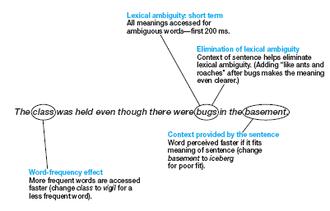

Slide 17
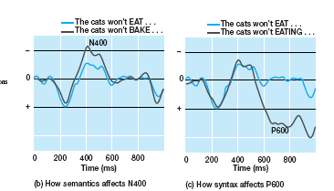
Understanding Sentences
Semantics (N400)
Syntax (P600)
Parsing sentences
The spy saw the man with the binoculars. (syntactic ambiguity)
Late closure principle

Slide 18
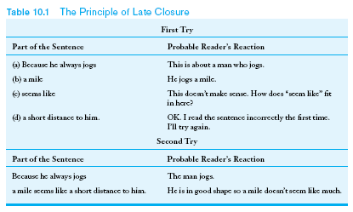
Late closure principle
Garden-path model (Syntax models)
Understanding of sentences based on syntax

Slide 19
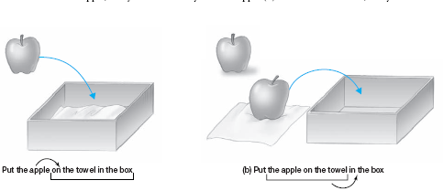
The Interactionist Approach to Parsing
Both syntax and semantics help understanding the sentence
when semantics comes into play?
EMT- eye movement tracking
Put the apple on the towel in the box.

Slide 20
Text/discourse processing
Continuity of the sentences in the story
Coherence- relations between individual sentences
Inferences
situation model- creating a representation of a story based on locations, people and objects

Slide 21

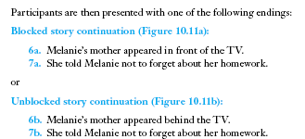
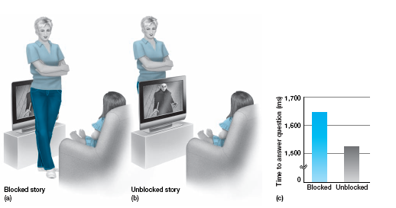
“Was the victim being stalked by a
vampire?”

Slide 22
→
readers represent story events in a manner similar to actual perception

Slide 23
Mark Pagel on language
http://www.ted.com/talks/lang/eng/mark_pagel_how_language_transformed_humanity.html

