Slide 1
Local Economic Systems
Session 5
The development of local economic systems – networking, collaboration & support mechanisms
Tim Crabtree

Slide 2
Focus of session
Exploration of how individual local food enterprises could collaborate with other organisations.
Such collaboration could be at a less formal level, for example the creation of networks or “communities of practice”
Or through “secondary structures” designed to provide inputs (the 5 capitals)
Or allow collaboration around operations, marketing & distribution or waste recycling.

Slide 3
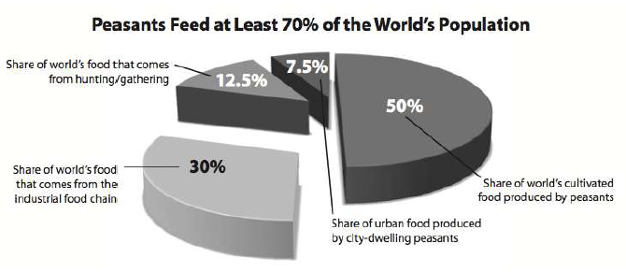
Who produces the world’s food?

Slide 4
The Food Industry in the U.K.
Total consumer spend on food and drink = £172 billion per annum

Slide 5
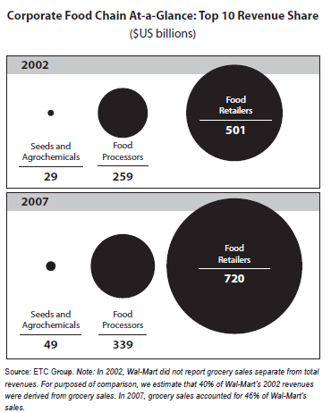

Slide 6
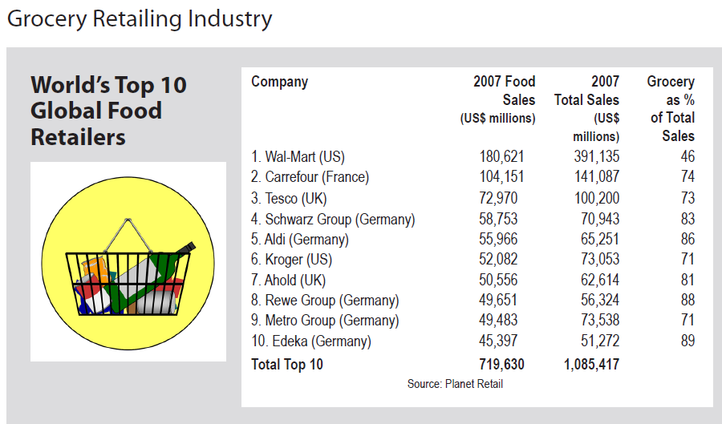

Slide 7
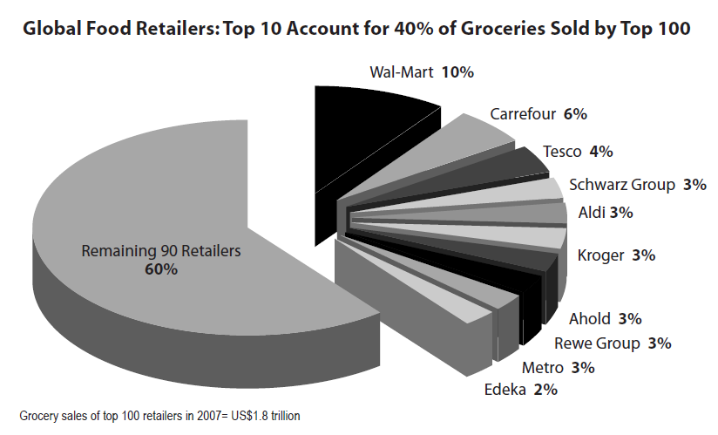

Slide 8
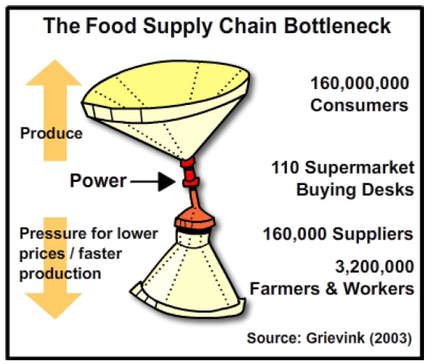

Slide 9
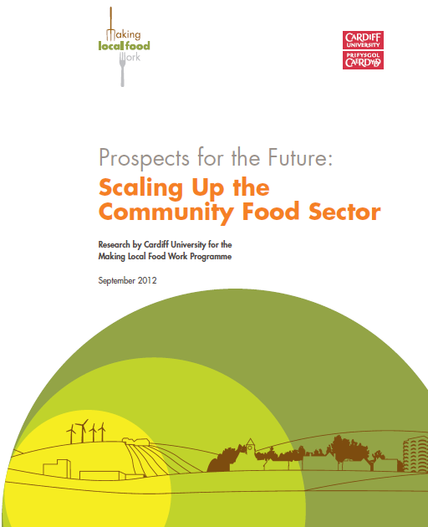

Slide 10
Research aims
to analyse the current characteristics of the community food sector;
to forecast how this sector can mature and grow in the coming years; and
to understand if collaboration – enterprises consciously working together to achieve joint aims – is an integral aspect of the future for community food enterprises.
Notes:
11:30 – 12:00
Kevin Morgan to chair an open discussion on the interim research findings.
Tim Crabtree to remain on stage with Kevin Morgan to answer questions and encourage discussion and debate.
Key questions are included on the slide and can be used to help structure discussion within this session. (These can be removed so please advise HE)
Please end the session promptly at 12:00
Lunch will be served from the Jubilee Room next door (Harriet and Eileen will direct people through). As it is a smaller room, please be patient and use the space in the main room to eat and network.
Next session will start promptly at 12:45
(We may be showing a short film on Real Food Store, Exeter – if time and technology allows. HE to update on the day.)

Slide 11
Key hypothesis
That ‘scaling up is really connecting up’
….and that this will require support structures that allow enterprises to actively work together, to learn from each other’s activities, and to share resources in a mutually beneficial manner.
Notes:
11:30 – 12:00
Kevin Morgan to chair an open discussion on the interim research findings.
Tim Crabtree to remain on stage with Kevin Morgan to answer questions and encourage discussion and debate.
Key questions are included on the slide and can be used to help structure discussion within this session. (These can be removed so please advise HE)
Please end the session promptly at 12:00
Lunch will be served from the Jubilee Room next door (Harriet and Eileen will direct people through). As it is a smaller room, please be patient and use the space in the main room to eat and network.
Next session will start promptly at 12:45
(We may be showing a short film on Real Food Store, Exeter – if time and technology allows. HE to update on the day.)

Slide 13
Household
gardens & kitchens
Allotments
Community
Gardens
Wholefood shops
Organic farms
Permaculture
initiatives
Farm shops
Farmers’ markets
Box schemes
City farms
Care farms
Lunch clubs

Slide 14
The “Core” Food
Economy
E.g.
Household
gardens & kitchens.
Allotments.
Community
Gardens.
Initiatives aimed at creating an “ethical alternative”
E.g.
Wholefood shops.
Organic farms.
Permaculture
Initiatives.
Differing Motivations
Initiatives seeking to “defend” the local economy
E.g.
Farm shops
Farmers’ markets
Box schemes
Initiatives using food as a vehicle for other purposes
E.g.
Care farms.
Lunch clubs.
City farms.

Slide 15
Competition or collaboration?
The community food sector has evolved in recent years, with new types of initiatives emerging, e.g. Transition Towns
There are reports of the different types of initiative competing amongst themselves for the same small % of consumers
The challenge, then, is to support mutually beneficial collaboration

Slide 16

























Slide 17
Three Key Ecological Principles
1. Cooperation moderates competition
2. Networking underlies ecosystem health
3. Diversity creates stability (resilience)

Slide 18
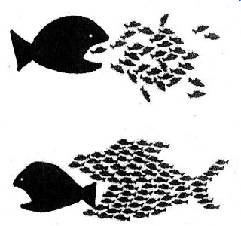

Slide 19
Nested systems
A community food enterprise can be thought of as a system, as can a local food economy.
Meadows:
“Systems can be embedded in systems, which are embedded in yet other systems.”

Slide 21
Direct delivery
+
Collaboration
+
“Food policy" partnerships working at a local level
+
National
food policy/influencing work

Slide 22
Collaboration
Collaboration between organisations in a local / regional area is potentially a way of overcoming the range of difficulties faced by community food enterprises.
This collaboration can take place in 4 ways:
  Around access to resources
  Around improving operations
  Around consumer engagement
  Around improving sustainability (closed loop processes)

Slide 23
Linking with other enterprises in the local food system
2. Collaboration around operations
Operations
Inputs:
The
5
Capitals
Demand &
Consumption
1. Collaboration around inputs
Waste
3. Collaboration around demand & consumption
Operations
Operations
Operations
Inputs:
The
5
Capitals
Demand &
Consumption
Inputs:
The
5
Capitals
Demand &
Consumption
Inputs:
The
5
Capitals
Demand &
Consumption
Waste
Waste
Waste
Operations
Inputs:
The
5
Capitals
Demand &
Consumption
Waste
4. Collaboration around “closing loops”

Slide 24
Collaboration is not easy
It involves dealing with an increased level of complexity.
It may require co-operation between individuals and organisations with divergent motivations.
It is subject to resource constraints: time and money.
It is carried out in a context of competition from large scale organisations able to influence the rules and ensure “success to the successful”.

Slide 25
Operations:
Primary Production
Processing
Distribution
Inputs:
Retail/Food service
Consumers
Natural
Marketing
Physical
Social
Core
Purpose
Human
Financial
Waste
Recycling
Financial
Investment
Co-production &
Provision of
Social Capital

Slide 26
2. Collaboration around operations
Operations
Inputs:
The
5
Capitals
Demand &
Consumption
Waste
3. Collaboration around demand & consumption
1. Collaboration around inputs
Operations
Operations
Inputs:
The
5
Capitals
Demand &
Consumption
Inputs:
The
5
Capitals
Demand &
Consumption
Operations
Inputs:
The
5
Capitals
Demand &
Consumption
Waste
Waste
Waste
Operations
Inputs:
The
5
Capitals
Demand &
Consumption
Waste
4. Collaboration around waste

Slide 27
The 5 capitals model
Supply to
customers
Capitals combined in
production operations
Natural
Capital
Social /
Organisational
Capital
Financial
Capital
Human
Capital
Manufactured
Capital

Slide 28
Barriers to developing supply
Natural
Capital
High cost of all land
& limited availability in urban areas.
Human
Capital
Leadership & management skills.
Absence of incentive structures for entrepreneurs.
Community / volunteer engagement has a cost.
Social /
Organisational
Capital
Choice of organisational structure & governance.
Big Society fatigue……
ICT could be powerful tool, but cost / skills barriers.
Manufactured
Capital
Access to suitable premises can be difficult –
“food hubs” could be one solution.
Financial
Capital
Cultural barriers: lack of entrepreneurship or understanding
of legal structures & types of finance.
Cost barriers: difficult to pay market rates.

Slide 29
Operations
Inputs:
The
5
Capitals
Demand &
Consumption
Collaboration
to provide
Social
Capital
Waste
Operations
Inputs:
The
5
Capitals
Demand &
Consumption
Waste

Slide 30
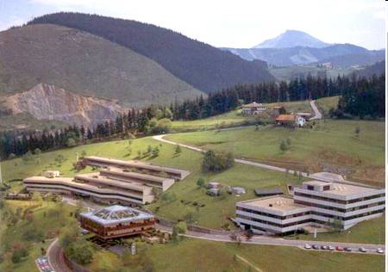
Social capital – the example of Mondragon in the Basque region, Spain
84,000 employed in
256 co-operatives
Supported by Mondragon Co-operative Corporation

Slide 31
MONDRAGON Corporation began in 1956
Started with a Technical College
Corporate Values:
  Co-operation.
  Participation.
  Social Responsibility.
  Innovation.
The Corporation’s Mission:
  the use of democratic methods in its business organisation,
  the creation of jobs,
  the human and professional development of its workers
  a pledge to development with its social environment.
In terms of organisation, it is divided into four areas: Finance, Industry, Distribution and Knowledge, and is today the foremost Basque business group and the seventh largest in Spain.

Slide 32


Slide 33
Operations
Inputs:
The
5
Capitals
Demand &
Consumption
Collaboration
to provide
Human
Capital
Waste
Operations
Inputs:
The
5
Capitals
Demand &
Consumption
Waste

Slide 34








Manchester Land Army
AIM:
To establish a financially resilient 'land army', which:
Has the capacity to involve a large 'unskilled' pool of individuals, resulting in potential increases in yields and income for growers.
Nurtures a small number of committed and trained individuals that growers are able to call upon in times of need.
Offers progression for potential new growers to meet increased demand.
Notes:
34

Slide 35
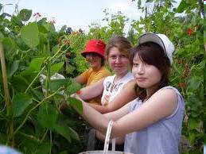
WWOOF

Slide 36
Operations
Inputs:
The
5
Capitals
Demand &
Consumption
Collaboration
to provide
Physical
Capital
Waste
Operations
Inputs:
The
5
Capitals
Demand &
Consumption
Waste

Slide 37
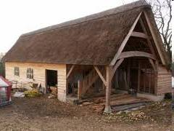
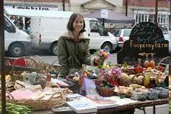
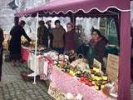
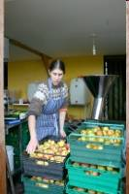
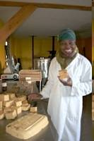
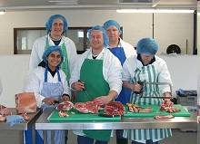
Dorset Small Producers’ Network –
Processing Barn at Five Penny Farm

Slide 38
Operations
Inputs:
The
5
Capitals
Demand &
Consumption
Collaboration
to provide
Natural
Capital
Waste
Operations
Inputs:
The
5
Capitals
Demand &
Consumption
Waste

Slide 39
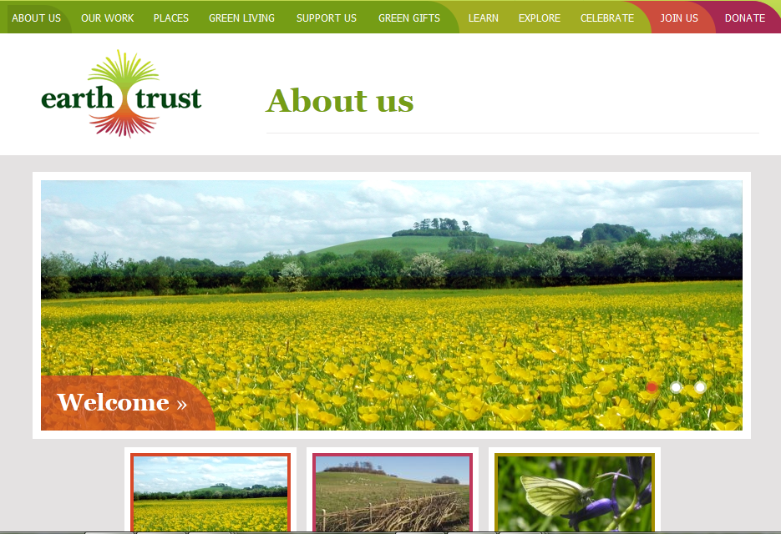

Slide 40
The Earth Trust
Set up in 1967
Now own 1,200 acres of farmland, woodland, nature reserves, research plantation and wetland
30 staff, 100 regular volunteers
750 regular supporters
Around 30,000 people each year take part in Trust activities annually

Slide 41
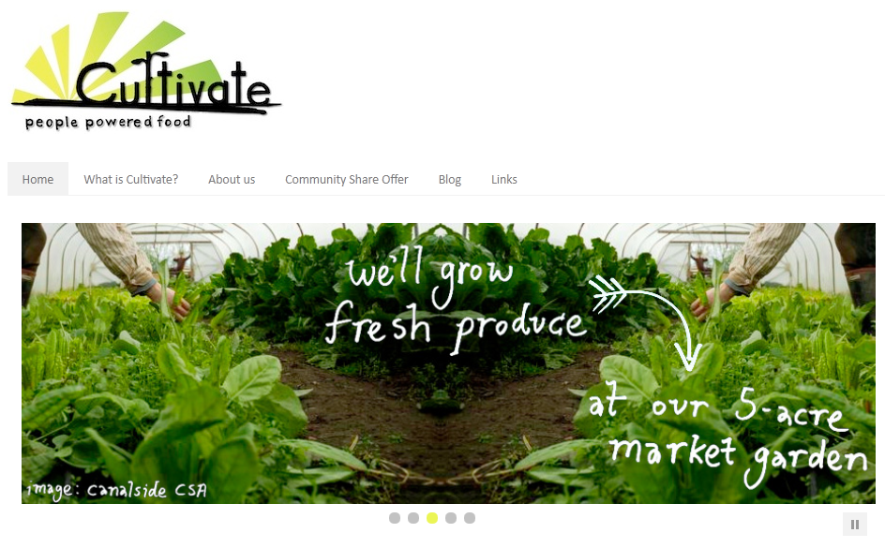

Slide 42
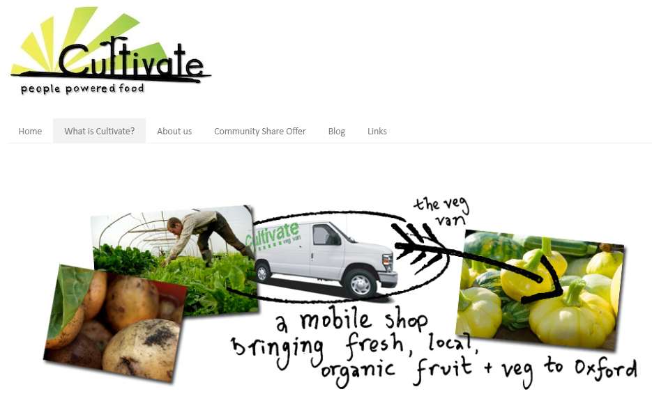
Cultivate

Slide 43
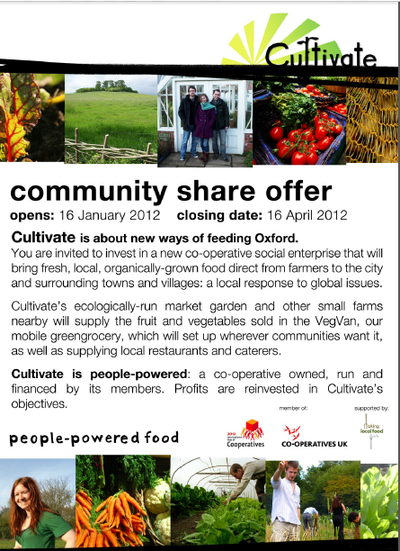

Slide 44



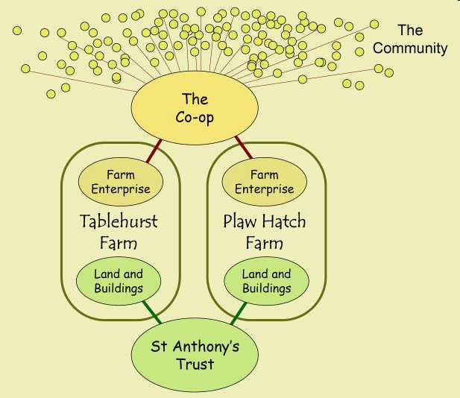
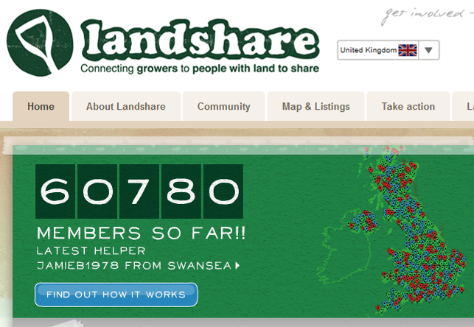
New ways of accessing land
+

Slide 45
Fordhall Community Land Initiative:
owns land and public access facilities
Land
Fordhall Farm Ltd: lifetime tenancy
Rent

Slide 46
Operations
Inputs:
The
5
Capitals
Demand &
Consumption
Collaboration
to provide
Financial
Capital
Waste
Operations
Inputs:
The
5
Capitals
Demand &
Consumption
Waste

Slide 47
Investment into food organisations
Investment:
grants
Increased
Financial
Capital
Investment in
Social
Capital
Investment in
Human
Capital
Food
operations
Food services
Investment:
loans
Investment in
Physical
Capital
Investment in
Natural
Capital
Investment:
equity
working capital

Slide 48
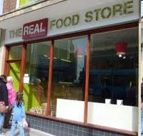
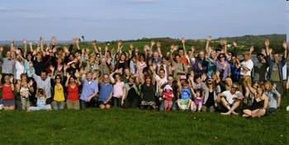


Wessex Community Assets –
a secondary structure helping communities raise local finance through share issues and loans
£152,775 raised
£105,000 raised

Slide 49
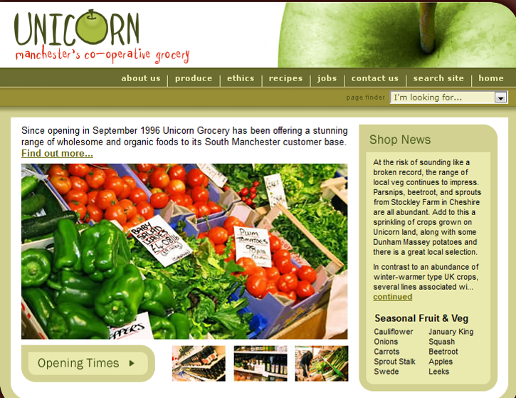
Unicorn Grocery

Slide 50
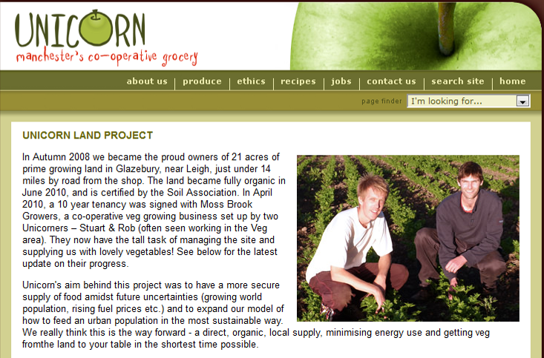
Loan stock issue to borrow funds from customers of Unicorn Grocery

Slide 51
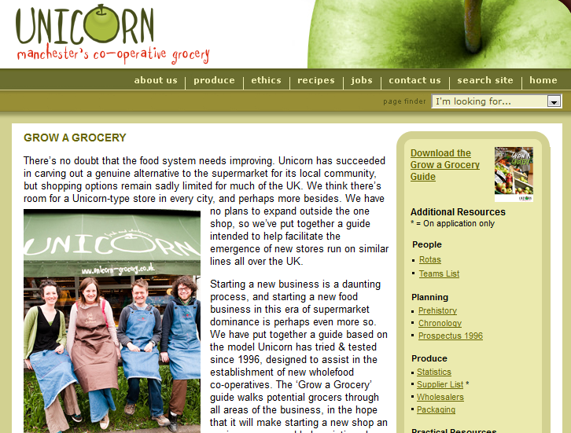
Unicorn Grocery: “Grow A Grocery” Guide

Slide 52
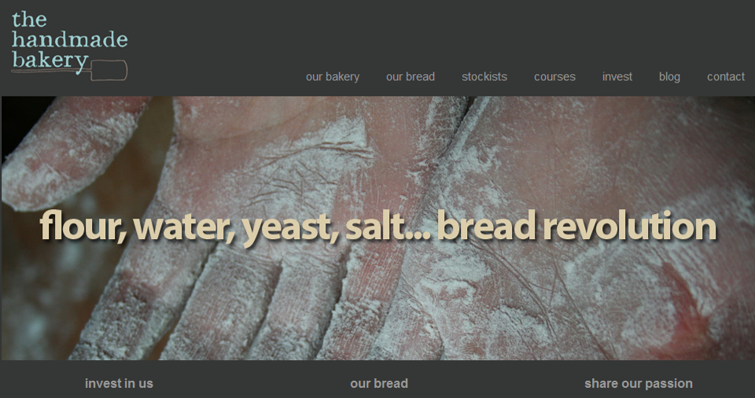
The Handmade Bakery

Slide 53
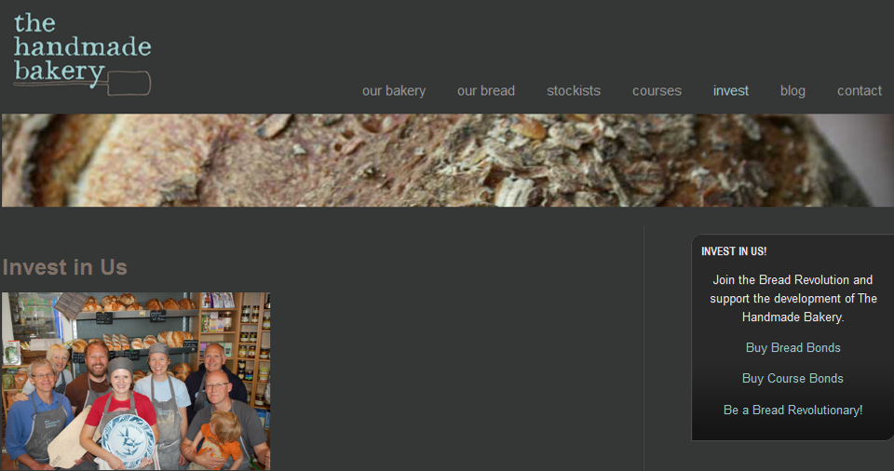
The Handmade Bakery

Slide 54
Collaboration
e.g.
Whole School Meals
Growing
Communities
Grameen-Danone
Operations
Operations
Inputs:
The
5
Capitals
Demand &
Consumption
Inputs:
The
5
Capitals
Demand &
Consumption
Waste
Waste

Slide 55

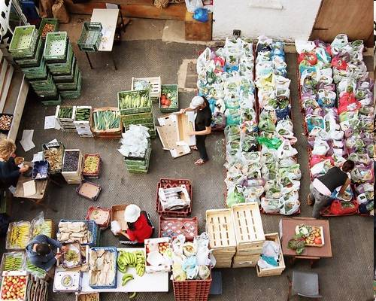
Growing Communities – Start Up Programme

Slide 56
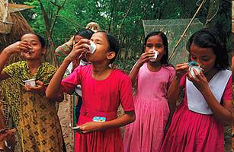
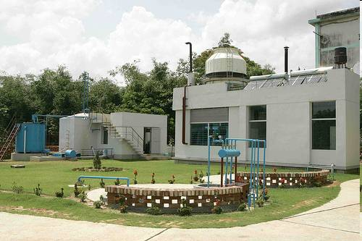
Grameen – Danone Joint Venture
Grameen-Danone Shoktidoi yogurt factory in Bangladesh
Notes:
56
56

Slide 57
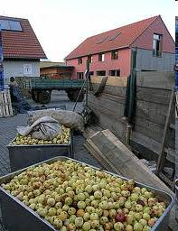
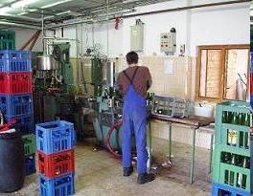
Hostetin Apple Juicing Plant, Czech Republic
- supporting local small orchard owners

Slide 58
Operations
Inputs:
The
5
Capitals
Demand &
Consumption
Collaboration
e.g.
Joint Branding
Joint Marketing
Events
Waste
Operations
Inputs:
The
5
Capitals
Demand &
Consumption
Waste

Slide 59
Manchester Veg People video

Slide 60
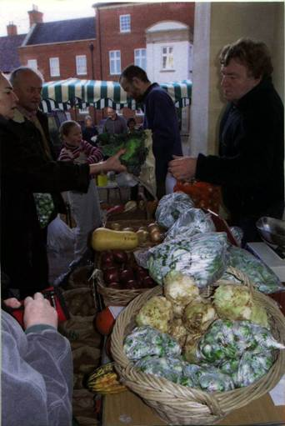
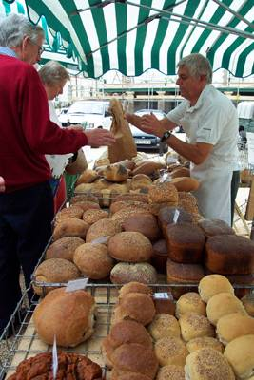
Farmers’ Markets
- a collaborative marketing mechanism
Notes:
60
60

Slide 61

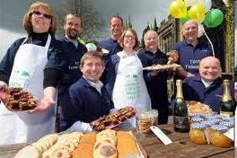
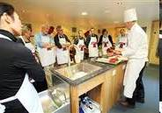

Taste Tideswell:
Using Branding to Promote the Local Food Sector

Slide 62






Slide 63
Operations
Operations
Inputs:
The
5
Capitals
Demand &
Consumption
Inputs:
The
5
Capitals
Demand &
Consumption
Waste
Waste
Collaboration
e.g.
Mobile Anaerobic
Digester or
Waste Oil
Collection

Slide 64

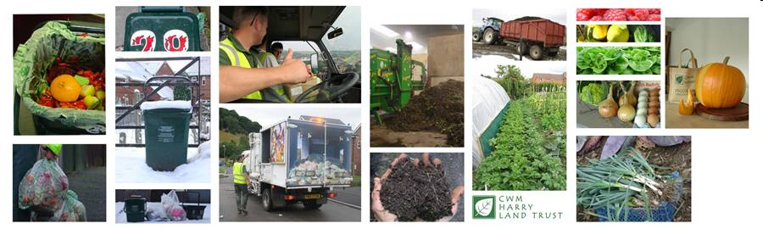
Cwm Harry Land Trust – recycling food waste

Slide 65
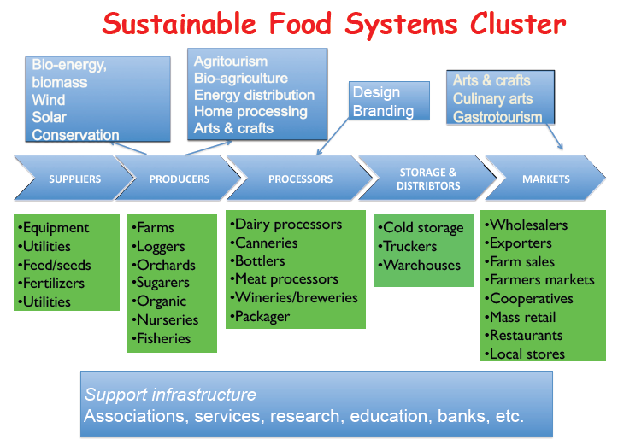
Rosenfeld, S.: Growing Jobs, Vermont-Style: Skills and Knowledge for Vermont’s “Sustainable Food System Cluster” and Natural Resources. Published by Vermont Department of Education, May 2010

Slide 66
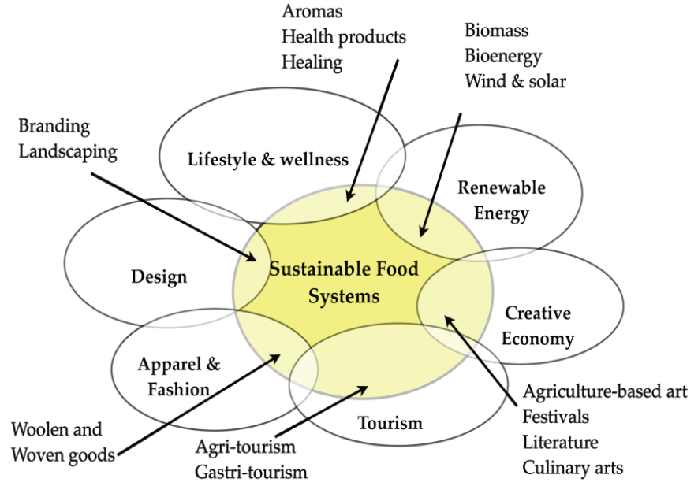
Convergence amongst clusters

Slide 67
Bridport Renewable Energy Group
With WCA have established BESCO (Bridport Energy Services Company)
Secured DECC funding for pilot anaerobic digestion scheme – purchase of mobile digester
Will work with local farms to research potential to integrate food waste recycling and renewable energy generation
Will design low cost DIY scheme

Slide 68
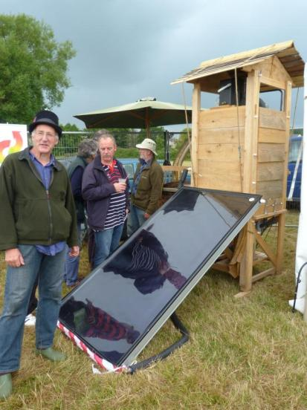
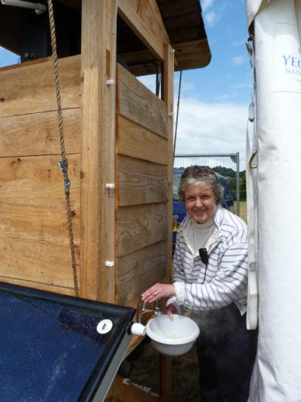
Bridport Renewable Energy Group at 2011 Bridport Food Festival: producing hot water for Festival cafe

Slide 69
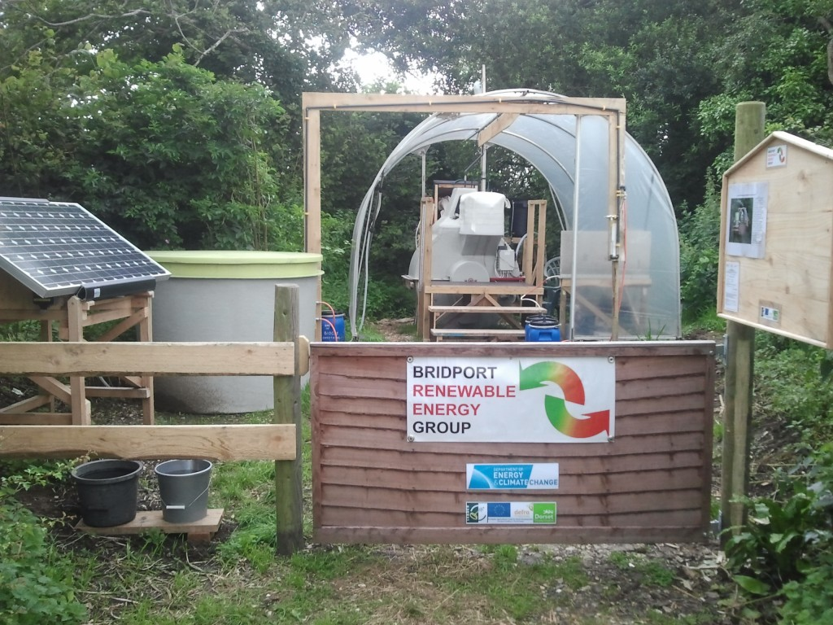

Slide 70

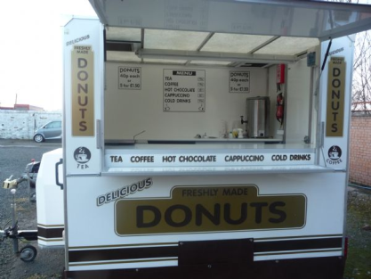
The Primordial Soup
Stage 2 – linking the portable Anaerobic Digester to a mobile catering trailer

Slide 71
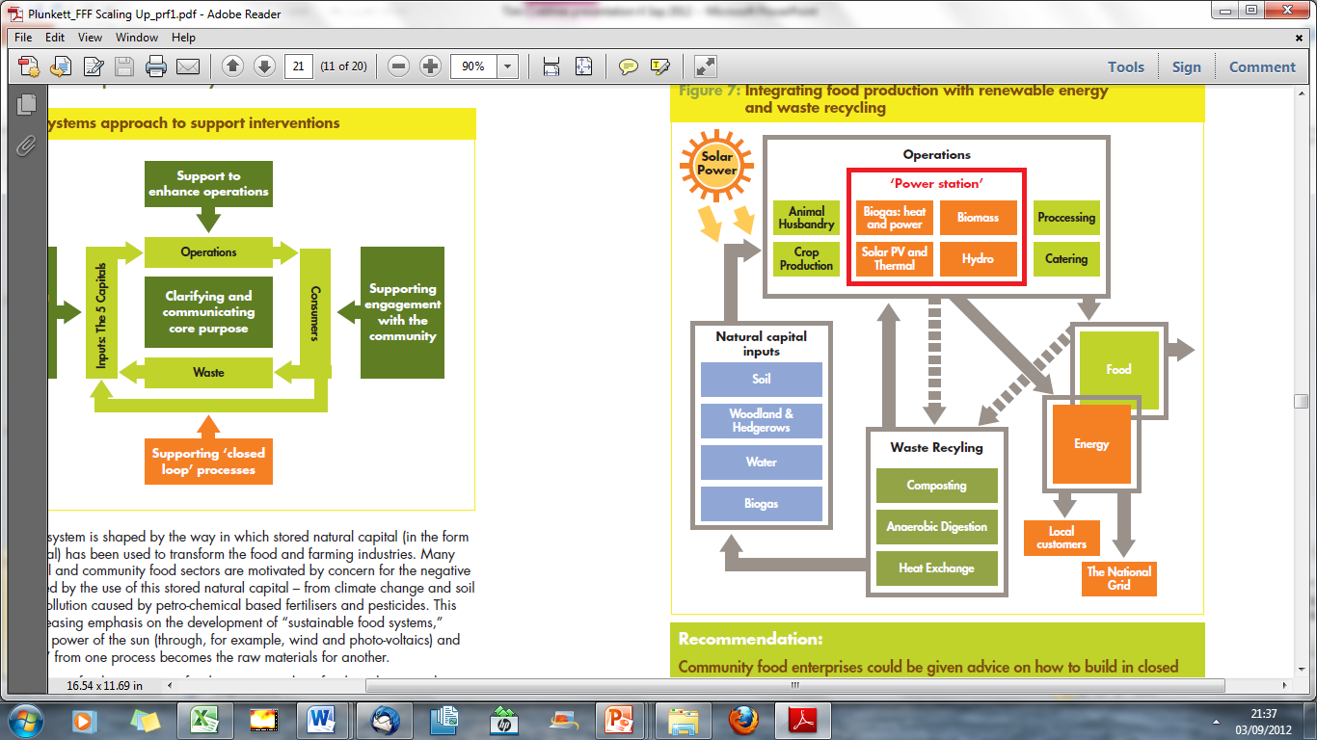

Slide 72
Direct
provision of
goods and services
Level 1
Provision of
secondary business
services
Level 2
Level 3
The 5 capitals
- subject to democratic governance

Slide 73
Level 1
Local Food Links – providing local catering services
Level 2
Supported by managed workspace: Bridport Centre for Local Food
Level 3
Underpinned by access to finance from Wessex Reinvestment Trust (a Community Development Finance Institution)

Slide 74
Shelter
Care
Warmth
Culture
Food
Communication
Level 2
services
Wastes
Wastes
Natural capital
Social capital
Physical capital
Financialcapital
Human capital

Slide 75
Level 1: Production
Seafood
Drink
Dairy
Fruit &
Veg
Energy
Meat
Bakery
goods
Level 2: Services e.g. Farmers Markets & the Centre for Local Food
Wastes
Wastes
Natural capital
Social capital
Physical capital
Financialcapital
Human capital
Level 3: Key Resources

Slide 76
