Slide 1


Alternative and local food:
concepts and practices
Session 1 – Introduction
Daniel Keech
Countryside and Community Research Institute
University of Gloucestershire, UK
dkeech@glos.ac.uk
Masaryk University, Brno, 1st – 4th October 2013
Notes:
1

Slide 2
Overview of the course
Together we will:
Explore the changing role of food in society over the last 2-3 decades, with particular emphasis on local food alternatives.
Critically consider the main narratives and policy debates around food supply, production and consumption, including the complexities and inter-connectedness of local and non-local food.
Use a small number of local case studies from the UK and Germany to introduce some potential local food analysis methods.
Carry out independent research which aims to help students demonstrate and communicate their grasp of the issues covered.
Notes:
2

Slide 3
Course progression (1)
Session 1: Tues 1st October, 10.00 – 11.40
Introductions, overview, research exercise
Session 2: Tues 1st Oct, 14.00 – 15.40
Changing narratives: debates about sustainability and security
Session 3: Wed 2nd Oct, 14.00 – 15.40
Responses from civil society; case study 1 – Community Supported Agriculture
Notes:
3

Slide 4
Course progression (2)
Session 4 – Thurs 3rd Oct, 8.00 – 9.40
Case study 2 – Farmers’ markets in the UK
Session 5 – Thurs 3rd Oct, 16.00 – 17.40
Case study 3 – Third sector juice schemes in Germany. Preparations for session 6.
Session 6 – Fri 4th Oct, 12.00 – 13.30
Report back on diaries in groups. Summary. Close.
Notes:
4

Slide 5
Working together
Small group: allows flexibility and informality
Questions can be asked as they arise; discussions may develop and be pursued where time allows.
However, a course outline has been provided and I will try to stick to this so that you know what to expect
I appreciate that English is not your first language. Please ask for clarifications where necessary. If there are problems talk to me, or to your course leader.
Notes:
5

Slide 6
Research exercise (1)
(feedback in session 6)
Get into pairs. Keep a diary keep of what you eat each day this week (from Tues – Thurs). Discuss: When you are buying food, what things do you look for and why?
When you have finished you can present your discussions to the rest of the group. See below:
Preference | Reason | Indicator
I buy ready-meals. | I don’t enjoy cooking. | Cooking instructions
I buy the cheapest food available. | I am a student with not much money. | Price
I try to buy organic food. | I believe it’s better for your health. | Certification label
Notes:
The purpose of this exercise is to get students to reflect on what social, cultural, political, ethical… values they attach to food in theory. On Friday we will recall this exercise when students present their diaries.
6

Slide 7
Research exercise (2)
(feedback in session 6)
Buying: What decisions were involved in making your purchases? Did you make any compromises?
Menu: What did you cook and eat and what decisions were linked to this?
Consequences: consider the sustainability issues of your meals and purchasing in this period (food chains; human and non-human actors; areas of tension etc…).
Changes: What would you change? What would you need to achieve that? Did local food help with any of these issues?
Notes:
7

Slide 8
Example layout
Tuesday 1st Oct
Breakfast – Orange juice, toast and honey, coffee.
Lunch – Vegetarian meal from university canteen, pasta with tomato sauce. Chocolate bar.
Evening meal – Frozen pizza and frozen chips with salad from the supermarket.
Comments – Always buy fair-trade coffee. Am a vegetarian. Just can’t resist chocolate! Quick evening meal, it’s only Tuesday and have work to do. Second coffee plus apple cake at new local produce café run by people I know.
Notes:
The exercise is intended to reveal a number of influences on food intakes and purchasing decisions. In this case, fair-trade coffee displays ethical concern for distant commodity farmers; evening meal is likely to be high in fat and suggests familiarity with Italian foods (see lunch). Vegetarianism may be a political choice.
Chocolate cake may carry guilt associations, unlike the coffee. Support for acquaintances shows social structures in some market situations. Tues is not a day for food hedonism, or perhaps reflects work-life balance issues.
8

Slide 9
Assessment of the module
To successfully fulfil the requirement of the module you will need to:
Attend 5 out of the 6 sessions
Present your food diary discussion in session 6 (in pairs, 10 minutes each.

Slide 10
Food diary presentation
Don’t just describe what you bought/ate. Draw out critical reflections based on what we have discussed, for example:
What social, ethical, economic, health, environmental factors inform your decisions?
What are you trying to achieve, if anything (say why not)?
Any narratives from academic literatures?
Who are the people affected by your decisions?
Possible conflicts and dilemmas you faced
What needs to change to affect your behaviour? Who drives the change?
Local food – how do they feature?
Concluding summary remarks

Slide 11
Any questions so far?
Introducing one another (2-3 mins)
Your name
What you study
What you hope to learn in this module
Notes:
11

Slide 12
Thank you for your attention.
Next session today at 14.00.
Notes:
12

Slide 13
Alternative and local food:
concepts and practices
Session 2 - Changing narratives:
debates about sustainability and security
Daniel Keech
Countryside and Community Research Institute
University of Gloucestershire, UK
dkeech@glos.ac.uk
Masaryk University, Brno, 1st October 2013
Notes:
13

Slide 14
Plenty, healthy, quality?
Some generalised key developments post 1945:
‘Green revolution’ self-sufficiency and surplus for trade and aid
Oil dependency highlighted in oil crisis of early 1970s (see Jones, A. (2001) Eating Oil. Sustain, London; and AEA (2005) The Validity of Food Miles as an indicator of Sustainability.)
CAP production subsidies until 2003 ⟹ surpluses, global dumping, falling food prices for consumers. Supermarket dominance and foreign direct investment (FDI).
CAP reform in 2003 ⟹ decoupling of subsidy from production and link to environmental stewardship
Notes:
14

Slide 15
Plenty, healthy, quality? (2)
Falling consumer prices until 2000s
Environmental degradation (Carson 1966), food safety scares, growth of organic movement from 1990s (see Julie Guthman 2002 and Gill Seyfang 2006…)
‘Quality turn’ and shift from public to individualised concerns in 2000s – health, lifestyle, ‘alternative hedonism’ (Soper 2004)
Obesity/famine paradox, the rise of social food co-ops in the absence of policy (see work by Elizabeth Dowler and Martin Caraher et al. 2001 onwards)
Notes:
15

Slide 16
Food in the public arena
Public health concerns around dietary intake affected by structural and social changes:
Fewer people work in agriculture, industrial settings, traditional family structures. Post-modern cities and working arrangements. ‘On the hoof dining, convenience shopping’.
Move in 1980s (in UK) away from institutionalised public catering to consumer choice, lowest price tendering and de-skilling kitchen labour. School cooks ⟹ food assembly.
State abrogates public health to the private domain.
Notes:
16

Slide 17
Food and social exclusion
Increased awareness of spatial health inequalities:
Jubilee line Westminster to Canning Town – a year less of life expectancy as you travel east nine stops. In other words, your average life expectancy in Westminster is 73/6 or 64/67 in Canning Town. DIET IS A CONTRIBUTORY FACTOR.
This led in the early 2000s to the establishment of food distribution co-ops. Opens up debates about physical access, the attractiveness of poor areas to supermarkets and the stigmatisation of food co-ops.
In 2013 new research (Oxfam 2013) links food poverty and the rise of food donation projects (often church-led) to welfare reform.
Notes:
17

Slide 18
Is food in crisis?
Agriculture in the ‘global north’ depends on fossil fuels and accounts for 40% of CO2 emissions, produces fewer calories than it consumes and depletes biodiversity.
C. 1bn people are starving while another 1bn suffer from diet-related ill health (acquired diabetes, CHD…) and obesity.
Peak oil, gas, phosphorous, water, price volatility and social unrest linked to price increases…
Population increases and urbanisation/rural migration.
Notes:
18

Slide 19
Some theories linked to sustainable food - sociology
Anthony Giddens | Reflexivity Speed of change and profundity of consequences is unprecedented. Work out solutions together.
Thomas Lyson | Social structuration Scale and structure of farms affects social structure of settlements.
Manuel Castells | Social movements Typography of civil groups; use of new communications to organise.
Notes:
19

Slide 20
Some theories linked to sustainable food - economics
Leyshon et al., Gibson-Graham | Alternative/feminist economics Change from the margins; experimental models can be expanded; role of women as reproducers of social life.
Jackson | Limits to growth Current model of capitalist growth assumes endless natural resources. (‘One planet living’ – nef).
Beddington, Royal Society | Sustainable intensification Mobilisation of technology and resource efficiency to feed growing and urbanising world.
Notes:
20

Slide 21
Some theories linked to sustainable food - geography
Van den Ploeg, Marsden et al. | Local as rural development Articulating values embedded in local foods and releasing value to farmers.
Winter; Edward-Jones; Garnett; Born and Purcell | Critiques of food miles Defensive localism; CO2 fetish; contexts of environmental performance metrics; the ‘local trap’.
Morgan | Politics of care Local green and global fair – cosmopolitan, mixed food systems build around city-regions.
Notes:
21

Slide 22
What do we mean by sustainable food?
Sustainable food is associated with well-being, environmental sustainability, social justice and resilience. (nef, 2007)*
In other words sustainable food is healthy, green, fair (Morgan 2010) and able to withstand shocks.
*Sumberg, J. (2009) Reframing the Great Food Debate: the case for sustainable food. New Economics Foundation, London.
Notes:
22

Slide 23
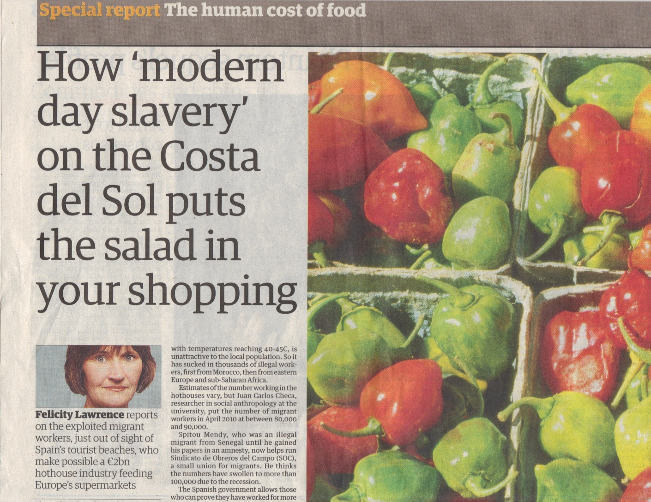
CO2 vs. social justice
Source: The Guardian 8th Feb ‘11
Notes:
23

Slide 24
The interdependence of food system and food culture
Notes:
24

Slide 25
Food system issues
Sustainable Food
Well-being | Social justice | Environ. Sust. | Resilience
Impact of pesticides on nearby residents | Poor labour conditions Dependence on gang-masters | Degradation (soil, water, over-fishing) Habitat destruct’n | Highly energy intensive Dependence on migrant labour
More processing = harder to control salt fat sugar consumption |  |  | Dependence on global trade
Road intensive = noise, pollution, traffic | Power balance against producers | Carbon intensive | Fuel cost
Junk food adverts target children | Power balance against small or indep. shops |  | Consolidation of retail sector
 |  | High levels of waste & packing
Production
Processing &
manufacture
Distribution
Advertising &
marketing
Disposal
Source: The Guardian 8th Feb ‘11
Notes:
25

Slide 26
Food culture issues
Sustainable Food
Well-being | Social justice | Environ. Sust. | Resilience
 | Poor avail. of healthy food in disadvantaged areas Low income = inadequate for healthy diet | Expectation of year-round avail. of all products
Time poverty = more consumption of prepared foods |  |  | Falling levels of food ‘literacy’
Loss of eating together |  |  | Fuel cost
Disconnection to rural and farming issues |  |  | Homogenisation of food & places
Cooking
Eating
Meaning
Notes:
26

Slide 27
Changing narrative - resilience?
Defra Narrative 2004 | Defra Narrative 2010
‘National self-sufficiency is neither necessary nor desirable.’ (Ministerial letter) | ‘Our food system needs to be prepared for shocks and to be able to manage risk.’ (Food 2030: How we get there, Defra 2010.)
Notes:
27

Slide 28
Key beliefs in local and sustainable food
It is better (healthier) to eat a more rather than a less diversified diet
It is better (healthier) to eat fresh food rather than preserved/prepared food
It is better (less environ. damaging, & food chain more transparent) to eat food produced closer to rather than further from the point of consumption
It is better (healthier, and less environmentally damaging) to eat food produced with a minimum of pesticides
It is better (less environmentally damaging) to eat food produced with a minimum of inorganic fertilisers
It is better (more socially just) to eat food produced, processed and/or marketed by smaller-local rather than larger-international operations
(Sustain: the alliance for better food and farming, London.)
Notes:
28

Slide 29
NGO and market innovations
Farmers’ markets
Hyperbolic organic sales (mainstreaming) (until 2008)
Box schemes
CSA and buying groups (growth since 2008: MLFW/LFF)
Food Links UK/Alimenterra
Public food procurement (FFL, SFT, free school meals)
Food access co-ops
NGOs as civil society agitators → under-paid market innovators?
Notes:
29

Slide 30
Possible questions emerging
How can the ethical motivations of the alternative food movement underpin, the development of a greener, fairer and healthier system/culture? Who decides?
How can the claims made for local food be substantiated? What implications have they got for a serious move to carbon-reduced and ‘cellular economy’ (Hardin Tibbs, BRASS 2011)?
What (infra-)structures are needed to make sustainable food viable? (distribution, finance, governance…)
Can the demand for ethical food be the basis for global solidarity, rather than nationalism, protectionism and stale local vs. global arguments?
Notes:
30

Slide 31
Changing narratives
Policy: Self-sufficiency ⟹ surplus ⟹ food security
Politics: Sufficiency/price ⟹ environmentalism/common concerns ⟹ quality/personal concerns (e.g. health and taste)
Retail power: Supermarkets as progressive ⟹ oppressive ⟹ appropriators
Third sector: Oppositional ⟹ entrepreneurial ⟹ technical specialists

Slide 32
In summary…
Food is complex – farming, nutrition, education, consumption, industry, diet, culture, shopping, politics, income, planning, waste, political activism…
"...the concept of a base-line sustainability standard is non-sense, as sustainability is an aspirational open-ended agenda involving trade-offs and a range of potentially conflicting priorities...” Smith, B. (2008) Developing Sustainable Food Supply Chains. Philosophical Transactions of the Royal Society for Biological Sciences. 363, pp. 849-861.
Organic, fresh, seasonal, local, fair-trade, affordable, safe…
How do we choose?
Notes:
32

Slide 33





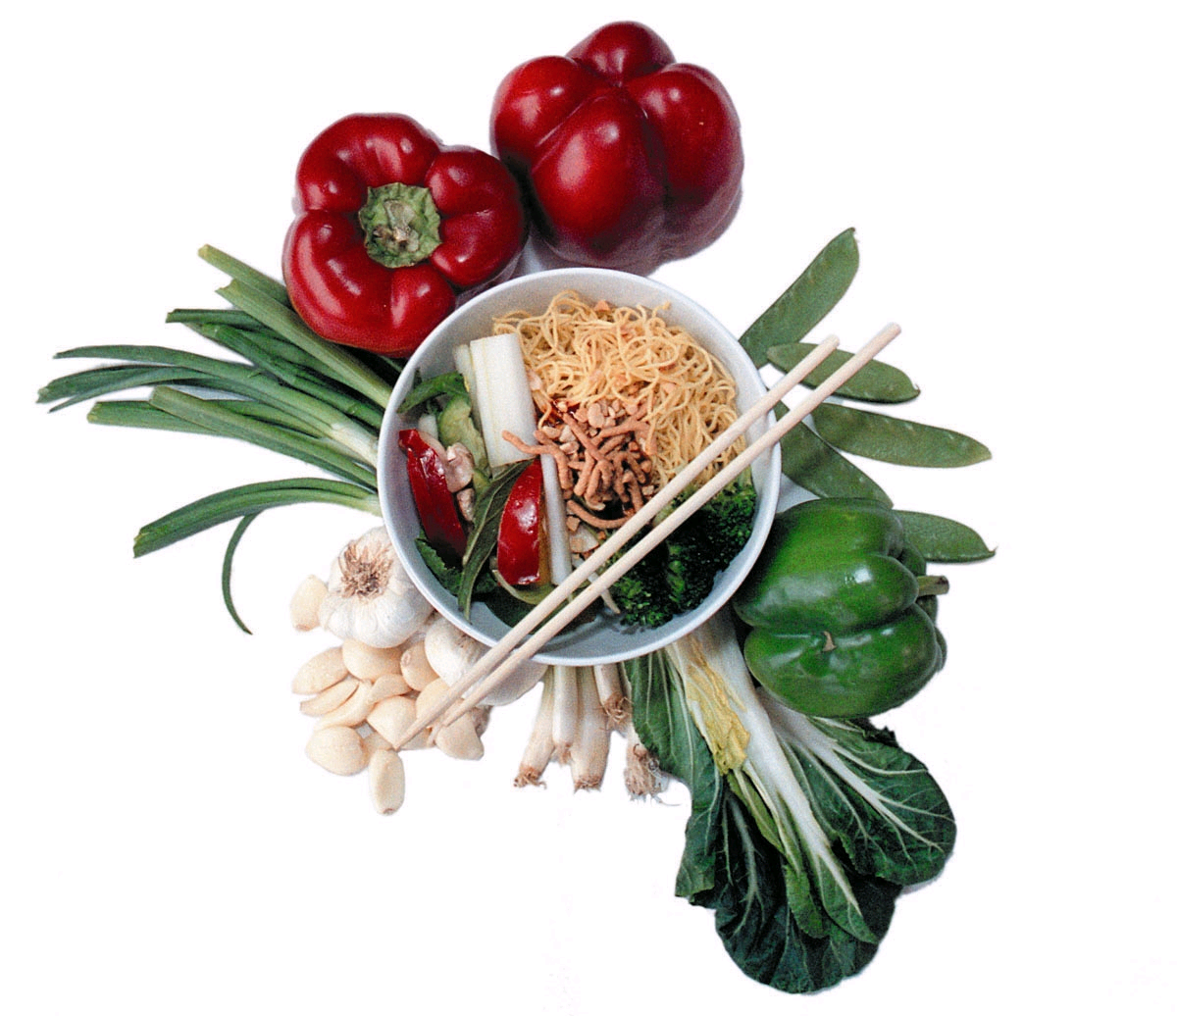





Slide 34

Questions?
Next session
Wed 2nd Oct, 14.00 – 15.40
Responses from civil society; case study 1 – Community Supported Agriculture

