Slide 1
Types, explanatory models and data based examples of environmental behaviour
Masaryk University, Brno
Audronė Telešienė
9th December, 2014

Slide 2
Structure of the lecture
Types of environmental behaviour
Explanations of environmental behaviour
Data based examples of env. behaviour in various countries

Slide 3
Types of environmental behaviour
What kinds of environmental behaviour are there for us?

Slide 4
Types of personal environmental behaviour (Stern, 2010)
Activism
Committed environmental activism
Public sphere
Environmental citizenship
Support or acceptance of public policies
Private sphere
Purchase
Disposal
Use
Environmentally significant behaviour

Slide 5
Operational definition: environmental behaviour
Personal environmental behaviour
Private sphere
(1) Sorting glass or tins, plastic or newspapers and so on for recycling
(2) Buying fruit and vegetables grown without pesticides or chemicals
(3) Cutting back on driving a car
(4) Reducing the energy or fuel used at home
(5) Choosing to save or re-use water
(6) Avoiding buying certain products
Public
sphere
(1) environmental group membership,
(2) financial support for environmental groups,
(3) policy driven actions of petition signing, and
(4) taking part in protests or demonstrations
ISSP 2010
ISSP 2010

Slide 6
Level of involvement in environmental behaviour, %
Shift towards, since 1993
 | Passive % | Active % | Total %
Private sphere behaviour | 69.1 | 30.9 | 100
Public sphere behaviour | 91.3 | 8.7 | 100
ISSP Environment, Lithuania, 2010, N=1023
Notes:
Hadler, M., & Haller, M. (2013). A shift from public to private environmental behavior: Findings from Hadler and Haller (2011) revisited and extended.International Sociology, 28(4), 484-489.
Overall, Hadler and Haller (2013) had observed three trends that have occurred across 16 countries that participated in the ISSP:
First, a homogenization in both public and private behaviors; Second, increasing prosperity, increasing international ties,
and better political opportunity structures can have negative effects to behaviors; and third, the growing gap between the
two behaviors seem to indicate a shift from public to private environmental behaviors. [Reyes, J. A. L. (2014). Environmental Attitudes and Behaviors in the Philippines. Journal of Educational and Social Research, 4(6), 87.]

Slide 7
Explanations of environmental behaviour
Why individuals behave as they do?

Slide 8
biographical situational
thesis of biographical availability
gender, age, education, income, marital status, etc.
notion of everyday life-world
worldview determinants
values, attitudes, beliefs, knowledge, concern, awareness
HEP-NEP theory
personal environmental behaviour
factors
Inglehart post-materialism
normative determinants
norms, behavioral intentions, and habits
VBN theory
exogenous factors
Affluence thesis
Macro-level
factors
Limitative/
operative determinants
constrained behaviour
theory

Slide 9
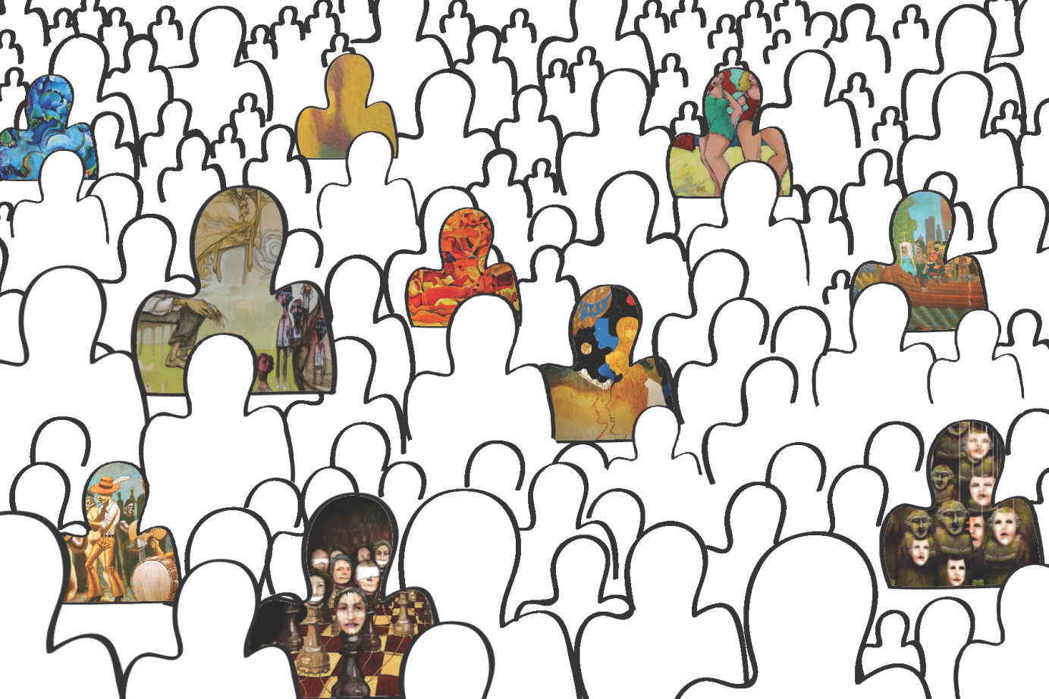
Everyday life-world, Alfred Shutz
Each individual’s worldview is different, because each individual has a unique life story, unique set of biographical situations.
Thus previous experiences serve as guides for todays actions

Slide 10
Biographical availability thesis
The absence of personal constraints that may increase the costs and risks of environmental behaviour (esp. movement participation).
  E.g. cutting back on driving a car → when having small children
  E.g. participating in a movement → when not married and not in job, e.g. studying
McAdam (1986)

Slide 11
Environmental behaviour types by socio-demographic variables, %
biographical situational
 | Private sphere environmental behaviour, % |  |  | Public sphere environmental behaviour,%
 | Active | Passive | p * | Active | Passive | p *
Total | 30.8% | 69.2% |  | 8.7% | 91.3%
Gender |  |  | .000 |  |  | .515
Male | 24.4% | 75.6% |  | 8.1% | 91.9%
Female | 36.4% | 63.6% |  | 9.3% | 90.7%
Age |  |  | .000 |  |  | .103
17-24 | 19.4% | 80.6% |  | 12.9% | 87.1%
25-39 | 25.6% | 74.4% |  | 8.9% | 91.1%
40-54 | 31.0% | 69.0% |  | 8.2% | 91.8%
55+ | 41.9% | 58.1% |  | 6.5% | 93.5%
Education level |  |  | .000 |  |  | .000
Primary/ not completed primary | 40.4% | 59.6% |  | .0% | 100.0%
Lower secondary | 20.0% | 80.0% |  | 2.4% | 97.6%
Secondary | 24.9% | 75.1% |  | 6.8% | 93.2%
Vocational/ technical | 34.0% | 66.0% |  | 6.4% | 93.6%
College | 33.3% | 66.7% |  | 8.3% | 91.7%
University degree | 40.7% | 59.3% |  | 21.0% | 79.0%
Place of residenceª |  |  | .000 |  |  | .000
Big city | 27.0% | 73.0% |  | 9.9% | 90.1%
Small city or town | 38.6% | 61.4% |  | 11.4% | 88.6%
Country village | 27.1% | 72.9% |  | 1.9% | 98.1%
* Chi-square test, significance
a.Questionnaire included categories “the suburbs or outskirts of a big city” and “a farm or home in the country”. We excluded these categories from our analysis because of small n
ISSP Environment, Lithuania, 2010, N=1023

Slide 12
Generalisation of influence of biographic situation (for Lithuanian case)
Active private sphere environmental behaviour is more common among
  women
  people aged 55+
  those with university degree
  inhabitants of small towns.
Public sphere environmental activities are more common among
  inhabitants of small city or town;
  those with university degree.

Slide 13
Correlations between private sphere behaviour, concern and knowledge
worldview determinants
 | Environmental concernª | Knowledge: causes of environmental problems^{b} | Knowledge: solutions of environmental problems^{c}
Private sphere environmental behaviour index^{d} | -.325** | -.118** | -.176**
Correlations between private sphere behaviour, concern and knowledge (Spearman rho)
** p < 0.01
a. Q: “Generally speaking, how concerned are you about environmental issues?”, answers from 1 – “not at all concerned” to 5 – “very much concerned”
b. Q:”How much do you feel you know about the causes of environmental problems?”, answers from 1 – “nothing” to 5 – “very much”
c. Q:”How much do you feel you know about the solutions of environmental problems?” answers from 1 – “nothing” to 5 – “very much”
d. Scale from 1 – “very active” to 4 – “very passive”
Knowledge about solutions is more effective
ISSP Environment, Lithuania, 2010, N=1023

Slide 14
Associations between public sphere behaviour, concern and knowledge (Eta coeff.)
worldview determinants
 | Environmental concern | Knowledge: causes of environmental problems | Knowledge: solutions of environmental problems
Public sphere environmental behaviour (environmental activism) ª | 0.201** | 0.195** | 0.193**
** p < 0.01
a. dichotomous variable
Environmental concern has greater effect on private sphere env.behaviour
ISSP Environment, Lithuania, 2010, N=1023

Slide 15
Generalisation of influence of env.worldview (for Lithuanian case)
Environmental concern has significant positive influence upon environmental behaviour.
Subjectively assessed knowledge about the causes and solutions of environmental problems has also significant influence upon environmental behaviour, though it is weaker than influence of environmental concern.

Slide 16
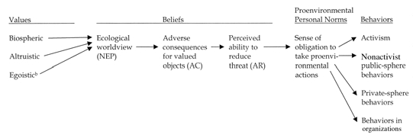
VBN theory (Stern 2000)
worldview determinants
normative determinants
+

Slide 17
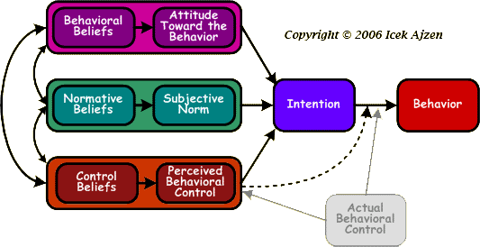
I.Ajzen. Theory of planned behaviour
normative determinants
http://people.umass.edu/aizen/tpb.diag.html#null-link

Slide 18
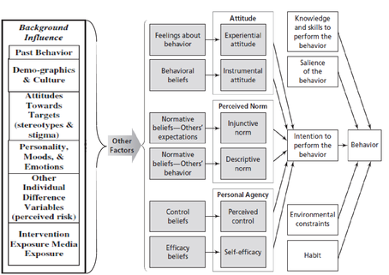
Integrated model
Eshetu, G. (2011). The Complimentary Effects of Integrative Behavioral Prediction and Media Priming for Message Delivery in Changing Hand Washing Behavior of Primary School Children In Chandba: A study in North Gondar Zone.

Slide 19
Limitative/operative determinants
Limitative determinants:
  availability of infrastructure, technologies
Operative determinants:
  having necessary tools to conduct a behavior,
  governmental regulations,
  community expectations.
Societal level factors that make limiting or enabling contexts for individual behavior.
e.g., Van der Meer (1981)

Slide 20
Constrained behaviour thesis
Behaviour that is relatively more difficult to conduct is less likely in many populations.
Constrains might occur because of behavioral situational characteristics (e.g. lack of income or time) or context forces (e.g. lack of infrastructure, low community support).
Interestingly, Guagnano et al (1995) state that when contextual factors are strong and environmental behavior is constrained, e.g. difficult to conduct, time-consuming, expensive attitudinal and normative variables only weakly correlate with behaviour.

Slide 21
M.Weber. Types of social action
rational
irrational
Value-rational
I do so because it corresponds to my values, principles.
Affectional action
I act as led by emotions
Traditional action
I do so because everybody is doing the same.
Instrumental action
I do this because it helps me to achieve the goal.
Why individuals behave as they do?

Slide 22
Linking theories
1. Behind -personal
2. Personal
3. Inside - personal
External factors
Biographic situation
Value
Affective
Traditional
Instrumental
Affluence thesis
notion of everyday life-world
constrained behaviour
theory
Inglehart post-materialism
VBN theory
Limitative/
operative determinants
thesis of biographical availability
HEP-NEP theory

Slide 23
Data based examples of env. behaviour in various countries

Slide 24
Private sphere env. behaviour
ISSP Environment, 2010, N=45199

Slide 25
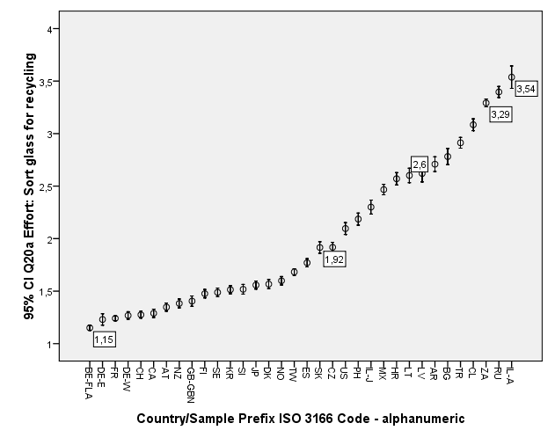
Recycling behaviour*Country
Never
Sometimes
Often
Always
ISSP Environment, 2010, N=41786

Slide 26
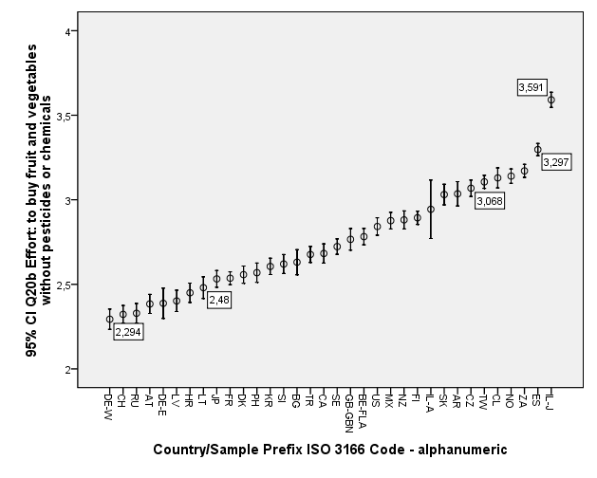

Slide 27
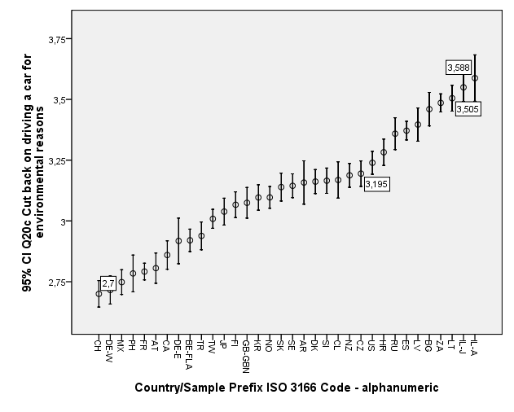
Cut back on driving a car*Country
Never
Sometimes
ISSP Environment, 2010, N=45199

Slide 28
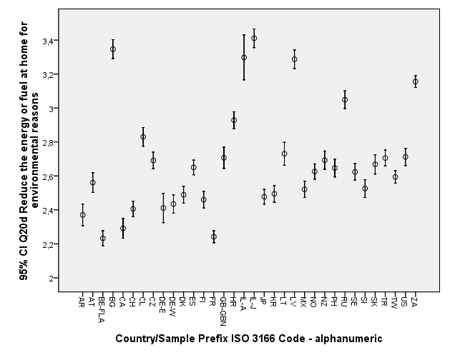

Slide 29
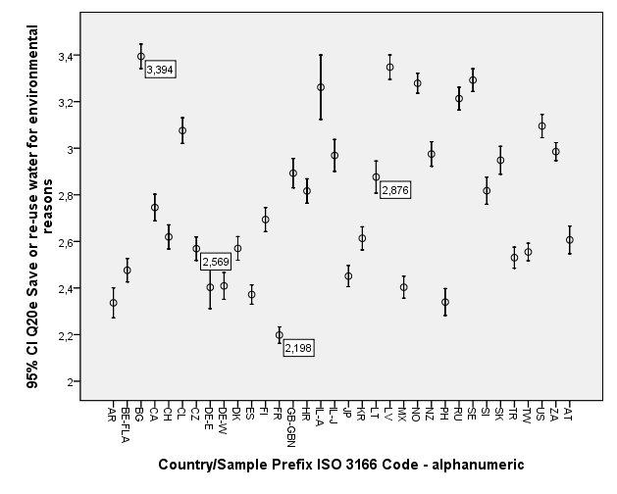

Slide 30
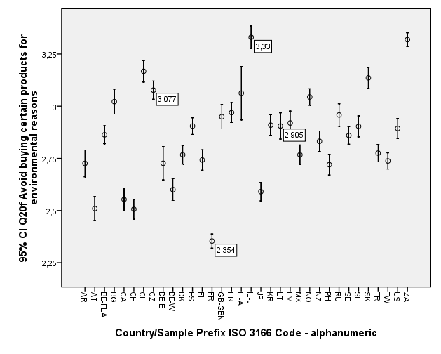

Slide 31
Public sphere env. behaviour
Electronic signature !
ISSP Environment, 2010, N=45199

Slide 32
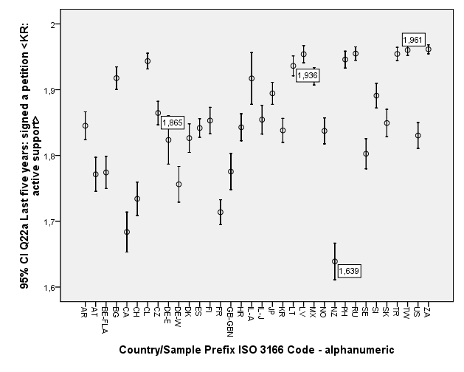
Signed a petition*Country
ISSP Environment, 2010, N=44489

Slide 33
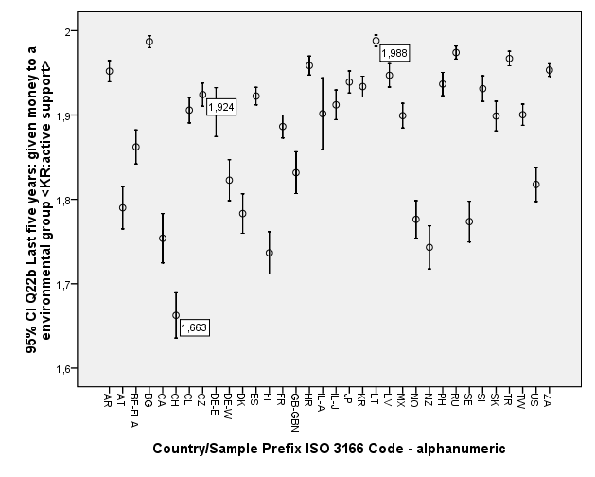

Slide 34
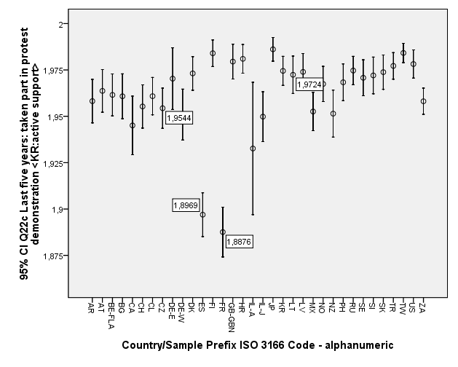
Took part in protest*Country
ISSP Environment, 2010, N=44411

Slide 35

Cutting back on driving a car: behaviour explained
influencing factors
Habit
Normative determinant
How to break
the habit?
No alternatives;
part of social status
Other pro-environmental behaviour
Normative determinant
Reducing personal car usage
Norm reinforcing
Knowledge and concern
Worldview determinants, shaped by biography
EXAMPLE. ISSP 2010 Environment data for Lithuania + Qualitative research

Slide 36
Why individuals act as they do?
Value-rational
Affectional action
Traditional action
because everybody is doing the same
Instrumental action
because it helps to achieve the goal
Because of emotions
because it corresponds to values, principles
Yes
Yes
No
Yes
Cutting back on driving a car

Slide 37


How to break the habit?
Examples
Sports mega events: Sochi Olympic games
Creative agency: Environmental Health Clinic

Slide 38
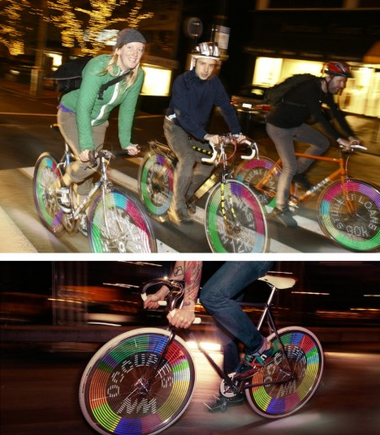
Bike Messenger

Slide 39
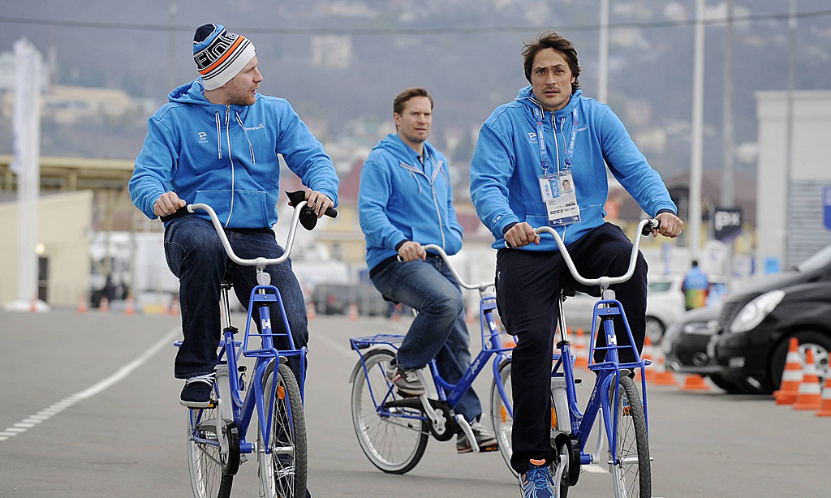
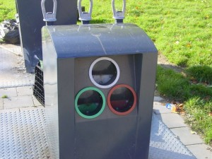
Sports mega-events oblige for infrastructural and socio-cultural transformations of urban systems.
Surveys traced change in environmental practices and consumption in Sochi.
P. O. Ermolaeva (2015) [unpublished]
Notes:
E.g household waste sorting containers, bike rental center, bike paths.

Slide 40
Concluding remarks
Behaviour specific explanations
recycling ≠ litter control ≠ car driving
Power of habit
Enabling/restraining contexts
Influencing worldviews
Reinforcing norms

Slide 41
Types, explanatory models and data based examples of environmental behaviour
Masaryk University, Brno
Audronė Telešienė
9th December, 2014

