Slide 1
Documents
National security: case of Russia
1992 Federal Law “About Security”
1996 President's annual address to the Federal Assembly (!first NS!)
NS Consept
1997 1st edition
10.01.2000 2nd edition
NS Strategy 2020

Slide 2

Concept
Strategy
lat. conceptio: 1) collection; 2) conception; 3) perception of the concept; 4) composition.
compact theory, deployed a certain concept
GK. stratos (army) and ago (lead).
generic action plan, the basis for specific plans, unplanned decisions

Slide 3

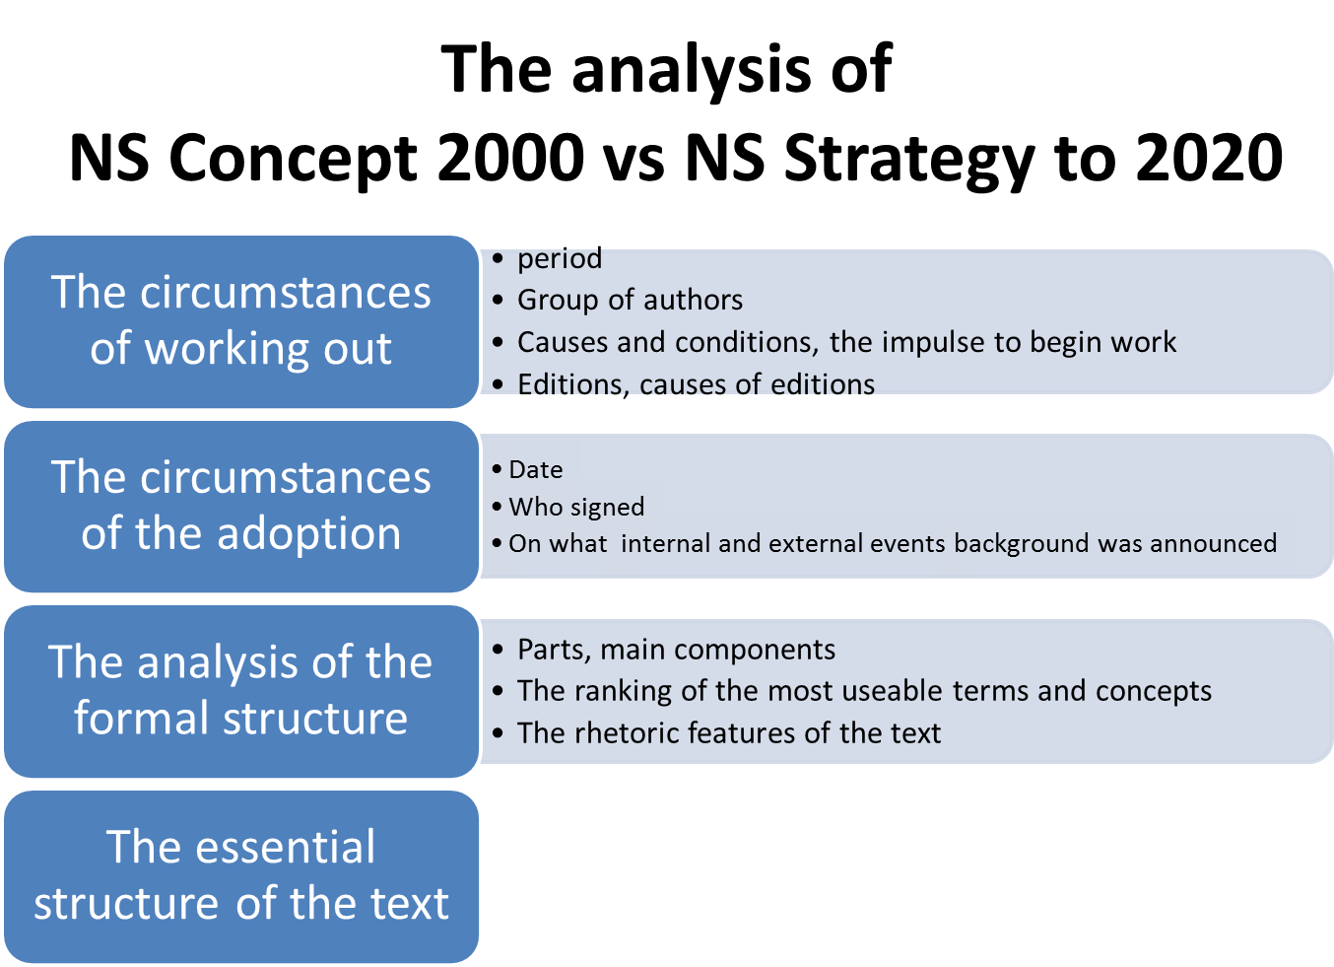

Slide 4
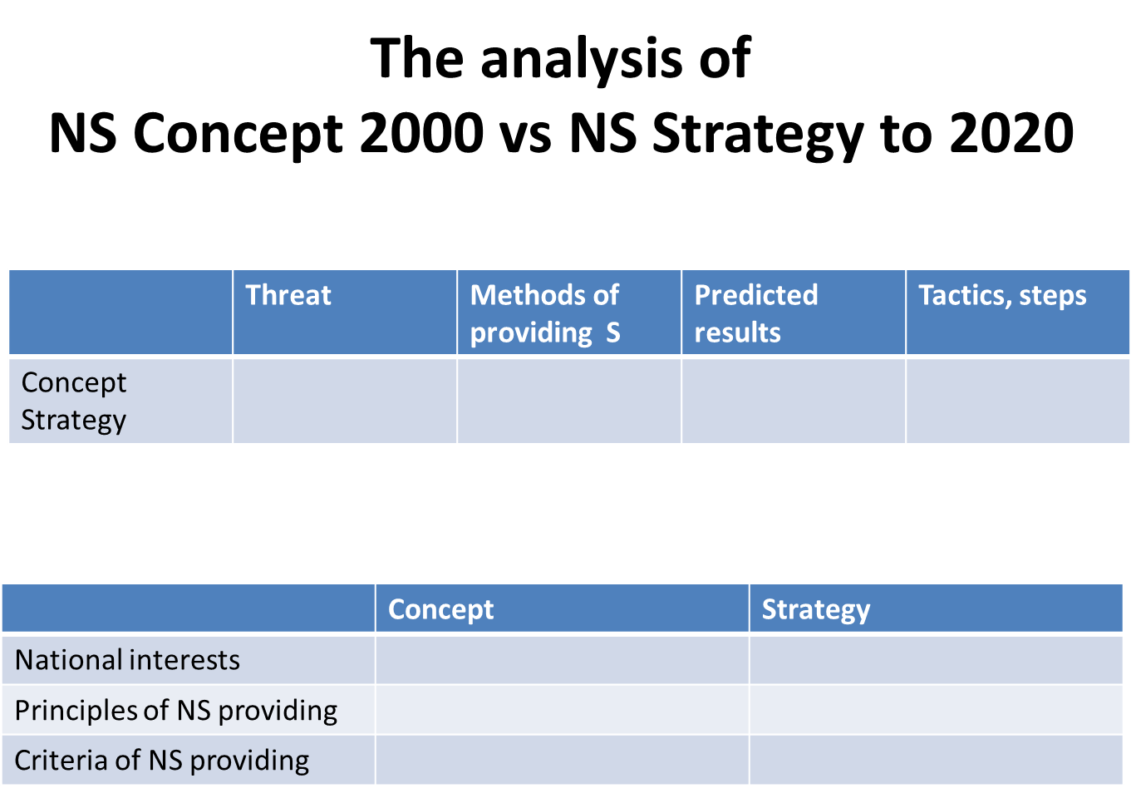
Conclusions: common and special,
Assumptions of Russian political system’s evolution based on docs
Research program (questions, hypothesis)

Slide 5

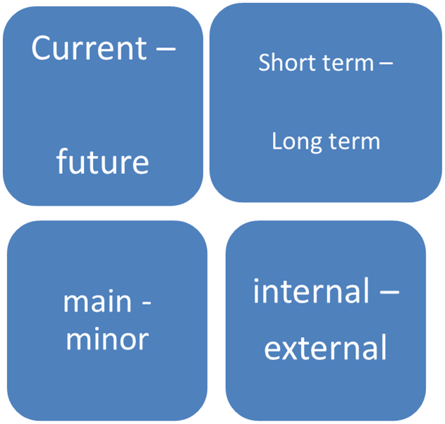
National interests
- conscious goals and values
Arena of providing NI
External
Internal
Borders

Slide 6
Criteria of NS providing
National security: case of Russia
High quality operational and strategic management, the availability of reserve capacity management
The ability to develop concepts and technologies
the ability to evacuate population and values
Protection of the built environment and population from external factors and destructive actions
The availability of supplies,
power reserve
the dominance of common interests
even if there are internal conflicts

