Slide 1
Lecture 2
R101: A practical guide to making R your everyday statistical tool (PSY532)
Basic ANOVA and regression

Slide 2
Programme
T-tests
Linear regression
ANOVA
Repeated-measures ANOVA
Logic of the analysis
Hypotheses from our dataset
  Regression: A hypothesis from a related but slightly different experiment
  ANOVA: As for regression + Hypothesis 2 from Lecture 1
  Repeated-measures ANOVA: Hypothesis 1a from Lecture 1
Working together in R:
  Obtaining descriptive statistics
  Running the analysis
  Checking assumptions
Reporting the analysis
Seminar: Repeated-measures ANOVA; bootstrapping
Readings: LSR for everything except Repeated-Measures ANOVA

Slide 3
T-tests
Reading: LSR, Ch 13
Used for comparing:
  two means that come from different groups with the same variance on a measure (Student t-test)
  two means that come from different groups with differing variances (Welch test)
  a group mean and a theoretical value (one-sample t-test)
  means recorded by the same people in different conditions (related samples t-test)
Quick demonstration of the Welch test: Did participants who were asked to think aloud during the soccer game score higher on the measure of supernatural strategising (PostSupIoC)?
R has other packages for running t-tests but an advantage of the lsr package is that it calculates a Cohen’s d, a measure of effect size – i.e., of the size of differences between two groups.

Slide 4
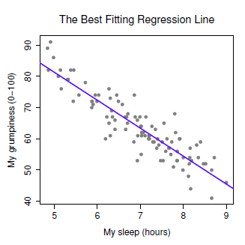
Linear regression
Reading: LSR, Ch 15
Logic of the analysis – one predictor
We use a sequence of calculations (maximum likelihood estimation; MLE) to draw a line that minimises the sum of the squared values of the residuals
MLE makes two key assumptions:
  Residuals are normally distributed (with mean 0) and have a standard deviation that is the same at every value of the predicted variable/ “outcome” variable (grumpiness)
  There is a linear relationship between the predictor (sleep) the outcome (grumpiness)
residual for observation i of N (e.g., day 78 of 80)

Slide 5

Logic of the analysis – one predictor (continued)
R² tells us the extent to which the sum of squared residuals is smaller than the sum of the following: square of (each value of the outcome variable minus the mean of the outcome variable)
Two answers to the same question of whether there is a significant relationship between the predictor and the outcome (null hypotheses in green):
  T-test to determine whether the slope of the regression line (slope coefficient in the model) is significantly different from zero
  F-test (ANOVA) to determine whether the model performs better than an intercept-only model (i.e., an equation in which the slope coefficient equals zero and the intercept then equals the outcome variable’s mean)
horizontal line at the mean of the outcome variable (grumpiness)
The model:
Slope coefficient
Intercept
Residual

Slide 6
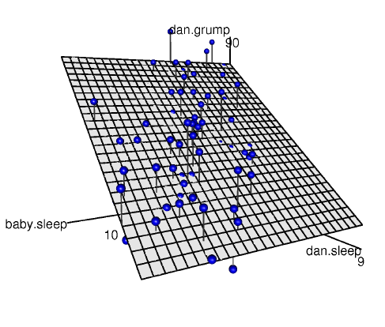
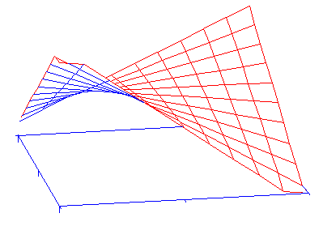

Logic of the analysis – two (or more) predictors
Y
We use MLE to determine an equation that minimises the sum of the squared values of the residuals (equation of a 3D plane for two predictors)
MLE makes the same key assumptions as for analyses with a single predictor
Interactions between the predictors are possible
Depression
X₂
X₁
Responsibility
The model:
Income
The model:
Y_{i} = b₂X_{i2} + b₁X_{i1} + b₃X_{i1}X_{i2} + b₀ + ε_{i}
http://www.ats.ucla.edu/stat/sas/teach/reg_int/reg_int_cont.htm

Slide 7
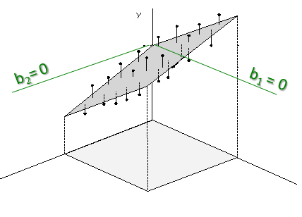
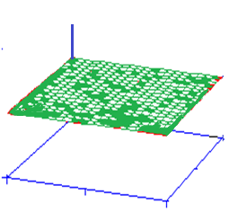
Logic of the analysis – two predictors (continued)
Y
b₁
R² has the same meaning, but you can also calculate adjusted R² , which is smaller than R² if there are many predictors and/or the sample size is small
Three associated hypothesis tests (null hypotheses in green):
  T-tests for each coefficient in the model: is it significantly different from zero?
  F-test (ANOVA) to determine whether the model performs better than an intercept-only model (i.e., an equation in which all slope coefficients equal zero and the intercept is then equal to the outcome variable’s mean)
  Hierarchical regression: F-test (ANOVA) to determine whether a model featuring one or more additional predictors performs better than the original model
b₂
X₂
X₁
Intercept-only model
Y
Horizontal plane from the mean of the outcome variable (Y)
X₁
X₂
p. 481

Slide 8
Hypothesis from our dataset (actually from another very similar dataset; SF in your Study Materials/Data folder)
Experiment
N = 97
100 trials of the soccer-themed slot-machine task under one of five win-frequency conditions
  1 win per 2 trials, per 3 trials, per 4 trials, per 8 trials and per 16 trials
Pre-game and post-game questionnaires almost identical to those in the Success-Slope experiment from Lecture 1. Final win amount (final credits) also calculated.
Hypothesis
In many causal judgement experiments, as the frequency with which two events co-occur increases, conclusions that one event causes the other have been found to increase in strength. Example: treatment with a certain drug and recovery. Here, we expect the same to the be the case for wins and choices made during the game. As win frequency increases, choices should come to be considered more causally effective (i.e., more strategic). Win frequency should predict natural or supernatural illusion of control.

Slide 9
Post-game measure of illusion of problem-solving – slight difference from SS data
‘Natural’ IoC
My skill in playing the game.
I got better with practice.
I developed a logical strategy for playing.
Experience in playing computer games.
Natural IoC variable: Average of these items
‘Supernatural’ IoC
I took advantage of moments when my luck was good.
I’ve always been a lucky kind of person.
I knew how to make my luck turn good.
A certain lucky way of playing just seemed to work for me.
The players I chose.
I learned how to predict the movements of the goalkeeper.
Supernatural IoC variable: Average of these items
All chance.
It was all chance.
We will use Supernatural IoC (PostSupIoC) as our outcome variable in this demonstration because it has more items and is therefore a potentially more reliable measure of the illusion of problem-solving.

Slide 10
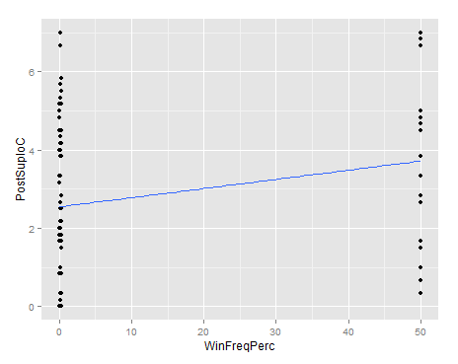
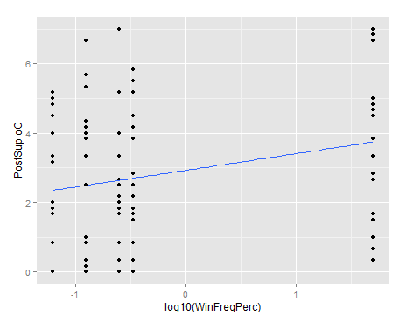
Working together in R – descriptive statistics
Graph – ggplot2 commands are in the script
Correlation table
As shown in the script, create a subset data frame of the variables you want to correlate, then use the correlate function in the lsr package. You should include all possible predictors of the outcome variable for which data is available.

Slide 11
Working together in R – Running the analysis
Revised hypothesis based on the correlation table
Once gambling-related beliefs and soccer interest assessed in the pre-game questionnaire (PreSoccerInterest; PreDBC_Sup) are accounted for, win frequency (LogWinFreqPerc) is a significant predictor of the illusion of supernatural control (PostIoCSup).
See script for a demonstration of a hierarchical regression approach to testing this hypothesis. We use the lm and anova functions for which you do not need to install a package (they are in the ‘base’ package). We also make use of the lsr package.

Slide 12
Working together in R – Checking assumptions
Assumption | Checks available in R | If the assumption is not met...
Normality of residuals | hist(residuals(model1), breaks = 20) plot(model1, which = 2) shapiro.test(residuals (model1)) | Transform one or more of the predictors
Constant variance of residuals lack of influential points homogenieity of variance | plot(model1, which = 4) plot(model1, which = 5) plot(model1, which = 3) ncvTest(model1) | Run regression without influential points (see script) Run regression with heteroscedasticity-corrected covariance matrix (see script)
Linearity of the relationship between the outcome and the predictor(s) | Plot of fitted values against observed values plot(model1, which = 1) residualPlots(model1) | Transform one or more of the predictors

Slide 13
Reporting the analysis
Table showing coefficients, R², T-test and hierarchical regression results (if any). Standardised coefficients (β) tend to also be reported.
Summary of results, given the hypothesis: Overall, the analysis indicated that illusion-of-control ratings increased with increases in win-frequency, once the influence of background beliefs and soccer interest was accounted for.
Hierarchical regression step | Predictors | b | SE b | β | t | p | Adj R²
1 | Intercept
 | DBC total
2 | Intercept
 | DBC total
 | Win-frequency

Slide 14
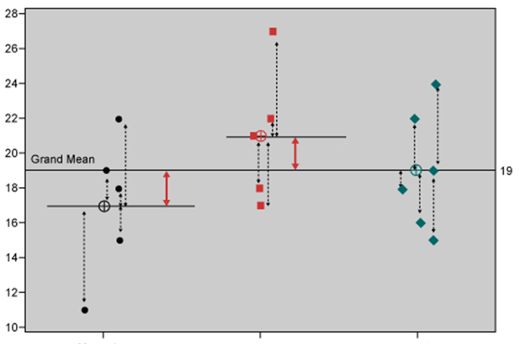
ANOVA: Independent measures
Reading: LSR, Ch 14 and 16
Logic of the analysis – one predictor (here, drug type, with 3 levels)
We calculate two quantities:
  Sum of squares expressing difference between each individual score and the group mean: ......
  Sum of squares expressing difference between group means and grand mean – variability due to factor (drug type)
These enable us to compute an F-value, which can then be tested for significance.
Anxiety
Group means
Anxifree
Joyzepam
Placebo
*Note: Data in illustration does not correspond to textbook

Slide 15
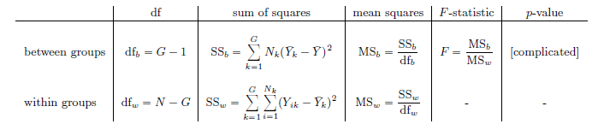

N is number of participants
G is number of groups
i is a participant number
k is an integer representing the group number/factor level
Effect size – eta-squared:
SS expressing difference between all scores (regardless of group) and grand mean

Slide 16
Logic of the analysis: The F-statistic as a model comparison
The F-test, as it is used in both ANOVA and regression, is really a comparison of two statistical models.
In an ANOVA with one predictor, the F-test is a comparison of an intercept-only model (M0, null hypothesis) to a model involving the intercept and the predictor (M1, alternative hypothesis).

Slide 17
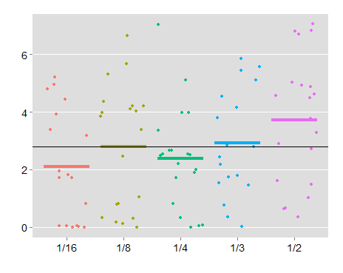
Logic of the analysis – ANOVA as regression (illustration for ANOVA with one predictor)
PostSup IoC
Grand mean
A group mean selected by researcher (e.g., the lowest win-frequency condition).
Win frequency
When we use the aov function, the chosen group’s mean is the intercept (baseline) in a “dummy coded” regression. In this case, the regression has four predictors (see next slide). Using the aov function additionally involves a model comparison (see script, ANOVA Example 1).

Slide 18
Win frequency data (first 6 cases) “dummy coded” with 1/16 as reference group
PNo | SupIoC | 1/8 (X₁) | 1/4 (X₂) | 1/3 (X₃) | 1/2 (X₄)
2 | 0.8333 | 1 | 0 | 0 | 0
3 | 0.0000 | 0 | 0 | 0 | 0
4 | 2.5000 | 0 | 1 | 0 | 0
5 | 4.1667 | 0 | 0 | 1 | 0
6 | 0.6667 | 0 | 0 | 0 | 1
7 | 4.5000 | 0 | 0 | 0 | 0
The regression model:
Y_{p}= b₁X_{1p} + b₂X_{2p} + b₃X_{3p} + b₄X_{4p} + b₀ + ε_{i}
We determine the values of b₀, b₁, b₂, b₃ and b₄ using the summary.lm function.
SupIoC of participant p
Mean of 1/16 group
Difference between means of 1/2 group and 1/16 group
Participant p’s code on X₁

Slide 19
Other possible contrasts in the regression component
The dummy coding in the previous slide contained a treatment contrast.
Other possible contrasts include Helmert, sum-to-zero (“effect coding”) and manually set orthogonal contrasts.
Win frequency data (first 6 cases) with Helmert contrast and 1/16 as reference group:
PNo0 | 1/8 (X₁) | 1/4 (X₂) | 1/3 (X₃) | 1/2 (X₄)
2 | 1 | -1 | -1 | -1
3 | -1 | -1 | -1 | -1
4 | 0 | 2 | -1 | -1
5 | 0 | 0 | 3 | -1
6 | 0 | 0 | 0 | 4
7 | -1 | -1 | -1 | -1
This coding enables us to contrast the second level with the reference level, the third with the average of the first two, and so on.

Slide 20
Win frequency data (first 6 cases) with sum-to-zero contrast (“effect coding”) and 1/2 as reference group (as per script):
PNo | 1/16 (X₁) | 1/8 (X₂) | 1/4 (X₃) | 1/3 (X₄)
2 | 0 | 1 | 0 | 0
3 | 1 | 0 | 0 | 0
4 | 0 | 0 | 1 | 0
5 | 0 | 0 | 0 | 1
6 | -1 | -1 | -1 | -1
7 | 1 | 0 | 0 | 0
This coding enables us to contrast the mean of each group except the reference group with the grand mean. The grand mean is “weighted” (see script) if the groups are not equal in sample size.
The regression model:
Y_{p}= (1/5)b₁X_{1p} + (1/5)b₂X_{2p} + (1/5)b₃X_{3p} + (1/5)b₄X_{4p} + b₀ + ε_{i}
Mean of 1/16 group minus weighted grand mean
Mean of 1/8 group minus weighted grand mean
(Weighted) grand mean

Slide 21
Rules for manually setting orthogonal contrasts
Rules:
The weights within any contrast must sum to zero
The weights for any pair of contrasts must sum to zero when the dot product is taken.
Illustration:
  Contrast A = (a, b, c, d, e)
  Contrast B = (f, g, h, i, k)
  Contrast C = (l, m, n, o, p)
If the rules are met:
a + b + c + d + e = 0, f + g + h + i + k = 0, and l + m + n + o + p = 0
a*f + b*g + c*h + d*i + e*k = 0, l*f + m*g + n*h + o*i + p*k = 0, and
  a*l + b*m + c*n + d*o + e*p = 0
For a worked example, see ANOVA Example 3 in script.
Each contrast should compare two sets of means (e.g., mean of a, b and d to the mean of c and e). Chunks with a negative weight (e.g., -1) are compared to chunks with a positive weight. So in this example, we would assign weights like this: (1, 1, -1, 1, -1) or (-1, -1, 1, -1, 1).
Reading: Field chapter
Notes:
.

Slide 22
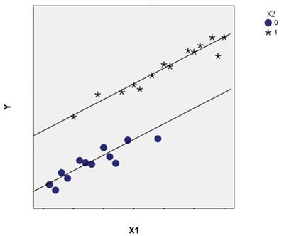
Logic of the analysis – ANCOVA (with one predictor and one covariate)
(categorical predictor, here with two levels; e.g., win-freq of 1/2 vs. 1/16)
If the categorical predictor has more levels (e.g., 5 as in our example), there might be more parallel lines:
  The vertical distance between lines represents the effect of the categorical predictor
Two covariates could be visualised as parallel regression planes.
Parallel slopes (lack of relationship between predictor and covariates) are assumed.
Covariates can be categorical!
(outcome variable; e.g., PostSupIoC)
(covariate; e.g., beliefs in value of strategies even before the game – PreDBC_Sup)

Slide 23
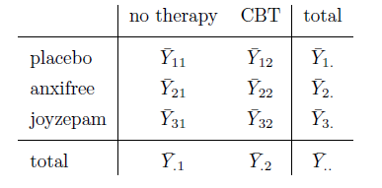
Logic of the analysis – ANOVA with two or more predictors
From the same data that gives us this table,
Factor B (2 levels)
Group means – e.g., for group 1,1
Row marginal means
Factor A
(3 levels)
Grand mean
Column marginal means
we can calculate...

Slide 24



Total sum of squares expressing distance between all data points and grand mean
Sum of squares expressing difference between row marginal means and grand mean – variability due to Factor A
Using the first four quantities, we can calculate the residual sum of squares
Sum of squares expressing difference between column marginal means and grand mean – variability due to Factor B
This is all the information we need for computing the F-value for each predictor and interaction term. We can also compute an effect size (eta-squared) for each predictor/interaction – e.g., for Factor A:
Sum of squares expressing the extent to which the group means cannot be predicted based on the marginal means alone – variability due to interaction between A and B (see next slide)
Four sets of degrees of freedom:
For Factor A
For Factor B
For the interaction between A and B
For the residuals

Slide 25
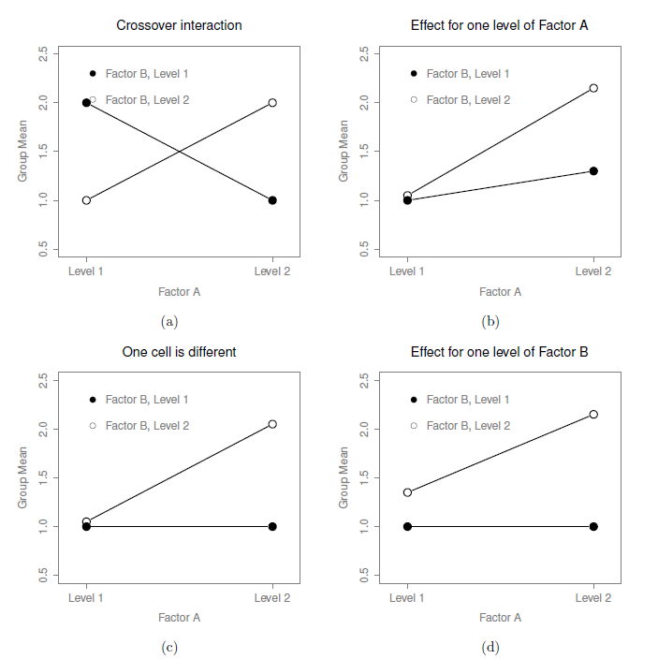
Interactions

Slide 26
Logic of the analysis: Different types of hypothesis tests (model comparisons) in unbalanced designs
An issue to consider in any factorial ANOVA (i.e., ANOVA with two or more predictors) where group sample sizes are not equal (e.g., where group 1,1 has N = 25 and group 3,1 has N = 17)
To do with the F statistic as a model comparison (see earlier slide)

Slide 27
Name | Model comparison method | Recommended for | Not recommended for
Type I Sums of Squares (R default) | Sequential; The first term that is entered “grabs” all the variance in Y that it can. The second term grabs as much as possible of the remaining variance, and so on. | Situations where cell sizes (1,1; 1,2 etc) reflect differences in proportions in the population. Situations where it is crucial to know the effect size (eta squared). | Situations where you do not have a theoretical justification for the ordering of predictors.
Type II Sums of Squares | Non-sequential, hierarchical; The null model always contains less terms, so that the term whose significance we are trying to test is not part of a higher-order term in the model (i.e., an interaction). | Most situations
Type III Sums of Squares (SPSS default) | Non-sequential, unique; The null model always contains one less term, corresponding to the term whose significance we are trying to test. |  | Situations where you expect a significant main effect and an interaction. The main effects are meaningless when there is a significant interaction.

Slide 28
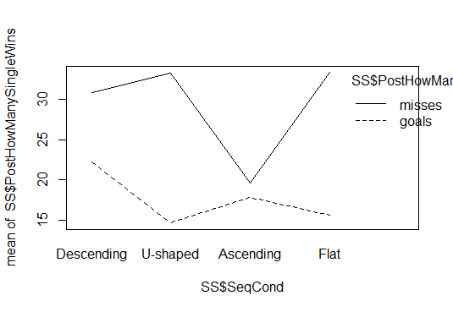
Working together in R – descriptive statistics
Interaction plot
Plot suggests that there might be an interaction.
Descriptive statistics
As shown in the script, check for a correlation between the outcome variable and any proposed covariates. Also use the psych package to generate relevant descriptive statistics, as we did in the last lecture.

Slide 29
Working together in R – Running the analysis
A different hypothesis – this time from our SS data (Hypothesis #2)
Once gambling-related beliefs (PreDBC_Total) are accounted for, a higher percentage of wins (PostHowManySingleWins) should be remembered in the descending condition relative to the others (SeqCond). Sequence condition could interact with question wording (PostHowManySingleCaptionType).
See script for a demonstration of a Type II Sums of Squares ANCOVA test of this hypothesis. We use the lm function for which you do not need to install a package. The Anova function we use is in the car package. We also make use of the psych package (describeBy), and the effects package (function: effect).

Slide 30
Working together in R – Checking assumptions
Assumption | Checks available in R | If the assumption is not met...
Normality of residuals | hist(residuals(anova_ SSHyp2)) shapiro.test(residuals (anova_SSHyp2)) | Try a generalised linear model – discussed in a few lectures’ time
Constant variance of residuals across predicted group means – homogeneity of variance | leveneTest(formula) – car package. Formula must specify a saturated model (i.e., a model with all possible main effects and interactions) with no covariates. | oneway.test() kruskal.test()
Homogeneity of regression slopes (ANCOVA) | HRS <- aov(outcome variable ~ predictor*covariate) or with multiple predictors: HRS <- aov(outcome variable ~predictor1*predictor2 *covariate) Anova(HRS, type = 2) | Try a more complex model where the covariate is a predictor
Independence between the covariate and predictor(s) (ANCOVA) | aov(predictor1*predictor2~covariate) | Try a more complex model where the covariate is a predictor.

Slide 31
Reporting the analysis – as in Results section
Table (or very clear graph) showing means and SDs across factor levels. As in the interaction plot.
In text: An ANCOVA (with Type II Sums of Squares) was conducted with percentage of remembered wins as the outcome variable, success-slope and question wording as predictors, and background beliefs (Drake Beliefs About Chance total score) as a covariate. After the significant influence of background beliefs was accounted for (F(1,325) = 11.32, p < .001, eta-squared = .03), the analysis revealed a significant main effect of success-slope (F(3,325) = 3.10, p = .03, eta-squared = .02), a significant main effect of question wording (F(1,325) = 38.08, p < .001, eta-squared = .09), and a significant interaction effect (F(3,325) = 3.83, p = .01, eta-squared = .03). Planned comparisons of the Descending condition’s mean to those of other groups under a treatment contrast revealed a significant difference between the Ascending and Descending groups (p = .05). As regards the interaction, the effect of question wording was found to be marginally significantly different in the Ascending, as compared to the Descending, condition (p = .07). As the descriptive statistics suggest, question wording was irrelevant to the win-frequency estimates of participants in the Ascending condition. Notably, the homogeneity of variance assumption was violated in the analysis.
F values (with degrees of freedom), p values and effect sizes can also be reported in a table.
A table showing estimated marginal means could also be included.

Slide 32
Discussing the analysis – as in Discussion section
The results suggest that more wins were remembered when most wins were concentrated early in the experienced sequence, rather than late in the sequence. This is partly consistent with our expectation that memory for wins would resemble memory for word lists, where the words at the top of the list are remembered more clearly. Interestingly, the early-wins condition did not differ from the evenly-spaced and U-shaped conditions in terms of remembered wins. For the U-shaped condition, a likely explanation is that the early wins there were clearly remembered. For the evenly-spaced condition, it is possible that memory was boosted by the “spacing” of the wins. The effects of spacing are well-known in the memory literature. Words tend to be remembered better the wider their spacing across time. The spacing effect is also likely to have been responsible for the effects of question wording. People seemed to have been underestimating the frequency of losses, possibly because these were not as widely spaced as wins. Why this effect of question wording was not observed in the late-wins (Ascending) condition is unclear.

Slide 33
Reading
Navarro, D. J. (2014). Learning statistics with R: A tutorial for psychology students and other beginners. Available online: http://health.adelaide.edu.au/psychology/ccs/teaching/lsr/. Chapters 13-16.
Baguley, T. Serious Stats: A Guide to Advanced Statistics for the Behavioural Sciences. Palgrave Macmillan: UK. Chapter 16 “Repeated Measures ANOVA” (pdf in Study Materials/Readings).
Field, A., Miles, J., & Field, Z. (2012). Discovering Statistics Using R. Sage: UK. Chapter 10. Comparing several means: ANOVA (pdf in Study Materials/Readings).

