Slide 1
Lecture 3 + Seminar 3
A workshop on graphing using ggplot2

Slide 2
Plotting packages in R
Graphics functions in the base package: plot( ), hist( ), etc.
lattice package
ggplot2
Specialised functions inside other packages: plotrix, car, plotmeans, etc.
Have an internal logic for a range of statistical plots

Slide 3
Programme
Graphing and figures – general principles
Guidelines for different kinds of graphs and publications:
Specialist (colour) publications
Presentations
Journal papers (APA guidelines)
Quick plots using qplot (plus, a review on saving graphs)
More flexible graphs using ggplot
Final formatting using ggplot
Seminar and assignment: At the seminar, you will complete an exercise to create an APA-style plot. Then, to complete the assignment, you will need to add at least one additional piece of formatting at home.
Reading: book by the author of ggplot

Slide 4
General principles: Graphs and figures should...
Summarise and/or reveal data, making large datasets coherent
Encourage the viewer to think about the data being presented (rather than some aspect of the graph, like how pink, “pretty” or poorly visible it is)
Avoid distorting the data
Encourage the viewer to compare different pieces of data

Slide 5
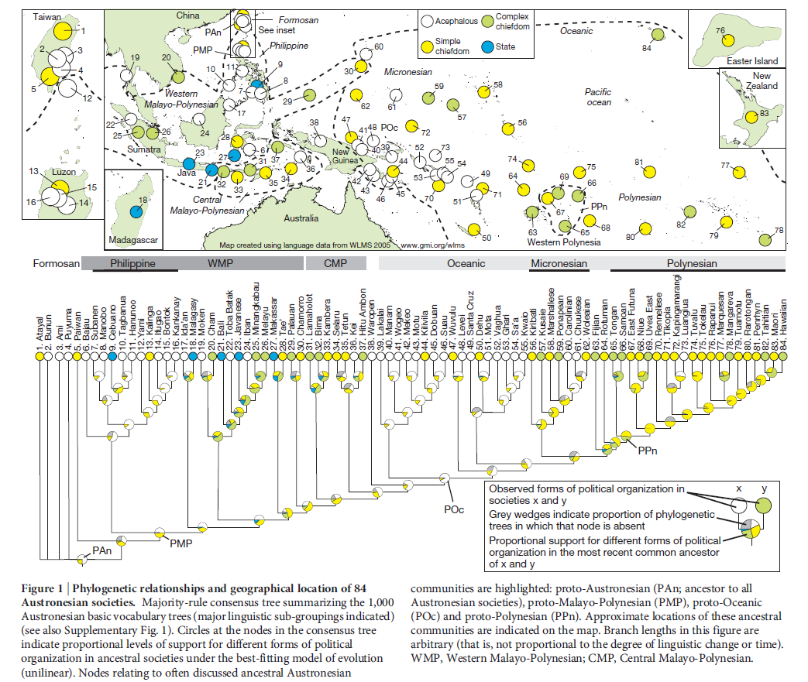
A graph that satisfies all four criteria despite its complexity:
Notes:
To be fully comprehensible, a graph like this needs to be prefaced by other figures.

Slide 6
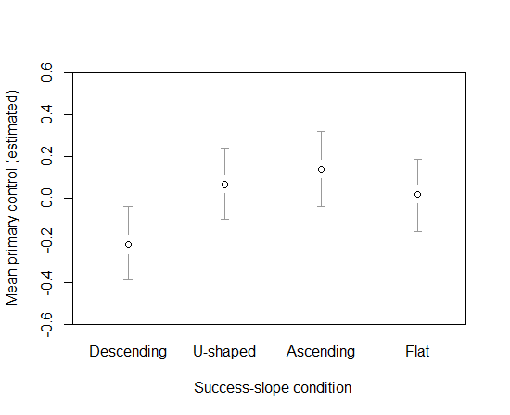
A graph that satisfies all four criteria despite its simplicity:
Figure 4.2. Estimated means (and 95% CIs) of inferred natural control across success-slope conditions when covariates (soccer interest and prior beliefs) were evaluated at their mean values.

Slide 7
Guidelines for different types of graphs
All graphs:
Think about when to start scales at the origin (0)
Bar graphs:
If needing colour, use pastel colours to avoid overwhelming the viewer.
Best to use some shading (e.g., grey or patterns) to prevent the graph from looking like a wire frame.
Histograms: consider displaying the mean/median value as well.
Graphs involving points (and possibly lines):
Vibrant colours work well for points and lines, making them quite visible.
Best to start y-axis at 0.
Use a line if there is a flow of time from one point to the next.
Patterns disappear if you stretch the x-axis too far.
Scatter plots:
Simplify the look by not using a thick border.
Any line through the dots must be thicker than the dots or in a brighter colour.

Slide 8
Guidelines for different publication types
Think about:
What story do you want to tell?
Who are you telling the story to?
Journal articles | Specialist (colour) articles | Conference presentations
Follow APA guidelines – e.g., page 4 in this style manual. | Follow APA guidelines as much as possible, but use colour if an additional explanatory tool is needed. Colours: think about whether they should be vibrant or neutral, given (a) your topic, and (b) whether you are plotting points or bars (see previous slide). | No caption available, so more labelling in the title or inside the graph is needed. Figures can be useful for a non-specialist audience. Same advice as for specialist articles regarding colour. For small sample sizes, you might not even need an x-axis and y-axis. Can instead label points of interest directly.
Notes:
Click on links

Slide 9
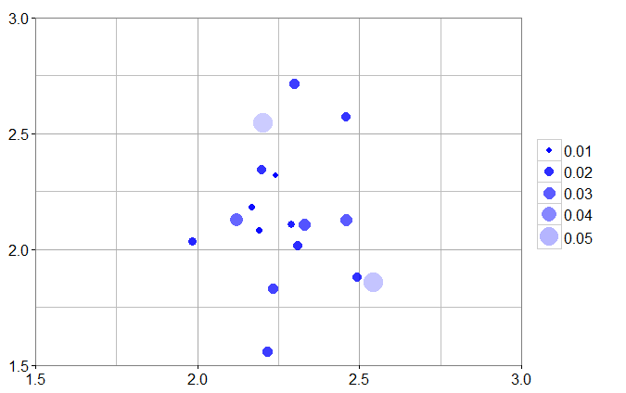
Highlighting individual data points:
University ratings by foreign students
Students highly unsure on average
University ratings by Czech students

Slide 10
Quick plots using qplot
The qplot function is in the ggplot2 package.
The function is very useful for data exploration, as it is possible to draw fairly complex plots with one or two lines of code.
The function is not useful for final plots for presentations and publications because the overall appearance of the plots is difficult to change.
Basic principle: "geoms" (representations of data) have "aesthetics“ (properties) that can be "mapped" to variables in the dataset or “set” to a desired value
geom examples: point, histogram, smooth (regression line)
aesthetics (aes) examples: x and y (the variables being plotted), colour, size, shape, alpha (transparency), group
additional arguments to do with avoiding overplotting: position and facet (facet_grid and facet_wrap)
Start script

Slide 11
Saving graphs: a review
In the Plots tab, Export -> Save Plot As Image... Then choose Image Format and Size
By default, graphs are saved to your working directory, but you can choose any folder by clicking “Directory” after clicking “Save Plot As Image”.
Back to script

Slide 12
More flexible graphs using ggplot
The ggplot function is also in the ggplot2 package.
Key concepts, apart from the already mentioned geoms, aesthetics, position, facet, setting and mapping:
Layers (+): The graph is not displayed until you add a layer, but it is customary to specify the aesthetics that apply to all layers at the very beginning.
Stats: Stats have default geoms, while geoms have default stats.
Each plot is treated as a variable (e.g., sepf3).
The aesthetics in each layer override any aesthetics specified at the beginning.
Search for these terms in the script and in the book for concrete examples.
We covered: overlaying of histograms and regression lines, adding error bars to line plots and bar plots, setting axis limits (coord_cartesian), faceting, and free scales.

Slide 13
Final formatting using ggplot
 | Adjusted through | Terms to find in the script
Overall colour-scheme: black and white? settings for colours | theme_set scale_colour_manual | theme_bw() scale_colour_hue() scale_colour_grey
Appearance of points | geom_point geom_params
Appearance of error bars | stat_summary (in our script) Other possibilities: geom_errorbar, geom_params | colour = "gray41"
Appearance of lines | scale_linetype_manual | scale_linetype_manual(values=c("dotted", "solid", "longdash", "dotdash"))
Gridlines | theme(panel.grid.major = element_line( )) theme(panel.grid.minor = element_line( )) | panel.grid.major = element_line(colour = "gray41", size = 1) panel.grid.minor.y = element_blank()

Slide 14
 | Adjusted through | Terms to find in the script
Labels along the axes | scale_x_continuous (when x is not a factor variable) scale_x_discrete scale_y_continous scale_y_discrete | scale_x_continuous(breaks = 1:2, labels = c("Trials 1-24", "Trials 25-48“, name = "Time period") scale_y_continuous(name = "")
Facet labels | theme(strip.text = ___) Changes to name of factor levels | strip.text.y = element_text(size=14, face = "bold") levels(longsub2$Measure) <- c("Kick Dir Entropy", "No. of Player\nChanges")
Text size | theme( ___ = element_text( )) | theme(axis.title.x = element_text(size= 20), axis.text.y = element_text(size=14, colour = "black")
Legend | scale_linetype_manual scale_colour_hue etc. Depending on what aesthetic (colour, linetype, shape) you have mapped the variable to theme(legend.text = ___) | scale_linetype_manual(values=c("dotted", "solid", "longdash", "dotdash"), name="Success Slope", breaks=c("Descending", "U-shaped", "Ascending", "Flat"), labels=c("Desc.", "U-shaped", "Ascending", "Flat")) legend.text = element_text(size=12)

Slide 15
Layering during final formatting (Script line 597)
If you are adding something to an existing layer – such as stat_summary( ) – you need to redraw the whole plot under its current name or a new name.
sepf3 <- ggplot(data = longsub2, aes(x=Time, y=Value, group = SeqCond)) +
geom_line(mapping = aes(linetype = SeqCond), stat = "summary",
stat_params = list(fun.y = mean), position = pd,
geom_params = list(size = .75)) +
facet_grid(Measure ~ ., scales = "free_y") +
stat_summary(fun.data = "mean_cl_normal", geom = "errorbar",
ymin = min,
ymax = max,
width = .05,
mult = 1,
position = pd,
colour = "gray41") +
geom_point(stat = "summary", stat_params = list(fun.y = mean), position = pd,
geom_params = list(fill = "white", shape = 21, size = 3)) +
scale_x_continuous(breaks = 1:2, labels = c("Trials 1-24", "Trials 25-48"),
name = "Time period") +
scale_linetype_manual(values=c("dotted", "solid", "longdash", "dotdash"))
sepf3

Slide 16
Layering during final formatting
If you are adding an entirely new layer, you can just use “+”, but it is best to avoid this, since you are highly likely to need to go back and make many changes to existing layers later on.
sepf4 <- sepf3 + theme(axis.title.x = element_text(size= 20))
sepf5 <- sepf4 + theme(axis.text.y = element_text(size=14, colour = "black"),
axis.text.x = element_text(size = 14, colour = "black"),
strip.text.y = element_text(size=14, face = "bold"))
There would be an error drawing this because some aspects of theme ( ) were already specified when drawing sepf4.

Slide 17
Reading
Wickham, H. (2009). ggplot2: Elegant Graphics for Data Analysis. Available online: http://moderngraphics11.pbworks.com/f/ggplot2-Book09hWickham.pdf
Additional resources:
Field, A., Miles, J., & Field, Z. (2012). Discovering Statistics Using R. Sage: UK. Chapter 4. Exploring data with graphs.
Support website: http://docs.ggplot2.org/current/
Notes:
Wickham book probably won’t be available online for long!

