Slide 1
Executive Hubris
U.S.-Israeli Perspectives

Slide 2
Hubris
Mediator = peace
Money = influence
Minority rights and concern
Media

Slide 3
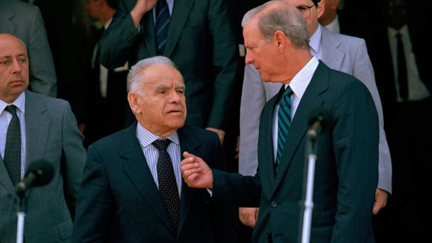

Slide 4
American
Since 1967 military aid
Since 1979 mediator
Since 1975 reassess 'threat'
Since 1982 "big brother"

Slide 5
Master
Paradox
Airlift
Modern relationship

Slide 6
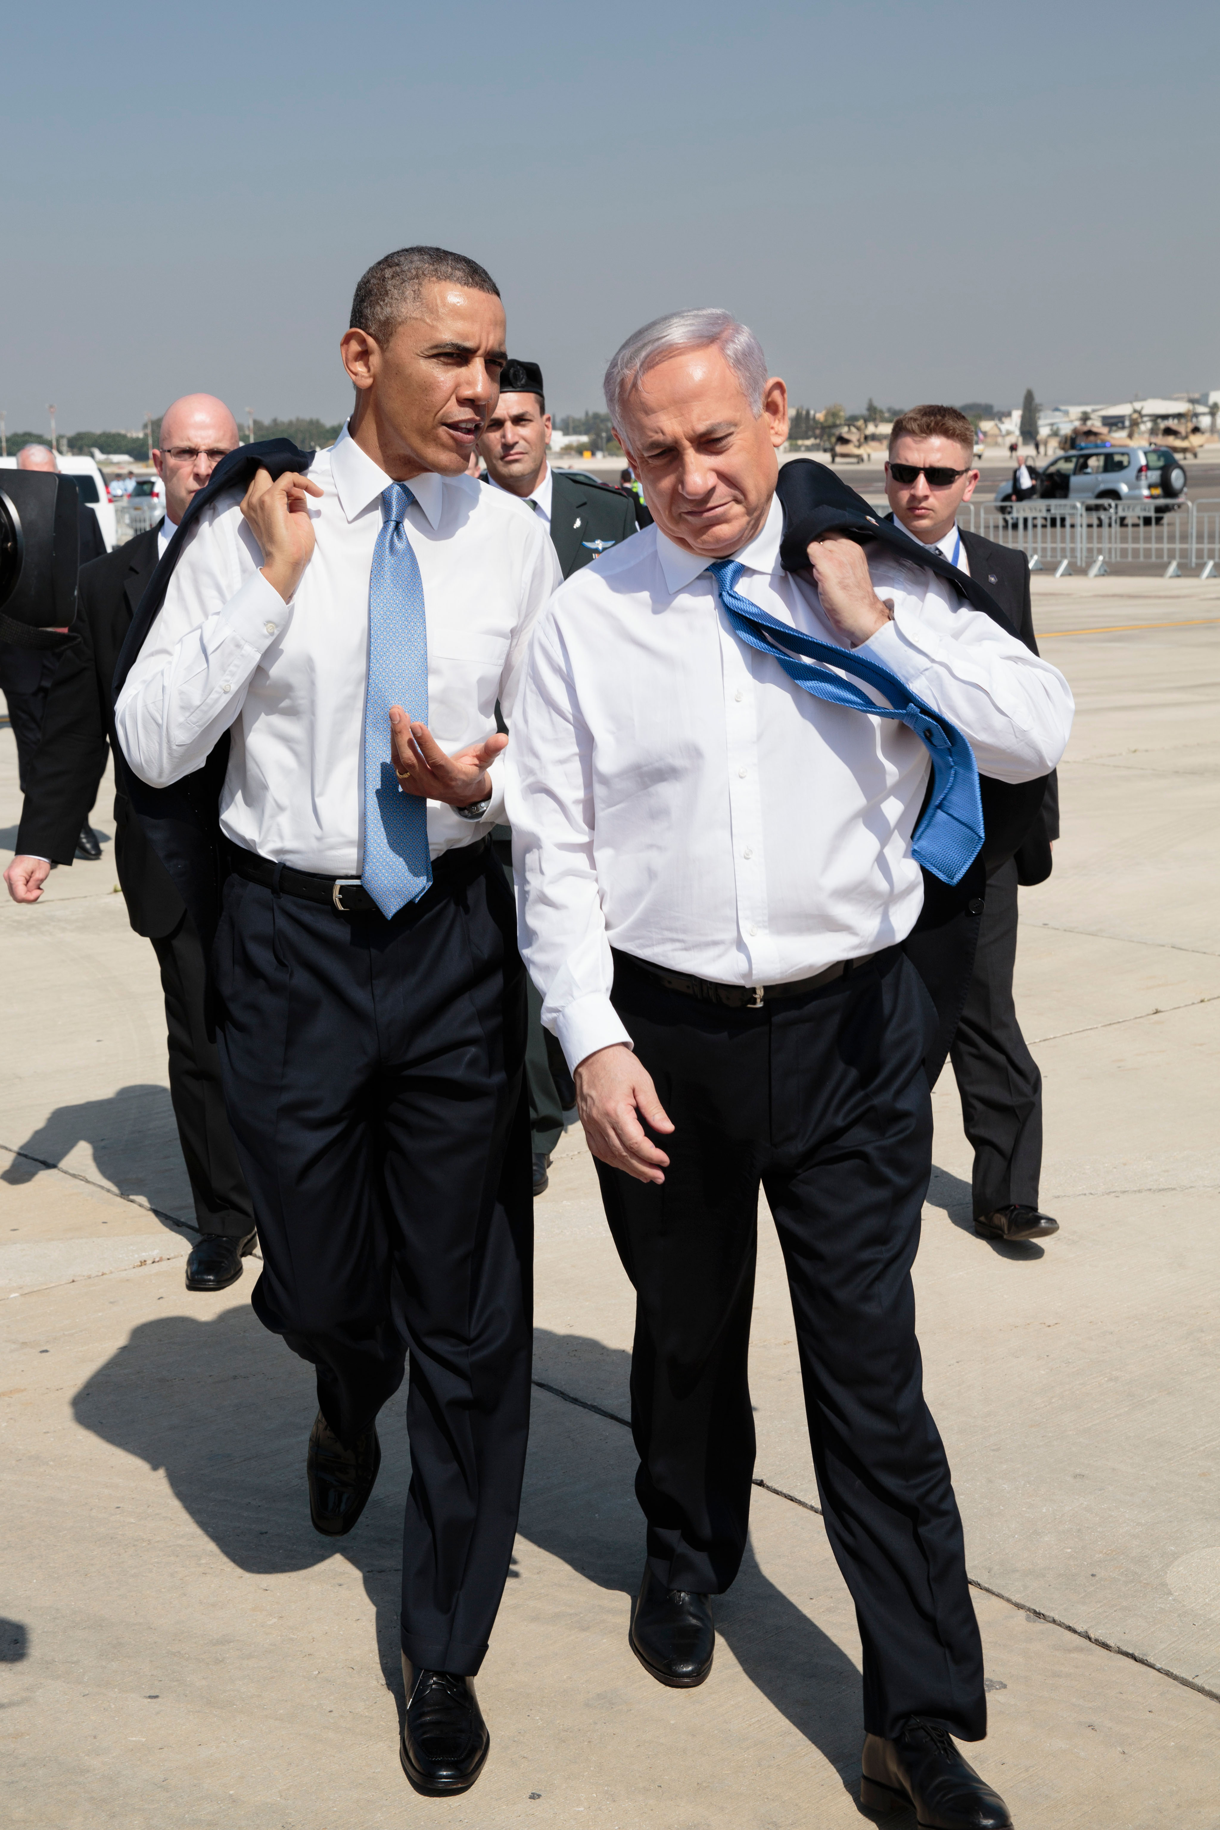
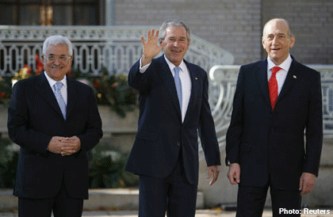

Slide 7
Israel
Since 1967 gained 2x land
Since 1967 minority issues
Since 1982 national security = foreign policy
Since 1993 "land for peace"
Since 2010 new allies

Slide 8
Unapologetic
Greater Israel
National security = foreign policy
Camp David
Lebanon

Slide 10
Policymakers
Presidents
National Security Advisors
Secretary's of State
Envoys: Dennis Ross

Slide 12
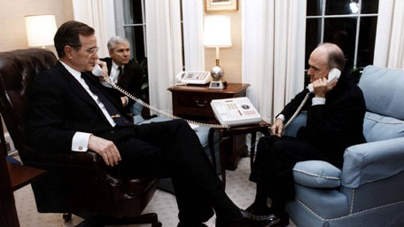
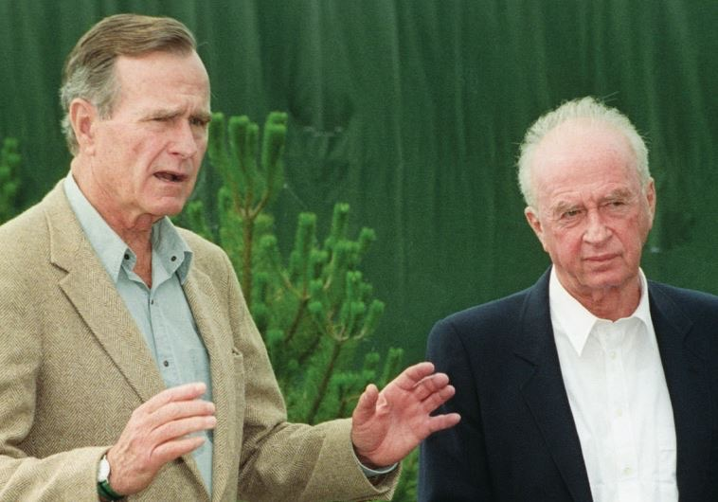

Slide 13
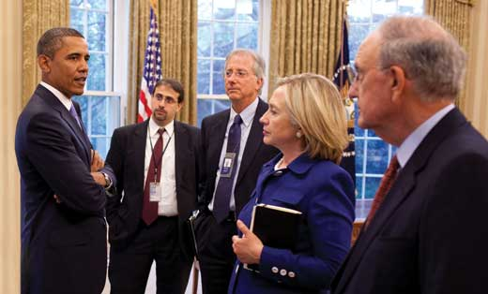
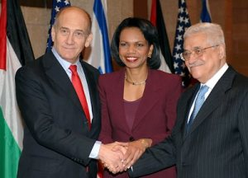

Slide 14
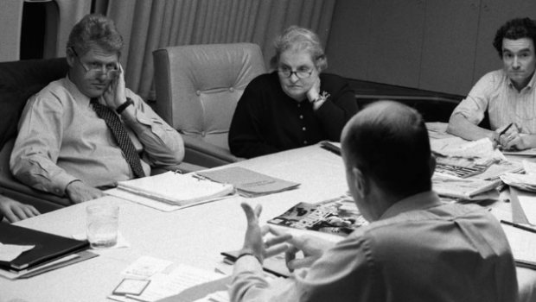

Slide 17
Sources/Readings
Dennis Ross
Missing Peace
Doomed to Succeed
The Prime Ministers by Yehuda Avner
Ally by Michael Oren
Menachem Begin: The Battle for Israel's Soul by Michal Gordis

