Slide 1
Frozen conflicts in the post-Soviet space

Slide 2
Current state
of conflicts
in the South Caucasus
a region where big powers meet and compete, and which is now a major energy corridor.

Slide 3
Nagorno-Karabakh
Abkhazia
South Ossetia
Conflicts with different intensity,
different methods and tools used for mediation

Slide 4
Severely impacted by the situation in and around Ukraine and the relations between the Russian Federation and the European Union.

Slide 5
The political environment puts significant limitations on the willingness and/or ability of actors to engage in conflict resolution.

Slide 6
Nagorno-Karabakh
Notes:
The protracted struggle over Karabakh must rank as Europe’s most dangerous and most forgotten conflict. It has now entered a new phase of intractability. It began in 1988 as a Soviet-era political dispute over the autonomy of one region, then escalated into a war between Armenia and Azerbaijan in 1991 and was halted, but not resolved, by an Armenian victory on the ground and a ceasefire in 1994.

Slide 7
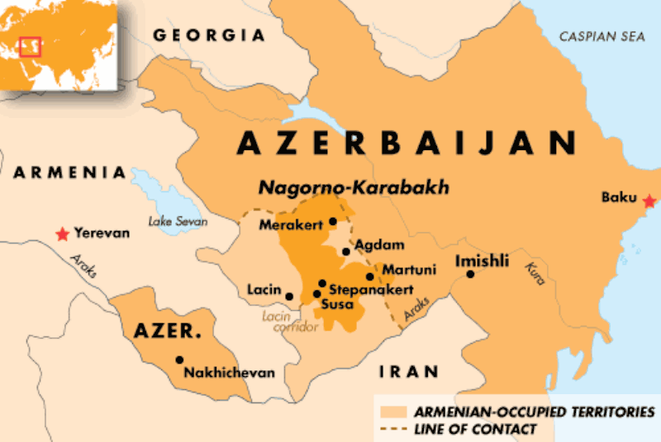

Slide 8
Nagorno-Karabakh
legal status
The territory is internationally recognised as part of Azerbaijan, which has not exercised power over most of the region since 1991.
Representatives of the governments of Armenia and Azerbaijan started to hold direct peace talks.
Notes:
Mediated by the OSCE Minsk group on the region's disputed status.

Slide 9
Nagorno-Karabakh
The official peace process has been unable to reach a peaceful settlement so far.
However, it is a process that is simultaneously in place, Internationally recognised and used by all participating parties.
Notes:
In retrospect the most auspicious moment for untying the knot was probably 1997-8, when it was still recognizably a post-conflict situation, President Heidar Aliev had unquestioned authority in Azerbaijan and Armenian President Levon Ter-Petrosian was supporting a deal. Unfortunately, most of Ter-Petrosian’s inner circle (led by Karabakh Armenians) mutinied and not only sabotaged the peace plan but deposed Ter-Petrosian as well.

Slide 10
Nagorno-Karabakh
Appearance of an old dispute caught up in historical resentments and a military standoff reminiscent of World War I trench-warfare
Changing dynamics have produced however an increasingly fluid and unpredictable situation in an already tense region
Notes:
Grim “no peace, no war” dynamic of the past nineteen years is basically the same

Slide 11
Nagorno-Karabakh
Karabakh is not a “frozen conflict.” It is not Cyprus, where the situation could easily stay in the same place for a number of years and there is almost no chance of new fighting
Here there are a number of factors that keep this conflict “stably unstable” and suggest that the status quo must break at some point – in favor of either peace or war
Notes:
One of these factors is the issue of the seven Azerbaijani “occupied territories” around Nagorny Karabakh. The dispute began in 1988 in the late Soviet era as a quarrel solely over the status of the autonomous region of the Armenian-majority Nagorny Karabakh Autonomous Region. When the dispute turned into a full-scale war, the Armenians captured, in part or whole, seven Azerbaijani regions outside Karabakh. They were ordinary regions of Azerbaijan that just had the misfortune to be strategically important geography in the battle over Karabakh.

Slide 12
Nagorno-Karabakh
The sides view the conflict through radically different prisms
In Azerbaijan the sting of defeat has been replaced in recent years by renewed confidence
The rise of AZ as a petro-state much wealthier than Armenia. Its GDP has risen more than 20 times and now stands at $75 billion (2014)
Notes:
The AZ government has spent more than $4 billion a year on the military—more than the entire Armenian state budget. Azerbaijan was deeply humiliated by its battlefield setbacks in 1992-1994. After Armenian forces cleared almost all of Nagorno-Karabakh, they occupied portions or all of seven adjacent Azerbaijani districts as a buffer zone. They constitute twice as much territory as Nagorny Karabakh and were home to around 550,000 Azerbaijanis, compared to just 40,000 in Karabakh itself. (All of the Azerbaijanis from these territories are now displaced refugees).

Slide 13
Nagorno-Karabakh
The passage of time has also altered Armenia’s view of the conflict.
The occupied territories are increasingly referred to as the “liberated territories”
The distinction between NK and the surrounding regions is gradually blurring on the ground.
Notes:
Armenian public now calls these seven districts not “occupied” but “liberated” territories. There are no longer sign-posts to tell you where one begins and the other ends. The Armenians argue that “possession is nine tenths of the law” and that the Azerbaijani boom is a flash in the pan which is already dissipating. But the numbers are real. And, perhaps even more important, Azerbaijan’s new perception of its status is real.

Slide 14
Nagorno-Karabakh
situation on the ground
Confrontation, low-intensity but volatile, between Azerbaijan and Armenia has entered a period of heightened sensitivity.
An immediate concern is military miscalculation, with implications that could far exceed those of a localised post-Soviet frozen conflict.
Notes:
The Armenians have rebuilt the old airport in Nagorny Karabakh, which will enable them to connect Yerevan and Karabakh by airplane. Although, there is currently communication by road and helicopter, the Azerbaijani side declared that this was a “red-line issue” in contravention of the Chicago Convention. Both sides have boxed themselves in on the airplane issue. The Armenians have a newly refurbished airport and seem determined to use it, even if this provokes a military response. One possibility is that they might use some kind of incident—perhaps a “medical emergency” in Karabakh—to launch an inaugural flight from Yerevan to their new airport. The Azerbaijani government has backed down from an initial threat to shoot down an airplane, but will feel compelled before its public to make a response to an Armenian flight. They might decide to fire a missile at the air-strip in the middle of the night or launch mortars across the Line of Contact. In short, it could get very dangerous very quickly – and also expose how limited are the international instruments of response.

Slide 15
Nagorno-Karabakh
situation on the ground
Frequent clashes along the Azerbaijani-Armenian frontier far from Nagorno-Karabakh, the conflict’s original focus.
The recent use of 122-mm artillery pieces for the first time since the signing of the 1994 ceasefire agreement and artillery strikes on infrastructure represent yet another step towards full-scale hostilities.
Notes:
Regional isolation. Baku is now even more aggressive in trying to restrict international contact with the separatist Armenians of Karabakh. For Baku to cut off contact with what it regards as a breakaway province looks like a counterproductive policy that has only confirmed the narrative of Karabakh Armenians that they are better off separate from Azerbaijan.

Slide 16
Nagorno-Karabakh
situation on the ground
The possibility of internal political unrest in both countries increases the uncertainty.
Unrest at home might tempt leaders to deflect attention by raising military tensions or to embark on risky attempts to capitalise on their adversary’s troubles.

Slide 17
Nagorno-Karabakh
Frequent provocative acts on both sides cause that the near-term threats to stability are increasing
Acute need to lessen chances of violent escalation during coming months
There is a risk that rising expectations and the gap between AZ’s self-perception and its continued lost territory, could trigger a new conflict
Notes:
For example, Baku’s pardon for an officer who killed an Armenian colleague during a NATO-sponsored language course in Hungary, and Yerevan’s declared plan to reopen the airport in Nagorno- Karabakh to fixed-wing flights.

Slide 18
Nagorno-Karabakh
Time is neither side’s ally.
The arms race is putting pressure on what is perhaps the most militarized zone in Europe, the so-called Line of Contact north and east of Karabakh that marks the ceasefire line between the two sides.
Azerbaijan relies on energy exports for the vast majority of state revenues
Armenia’s economy has long lagged far behind, and stagnation continues.
Notes:
The line is around 160 miles long, heavily fortified, dug with trenches, with more than 20,000 troops on each side. Just six international monitors from the OSCE make twice-monthly inspections of the ceasefire line. This means that the truce persists due to the good sense of the two parties.

Slide 19
Nagorno-Karabakh
Diplomacy should stress need for a quiet period during which both sides dial down rhetoric.
Intensified regular contacts as well as meetings between ministers and parliamentarians should be supported.

Slide 20
Nagorno-Karabakh
search for a solution
A crisis hotline should be reestablished between Yerevan and Baku to lessen chances of a military escalation.
Diplomacy should act more decisively to broker an agreement. It could advance this by achieving a suspension of arms supplies to both sides.
Notes:
Diplomats should move faster than the military commanders to “solve” the smoldering Karabakh conflict.

Slide 21
Nagorno-Karabakh
search for a solution
The officially designated mediators from the Organisation for Security and Cooperation in Europe (OSCE), the Minsk Group – led by Russia, the U.S. and France – can deliver results.
The problem could be resolved only on the basis of compromise and mutual concessions. Without mutual concessions, there can be no solution.
Notes:
Russia’s position raises particular questions about the format’s effectiveness. It is not only a Minsk Group co-chair but also has major strategic interests in the South Caucasus and supplies arms to both sides of the conflict.
But conflicts that last this long are not liable to easy resolution.

Slide 22
Nagorno-Karabakh
search for a solution
As political tensions recede in both countries, there should be a concerted effort to restart negotiations, backed by pressure from international actors.
Firmly and consistently, the sides need to be brought back to the table before someone decides the time has come to use their expensive new weapons.

Slide 23
Conflicts in Georgia
South Ossetia and Abkhazia
Both have many common features but also substantial differences
The solution will probably need many years

Slide 24
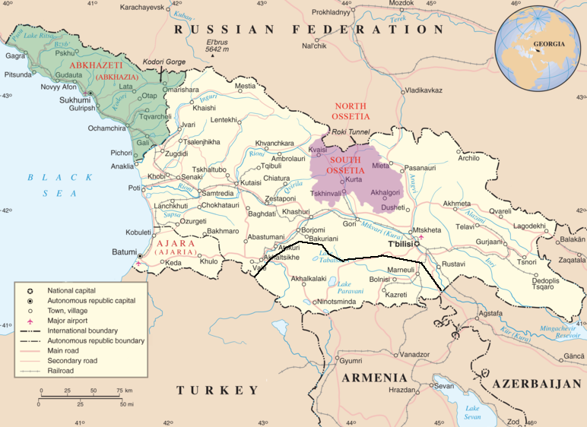

Slide 25
Conflicts in Georgia
In the Georgian context several partially conflicting trends could be observed:
So called treaties signed between the RF and Abkhazia on "Strategic Partnership and Integration"
And between the RF and South Ossetia on "Alliance and Integration"
Their respective signing and ratification processes dominated the recent period and created a rather confrontational climate

Slide 26
Conflicts in Georgia
Installing additional and very prominent so called border signs along the South Ossetian administrative boundary line was perceived as a provocative step by Georgian government, disregarding and disrespecting the conciliatory steps taken by the Georgian side inter alia through the contacts between Special Envoy Abashidze and Russian Deputy Foreign Minister Karasin.

Slide 27
Conflicts in Georgia
Negative climate has affected the situation on the ground in the two entities - and the prospects for longer term conflict resolution - in particular by increasing restrictions and a climate of intimidation of civil society actors engaged in confidence building activities.

Slide 28
Conflicts in Georgia
Overall, a environment of uncertainty and insecurity has increased in the entities, which is not conducive for efforts directed towards longer term conflict resolution.

Slide 29
Conflicts in Georgia
While this is making efforts in line with the EU’s non-recognition and engagement policy more difficult, it is important to continue to support those societal actors that are open minded.
Moves by the Russian side to now implement steps through the back door that the Abkhaz had rejected to include in the treaty or to go even beyond that – e.g. in the context of property rights and oil exploration - should also be seen in this context.

Slide 30
Conflicts in Georgia
Secondly and in parallel to this development, the Georgian government - driven to a large degree by Deputy Foreign Minister David Dondua, who took over the position as Chief Negotiator since the 30th round of Geneva International Discussions in December 2014 - started reviewing the Georgian approach to the entities.
While this has not led to any significant steps so far, it has already impacted on the climate of the discussions, where more of an exchange across the table - if heated at times - started to take place.

Slide 31
South Ossetia

Slide 33
South Osetia
Where do we stand?
The short sharp war of August 2008 changed the political scene drastically.
Immense structural damage has been caused, and refugees are unable to return home.

Slide 34
South Osetia
Where do we stand?
The situation around the administrative boundary line of South Ossetia remains tense.
The shock has been contained, but this persisting conflict reminds us that the risk of regression remains.
The existing tensions weighs heavily on the populations who live close to the separation lines.

Slide 35
South Osetia
Russian involvement
RF recognized its independence, contrary to the quasi-totality of the international community, including its closest allies inside the CIS.
Russia stations around 5000 soldiers in the region of South Ossetia

Slide 36
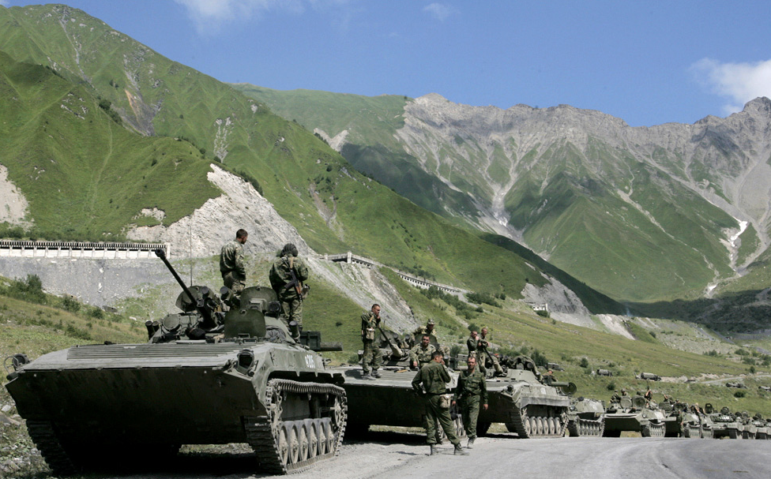
South Osetia

Slide 37
South Osetia
ABL borderisation
Continuing ‘borderisation’ to the detriment of the local population, particularly those intending to cultivate their fields.
On September the de facto authorities of South Ossetia terminated simplified procedure for crossing points with TAT.

Slide 38
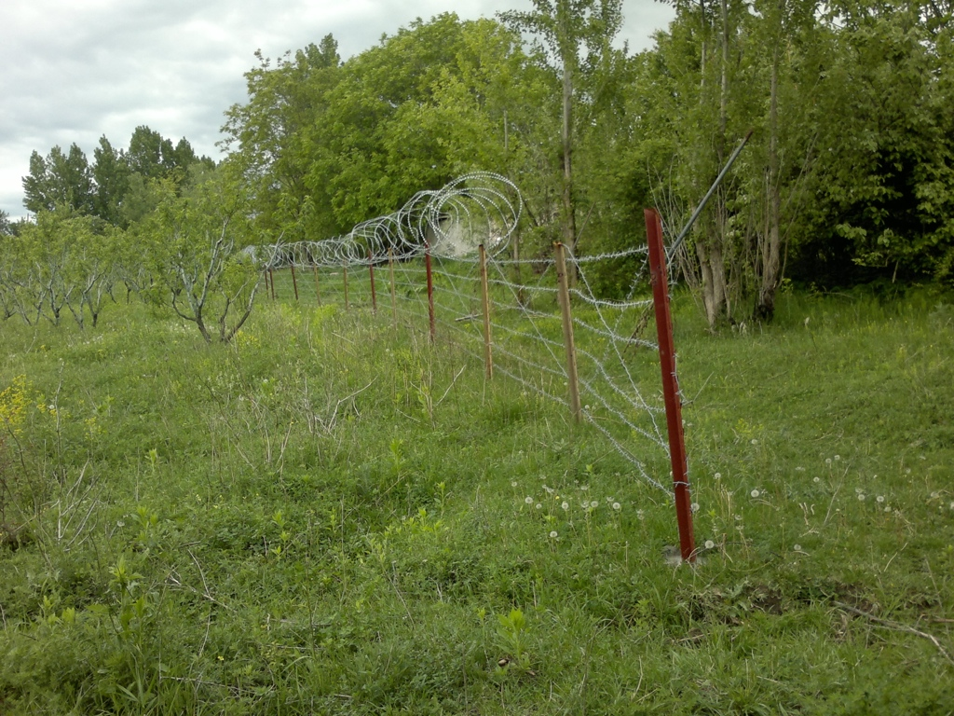
South Ossetia

Slide 39
South Ossetia
borderisation
During the last months, ‘borderisation’ has become particularly visible.
In response, the GEO police started ad hoc patrolling to provide greater security and to ensure TAT farmers’ access.
Occurance of security incidents is more likely.

Slide 40
South Ossetia
borderization
Out of the 70 kilometres of the SO ABL that is easily passable, over 50 percent is now fenced.
Other ‘borderisation’ activities included the attachment of motion sensors to surveillance pylons.

Slide 41
South Ossetia
borderisation
The installation of multiple surveillance cameras suggests a desire to maintain a continuous watch over this section of the ABL, where TAT and SO populations live in close proximity.

Slide 42
South Ossetia
borderisation
With insufficient infrastructure in the village and the poor road conditions people fear a loss of livelihood as they will no longer be able to take goods into TAT (Tbilisi Administered Territory) for sale or access markets, health care or education facilities on TAT due to the restrictions.

Slide 43
South Ossetia
possible consequences
In several cases commuters had difficulties crossing ABL onto TAT with their goods.
In the Akhalgori valley the announced restrictions allegedly raise concerns, as the valley will become fully dependent on Tskhinvali and the RF for the supply of goods.
Notes:
Prices are expected to rise drastically.

Slide 44
South Ossetia
type of incidents
The RF BG (border guards)hotline-holder in SO informed the EUMM that some individual(s) from TAT had crossed the ABL from TAT into SO and removed 90 fencing poles along the ABL.
On the same day, the EUMM met RF BG representatives at the location and observed that fencing poles had indeed been removed.
The RF BGs asked the GEO MIA to investigate and provide a response.
Notes:
On 26 August 2013

Slide 45
South Ossetia
military buildup
Opening of a new training facility within the RF AF 4th Military Base in SO.
Periodical rather extensive military training activities in SO
Recorded explosions and shooting from the direction of SO military bases.

Slide 46
South Ossetia
According to Z. Abashidze while Georgia had made “dramatic mistakes” in August 2008 it was still a victim of RF aggression.
The only existing option was to re-establish bilateral relations through a step-by-step approach on non-conflict issues.
Notes:
Speak about Saakashvili error and Ivanishvili point of view

Slide 47
South Ossetia
Former GEO Minister of Defence, I. Alasania, said that the gradual improvement of relations with the RF would create space “for GEO to deal directly with the Abkhaz and South Ossetians”.
He added that “nobody has any illusion that anything will change this decade…so we have to be patient”.

Slide 48
South Ossetia
conclussions
On-the-ground reality of ‘borderisation’ and other difficult bilateral issues (such as GEO’s NATO aspirations) make any short-term resolution unlikely.
In late August Mr Medvedev seemed to backtrack on his earlier comment that the future of ABK and SO “lies with…the Georgian people and the leaders they elect”.

Slide 49
South Ossetia
conclussions
According to Mr Medvedev the RF would continue building economic, security and socio-political relations with the “two states” of ABK and SO on the basis of “mutual respect and equality”.
He pledged also to protect both breakaway regions from any “potential conflict or even disappearance”.

Slide 50
Abkhazia

Slide 51
Notes:
Georgia has a long memory and strong passions. The magnificent Abkhaz seashore was long ago the ancient Colchis, and the Golden Fleece attracted the Argonauts, leading to the drama of Jason and Medea. The myth is never detached from reality.

Slide 52
Abkhazia
Contradicting situation at place
New more conciliatory GEO approach
Inward-looking Abkhazia, especially since 2011

Slide 53
Abkhazia
Abkhazia is cut off from mainstream international politics
Pushes back against Western countries that have traditionally supported Tbilisi.
The Abkhaz government has stopped access to foreign diplomats accredited in Tbilisi,
Notes:
On the ground that this implies recognition of Georgian sovereignty over Abkhazia.

Slide 54
Abkhazia
Some Europeans have proposed projects in Abkhazia under the EU’s strategy of “engagement without recognition,”
These proposals were rejected by de facto ABK authorities on the ground that they were offering merely a fraction of what Abkhazia gets from Russia.

Slide 55
Abkhazia
Georgia now has its most progressive government team dealing with the two breakaway territories of Abkhazia and South Ossetia
A minister named Paata Zakareishvili, who has two decades of experience in working with Abkhaz and Ossetians in the nongovernmental sector, holds this portfolio.

Slide 56
Abkhazia
The previous government, led by Mikheil Saakashvili’s United National Movement, had re-cast the conflicts as purely Georgian-Russian disputes
They downplayed the local origins of them in the late 1980s and early 1990s and the role extreme Georgian nationalism had played in triggering them.

Slide 57
Abkhazia
GEO new approach
Since taking office, the new government has worked to reverse previous practices. “Saakashvili was always looking for an opportunity to say no to Abkhaz and South Ossetians,” said Zakareishvili. “We are looking for reasons to say yes—while always taking into account of course the state interest of Georgia.”

Slide 58
Abkhazia
GEO new approach
The results of the new approach have been small but significant
More commercial traffic across the Inguri, and two new crossing points were opened
The fear persists that the border will be tightend

Slide 59
Abkhazia
GEO new approach
The two sides are finally working together properly on the important issue of the missing, both the dead from the war and the living who are detained.

Slide 60
Abkhazia
contradictions
Ahead of the 7th anniversary of the conflict, conciliatory statements by both GEO and RF political leaders
These were not, however, adequately supported with positive conciliatory actions on the ground.

Slide 61
Abkhazia
Russian involvement
Throughout August the RF AF have been conducting training in ABK, starting with training of about 2,000 servicemen from over 200 sapper (military engineer) units of the southern military district.

Slide 62
Abkhazia
Russian involvement
Further military exercises of the RF AF Southern Military District in ABK focussed on motorised infantry, signals, artillery and intelligence training.

Slide 63
Abkhazia
GEO former Prime Minister Bidzina Ivanishvili stated that although conflict resolution is a long-term process, “we will eventually settle our relations”.
He noted that GEO government “remains firm on the return of occupied Abkhazia and South Ossetia”.

Slide 64
Abkhazia
Conclussions
Abkhazia continue to be a protracted conflict where the irresistible force of Russian protection collides with the immovable object of widespread international recognition that Georgia holds sovereignty over the republic.
A game-changing move is needed.

Slide 65
Abkhazia
Conclussions
One of the possible moves is to rebuild the broken railway line around the Black Sea connecting Sochi, Abkhazia, western Georgia and Armenia
If the railway were to be rebuilt, the benefits would be massive to the whole region.

Slide 66
Abkhazia
Conclussions
The new Tbilisi government floated the idea last fall, but it met resistance from Azerbaijan and the Georgian opposition.
Lukewarm reaction from de facto authorities and Russia

Slide 67
Abkhazia
Conclussions
It is striking to see how many people are either resisting or failing to support a big regional project that could reconnect broken parts of the region.
It illustrates how everyone has grown comfortable with a status quo that is still producing long-term discomfort to Abkhaz, Georgians and others.
Notes:
This attitude needs to be overcome at first place

Slide 68
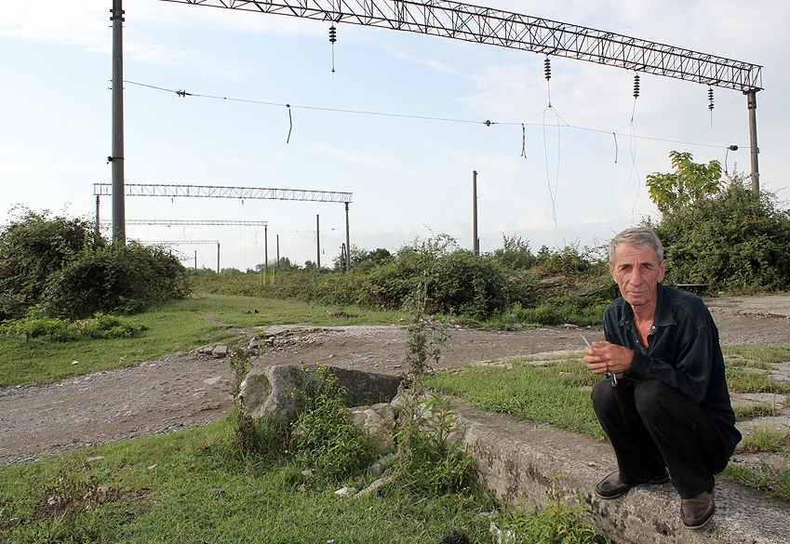

Slide 69
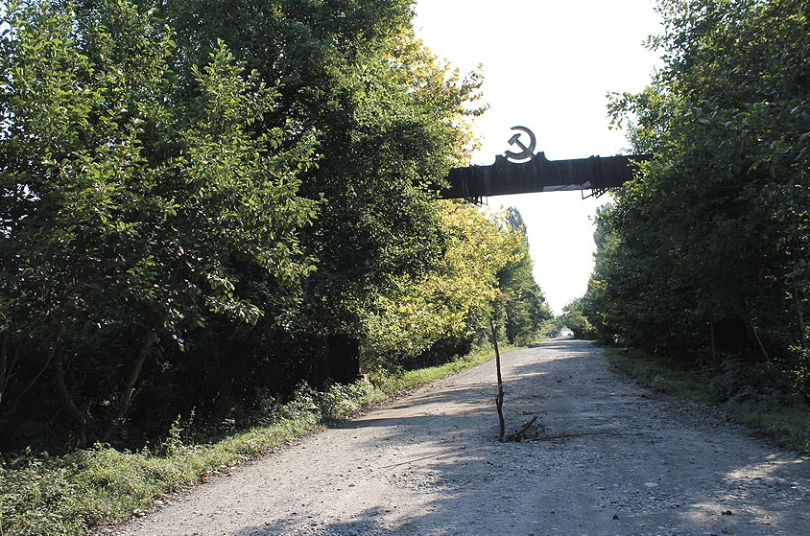

Slide 70
October 16
Involvement of main stakeholders (EU / USA, Russia)
different approaches
and interest

