Slide 1
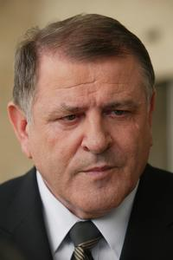
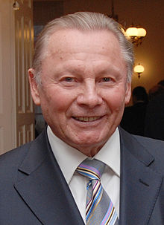
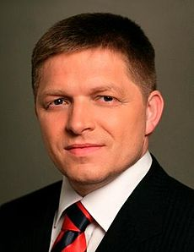
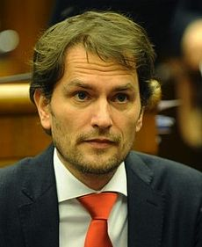
Populism in Slovakia

Slide 2
General conditions
Post 1989 Slovakia provided a solid base for populism
Factors:
  Negative economic impact after 1989
  Problematic realization of privatization of public property
  Negative public image of domestic politics
  Polarization of the party system (and the society) – peak in the 2nd half of the 90s

Slide 3
Waves of populism in Slovakia
1. wave (emerged after 1989):
  HZDS (Movement for Democratic Slovakia)
  ZRS (Association of Slovak Workers)
2. wave (1998-2002)
  SOP (Party of Civic Understanding)
  SMER (Direction)
  ANO (Alliance of New Citizen)
3. wave (around 2010)
  OĽaNO (Ordinary People and Independent Personalities)

Slide 4
1st wave (HZDS)
Separated from the main Slovak dissent movement
Leader – Vladimír Mečiar (in lead until 2013)
Dominating Slovak party in the 90s
Usage of populism even after becoming part of the establishment

Slide 5
1st wave (ZRS)
Separated from the transformed communists
Radical left party with extensive use of populism
Complex attacks on all ruling (and existing) parties
Situated in a role of the defender of the betrayed masses
Presented as the only „clean“ alternative

Slide 6
2nd wave
Specific situation of the 2nd half of the 90s
Extensive polarization of the party system
Growing number of citizens and voters seeking for a „middle way“
These trends lead to emergence of different type of populist parties

Slide 7
2nd wave (SOP)
Created in 1998 by a popular mayor Rudolf Schuster who later became the Slovak president
Centre / centre-left party with an aim to stay neutral
Pressure of the culminating polarization of politics and society → SOP had to choose its bloc position
Connection with anti-Mečiar parties resulted in decline of support
Entering government 1998 started the end of the party

Slide 8
2nd wave (SMER and ANO)
Created after elections 1998 – still a strong polarization
Main features:
  Professional PR and communication
  Party structure only as a secondary aim
  Criticism of the establishment
  Call for a new generation of Slovak politicians
Differences:
  SMER – denial of any ideological stance
  ANO – openly centre-right liberal status

Slide 9
Evaluation of V. Mečiar and M. Dzurinda by supporters (2001)
 | Both positive | VM positive MD negative | MD positive VM negative | Both negative | Do not know (at least one)
HZDS | 5,2 | 88,1 | 0 | 2,2 | 4,5
SNS | 1 | 57,3 | 6,3 | 20,8 | 14,6
KSS | 0 | 44,9 | 6,1 | 42,9 | 6,1
SDKÚ | 4 | 3 | 81,2 | 3 | 8,9
SMK | 1,4 | 2,1 | 59,3 | 20,7 | 16,4
KDH | 7,4 | 5,6 | 29,6 | 29,6 | 27,8
ANO | 0 | 15,3 | 20,8 | 55,6 | 8,3
SMER | 1,9 | 24,1 | 17,5 | 42,9 | 26,5
non-voters | 1,2 | 14,7 | 13,5 | 44,1 | 13,7
undecided | 1,5 | 14,2 | 16,1 | 38,7 | 29,5

Slide 10
3rd wave (OĽaNO)
Created before elections 2012
Structure:
  Not a classical party (4 members)
  Basis for independent candidates
„Ideology“:
  Strong criticism of parties and party system
  Main topics – corruption, partitocracy
The „Gorilla“ scandal as the main theme for the campaign

Slide 11
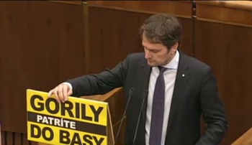

Slide 12
 | HZDS | ZRS | SOP | SMER | ANO | OĽaNO
Created | 1991 | 1994 | 1998 | 1999 | 2001 | 2011
Ideology | Denial / mix of nat., pop. rad., soc. | Radical left | Vague, later centre-left | Denial, later social demoratic | Centre-right liberal | Vague, independents
Social groups | Post 1989 losers | Post 1989 losers | Dissapointed | Dissapointed | Dissapointed | Dissapointed
Membership priority | High | Medium | Low | Low | Low | Non existing
Special features | Populist even after being main part of the system |  |  |  |  | No party at all

Slide 13
Success rate of populist parties
Party | 1st elections | Entered government? | 2nd elections
HZDS | 37,26 | yes | 34,96
ZRS | 7,34 | yes | 1,3
SOP | 8,01 | yes | 1,36
SMER | 13,46 | no | 29,14
ANO | 8,01 | yes | 1,42
OĽaNO | 8,55 | no | -

