Slide 1
The Nature of Broadcasting - A Theoretical Perspective
Henry Loeser
Past, Present and Future

Slide 2

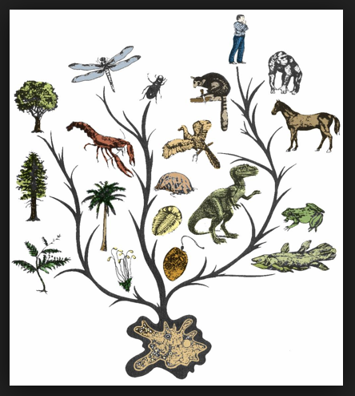
Natural Law
Structure of Nature
All living things seek utility
Nurture (Rationality)
Communication

Slide 3
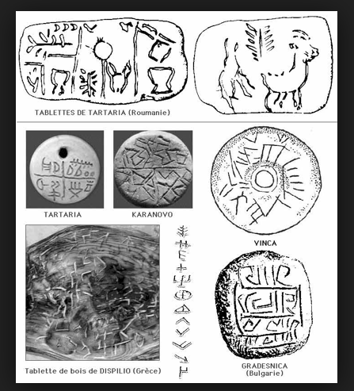
Human Evolution
Groups
Symbolic Interaction
Language

Slide 4
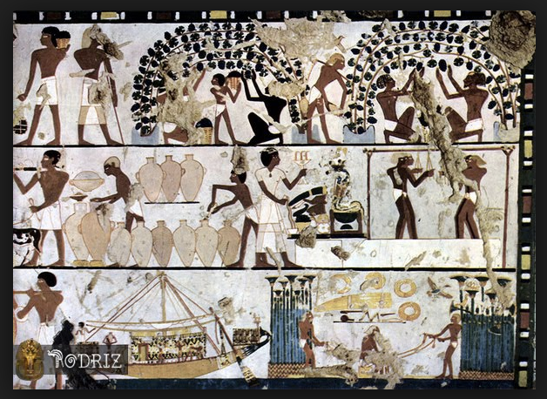
Forming Societies
Specialization
Agency vs. structure
Mass Communication

Slide 5
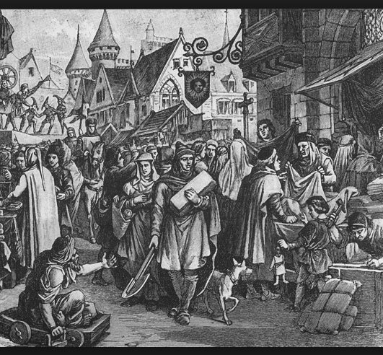
Medieval Europe
Dual authoritarianism of monarchy and church
Rise of merchant class media

Slide 6
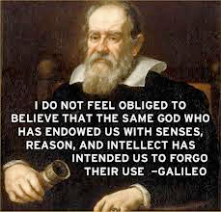
Enlightenment
Science & technology
Secularism

Slide 7

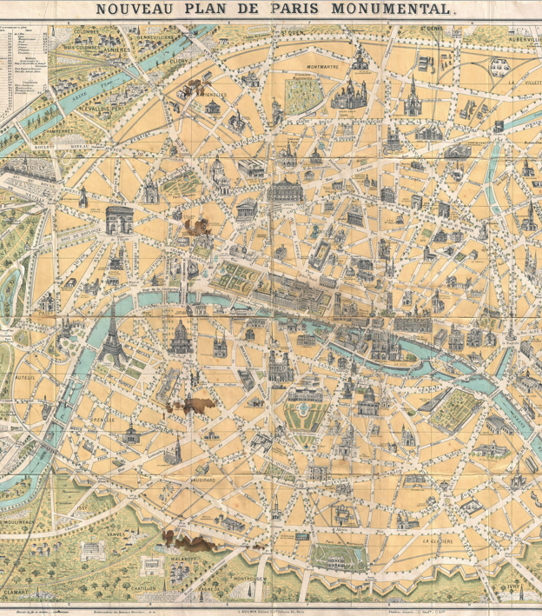
Modernity
Urbanization
Democracy
Mass Media forms

Slide 8

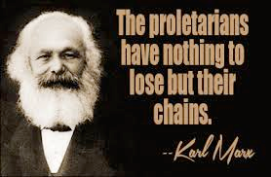
Conflict Theory
Dysfunctional society
Agency vs. Structure
Legal alternativism

Slide 9

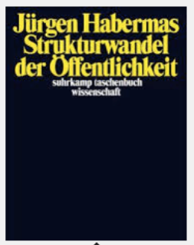
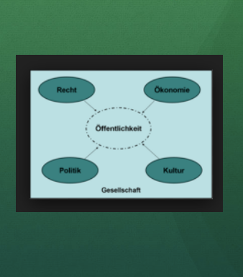
The Public Sphere

Slide 10

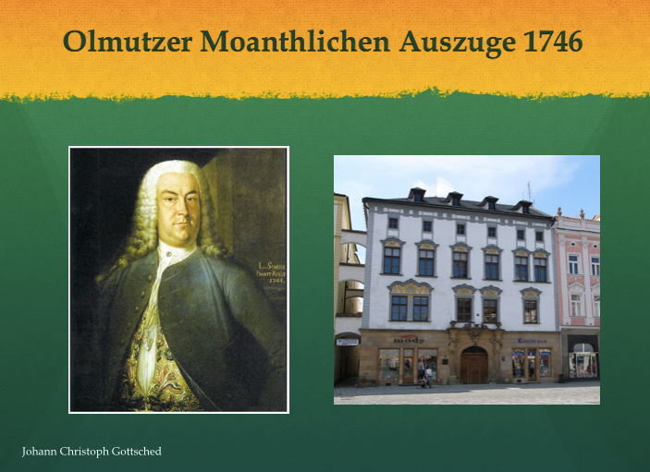
Alternative Press
Activist media

Slide 11
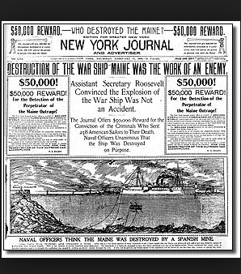
Re-Feudalization
Newspaper conglomerates
Politicization

Slide 12
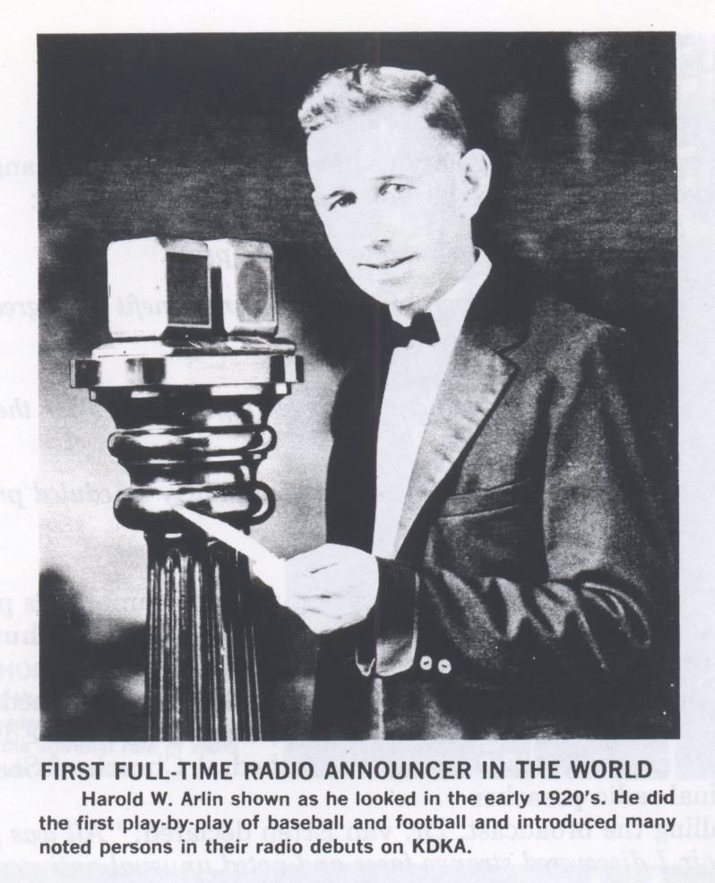
Radio

Slide 13

Community Radio

Slide 14
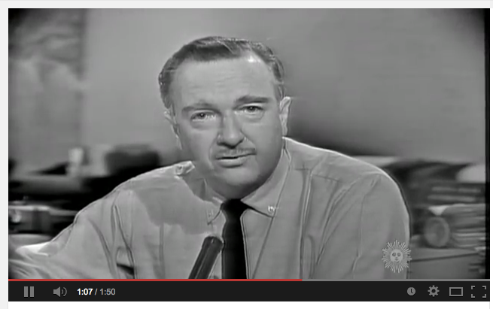
Television
https://www.youtube.com/watch?feature=player_detailpage&v=6PXORQE5-CY

Slide 15
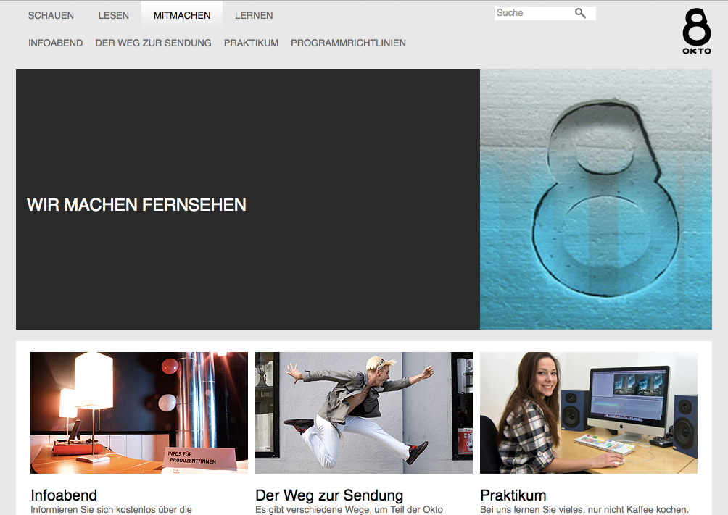
Community TV

Slide 16

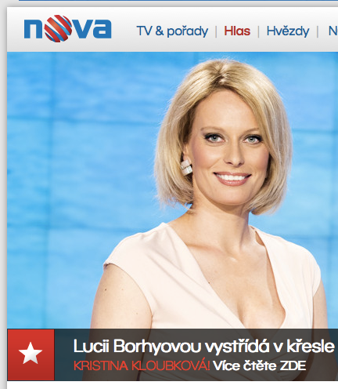
Terrestrial Paradigm
Public Service
Commercial
Alternative

Slide 17

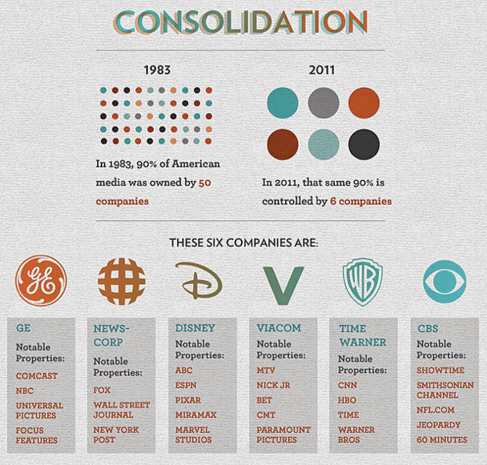
Re-Feudalization II
Policy issues
Commercial conglomerates
Alternatives struggle

Slide 18

IP - The Great Liberator?
One-to-many revolution
low barriers to entry
virtual democracy

Slide 19
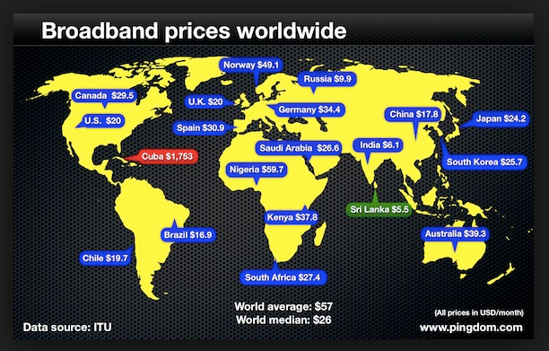
Q1 - The Pipes

Slide 20
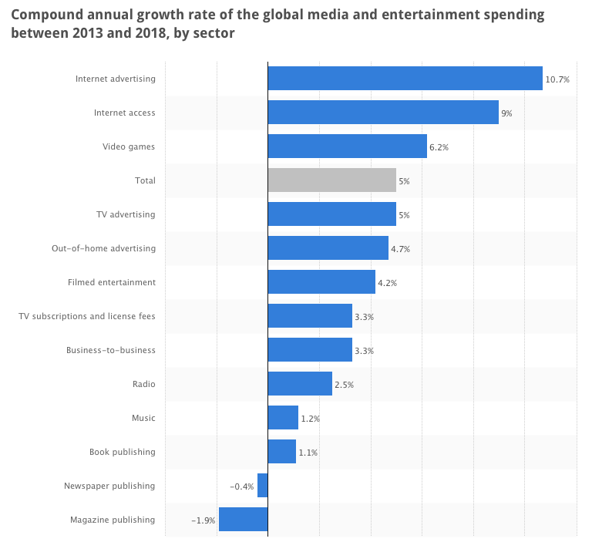
Q2 - The Revenue

Slide 21
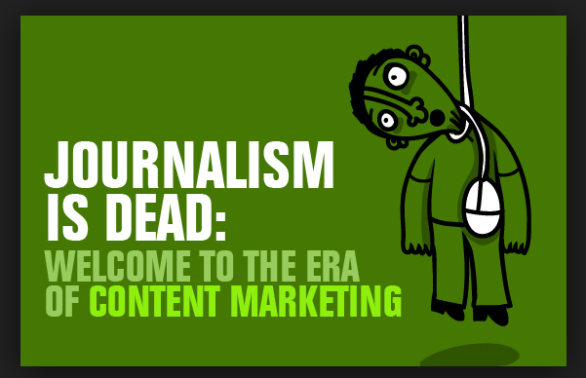
Q3 - The Content
Information
Opinion
Entertainment

Slide 22
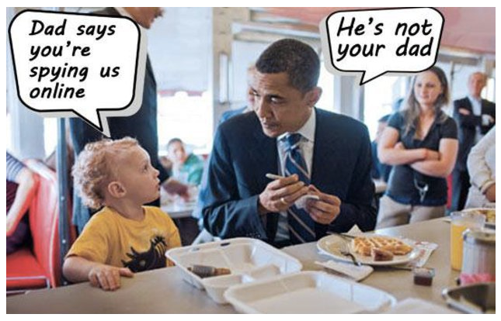
Q4 - Your Data

Slide 23
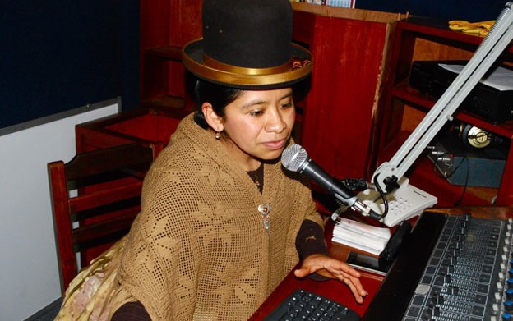
Re-Feudalization III?

Slide 24

ICT4D

Slide 25

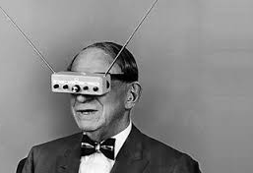
The Future
Beyond RF
Beyond streaming
Neutrality
Creative Commons
Policy reform
Funding solutions

Slide 26
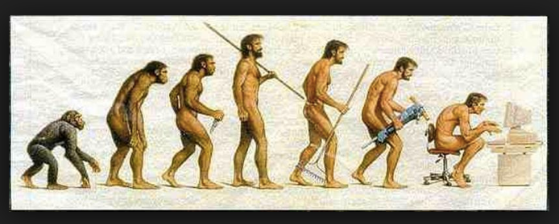
Human Evolution
Structural Functionalism?
The Public Sphere?
Broadcasting plurality?

Slide 27
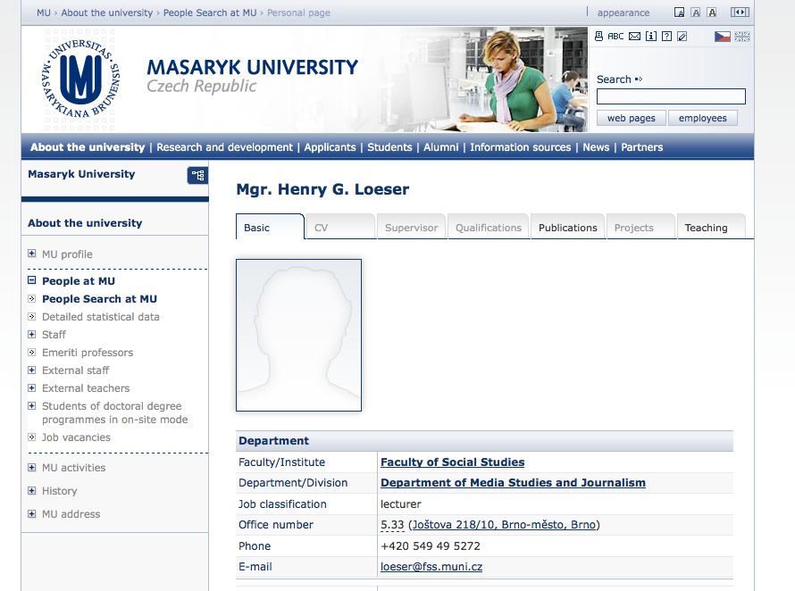
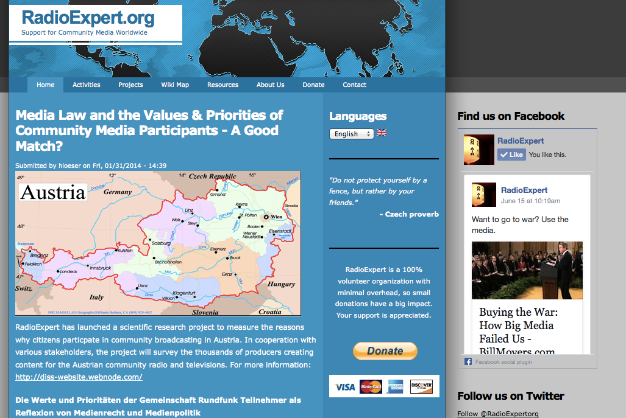
Thank You!

