Slide 1
Introductory Session
EGO402 EU Law and European System of HR Protection
Hubert Smekal
(hsmekal@fss.muni.cz)
20 September 2016

Slide 2
Expansion of rights
Hafner-Burton, Emilie M. – Ron, James. „Seeing Double. Human Rights Impact through Qualitative and Quantitative Eyes“. World Politics, vol. 61, No. 2, 2009, p. 362.

Slide 3
Expansion of rights
Ramos, Howard – Ron, James – Thoms, Oskar N.T. „Shaping the Northern Media's Human Rights Coverage, 1986-2000“. Journal of Peace Research, Vol. 44, No. 4, 2007, p. 387.

Slide 4
Expansion of rights
Elkins, Zachary – Ginsburg, Tom – Simmons, Beth. „Getting to Rights: Treaty Ratification, Constitutional Convergence, and Human Rights Practice“. Harvard International Law Journal, Vol. 54, No. 1, p. 70.

Slide 5
Expansion of rights
Landman, Todd. „Measuring Human Rights: Principle, Practice, and Policy“. Human Rights Quarterly, Vol. 26, No. 4, 2004, p. 915.

Slide 6
Expansion of rights
Rhetoric of rights
Rights
Subjects of rights
  Rights holders
  Potential rights perpetrators (duty bearers)
Rights in IR (criminal courts, HI, R2P, extraterritoriality, universal jurisdiction)

Slide 7
Terminology
Human rights
Fundamental rights
Civil rights
Freedoms
Rights – philosophy, political science, law
Law and right

Slide 8
Historical overview
Natural-rights based proclamations
Positivation in national legal systems
Postwar drive towards universality of rights
1970s (UN Conventions, CSCE, AI, Carter)
State as protector and oppressor
Sovereignty
Turn in IL: ECtHR, R2P

Slide 9
ICTY – Tadić case
It would be a travesty of law and a betrayal of the universal need for justice, should the concept of State sovereignty be allowed to be raised successfully against human rights. Borders should not be considered as a shield against the reach of the law and as a protection for those who trample underfoot the most elementary rights of humanity.

Slide 10
HR controversies
Foundation of rights
Generations of rights
Relativism and universalism
Collective rights

Slide 11
The Declaration of Independence
We hold these truths to be self-evident, that all men are created equal, that they are endowed by their Creator with certain unalienable Rights, that among these are Life, Liberty and the pursuit of Happiness.
--That to secure these rights, Governments are instituted among Men, deriving their just powers from the consent of the governed, (…)

Slide 12
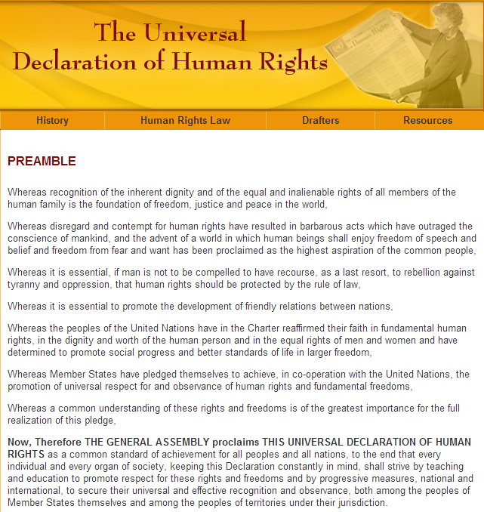
http://www.un.org/en/documents/udhr/

