Slide 1
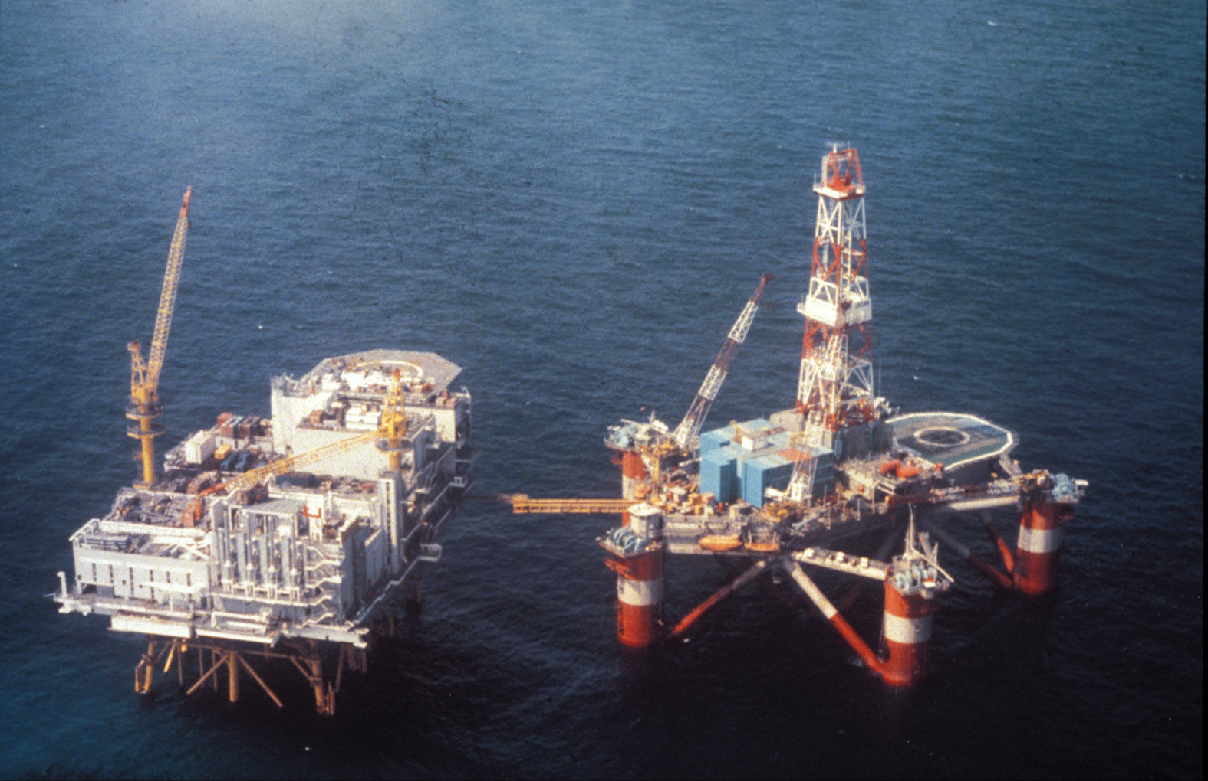

Slide 2
The Alexander Kielland Plattform Collapse 27th March 1980 Norwegian Sector North Sea
123 oilworkers were killed (Mostly Norwegians, however there were individuals from many European countries and from North America)
89 survivors
Rescue operation involving all North Sea nations
Most of the survivors continued working in the North Sea
The biggest industrial accident in Norway
Research on Post Traumatic Stress (PTS), memories
The accident changed safety standards internationally

Slide 3
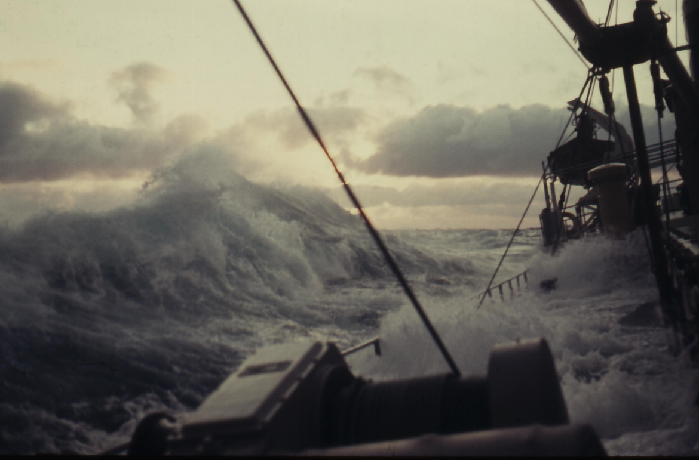
Very difficult weather conditions – heavy wind, strong current, low visibility

Slide 4
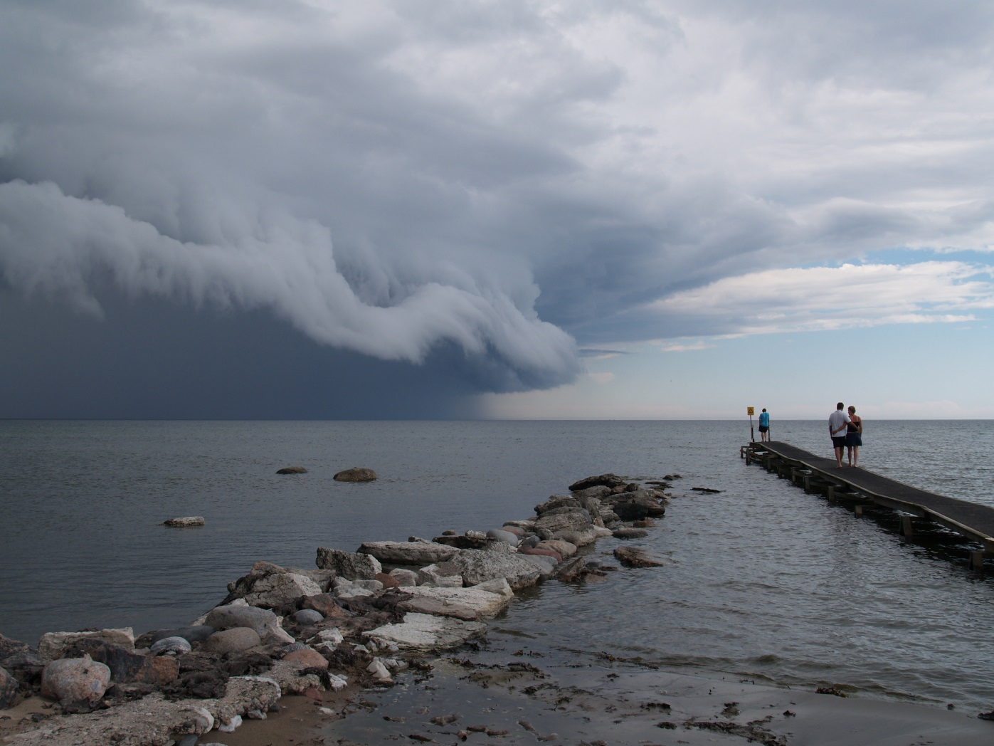
Shelf Clouds with heavy thunderstorm– outside the Swedish island of Öland in the Baltic Sea (2005)

Slide 5
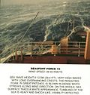

Beauforts Scale
Force 10 Very high waves with overhanging crests. Large patches of foam from wave crests give the sea a white appearance. Considerable tumbling of waves with heavy impact. Large amounts of airborne spray reduce visibility.
Force 11 Exceptionally high waves. Very large patches of foam, driven before the wind, cover much of the sea surface. Very large amounts of airborne spray severely reduce visibility.
Force 12 Huge waves. Sea is completely white with foam and spray. Air is filled with driving spray, greatly reducing visibility.

Slide 6
The Piper Alpha OilPlattform Accident (explosions and a fire) 6th July 1988
167 Oilworkers killed (including two rescue workers)
61 survivors
the worst offshore oil disaster in terms of lives lost and industry impact

Slide 7
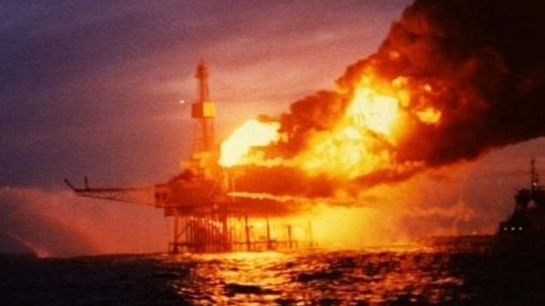
The Plattform on fire shortly after one of the explosions (second explosion)

Slide 8
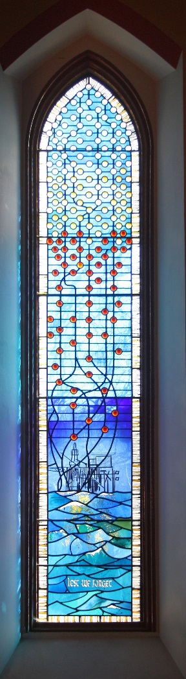
The Piper Alpha Window Ferry Hill Church Aberdeen

Slide 9
The spiritual idea of the window
The window was created by Jennifer Jane Bayliss, a member of the congregation. Each of the small circular discs represents a victim of the disaster. At the foot of the window they are red, as the souls of the dead emerge from the flames in the stormy sea. As they rise up the window the colour lightens as the souls rise to Heaven
A number of other monuments exist – all with different expressions –

Slide 10
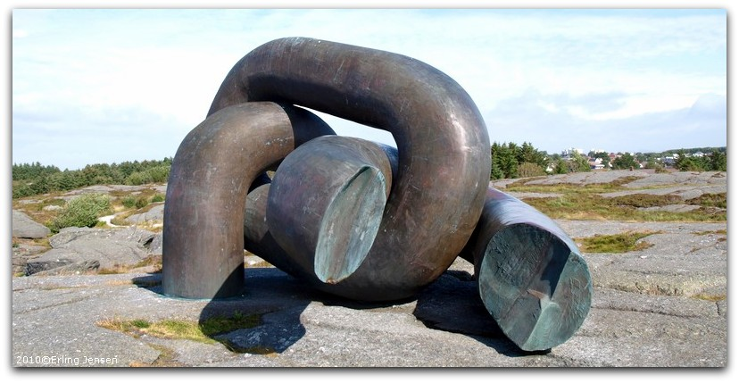
The Norwegian monument after the Alexander Kielland accident is a broken chain placed on a rock close to the sea

