Slide 1
German energy transition - Energiewende
Filip Černoch
cernoch@mail.muni.cz
Energy policy of the EU
Notes:
Laboratoř nové energetiky – zajímavý fenomén, kdy se průmyslová, moderní země rozhodne kompletně přepracovat svoji energetiku a skutečně do toho investuje obrovské úsilí, čas, peníze.
Co to vlastně je?
Jak to ovlivnilo podobu energetiky v Německu?
Jak to ovlivňuje energetiku v okolních zemích

Slide 2
Origins of EW
1st pillar: nuclear phase-out.
Long and successfull tradition of nuclear industry in Germany – in 70s 17 000MW.
German anti-nuclear movement – Ausserparlamentarishe Opposition in 60s (leftist students), environmental movements, local oposition.
Three Mile Island in 1979, Chernobyl in 1986.
1998 Greens in federal govt (with SPD) – Germany´s plan to gradually withdraw from the atom.
In 2010 the Atomic Energy Act amended – plant lifespan extended, production limits on nuclear electricity increased.
2011 Fukushima – phase-out by 2022.

Slide 3
Origins of EW
2nd pillar: climate protection measures.
In 70s anti-nuclear sentiment, environmental consciousness and oil crisis raised the issue of RES.
1974 first RES subsidy program – PV parks. Furthered in 1977 – 25% of investment costs reimbursed.
1990 – Act on the Supply of Electricity from RES into the Grid (StrEG).
2005 – Merkel´s great coalition (CDU/CSU + SPD) – ambitious climate plans, incl. RES and EE.
2010 – Energy Concept for an Environmentally Sound, Reliable and Affordable Energy Supply ->Energiewende.

Slide 4
Targets of the EW
To cut greenhouse gas emissions by 40% by 2020, by at least 80% by 2050.
Share of RES in gross final energy consumption to 60% in 2050 (10% in 2010). The share of RES in elektricity supply 80% by 2050.
Reduction of energy consumption by 50% by 2050 (reference year 2008).
By 2050, elektricity consumption to drop by 25% compared to 2008. Final energy consumption in the transport sector to be reduced by around 40% by 2050 compared to 2005 levels.
Nuclear phase out by 2022. (Fukushima Daiichi 2011).

Slide 5
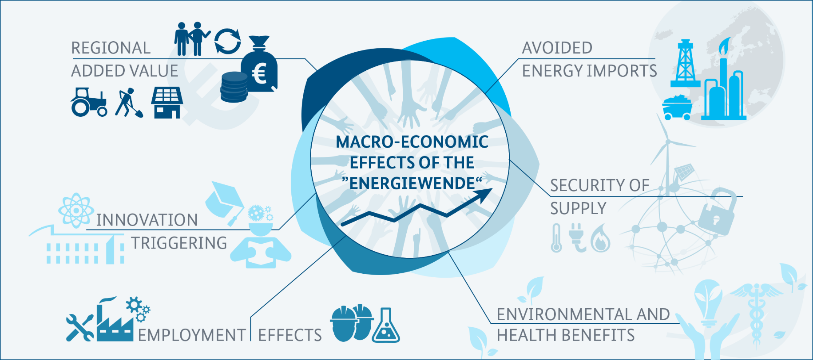
Declared benefits of the Energiewende

Slide 6
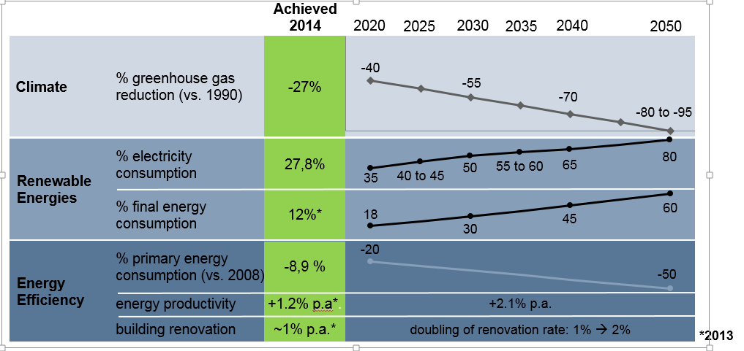
Targets of the EW

Slide 7
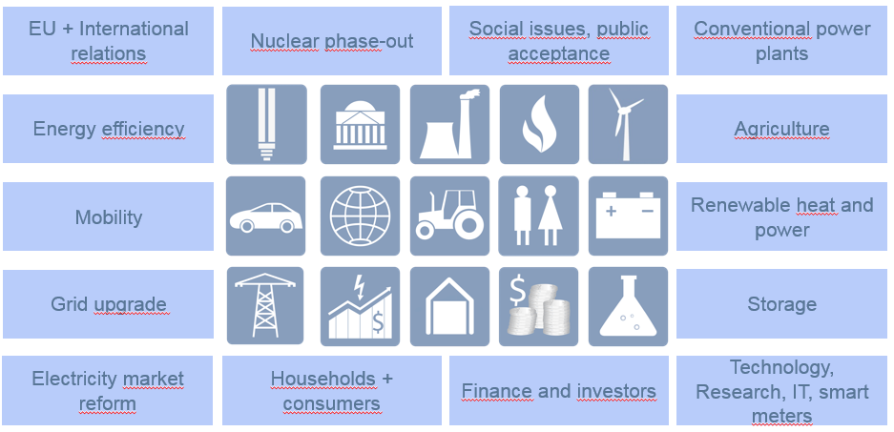

Complexity of EW
  EW is not limited to the power sector only, it is multidimensional restructuring of the supply system

Slide 8
Performance of German energy sector

Slide 9
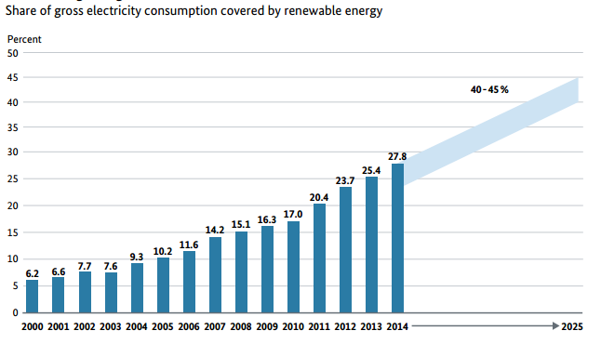
Performance of German energy sector
In 2015 RES covered almost 33% of gross electricity consumption.
As a result of lowered financial support the pace of new instalations has plateued since 2012.

Slide 10
Share of RES in gross final energy consumption (in %)

Slide 11
Performance of German energy sector
Increasing of the proportion of hard (from 117 TWh to 121,7 TWh between 2010-2013) and brown (from 145,9 TWh to 160,9 TWh) coal in elektricity production.
Emissions of CO2 has been increasing slowly.
The proportion of nuclear power in the primary elektricity consumption decreased from 10,8% to 7,7% between 2010-2013.

Slide 12
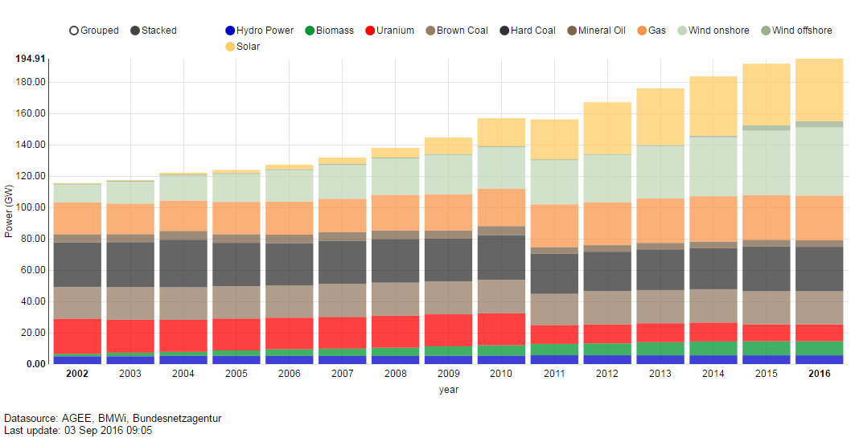
Net installed electricity generation capacity in Germany

Slide 13
German annual final energy consumption (in PJ)
Notes:
- Mild winter in 2014

Slide 14
Major challenges

Slide 15
1) Costs of EW
€550 bn. until 2050 (yearly investments €15bn., or 0,5% of GDP respectively).
  EEG surcharge and other levies.
  Expenses on construction of power grid increases - in 2012, the expenses of all four German TSOs on development of network were €1,152 billion, about 305 millions more than in 2011. Estimates for 2013 were €1,242 billion.

Slide 16
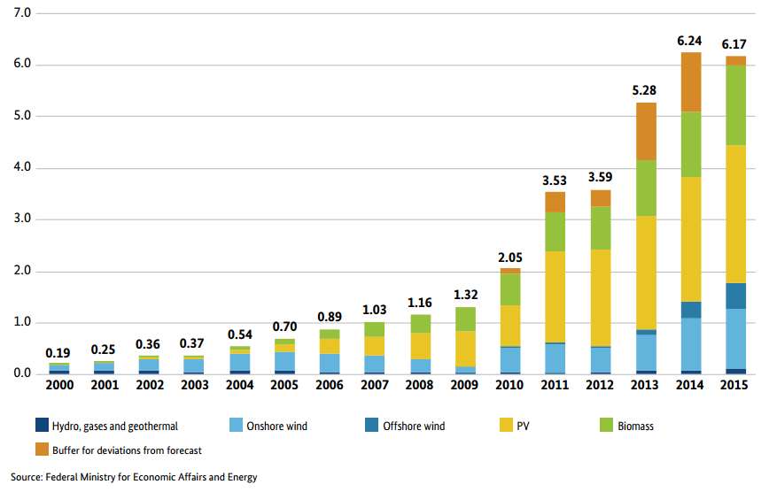
EEG surcharge in cents/kWh

Slide 17
Prices of electricity
Wholesale prices of electricity among the lowest in the EU (this reinforces the competitiveness of industry).
Households pay one of the highest prices in the EU (regulated component of prices).
Cost unevenly distributed. Paid mainly by households, companies exempted to a great extend.

Slide 18
Average wholesale baseload electricity prices (in €/MWh)

Slide 19
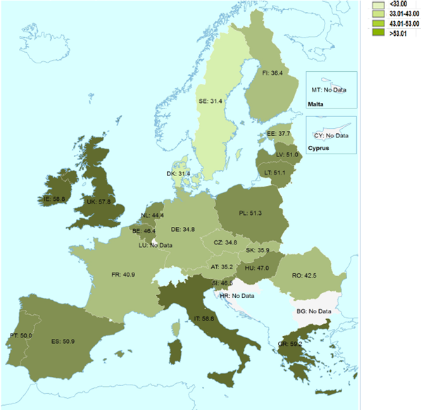

Slide 20
Electricity prices – medium size households (eur/kWh)

Slide 21
Electricity prices – medium size industries (eur/kWh)

Slide 22
Reform of EEG in 2014
Annual growth targets (2,5 GW each for wind and solar-PV).
Growth targets for new biomass minimal (100MW).
Auctions for PV-parks (starting 2015) and wind energy announced for 2017.
Balancing and wholesale market integration mandatory for new installations (except small ones).

Slide 23
2) Public support of EW
8 out of 10 German citizens support faster growth of RES.
Resentments about perceived gap between ambitious targets and rhetoric and reality.
Less than half of public with positive attitude toward implementation of EW.
Politics identified as reason for deficits in implementation.

Slide 24
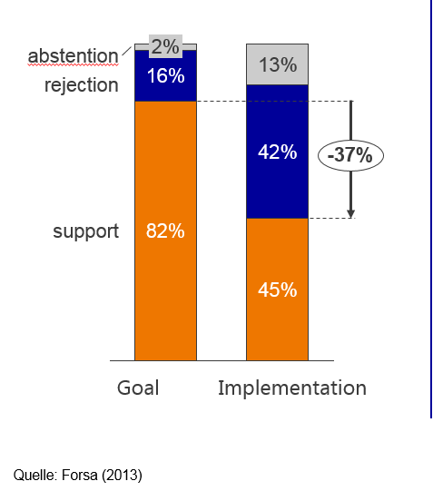
Q: Are you satisfied with goals and implementation of EW?

Slide 25
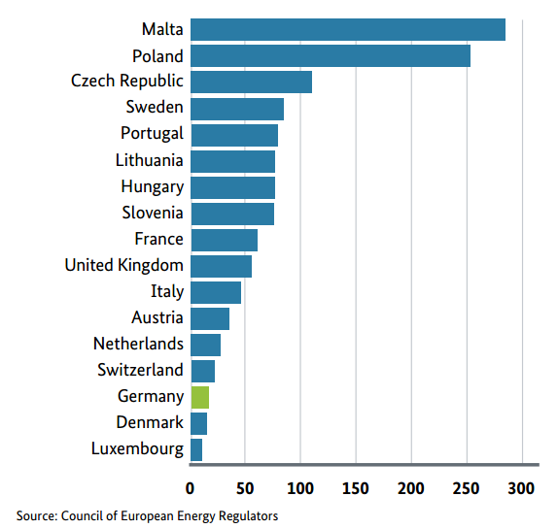
3) Stability of the grid
Unschedulled outages in 2013 (minutes per year)

Slide 26
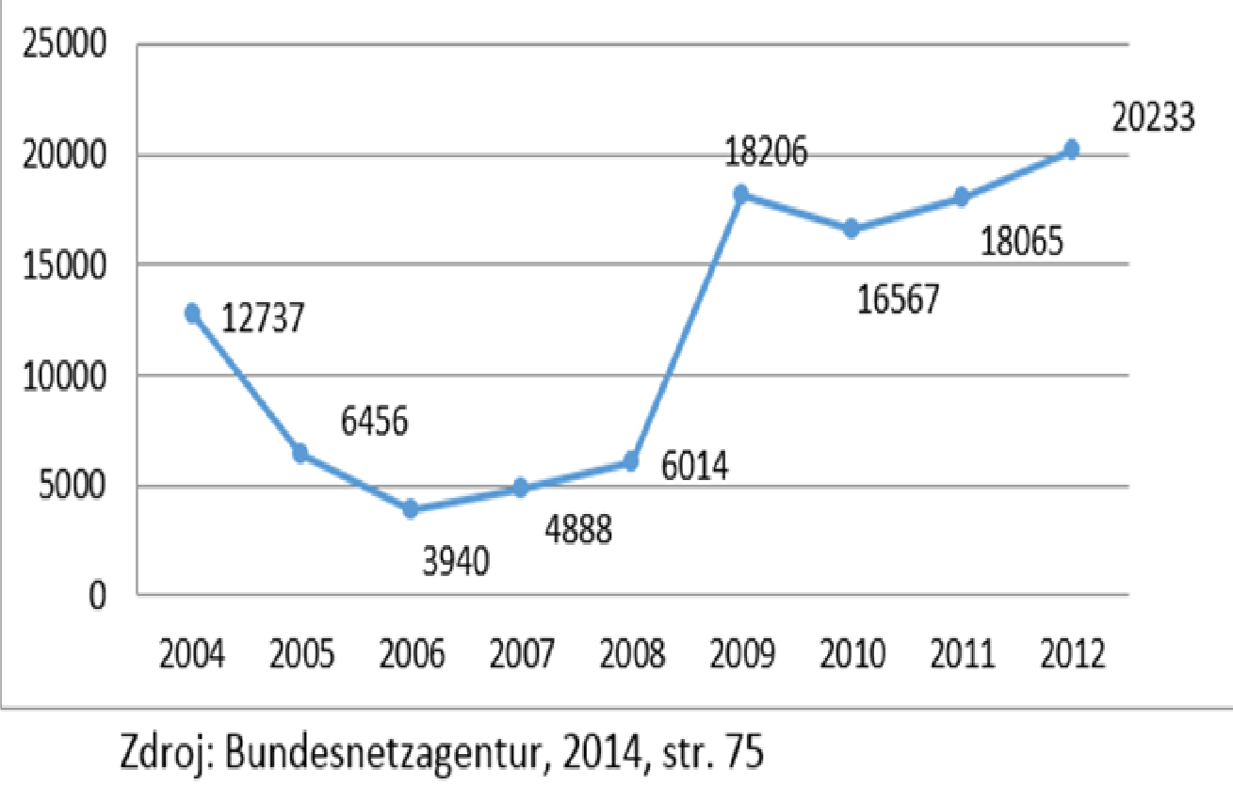
Number of activations of the minute reserve to balance RES

Slide 27
Non-dispatchable RES vs. consumption of regulation enegy | 2009 | 2012 | Balance
Installed capacity of PV a wind energy (GW) | 36 | 65 | +55 %
Production of electricity from PV and wind energy (TWh) | 45 | 77 | +59 %
Consumption of regulation energy (MWh/month) | 285 | 180 | -37 %
Source: Bundesnetzagentur, 2014, pg. 77; Eurostat 2014

Slide 28
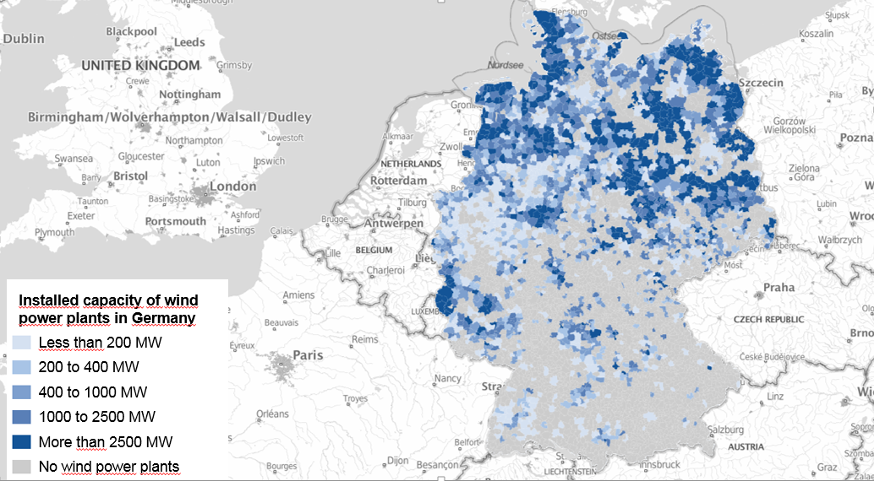
4) Grid capacity
Grid is not fit to accomodate 1 500 000 PV units and 23 000 wind turbines.

Slide 29
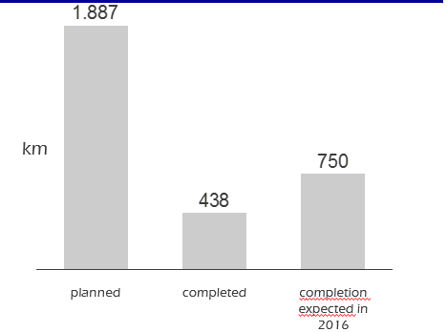
Building of the grid
In 2010 plan to build 1887km by 2015, in Q3 only 23% finished

Slide 30
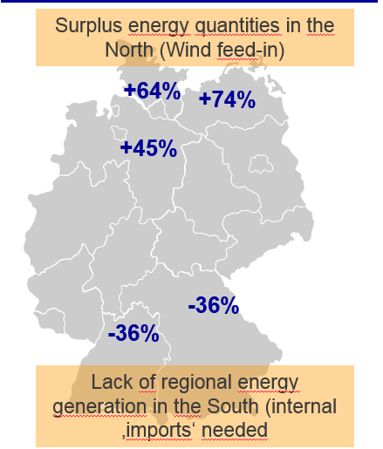
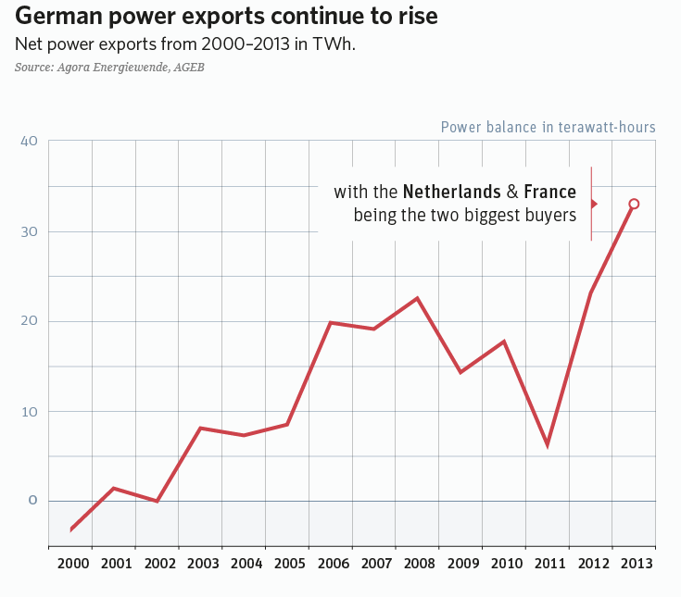

Slide 31
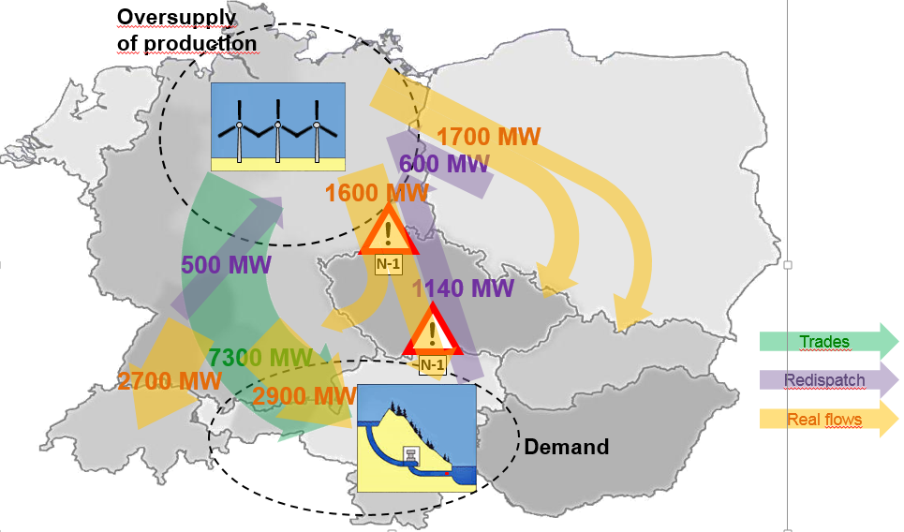
Trades and flow of electricity 2014/2015

Slide 32
4) Restructuralisation of energy production
Extensive development of RES at the expense of traditional sources. The resulting proportion of these two productive segments will be based on:
  Almost zero variable (fuel) costs.
  Financial support of RES paid by the end user within regulated part of the bill.
  Expenses associated with maintaining balance and stability of network.
In present, the costs on support of RES and funciton of networks exceed the savings from lower commodity prices (= higher costs for society). But competitivenes of RES have been changing.

Slide 33
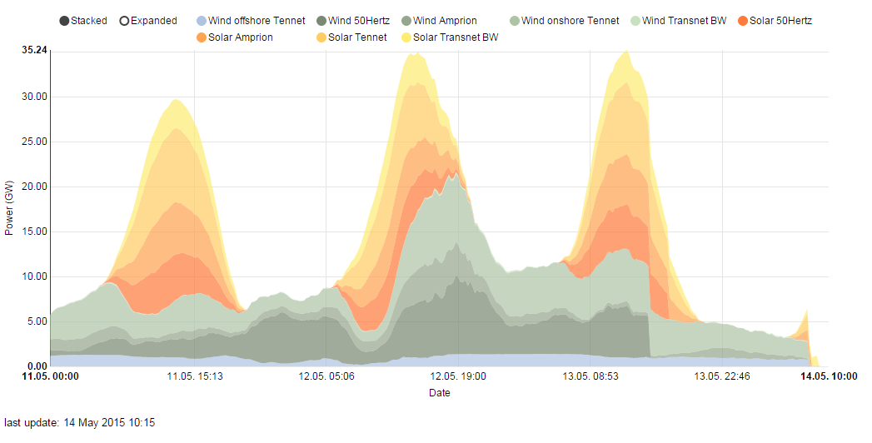
Solar + wind production in Germany in week 20 2015

Slide 34
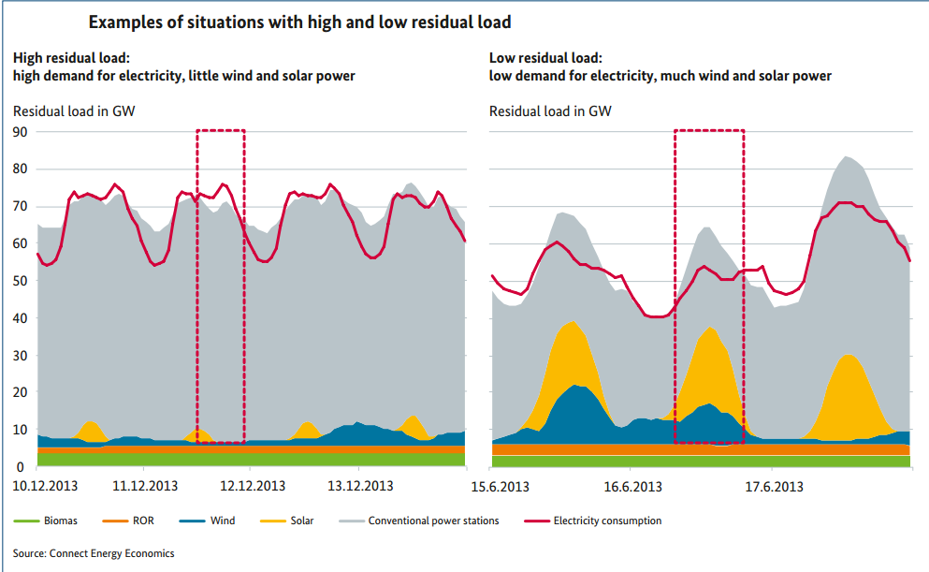
4) Restructuralisation of energy production
Source: BMWi, Green paper

Slide 35
Impact of EW on neighbouring countries

Slide 36
Impact of EW on neighbouring countries
Trade with electricity – price convergence
  Price volatility
  Wholesale price of electricity

Slide 37
Czech Republic - producers
Producers face reduced revenues. (EBITDA of ČEZ decreased from €3,5 bn. in 2009 to €2,5 bn. in 2015.
Low variable cost generation portfolio (nuclear, hydro) – still profitable company.
88 % of electricity generated from low-merit or mid-merit sources (coal 50 %, nuclear 30 %, hydro 5,5 %).

Slide 38
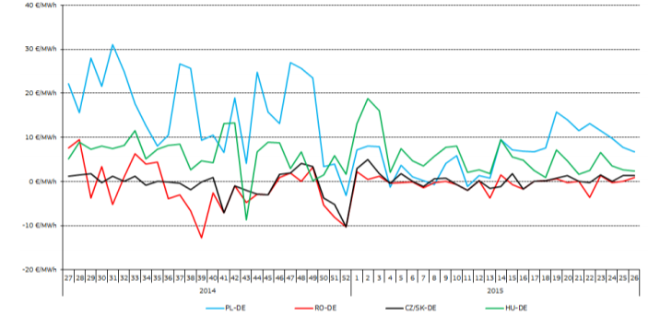
Czech Republic - consumers
Profit from Energiewende – import of cheaper electricity.

Slide 39
Czech Republic - government
Nuclear energy as a baseload source of energy questioned.
Nuclear is planned to replace decommissioning of 14 GW (out of 24 GW total) in 2030.

Slide 40
Poland - producers
Ageing fleet. 47 % capacity older than 30 years, Older sources have to operate at greater than 50 % capacity = minimum load of app. 10 GW.
84 % electricity from coal (decreasing competitiveness in Poland due to the depletition of deposits, low productivity, low global prices).
Production is not competitive – saved only by restricted imports.

Slide 41
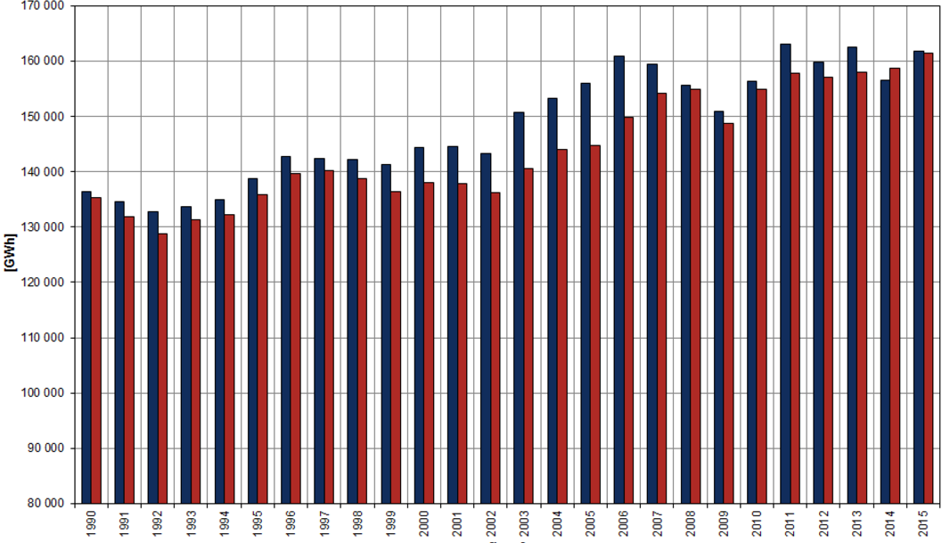
Production and consumption of energy, 1990 - 2015

Slide 42
Poland - consumers
Unable to profit from low wholesale prices.
Resource adequacy – not using import to shave peak demand Poland needs to finance high security margin (18 % above peak load).

Slide 43
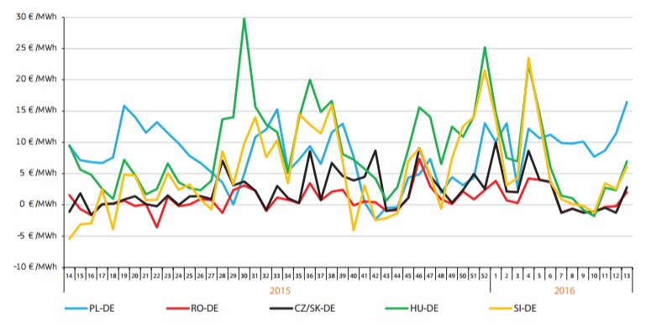
Regional weekly baseload price premiums or discounts to the German market, 3-4Q 2015

Slide 44
Poland – government
Strong position in the sector, justified primarily by security of supply concerns.
Emphasis on coal – for security and social reasons.
Achieving multiple governmental goals (dominant role of the coal in the system, its economic sustainability, participation on IEM, compliance to the EU energy and climate policy).

Slide 45
Sources
BMWi (2015): Making a success of the energy transition.

Slide 46
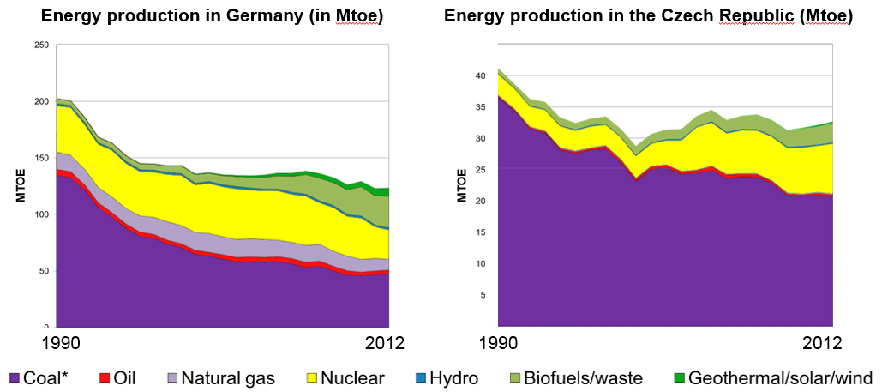
Energy supply in Germany and Czech Rep.

