Slide 1
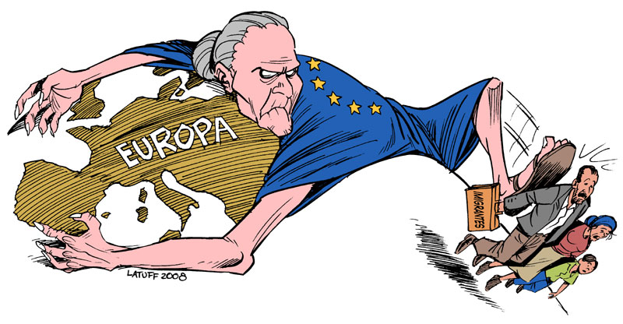
Current populism in South Europe

Slide 2
GDP per capita in pps
(purchasing power standards)
Source: Eurostat

Slide 3

Expectations on personal economic
status: long-term trend
Source: Ipsos database

Slide 4

International sentiment
Opinion on the economic situation of the country: a comprehensive overview
Source: Ipsos Global @dvisor

Slide 5
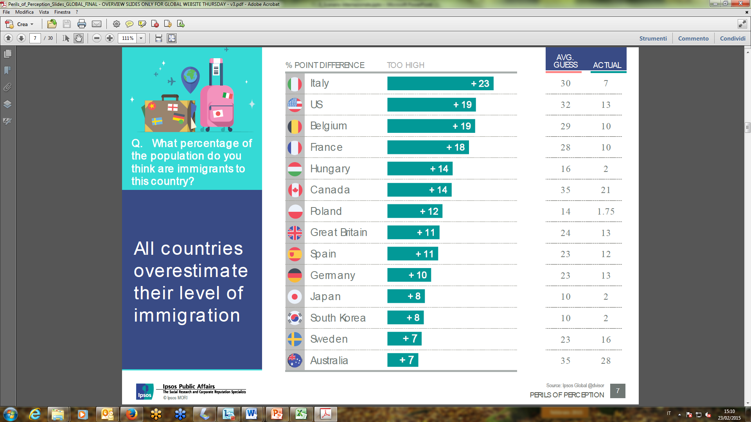
5

Slide 6
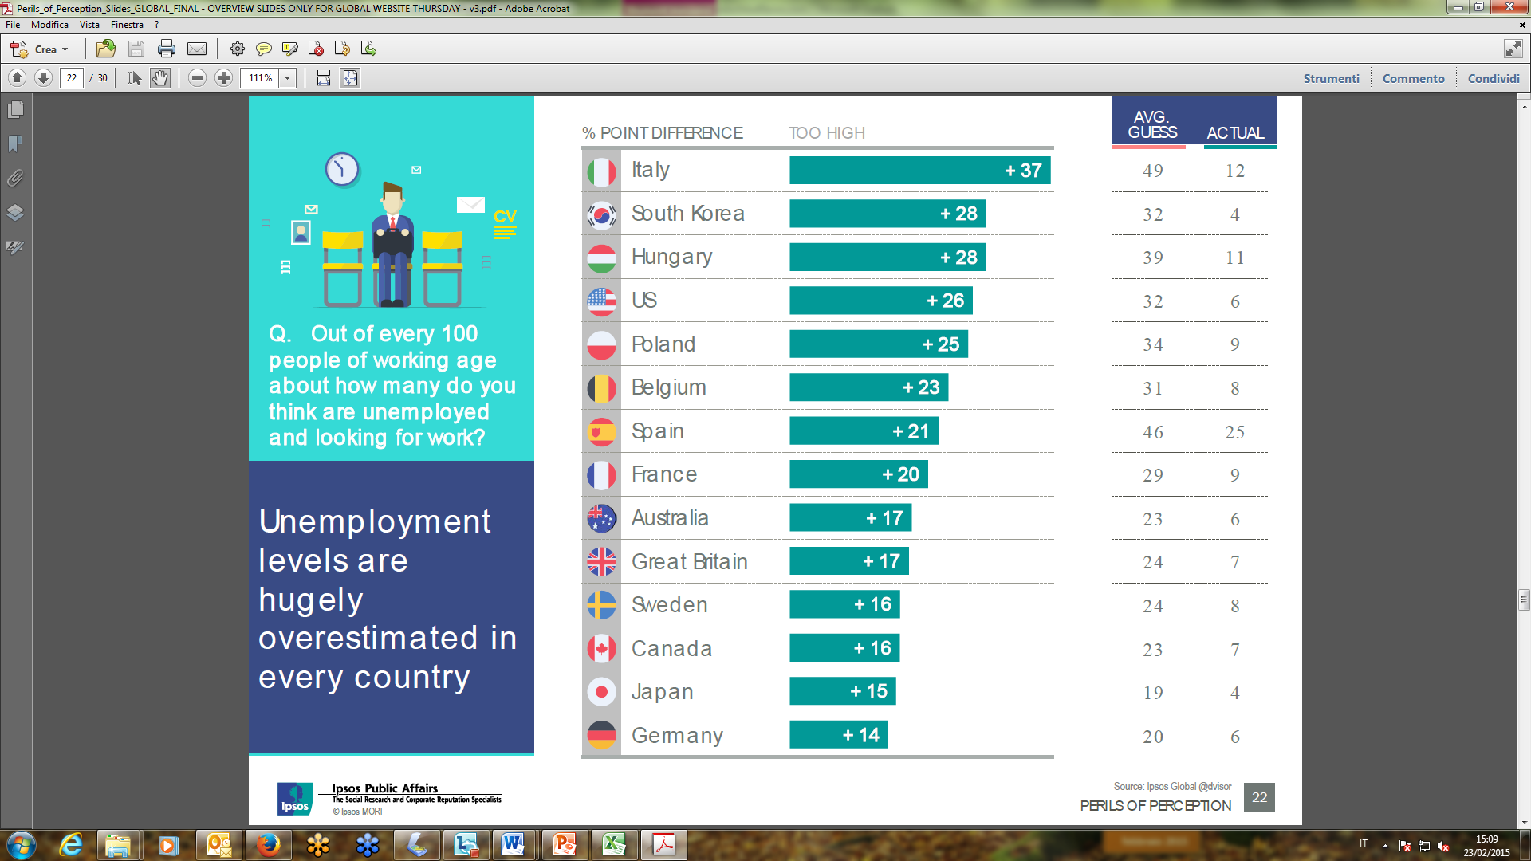
6

Slide 7
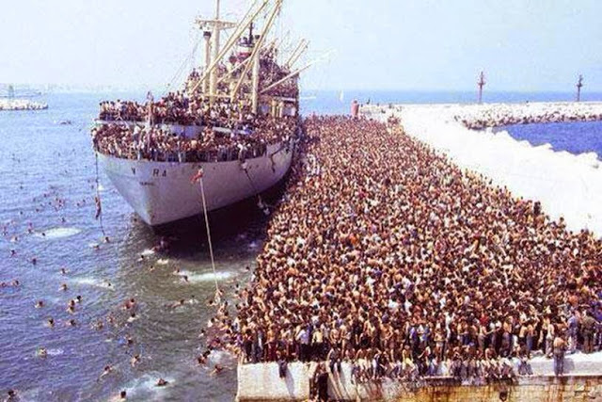
Deception

Slide 8
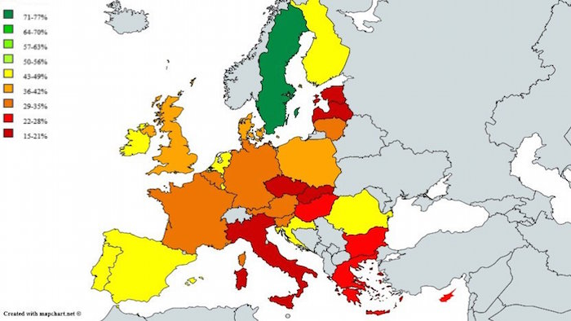
Attitudes of the people towards migration

Slide 9
Trust in government and society institutions
(% positive trend on valid votes)

Slide 10
The others and us: a difficult world
% Strongly + quite agree
+7
+13
-8
+3
Source: Ipsos Barometer of civic sense for Comieco in cooperation with Corriere della Sera

Slide 11
Trust in political parties
Source: Eurobarometer 2015

Slide 12
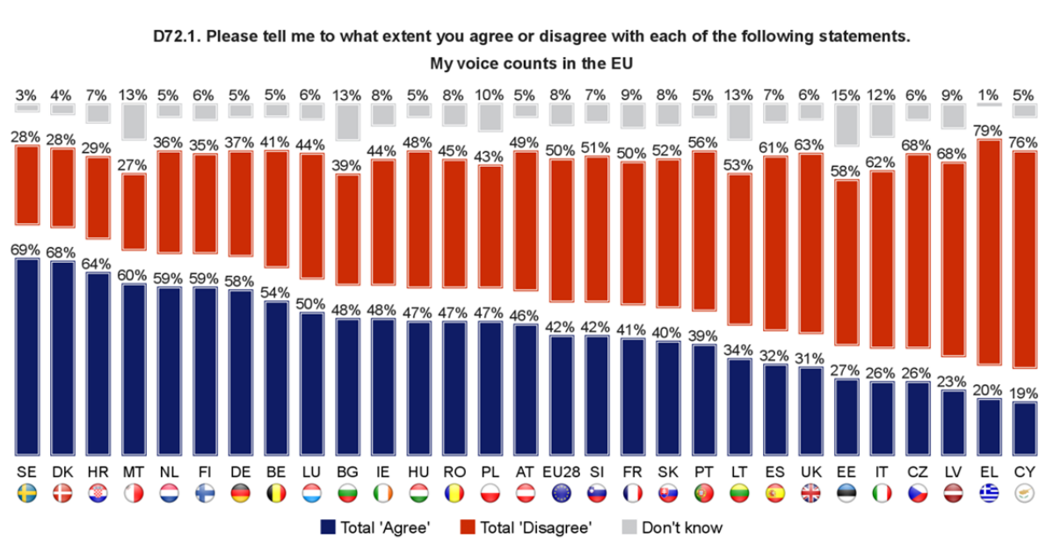
My voice counts in Europe
Source: Eurobarometer 2015

Slide 13
Italy as ‘anomaly’
Narrative of inefficient country, pathological abnormality and continuous stagnation
Abnormal historical development – absence of bourgeois revolution, lack of state-building process, unification without unity (‘Italy without Italians’)
Existence of ‘two Italies’, myth of anti-fashism, role of the Catholic Church
Collaps of the First Republic and 20 years of Berlusconi strengthened the narrative of ‘permanent political crisis’

Slide 14
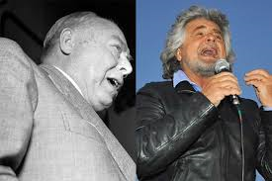
Long tradition of Italian populism
It’s not a new phenomenon – fascist regime used many populist attributes
Fronte dell’Uomo Qualunque first post-war populist actor in Europe
Similar language of Giannini and Grillo

Slide 15
Structural factors
Collapse of the bipolar party model
  Fall of Berlusconi IV marked the end of ‘fragmented bipolarism’
  Enhanced by the caretaker Monti’s government
  De-structured party system opened political space for newcomers and caused high electoral volatility without changing the voting system

Slide 16
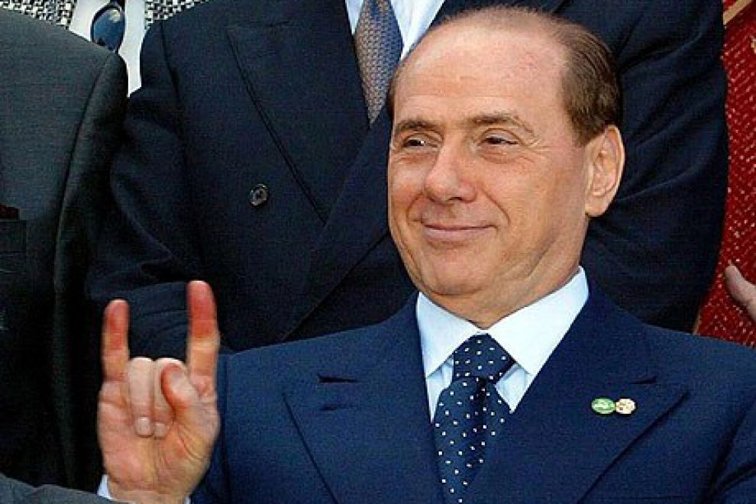
Silvio Berlusconi

Slide 17
Social de-legitimization of political elite
Repeated scandals of established political parties, even those originally protest and anti-establishment (LN and IDV)
Loss of voters’ confidence (2011 – 12% trusted political parties)
Strengthening of the climate of anti-establishment and anti-politics
Declining interest in the elections

Slide 18
Turnout at General Elections between 1948 and 2013
Turnout at European Elections 2014

Slide 19
The Italian political offer the main political parties
Forza Italia is a political party founded by Silvio Berlusconi in 2013 and it belongs to the Centre-right coalition.
Lega Nord is a political party based on a territorial and autonomist nature. Led by Matteo Salvini, its current secretary, LN becomes a national and anti-European party.
Partito Democratico (Democratic Party) is a Centre-left political party which is currently the main governing party.
Movimento 5 Stelle is a political movement founded in 2009 by Beppe Grillo, a comedian. M5S defines itself as an organisation without a political orientation (right or left). Nowadays, it is the main opposition party to the Renzi government.

Slide 20
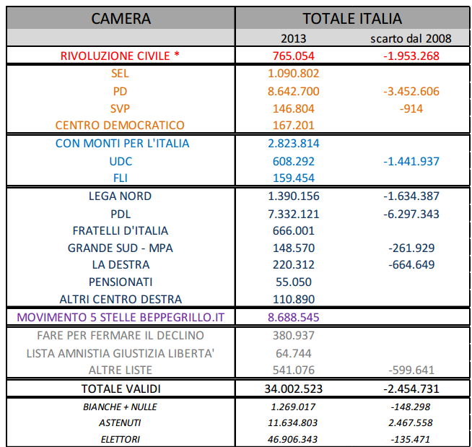
The vote in 2013 compared with year 2008
– variance in absolute values

Slide 21
Voting volatility between 1948 and 2013
(index of electoral volatility – Source: CISE)

Slide 22
The third general election in Europe for its volatility since 1945

Slide 23
Five Star Movement and Beppe Grillo
M5S is strengthening its consensus which seems other than a «bubble» created by the reactions against judicial investigations, by reaffirming the idea that the Movimento is the only incorruptible political institution. Actually, this is reinforced by some particularly rewarding choices such as the presence of a young, skilled, expert and proposal-making leadership. Moreover, choosing to take part in TV talk shows makes young exponents more visible. Finally, the proposal of a citizenship income achieved a strong consensus by those people who more exposed to the economic crisis.
«Damn, you are the leader!». This is what Beppe Grillo said during a press conference jokingly with Luigi Di Maio, considered as the future leader of the Movimento 5 Stelle by many people.
Waiting to know who’s going to lead the movement, the young Member of Parliament is at the top of the list at the moment.

Slide 24
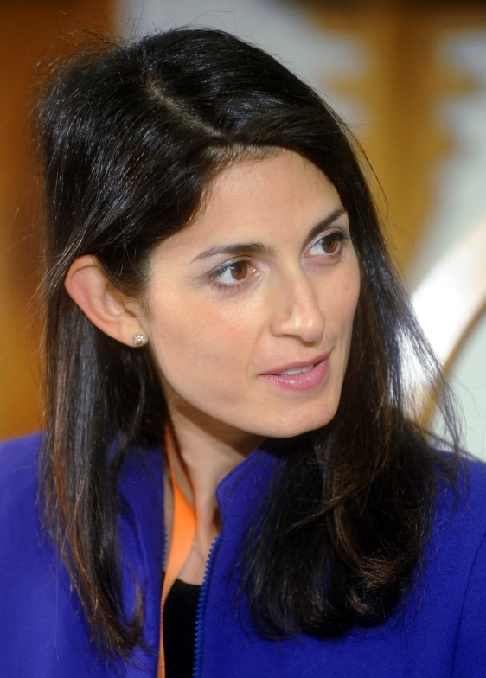
Example of the Eternal City
37 years old Virginia Raggi became the youngest mayor and the first women in the office
Lawyer well connected to the old political establishment
Praised by mainstream media
Criticized by grassroots activists
Attracted moderate voters from centre and centre-right (60%)

Slide 25
LEGA NORD and Matteo Salvini
The growth of the Lega Nord has stopped: today it does not succeed in broadening its consensus among the moderate electorate, who appears frightened by its amazing language, by the word «ruspa» (‘bulldozer’) and by the words used against the bishops. In addition, the Italians are partially changing their attitudes with regards to immigration.
The «other» Matteo, who was labelled as the true opposer to Renzi by many people, stops his growth. The language chosen by Matteo Salvini seems to strike less, probably due to the emotions generated by the recent images of the refugees and the unexpected decisions of Europe (and of Germany) on this topic.

Slide 26

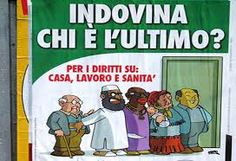


Shift towards migration/muslim issues

