Slide 1
IT and the state
11. 10. 2017
Veronika Netolická
Modern technology

Slide 2
In general
Specific
Behaviour
Activities
Pupose

Slide 3
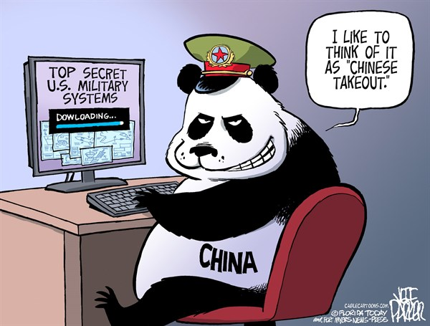
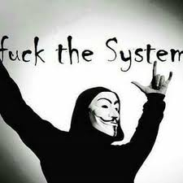


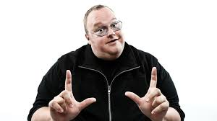
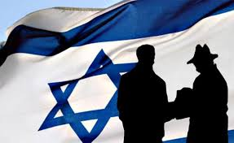
Ideology
Individuals State
Profit
Hacktivism Militia Cyberterrorisms
Espionage
Sabotage
Financial crime
Stolen identity

Slide 4
Triad of cyber security
CIA
Confidentiality
Integrity
Availability

Slide 5
Main state activities in cyberspace
Espionage
Sabotage
Censure
Information war/propaganda
Demonstration of power
Support of conventional attack

Slide 6
Cyber espionage vs. Sabotage
Espionage
Obtaining strategically sensitive or strategically important information from individuals or organizations by using or targeting IT means. It is used most often in the context of obtaining a political, economic or military supremacy.
Sabotage
Deliberate action aimed at weakening a polity or corporation through subversion, obstruction, disruption or destruction. In a workplace setting, sabotage is the conscious withdrawal of efficiency generally directed at causing some change in workplace conditions.

Slide 7
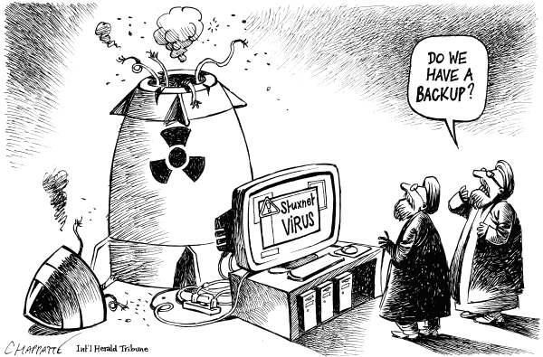

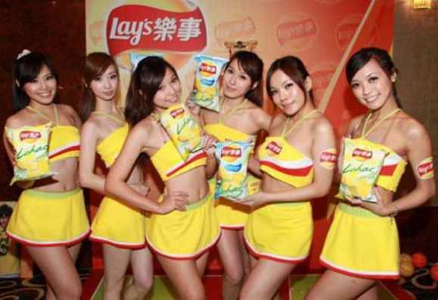
Cases

Slide 8
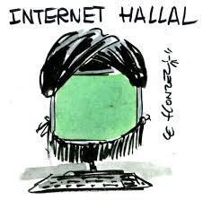
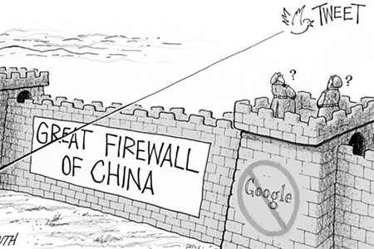
Censure
Commonly link with non-democratic regime
Halal internet vs. forbidden applications
Using different ways from residents

Slide 9
Demonstration of power
Estonia (2007) and Latvia (2008)
Similar modus operandi (DDoS, defacement and malware)
Russian Federation – absence of direct evidence
Estonia - due to the removal of the bronze statue of an unknown Soviet soldier
for RF symbol of freedom vs. symbol of occupation
Latvia – main reasons: law about non-acceptance Nazi and Soviet symbols, planning of American antimissile defense

Slide 10
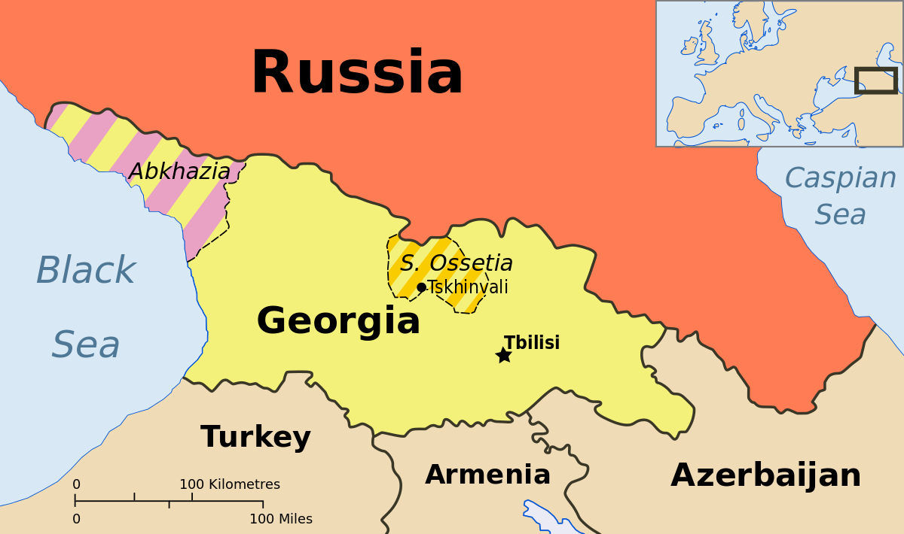
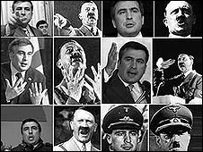
Support conventional attack
Georgia (2008)
In the background of a five-day war
Target: destroying of active communication and information
Methods: defacement, DoS, DDoS, malware
Patriotic hacking (nationalistic mode in society)
Russian Business Network
Attacks also on RF

Slide 11

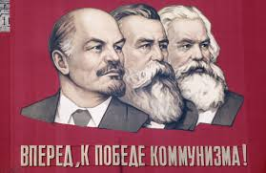
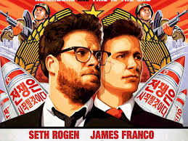
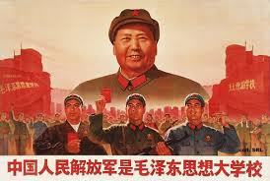
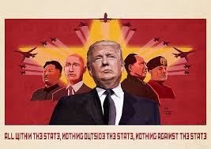
Information war/ propaganda

Slide 12
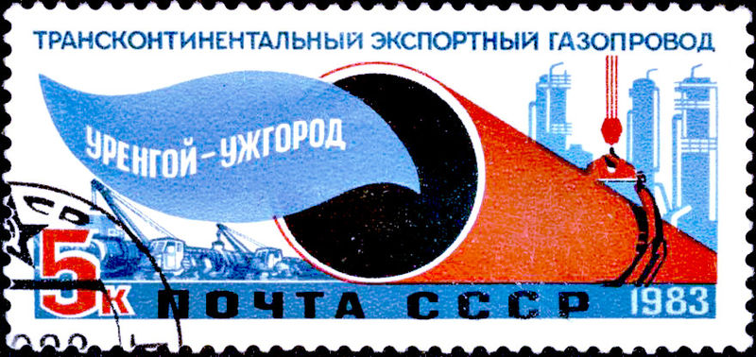
Demystification ???
1982: trans-siberian sabotage

Slide 13
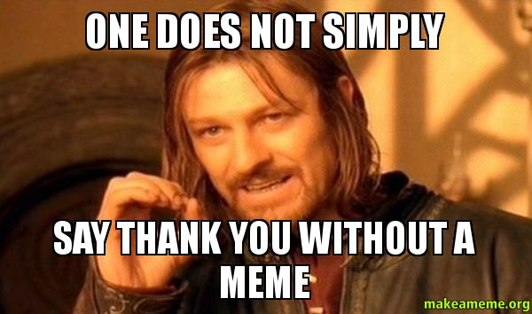
Thank you for your attention!!!

