Slide 1
Modern technology and conflicts
Climate, energy and resources
6.12. 2017
Jakub Drmola

Slide 2
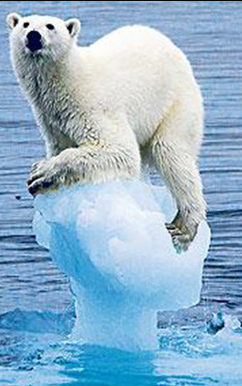
Climate change
extinctions are historical norm
  99% of all species
  most often due to climate changes
  usually triggered by volcanic activity
planet will survive, life and people will too
geopolitics of climate change
  lack of food and water
  countries cannot adapt
  migration and conflicts as a result
all countries to be impacted
“lifeboat” countries?

Slide 3
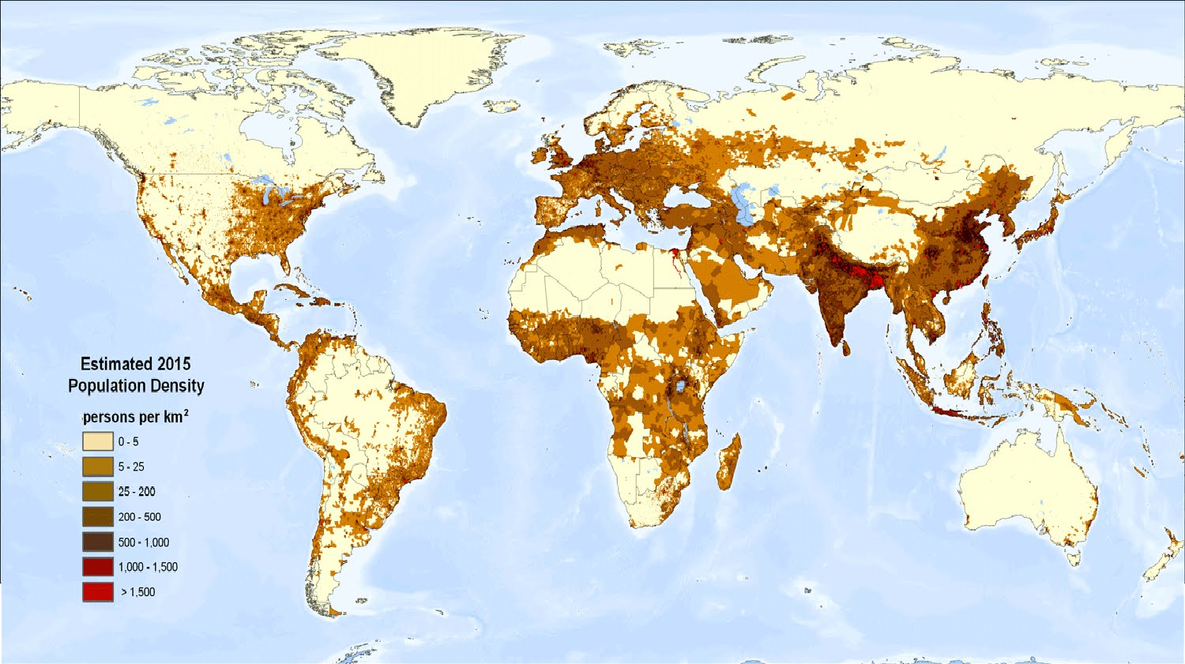

Slide 4
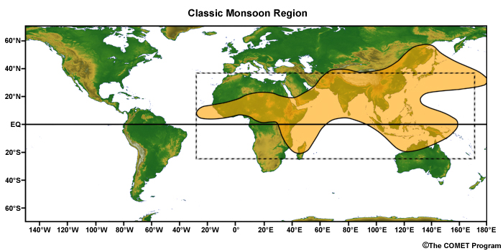

Slide 5
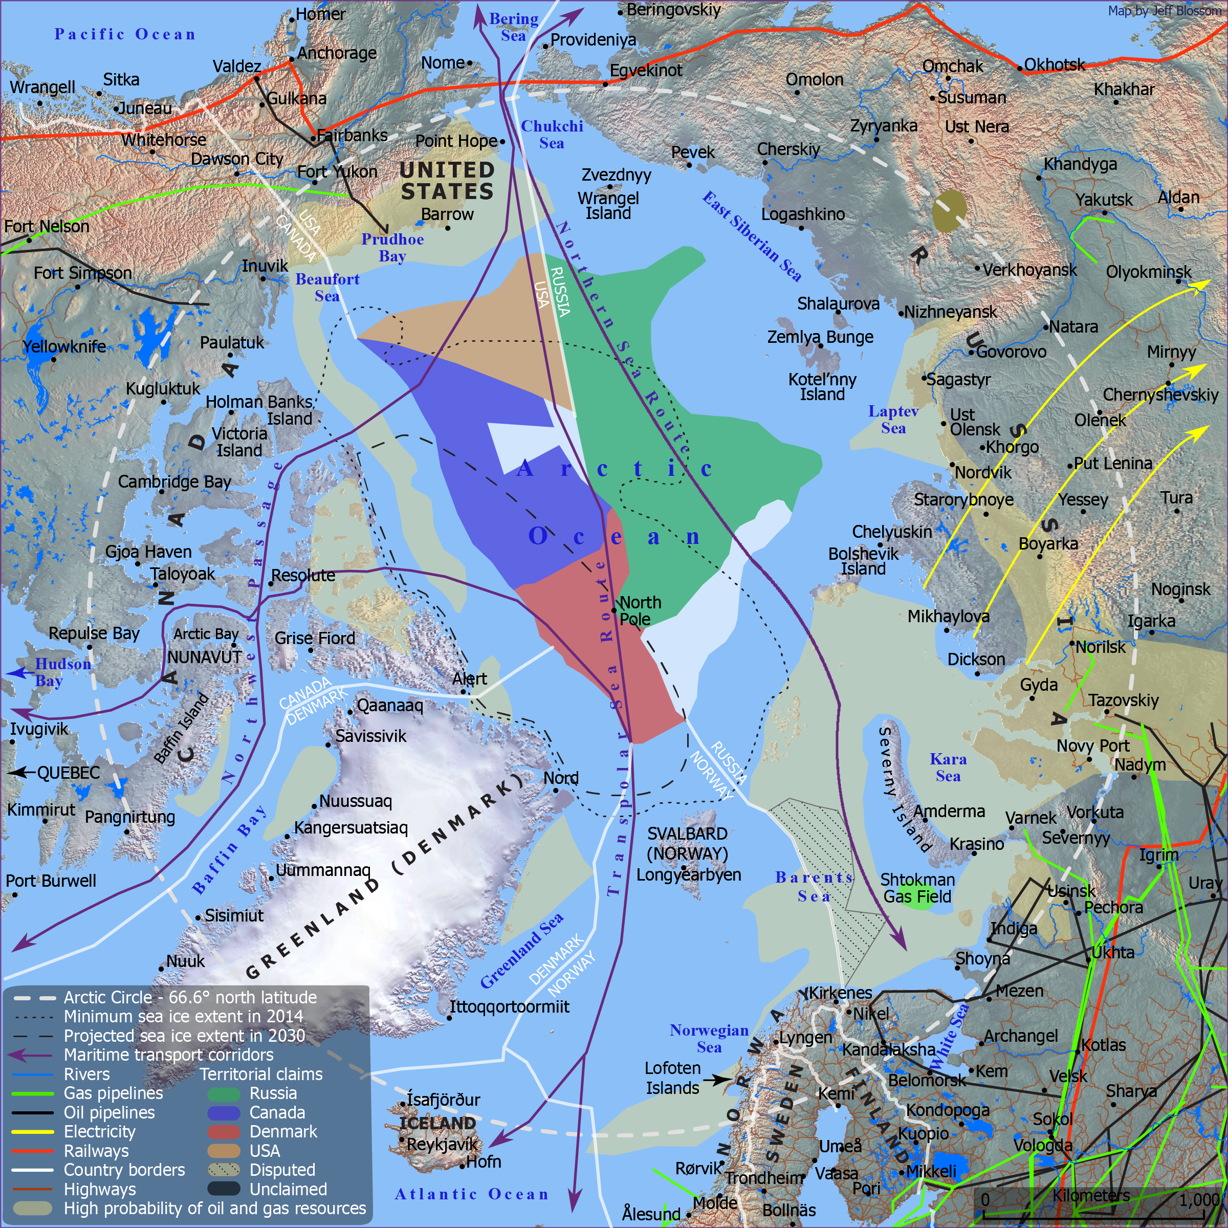
Arctic
new maritime routes
new resources
new farm land
new conflict?

Slide 6

Geo-engineering
influencing climate change intentionally
  + unintentional effects of pollution
the goal is to slow climate change down
usually through increasing albedo (reflectivity)
  SRM - Solar Radiation Management
aerosol dispersal, buildings and engineering
risk of unilateral actions and dependence
or “carbon capture” technology
artificial/organic

Slide 7
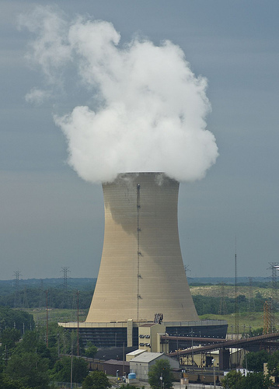
Energy sources
buried sunshine(87%)
sunshine as biomass (7%)
sunshine as wind/heat (4%)
geothermal + nuclear fission (2%)
storing energy is still an issue
consumption is and always will be growing
nuclear fusion as savior?
ITER, 2030?, $20 000 000 000

Slide 8
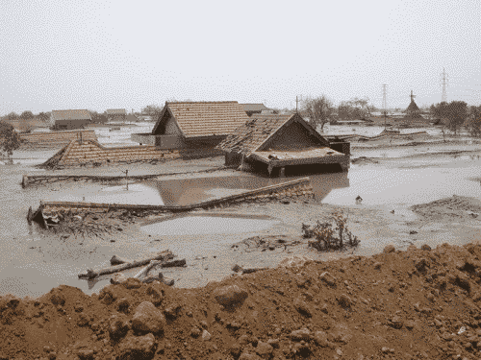
Extracting buried sunshine
2006, Indonesia, East Java, Sidoarjo
natural gas drilling created a mud volcano
180 000 m³/day -> 10 000 m³/day
area circa 10 km²
fracking?

Slide 9
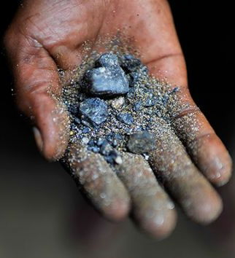
Coltan
mined for niobium and tantalum content (capacitors)
pretty much in all modern electronics
circa 60% from Central Africa
  https://www.youtube.com/watch?v=fPIB17PE2vM
“resource curse”, cause of conflict
fuels slavery and civil war
destroys environment too

Slide 10
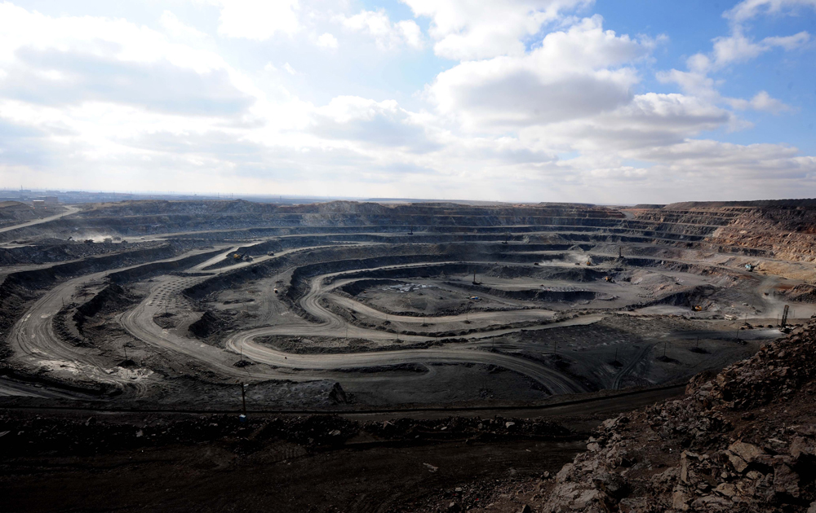
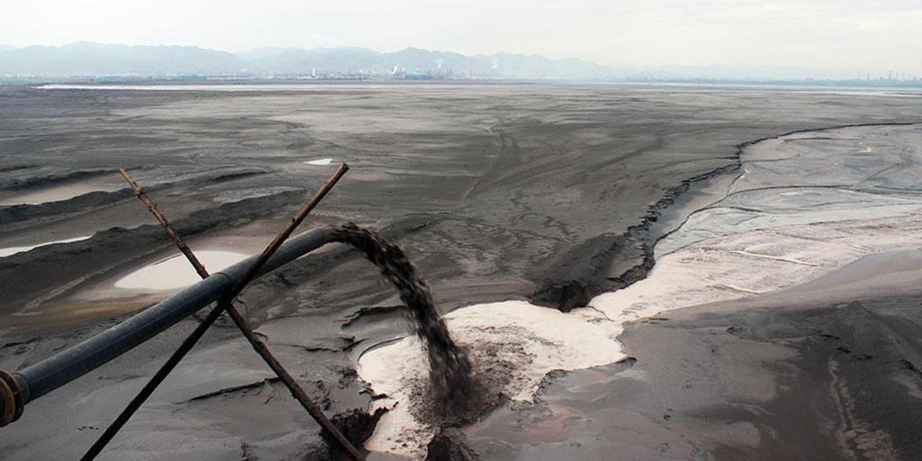
REE mining
- 90% coming from single mining complex in Baotou, Northern China
- cerium, neodymium, yttrium, terbium, scandium, dysprosium, …
- devastating to environment
- geopolitical tool for China
- other possible deposits?
  Afganistán, DPRK …

