Slide 1
Block II: Why Regulate and How?
MEB443 - Introduction to fundamentals of energy regulation
-------------------------------
Martin Šik

Slide 2
Some caveats
My background is public policy and law
Most of what I am going to talk about is based on the EU experience
I specialize in energy regulation and especially in the power sector as opposed to gas
Notes:
I am not an economist or an engineer
Most of my knowledge about the topic is based on work experience, anecdotal evidence, and self-study

Slide 3
Why regulate energy and network industries in general?
Economic regulation:
‘Economic regulation, a form of government intervention designed to influence the behaviour of firms and individuals in the private sector.’
Specialized term best defined in terms of its main components:
  Market entry (licensing)
  Price control
  Quality control
  Fostering markets in liberalized segments
Economic regulation is distinct form other forms of state intervention/regulation
  Fiscal policy
  Command and control
  Public ownership
  It’s closely linked with the concepts of natural monopoly and network industries
  Also defined as ex-ante regulation as opposed to ex-post regulation → competition rules

Slide 4
Why regulate energy and network industries in general?
Network industries vs. natural monopolies → the two concepts largely overlap
  Natural monopoly → mostly an economics concept
  Network industry → mostly a technical concept
In the past, the network industry category was a sub-set of natural monopolies:
  Network industries are dependent on physical infrastructure (networks) → high CAPEX and lock-in effect
  Not to be confused with network effect (externality) → related concept
  Many of the technical features of network industries result in properties which qualify them as (natural) monopolies → high cost of entry, low variable costs relative to fixed costs
  Network industries very often provide essential services → public utilities
Currently, some industries traditionally depending on networks are not considered monopolies → case for liberalization

Slide 5
Why regulate energy and network industries in general?
Justification for economic regulation of network industries → remedying the shortcomings of monopoly
  The vices of ‘non-natural’ monopolies are best prevented by not allowing monopolization → competition/anti-trust law, merger control and forced divestment, prohibition of exploitative abusive, etc.
  Natural monopolies are actually desirable from an economic point of view → economic regulation aims at making sure that the society as a whole enjoys the ensuing economic benefits
  By approximating allocative efficiency (quantity argument) → produced quantity up to the point where the last unit provides a marginal benefit to consumers equal to the marginal cost
  By preventing the extraction of monopoly rent (price argument)
I would argue that this justification may simply serve to provide a scientific augment (compatible with the neoliberal discourse) for a natural urge to subject essential services to public control
  Is this true in the if done by non-democratic institutions (independent regulators)?
Notes:
Exploitative, exclusionary, and discriminatory abuse.
Quality and quantity arguments are really just two sides of one coin

Slide 6
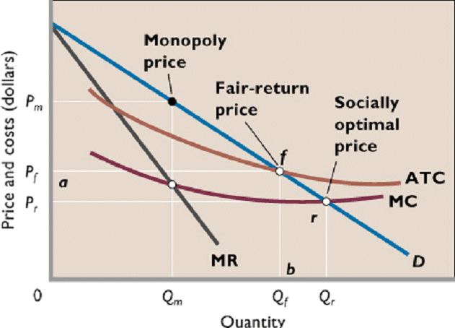
Market Failure rationales, the rise, vices and virtues of natural monopolies
Microeconomics
Monopolies are generally considered a market failure → public policy intervention
Natural monopoly → an industry in which multi-firm production is more costly than production by a monopoly
  economies of scale that are large in relation to the size of the market
  high fixed costs (ie. high capex) and constant or decreasing variable costs → decreasing average costs
  Inelastic demand is an important condition for monopoly → fulfilled in case of essential services
Notes:
Exploitative, exclusionary, and discriminatory abuse.

Slide 7


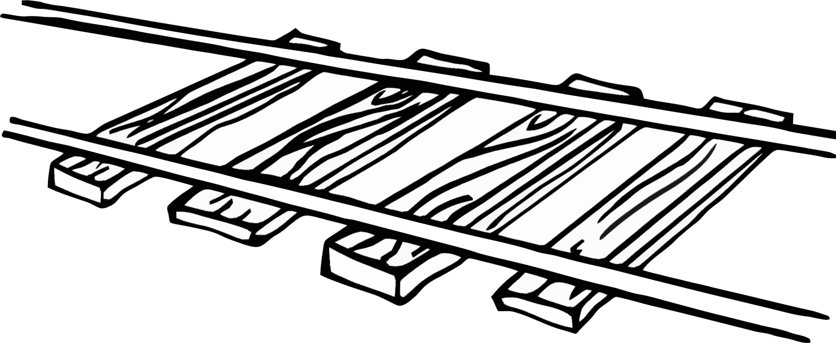


What is a network industry/natural monopoly?
Based on the foregoing description, what would you consider a network industry/natural monopoly?
Notes:
Exploitative, exclusionary, and discriminatory abuse.

Slide 8
Power and gas
Gas – more interesting from a geopolitical point of view and energy security in terms of international relations
  Few sources – less variable mix of marginal and investment costs
  International implications
Power – more interesting in terms of regulatory policy and security of supply in terms of technical aspects
  a great variety of sources – a very diverse mix of possible marginal and investment costs
  Mostly domestically produced with limited cross-border trade
  ‘Electric power systems are generally regarded to be the largest and most complex industrial systems ever built’

Slide 9
How to regulate?
In terms of allocative efficiency price should be set at the level of marginal cost, however these are by definition below the average total cost → loss making and market exit
Price should be set at the level of average total cost (retrospective approach) → the firm can recover both its fixed and variable costs without subsidization
  Political control over price is believed to lead to prices below this level and chronic underfinancing of public utilities → argument for independent regulation
From a purely economics point of view it’s even better to set the price at the level of long-run marginal costs (LRMC) → prospective approach
  Better allocative efficiency → provides correct investment signals
  But difficult in terms of regulatory accounting
In practice it is rather difficult to determine a regulated firm’s cost function

Slide 10
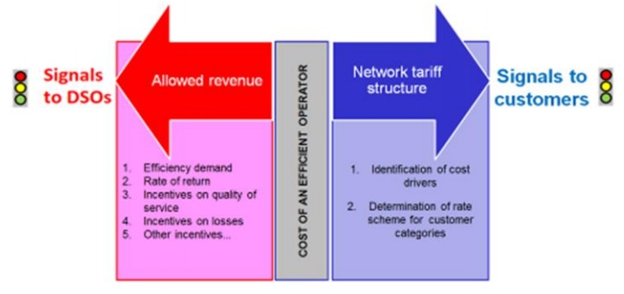
How to regulate?
Regulator has two jobs: (1) to estimate what are the costs of operating a system and (2) determine which customer groups will pay what tariff to cover the system cost

Slide 11
finding the right cost function and translating it into allowed revenue
Apart from making sure that a regulated company doesn’t make an excessive profit (monopoly rent), the regulator also needs to ensure that it can operate and finance future investments → financeability
  a regulated company need to cover its operational and capital costs → establishing revenue requirement and allowed revenue through a regulatory formula:
  The individual components are also called building blocks → regulatory framework is a series of design decisions about the individual blocks
  All of these are, in economics terms, fixed costs in the short run
  Variable costs are typically losses and are often treated separately
  Allowed revenue = operational costs + depreciation allowance + return on investment

Slide 12
financeability
Tariff revenue
Revenue requirement
Revenue from customer group A
Operational costs
Revenue from customer group B
Depreciation allowance
Revenue from connection charges
Revenue from use of network charges
Revenue from capacity charges
Return on investment/profit

Slide 13
building blocks – regulatory asset base
Regulatory asset base (RAB) is the regulatory value of investments made in long term assets necessary to operate a regulated business
  Usually based on the book value of tangible fixed assets
It drives two of the building blocks → think of it as a principal on which the company earns interest (return on investment) and which it is repaid in yearly instalments (depreciation allowance)
Regulation is many ways reverse engineering finance
  Finance → estimating future cash-flows in order to determine if an investment is profitable
  Regulation → establishing future cash-flows in order to ensure that an investment is profitable
The regulators should make a judgement on the usefulness and efficiency of investment projects (mostly transmission) → CBA

Slide 14
building blocks – depreciation allowance
Depreciation allowance = RAB / depreciation rate
There are some important regulatory decisions to be made:
In terms of ATC vs. LRMC approach →
  Historic value
  Indexation
  replacement value
In terms of inter-generational fairness → assets with long useful life which are expected to serve both current and future customers. Who should bear the costs?
  Speed of depreciation → straight line vs. front-loaded
  implications for risk profiles of infrastructure projects

Slide 15
building blocks – return on investment
Return on investment is meant to cover a regulated company’s cost of capital and is basis of its profit in accounting terms
It provides funds to compensate shareholders for equity and for debt servicing → it is composed of a return on equity and a return on debt.
The most common method is to calculate Weighted Average Cost of Capital (WACC).
As part of finding the right cost function, the regulator also has to find the right WACC
  Competitive interest rates on debt
  Capital asset pricing model (CAMP) → cost of equity
  The right capital structure → cost of capital minimizing debt to equity ratio

Slide 16
Regulatory regimes
There are a great variety of regulatory regimes which differ in terms of how they approach the different building blocks
Regulatory regimes
Traditional approach
Rate of return
Cost of service
Incentive-based
Revenue cap
Price cap
yardstick
sliding scale/profit sharing
Rate of return vs. cost of service → ex-post vs. ex-ante adjustment of rates
Price cap vs. revenue cap → treatment of volume risk
Caps vs. yardstick → actual or benchmarked costs
Profit sharing vs. the rest → sharing of risk of under/over spent

Slide 17
incentive-based regulation
Averch-Johnson effect (aka ‘gold-plating’) → the tendency of regulated companies to engage in excessive amounts of capital accumulation in order to expand the total volume of their profits.
Without the discipline of competition, regulated companies are generally likely to become inefficient, increase both their OPEX and CAPEX to make their life easier
Traditional regulatory approaches (ie. rate of return and cost of service) rely on detailed cost auditing to discover and prevent inefficiencies → information asymmetry
Incentive-based regulation has been the answer to this
  first introduced in the UK (British Telecom) in 1980’s and known as RPI-X

Slide 18
incentive-based regulation
The idea is to partially decouple the regulated company’s actual costs from its allowed revenue → it can retain all or part (sliding-scale/profit sharing) of the extra profit resulting from increased efficiency
The company knows its cost function best → removing information asymmetry
This regime is generally applied for a number of years (regulatory period) and the allowed revenue is re-set at the beginning of the next regulatory period according to actual costs → transfer of efficiency gains to the customer
  The allowed revenue is set at the beginning of a regulatory period based on actual costs
  The allowed revenue is adjusted for inflation and efficiency targets (RPI-X) and other elements
Should be applied only to controllable costs
Often complemented with cost benchmarking and efficiently targets (X factor)

Slide 19
Traditional vs. incentive-based regulation
Cost-plus regulation
Revenue cap
Cap
costs
profit
costs
profit
loss

Slide 20
proscribing how allowed revenue is earned
The second part of the regulatory job
Traditional approach → tariffs charged by vertically integrated utilities have included both the cost of operating the network and the cost of producing/purchasing energy
Deregulation → only access tariffs covering network costs plus any other regulated charges
Tariffs should be based on the cost-causality principle → cost of infrastructure investments charged to those network users who benefit from them or have been responsible for incurring the network investment costs
  In practice some proxy – such as network utilization – may have to be used to determine causality

Slide 21
proscribing how allowed revenue is earned
The cost-causality principle dictates that there should be no cross-subsidization between the various customer groups
  The emphasis on cost-causality stems from concerns about allocative efficiency
  This is well illustrated in the case of DER (e.g. rooftop PV) → total volume consumed may decrease significantly but the demanded peak capacity is likely to remain unchanged
Tariffs usually comprise multiple (most typically three) prices
  Per kWh (volumetric) → to cover variable costs
  Per kW (capacity based) → to cover the capital costs
  Per connection point → to cover direct costs incurred in servicing a customer (e.g. metering or billing)
  even tough the biggest share of costs is capacity-related, tariffs (especially for LV customers) tend to be mostly volumetric

Slide 22
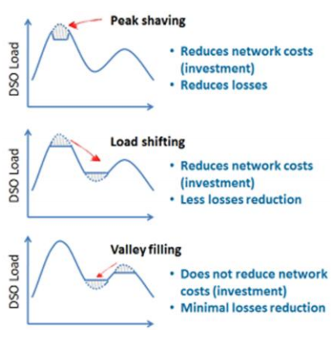
proscribing how allowed revenue is earned
Networks have been traditionally designed in a fit-and-forget fashion
  Ability to meet the peak load which occur only in a limited number of hours
  A lot of redundancy
Tariffs may provide incentives for efficient network use → according to economics theory, fixed costs should be recovered during congestion
  Politically not acceptable, but some approximation:
  Time-of-use tariffs
  Critical peak pricing

Slide 23

Q&A

Slide 24
Block III: Reforming an industry
MEB443 - Introduction to fundamentals of energy regulation
-------------------------------
Martin Šik

Slide 25

Traditional organization of the power industry
Ever since the electricity industry reached maturity and until recently, regulation around the world was uniformly of the sort applied to a public service provided under monopoly arrangements:
  guaranteed franchise (legal monopoly) for the – typically vertically integrated – electricity utility
  price regulation based on the costs incurred to provide the service.

Slide 26
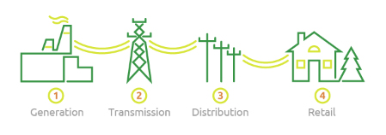
Power industry value chain
Similar patterns are present also in other network industries

Slide 27
Market discipline vs. monopoly regulation
The neoliberal economics argues that state intervention in price formation and quality determination is only a second-best solution
Competition and market discipline should be the main regulator wherever possible → wave of economic liberalization affecting air travel, telecommunications, banking services, gas supply etc.
  Economic efficiency
  Innovation
Network industries have been traditionally vertically integrated along the value chain → but what if some parts actually are not natural monopolies and competition may exist and be beneficial?
  A mixture of technological → increased interconnection capacity, new generating technologies, metering, communications and information processing
  And political reasons → excess of governmental intervention, confusion over the State’s dual role as owner and regulator, financial and technical management inefficiencies due to the lack of competition, or lack of investment capacity.
These competitive segments could become more efficient if de-monopolized → removal of legal monopoly = liberalization

Slide 28
Market discipline vs. monopoly regulation
Power industry reform first introduced in Chile in 1982
  Separation of the basic activities involved in the provision of electric power.
  Most of the industry was privatized
  An organized, competitive wholesale market was created, with centralized dispatching based on declared variable costs. All generators were paid a “system marginal price”, and long-term contracts were instituted to offset price volatility.
More similar reforms were not introduced until 1990 when the power industry was transformed in England and Wales, and shortly thereafter in Argentina (1991) and Norway (1991)
Than came EU liberalization packages and FERC standard market design orders

Slide 29
The development of a market
Markets are institutuons → they are one of several means of allocating scarce resources and arguably the most efficient
As an organic process
  Agents realise that there are potential gains from trade
  Market institutions (trading rules, meeting places etc.) that reduce transaction costs are established
  Thus market institutions survive only until better alternatives become available (Example: trading floors vs. computers)
By discretionary decision
  Barriers to trade are reduced or abolished
  Market institutions are created through legislation, decision by regulator etc.
  Thus market institutions may survive even if better alternatives become available
A number of markets in Europe have been created by discretionary decision
  Markets for allocation of radion spectrum, 3G licenses, emission permits, green certificates, etc.
  “New” markets for electricity, railway services etc.
Competition in a market vs. competition for a market

Slide 30
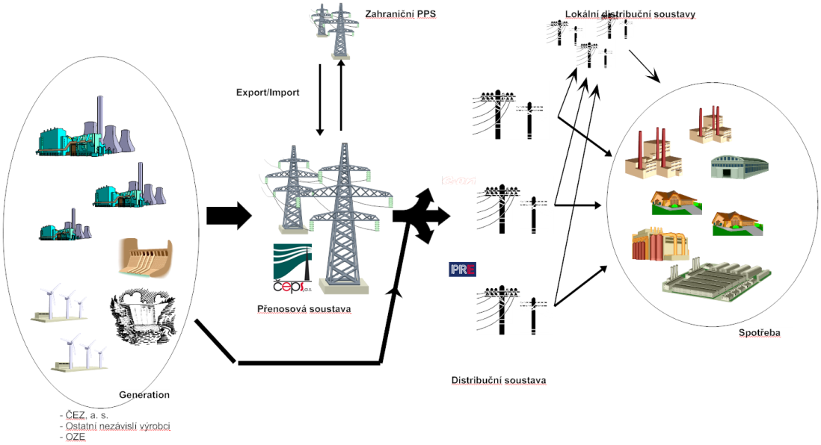
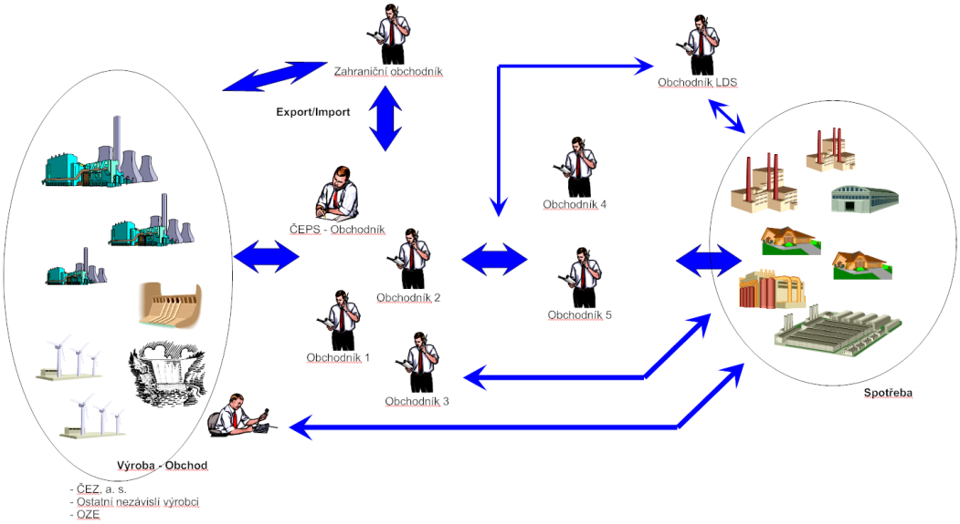
Market discipline vs. monopoly regulation
Industry liberalization has gone hand-in-hand with dramatic decentralization of planning and operating functions:
  System expansion – now focused on investment – and operation are the result of individual company decisions based on the maximization of business earnings
  Economic and financial risk and anticipated returns on investment, instead of the traditional cost minimization criteria, drive decision-making.
  The challenge for administrative and regulatory authorities is to design liberalized market rules that ensure that the strictly entrepreneurial behavior of each market player leads to overall minimization of system costs, reflected in the tariff charged to final consumers.

Slide 31
Policies of energy industry liberalization and deregulation – the enablers
Liberalization as such and the enablers are mostly the result of EU policies → three liberalization packages (1996/8-2003-2009)
Liberalization could in theory work under competition rules → ex-post regulation
  Former monopolists (incumbents) as well as network operators will by definition have a dominant position → prohibition of certain anti-competitive practices such as refusal to deal, essential facilities doctrine, margin squeeze
  In practice however, enforcement is rather difficult and the implementation of a liberalization policy uncertain
To enable liberalization, three dedicated polices have been developed and implemented:
  third party access
  unbundling
  independent energy regulators

Slide 32
Third party access (TPA)
TPA constitutes a statutory obligation on network operators to allow any interested party access to its infrastructures
Two types have emerged
  Negotiated TPA → network operator is mandated to allow access on non-discriminatory terms at a price which is NOT set by the regulator but is subject to ex-post regulation ; it should charge the same price it would charge to its own downstream branch
  Regulated TPA → access on terms and at a price determined by the regulator; ex-ante regulation
Access (incl. connection) can be refused only based on objective and non-discriminatory criteria → typically lack of capacity

Slide 33
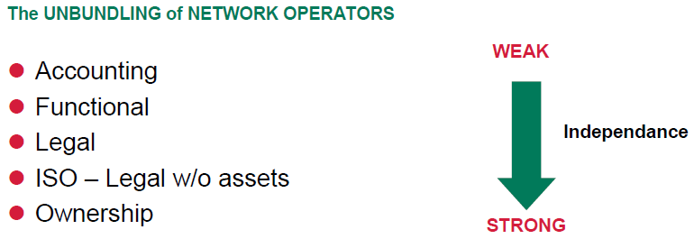
unbundling
TPA is conceptually possible with a vertically integrated company, it is however deemed inefficient → those branches controlling essential facilities (ie. networks) are likely to favor their affiliates, thus hampering competition in the liberalized segments
Unbundling is the separation of natural monopoly businesses from the rest of the value chain
  Non/discriminatory treatment of all network users
  Prevention of cross-subsidization between monopoly and competitive branches
It can take different forms:

Slide 34
Independent Energy Regulator – roles and responsibilities
Protecting the interests of energy consumers → what about regulatory capture?
Fostering markets in liberalized segments → regulation of competitive wholesale markets
  Deciding on ‘the detailed rules’ → network access, market organization
  Market monitoring and market manipulation prevention
  EU integration a major focus → cross-border issues
  Renewables and energy transition now central to many markets
  Many of the detailed rules are now enacted at the EU level (network codes) → generally following the Lamfalussy process
Fostering markets in liberalized segments → regulation of competitive retail markets
  Opening-up of retail markets to competition → every customer is free to chose their supplier
  Emphasis on easy supplier switching
  Active customers and customer protection an increasing focus

Slide 35
Independent Energy Regulator – roles and responsibilities
Economic regulation of monopoly energy networks → Ex-ante price and quality regulation
  Sets network revenues and tariffs → Regulated TPA and price controls
  Setting quality of supply requirements and their integration into the regulatory formula → both technical and commercial quality
License/certify and monitor market players → control of market entry
  Licensing generators, suppliers, network companies
  Network unbundling, certification of unbundled companies
Some ex-post role too
  Dispute resolution between market participants with special focus on consumer protection
  Some competition policy responsibilities → usually in cooperation with competition authorities

Slide 36
Independent Energy regulator – why independence?
To provide a predictable and stable climate for investors
  to shield them from interference by politicians eager to reduce energy prices as part of their campaign
  To prevent discrimination and ensure a level playing field in an environment with a lot of public ownership
  Investor confidence and long-term stability leads to low cost of capital which, in a capital-intensive industry, benefits the end customers more than short-term price reductions
The introduction of independent regulators in the EU member states has been the result of EU legislation → it proves the growing EU-level involvement in regulatory activities
In line with the general trend of rise of EU agencies, a new agency (Agency for the Cooperation of Energy Regulators) has been established to assist and help the coordination of national regulators on cross-border, regional and pan-European issues
  It has rather limited powers but is , in accordance with Majone’s assumption, mainly responsible for monitoring the internal market, drafting reports and providing opinions

Slide 37
Electricity and gas challenges
Gas – uncertainty about future demand – risk of asset stranding
  Global LNG market?
  Is unbundling and liberalization (de-monopolization) inhibiting investment in large cross-border project due to lack of coordination and uncertainty about future revenue streams?
  Large pipeline project typically have a large carrying capacity→ more often than not used for transit → the transit courtiers want to have their slice of the cake, too → lack of coordination b/w countries
  Renewable gas
Power – uncertainty about what the industry as such will look like a few years from
  DER ➔ decentralization
  RES ➔ intermittency
  The role of network companies
  Demand ➔ impact of e-mobility vs. energy efficiency
  Storage
Rise of uncertainty and complexity

Slide 38
Why do we have electricity markets?
Commitment/dispatch optimization
Investment signals
Notes:
Optimalizace provozu - To do značné míry zvládne TSO – viz např. organizované trhy v USA, diskuze kolem self-dispatch vs. central-dispatch systémy v EU

Slide 39
Can an EOM ensure adequate generation capacity to ensure security of supply?
Security of supply is a public good ➔ underinvestment
Investment cycles ➔ installed capacity oscillates around a the long-term equilibrium
The right level of prices ➔ missing money problem and VOLL
Notes:
Bezpečnost dodávek je veřejný statek ➔ vcelku zřejmé, filozofický problém s tím nastavení trh nemůže nic udělat.
VOLL je pro každého zákazníka jiná (např. podívat se večer na zprávy vs. dokončit zakázku se smluvní pokutou)
Příklad s tím, že DSR není o tom spotřebovávat, když je elektřina nejlevnější, ale nespotřebovávat, když je nejdražší.

Slide 40
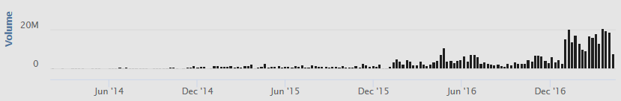
Investment signals
Generation capacity is „chunky“ ➔ impossible to add in small increments
Long lead times (investment decision to commissioning) ➔ lack of reliable investment signals
A mismatch between project useful life (> 30 yrs) and forward curve liquidity (< 3 yrs)

Slide 41
Investment signals
A wide selection of available technology options with varying OPEX/CAPEX ration ➔ e.g. OCGT vs. Nuclear
Risk averse investors more likely to opt for the least risky options ➔ low CAPEX and short lead times
  May or may not coincide with the option which minimizes total system costs

Slide 42
The role of politics
Power generation shares some features with other industries → high capital intensity, long lead times
  E.g. aluminum, oil
  „Boom and bust“ phenomenon
… But there are important peculiarities
  Limited storage possibilities
  Essential for modern society → high political sensitivity
Black out

Slide 43
The role of politics
Will politicians let go and let the market find an equilibrium?
  What are their risk acceptance levels?
  It contrary to the concept of politics to “sit down and kick back”
Influencing the policy-making
  Olson theory → concentrated groups, who stand to benefit significantly from a policy have a better chance of influencing the policy than disperse groups (e.g. customers) who are to bear the costs even if benefits overall outweigh costs for the society
  Information asymmetry → those who would benefit from a CRM supply information necessary for a policy analysis
The case of capacity mechanisms and the security of supply debate is an example of tension between expertise and politics
  the current developments make perfect sense form an expert point of view but are unacceptable politically
  Which should prevail? → expert knowledge or democratic legitimacy?

Slide 44
Q&A

Slide 45
Student outreach - come work for us!

Slide 46
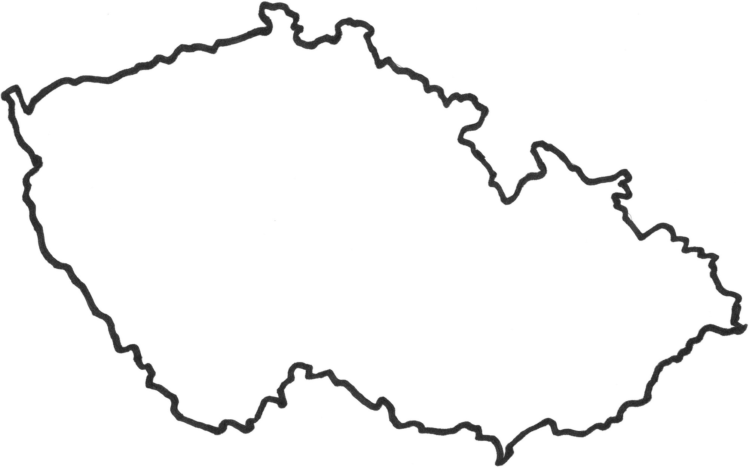
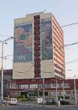
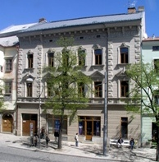
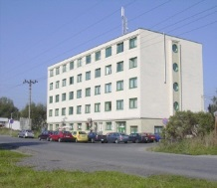
About ERO
Established in 2001
Independent regulatory body tasked with a wide range of responsibilities
Headed by a 5-member Board appointed by the Govermnebt of the Republic for a term of 5 years (staggering)
Almost 250 staff (including several MUNI alumni)
A budget of over € 11M
Headquartered in Jihlava with subsidiary offices in Prague and Ostrava

Slide 47
Regulatory mandate
Power
Natural Gas
District heating
Renewables
… more industries to come?
ERO‘s main tasks
Consumer protection
Price regualation with a view to ensuring effective operation of natural monopolies
Promotion of high-quality and reliable energy supplies
Promotion of competition and anti-trust oversight (in cooperation with the competition office)
Promotion of renewables and CHP

Slide 48
Main areas of competence in the power sector
Licensing
(all)
Price regulation
(2 and 3)
Competition oversight
(1 and 4)
Market integrity and transparency
(1 and 2)
Wholesale market

