Slide 1
Ideological Paradox
Bureaucracy and Political Parties

Slide 2
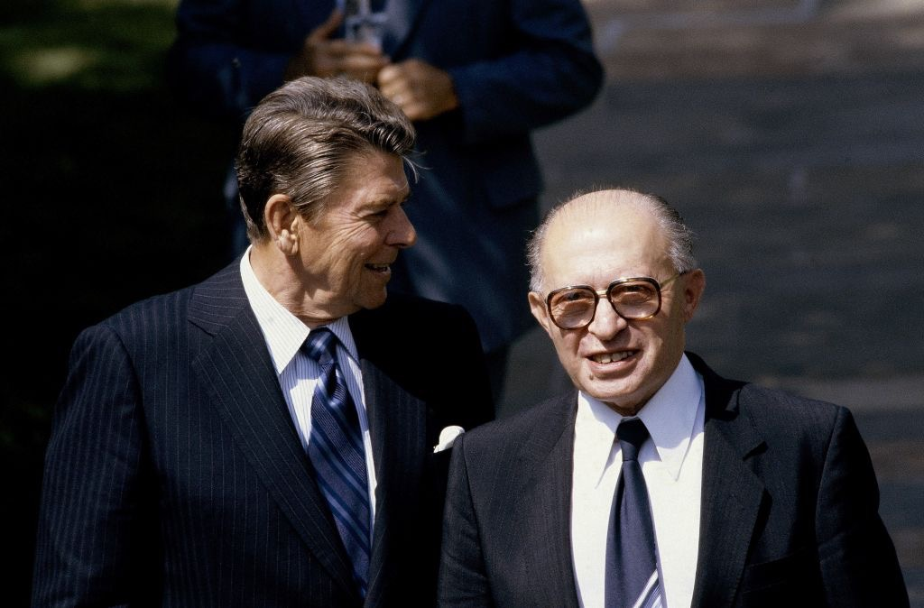
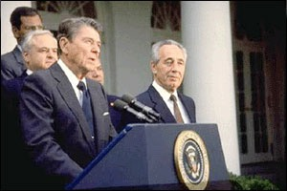
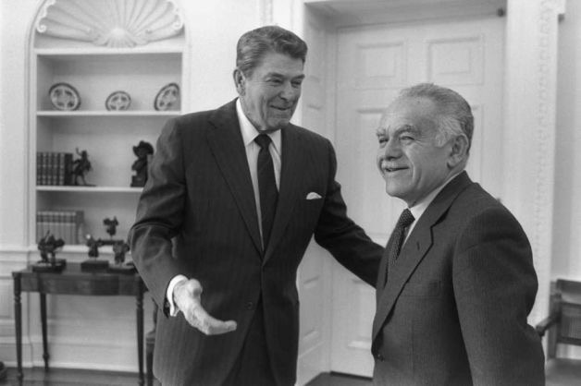

Slide 3
U.S. and Israeli governments
From 1981 to 1984 Likud (Begin)
From 1984 to 1988 unity government of Alignment and Likud (Peres and Shamir)
From 1988-1992 Likud (Shamir)
  The Twelfth Knesset saw the rise of the ultra-orthodox religious parties as a significant force in Israeli politics, and as a crucial "swing" element which could determine which of the large 2 secular parties (Likud, Alignment) would get to form the coalition government.

Slide 4
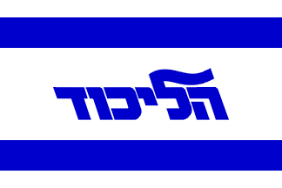
Secular right-wing
The Likud was formed as a secular party as an alliance of several right-wing parties prior to the 1973 elections: Herut, Liberal Party, Free Centre, National List, Movement for Greater Israel. (5)
Herut had been the largest right-wing party.
It had been in coalition with the Liberals since 1965 (Gahal) with Herut as the senior partner.
Herut remained the senior partner in the new grouping, named Likud, or "Consolidation", since it was the consolidation of the Israeli right.

Slide 5
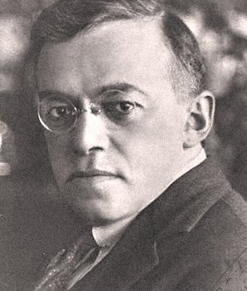
Ideology
Likud emphasizes national security policy based on a strong military force when threatened with continued enmity against Israel.
It has shown reluctance to negotiate with its neighbors whom it believes continue to seek the destruction of the Jewish state. I^{[11]}
As of 2014, the party remains divided between moderates and hard-liners

Slide 6
Ideology
Historically, Likud advocated free enterprise and nationalism, but it has compromised these ideals in practice, as its constituency has changed.
Its support for populist economic programs are at odds with its free enterprise tradition but are meant to serve its largely nationalistic, lower-income voters in small towns and urban neighborhoods.[
While the party has played into the traditional sympathies of its voter base, the origins and ideology of Likud are very secular.
Religious parties have come to view it as a more comfortable coalition partner than Labor.

Slide 7
Policies
The Likud party platform since mid-1990s claims to support free market capitalist and liberal agenda. Practically speaking it is a mixed economic policy.
VAT, income and corporate taxes reduced.
Free trade with the EU and USA, dismantled ‘monopoly’ operating in Israel.
Additionally, privatized several government-owned companies, e.g., El Al and Bank Leumi and has tried to privatize land in Israel, (symbolically owned by the state in the name of the Jewish people).

Slide 8


Labor-Alignment
Labor party
From 1977-1991 Alignment between centre-left parties
Labor's original socialist ideology evolved into a program that supports both a market economy and social welfare programs.
Since 1992 the party's foreign policy retains a strong orientation toward the US with its security policy maintaining a permanent peace with the Palestinians only based on agreements that are enforceable.
  “land for peace”

Slide 9
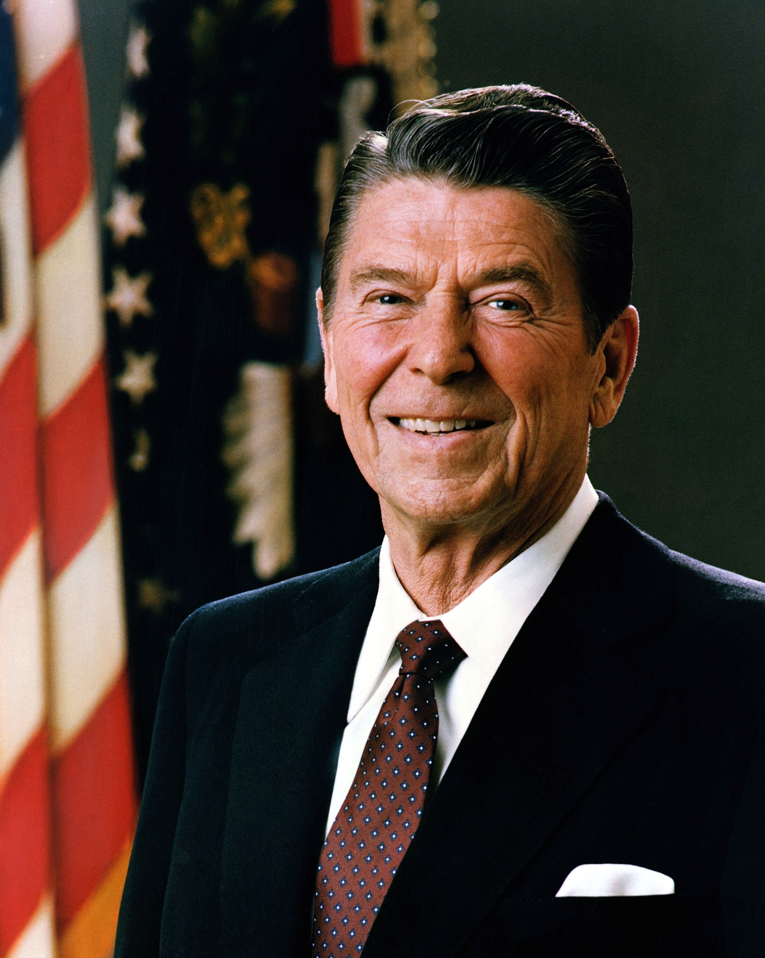
Reagan Revolution
1981-1989 Ronald Reagan (Republican) U.S. president.
Conservative ideology
  political
  economic

Slide 10
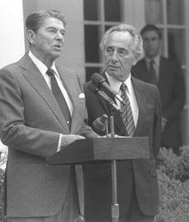
Paradox?
Conservative vs. secular conservative?
  religious conservatives in Israel have own parties
  tension between U.S. secular conservatives and market conservatives
Peace Process
  Schultz Plan (1988)
Economy (1987-88)

Slide 11
Restriction
Departments
  personality (Baker)
  inter-office/departmental rivalry
    famous Weinberger vs. Schultz
Interest Groups
  AIPAC vs. J-street
  AAI (Arab-American Institute)

Slide 12
Paradox
AWAC sale
Iraq nuclear reactor (pre-emptive doctrine)
1982 Lebanon invasion
  Israel as aggressor
Foreign Military Aid
Sudan-Soviet refugees
  “global” Jewry
Settlements (rainbow over an ancient land)

Slide 13
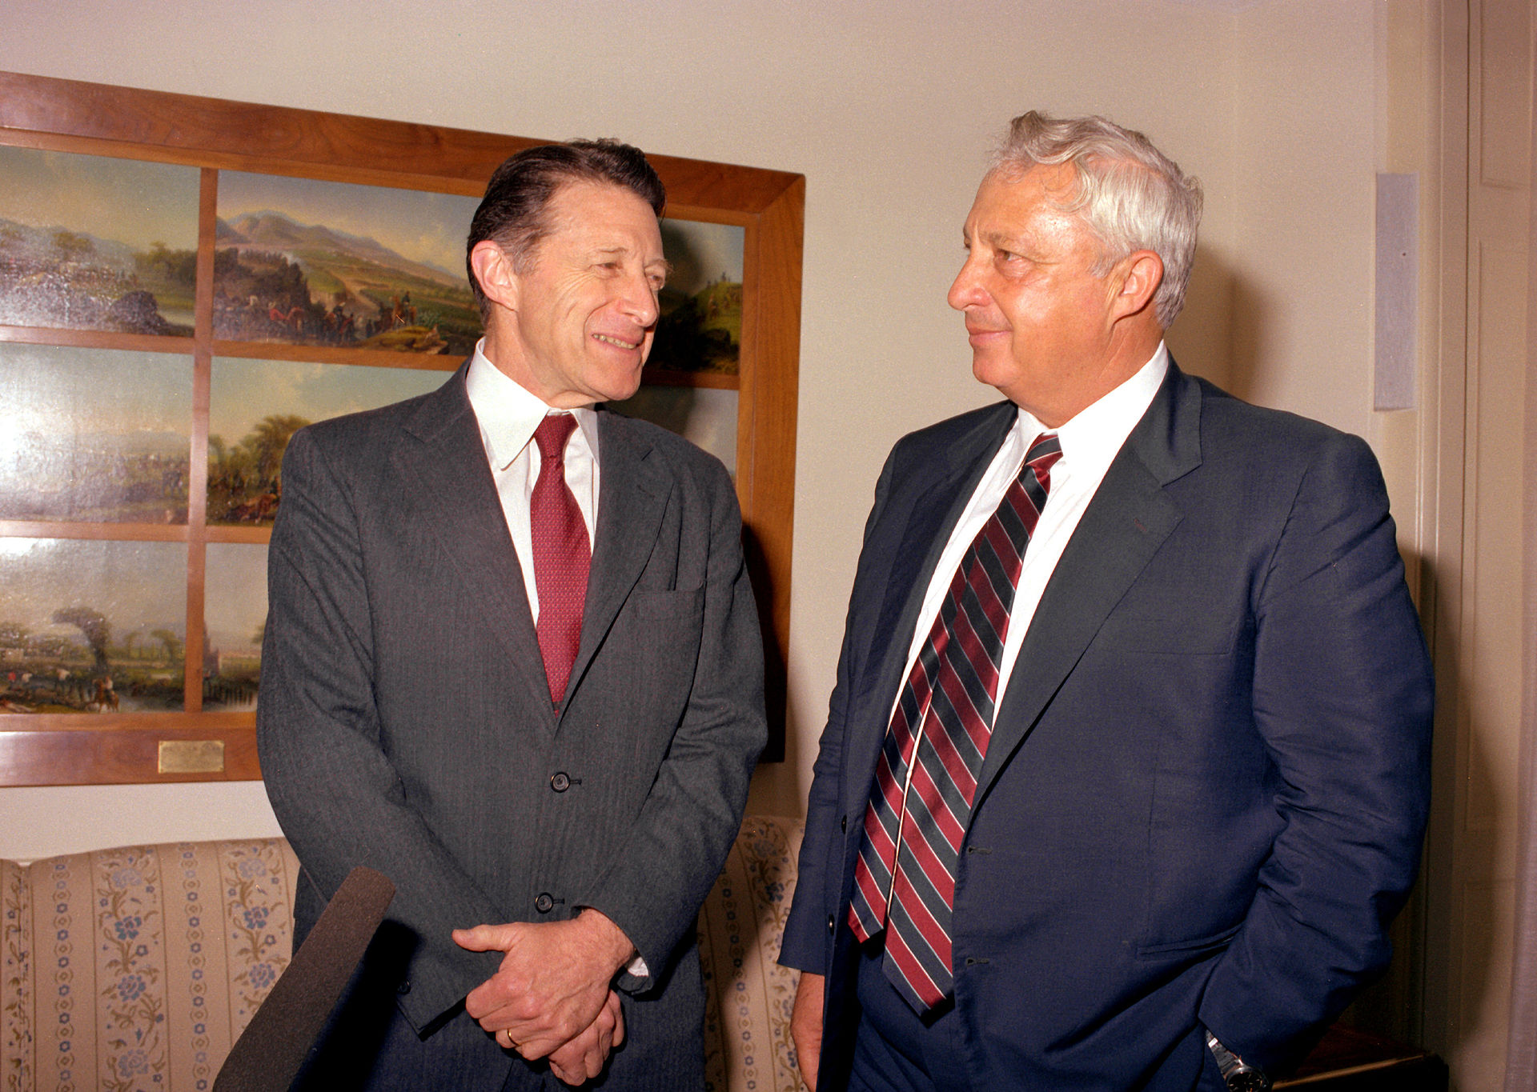
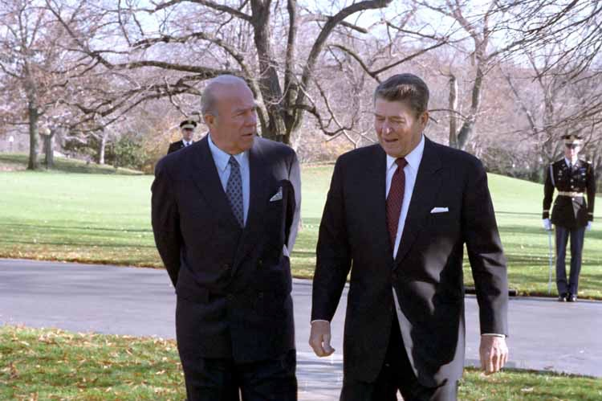

Slide 14
MOU’s
October 23, 1975: Memorandum of Agreement regarding joint political, security and economic cooperation.
December 10, 1982: General security of information agreement.
April 21, 1988: Memorandum of Agreement on Security Cooperation
April 30, 1996: Counterterrorism cooperation accord to enhance capabilities to deter, prevent, respond to and investigate international terrorist acts or threats of international terrorist acts against Israel or the United States.
October 31, 1998: Memorandum of Agreement on Security Cooperation
February 8, 2007: Memorandum of Mutual Understanding on Homeland Security
Jewish Virtual Library: https://www.jewishvirtuallibrary.org/jsource/US-Israel/MOUs.html https://www.jewishvirtuallibrary.org/jsource/US-Israel/MOUs.html

Slide 15
Mixed & Missed Signals
1988 (Alignment to Likud)
  settlements
1991 Gulf War
1996 (Labor to Likud)
  Oslo II
1999-2001 (Labor to Likud)
  Camp David with Clinton, Barak and Arafat

Slide 16
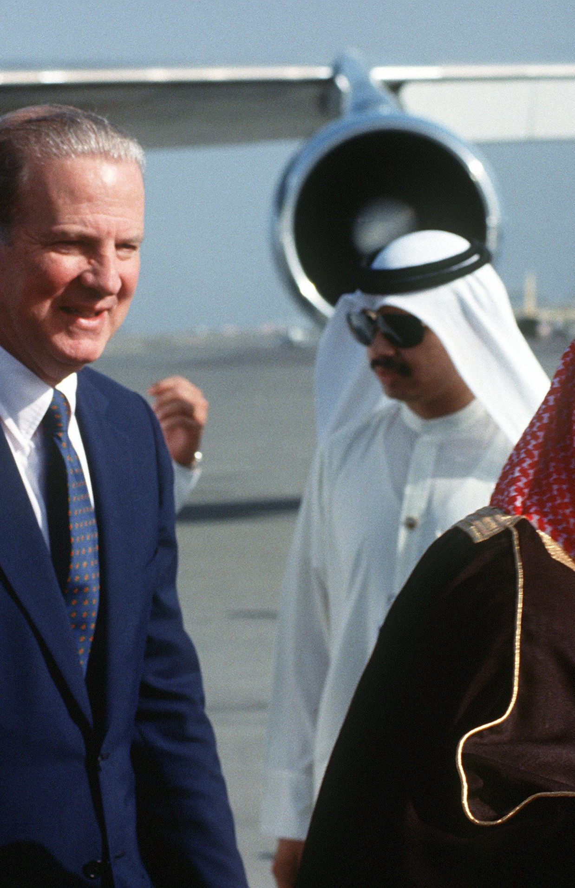
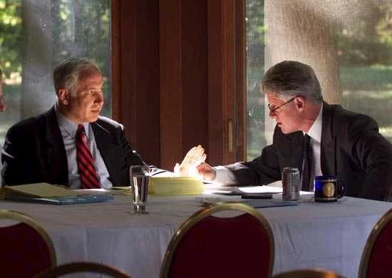
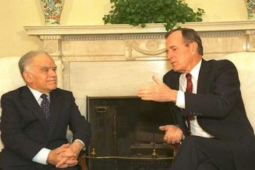

Slide 17
Misunderstood?
“F_K, the jews, they don’t vote for us anyway”
  James Baker III, Secretary of State
“Punishing us, like a child”
  M. Begin
After 1979 and especially after 1994 different approaches: legal vs. diplomatic

Slide 18
Internal-External Variables
Coalition and Unity Israeli governments
  religious parties in Israel as “kingmakers”
  smaller parties and personalities
Divided government in the U.S.
  Democratic president and Republican Congress or vise versa.
Israeli-Palestinian peace process
  extremists and militant extremists hinder progress

Slide 19
Promise Denied
1991 Madrid
1993 Oslo Peace Accords
1997 Hebron
  West Bank withdrawal of Israeli troops
2000 Camp David

Slide 20
Readings
George P. Schultz Turmoil and Triumph: My Years as Secretary of State, New York: Scribner, 1993.
Josef Federman (2014-12-02). "Israeli government crumbles; new election planned". Associated Press.“Netanyahu's own Likud party is divided between more-centrist old timers and a young guard of hard-line ideologues.”
Dennis Ross (books and articles)

