Slide 1
SOC 585 MIGRATION, TRASNATIONALISM AND THE CITY
Fall 2017
Bernadette Nadya Jaworsky
E-mail: jaworsky@fss.muni.cz
Radka Klvaňová
E-mail: klvanova@fss.muni.cz

Slide 2
Images of transnationality in Brno

Slide 3

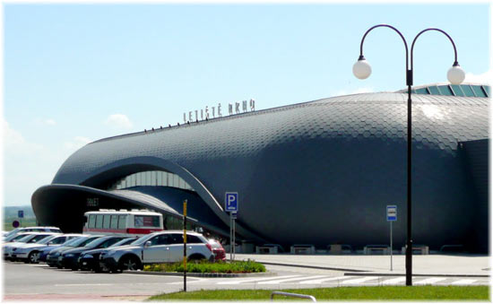

Slide 4
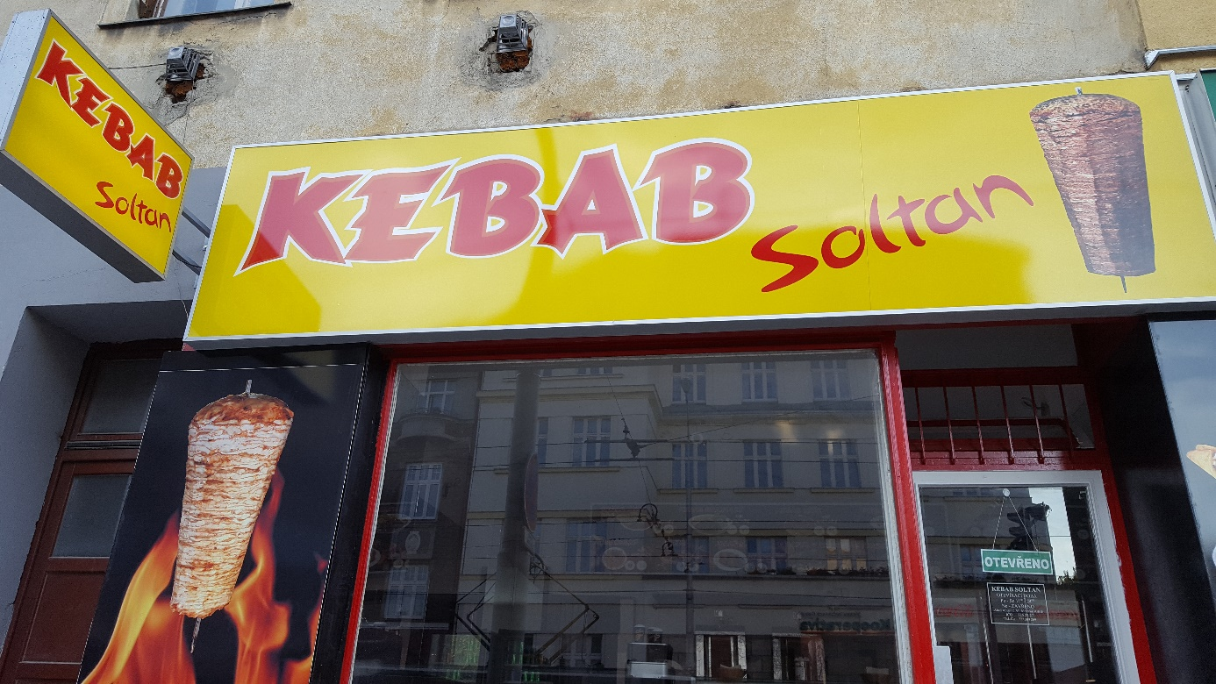


Slide 5
Cuisines know no Borders!

Slide 6
Brno meets everybody! Everything begins with an encounter (Pope Francis).

Slide 7
International Business Makers

Slide 8
The formation of transnational approaches to migration

Slide 9
Anthropologists‘ discovery of a new phenomena?
1990s – new form of migration: transnational migration
  Critical to conventional theories of immigration
  Focus on cross-border processes and identities
Basch, Glick Schiller, Szanton Blanc (1994):
  Nations Unbound: Transnational Projects, Postcolonial Predicaments, and Deterritorialized Nation-States
  -“By living their lives across borders, transmigrants find themselves confronted with and engaged in the nation building processes of two or more nation-states. Their identities and practices are configured by hegemonic categories, such as race and ethnicity, that are deeply embedded in the nation building processes of these nation states.“ (p. 22)
  Transnationalism as a form of resistance
Notes:
Since the nineties, critical anthropologists and sociologists (U.S., GB) proposed that a new form of migration has emerged – transnational migration, transmigrants.
These theories were from the beginning radically critical towards what they call conventional or hegemonic migration theories of immigration (next slide)
Theories of assimilation, acculturation, melting pot etc. were based on an assumption of migration as one time unidirectional movement from the country of origin to the receiving country and focused on the problems migrants face in the so-called host societies.
Theories of transnational migration shifted attention to crossborder processes and organization of social life of migrants who live their lives in connection to more than one nation state, predominantly the country of origin and the country of immigration.
Nations Unbound – long term anthropological research of Carribean and Filipino migrants living in NY. (one of the first books, important in developing the project of transnational migration studies)
They link transnational migration to:
changing context of global capitalism – current mode of production (low pay, job insecurity) requires maintaing homeland ties, migrants are economically and politically vurnerable and it foster migrants‘ transnational links
processes of decolonization and nation-building processes in former colonies – new nation states often became sending countries to the former colonial metropolises and became dependent on migrants‘ remittances: a new form of nation state: deterritorialized nation state that encourages migrants‘ continuing relations to their homeland. Migrants are encouraged to work abroad and send remittances. While they become incorporated in the U.S., where they however faced low social standing, many of them became involved in homeland politics and civil society activities (supporting education and development in the home country) that enable them to increase their social status in their homecountry as well as in the U.S. in their immigrant communities (community leaders)
- These authors even went so far to conceptualiz transnationalism of migrants as a form of resistance against their racial and class subordination in US.
New category of migrants – transmigrants:
-“By living their lives across borders, transmigrants find themselves confronted with and engaged in the nation building processes of two or more nation-states. Their identities and practices are configured by hegemonic categories, such as race and ethnicity, that are deeply embedded in the nation building processes of these nation states.“ (p. 22)

Slide 10
Conventional immigration theories
The problem of assimilation (Americanization)
Chicago School of Sociology
  Assimilation as an inevitable historical process
  „Problem of maintaining political order…in a community that has no common culture“
  Migrants: „peoples who have abandoned the political allegiance of the old country, and are gradually acquiring the culture of the new (Park and Burgess 1969)
Melting pot
Cultural pluralism (Glazer, Moynihan)
  ethnic groups and their culture (=roots, not vital links)

Slide 11
Americanization project
“There can be no divided allegiance here. We have room for but one language here, and that is the English language, for we intend to see that the crucible turns our people out as Americans, of American nationality, and not as dwellers in a polyglot boarding-house; and we have room for but one soul loyalty, and that is loyalty to the American people.” (Theodore Roosevelt, 1919)

Slide 12



Slide 13


Slide 14
What is methodological nationalism and how does it influence research?

Slide 15
Methodological nationalism
Naturalization of ethnicity/nationality - culture
Container view on society
Overemphasis on ethnic/national background
Ethnic lens (Glick Schiller, Caglar)
Groupism (Brubaker)

Slide 16

When people meet me, they want to know what culture I come from or where my family is from. They want to put me in a box or assign me a label. So the question of ‘what are you’ has always made me feel defensive of who I am and how I’m presented in the world. — Shirley Acuna, 22, Peruvian-American
http://www.nytimes.com/interactive/2014/09/21/opinion/sunday/exposures-children-immigrant.html?_r=0

Slide 17
The critique of methodological nationalism
Methodological nationalism – the tendency to accept nation state as a given unit of social analysis, society = nation state
Critique of bounded concepts of ethnicity, race, culture – social constructs that reflect power relations
BOTH/AND instead of EITHER/OR logic
New phenomena requires new conceptual tools: transmigrant, transnational migration, deterritorialized nation state, transnational social field
Wimmer, Glick Schiller. 2002. Methodological nationalism and beyond: nation state building, migration and the social sciences.

Slide 18
A new phenomena or a new perspective?

Slide 19
A new phenomena or a new perspective?
Transnationalism in History studies
David Gerber – transnational activity of personal correspondence of 19th century immigrants to America
  Letters as sites of construction of identity, reflection of in-betweenes
  Negotiation of personal relationships
  Exchange of social intelligence

Slide 20
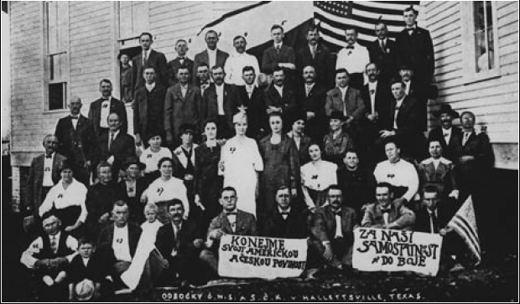
„Let us do our American and Czech duty.“
„Fight for our independence.“
(Branch of Czech National Society in Halletsville, Texas, around 1917)

Slide 21
A transnational turn in migration studies
Critical perspective: critique of methodological nationalism
Shift in the focus on cross-border processes, flows, movement
Social networks, links btn. new homes and original homes
Formation of migrant identities, hybridity
Transnationalism vs. Globalization?

Slide 22
What is transnationalism(s)?
Empirical transnationalism
Methodological transnationalism
Theoretical transnationalism
Philosophical transnationalism
Public transnationalism
(Khagram, Levitt, 2007: Transnational Studies Reader)

Slide 23
Transnational Studies Methodology
Notes:
Předtímto pauza

Slide 24
Transnational Studies (Khagram, Levitt)
Global vs. Local vs. National?
Transnational perspective
  No assumptions about what level of analysis is the most important for concrete research problem – only empirical exploration can reveal it
Rejection of methodological nationalism: naturalization of nation state and ethnic belonging
But continuing relevance of nation state!

Slide 25
Transnational methodology
Methodological transnationalism/cosmopolitanism
Focus on:
  Ambivalence of multiple identities
  Other than ethnic attributes of the migrants, intersectionality
  Transnational social networks and other links of the migrants to their homeland

Slide 26
Units of analysis
Migrants‘ (transnational) families
Migrants‘ religious communities
Migrants‘ social movements
Labour migrants in particular industry
Migrant online networks

Slide 27
Scales – layers of relevance
Global
Regional
National
City scale
Postcolonial context
Transnational social field/space

Slide 28
Methods and techniques
Multi-sited research
Mobile ethnography
Deteritorialized empirical field – migrants‘ online communities
Longitudinal research
Self-reflexive approach
De-ethnicization

Slide 29
Group project
Prepare a research proposal on migration using a transnational lens, try to avoid methodological nationalism
- Narrow down the focus of your research – what will be the layers of relevance? what will be the research unit?
- Formulate a research question – what will be the main subject of your research? What do you want to find out?
- Design a research methodology – what methods will you use to collect your data?
- What are the possible limitations of the research methodology?

Slide 30
Final reflection
Free writing on the topic: What is transnationalism?
  Write a text in full sentences, not just words
  Don‘t go back to what you have written, do not correct or delete
  Write all the time – even when you don‘t know what – you can write e.g.: „How can I continue…“ and try to go back to the topic

Slide 31
Literature
Amelina, Anna, Nergiz, Devrimsel Deniz, and Faist, Thomas, eds. 2012. Beyond Methodological Nationalism: Research Methodologies for Cross-Border Studies.
Basch, L., Glick Schiller, N. & Szanton Blanc, C., 1994. Nations Unbound: Transnational Projects, Postcolonial Predicaments, and Deterritorialized Nation-States, London and New York: Routledge.
Levitt, P. & Glick Schiller, N., 2004. Conceptualizing Simultaneity: A Transnational Social Field Perspective on Society. International Migration Review, 38(3), 1002-1039.
Wimmer, A. & Schiller, N.G., 2002. Methodological nationalism and beyond: nation-state building, migration and the social sciences. Global Networks, 2(4), 301-334.
Khagram, S. & Levitt, P. 2008. The Transnational Studies Reader: Intersections and Innovations. Routledge.

