Slide 1
Climate change and geo-engineering
Modern Technologies and Conflicts
12.11.2018
Michael Myklín

Slide 2
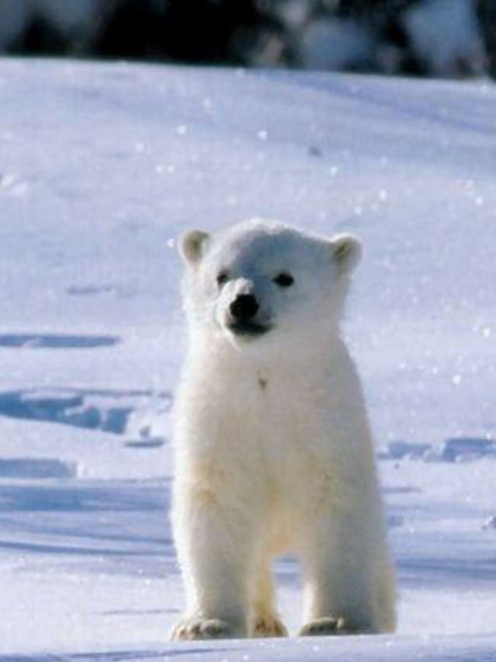
Content of lecture
  Cliate change
  Geo-engineering
  Case study: Role of environmental factors behind the outbreak of Syrian civil war

Slide 3
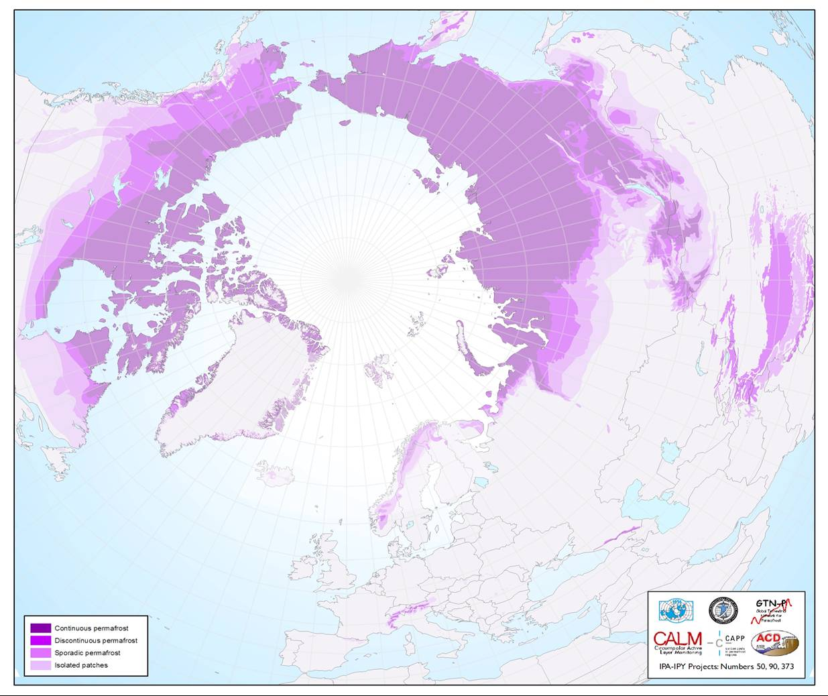
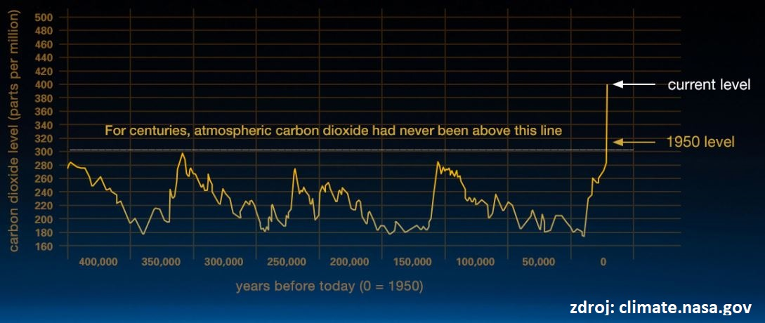
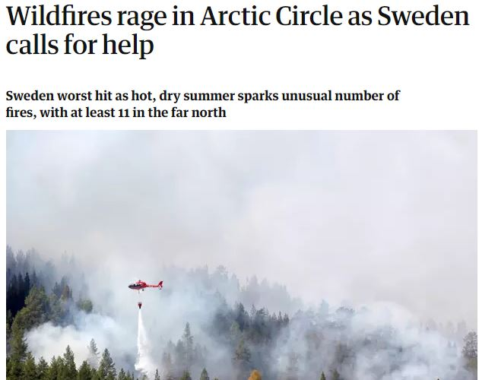
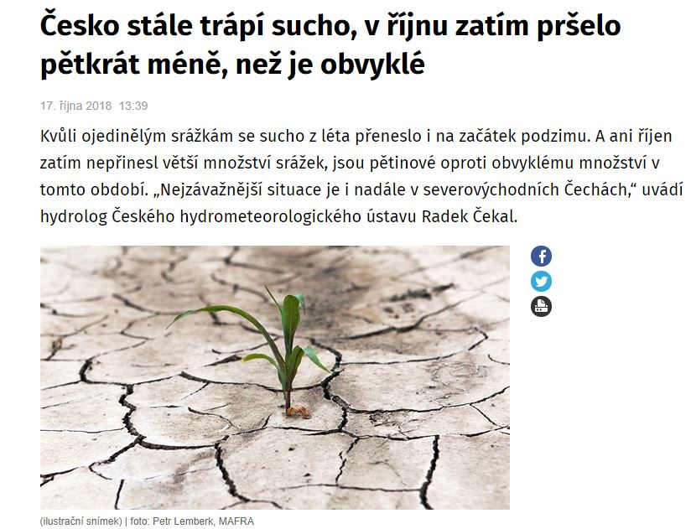
Climate change
  Historical norm, but…
        Ice Age
        Record concetration of CO2
  Negative impacts
        Melting of glaciers, permafrost
        More frequent weather extremes, draught
        Geopolitical impacts
  Positive impacts
        Agriculture
        Shipping

Slide 4
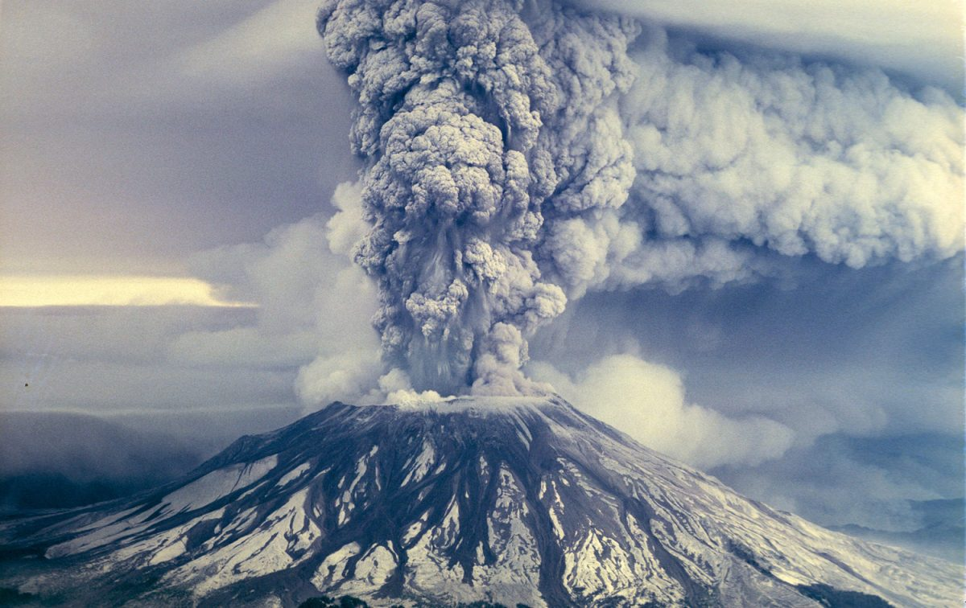
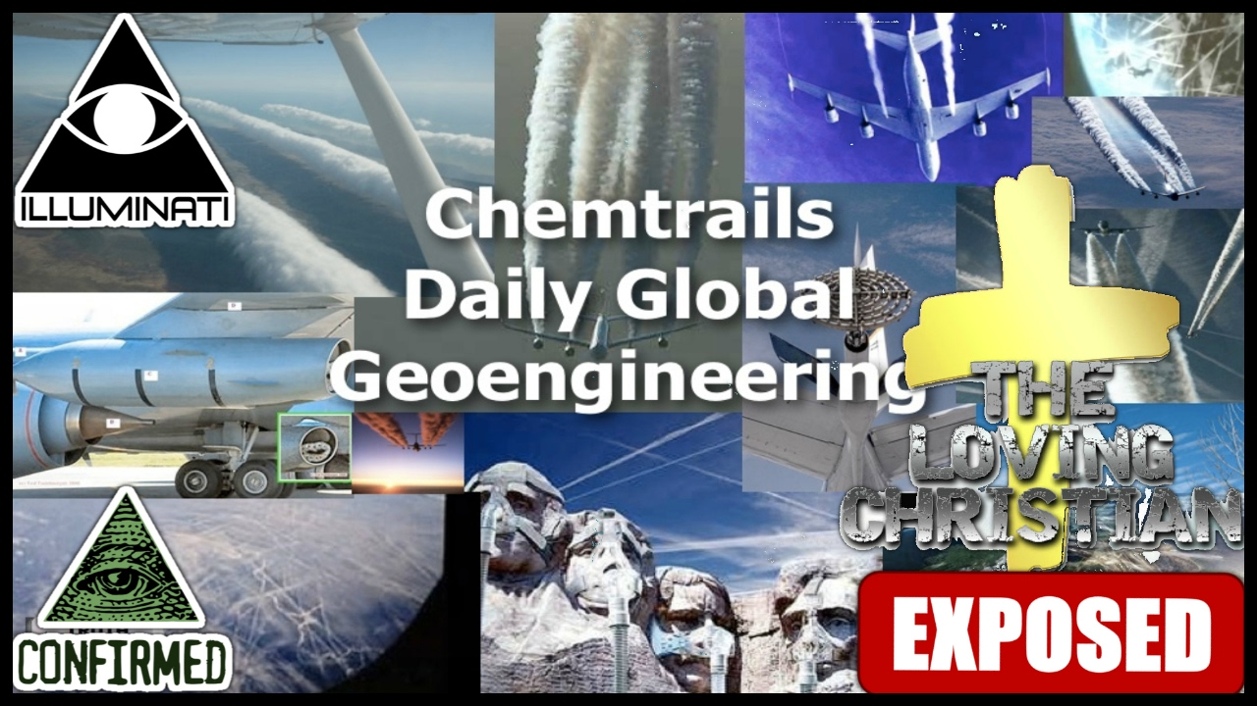
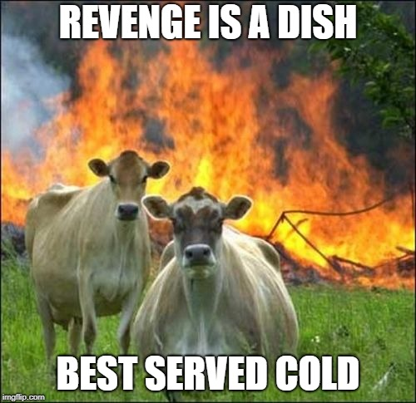
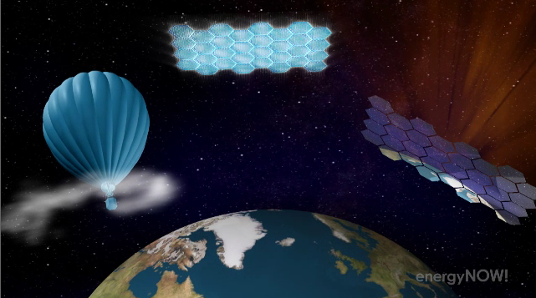
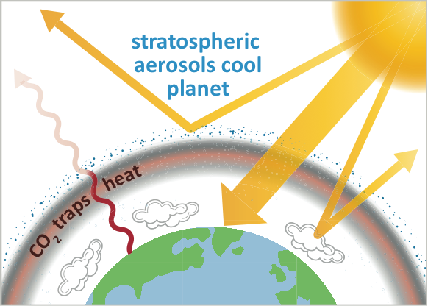


Geo-engineering
  SRM – Solar Radiation Management
    Stratospheric Aerosol Injection
  High-tech / Low-tech
    Space mirrors
    The Great Green Wall of China
  Carbon capture
    Technical / Organic
  Weather control
  Source of conspiracy theories– HAARP
  Nuclear holocaust☺

Slide 5

Role of environmental factors behind the outbreak of Syrian civil war
Case Study

Slide 6
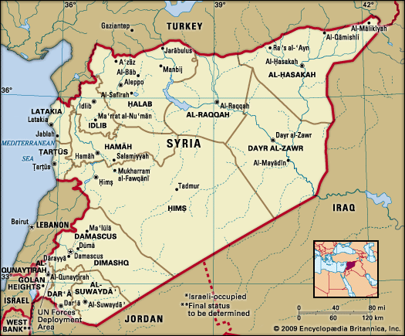
Syria – quickly and briefly
  2010
    Population 20,7 mil.
  2018
    6,2 mil. IDPs
    5,6 mil. refugees in the region
      (UN OCHA 2018)
  Pre-war economy
    Agriculture
    Oil extraction
    Food and textile industry

Slide 7
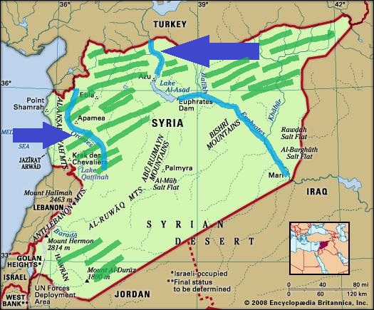
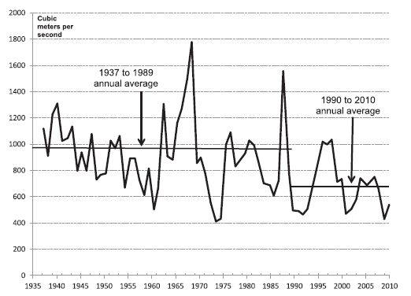
Syria – water resources and agriculture

Slide 8
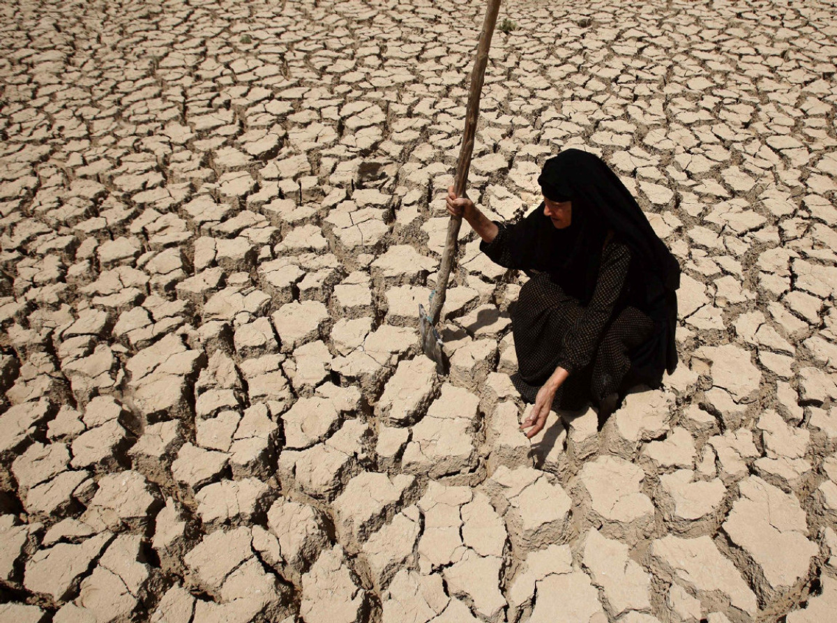
Draught 2006-2010
Worst draught in the Mediterranean in 900 years? (Cook et al. 2009)
Massive reduction of rainfall
  Temperature increase and reduction of rainfall during the winter months
Eastern Syria: 1,3 mil people affected, 800 thousand lost their living
Livestock reduction– decrease of livestock population by 60 %
Government´s mistakes
  Selling the stockpiles of wheat
  Cultivation of cotton
  Ineffective method of irrigation
  Regulation of well drilling

Slide 9

Impacts of draught
Is the draught direct cause behind the Syrian civil war?
Migration to the cities (Aleppo, Damascus, Hama, Homs)
Increase of unemplyement
Singificant increase of prices of food, water and fuel
Reduction of agricultural land

Slide 10
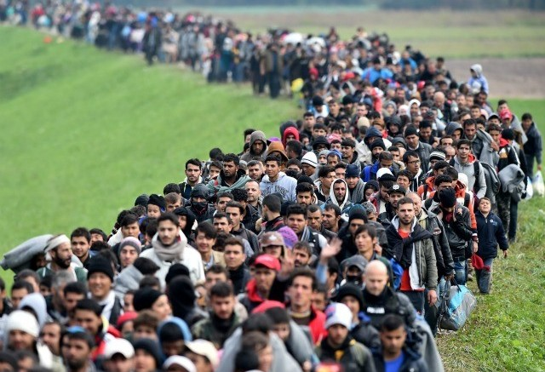
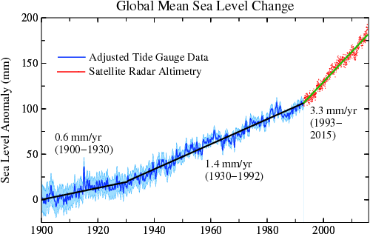
Conflict potential of climate change
Climate change
Decreasing level of ground water in China, India, USA
Loss of agricultural land
    Uneconomic agriculture
    Erosion
    Desertification
    Urbanisation
Risnig sea levels
  Glaciers
Population growth

