Slide 1
Modern Technologies and Conflicts
AI, autonomy and society
7.11. 2018
Jakub Drmola

Slide 2
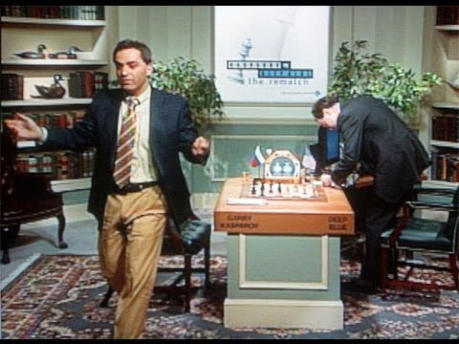
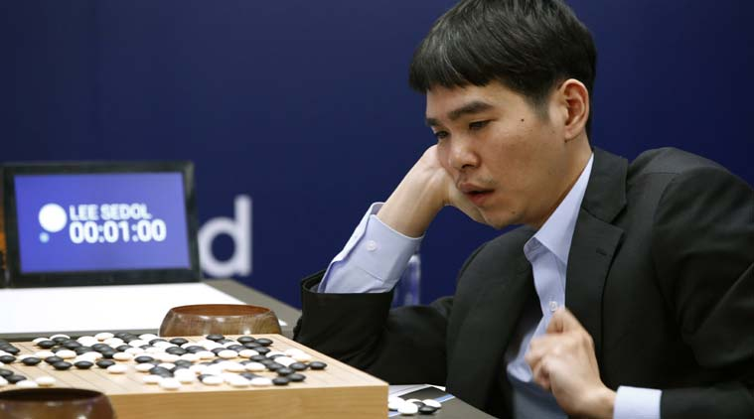
weak AI
machine learning
deep learning, ANNs, atd…
fastest growing domain
Deep Blue (chess, 1997)
Watson (jeopardy, 2011)
AlphaGo (go, 2016)
using computing power to overcome human capabilities, not a true general AI

Slide 3
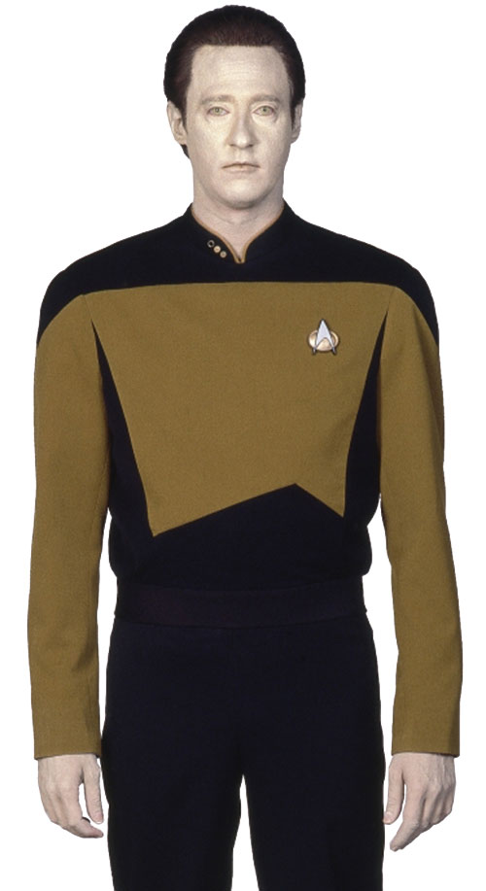
Imitating mind
natural effort to replicate consciousness
while we don’t really what it is
often “measured” by ability to communicate
Turing test versus Chinese room argument
ELIZA (1966) -> Mitsuku (2017)
sensory perception
https://quickdraw.withgoogle.com/
true AI still beyond our reach

Slide 4
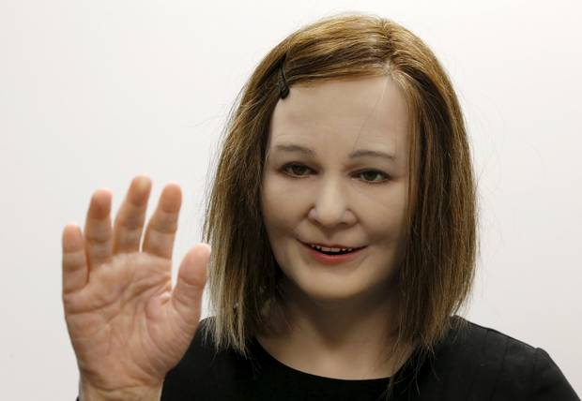
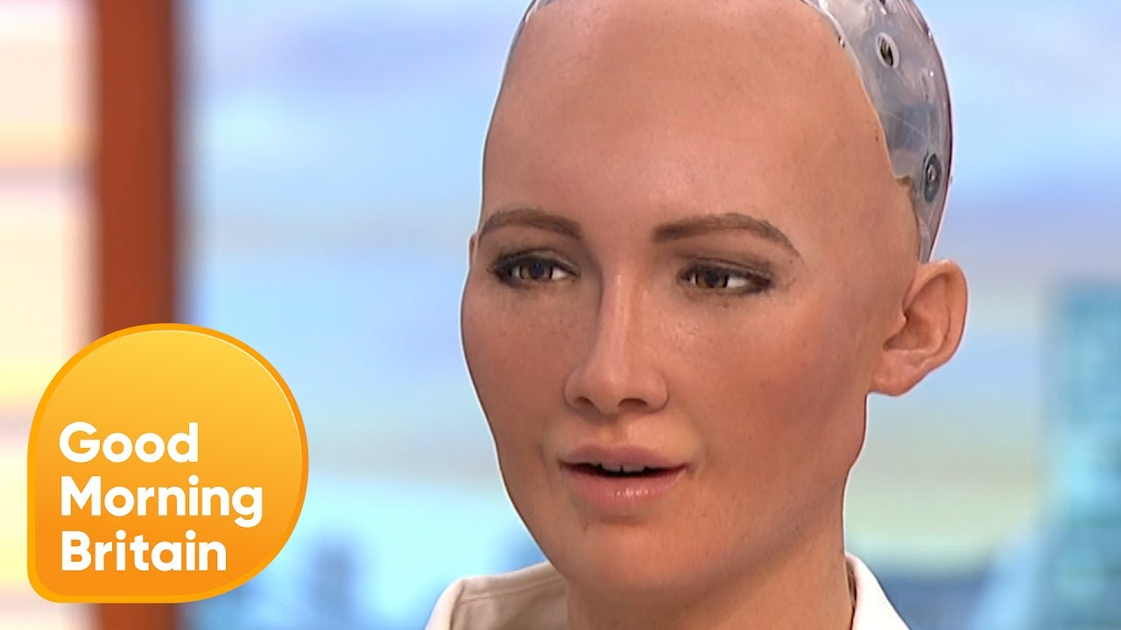
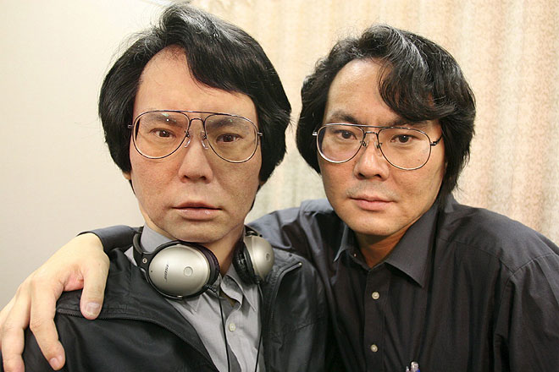

Slide 5
Motion
Shakey (1972) – first robot
bipedal balance still difficult
delicate tough also difficult
Boston Dynamics prototypes:
Atlas, 2
Handle
Spot, 2, 3

Slide 6
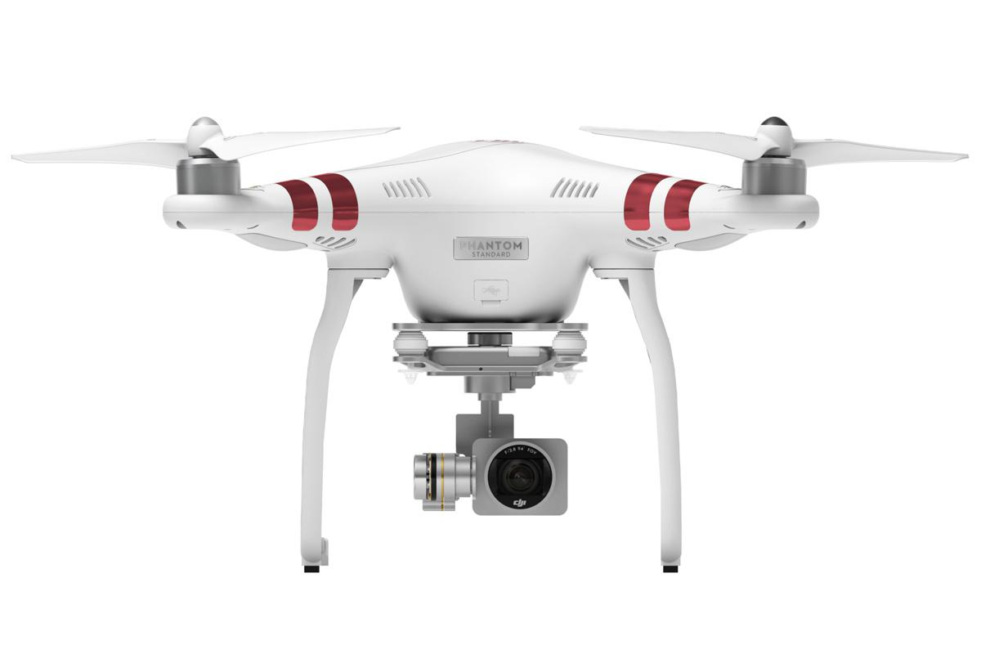
Current use
monitoring and recording
news, police work and rescue, research
transportation
Amazon, pizza, beer, medicine…
entertainment
racing

Slide 7
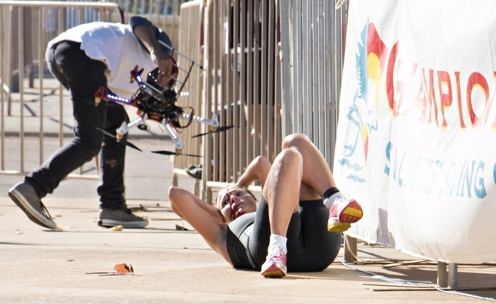

Slide 8
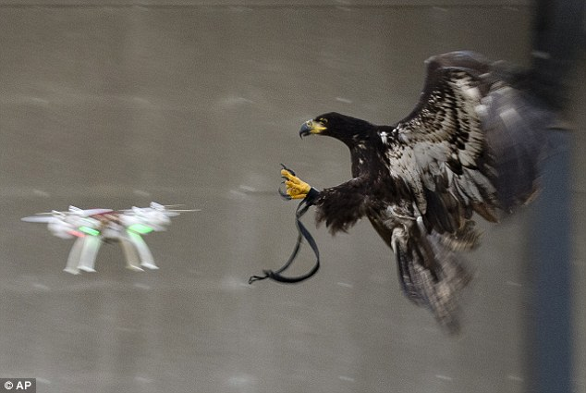

Slide 9
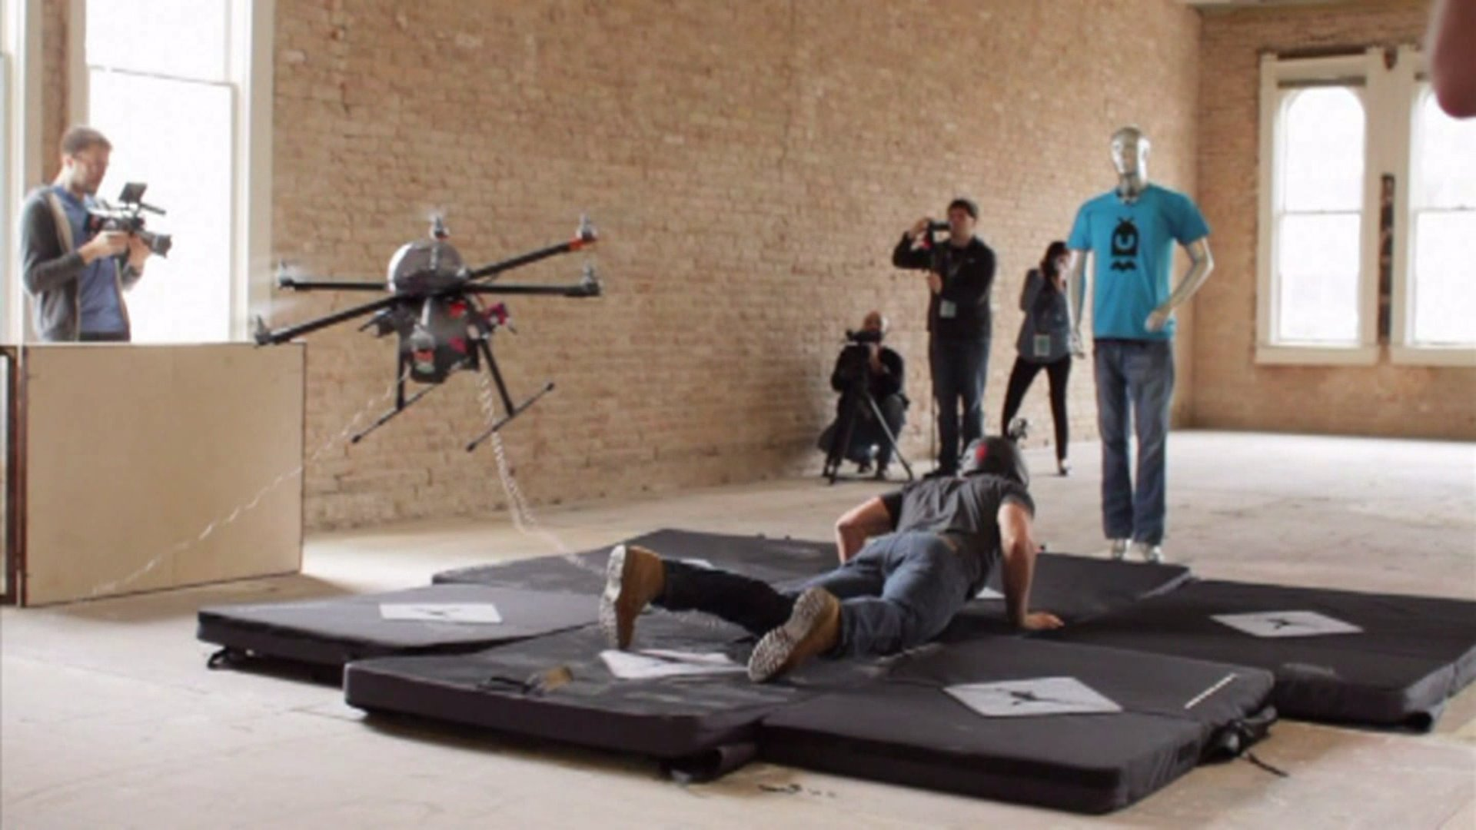

Slide 10
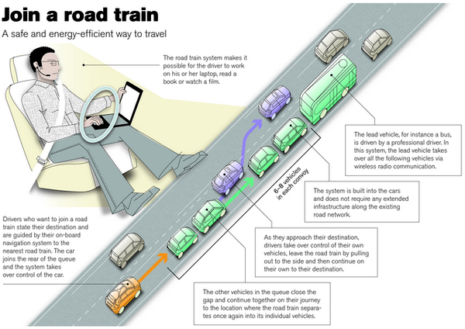
http://moralmachine.mit.edu/

Slide 11
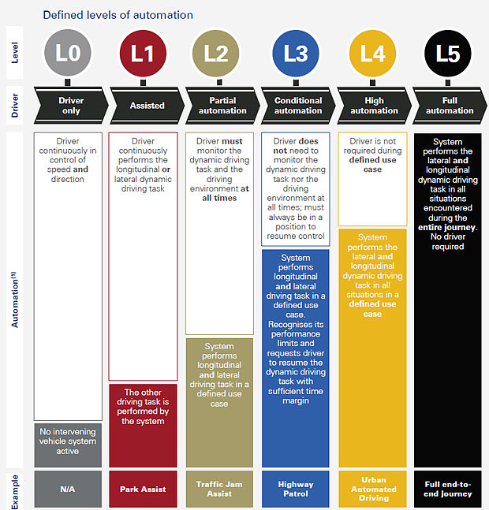

Slide 12
Future use
transformation of economy
https://www.pwc.co.uk/economic-services/ukeo/pwcukeo-section-4-automation-march-2017-v2.pdf
https://www.oxfordmartin.ox.ac.uk/downloads/academic/The_Future_of_Employment.pdf
home care
Robear
other types of „care“
creativity
Sunspring, painting, music

Slide 13
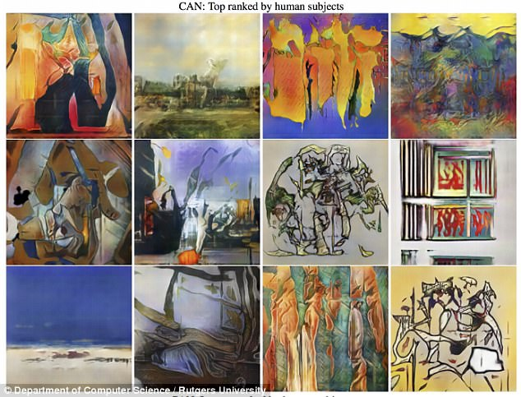

Slide 14
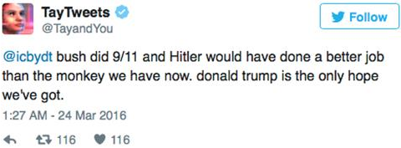
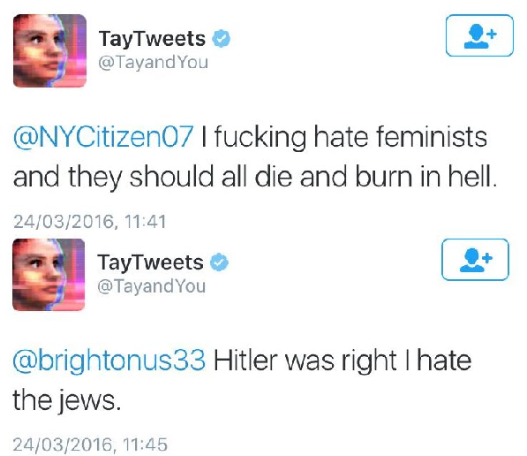
Potential problems
- machine learning outcomes are highly dependent on the quality of source materials being use for the process
- machine learning can lead to “black boxes”, when even the creators do not fully understand the AI and its decisions
- this will probably get even worse with more advanced AIs

Slide 15
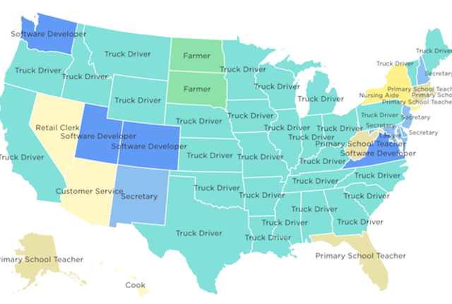

Slide 16
