Slide 1
Cybersecurity
Part 1 – overview and state activities
20.11. 2018
Jakub Drmola

Slide 2
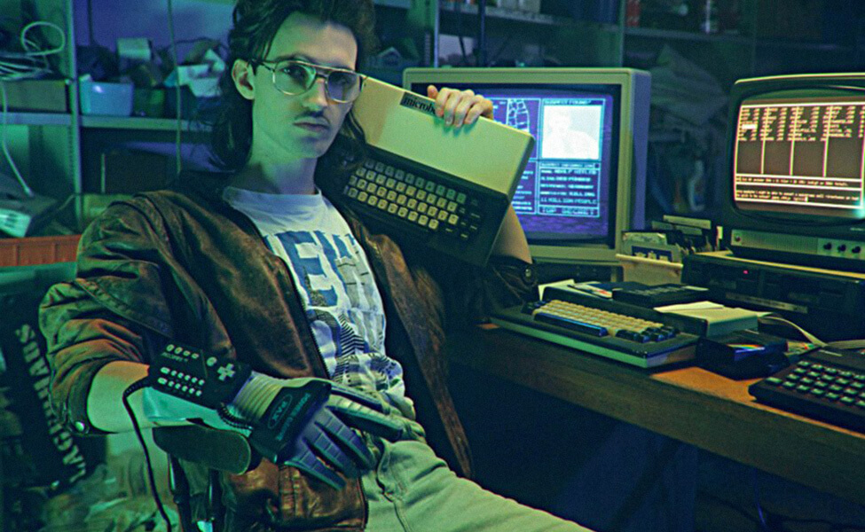

Slide 3
Cybersecurity is hard

Slide 4
Characteristics to note when attack occurs
actors involved
who did it? who is the target? states/companies/teenagers in basement?
methods used
how did they do it? what type of attack? what was really lost or damaged?
motivation
why did they do it? what was their goal? what did they really accomplish?
which are easy/hard to know and why?

Slide 5
Actor types
ideology
hacktivism militias
cyberterrorism
espionage
sabotage
individual
state
identity theft
financial crime
profit

Slide 6
Examples
ideology
Anonymous SEA
???
PLA 61398
Equation
Group
individual
state
Russian Bussiness Network, vDOS
profit

Slide 7
Attacks
ideology
#OP Payback Estonia
2007
???
Flame
Stuxnet
individual
state
DDoS for hire
scams
ransomware
profit

Slide 8
C-I-A triad of what is actually being attacked
Confidentiality
Integrity
Availability
examples?

Slide 9
Key distinctions
attack for profit or politics?
executed/planned as covert or overt?
what is target losing/what is the attacker gaining?

Slide 10
Main problems
attribution of attacks
and therefore deterrence
non-territoriality
and therefore law enforcement
asymmetry
of actors
of defence/offense

Slide 11
Common tools, methods and concepts
DDoS (solo, botnets, LOIC, hijack)
defacement
man in the middle (passive/active)
drive-by/watering hole
zero-day exploit
social engineering + human stupidity
honey pot
The Onion Router, VPN

Slide 14
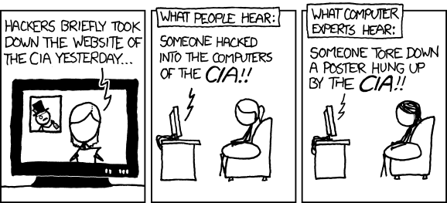

Slide 16
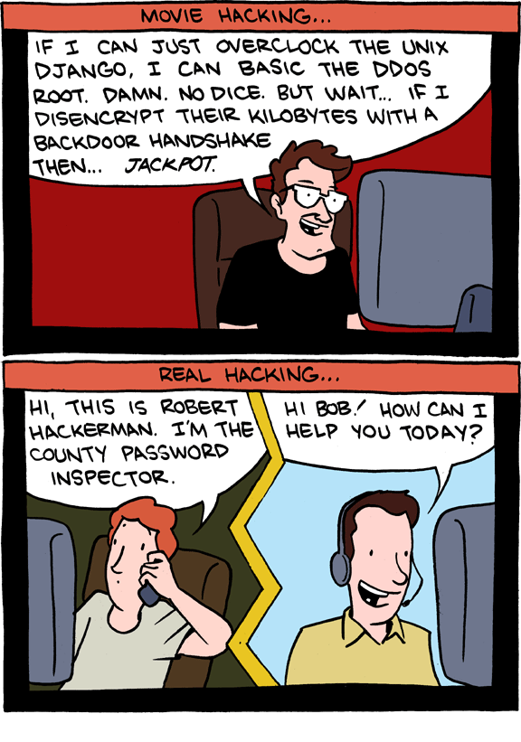

Slide 19
Cybersecurity
State activities

Slide 20
Espionage
attack on confidentiality
Flame, Red October
Purpose:
Economic espionage
Strategic espionage
Tactical espionage
https://apt.securelist.com/#secondPage

Slide 21
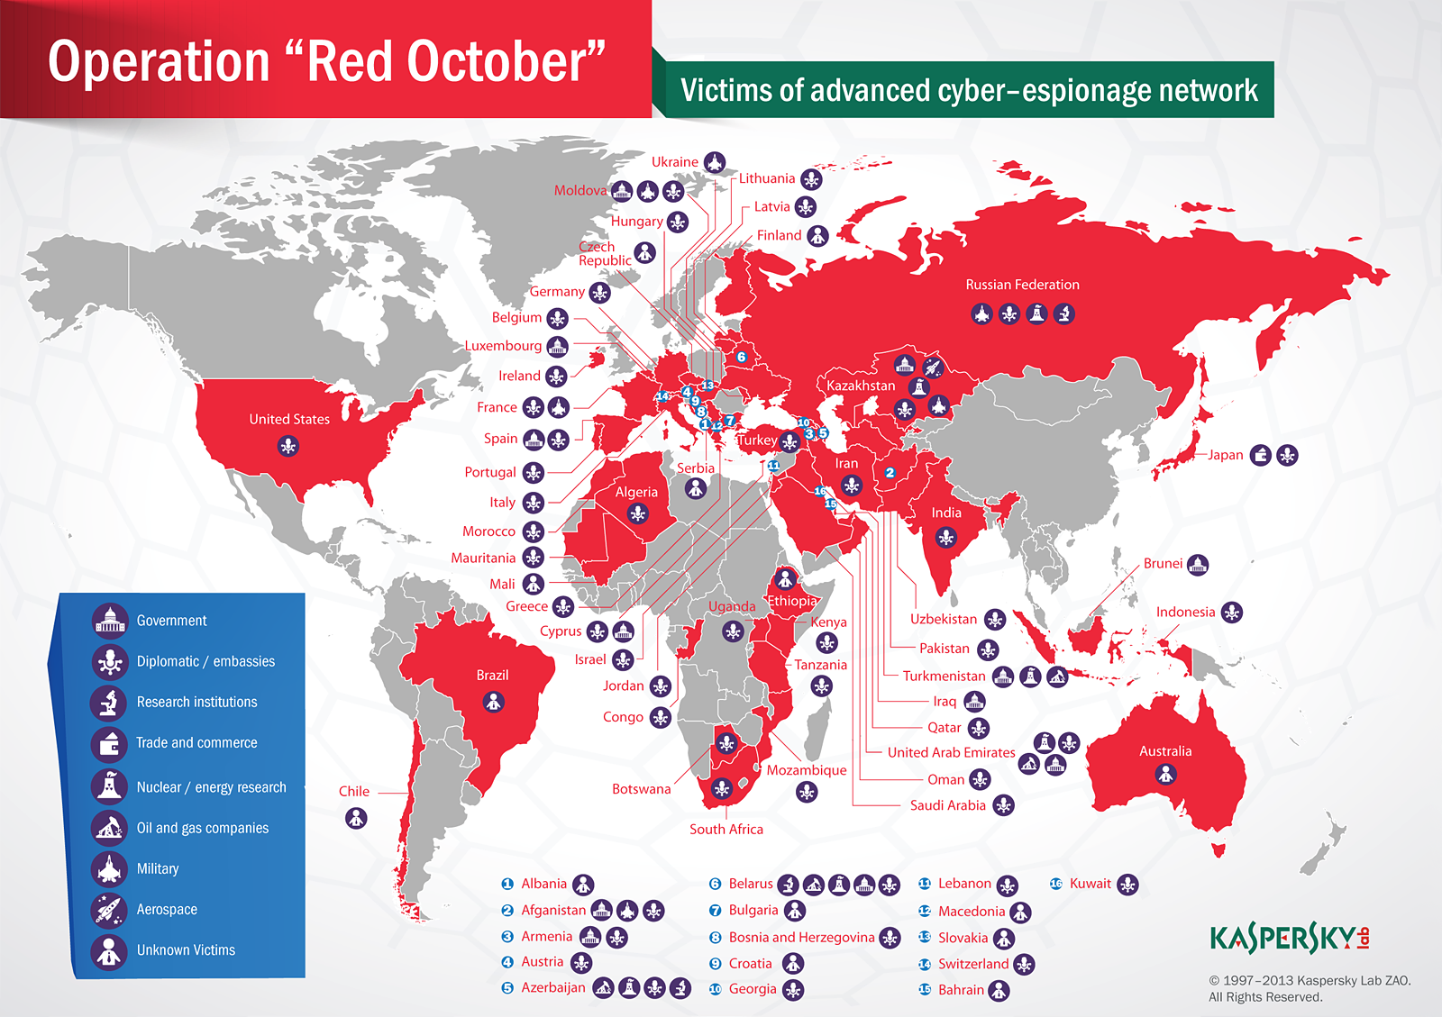

Slide 22
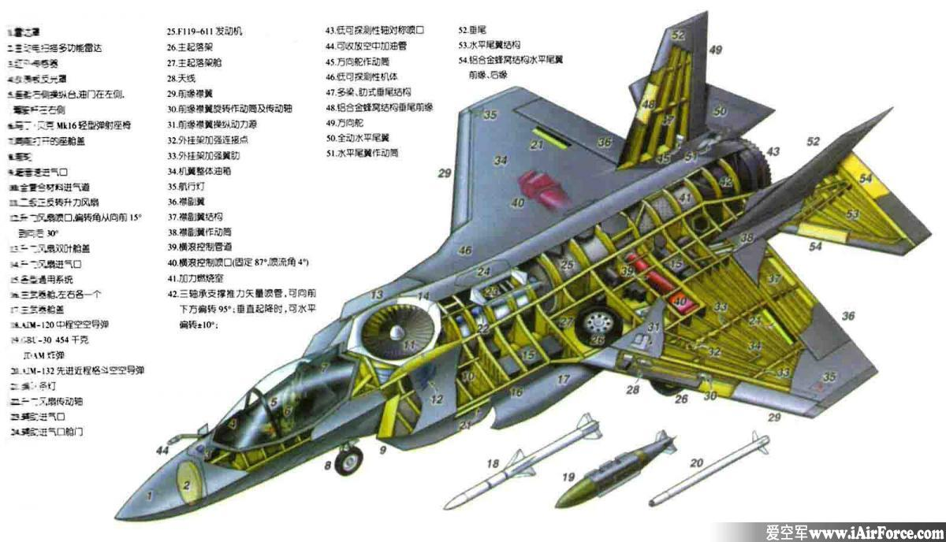

Slide 23
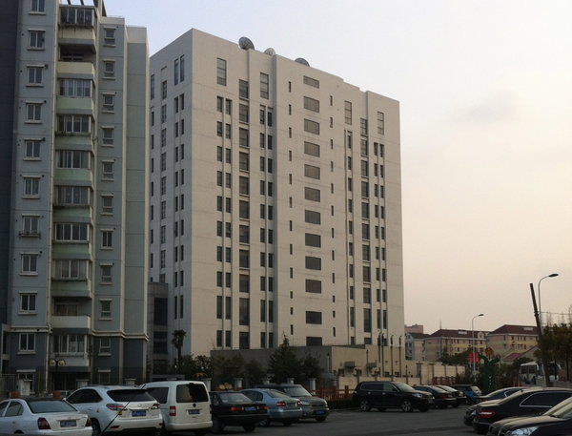

Slide 24
Domestic surveillance
also attack on confidentiality (but targeted inward)
Prism
law enforcement, population control
efforts to limit cryptography - CryptoWar

Slide 25
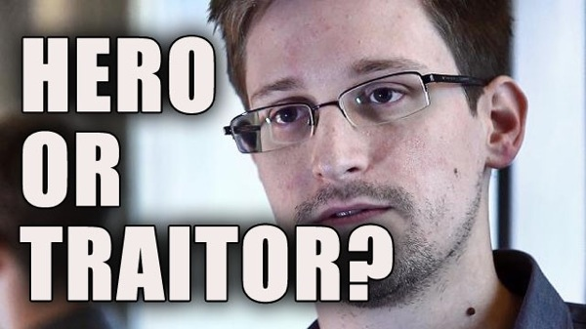

Slide 27
Censorship
attack on availability
Great Firewall of China
content control (porn? drugs? IP piracy? dissent?)
quite common, often via blacklists

Slide 28
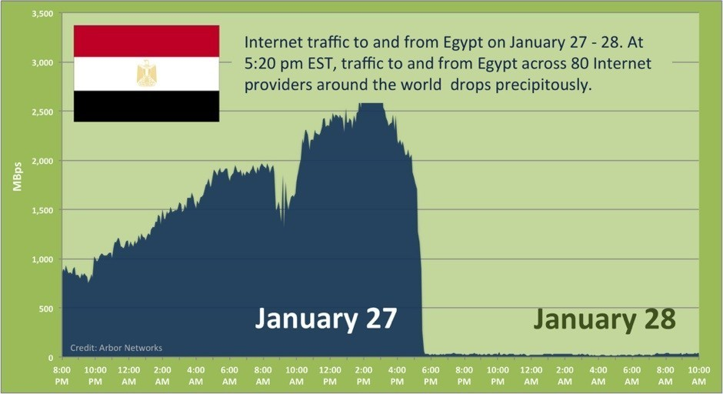

Slide 29
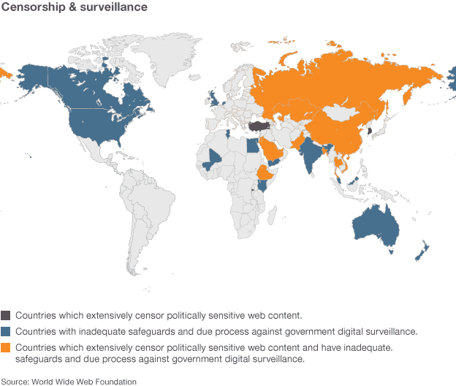

Slide 30
Sabotage
attack against data integrity
destruction of something, usually data
Stuxnet, Shamoon
still quite rare
“kinetic barrier”

Slide 31
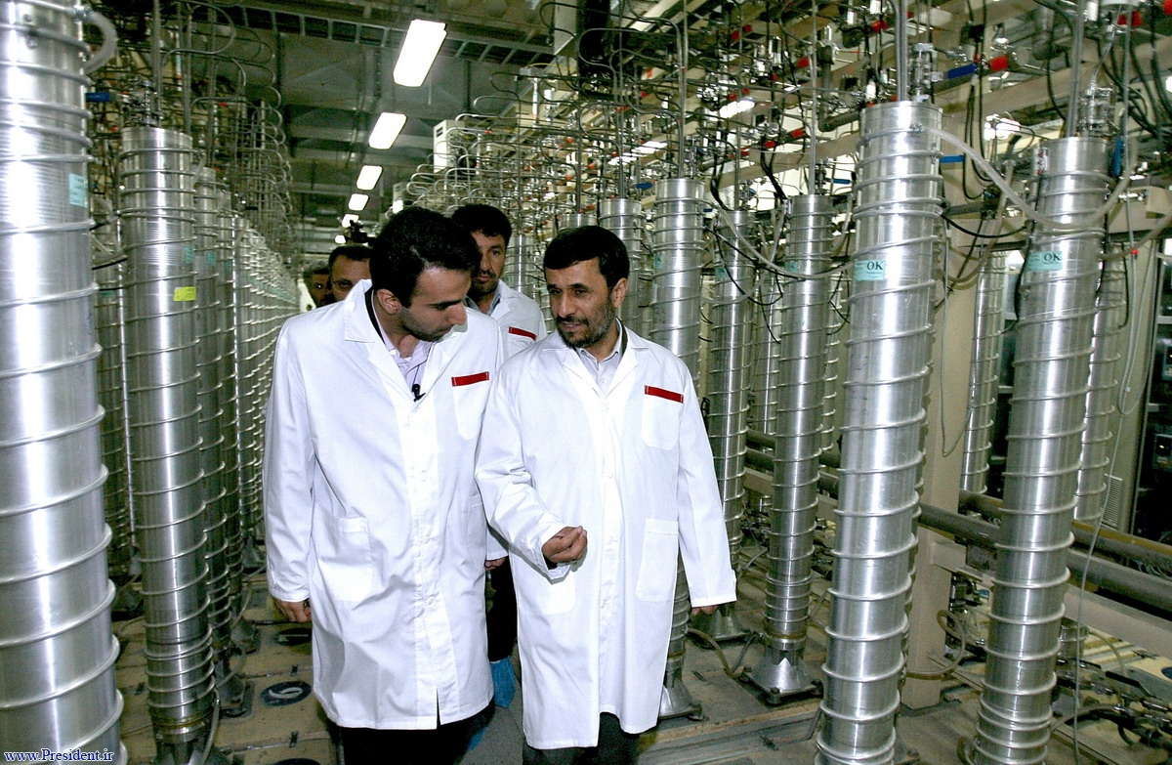

Slide 32
Operational support
various forms, not a single specific type
used to enhance or enable military operations
Orchard 2007 (integrity)
air defence system sabotage
Georgia 2008 (availability)
DDoS on communication channels
ISIS (confidentiality)
intel collection for targeting

Slide 33
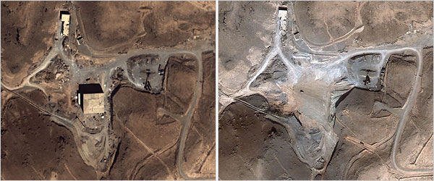
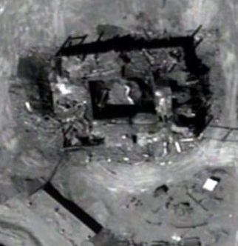

Slide 34
Other activities
Information warfare and propaganda
not necessarily cyberattack in narrow sense, but often uses their products or tools
influencing populations, their opinions and actions to advance ones goal
e.g. Russian election meddling
Show of force and will
harming another state through cyberattacks to send a message
Estonia 2007, Ukraine right now (most often DDoS)

Slide 35
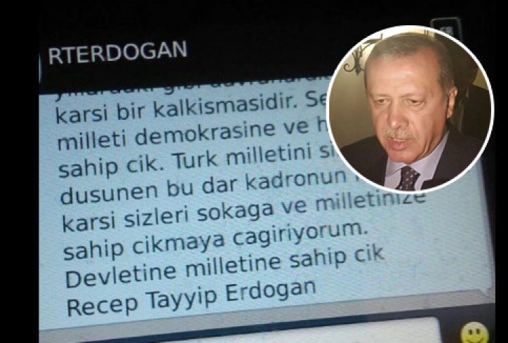

Slide 36
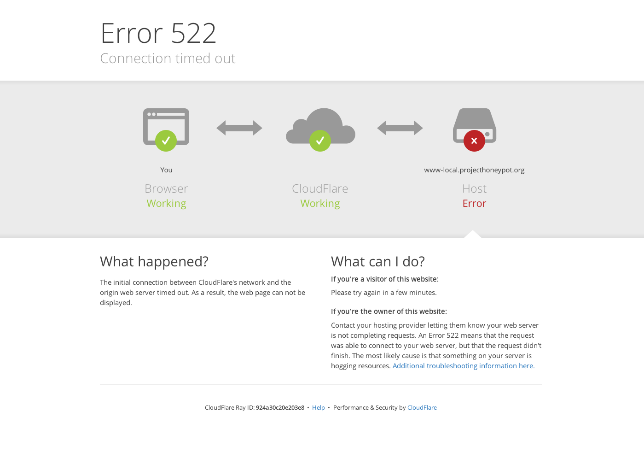

Slide 37
 | confidentiality | integrity | availability
internal | surveillance | - | censorship
external | espionage | sabotage | suppression

Slide 38
Will there be a cyberwar?

