Slide 1
SOCIAL POLICY/ SOCIAL WORK, IDENTITY AND THE ENVIRONMENT
SOCIAL SPACE – PRIVATE SPACE – PUBLIC SPACE AND WELFARE OF THE PUBLIC
THE QUESTION OF IDENTITY
Hans-Jørgen Wallin Weihe
H.J.Wallin.Weihe@hil.no
Lillehammer University College
Box 952
2604 Lillehammer
Norway
Thursday 1st of december 2016
The Masaryk University, Brno, Czech Republic

Slide 2
The spiritual and philosophical dimension
Katherine Augusta Westcott Tingley (1847 – 1929) USA, Sweden and internationally
Thesophical Society
Social Worker in New York
Active in peace movement
Eastern and western tradtions of thought
Famous statements « Music becomes a part of life itself, and one of those subtle forces of nature which, rightly applied, call into the divine powers of the soul»; «True drama points away from unrealities to the real life of the soul»
The Center at Visingsö in lake Vättern in Sweden
Another Centre in California
The intuitive flame burns in every child
Raja –Yoga (Indian mystisicm)

Slide 3
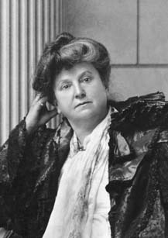
Katherine Augusta Westcott Tingley (1847 – 1929)

Slide 4
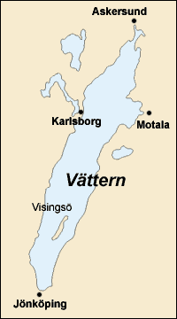
Visningsö - an isolated island in the middle of southern Sweden – historically important and a world apart

Slide 5
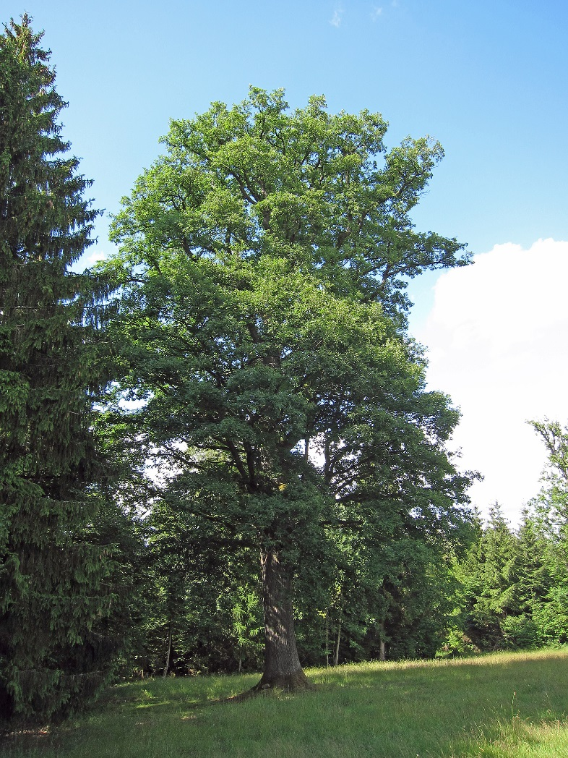
Oakforest – Visningsö has a large oakforest – planted in order to have old oak to build warships to the Swedish navy – for the Thesophical Society a connection to the spiritual and even pre-Christian Celtic

Slide 6
Social Reform
Octavia Hill (1838 – 1912)
The Welfare of Working people
The Settlement Movement (Mixed living with people of different economy and background)
National Trust Preserving of places of historic interest and natural beauty for the public
Member of the Royal Commission of Poor Laws in 1905
Founder of the Charity Organization
Housing for the poor
Museums for the public
Open spaces (parks –green places for the public

Slide 7
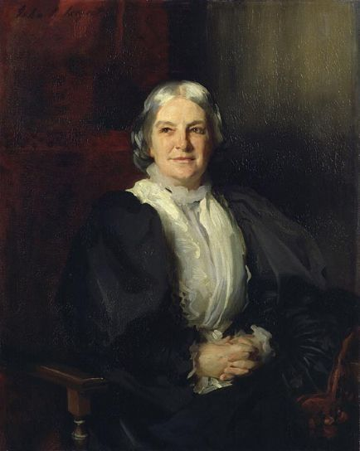
Octavia Hill (1838 – 1912)

Slide 8
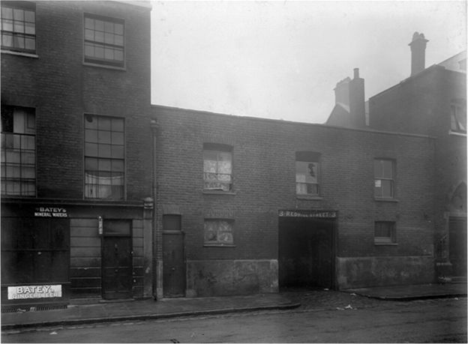
Marlybone Slum Nineteenth Century

Slide 9
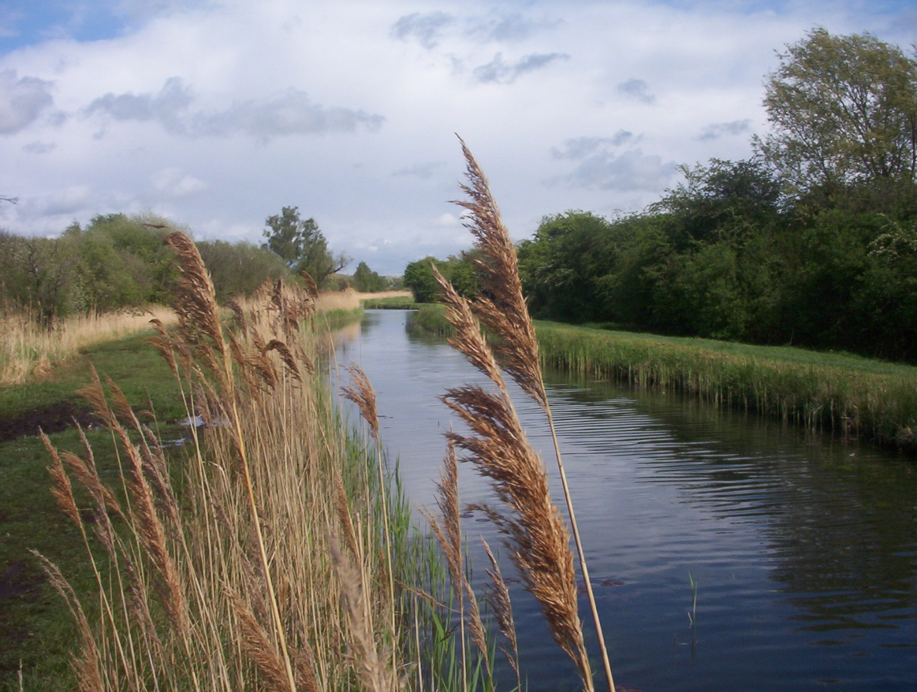
Wicken Fenn National Trust 1899

Slide 10
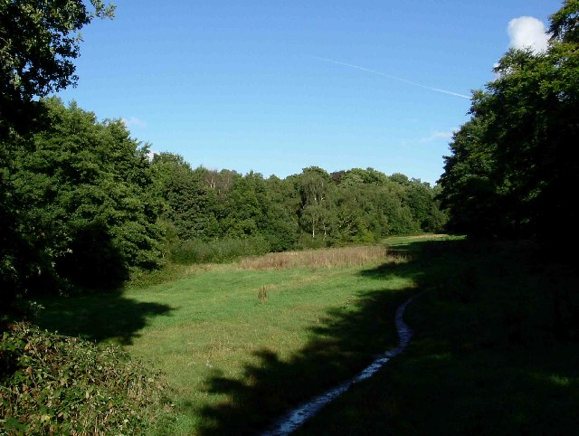
Hampstead Heath National Trust

Slide 11
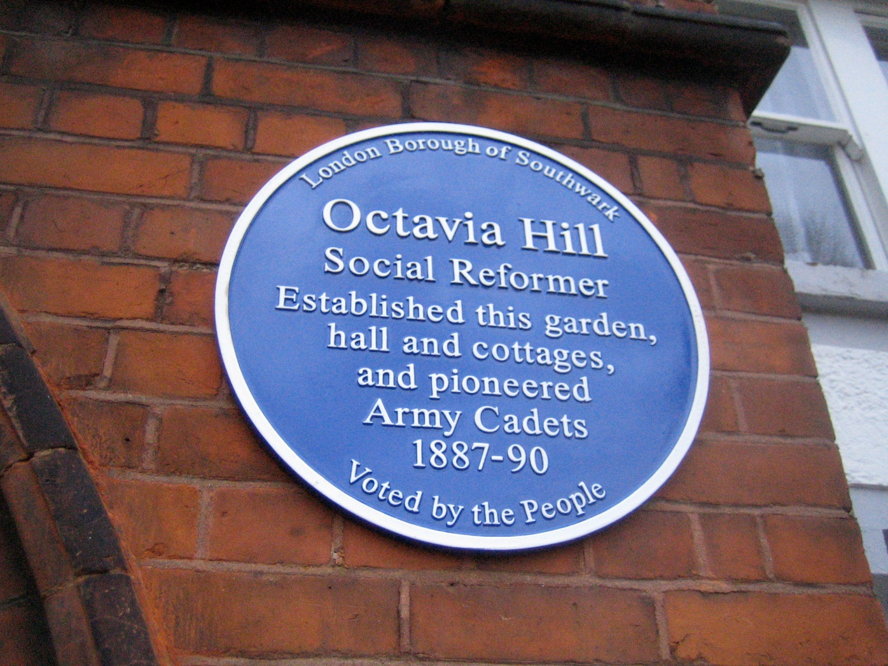
London Borough of Southwalk (1887 -1890)

Slide 12
The Aesthetics – the beuty of nature and humans in nature
John Singer Sargent (1856 – 1925) American portrait painter who lived most of his life in Europe
Active in Social Reform in co-operation with Octavia Hill (1838 – 1912)
The preservance and influence of beauty
The emphasize upon nature as part of a shared heritage regardless of economy, class and social standing
The emphasize upon aesthetics as of crucial importance for social development

Slide 13
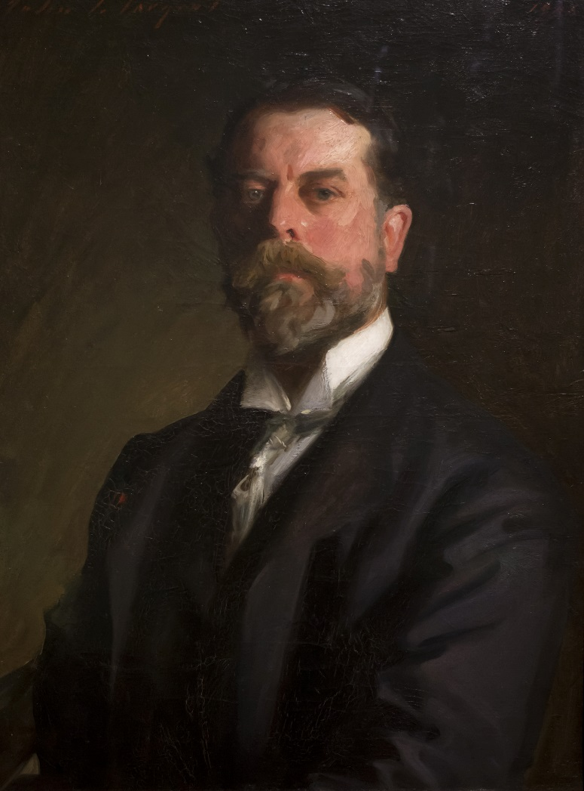
John Singer Sargent (1856 – 1925) – self portrait Florence Uffizi Art Gallery

Slide 14
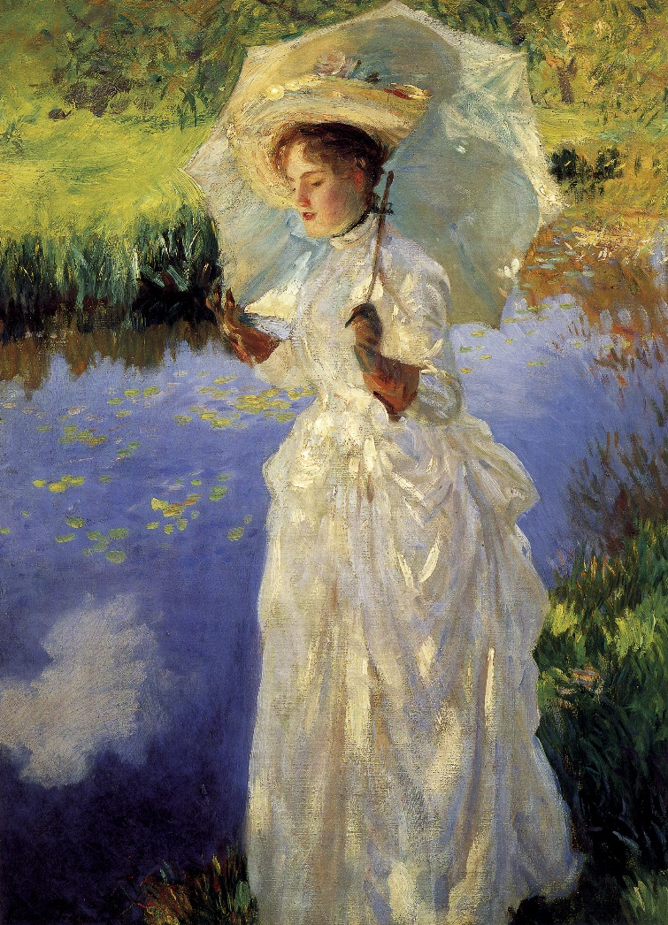
Moorning Walk 1888 (Private Collection)
John Singer Sargent

Slide 15
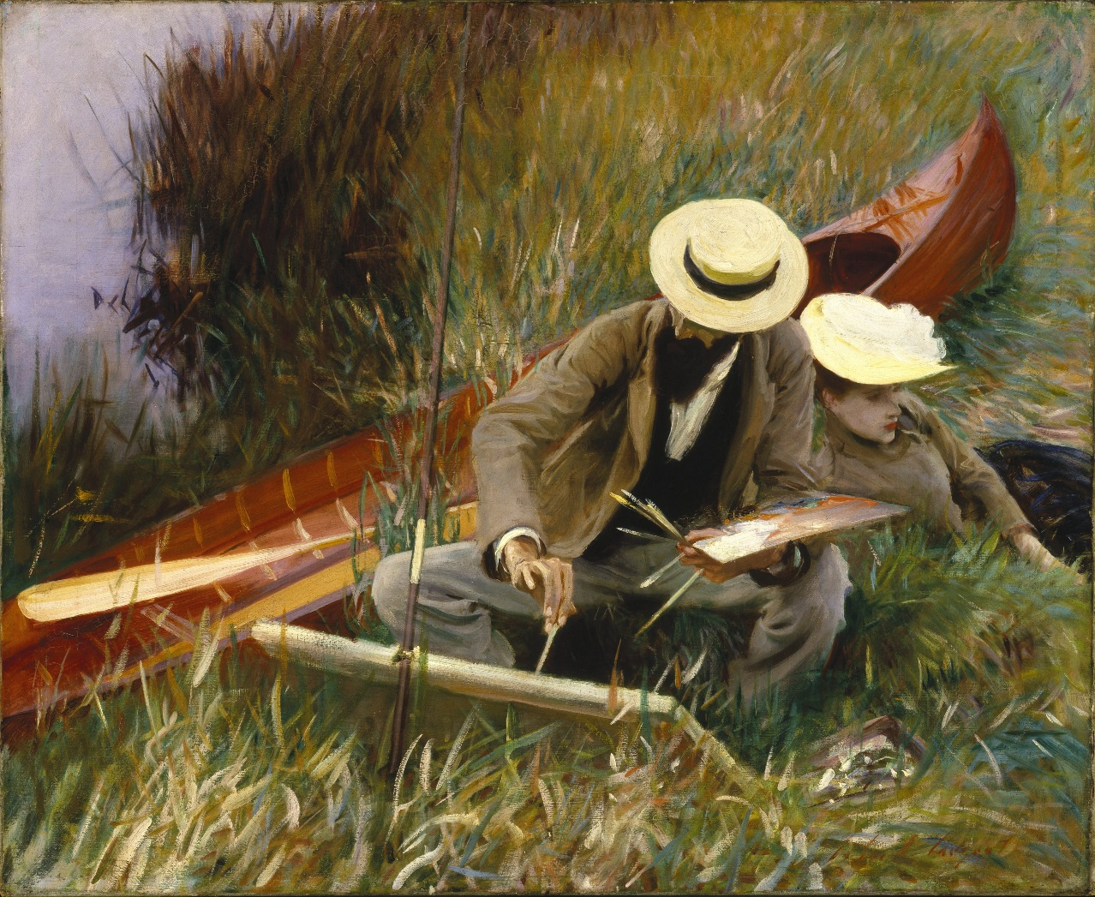
Out-of – Doors Study (1889) The painter Paul César Helleu (1859 -1929) sketching with his wife
Brooklyn Art Museum

Slide 16
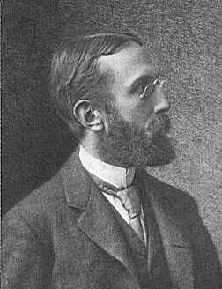
The construction of nature
Charles Eliot (1859 – 1897)landscape architect (USA)

Slide 17
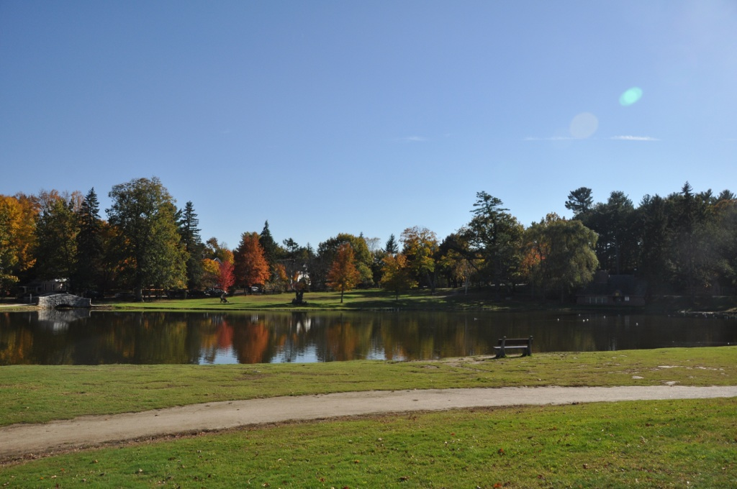
White Park Pond, Concord Masschusets

Slide 18
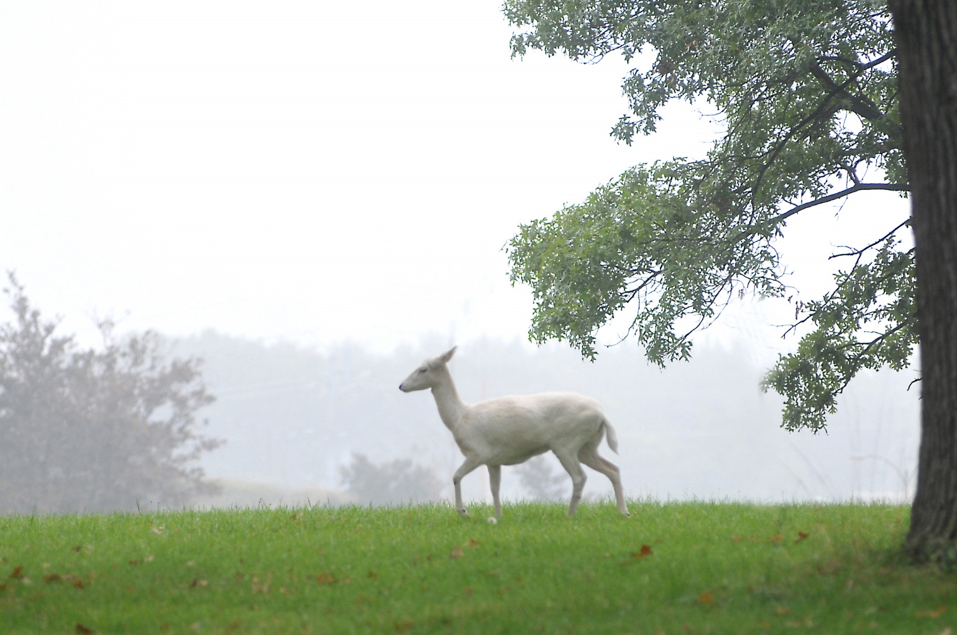
Belle Isle Nature Zoo Michigan
Fallow Deer (white variety)

Slide 19
The revolutionary approach
Alexandra Kollontai (1872 – 1952) (Russian)
Communist Revultionary
Soviet Ambassador to Norway and later Sweden
Advocay of free love (Human instincts as natural as thirst and hunger)
Humans as nature –
The biological human

Slide 20
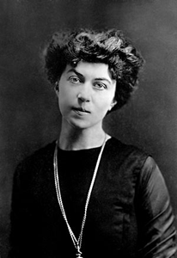
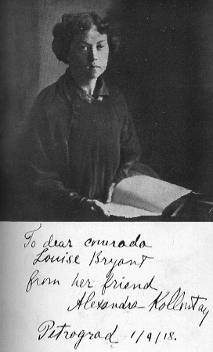
Alexandra Kolontai (1872 – 1952)

Slide 21
The survival and care of nature is the survival om mankind
Rachel Carson (1907 – 1964) American biologist and author
The Sea Around Us (1954) (Book)
Silent Spring (1962) (Book)
Ban of certain pestcides
US Environmental Agency

Slide 22
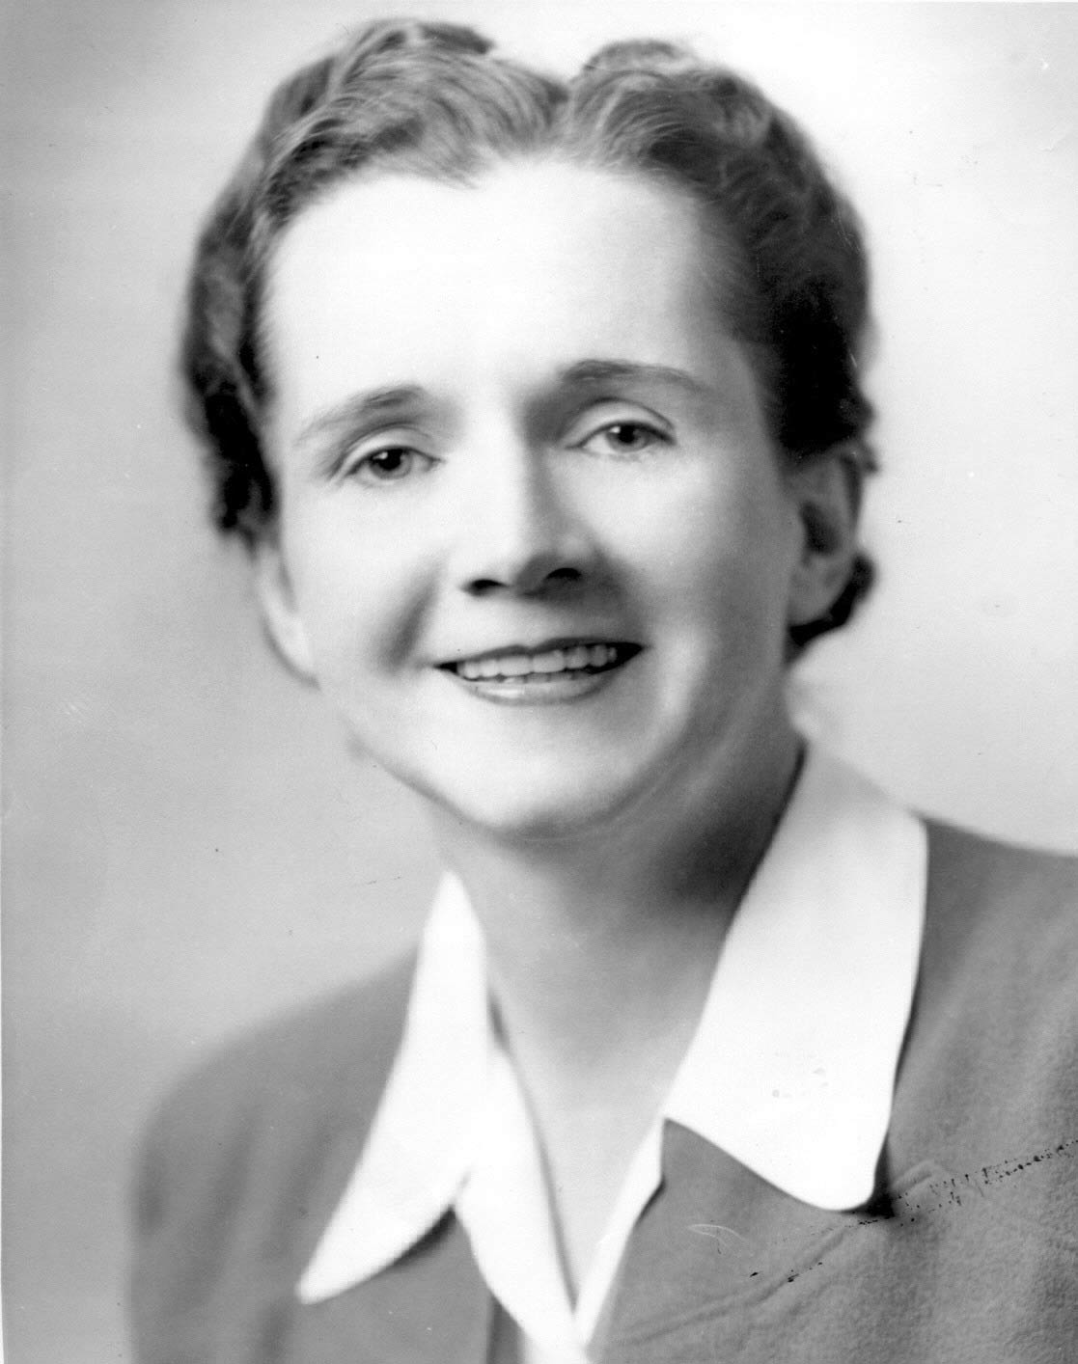
Rachel Carson

Slide 23
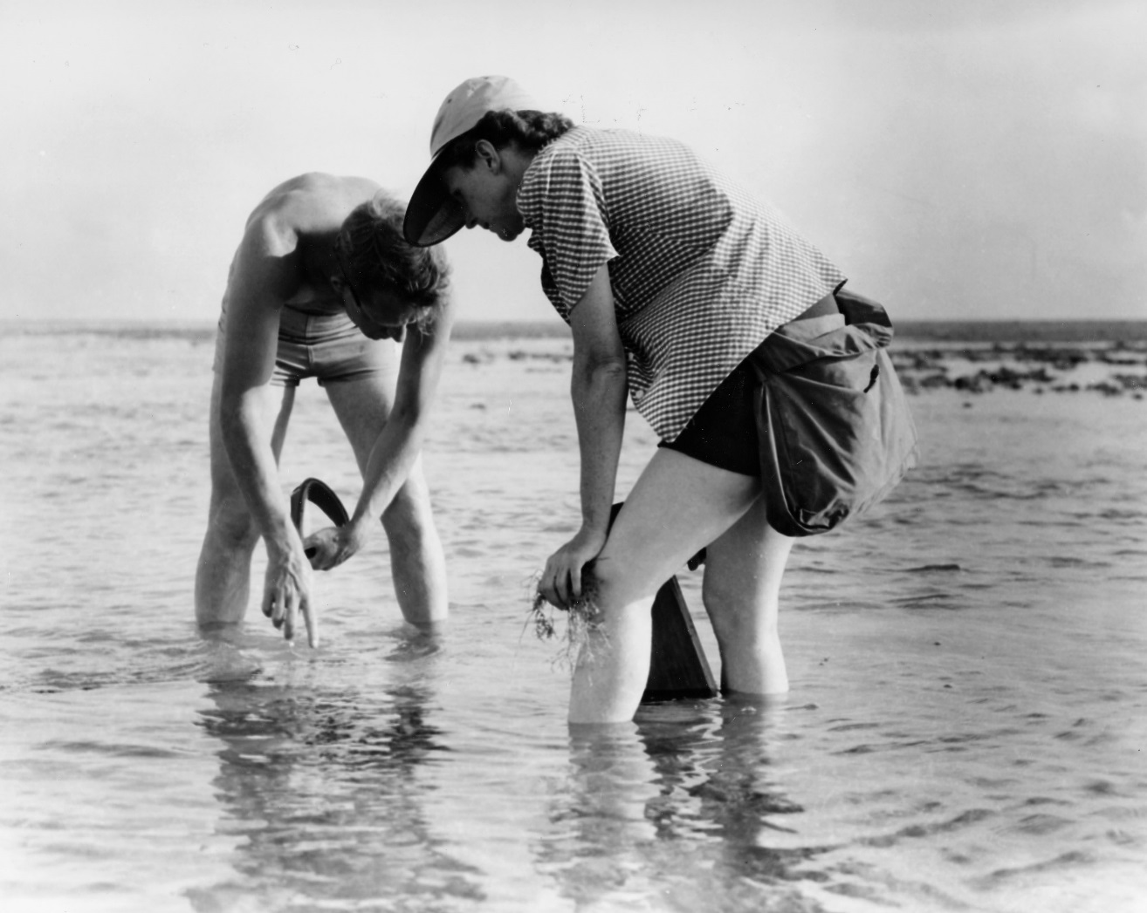
Rachel Carson marinbiological work

Slide 24
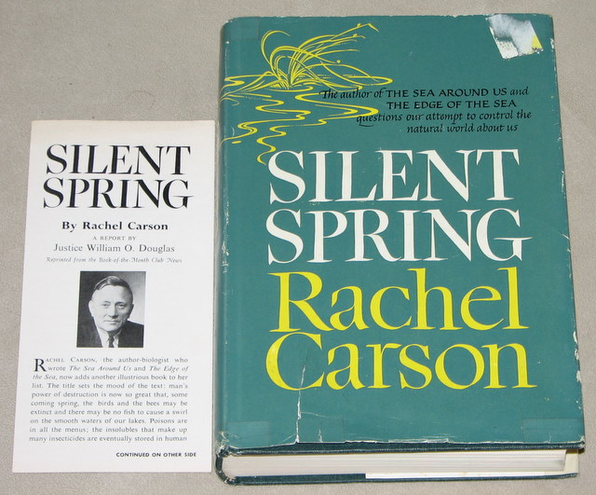
Silent Spring – one of the most influential environmental books of last century First Print round 150000 copies - since then never out of print

Slide 25
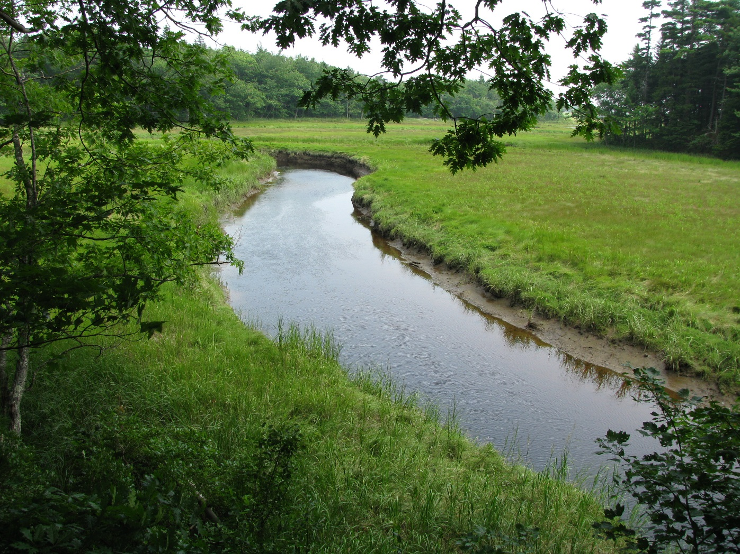
Tidal Salt Marsh Rachel Carson National Wildlife Refugee, Maine USA

Slide 26
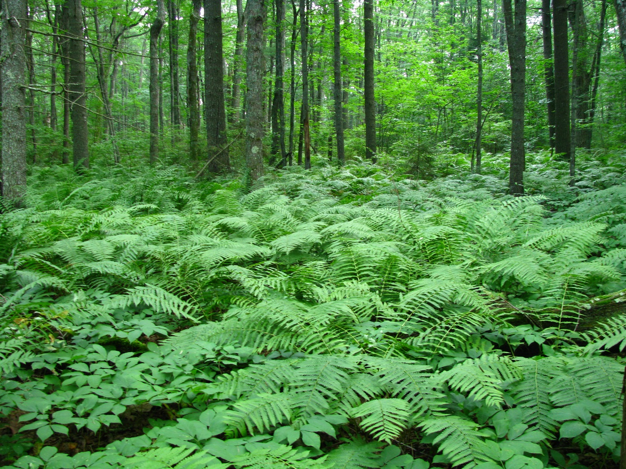
Rachel Carson National Wildlife Refugee, Maine USA

Slide 27
Reform and change
John Steinbeck (1902 – 1968) american author
Nobel prize in litterature (1962)
National Book Award
Pulitzer Prize
Grapes of Wrath (1939)
Cannery Row (1945)
East of Eden (1952)
Themes of Injustice
Themes of humans living from agriculture, fishing and nature
Living from nature and sharing with friends
Ecological philosophy (The Biologist Ed Ricketts – tectbook on ecology)

Slide 28
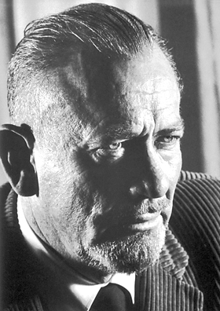
John Steinbeck (1902 – 1968)

Slide 29
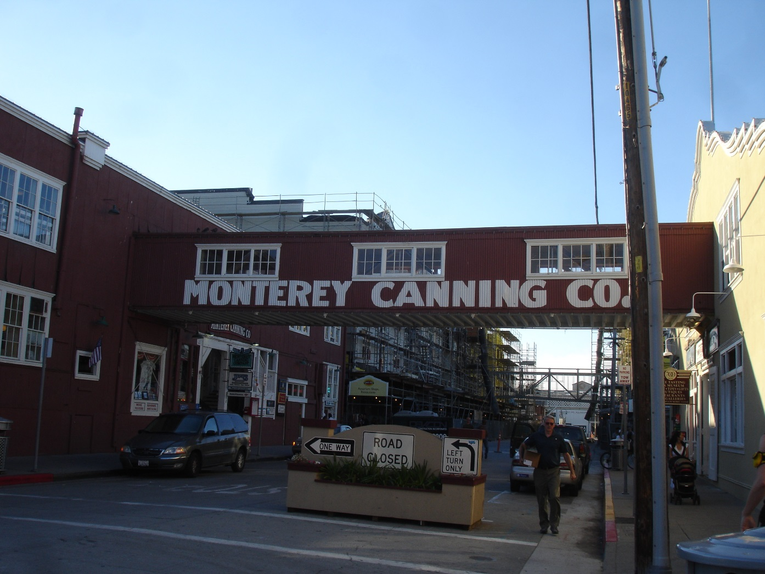
Montery Canning – work- environment

Slide 30
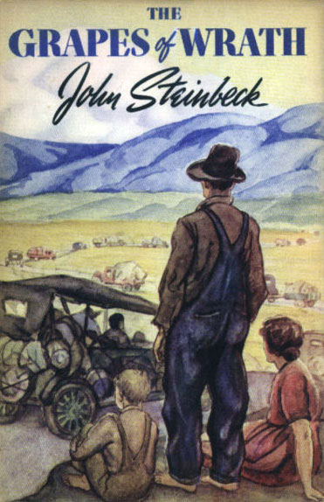

Slide 31
The biological approach – ecology in practice
Edward Flanders Robb Ricketts (1897 – 1948) American ecologist, marine biologist, author and close friend of John Steinbeck
The Log from the Sea of Cortez (1951)
Between Pacific Tides (1939) – a pioneer study of ecology
Boundless curiosity of nature
Unsucessful relationships living in his lab
The social meaning of ecology
No social boundaries in curiosity – the curiosity as the basis acknowledgmrent and change

Slide 32
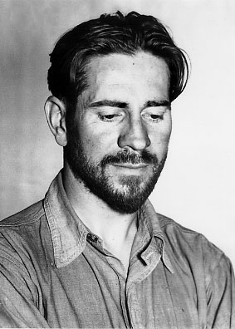
Edward Flanders Robb Ricketts (1897 – 1948)

Slide 33
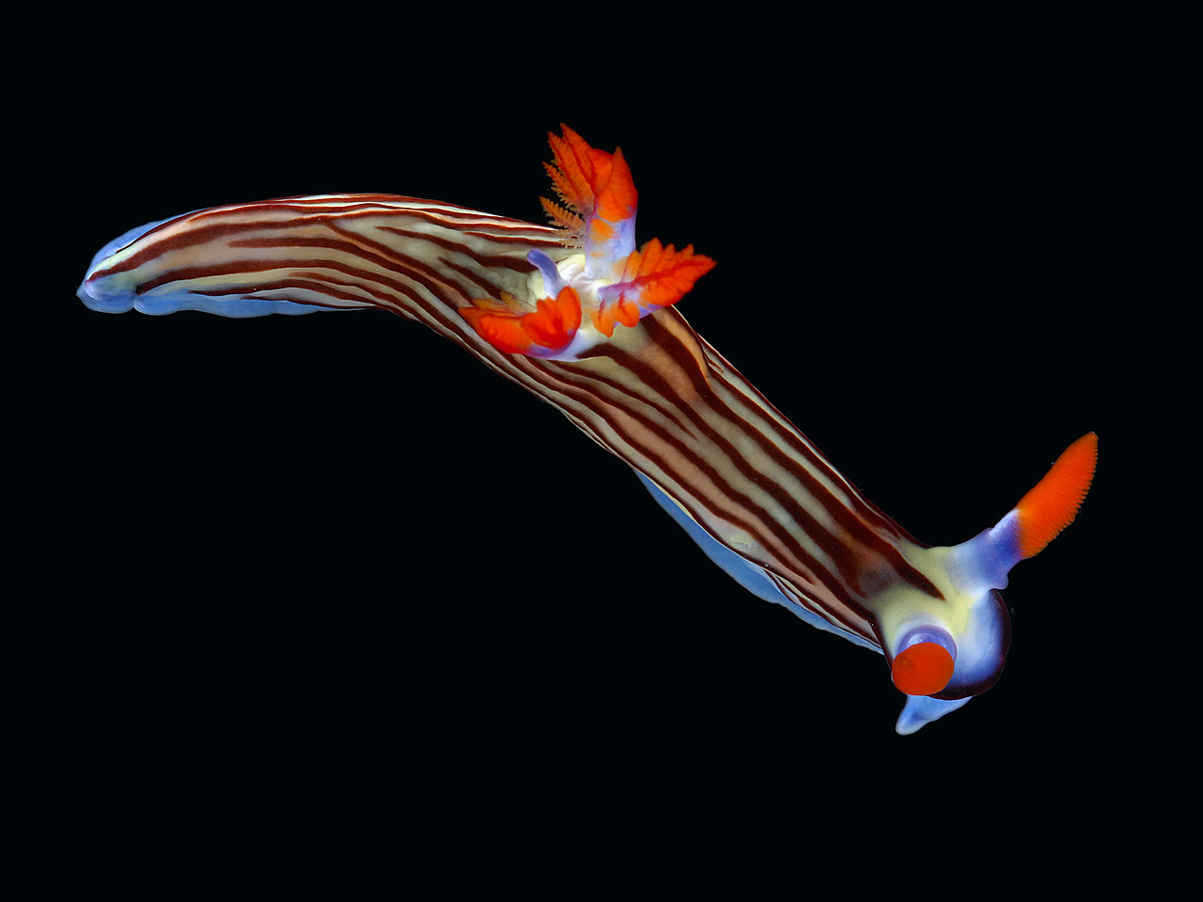
Sea Slug

Slide 34
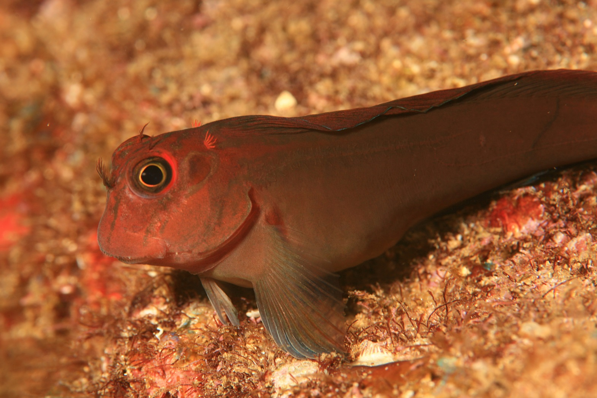
Blenny

Slide 35
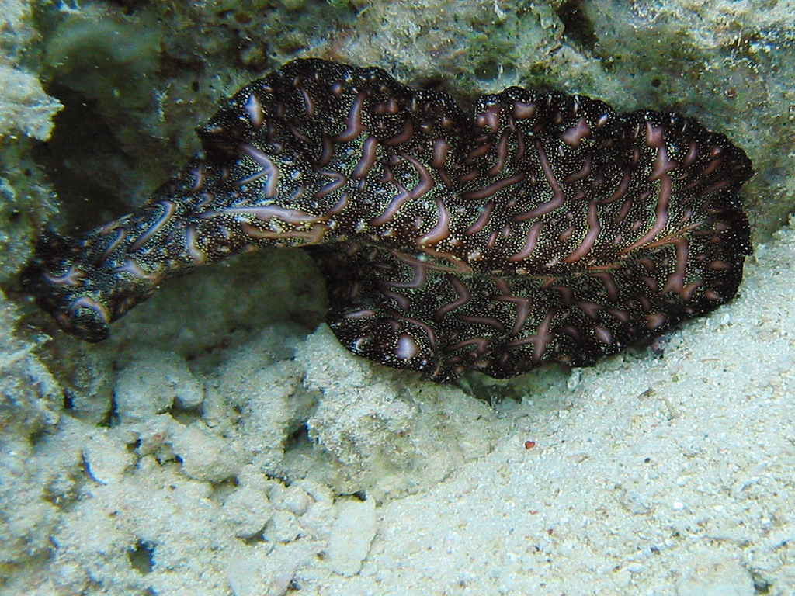
Flatworm

Slide 36

Venus- Fly – Trap Sea Anemone

Slide 37
Saint Francis of Assisi (1181/1182 – 1226)
Italian friar and preacher
Patron saint of Italy
Founder of Order of Friars Minor, the womens Order of Saint Clare and the Third Order of saint Francis
Support and solidarity with the poor
Men should protect and be custodians of nature
The Patron Saint of Ecology
Franciscan friars

Slide 38
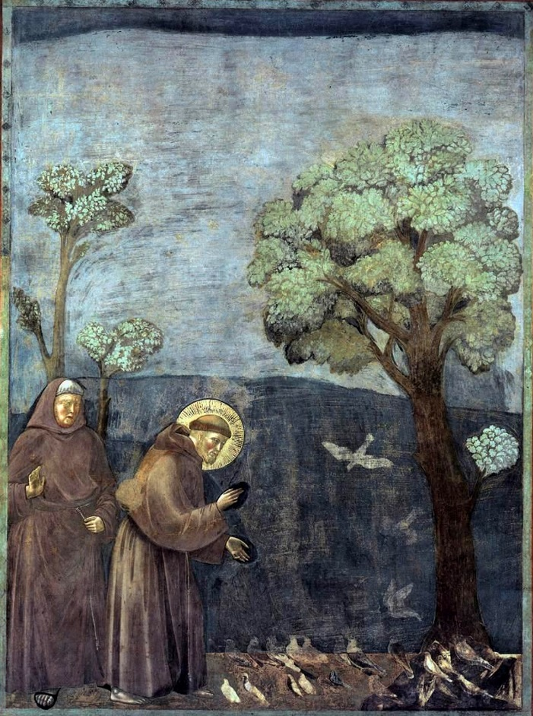
Legend of the birds

Slide 39
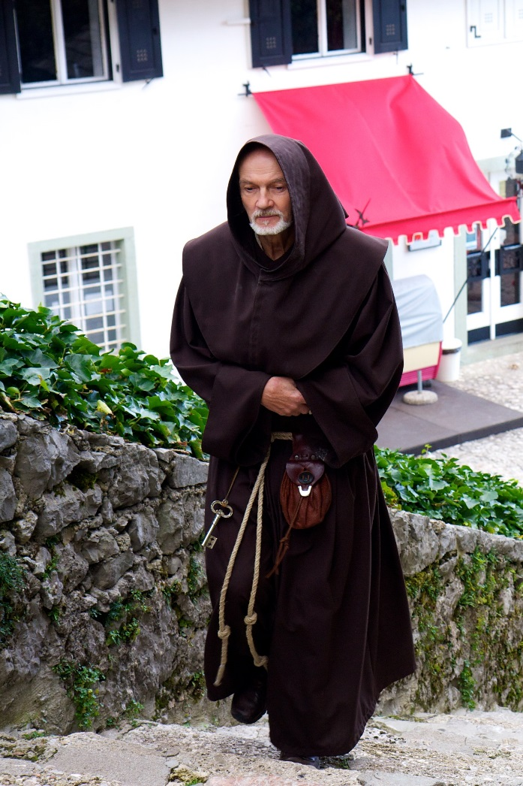
Fransician friar

Slide 40
Mendicant Orders
Lifestyle of poverty
Preaching, evangelization and ministry to the poor
Travelling the world to preach
Franciscans
Dominicans
Carmelites
Social change and care
Social responsibility

Slide 41
Tradition of social work and the tradition of environmental work
Traditions of complexity
We acknowledge some traditions and ignore other traditions
Environmental concerns was expressed by many politicians and thinkers we hardly want to associate with. The vegetarian and teetotaler Adolf Hitler was one of them.
Humans should be acknowledged as part of the environment
We need to acknowledge that both social work and concern of the environment includes a multitude of sometimes conflicting traditions
Regardless concern of the environment is closely connected to social policy and questions of welfare

Slide 42
Use of the environment in social policy and in therapy
The environment as the foundation for human life
Use of parks, nature and animals as an connection to self and stimulate pro-social behavior
Horticulture therapy/nature therapy
Use of the environment as a healing process and for specific therapeutic purposes
Teaching/pedagogy – the environment crucial for the development of the cognitive and curiosity

Slide 43
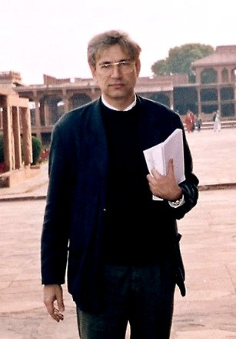
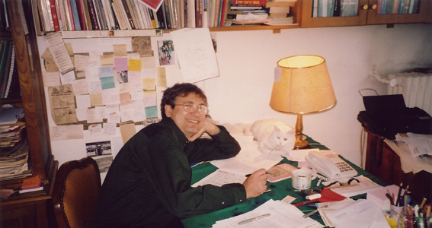
Feret Orhan Pamuk( 1952 - ) The cross- cultural dimension – the urban environment and nature
Turkish Noble Laurate (2006)
Snow (2002) Istanbul (2003)

Slide 44

Carp - Cyprinus carpio – the wisdom, adaption, interaction, invasive, problem and source of food and pride – connection to the spiritual as well as the worlderly. The farmfish of Europe as well as the Ottoman Empire.

Slide 45
The urban identity – the co-existing differences in interaction and conflicts
The shared pain
Guilt and responsibility
The socially rejected
Those included
The acceptabl truth
The unacceptable truth
The shared identity and the identity rejected
The past and the present
Always the land and the sea. The air and the water. The plants and other living beings

